Slide 1
Federal Employee Dental & Vision Insurance Progam (FEDVIP)
TSgt Howard Bentley
Human Resources Specialist
CAJS J1-HR-CS

Slide 2
FEDVIP
Agenda
Basics
Eligibility
Types of plans
Enrolling
Website

Slide 3
FEDVIP - Basics
Provides Dental &/or Vision Coverage
No pre-existing conditions
Premiums are via pre-tax Contributions
Notes:
The new Federal Employees Dental and Vision Insurance Program (FEDVIP) will be available to eligible technicians, retirees, and their eligible family members. FEHB providers do not currently offer anything more than restorative work. No preventative care. FEDVIP does pay for preventative care.
This new Program allows dental and vision insurance to be purchased on a group basis which means competitive premiums and no pre-existing condition limitations.
The member pays the entire premium.
Premiums for enrolled Federal and Postal employees will be withheld from salary on a pre-tax basis.

Slide 4
FEDVIP - Eligibility
Eligible for FEHB = Eligible for FEDVIP
Enroll in Dental and/or Vision
Technician and immediate family
Children
Notes:
Eligible individuals can enroll in a dental plan and/or a vision plan.
Employees must be eligible for the FEHB Program in order to be eligible to enroll in FEDVIP. It does not matter if they are actually enrolled in FEHB - eligibility is the key. Annuitants are eligible to enroll in FEDVIP no matter what their FEHB status is.
They may enroll in a plan for Self-only, Self plus one, or Self and family coverage. Eligible family members include an enrollee's spouse and unmarried dependent children under the age of 22, or if age 22 or older, incapable of self-support. The rules for family members' eligibility are the same as they are for the FEHB Program.
Question: Who is NOT eligible to enroll in FEDVIP?
Answer: The following people are not eligible to enroll in FEDVIP, regardless of FEHB eligibility or receipt of an annuity or portion of an annuity.
deferred annuitants,
former spouses of employees or annuitants,
FEHB temporary continuation of coverage (TCC) enrollees,
temporary employees who are:
serving under an appointment limited to one year or less and have not completed at least one year of current continuous employment, excluding any break in service of 5 days or less; or
expected to work less than 6 months in each year.

Slide 5
FEDVIP - Types of plans
Self Only
Self Plus One
Self and Family
Notes:
Question: What enrollment types are available?
Answer: An eligible individual may choose one of the following enrollment options:
Self Only, which covers only the enrolled employee or annuitant;
Self Plus One, which covers the enrolled employee or annuitant plus one eligible family member specified by the enrollee; or
Self and Family, which covers the enrolled employee or annuitant and all eligible family members.

Slide 6
FEDVIP - Enrolling
Online at www.benefeds.com
For newhires:
Need hire date
Agency ID
Air – Department of the Air Force
Payroll ID 97380100
Army – Department of the Army
Payroll ID 97380800
Notes:
Online at www.benefeds.com
For newhires:
Need hire date
Agency ID
Air – Department of the Air Force
Payroll ID 97380100
Army – Department of the Army
Payroll ID 97380800

Slide 7
FEDVIP – Common Problems
Trying to find the form to enroll
Trying to use the SF 2809 to enroll
Wrong/can’t find Payroll ID number

Slide 8
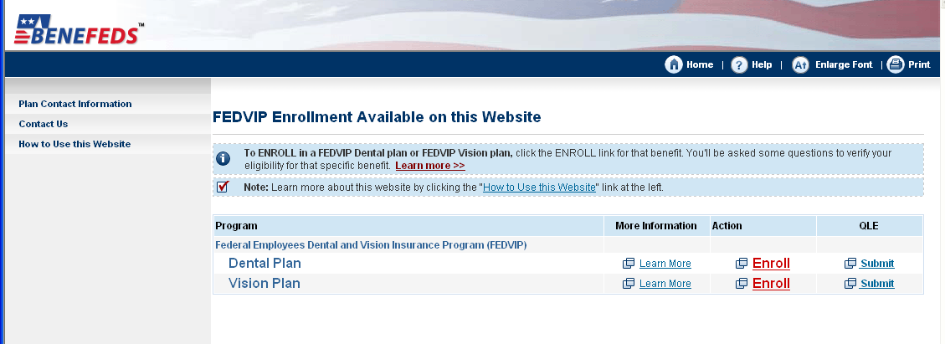
FEDVIP - Website

Slide 9
FEDVIP - Questions

