Slide 1

Maryland Clean Boating Lesson Plan
Section 4
Vessel Cleaning and Maintenance
Notes:
Time: 10 minutes
Objective: Participants will learn and adopt alternative methods of vessel cleaning and maintenance.
Handout:
Clean Boating Tip Sheet: Vessel Cleaning and Maintenance
Additional Resources;
Clean Boating Tip Card (available by calling DNR 410-260-8770)
Maryland Clean Marina Initiative web page www.dnr.maryland.gov/boating
“Your Boat and the Bay” available from the Chesapeake Bay Foundation by calling 410-268-8816.
“21 Steps” available from the Boat U.S. Foundation for Boating Safety and Clean Water by email: cleanwater@boatus.com

Slide 2
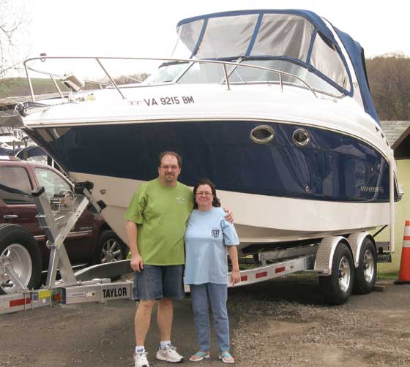
Vessel Cleaning: Environmental Concerns
Boats require maintenance and cleaning.
Cleaners can run-off directly into the waters.
Boat cleaners can strip oil from fish gills, reducing their ability to breathe.
Paints and chemicals are typically hazardous.
Paint chips containing heavy metals could enter the water, and the food web
Notes:
Environmental Concerns
Boaters are well aware of the care a vessel requires. In order to keep your boat safe, reliable, and attractive, you must clean and maintain it. As you do so, minimize environmental impacts by following the recommendations listed here.
Sanding, blasting, and pressure washing are meant to remove paint and marine growth. In the process, toxic heavy metals such as copper and tin may be released. If heavy metals find their way into the water, they may be consumed by mussels, worms and other bottom-dwelling creatures and passed up the food chain to fish, birds and humans. Heavy metals that are not incorporated into living tissue will remain in the sediments where they will substantially increase the cost of dredge spoil disposal.
Paints, solvents, thinners and brush cleaners generally are toxic and may cause cancer. If spilled, they may harm aquatic life and water quality. Additionally, the fumes–known as volatile organic compounds (VOCs)–released by some paints and solvents contribute to air pollution. Likewise, oil and grease from maintenance areas threaten aquatic life.
Many of the cleaning products used on boats are also toxic. Many contain caustic or corrosive elements. They may also contain chlorine, phosphates, inorganic salts, and metals. Even non-toxic products are harmful to wildlife. For example, detergents found in many boat cleaning products will destroy the natural oils on fish gills, reducing their ability to breathe.
Boaters can minimize environmental impacts by following the recommendations listed below:

Slide 3
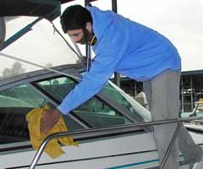
Vessel Cleaning: Clean Carefully
Rinse with fresh water after every trip.
When the boat is dirty, clean with fresh water and elbow grease first. Avoid soaps.
“Spot Clean” scuffs or stains and wipe up rather than hose soap into the water.
Wax the boat to prevent dirt from setting in.
Choose cleaners carefully.
Notes:
Cleaning Vessels Carefully
Wash frequently with a sponge or nonabrasive pad and plain water. This approach is very effective at removing salt. Additional “elbow-grease” is required to remove stains.
When detergents are necessary, use soaps that are phosphate-free, biodegradable, and non-toxic. Any soap should be used sparingly because even non-toxic products can be harmful to wildlife. For example, detergents will destroy the natural oils on fish gills, limiting their ability to breathe.
Wax your boat, if appropriate. A good coat of wax prevents surface dirt from becoming ingrained.
Avoid detergents that contain ammonia, sodium hypochlorite, chlorinated solvents (bleach), petroleum distillates and lye.

Slide 4


Vessel Cleaning: Read Product Labels!
Read product labels.
Don’t believe general “environmental” claims.
Look for independent certifications such as “Green Seal” or EPA “Design for the Environment.”
Notes:
Read product labels: Labels convey information about the degree of hazard associated with a particular product. For example,
DANGER equates to extremely flammable, corrosive or toxic;
WARNING indicates that the material is moderately hazardous; and
CAUTION signals a less hazardous product. Select products that contain no warnings or which merely CAUTION consumers.
Be wary of unqualified general claims of environmental benefit, e.g., “environmentally friendly” or “biodegradeable.” Instead, look for independent certification that the product is less harmful such as Green Seal or EPA’s Design for the Environment.
For additional information about environmentally responsible products, contact Green Seal. Green Seal is an independent, nonprofit organization that sets environmental standards for consumer goods. Products that meet their criteria are awarded a “Green Seal of Approval.” You may search Green Seal’s database of Green Seal-certified, environmentally responsible products at www.greenseal.org or call (202) 588-8400.

Slide 5
Alternatives to Toxic Products
Alternative
Borax
Baking soda
Baking soda and vinegar
Vinegar and water
Baking soda
Apple cider vinegar
Product
Bleach
Scouring powder
General Cleaner
Glass Cleaner
Head and Shower Cleaner
Chrome Cleaner
Notes:
Give students copies of Clean Boating Tip Sheet: Vessel Cleaning and Maintenance to take home.

Slide 6
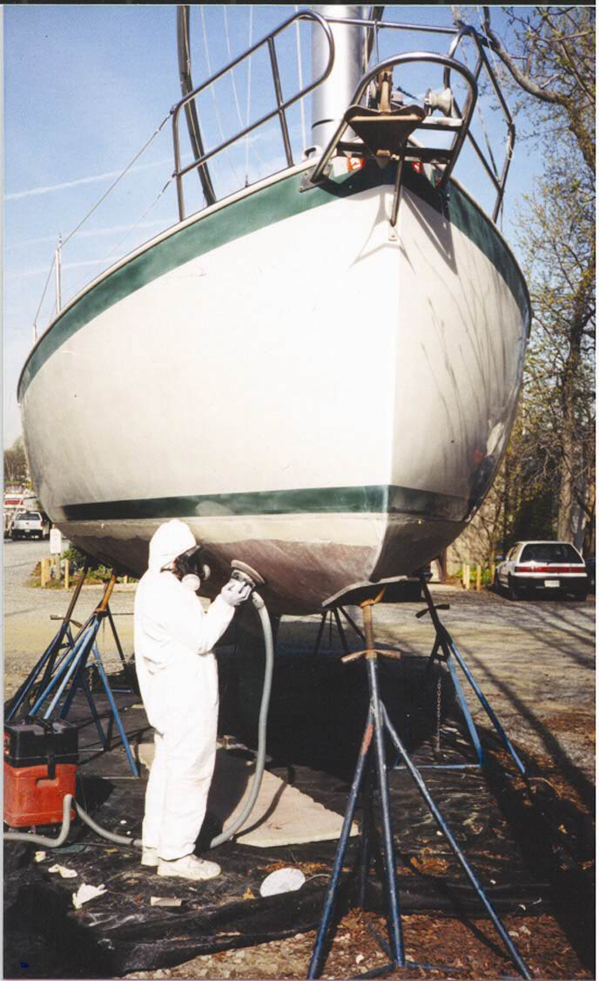
Maintain Mindfully
Collect paint dust and chips.
Use dustless sanders/grinders.
Follow marina rules.
Use low-toxic antifreeze (usually pink in color).
Consult a professional to pick your bottom paint.
Dispose of solvents and waste gas properly–accepted at household hazardous waste collection days.
Notes:
Maintaining Vessels Mindfully
Collect all paint chips, dust, and residue. Vacuum sanders are excellent way to do this. Many boatyards rent these to “do it yourselfers”
Respect and follow environmental rules at marinas and boatyards
Use less toxic propylene glycol antifreeze if you winterize your boat yourself.
Select a bottom paint developed for the mid-Atlantic region as opposed to tropical waters. Talk to a professional to pick your paint Paints have varying strengths. The right paint depends on how fast your boat travels and how often it gets used.
Collect used oil, antifreeze and lead acid batteries for recycling. Go to www.menv.com to find oil and antifreeze recycling locations.
Vendors selling new batteries and many marinas will usually accept old batteries for recycling.

Slide 7

Pass it On. “Pier Pressure”
Let your friends know that your care about clean water and want to do your part.
Share information you learn here with them.
In a friendly way, use “Pier Pressure” to get them to help protect our waterways too.
Notes:
Showing your peers that you care about clean water and air can be very influential. Don’t hesitate to share what you have learned here with your boating friends.

