Slide 1



False Claims Act and Whistleblower Protections
Genetic Disease Screening Program
Employee Education and Training
MARK B HORTON, MD, MSP
Director
ARNOLD SCHWARZENEGGER
Governor
Notes:
06/03/25

Slide 2
Why have this training?
To comply with Federal law – the federal Deficit Reduction Act of 2005 (DRA) as amended in 2007 by § 6032.
To familiarize employees with GDSP False Claims policies and procedures.
To provide guidelines for detecting and preventing fraud, waste, and abuse.
To ensure GDSP receives continued Medi-Cal and Medicaid funding.
Link: Federal Deficit Reduction Act

Slide 3
Policies
Include information about the Federal and California FCA Whistleblower protections under these laws.
These policies may be updated as needed and subsequent training may be required.

Slide 4
Who needs this training?
All GDSP employees and management.
All GDSP contractors.
All GDSP agents.

Slide 5
The Genetic Disease Screening Program takes allegations of funding fraud, waste and abuse very seriously!!!
All complaints regarding potential fraud, waste and abuse of program funding are investigated and employees who report these issues will be protected from retaliation.
The Genetic Disease Screening Program has procedures for detecting and preventing fraud, waste, and abuse. The Screening Information System (SIS) has a set of checks and balances known as inconsistencies that assure contractors cannot bill inappropriately.
There are program standards and guidelines for contractors that provide services included in the contracts and/or vendor agreements.

Slide 6
The Federal False Claims Act (31 USC § 3279-3733)
Enacted in 1863 to combat fraud by government contractors.
Used extensively to combat fraud in government health care programs.
Amended in 1986 to include non-retaliation (whistleblower) protections.
Link to: Federal False Claims Act

Slide 7
Liability under the federal False Claims Act
The False Claims Act establishes liability for any person who KNOWINGLY presents false or fraudulent claims to the US government for payment.
The Act includes “Qui Tam” provisions that allow private citizens (relators) to sue violators on behalf of the government.

Slide 8
California False Claims Act (CFCA)
Was enacted in 1987 (Gov’t Code 12650 et. Seq).
Was modeled after the
Federal False Claims Act.
Allows the government or
individual (relator) to bring civil actions to
recover damages, penalties, and costs when government contractors, vendors or others defraud the government.

Slide 9
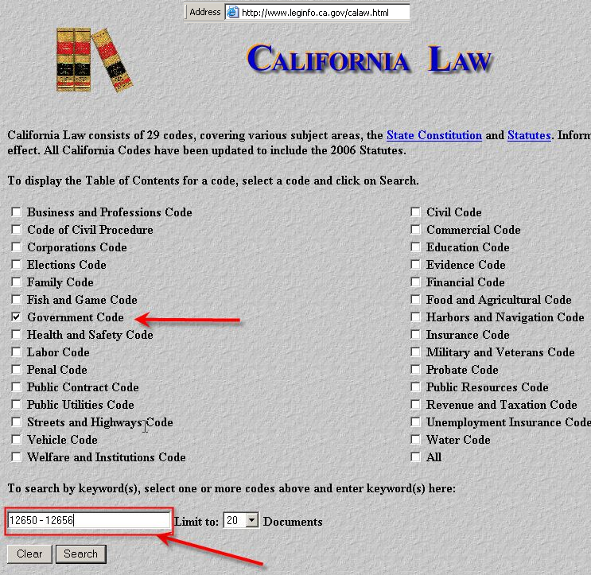
To View the California False Claims Act (CFCA) in its entirety
Link to the following site:
http://www.leginfo.ca.gov/calaw.html
Search for 12650-12656 in the Government Code Section

Slide 10
Liability Under CFCA
Fraudulent acts under the CFCA:
Knowingly “presents or causes to be presented” a false claim to the state.
Knowingly makes, uses, or causes to be made or used a false record or statement to get a false claim paid or approved.
Conspiring to defraud the state by submitting a false claim or be paid one.
Delivering less property to the state than stated in the receipt.
Falsifying a receipt for state property.
Knowingly buying or taking a pledge of public property from another not authorized to sell or pledge the property.
Knowingly benefitting from a false claim to the state.
Benefits from an inadvertent submission of a false claim and fails to disclose the false claim within a reasonable time after discovery.

Slide 11
What is “Knowingly”?
Any person with respect to the information does any of the following:
Has actual knowledge.
Acts in deliberate ignorance of the truth or falsity of the information.
Acts in reckless disregard of the truth or falsity of the information.
Proof of specific intent to defraud is not required.

Slide 12

“Claims” Include:
Any request or demand for money, property, or services made to any employee, officer, agent, contractor, grantee, or other recipient, if any portion of the money, property or services was provided by the state or any political subdivision thereof.
CA Government Code 12650 (b)(1)

Slide 13
Remedies under the CA False Claims Act
Damages:
Any person violating the CFCA shall be liable to the state for three times the amount of damages the state sustains from the acts of that person. (Government Code 125651 (a))
Civil Penalties:
Not less than $5,000, but no more than $10,000 per claim.
Costs/Attorneys’ Fees.

Slide 14
Who Can Bring a claim under the CFCA?
The state Attorney General or a “prosecuting authority” may initiate false claims cases on their own.
A “prosecuting authority” could include the county counsel, city attorney, or other government official in charge of pursuing civil cases.
Private citizens (relators) may file actions. Like the federal FCA, California’s False Claims Act allows “qui tam” actions.

Slide 15
Qui Tam Actions (31 USC Section 3730)
Allow private citizens (“relators”) to bring civil actions on behalf of the Government in return for an incentive.
Promote the practice of private persons coming forward and aiding the government in pursuing fraud and waste.

Slide 16
California - CFCA Qui Tam Incentives
If the Attorney General (AG) initiates or takes over the case from a local prosecuting authority and prevails, the AG gets 33% of the recovery. (Government Code Section 12652 (g)).
If the prosecuting authority takes the case and prevails, he/she gets 33%.
If the prosecuting authority intervenes in an action initiated by the AG or remains a party in an action assumed by the AG, the prosecuting authority receives a portion of the AG’s 33% as determined by the court.

Slide 17
California - CFCA Qui Tam Incentives (cont.)
If a “relator” brings the case and the AG or prosecuting authority intervenes, the relator gets between 15% and 33% of the recovery, depending on the relator’s contribution to the prosecution. The AG or prosecution authority gets 33%.
If the relator brings the case and neither the AG nor the prosecuting authority intervenes, relator receives 25% to 50% of the overall recovery as determined by the court.
The successful relator gets costs and fees.

Slide 18
Qualifications to Qui Tam Incentives in the CFCA
If the defendant prevails and the court finds that the qui tam plaintiff (relator) was clearly frivolous, clearly vexatious, or took action for the purposes of harassment, then the court may award to the defendant reasonable attorney’s fees and expenses.
There is no guaranteed minimum recovery for actions initiated by:
Present or former employees of the State or political subdivision who did not initially utilize internal procedures for reporting.
Present or former employees who actively participated in the fraudulent activity.

Slide 19
Whistleblower Protections
The Federal False Claims acts protects whistleblowers who initiate, assist with, or testify for a false claim action. (31 USC § 3730(h))
This section protects employees against discharge, demotion, suspension, threats, harassment, or discrimination by the employer because of lawful acts done by the employee in cooperating with the False Claims Act.

Slide 20
Whistleblower Protections in the CFCA (CA Government Code 12653)
Prevents employers from making, adopting and enforcing any rule that would prevent an employee from acting in furtherance of a false claims action.
No employer shall discharge, demote, suspend, threaten, harass, deny promotion to, or in any other manner discriminate against an employee because of lawful acts done by the employee in an action filed or to be filed under the CA False Claims Act.

Slide 21
Federal Administrative Process for False Claims and Statements Detailed information regarding the administrative process can be found in: Government code 31 USC § 3801 to 3808, this code includes information regarding:
Definitions,
Individual liability (up to $5,000 for each fraudulent claim),
Hearings and judicial Review, and
The right to administrative offset.

Slide 22


What You Can Do to Report Fraud and Abuse
Report the suspected incident either orally or in writing.

Slide 23
Who to Contact
Report any suspected fraud, waste or abuse to either:
Your supervisor or manager,
the California Department of Public Health, Deputy Director of the Center For Family Health at (916) 440-7600.

Slide 24
What will happen?
The nature and details of the suspected fraud will be documented in writing.
The report will be forwarded to the Deputy Director of the Center for Family Health in the Department of Public Health within 2 days of the report.

Slide 25
The Investigation
Will be initiated by the Department of Public Health.
Corrective actions will be taken, if necessary, which may include filing a claim with the Attorney General’s office.
All complaints regarding potential fraud, waste and abuse of program funding will be taken seriously.

Slide 26
Billions of $$$ are lost to Fraud
It is estimated that 5% of total U.S. health care funds are lost to fraud!
“During FY 2006, the Federal Government won or negotiated approximately $2.2 billion in judgments and settlements, and it attained additional administrative impositions in health care fraud cases and proceedings. The HCFAC account has returned over $10.4 billion to the Medicare Trust Fund since the inception of the program in 1997”.
Healthcare Fraud and Abuse Control Program 2006

Slide 27
So Now You Know
You can help protect government funds by reporting any suspected fraud, waste, or abuse.
The False Claims laws are the single biggest weapon for combating fraud perpetrated by government contractors, vendors and others against the federal and state government.

