Slide 1

PASS
Palmetto Assessment of State Standards

Slide 2
Test Essentials
All students in grades 3-8 must participate in PASS or the South Carolina Alternate Assessment
All PASS items are aligned with the South Carolina Academic Standards.
PASS consists of writing, English language arts, mathematics, science, and social studies tests.
PASS tests are not timed.
All PASS tests contain multiple-choice test questions. The writing test also includes one extended-response (writing) item.

Slide 3
What will the questions on PASS be like?
The following questions will be similar to questions that will be on the PASS test.

Slide 4
English language Arts – Grade 3
Read the article. Then answer the question.
Most people know honey comes from a hive. But it takes a lot of work to make the sticky, sweet honey so many of us love to eat.
Worker bees are one of three types of honeybees. They live in a colony, or hive, with drones and a queen. Worker bees are the smallest of these honeybees, but they do all the work! These busy bees visit 50 to 100 flowers each day to collect nectar. This sweet liquid produced by flowers is used to make honey. Worker bees then feed this nectar to the queen. They also must guard the entrance to the hive. The bees move their wings 11,400 times a minute to keep the hive cool. Moving their wings so fast causes the bees’ familiar buzzing sound.
So the next time you put some honey on your toast or biscuit, think about these hard-working honeybees.

Slide 5
What would be the best title for this article?
A. A Taste of Honey
B. Buzz, Buzz
C. Busy Bees
D. Fit for a Queen
Key = C

Slide 6
Writing – Grade 4
What is the correct way to write this sentence?
A. If you were to ask everyone to identify a few of their favorite American athletes, Michael Jordan’s name would surely be on the list.
B. If you were to ask everyone to identify a few of his favorite American athletes, Michael Jordans’ name would surely be on the list.
C. If you were to ask everyone to identify a few of their favorite American athletes, Michael Jordans’ name would surely be on the list.
D. If you were to ask everyone to identify a few of his favorite American athletes, Michael Jordan’s name would surely be on the list.
Key = D

Slide 7
Mathematics – Grade 5
Key = D

Slide 8
Science – Grade 4

Slide 9
Social Studies – Grade 4

Slide 10
What will the PASS test look like?
The test booklet will look very similar to the one from last year.
This year instead of marking your answers in your test booklet, you will mark your answer on an answer sheet.
Double check to make sure that the number in your test booklet is also the same number as the one you are marking on your answer sheet.

Slide 11
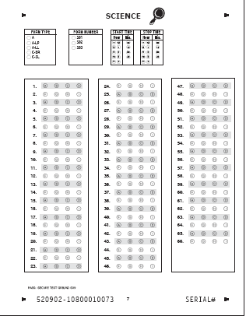
Your answer sheet will look similar to this. The number of questions will vary from test to test.

Slide 12
Important Test-Taking Hints
Do’s:
Stay calm and focus on doing your best
Read each question carefully
Check to make sure you answered all questions
Check for careless mistakes
Get a good nights sleep
Eat a good breakfast
Don’ts:
Be upset if you don’t know every answer
Rush through the test

Slide 13
When will the PASS test be given?
May 12 (Tuesday)
May 13 (Wednesday)
May 14 (Thursday)
May 15 (Friday)
ELA (Reading and Research)
Mathematics
Science or Social Studies*
Social Studies**
*All students in grades 3, 5, 6 and 8 will take either the science or the social studies test on May 14. All students in grades 4 and 7 will take the science test.
**All students in grades 4 and 7 will take the social studies test on this date.

Slide 14
Links to Additional Information
For more detailed information about PASS, click on the PASS Test Information button on the home page of the South Carolina Department of Education Web site: http://www.ed.sc.gov
In the pop-up window, click on PASS TEST INFORMATION
to open the Office of Assessment PASS Web page. The links for writing, English language arts, mathematics, science, and social studies provide additional information about each test.

