Slide 1
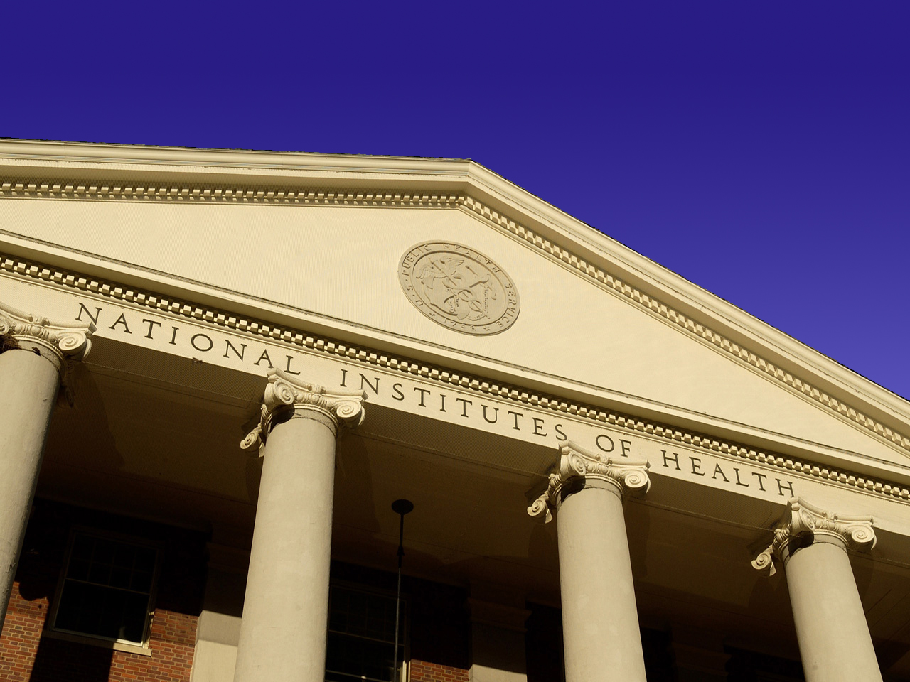


NIH at the Crossroads: Strategies for the Future
Elias A. Zerhouni, M.D.
Director
National Institutes of Health

Slide 2
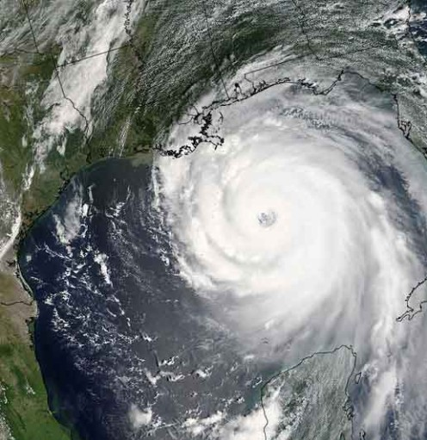
NIH Budget Facing a “Perfect Storm” in 2006
Federal & Trade Deficits
Defense and Homeland Security needs
Katrina
Pandemic flu
Post- Doubling effects
Physical Sciences focus
Biomedical research inflation- 3 to 5%

Slide 3
Competition for funds from the NIH and other sponsors, intensifying year by year, now stands at an unprecedented level, and shows no sign of abating. Never before have so many established investigators faced so much uncertainty about their longevity as active scientists. Never before have so many novices faced so many disincentives to entering or continuing a research career.
Dr. William F. Raub, NIH Associate Director for Research and Training, strategy paper, 1982

Slide 4
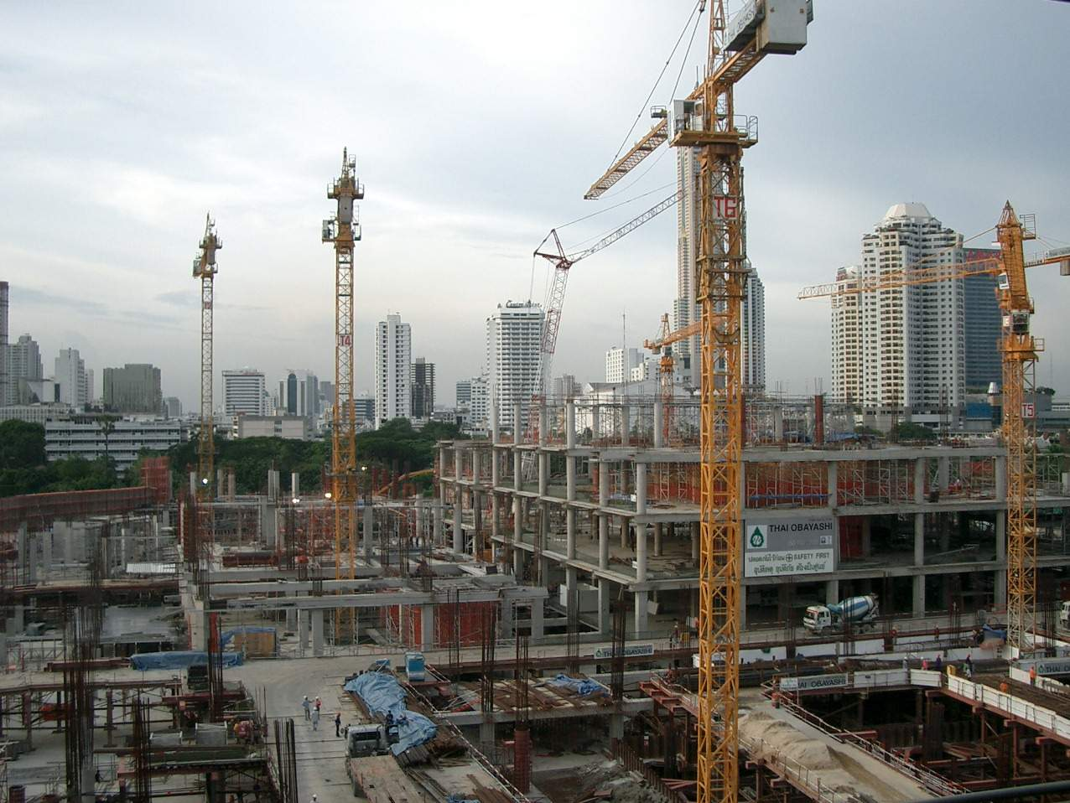
What Is Really Happening? 3 Fundamental Drivers
Large capacity building throughout U.S. research institutions and increase in number of new faculty
Appropriations below inflation after 2003
Increases of 3 % in ‘04, 2% in ‘05 and 0% in 06
Biomedical Inflation in 2004 was ~ 5%
Budget cycling phenomenon
Notes:
BRDPI FY04 (actual) 3.5%
FY05 (est.) 3.3%
FY06 (est.) 3.2%
FY07 (est.) 3.2%

Slide 5
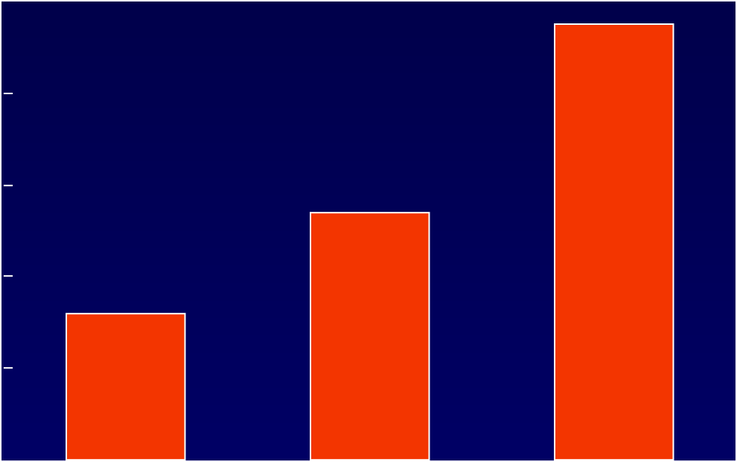
Investment in Research Facilities at U.S. Medical Schools
10
9.5B
8
6
Dollars (in billions)
5.4B
4
3.2B
2
0
1990-1997
1998-2002
2003-2007
Year
AAMC – Survey of Research Facility Investments (99 of 125 AAMC Member Schools)
*
Data Based on AAMC Faculty Roster

Slide 6
New Grant Applications, Applicants and Success Rates During and After Doubling Period
35%
Projected
60,000
30%
49,656
50,000
43,069
25%
40,000
20%
% Success Rate of Grants Funded
30,000
Number of Applications/Applicants
15%
+8,359
20,000
10%
+8,303
5%
10,000
0%
-
0
1998
1999
2000
2001
2002
2003
2004
2005
2006
2007
Success Rates
Applications
Applicants

Slide 7
New Grant Applications, Applicants and Success Rates During and After Doubling Period
35%
Projected
60,000
30%
49,656
50,000
43,069
25%
40,000
20%
% Success Rate of Grants Funded
30,000
Number of Applications/Applicants
15%
20,000
10%
+5,208
5%
+5,334
10,000
0%
-
0
1998
1999
2000
2001
2002
2003
2004
2005
2006
2007
Success Rates
Applications
Applicants

Slide 8
Inflation Eroded Gains in NIH Funding Real and Nominal NIH Funding Levels Since 2003
30
29
Nominal funding
28
27
Billions of Dollars
26
Adjusted by BRDPI
25
24
FY 2003
FY 2007
% Chg.
7.3% loss in purchasing power since 2003
NIH Nominal Funding
26.7
28.2
5.5%
23
Adjusted by BRDPI
26.7
24.8
-7.3%
22
FY 2003
FY 2004
FY 2005
FY2006
FY2007
Note: BRDPI is the Biomedical Research and Development Price Index
Notes:
7.3% loss does not reflect increased requirements for biodefense and program evaluation (PE) tap. Biodefense has grown by $530 million since 2003, and is now 6% of NIH budget. PE tap has grown $100 million from 2003 to 2006. Purchasing power for NIH non-biodefense net of PE tap has fallen 9.0% since 2003.

Slide 9
The Budget Cycling Phenomenon: What Funds are Available in any One Year?
Budget Increase
From current year to
previous year
Uncommitted Funds
From ending grants
started 4-5 years ago
Committed Funds
Continuing grants
NIH Appropriations

Slide 10
NIH Congressional Appropriations
$30
$28.0
$28.6
$28.6
$28.6
$25
$27.1
$23.3
?
$20
$20.5
$17.8
Billions of Dollars
$15
$15.6
$13.7
$10
$5
$0
FY
FY
FY
FY
FY
FY
FY
FY
FY
FY
1998
1999
2000
2001
2002
2003
2004
2005
2006
2007
DOUBLING

Slide 11


The Bottom Line: Demand for Grants “Took Off” Just as NIH Budget Was “Landing!”
Post doubling “boom” in applications has led to demand/supply imbalance
NIH managed well despite small increases in 2004 (2.9%) and 2005 (2%) but flat 2006 made it difficult to adjust
~80% of success rate drop is due to increased demand for grants
~20% of drop is due to increased costs of grant and inflation effects.
Budget cycling effect will improve demand vs supply of grants in 2007
Applications
Budget

Slide 12
The Question on Everyone’s Mind: What are MY chances of being funded?

Slide 13
Payline Is Not Funding Cut-off Line
>99% of grants under the
payline are funded
Payline
100
-
75
-
Success Rate
per application
50
-
Percent R01s Funded
25
-
0
0
10
20
30
40
Percentile Score

Slide 14
Success Rate per Application Understates Funding Rate per Applicant
40%
Applicant
35%
27.6%
30%
25%
Success Rate for R01 Equivalents
Applications
20%
22.3%
15%
10%
5%
0%
1995
1997
1999
2001
2003
2005
Fiscal Year
Success Rate files as of May 3, 2006. Program srf_indiv_060103_rfm
Individuals are determined using the pi_profile_person_id in IMPAC-II
Notes:
FY 2005- 22.3% success rate for applications, but 27.6% for applicants
FY 2006- 19.8% for applications, but ~25% for applicants

Slide 15
Common Misperceptions

Slide 16
Common Misperception: NIH is Over-emphasizing Applied Research
60.0%
56.4%
53.9%
55.2%
55.2%
55.2%
55.8%
56.6%
52.1%
56.1%
50.0%
53.0%
43.5%
40.5%
39.2%
39.8%
41.0%
41.0%
40.8%
40.0%
40.8%
38.4%
38.5%
30.0%
20.0%
10.0%
7.0%
5.7%
5.5%
5.2%
4.8%
5.0%
3.7%
3.1%
3.1%
0.0%
3.6%
FY 1998
FY 1999
FY 2000
FY 2001
FY 2002
FY 2003
FY 2004
FY 2005
FY 2006
FY 2007
Basic Research
Applied Research
Other

Slide 17
Common Misperception: NIH Shifting Towards Solicited Research with too many RFAs
100%
90%
93%
91%
80%
70%
60%
Percentage of Grants
Unsolicited
Solicited
50%
40%
30%
20%
10%
0%
1994
1996
1998
2000
2002
2004
2006
Fiscal Year

Slide 18
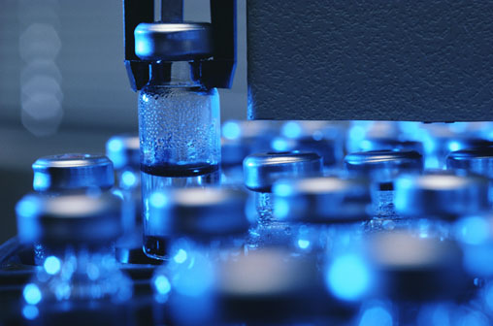

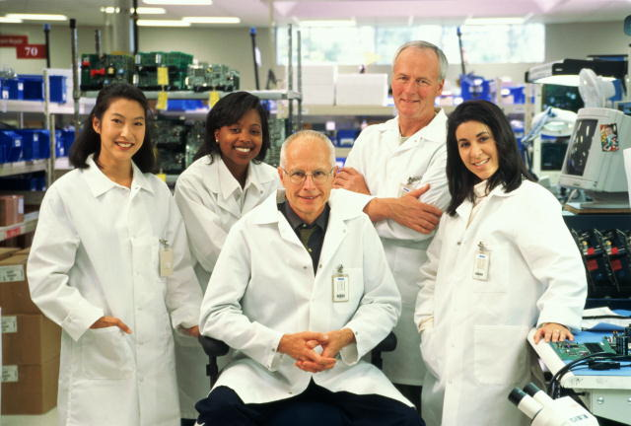

Common Misperception: NIH Roadmap is Shifting Major Funds Away from Grant Pool
FY2005 Request = $28.757B
Developed to increase synergy across NIH
Not a single initiative but over 345 individual awards in FY 2005, 133 institutions, 33 states:
40% basic
40% translational
20% high risk
Non-Roadmap
99.2%
Roadmap
0.8%

Slide 19
But Roadmap takes resources away from Us!
Because NCI is the largest institute we contribute the most and it is a tax on Cancer Research!
Both NIH and NCI have analyzed that issue and found that NCI grantees have consistently received more than NCI contributed to the Roadmap
This is not including cancer research performed by non NCI grantees

Slide 20
FY 2005 Roadmap Awards to NCI Grantees
 | Total Number of Awards | Total Amount of Awards
Total 2005 Roadmap | 352 | $240M
TOTAL (NCI grantees) | 53 (15%) | $42.1M (18%)
Pathways to Discovery | 30 | $28.8M
Research Teams | 17 | $8.2M
Clinical Research | 6 | $5.1M
NCI 2005 Investment in Roadmap = $30.5M (13%)

Slide 21
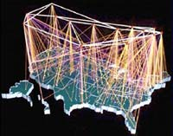
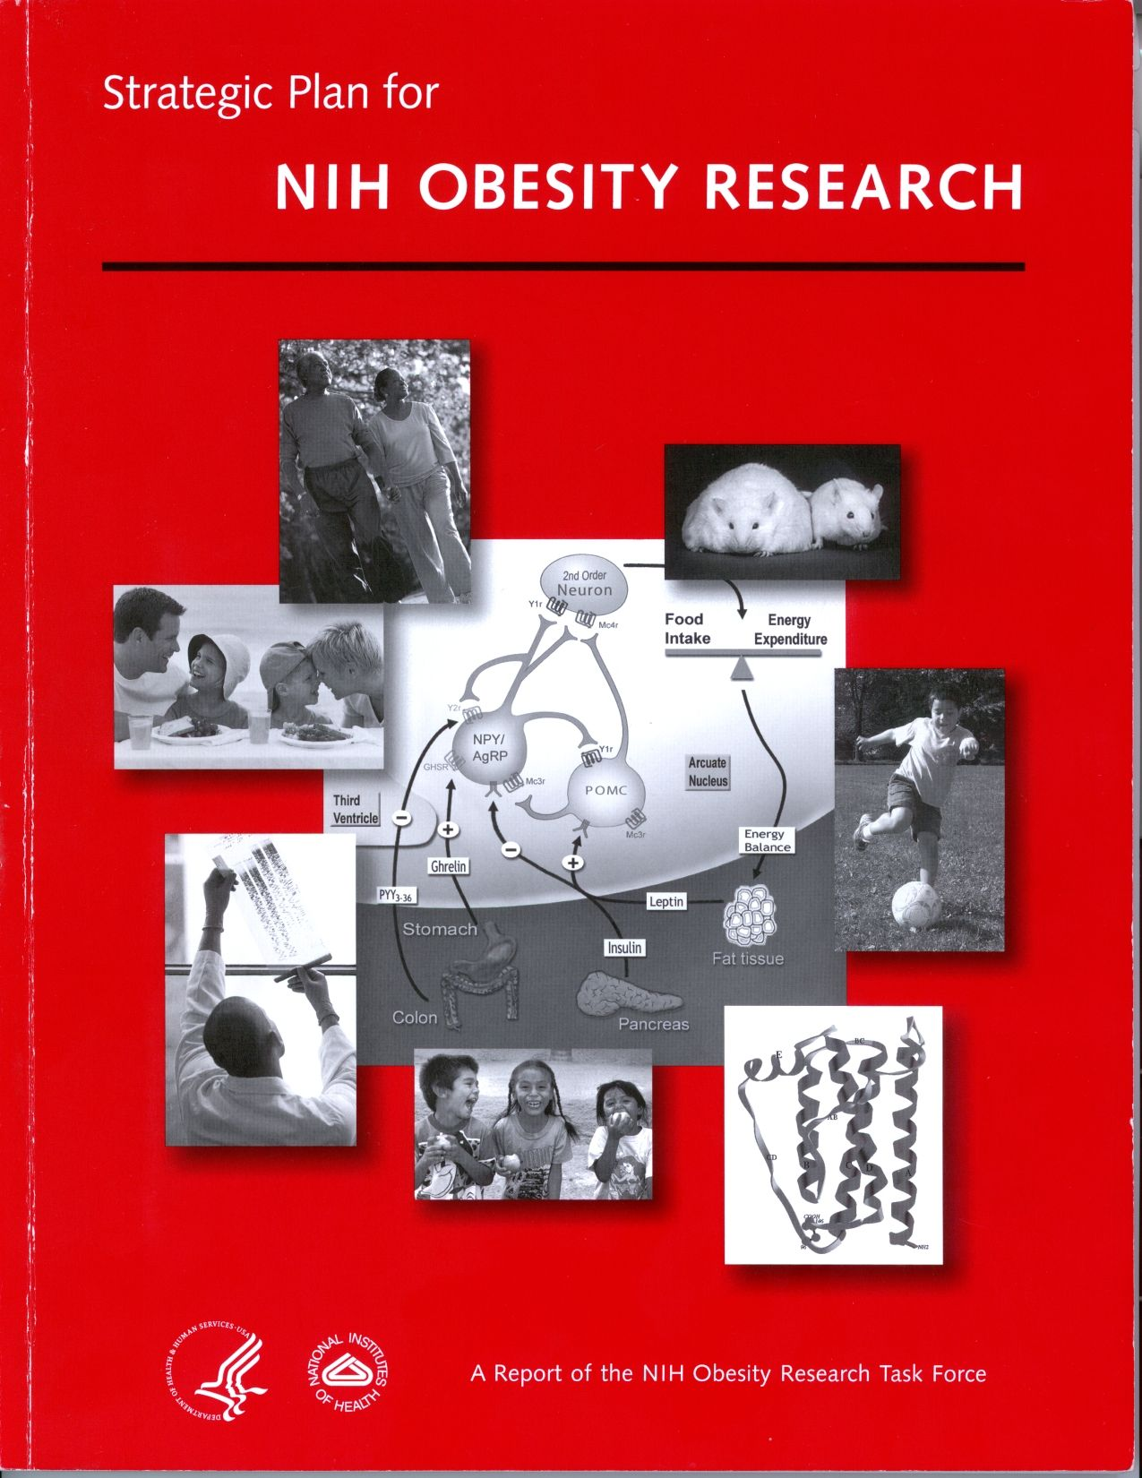


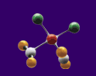
NCI and Trans-NIH Initiatives
Re-engineering the Clinical
Research Enterprise
Clinical Research Networks and
NECTAR
PROMIS
Translational Research Core
Service
New Pathways to Discovery
Molecular Libraries and Imaging
Nanomedicine
Bioinformatics and Computation
Biology
Research Teams of the Future
Strategic Plan for NIH Obesity
Research

Slide 22
Where Do We Go From Here?

Slide 23
NIH Must Develop Adaptive Strategies: Key Principles
Protect core values and mission: Discovery and New Knowledge
Protect the future: New Investigators
Pathway to Independence Program
Institutes and Centers efforts to assist new investigators
Manage the key drivers
Supply/demand of grants
Proactive communications
A unified message about value of NIH’s investment and need for sustainability
Promote NIH’s vision for the future

Slide 24
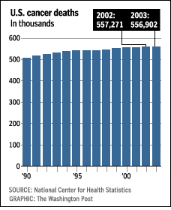
Cancer
For the first time in recorded history, annual cancer deaths in the United States have fallen
10 million survivors
Improved effectiveness of early detection and screening
Thanks to the doubling, new targeted, minimally invasive treatments for cancer multiplied
New drugs developed for cancer prevention
Average investment
per American
~$8.60
per year
30-year investment
per American:
~$260
Total
Survivorship
9
6
Millions of People
3
1971
1986
1990
2003

Slide 25
Balanced National Biomedical Research Portfolio
Clinical
Applications
Clinical Applications
Translational
Research
Translational Research
Basic Research
and
Technology Development
Basic
Research
NIH
Private Sector

Slide 26

Protecting the Future: Pathway to Independence Award
Enhanced Support for New Investigators- PATHWAY TO INDEPENDENCE AWARD
Five years of support consisting of two phases
Phase I provides 1-2 years of mentored support for advanced post doctoral fellows- 90k per year
Phase II provides up to 3 years of independent RO1 equivalent research support- 250k per year

Slide 27
Central Themes in NIH Communications: A Vision for the Future

Slide 28
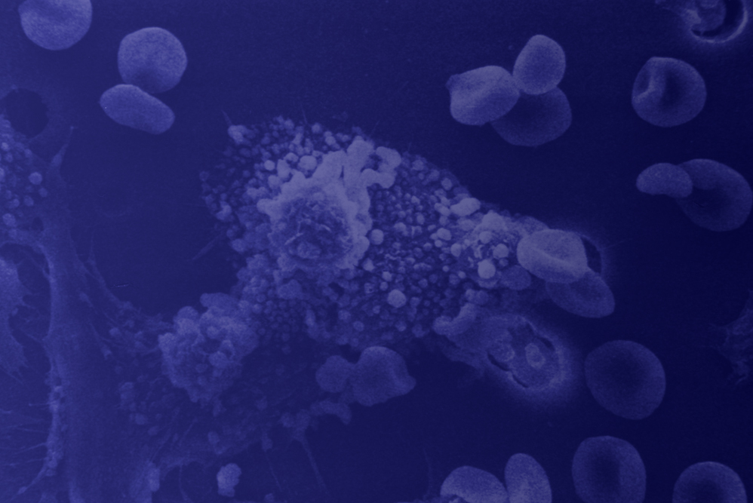
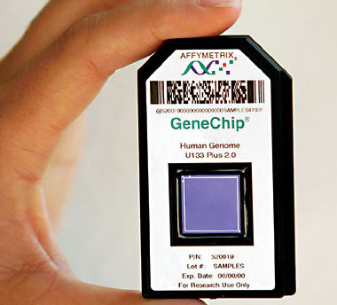
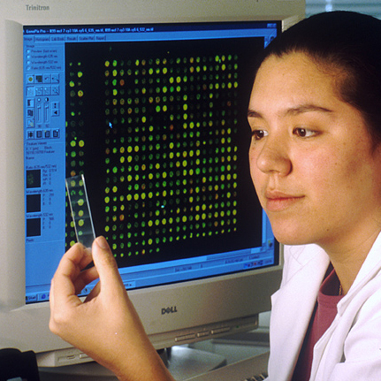

The Future Paradigm:
Transform Medicine from Curative to Preemptive
Predictive
Personalized
Preemptive
Participatory

Slide 29

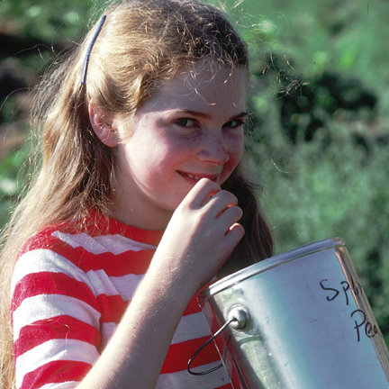

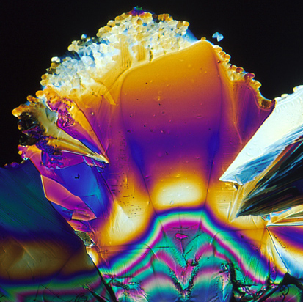
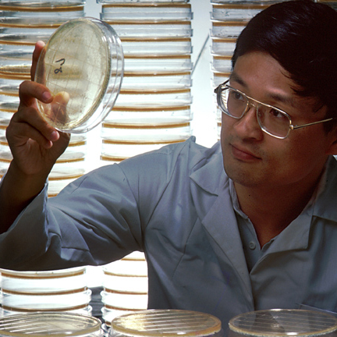
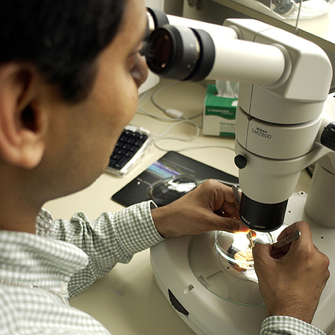
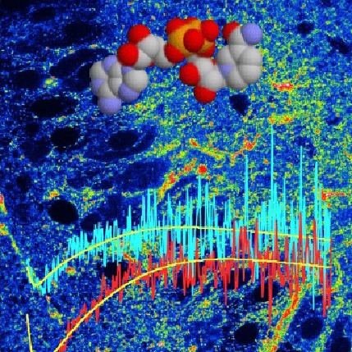
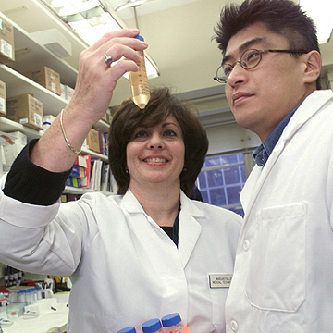
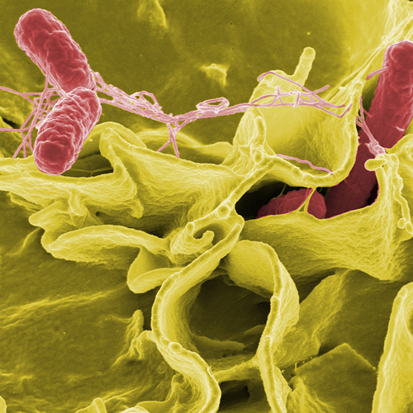
NIH
Transforming medicine and health through discovery

