Slide 1
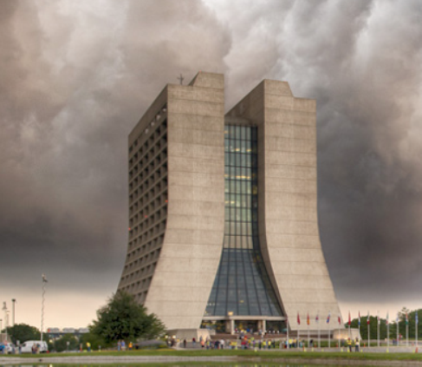
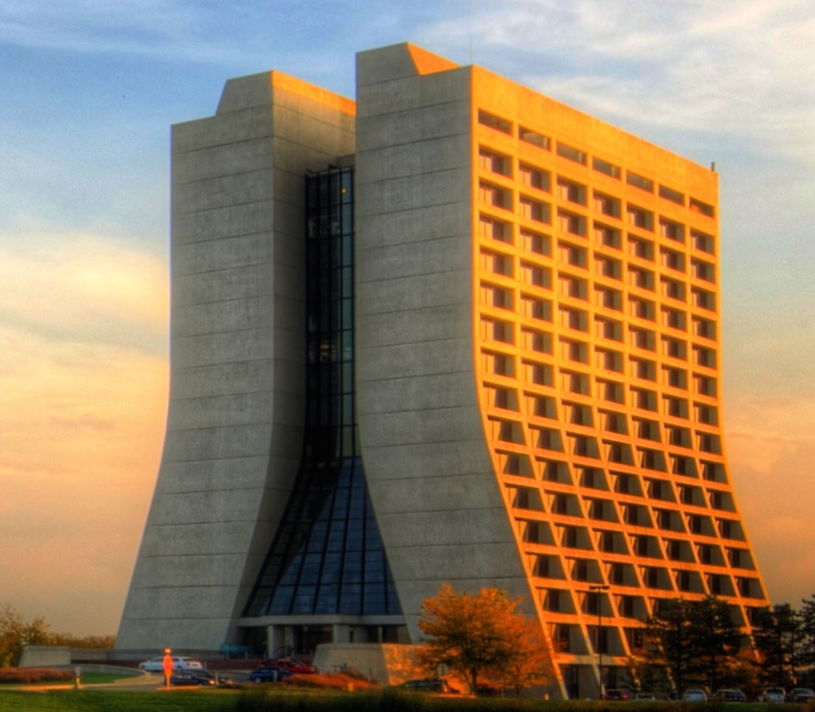
Opportunities for Experiments Based on Stored Muon Beams at Fermilab (in next ~5-10 years, for ~3-20M$)
Milorad Popovic
MAP Meeting
May, 2015

Slide 2
How to get 100k events
In next year or two there will be stored muon beam at ~3 GeV/c in the storage ring with ~60 meters long straits (Debuncher ring as g-2 delay beam line).
There will be ~400 CC neutrino events in some imaginary 100 ton detector, 10 meters downstream from the one ring’s straits, running for 10^7 sec Booster at 3 Hz, 8 GeV beam(5x10^12 protons per pulse) and storing muons for 100 turns.
Numbers in point 2., are g-2 beam , and are just to establish reference point.
Running (two Booster batches stacked) 120 GeV beam from MI on the same target and using ICARAUS (600 ton) detector for 2x10^7 seconds (Fermilab year) will create 40000 CC neutrino events.
All this is for investment of ~10M$ in building to house detector and willingness to move ICARUS detector in suggested location!
December 5, 2014
<number>

Slide 3
Motivation
Measure neutrino cross-section with better than 10% precision
Take advantage of the existing accelerator complex configuration providing beam to the New Muon g-2 Experiment
Utilize existing detectors (MicroBooNE, ICARUS)
Minimize initial investment. Providing a suitable building to house the detector would be the only investment required
Describe possible improvements in collecting and storing muons that would allow cross-section measurements with a precision of a few percent with a modest additional investment.
Provide a suitable test facility for future NF
December 5, 2014
<number>

Slide 4
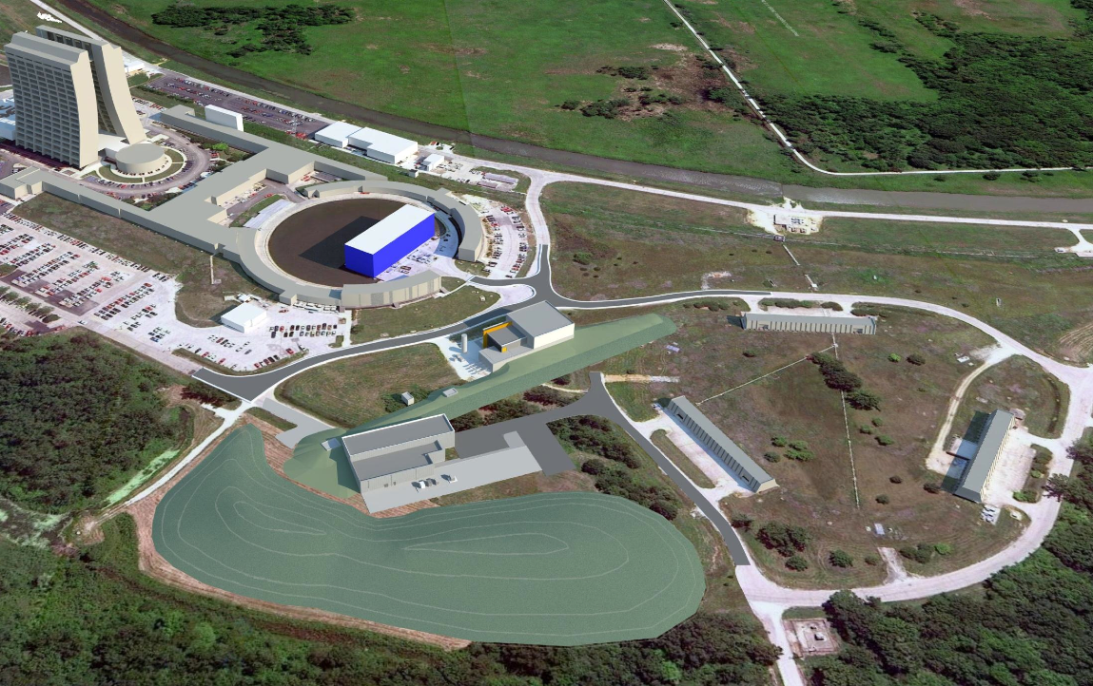
Muon Campus = Mu2e + g-2 + ???

g-2
Mu2e
■
<number>
Notes:
<number>

Slide 5
Proton Beam Like for g-2, but with g-2 off
5x10¹² protons in a Booster pulse
3 Hz, 8 GeV Booster
Muons are stored for ~100 turns
Running time 10⁷ Sec (1 year)
100 ton detector, 10 meters downstream from ring
~ 400 CC neutrino events
This is for about the cost of moving an existing detector (BooNE??, 60T) and building a new detector housing (about 3M$)
December 5, 2014
<number>

Slide 6
Looking in the near future ( cost~$3M)
1x10¹³ protons from MI (two Booster pulses slip stacked)
~1 Hz, 120 GeV MI ( every 1.33 sec)
Muons are stored for ~100 turns
Running time 1year(2x10⁷ Sec)
100 ton detector, 10 meters downstream from ring
~ 2/3/1.33*120/8*2x400 6000 CC neutrino events
So in 10 bins even if detector is only 50% efficient, cross section
Can be measured with error less then 10%
December 5, 2014
<number>

Slide 7
Looking Into the Future ( cost~$10M)
1x10¹³ protons from MI (two Booster pulses, slip stacked)
~1 Hz, 120 GeV MI (1.33 sec)
Running time 1year(2x10⁷ Sec) Fermilab year is ~2x10⁷ Sec
Larger detector, ~500 ton detector( x5) ICARUS is 600 ton
~30000 CC neutrino events
December 5, 2014
<number>

Slide 8
Looking Into the Future ( cost~$??)
1x10¹³ protons from MI (two Booster pulses, slip stacked)
1 Hz, 120 GeV MI
New Li lens r = 2 cm to increase collection of pi’s ( x1.5)
CERN has made this size Lens
Make ring to be racetrack (x1.5x2) Provide a suitable test facility for future NF
Running time 1year(2x10⁷ Sec) Fermilab year is ~210⁷ Sec
Larger detector, ~500 ton detector( x5) ICARUS is 600 ton
~100k CC neutrino events
December 5, 2014
<number>

Slide 9
Questions ?
The End and New Beginning
Or
The way to the nuSTORM
(everything is used in upgrade)
December 5, 2014
<number>

Slide 10
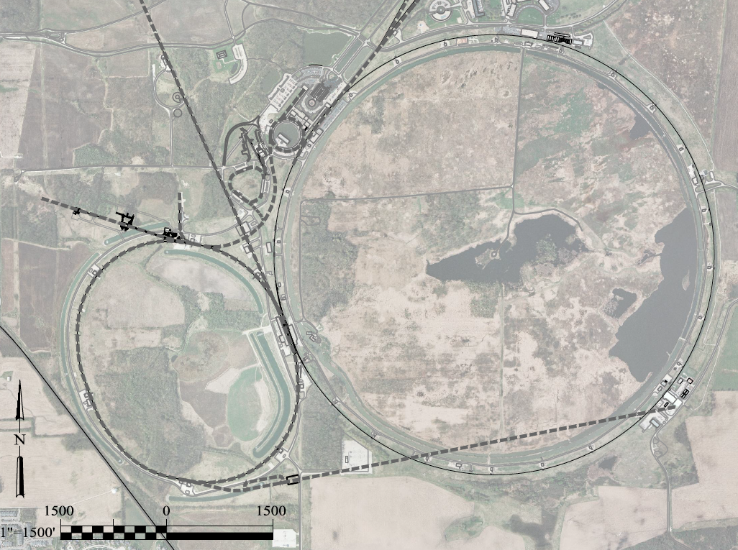
Questions ?
nuSTORM can be moved to Muon Campus
and there are two options. Depending what
is distance needed to far detector we can use
CDF or D0 Building to house far detector.
December 5, 2014
<number>

Slide 11
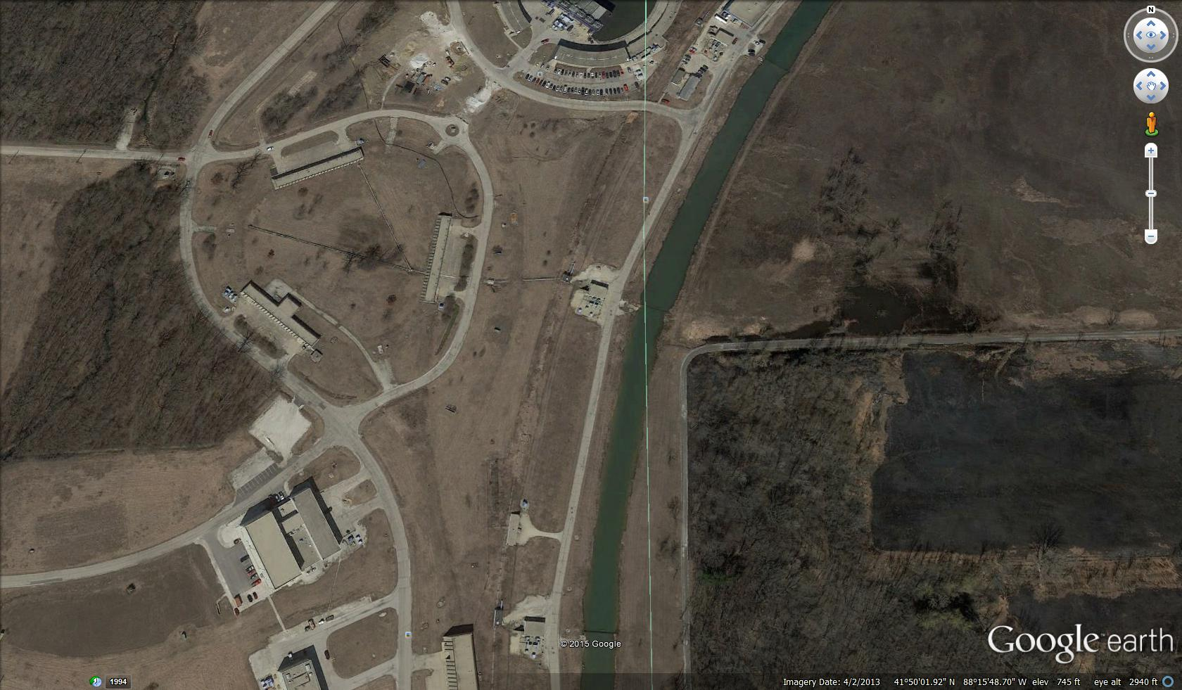
If Far Detector is in CDF
In this case A0 and CDF buildings
can be used for detectors. Distance
To CDF is 1.5 km. Blue box is near
detector used initially. The red lines are
nuSTORM upgrades.
New Target
Station
December 5, 2014
<number>

Slide 12
If Far Detector is in D0
Distance to D0 is 1.1 km. Blue box is near
detector used initially. The red lines are
nuSTORM upgrades.
December 5, 2014
<number>

Slide 13
Questions ?
May be there is more to all this
December 5, 2014
<number>

