Slide 1
生程式人工智慧導論
穩定擴散_控制網路
吳凱印
國立臺北科技大學資訊工程系

Slide 2
目錄

Slide 3
目錄
介紹
Stable diffusion應用UI執行

Slide 4
介紹
02

Slide 5
Stable diffusion
Stable diffusion是一種潛在擴散模型（latent diffusion model; LDM），是2022年發布的深度學習文字到圖像生成模型，由初創公司StabilityAI、CompVis與Runway合作開發。 arxiv
Stable Diffusion 的主要步驟：
文本嵌入 (Text Encoding)：將輸入的文字轉換為數字向量，使模型能理解描述內容。使用CLIP模型來解析文本，將輸入的 Prompt 轉換成「潛在空間 (Latent Space)」的向量表示。
噪聲添加 (Forward Diffusion Process)：在訓練過程，透過一系列步驟，將圖像逐漸轉換為純高斯噪聲，使模型學習如何從雜訊中還原圖像。
反向擴散 (Reverse Diffusion Process)：透過訓練過的模型(U-Net)(也可稱noise predictor)，根據文字提示從純噪聲(Random noise)中恢復出合理的圖像。
圖像解碼 (Decoding)：將noise predictor生成的「潛在圖像 (Latent Image)」轉換為最終可見的圖像(VAE解碼)。
Notes:
CLIP 由圖像編碼器和文字編碼器組成，經過訓練可以將圖像及其文字描述編碼為彼此相似的向量。因此，CLIP 的文字編碼器計算的提示的文字表示可能包含提示中所述的圖像的資訊。

Slide 6
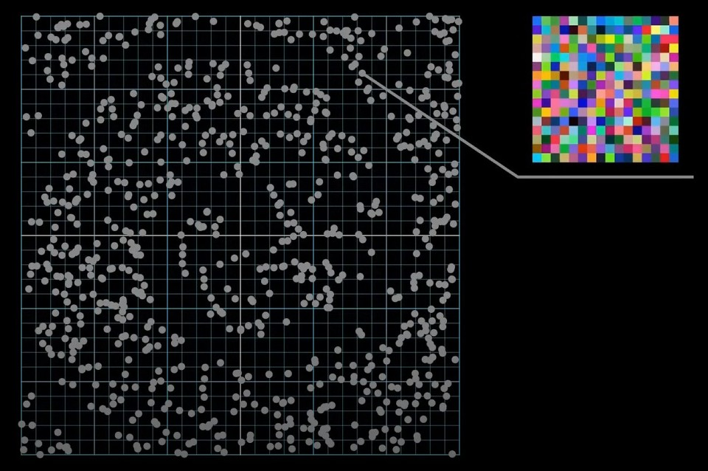
Stable diffusion
https://www.youtube.com/watch?v=FMKa4075VZg
當我們說一張圖片看起來像是真的，在數學上表示：該圖片的像素點不是雜亂的。
圖片的本質是一串數字或是向量，每個像素點保存的就是該點的RGB信息，當我們把每個數字當成是一個座標，那麼一張圖片就變成了一個向量，這個向量所在的空間叫做像素空間(Pixal Space)。
取像素空間中的一個向量，將其座標轉化成顏色，便能得出一張照片。
絕大部分像素空間中的向量對應的圖片都是無意義的噪聲(noise)
Pixal Space

Slide 7
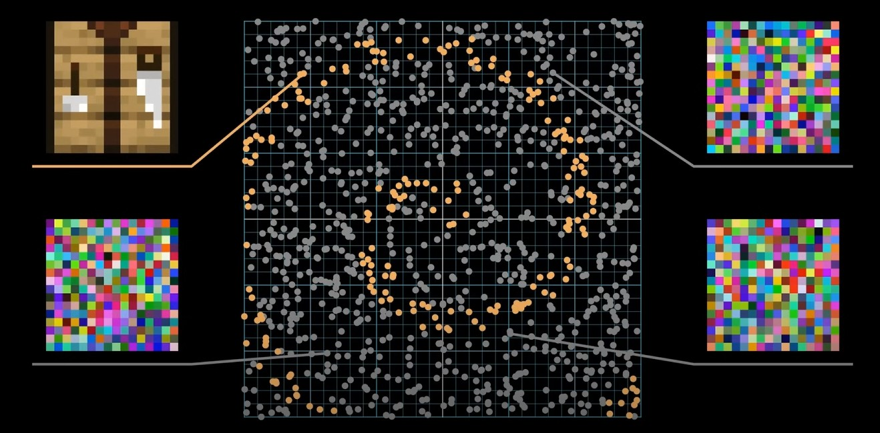
Stable diffusion
https://www.youtube.com/watch?v=FMKa4075VZg
只有極少部分位置的向量所代表的圖片才是有意義的。

Slide 8
Stable diffusion
https://www.youtube.com/watch?v=FMKa4075VZg
因為圖像具有結構性，一張自然圖片通常是一團團色塊，意謂著大部分情況下一個像素其相鄰的像素顏色都差不多，這就對這些像素的數值構建起了約束，而隨機生成的像素通常不滿足這些約束，看起來就會是亂七八糟的噪聲了。

Slide 9
Stable diffusion
https://www.youtube.com/watch?v=FMKa4075VZg
一張圖片要象徵的除了色塊，還有結構、透視、光影、色彩等等要素，而在AI眼裡，所有這些複雜的要求無非就是只有極少部分的向量所對應的圖片是看起來真實且有意義的，其就像一條礦脈；我們在真實世界裡收集圖片並做成數據集，就相當於在這條礦脈中標註出一些位置並告訴AI這些是有意義的。

Slide 10
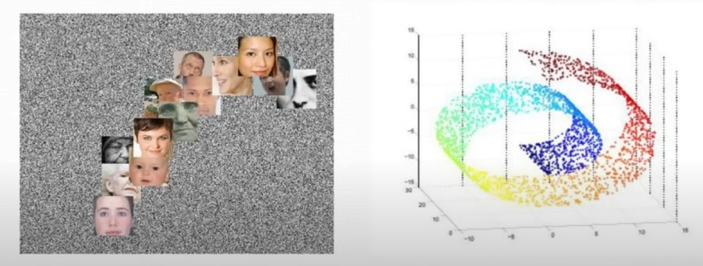
Stable diffusion
https://www.youtube.com/watch?v=FMKa4075VZg
所以真正重要的是這條礦脈在像素空間裡它的形狀和結構是甚麼樣子的，這個觀點被稱作流形假設 (Manifold hypothesis)，簡單來說一張看起來真實的圖片本質上等價於其在像素空間中滿足某一特定的形狀結構。
換句話說，只要從空間中的任一位置，可以一路走的這個流形結構上的某個點，那麼翻譯出來的這張圖片就是真實的。

Slide 11
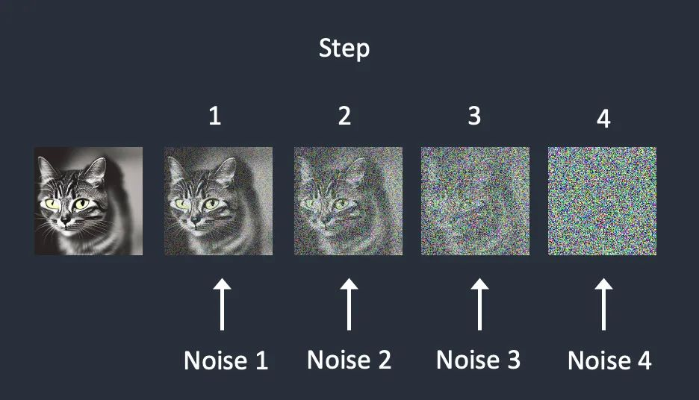
Stable diffusion
https://www.aiuai.cn/aifarm2083.html
而需要訓練的神經網路被稱作噪聲預測器(noise predictor)，其訓練方式便是為圖片一步步添加隨機噪聲使其變得嘈雜，而noise predictor的訓練會以正確答案為基準，最終識別出圖像中添加了多少次噪聲。

Slide 12
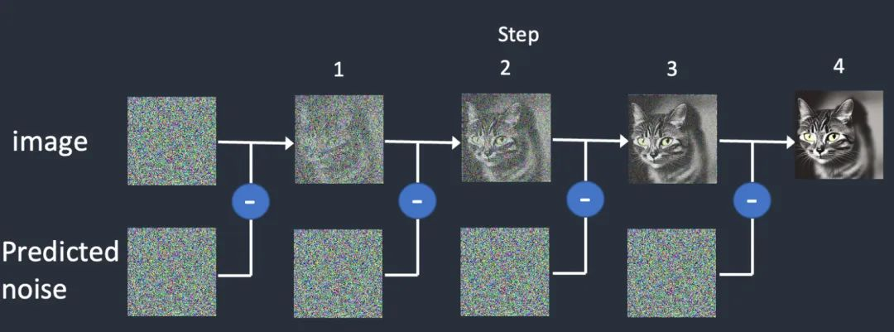
Stable diffusion
https://www.aiuai.cn/aifarm2083.html
有了noise predictor後，便可以先生成一張隨機噪聲圖(random noise)，透過noise predictor告訴我們這張圖添加了幾次噪聲，使用noise predictor給出的噪聲圖從原始圖像中消除噪聲，重複步驟便可生成圖像，這個過程稱為反向擴散(Reverse process)。

Slide 13
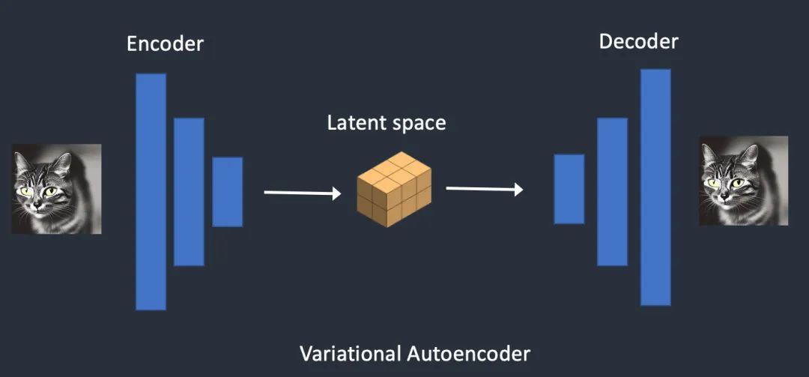
Stable diffusion
https://www.aiuai.cn/aifarm2083.html
而Stable diffusion的設計是為了解決速度問題，由於像素空間非常大，一張512x512大小的RGB彩色影像，這將是一個768,432（512x512x3）維度的空間。
為避免在高維影像空間中操作，首先將影像壓縮到稱為潛空間(Latent space)的區域中。潛空間大小比像素空間小了48倍。因此，模型所處理的計算資料量少很多，也因此比一般擴散模型快得多。
實現影像潛空間壓縮的技術稱為變分自動編碼器（VAE）

Slide 14
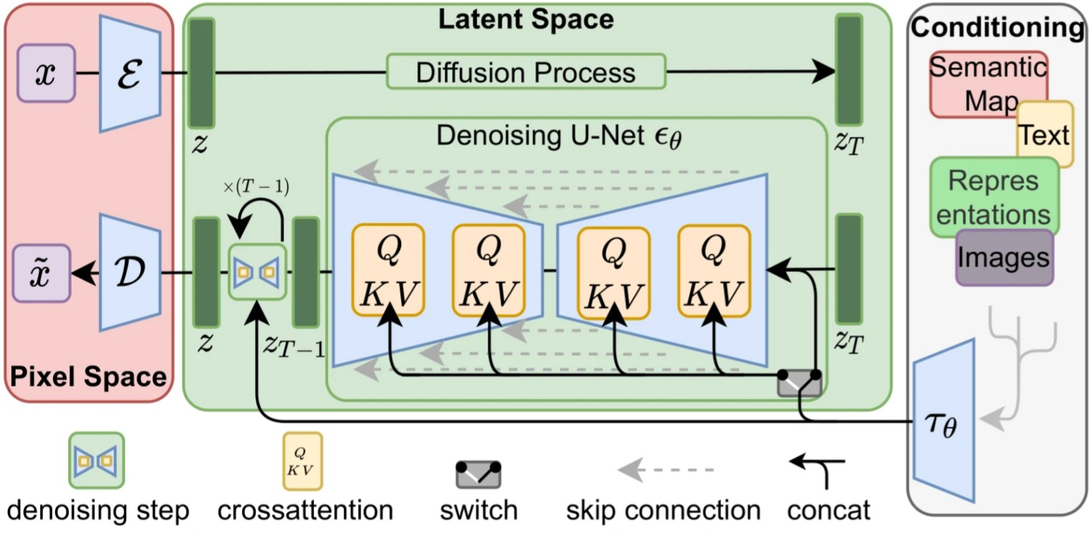
Stable diffusion
arxiv
VAE
潛空間
noise predictor
Clip

Slide 15
Stable diffusion應用UI執行
03

Slide 16
本地運行
04

Slide 17
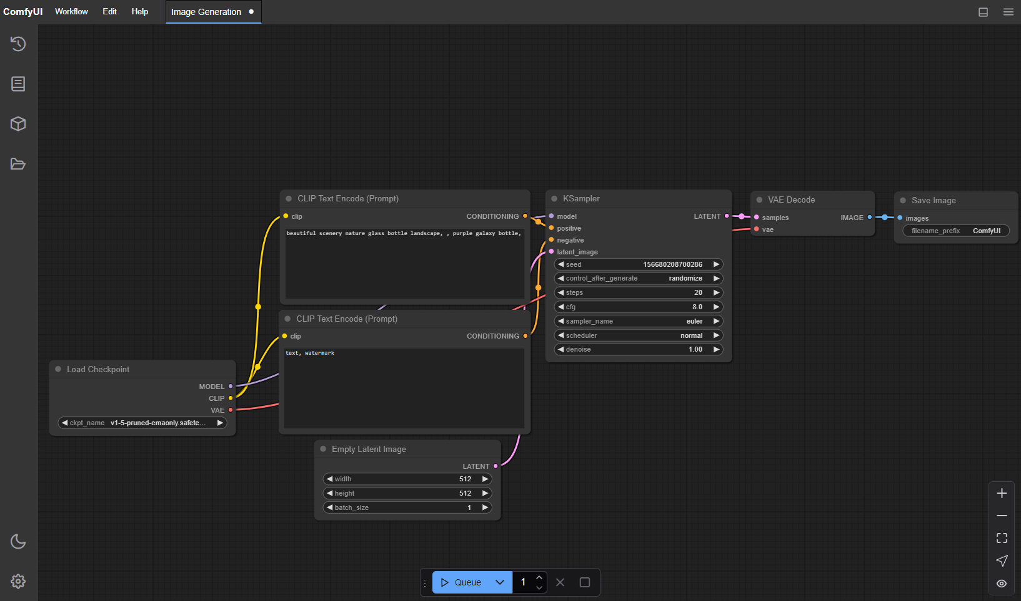
ComfyUI
ComfyUI是一款開源的AI繪圖軟體，用於精準控制Stable diffusion AI繪圖的生圖流程。

Slide 18
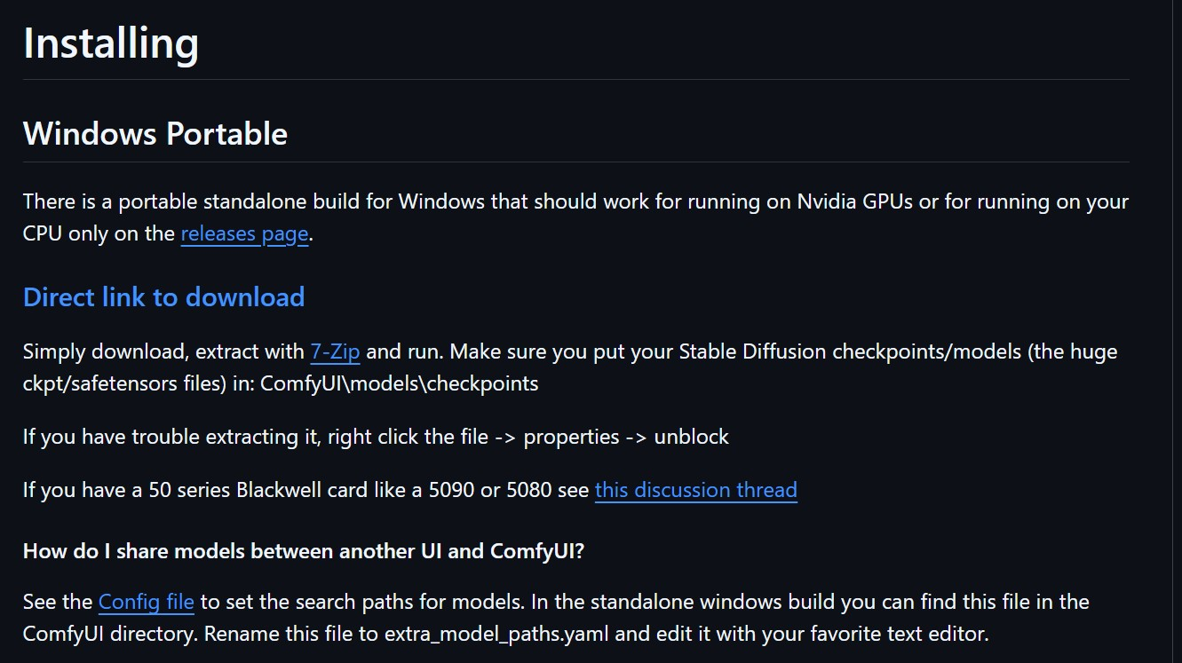
下載
推薦給擁有Nvidia顯示卡，顯存在12G以上的同學嘗試(8G應該也能試試看)。
點擊便可下載

Slide 19
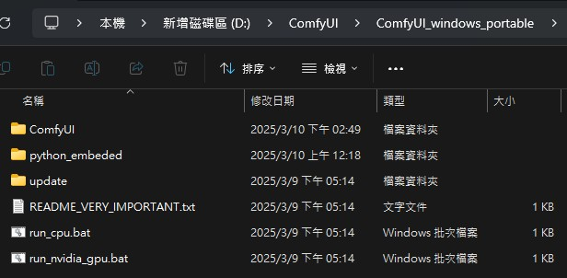
下載
下載完後解壓縮，點進去裡面有這些檔案

Slide 20
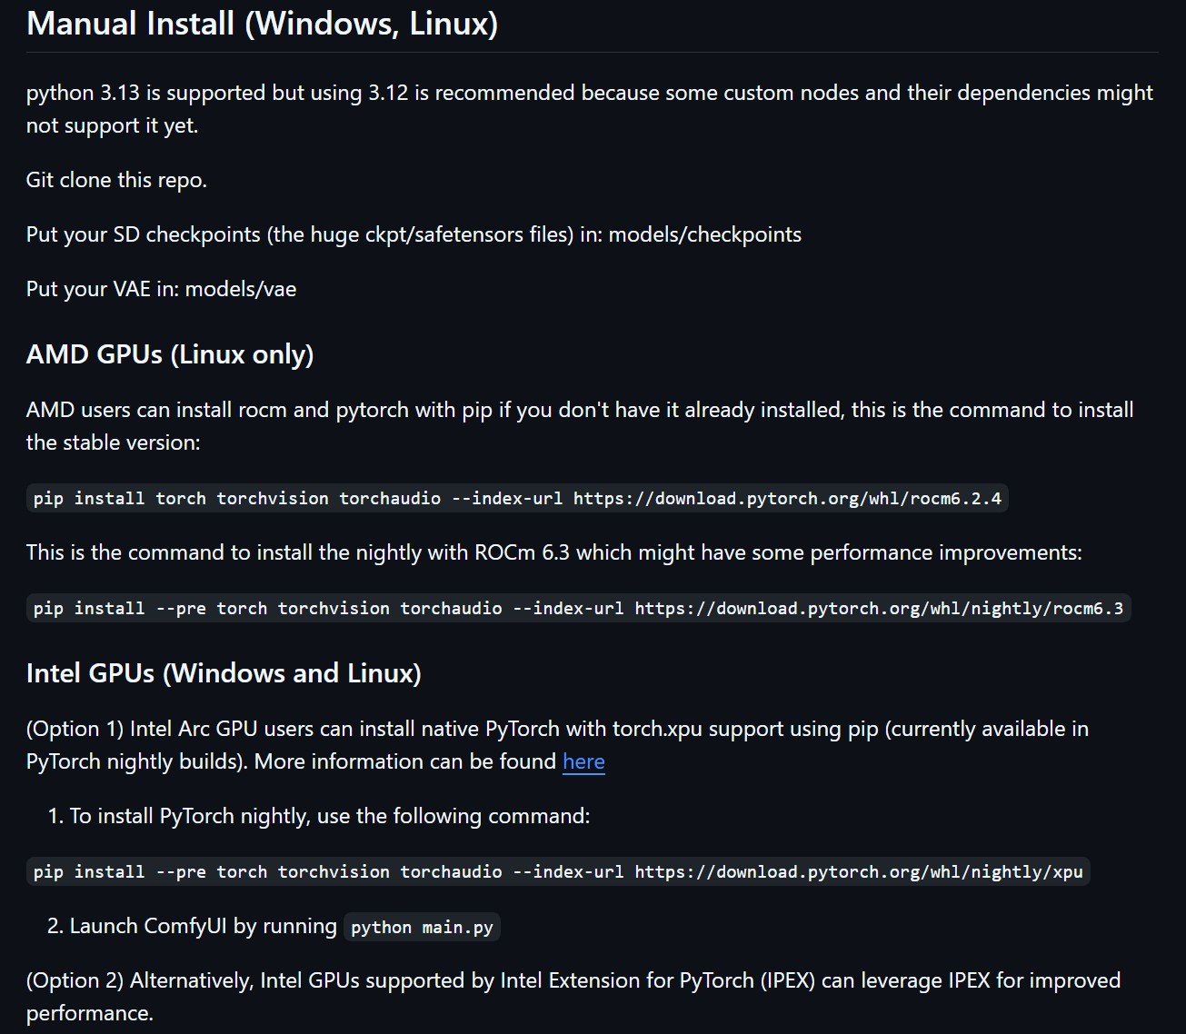
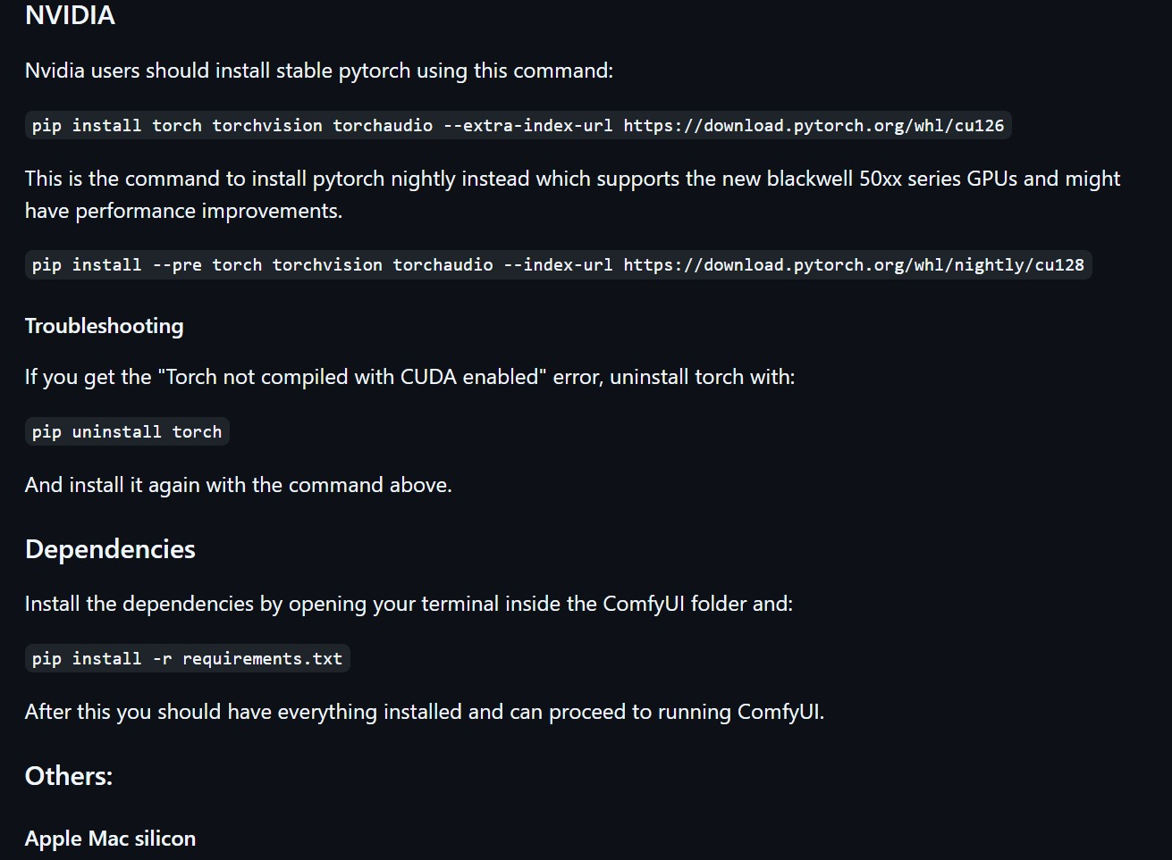
下載
針對不同品牌的GPU有不同的預先處理方式，這邊以NVIDIA為主

Slide 21
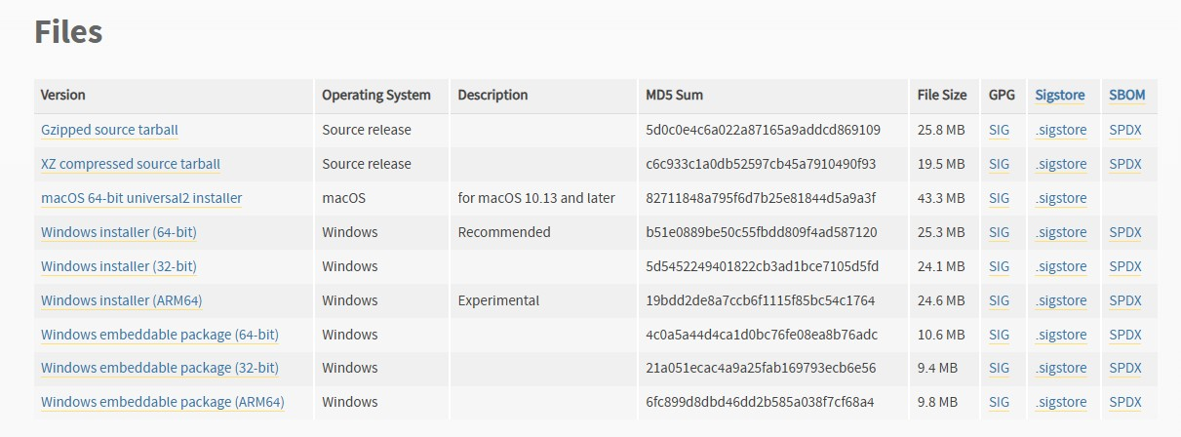
Python
需下載Python 3.12.x版本

Slide 22
Python
需下載Python 3.12.x版本

Slide 23
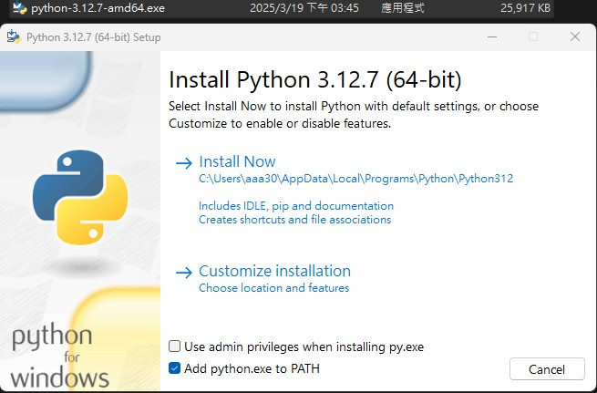
Python
點擊安裝
建議勾選

Slide 24
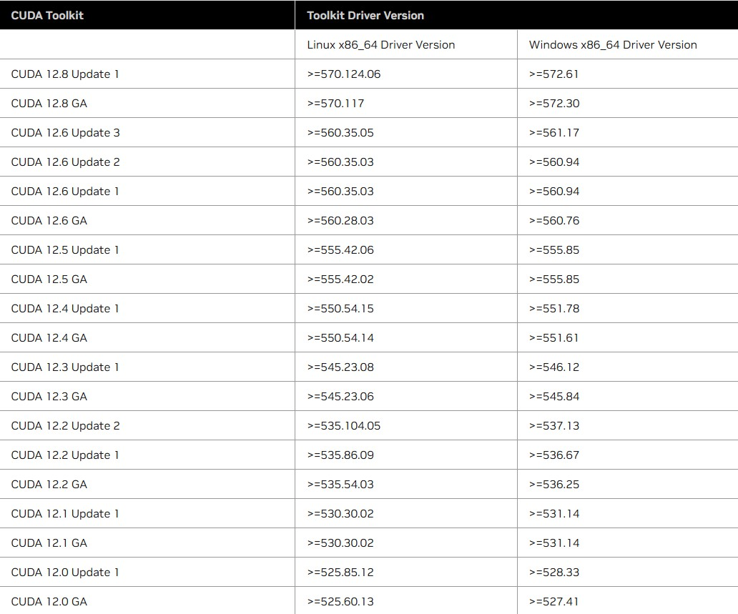
Cuda
安裝Cuda toolkit，依據自身顯卡驅動版本選擇對應的cuda版本，建議更新驅動，然後選擇cu124 or cu126

Slide 25
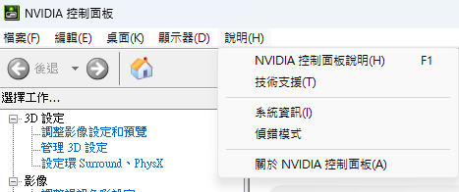
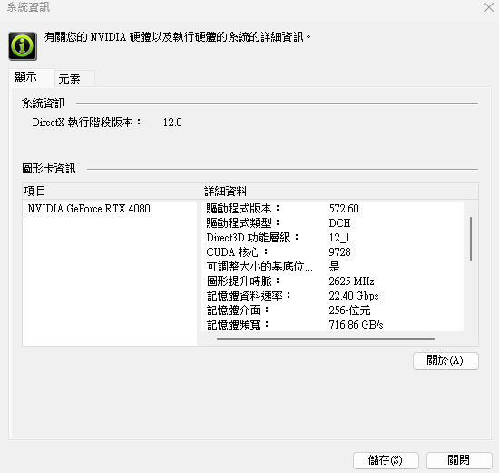
Cuda
開啟Nvidia控制面板，說明->系統資訊，便可查詢當前驅動版本

Slide 26
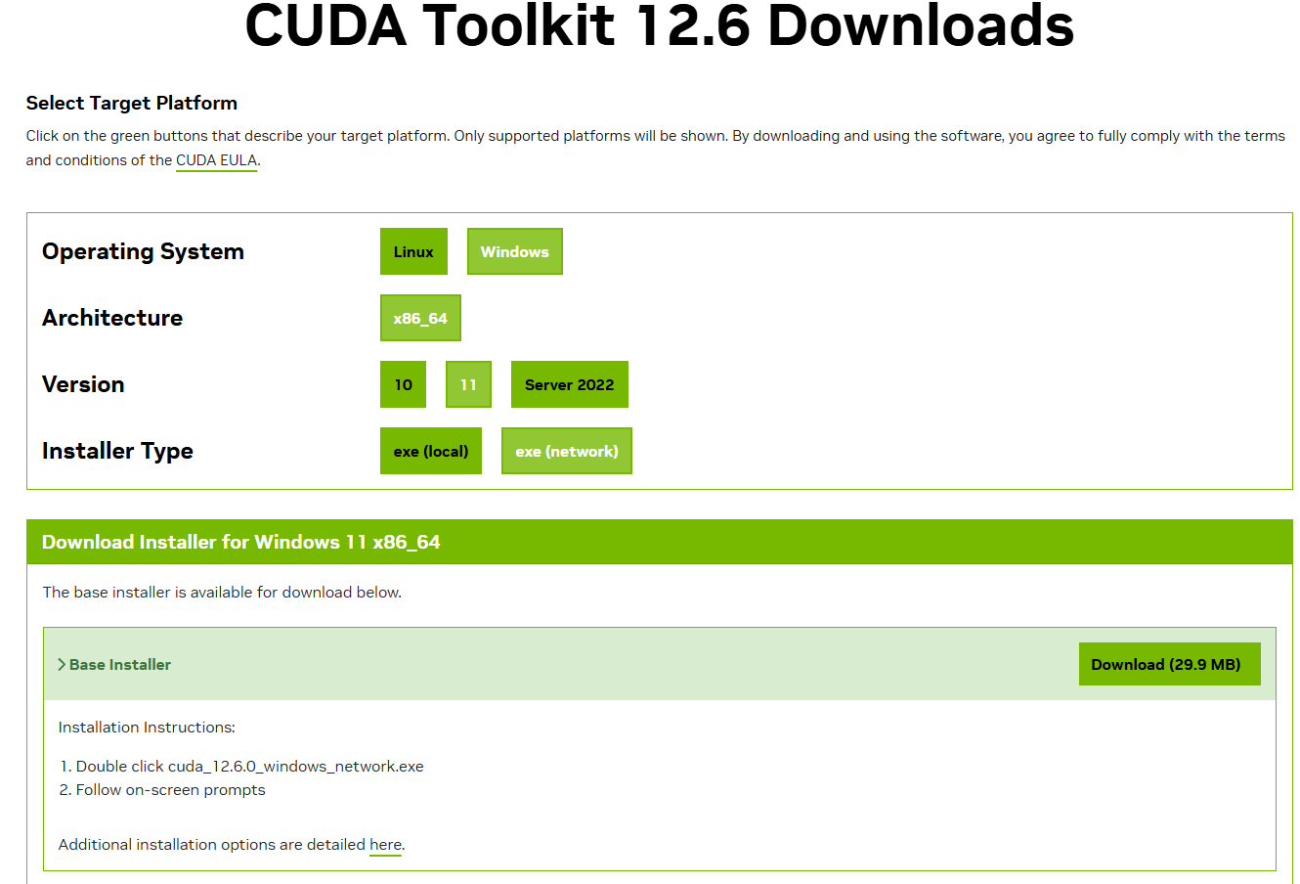
Cuda
下載檔案
看個人作業系統

Slide 27
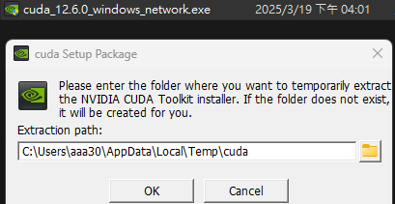
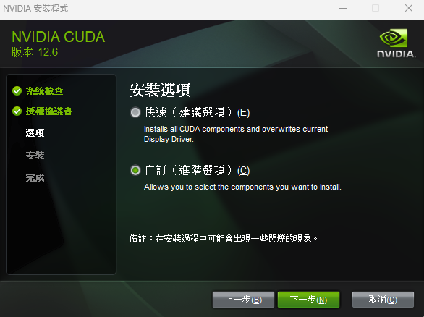
Cuda
開始執行安裝
若是未安裝過選快速就可以了，如果電腦裡有Geforce experience請選自訂

Slide 28
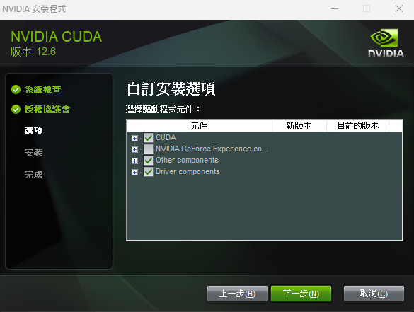
Cuda
把Geforce experience的選項取消勾選後便可安裝

Slide 29
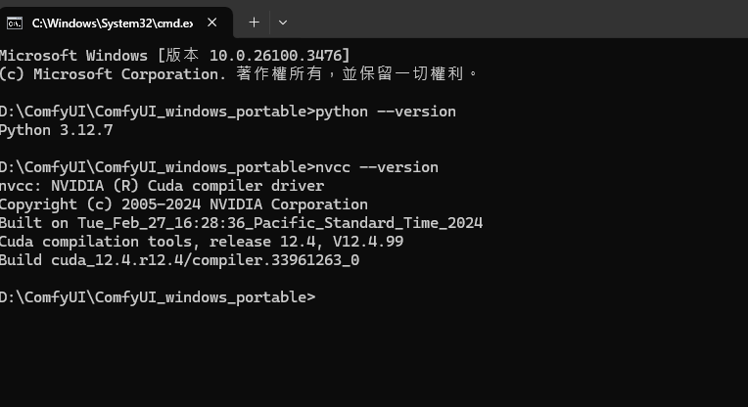
Cuda
安裝完成後透過cmd確認python和cuda版本是否正確安裝
python –version
nvcc –version

Slide 30
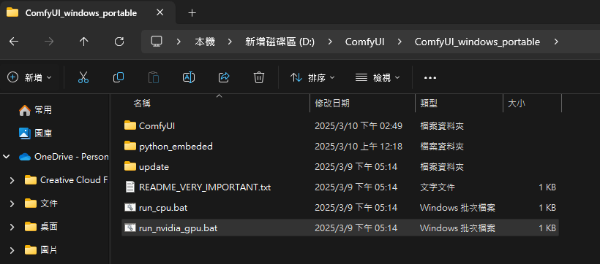
執行ComfyUI
點擊run_nvidia_gpu.bat便可執行，第一次執行會安裝一些依賴項會比較久

Slide 31
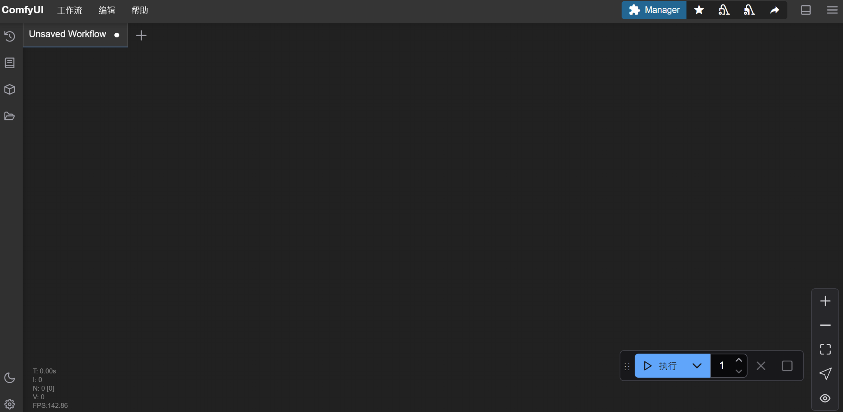
執行ComfyUI
跳出這個介面便是安裝成功

Slide 32
雲端運行
05

Slide 33
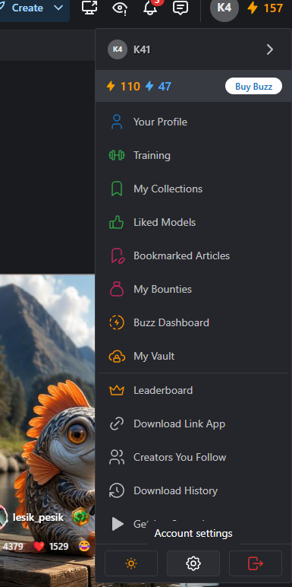
Civitai
Civitai，一個開放模型下載的網站，可以上去下載任意你想要的模型
創建帳號後，點擊頭像->Account Settings

Slide 34
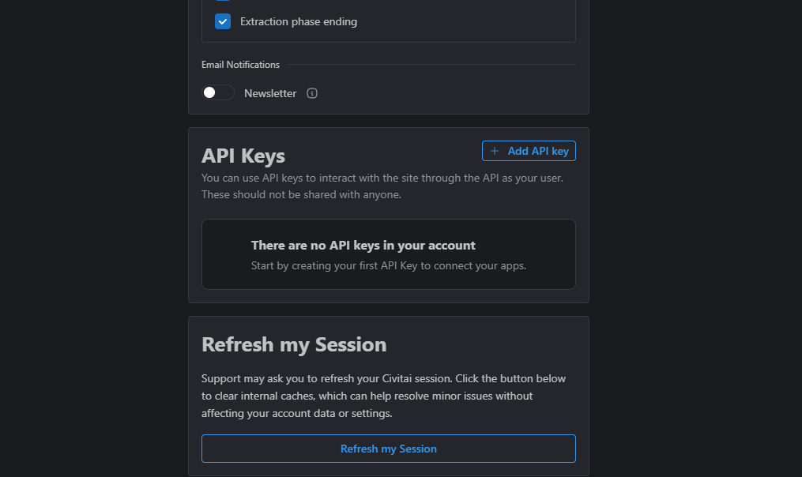
Civitai
移到最下面，找到API Keys，選擇Add API Key

Slide 35
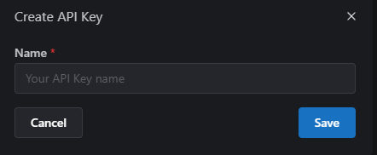
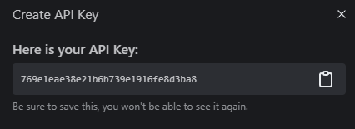
Civitai
隨意命名，API Key出現的時候也記得要複製

Slide 36
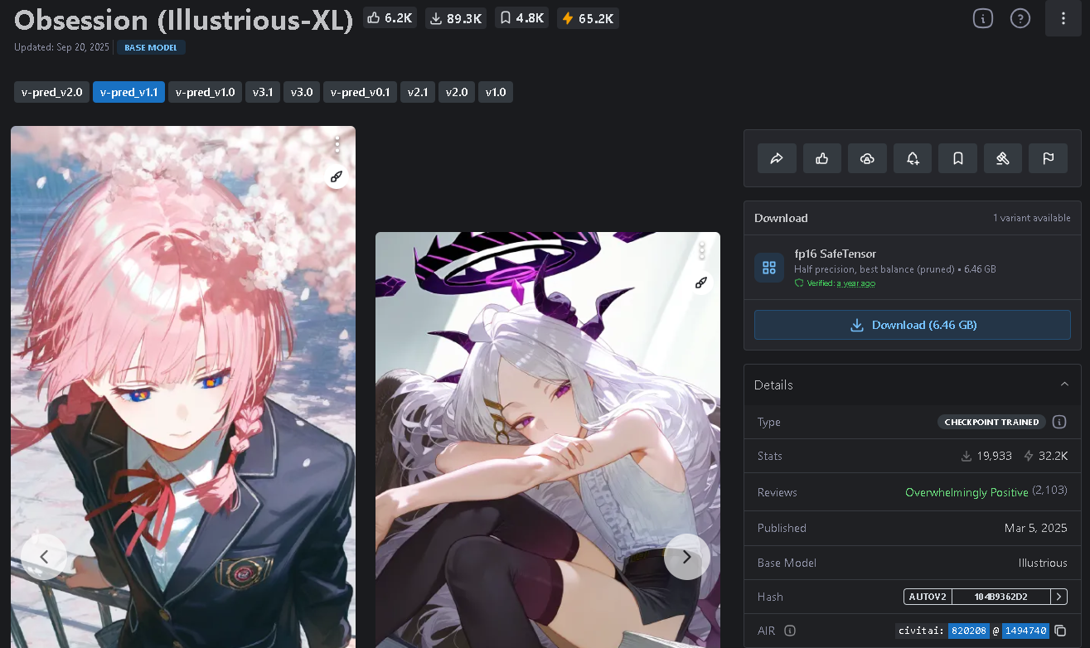
Civitai
Obsession (Illustrious-XL) Checkpoint：https://civitai.com/models/820208/obsession-illustrious-xl?modelVersionId=1494740

Slide 37
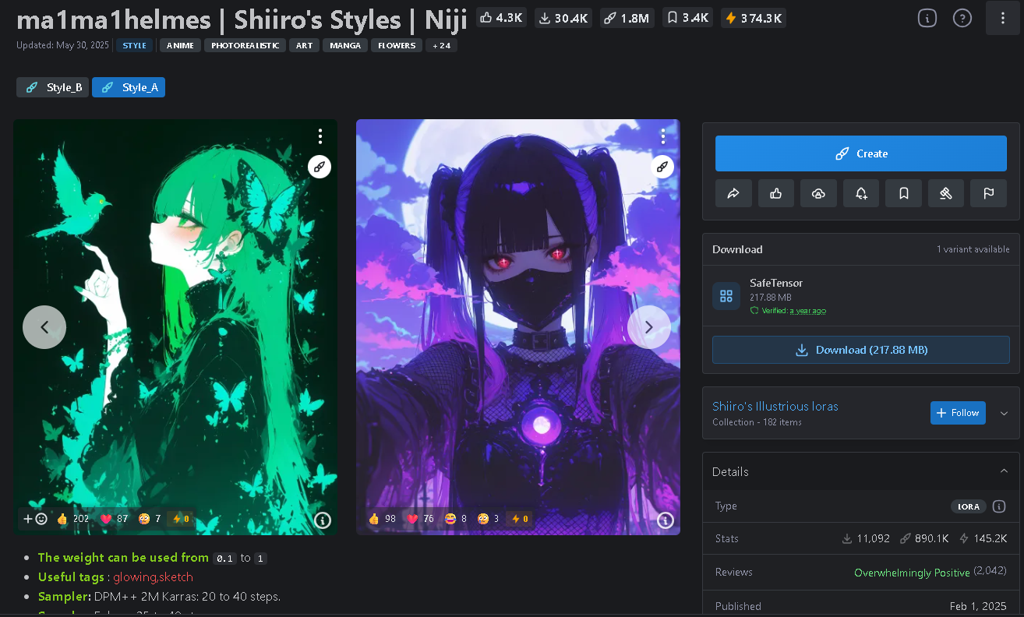
Civitai
ma1ma1helmes LoRA：https://civitai.com/models/1204563/ma1ma1helmes-or-shiiros-styles-or-niji?modelVersionId=1356500

Slide 38
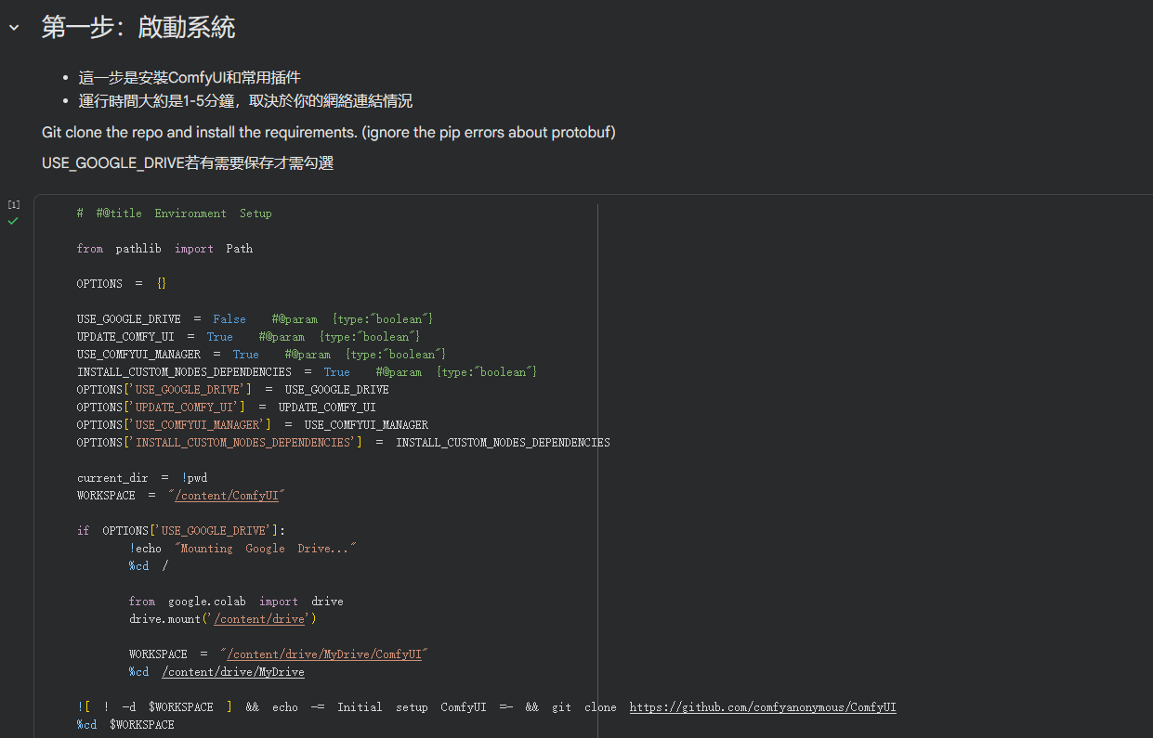
Colab
Colab 程式碼下載連結
點擊執行，安裝comfyui及相關插件

Slide 39
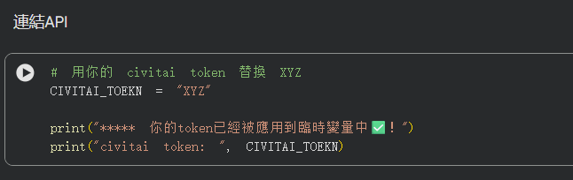
Colab
將Civitai Api貼上

Slide 40
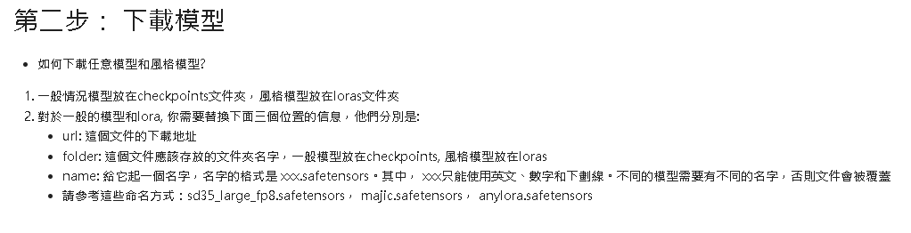
Colab
下載checkpoint和lora，有提供範例的，也可自行去civitai上找尋自己想要的

Slide 41
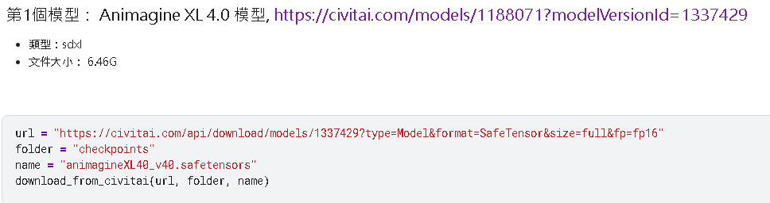
Colab
下載checkpoint

Slide 42
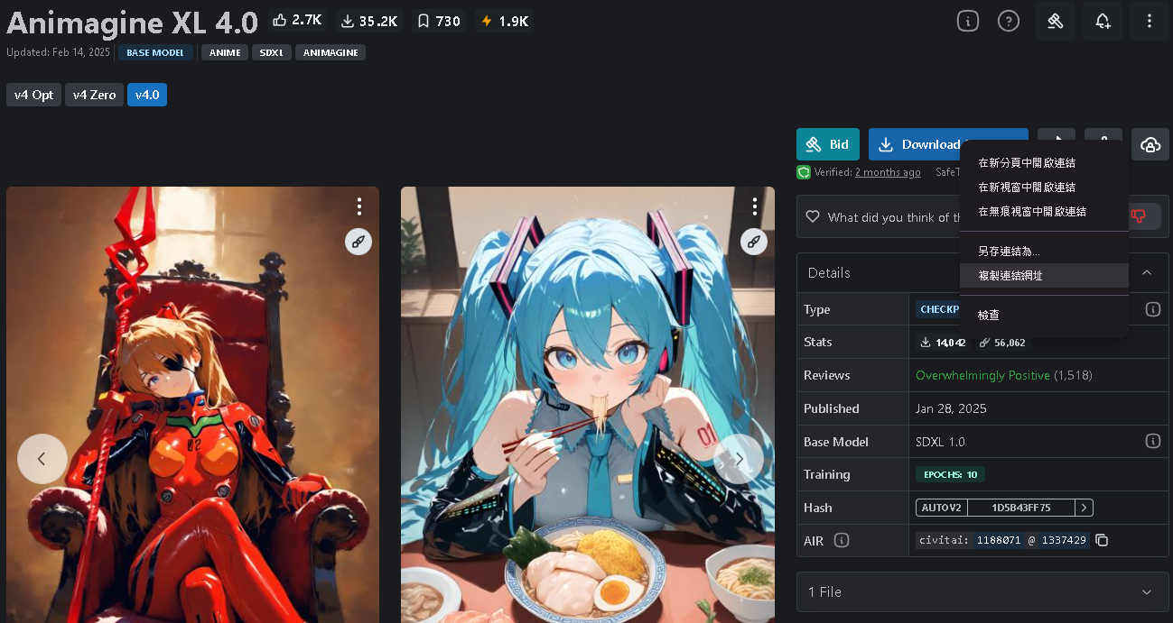
Colab
對下載按鈕點擊右鍵->複製連結網址(url)

Slide 43
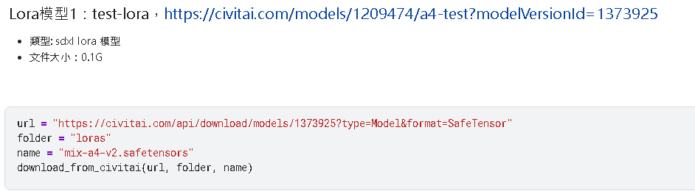
Colab
lora同checkpoint

Slide 44
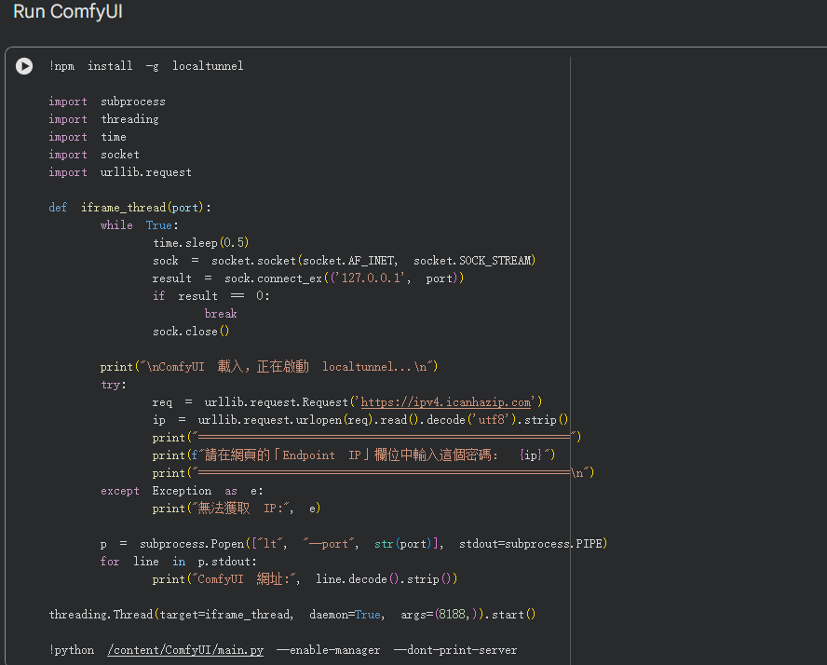
Colab
下載完後執行啟動ComfyUI網頁

Slide 45
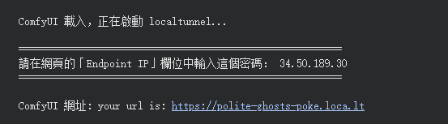
Colab
確認執行階段後點擊連結

Slide 46
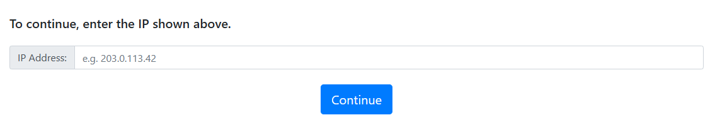
Colab
輸入分配IP後點擊繼續

Slide 47
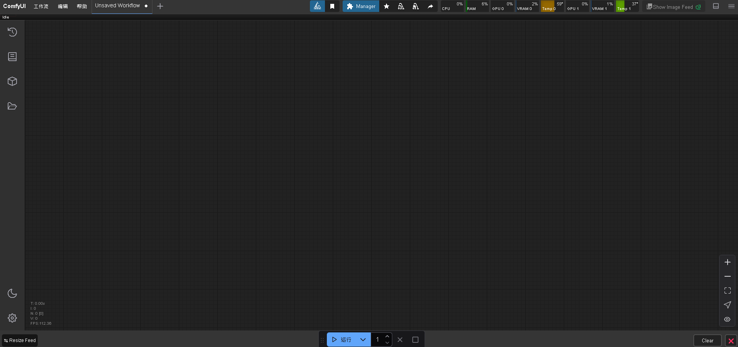
Colab
成功進入ComfyUI

Slide 48
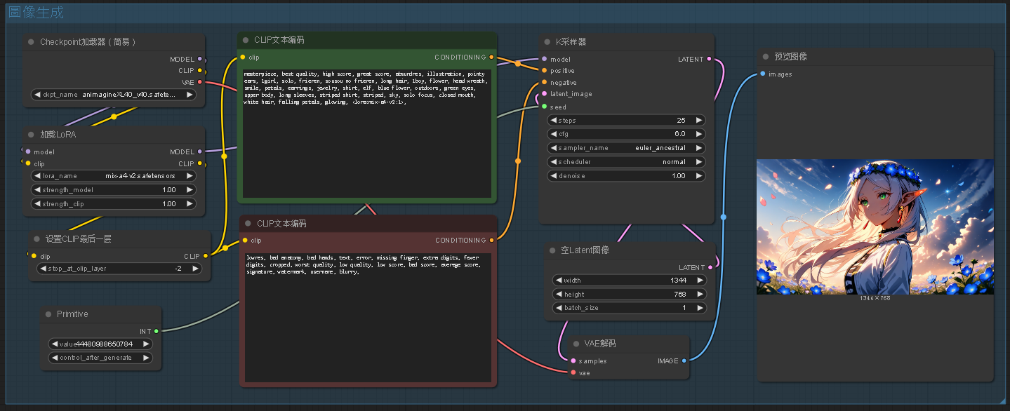
Colab
工作流下載

Slide 49
成功案例
失敗案例
06

Slide 50
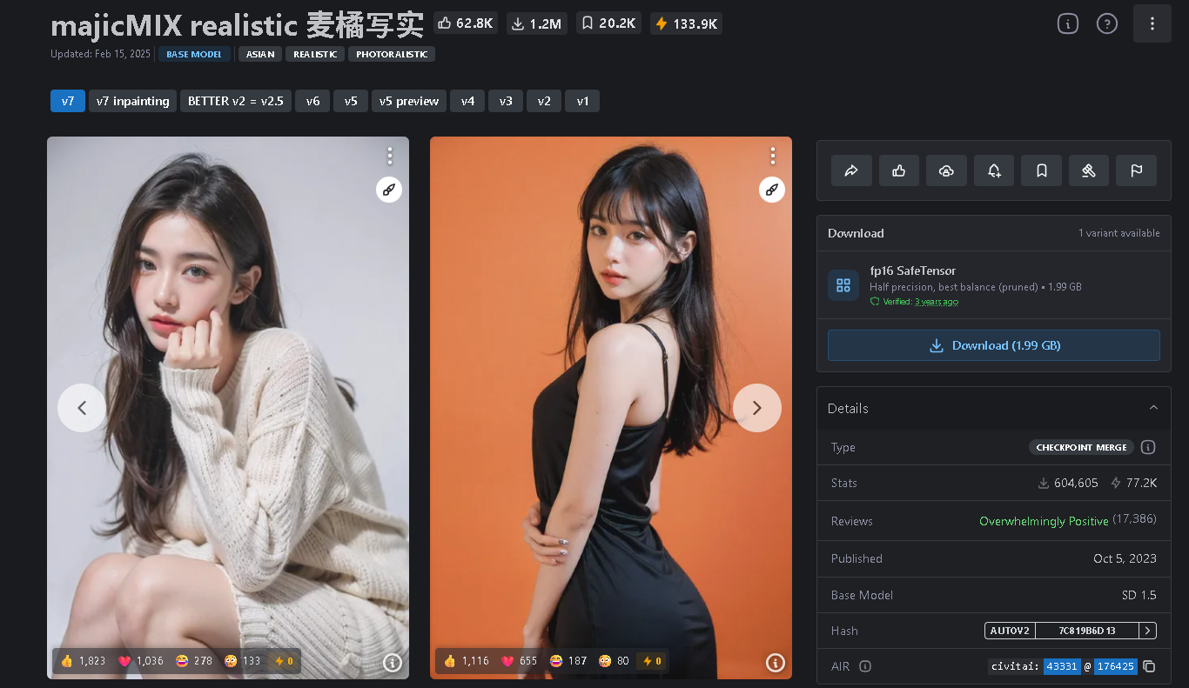
Civitai
麦橘写实 checkpoint：https://civitai.com/models/43331/majicmix-realistic

Slide 51
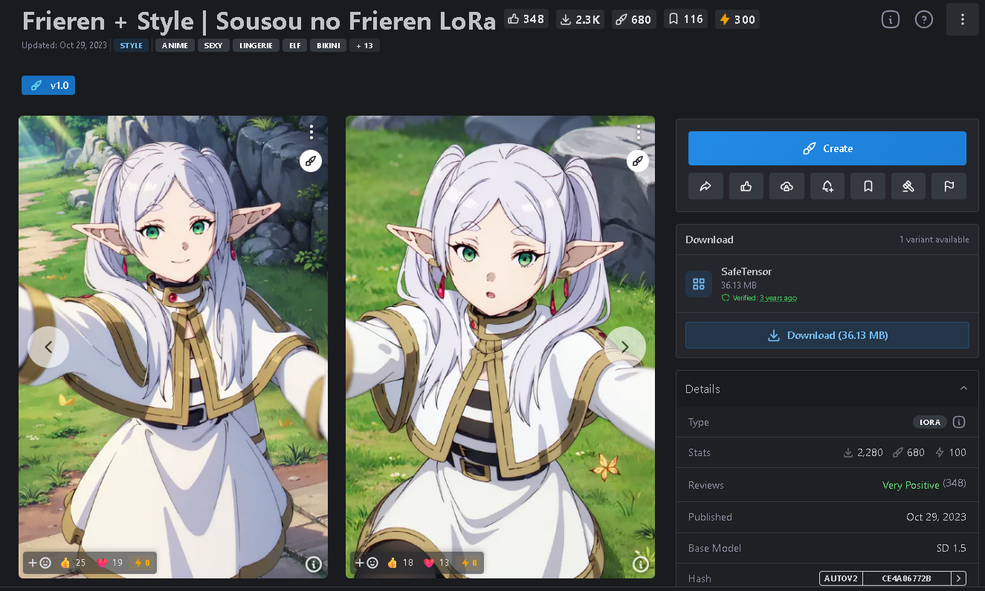
Civitai
芙莉蓮 LoRA：https://civitai.com/models/180978/frieren-style-or-sousou-no-frieren-lora

Slide 52
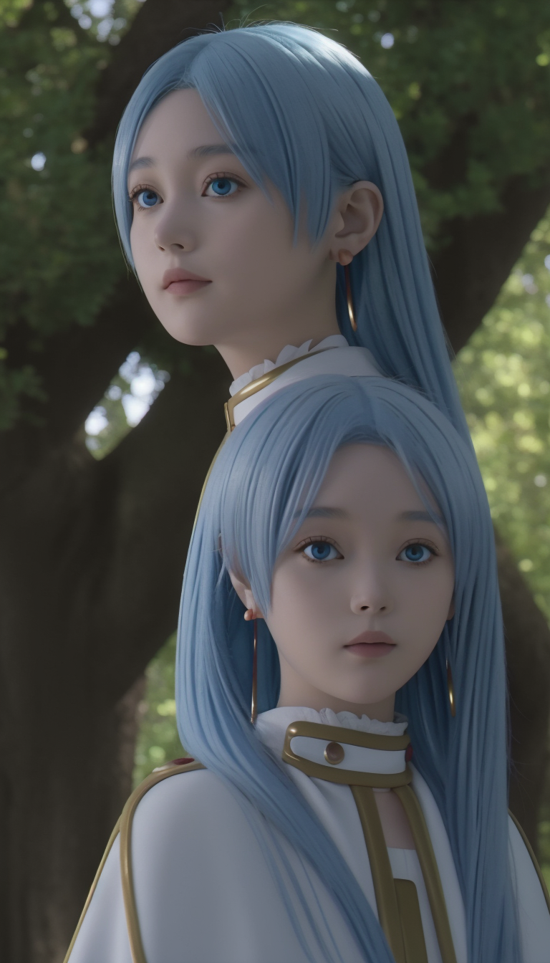
失敗案例
麦橘写实 checkpoint：https://civitai.com/models/43331/majicmix-realistic
+
芙莉蓮 LoRA：https://civitai.com/models/180978/frieren-style-or-sousou-no-frieren-lora
Notes:
1344 * 768
positive : masterpiece, best quality, high score, great score, absurdres, illustration, pointy ears, 1girl, solo, frieren, sousou no frieren, long hair, 1boy, flower, head wreath, smile, petals, earrings, jewelry, shirt, elf, blue flower, outdoors, green eyes, upper body, long sleeves, striped shirt, striped, sky, solo focus, closed mouth, white hair, falling petals, glowing,
negative : lowres, bad anatomy, bad hands, text, error, missing finger, extra digits, fewer digits, cropped, worst quality, low quality, low score, bad score, average score, signature, watermark, username, blurry,

Slide 53
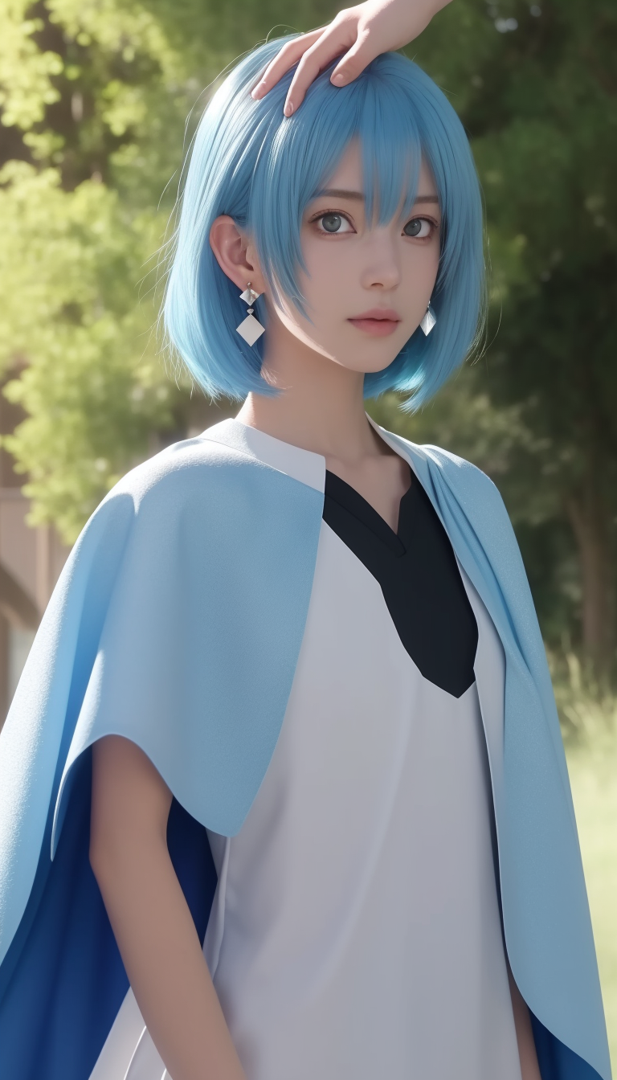
失敗案例
麦橘写实 checkpoint：https://civitai.com/models/43331/majicmix-realistic
Notes:
1344 * 768
positive : masterpiece, best quality, high score, great score, absurdres, illustration, pointy ears, 1girl, solo, frieren, sousou no frieren, long hair, 1boy, flower, head wreath, smile, petals, earrings, jewelry, shirt, elf, blue flower, outdoors, green eyes, upper body, long sleeves, striped shirt, striped, sky, solo focus, closed mouth, white hair, falling petals, glowing,
negative : lowres, bad anatomy, bad hands, text, error, missing finger, extra digits, fewer digits, cropped, worst quality, low quality, low score, bad score, average score, signature, watermark, username, blurry,

Slide 54
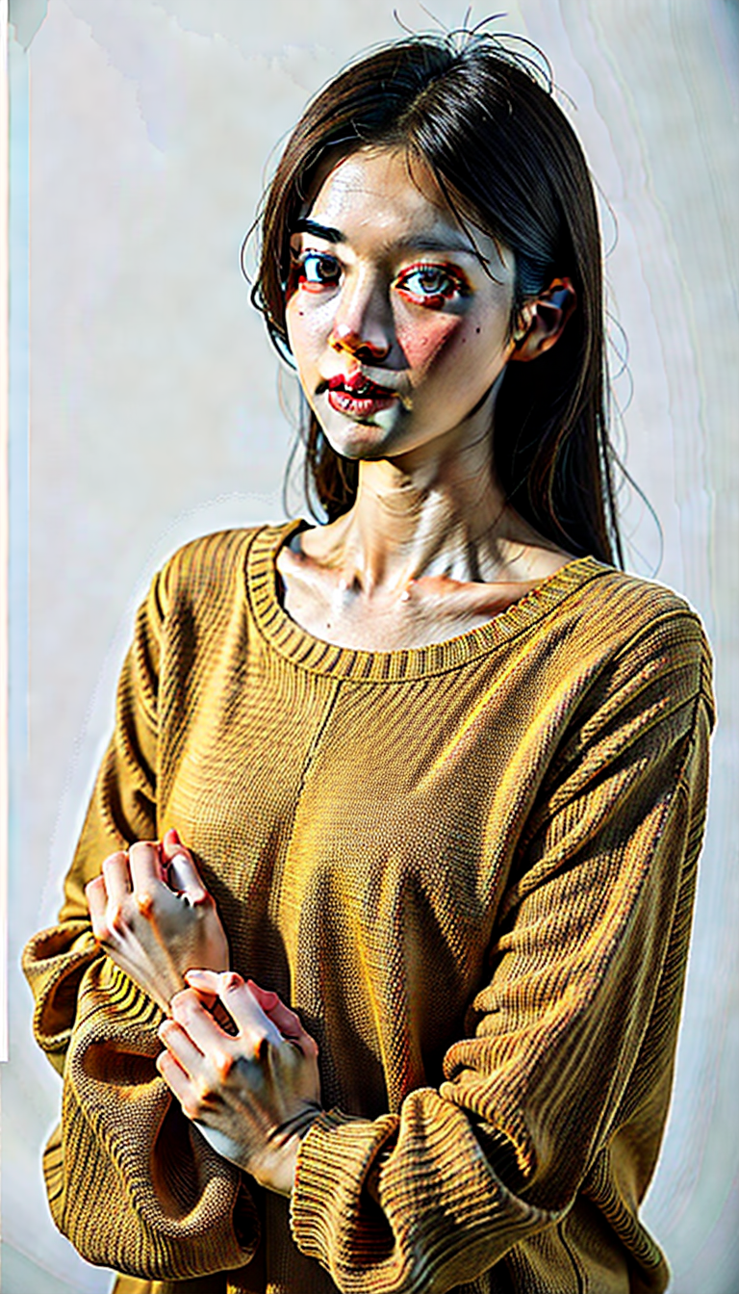
失敗案例
麦橘写实 checkpoint：https://civitai.com/models/43331/majicmix-realistic
提示詞不夠詳細
Notes:
1344 * 768
positive : 1girl,sweater,white background,
negative :(worst quality:2),(low quality:2),(normal quality:2),lowres,watermark,

Slide 55

Sample
Obsession (Illustrious-XL) Checkpoint：https://civitai.com/models/820208/obsession-illustrious-xl?modelVersionId=1494740
Notes:
1344 * 768
positive : masterpiece, best quality, high score, great score, absurdres, illustration, pointy ears, 1girl, solo, frieren, sousou no frieren, long hair, 1boy, flower, head wreath, smile, petals, earrings, jewelry, shirt, elf, blue flower, outdoors, green eyes, upper body, long sleeves, striped shirt, striped, sky, solo focus, closed mouth, white hair, falling petals, glowing,
negative : lowres, bad anatomy, bad hands, text, error, missing finger, extra digits, fewer digits, cropped, worst quality, low quality, low score, bad score, average score, signature, watermark, username, blurry,

Slide 56
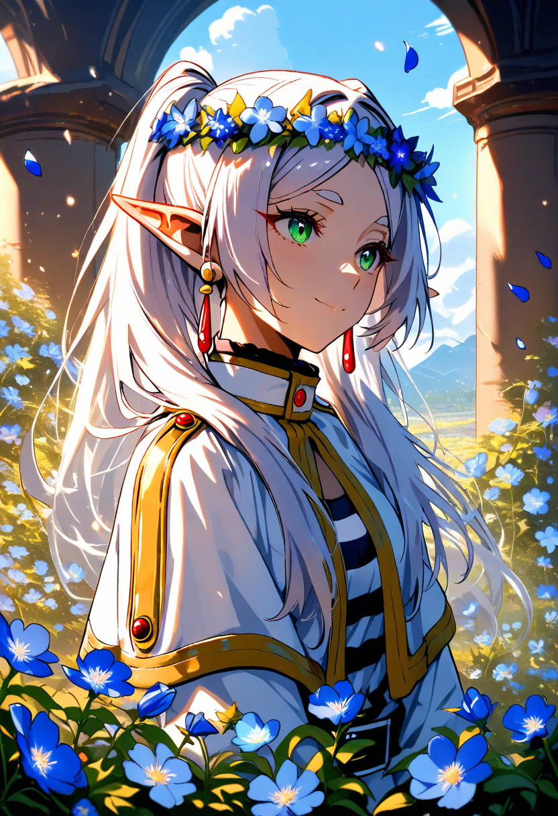
Sample
Animagine XL 4.0 checkpoint：
https://civitai.com/models/1188071/animagine-xl-40?modelVersionId=1337429
test-lora：
https://civitai.com/models/1209474/test-lora?modelVersionId=1373925
Notes:
832 * 1216
positive : masterpiece, best quality, high score, great score, absurdres, pointy ears, 1girl, frieren, sousou no frieren, long hair, 1boy, flower, head wreath, smile, petals, earrings, jewelry, shirt, elf, blue flower, looking at another, outdoors, green eyes, upper body, long sleeves, striped shirt, striped, sky, solo focus, closed mouth, white hair, falling petals, <lora:mix-a4-v2:1>,
negative : lowres, bad anatomy, bad hands, text, error, missing finger, extra digits, fewer digits, cropped, worst quality, low quality, low score, bad score, average score, signature, watermark, username, blurry,

Slide 57
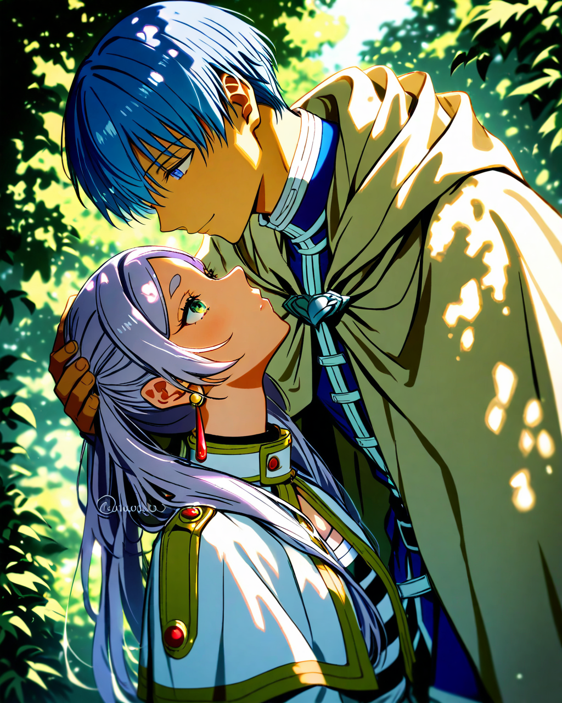
Sample
Animagine XL 4.0 checkpoint：
https://civitai.com/models/1188071/animagine-xl-40?modelVersionId=1337429
test-lora：
https://civitai.com/models/1209474/test-lora?modelVersionId=1373925
Notes:
1024 * 1280
positive : masterpiece,best quality,1boy, 1girl, frieren, himmel \(sousou no frieren\), outdoors, upper body, eye contact, light blue hair, cape, capelet, earrings, dappled sunlight, day, hand on another&#039;s head, kesyeru, sousou no frieren, twitter username, watermark, <lora:mix-a4-v2:1>,
negative : nsfw,lowres,bad anatomy,bad hands,text,error,missing fingers,extra digit,fewer digits,cropped,worst quality,low quality,normal quality,jpeg artifacts,signature,watermark,username,blurry,artist name,

Slide 58
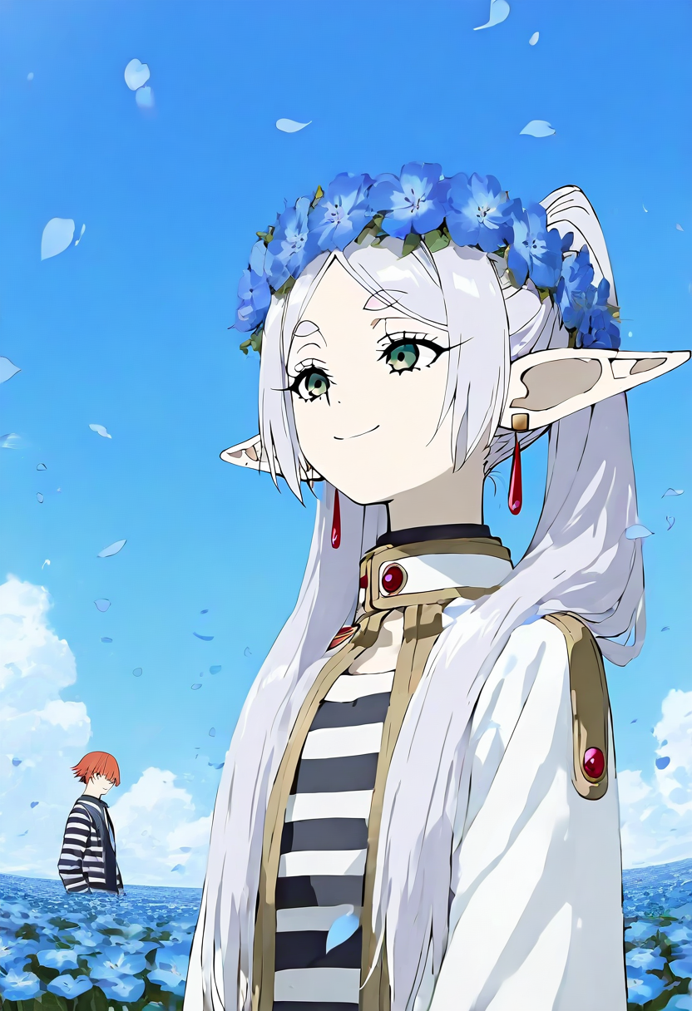
Sample
Obsession (Illustrious-XL) Checkpoint：https://civitai.com/models/820208/obsession-illustrious-xl?modelVersionId=1494740
ma1ma1helmes LoRA：
https://civitai.com/models/1204563/ma1ma1helmes-or-shiiros-styles-or-niji?modelVersionId=1356500
R754496 LoRA：
https://civitai.com/models/1201355/r754496-or-shiiros-styles-or-niji
Notes:
832 * 1216
positive : r17329_illu, xxx667_illu, very awa, anime screencap, masterpiece, best quality, Good quality, frieren \(Sousou no Frieren\), high score, great score, absurdres, pointy ears, 1girl, frieren, sousou no frieren, long hair, 1boy, flower, head wreath, smile, petals, earrings, jewelry, shirt, elf, blue flower, looking at another, outdoors, green eyes, upper body, long sleeves, striped, sky, solo focus, closed mouth, white hair, falling petals, <lora:r17329_illu-000015:0.45>, <lora:XXX477-000016:0.5>,
negative : lowres, bad anatomy, bad hands, text, error, missing finger, extra digits, fewer digits, cropped, worst quality, low quality, low score, bad score, average score, signature, watermark, username, blurry,

Slide 59
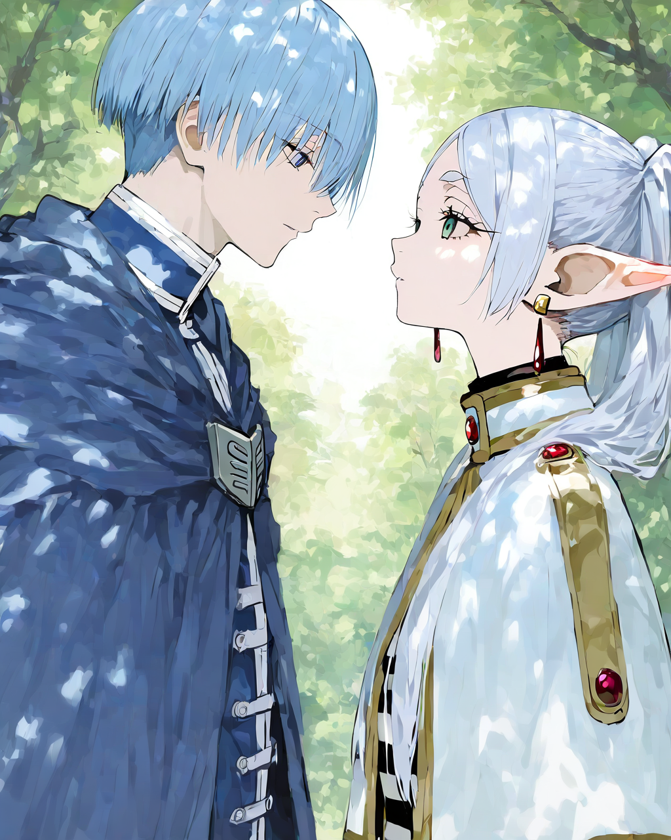
Sample
Obsession (Illustrious-XL) Checkpoint：https://civitai.com/models/820208/obsession-illustrious-xl?modelVersionId=1494740
ma1ma1helmes LoRA：
https://civitai.com/models/1204563/ma1ma1helmes-or-shiiros-styles-or-niji?modelVersionId=1356500
R754496 LoRA：
https://civitai.com/models/1201355/r754496-or-shiiros-styles-or-niji
Notes:
1024 * 1280
positive : r17329_illu, xxx667_illu, very awa, anime screencap, masterpiece,best quality,1boy, 1girl, frieren, himmel \(sousou no frieren\), outdoors, upper body, eye contact, light blue hair, cape, capelet, earrings, dappled sunlight, day, hand on another&#039;s head, kesyeru, sousou no frieren, <lora:r17329_illu-000015:0.45>, <lora:XXX477-000016:0.5>,
negative : nsfw,lowres,bad anatomy,bad hands,text,error,missing fingers,extra digit,fewer digits,cropped,worst quality,low quality,normal quality,jpeg artifacts,signature,watermark,username,blurry,artist name,

Slide 60
Sulphur 2 影片生成
07

Slide 61

ComfyUI安裝 Download
Notes:
NVIDIA驅動需要更新到版本580以上

Slide 62


ComfyUI安裝 Download
下載好安裝檔後執行並自行選擇安裝位置
Notes:
NVIDIA驅動需要更新到版本580以上

Slide 63


ComfyUI Desktop執行
執行comfyui desktop後新建安裝、命名與選擇安裝地點後安裝
Notes:
NVIDIA驅動需要更新到版本580以上

Slide 64

ComfyUI Desktop執行
安裝完後的運行畫面
Notes:
NVIDIA驅動需要更新到版本580以上

Slide 65

ComfyUI Desktop執行
找範本->影片->LTX-2.3導入工作流
Notes:
NVIDIA驅動需要更新到版本580以上

Slide 66

ComfyUI Desktop執行
工作流出現紅框是正常，1.是未載入圖片，中間是打提示詞的地方，下面則是照圖放模型
Notes:
NVIDIA驅動需要更新到版本580以上

Slide 67

模型下載
https://huggingface.co/SulphurAI/Sulphur-2-base/blob/main/prompt_enhancer/sulphur_prompt_enhancer_model-q8_0.gguf
https://huggingface.co/SulphurAI/Sulphur-2-base/blob/main/sulphur_dev_fp8mixed.safetensors
https://huggingface.co/Comfy-Org/ltx-2/blob/main/split_files/text_encoders/gemma_3_12B_it_fp4_mixed.safetensors
https://huggingface.co/Comfy-Org/ltx-2/blob/main/split_files/loras/gemma-3-12b-it-abliterated_lora_rank64_bf16.safetensors
https://huggingface.co/Kijai/LTX2.3_comfy/blob/main/loras/ltx-2.3-22b-distilled-1.1_lora-dynamic_fro09_avg_rank_111_bf16.safetensors
https://huggingface.co/Lightricks/LTX-2.3/blob/main/ltx-2.3-spatial-upscaler-x2-1.1.safetensors
教學影片 link

Slide 68

Sample 登記表
Notes:
768 * 960 5s
Sousou no Frieren, an illustration-style, Frieren and Himmel. Frieren gradually leans into Himmel's arms, light filters through the leaves, and the two lean on each other.
Sousou no Frieren，插畫風格，弗里倫和希梅爾。弗里倫漸漸依偎進希梅爾的懷抱，陽光透過樹葉灑下，兩人互相依偎著。

Slide 69


Sample
Notes:
896 * 448
Sousou no Frieren, cosplay, Frieren and Himmel. Frieren and Himmel pose for a photo, glancing at each other before smiling at the camera.
Sousou no Frieren，cosplay，Frieren and Himmel。Frieren與Himmel合照，兩人彼此互望一眼後又看相鏡頭露出微笑。

Slide 70


Sample
Notes:
896 * 448
Sousou no Frieren, cosplay, Frieren and Himmel. Frieren poses for a photo with his companions, the red-haired warrior makes a funny face, elf Frieren smiles, the purple-haired magician makes his cheeks pout, and the dwarf and the old man laugh heartily.
Sousou no Frieren，cosplay，Frieren and Himmel。Frieren與夥伴們合照，紅色頭髮的戰士扮鬼臉，elf Frieren微笑，紫色頭髮的魔法使臉頰嘟起，矮人與大叔開懷大笑。

Slide 71


Sample
一個女人坐在水邊，背後是湍流的瀑布，水波蕩漾，微風吹過女人的頭髮帶起飄逸，女人看向鏡頭，伸出一隻手揮舞
Notes:
704 * 384
A woman sits by the water, with a rushing waterfall behind her. The water ripples gently, and a breeze blows through her hair. She looks at the camera and waves one hand out.
一個女人坐在水邊，背後是湍流的瀑布，水波蕩漾，微風吹過女人的頭髮帶起飄逸，女人看向鏡頭，伸出一隻手揮舞

Slide 72


Sample
四個人在雪山前合照，各自比出不同的pose
Notes:
384 * 320
The four people took a group photo in front of the snow-capped mountain, each striking a different pose.
四個人在雪山前合照，各自比出不同的pose

Slide 73


Sample
Anime Chainsaw man 角色 Reze，紫色頭髮個可愛動漫女孩，正在自由的跳舞並擺出可愛的表情。
Notes:
640 * 1152
Reze, a character from the anime Chainsaw Man, is a cute anime girl with purple hair, dancing freely and making adorable expressions.
Anime Chainsaw man 角色 Reze，紫色頭髮個可愛動漫女孩，正在自由的跳舞並擺出可愛的表情。

Slide 74


Sample
純色背景，紫色中短頭髮的可愛動漫女孩，川著白色襯衫黑色短褲黑色絲襪，脖子上有頸圈，正在自由的跳舞並擺出可愛的表情。
Notes:
640 * 1088
Against a solid-color background, a cute anime girl with short purple hair, wearing a white shirt, black shorts, and black stockings, with a choker around her neck, is dancing freely and making adorable expressions.
純色背景，紫色中短頭髮的可愛動漫女孩，川著白色襯衫黑色短褲黑色絲襪，脖子上有頸圈，正在自由的跳舞並擺出可愛的表情。

Slide 75


Sample
一隻在草地上的犀牛，牠正在奔跑，這時他轉頭朝向鏡頭，然後朝鏡頭方向奔跑過來
Notes:
1024 * 576
A rhinoceros is running on the grass. It turns its head towards the camera and then runs towards the camera.
一隻在草地上的犀牛，牠正在奔跑，這時他轉頭朝向鏡頭，然後朝鏡頭方向奔跑過來

Slide 76


Sample
一位戴著眼鏡與牛仔帽，穿著黑色皮衣黑色皮褲的西格瑪男人，蹲下身子撫摸小孩的頭，並將手中的冰淇淋遞給小孩，並展露出微笑
Notes:
512 * 768
A Sigma man wearing glasses, a cowboy hat, a black leather jacket, and black leather pants knelt down, stroked the child's head, handed the child an ice cream, and smiled.
一位戴著眼鏡與牛仔帽，穿著黑色皮衣黑色皮褲的西格瑪男人，蹲下身子撫摸小孩的頭，並將手中的冰淇淋遞給小孩，並展露出微笑

Slide 77


Sample
一位戴著眼鏡與牛仔帽，穿著黑色皮衣黑色皮褲的西格瑪男人，身處於地下停車場中，正對著鏡頭，透過腳步變換與手部擺動，展現他那自信、奔放不羈的舞姿
Notes:
512 * 896
A Sigma man wearing glasses, a cowboy hat, a black leather jacket, and black leather pants is in an underground parking lot, facing the camera. Through changes in footwork and hand gestures, he displays his confident and unrestrained dance moves.
一位戴著眼鏡與牛仔帽，穿著黑色皮衣黑色皮褲的西格瑪男人，身處於地下停車場中，正對著鏡頭，透過腳步變換與手部擺動，展現他那自信、奔放不羈的舞姿

Slide 78


Sample 06/10
Notes:
US President Trump pointed his finger at the camera, then lowered it, and then raised and lowered his other hand as well.

Slide 79

Sample 06/10

Slide 80

Sample 06/10
Notes:
Sousou no Frieren, an illustration-style song, Frieren and Himmel. Frieren gradually leans into Himmel's arms, light filters through the leaves, and the two lean on each other.

Slide 81


Sample 06/10
Notes:
A cute Samoyed dog walking along the edge of a lush green rice field, cheerfully and happily running towards the camera.

Slide 82


Sample 06/10
Notes:
she is taylor swift, performing on the stadium singing "love story" and dancing,change her clothes to bikini

Slide 83
繳交資訊
08

Slide 84
Regulations
You should finish your homework on your own.
Do not share your codes with any living creatures.
Your HW will get 0 pt if you violate any of the above rules.
Professor & TAs preserve the rights to change the rules & grades.

Slide 85
助教聯絡資訊
05
章節07

Slide 86
助教聯絡資訊
TA Email
  賴秋彤 t114598033@ntut.org.tw
Email 標題(主旨)
  請按照此格式(X為作業編號)： [ai2026s-hwX-學號]

