Slide 1
生成式人工智慧導論
06穩定擴散
鄭傳脩
國立臺北科技大學資訊工程系

Slide 2
使用模型

Slide 3
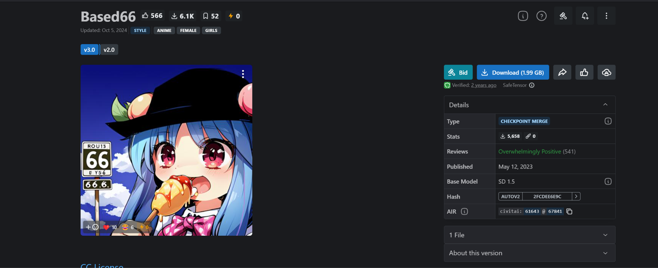
Civitai
Checkpoint：based66_v30

Slide 4
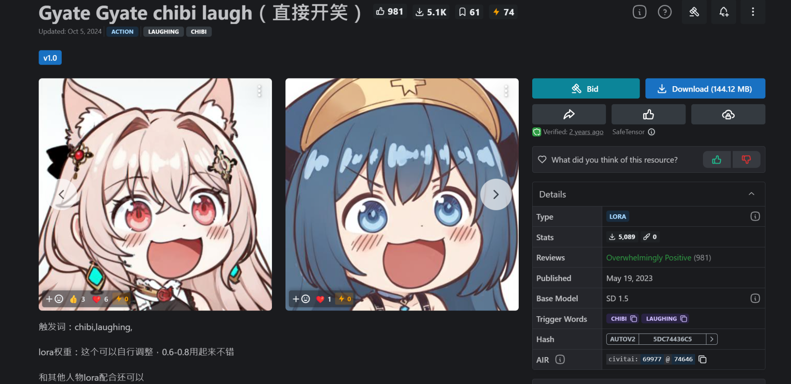
Civitai
LoRA: chibi-laugh

Slide 5
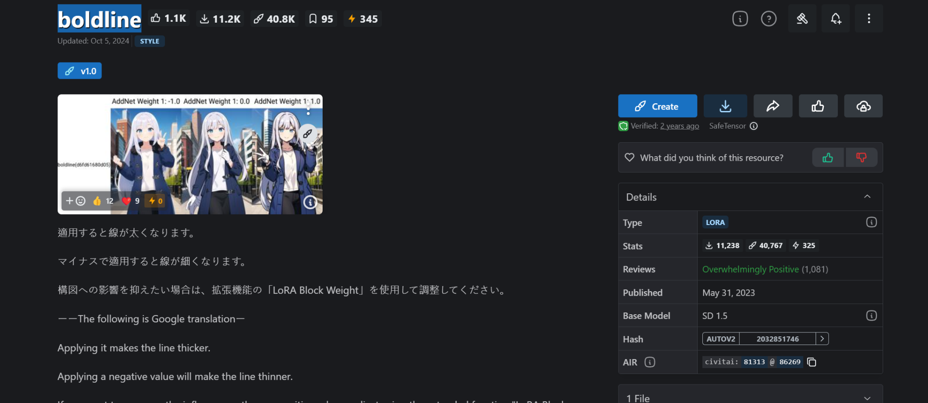
Civitai
LoRA: boldline

Slide 6
雲端運行
02

Slide 7
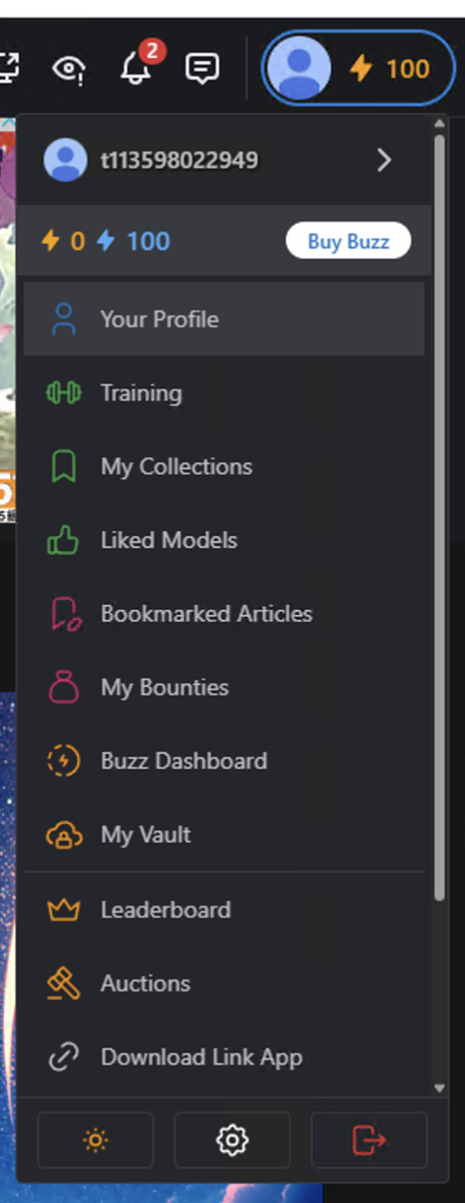
Civitai
Civitai，一個開放模型下載的網站，可以上去下載任意你想要的模型
創建帳號後，點擊頭像->Account Settings

Slide 8
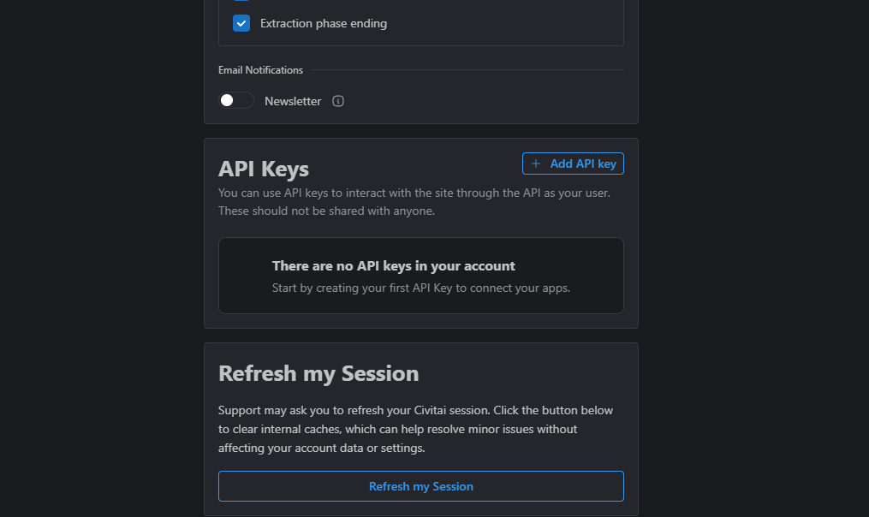
Civitai
移到最下面，找到API Keys，選擇Add API Key

Slide 9
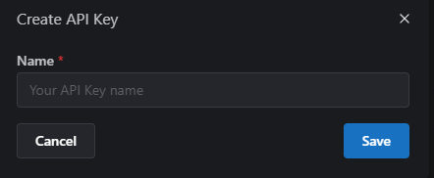
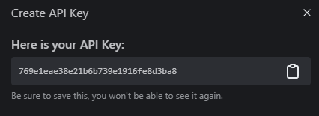
Civitai
隨意命名，API Key出現的時候也記得要複製

Slide 10
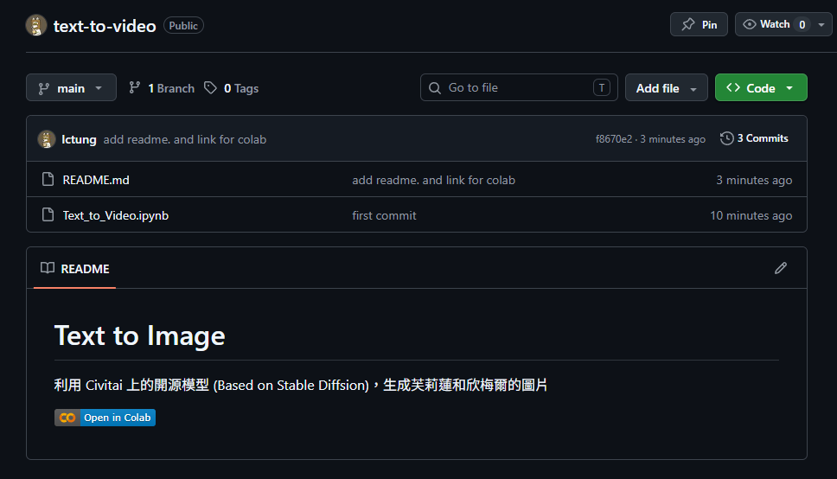
Colab
Colab 程式碼下載連結

Slide 11
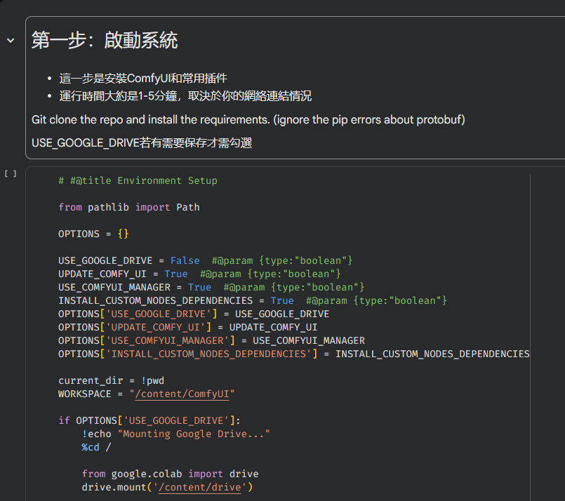
Colab
安裝 Comfy UI 所需要的套件

Slide 12
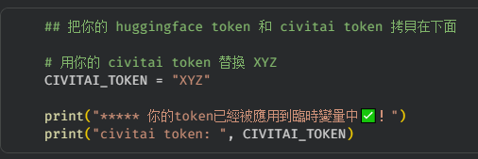
Colab
將 Civitai API Key貼上

Slide 13
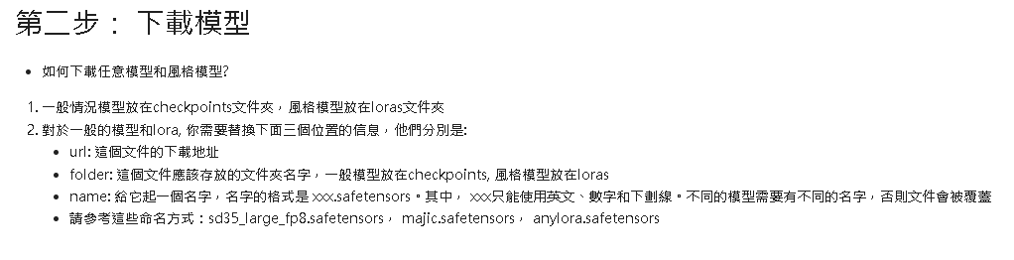
Colab
下載 checkpoint 和 LoRA，有提供範例的，也可自行去civitai上找尋自己想要的

Slide 14
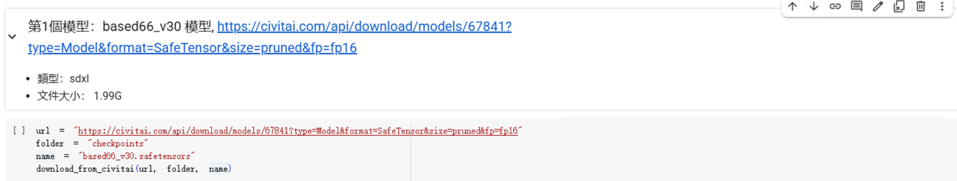
Colab
下載checkpoint(Based66_V30)

Slide 15
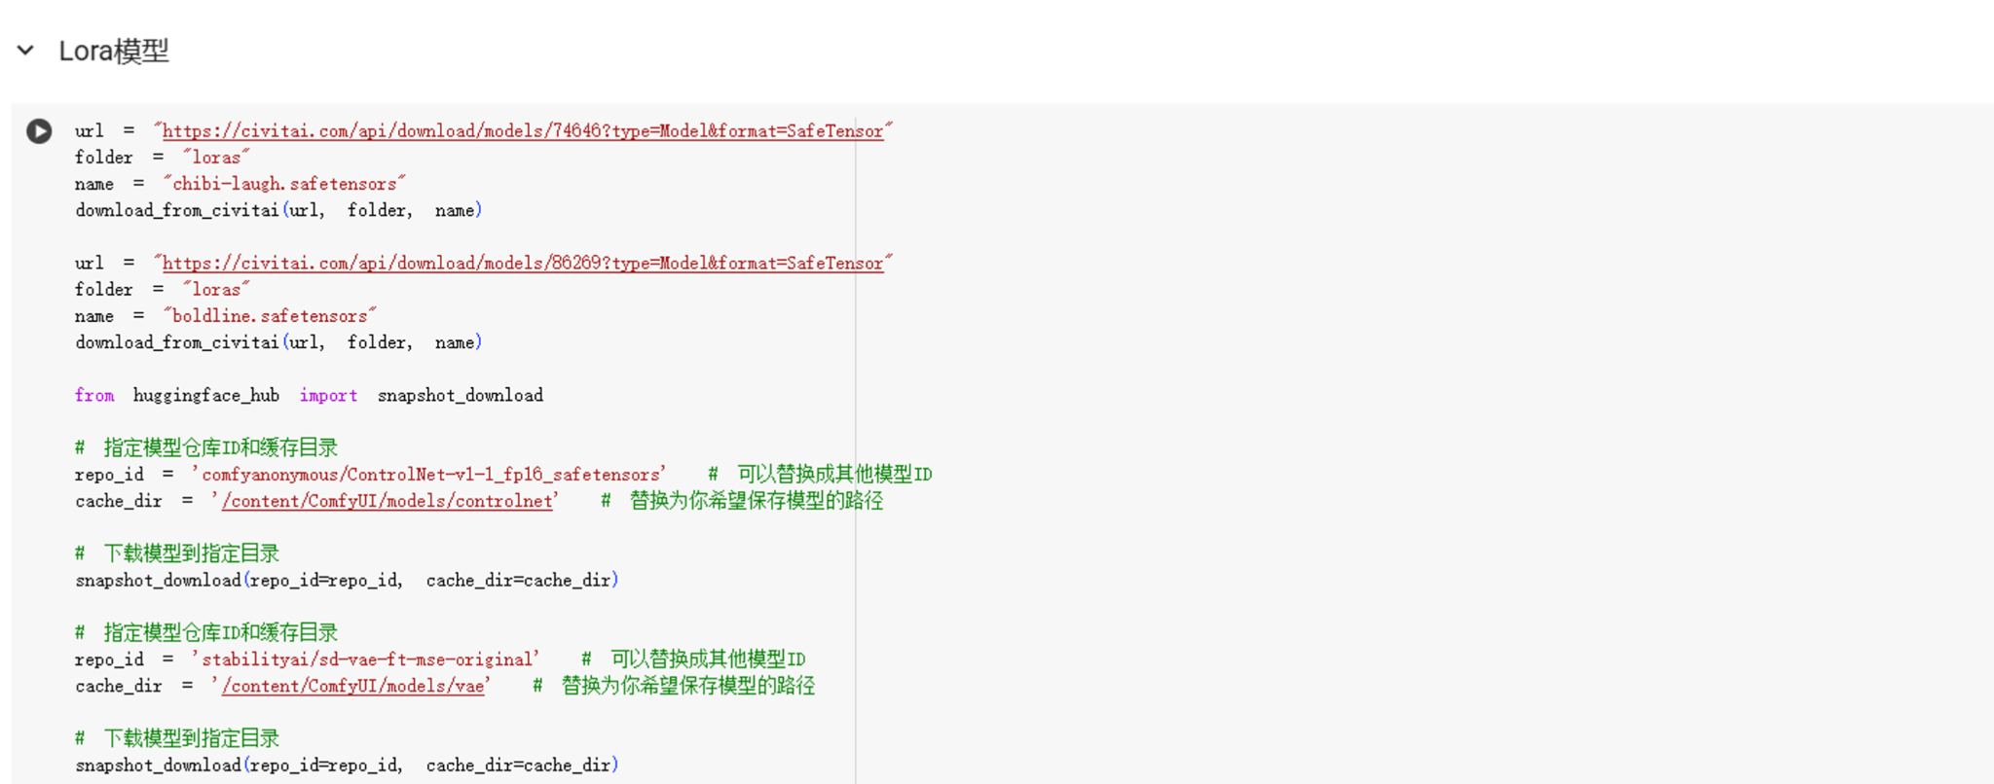
Colab
LoRA同checkpoint

Slide 16
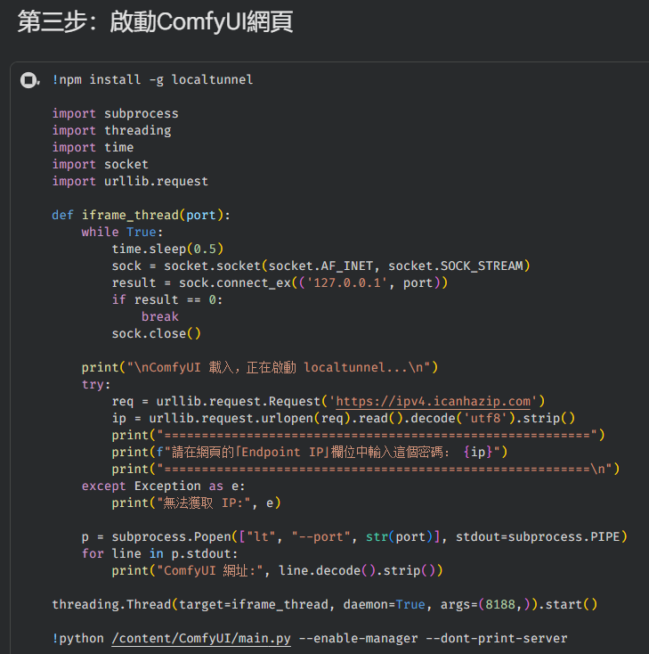
Colab
下載完後執行啟動ComfyUI網頁

Slide 17
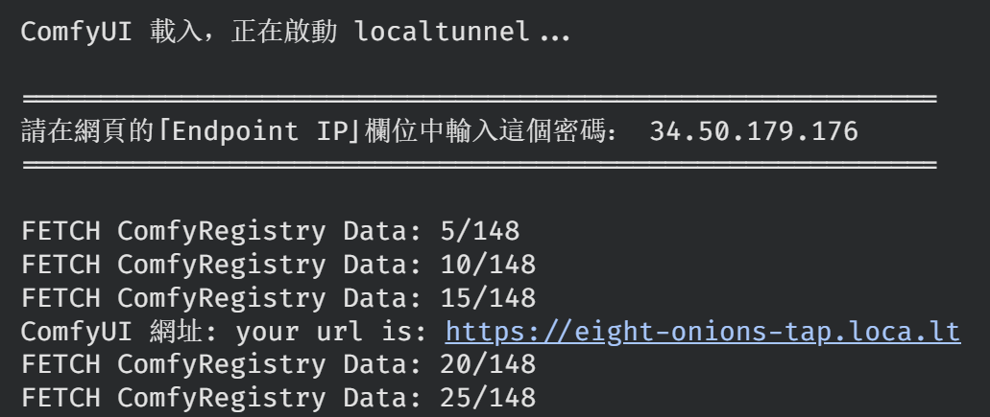
Colab
確認執行階段後點擊連結
分配IP

Slide 18
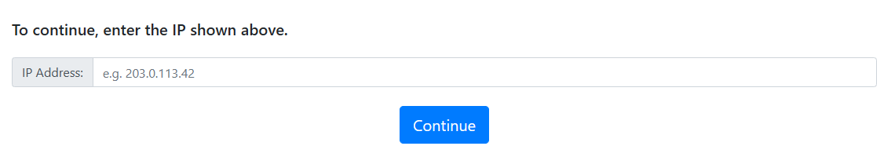
ComfyUI
輸入分配IP後點擊繼續

Slide 19
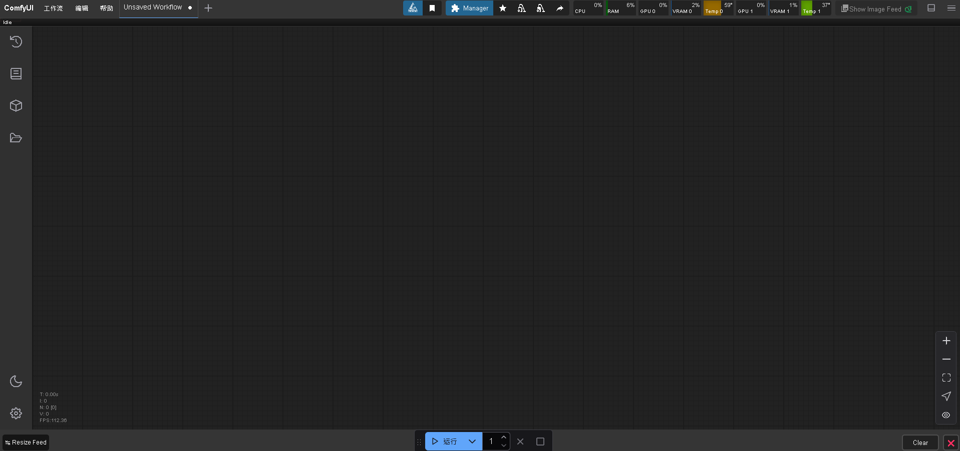
ComfyUI
成功進入ComfyUI

Slide 20
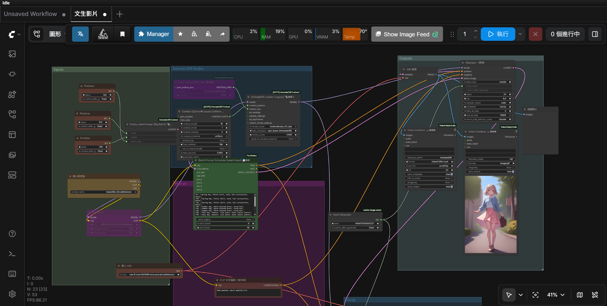
ComfyUI
工作流下載

Slide 21
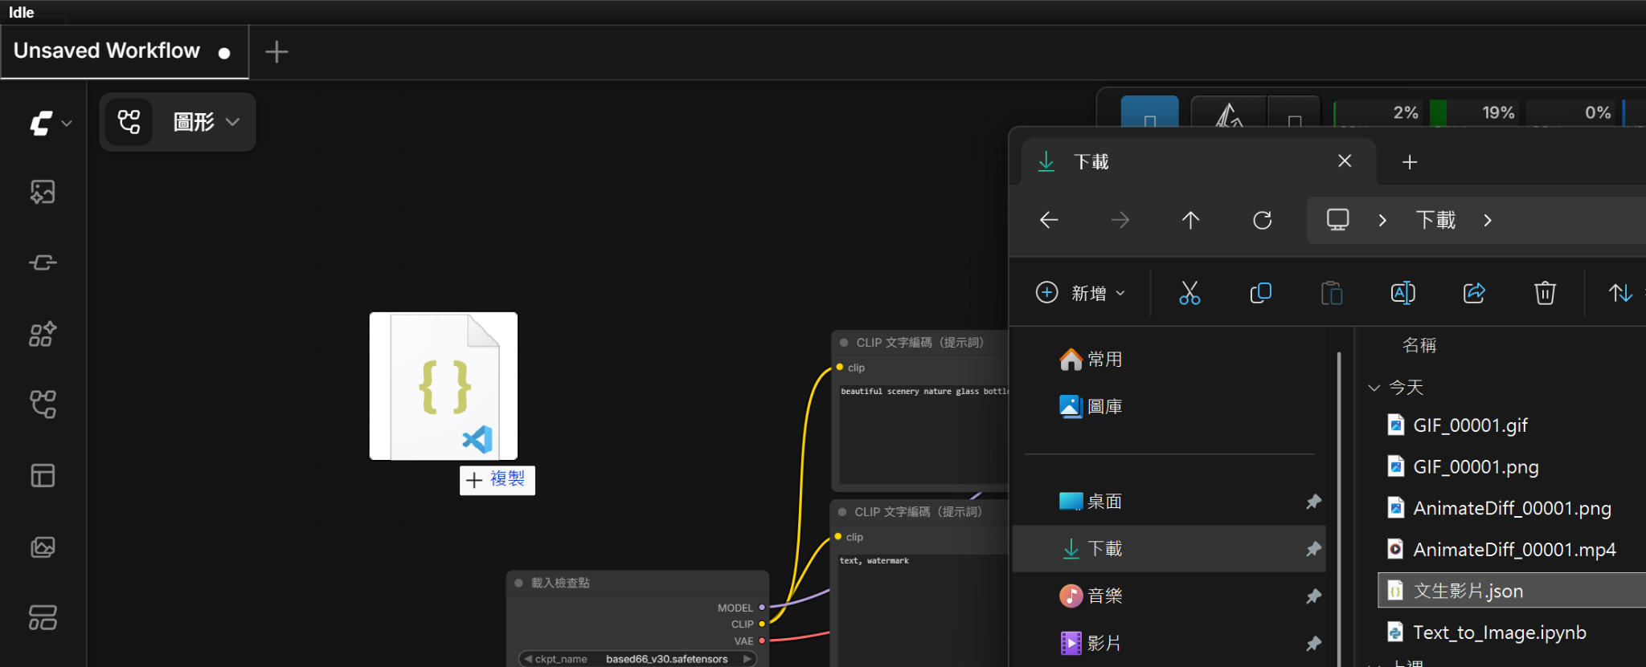
ComfyUI
匯入剛剛下載的工作流(.json)
拖拉檔案至 ComfyUI

Slide 22
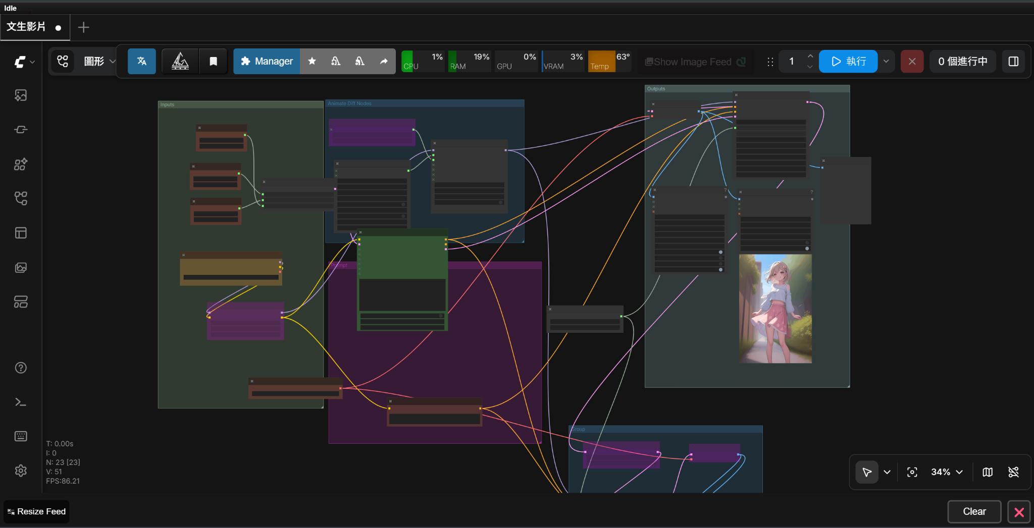
ComfyUI
安裝遺失套件

Slide 23
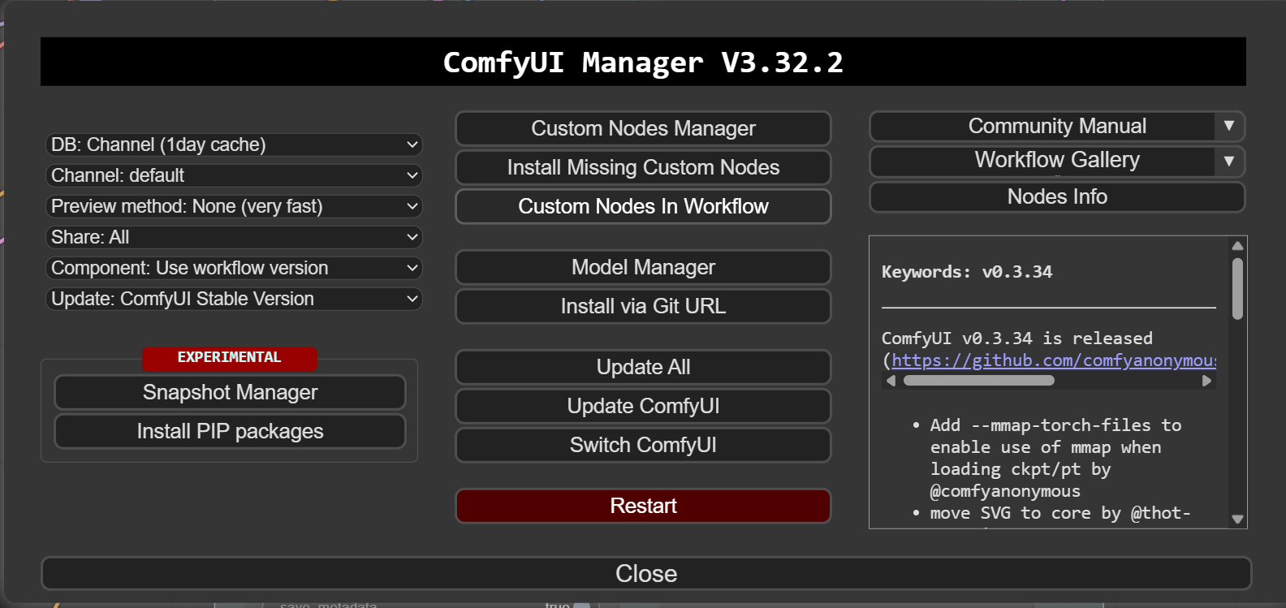
ComfyUI
安裝遺失套件後重新整理網頁

Slide 24
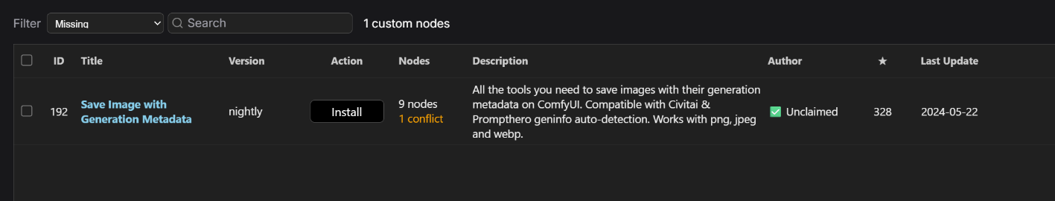
ComfyUI
安裝遺失套件後重新整理網頁

Slide 25
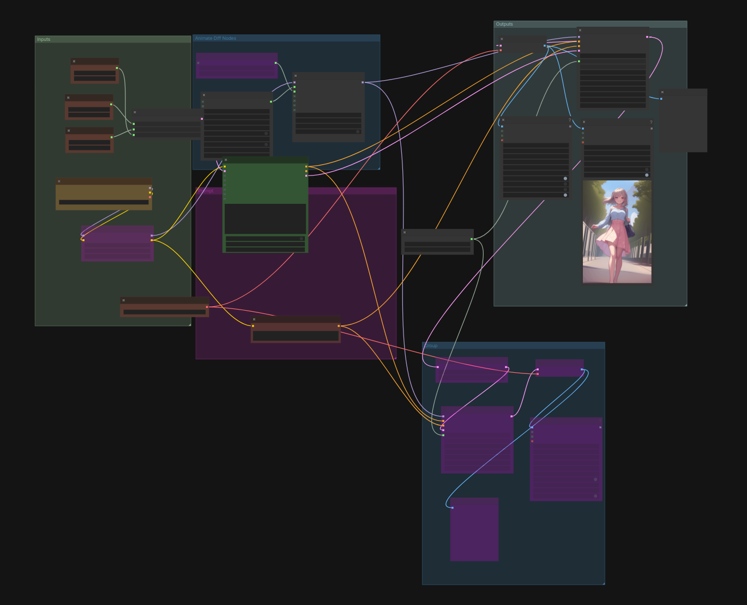
ComfyUI
確認所有nodes皆無紅框

Slide 26
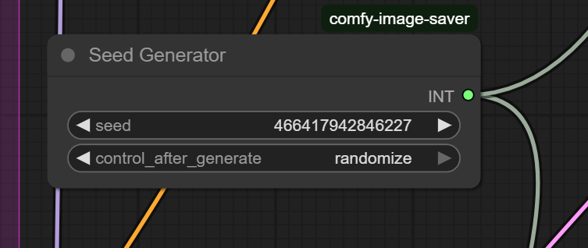
ComfyUI
更改種子生成器為randomize

Slide 27
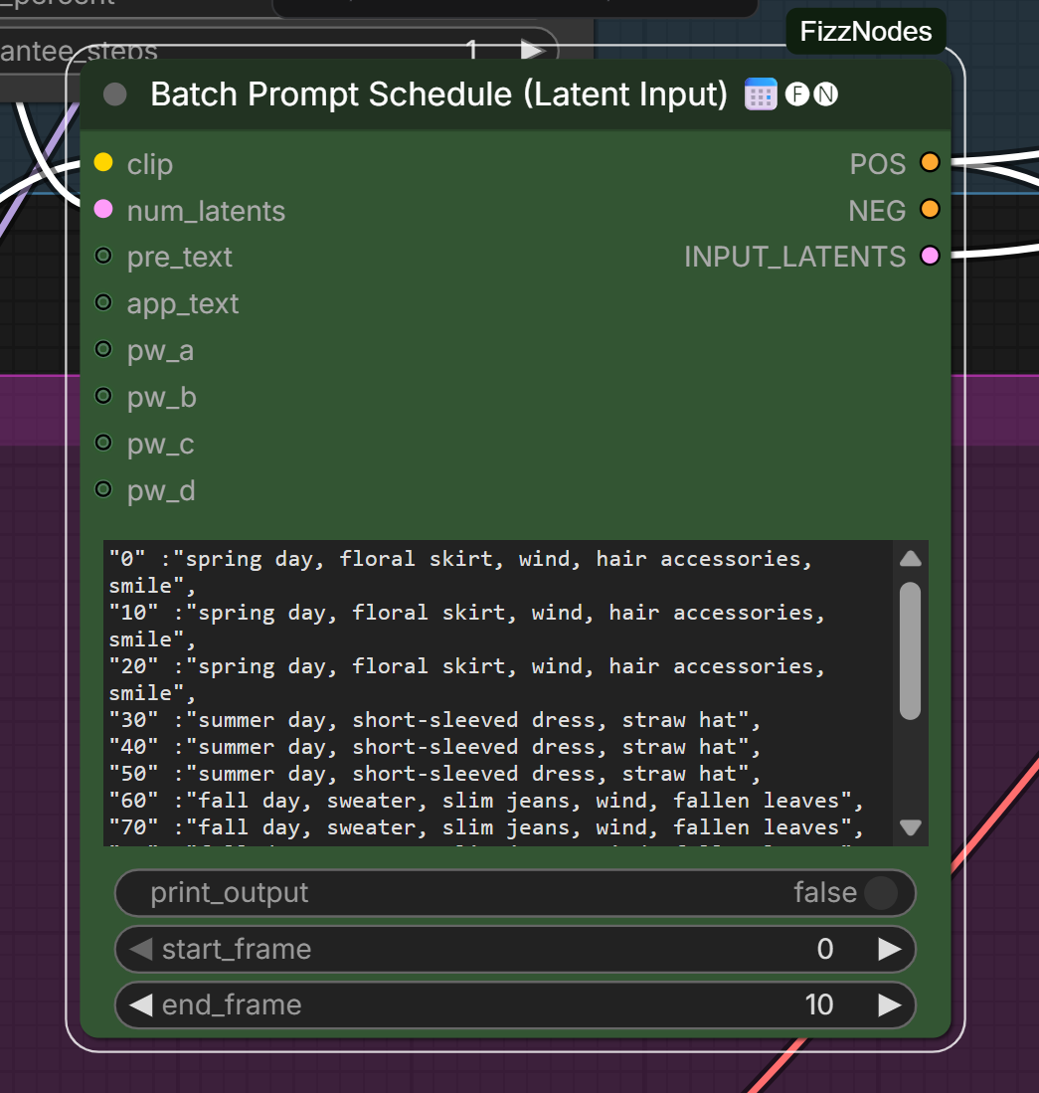
ComfyUI
請更換成自己的提示詞
提示詞模板請參考下面的備忘稿
Notes:
"0" :"spring day, floral skirt, wind, hair accessories, smile",
"10" :"spring day, floral skirt, wind, hair accessories, smile",
"20" :"spring day, floral skirt, wind, hair accessories, smile",
"30" :"summer day, short-sleeved dress, straw hat",
"40" :"summer day, short-sleeved dress, straw hat",
"50" :"summer day, short-sleeved dress, straw hat",
"60" :"fall day, sweater, slim jeans, wind, fallen leaves",
"70" :"fall day, sweater, slim jeans, wind, fallen leaves",
"80" :"fall day, sweater, slim jeans, wind, fallen leaves",
"90" :"winter, down jacket, woolen hat, ear protection gloves, snowflakes",
"100" :"winter, down jacket, woolen hat, ear protection gloves, snowflakes",
"110" :"winter, down jacket, woolen hat, ear protection gloves, snowflakes"

Slide 28
ComfyUI
按下運行開始生成影片

Slide 29
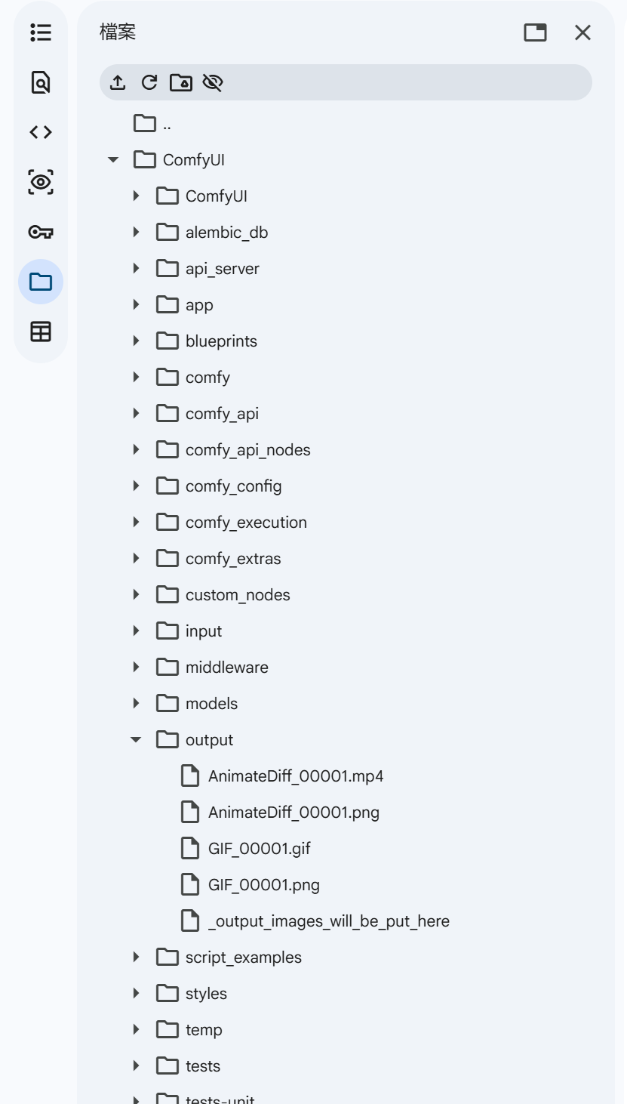
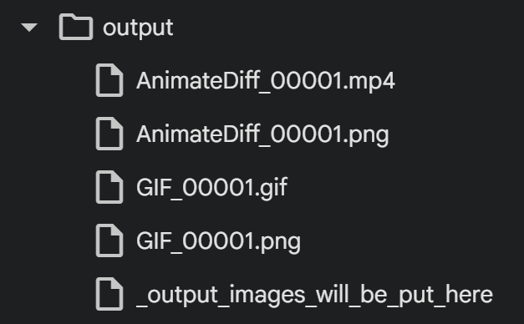
Colab
生成完畢後，回到Colab找到生成的影片
生成影片
生成圖片
下載這兩個檔案放在作業網頁
生成圖片

Slide 30
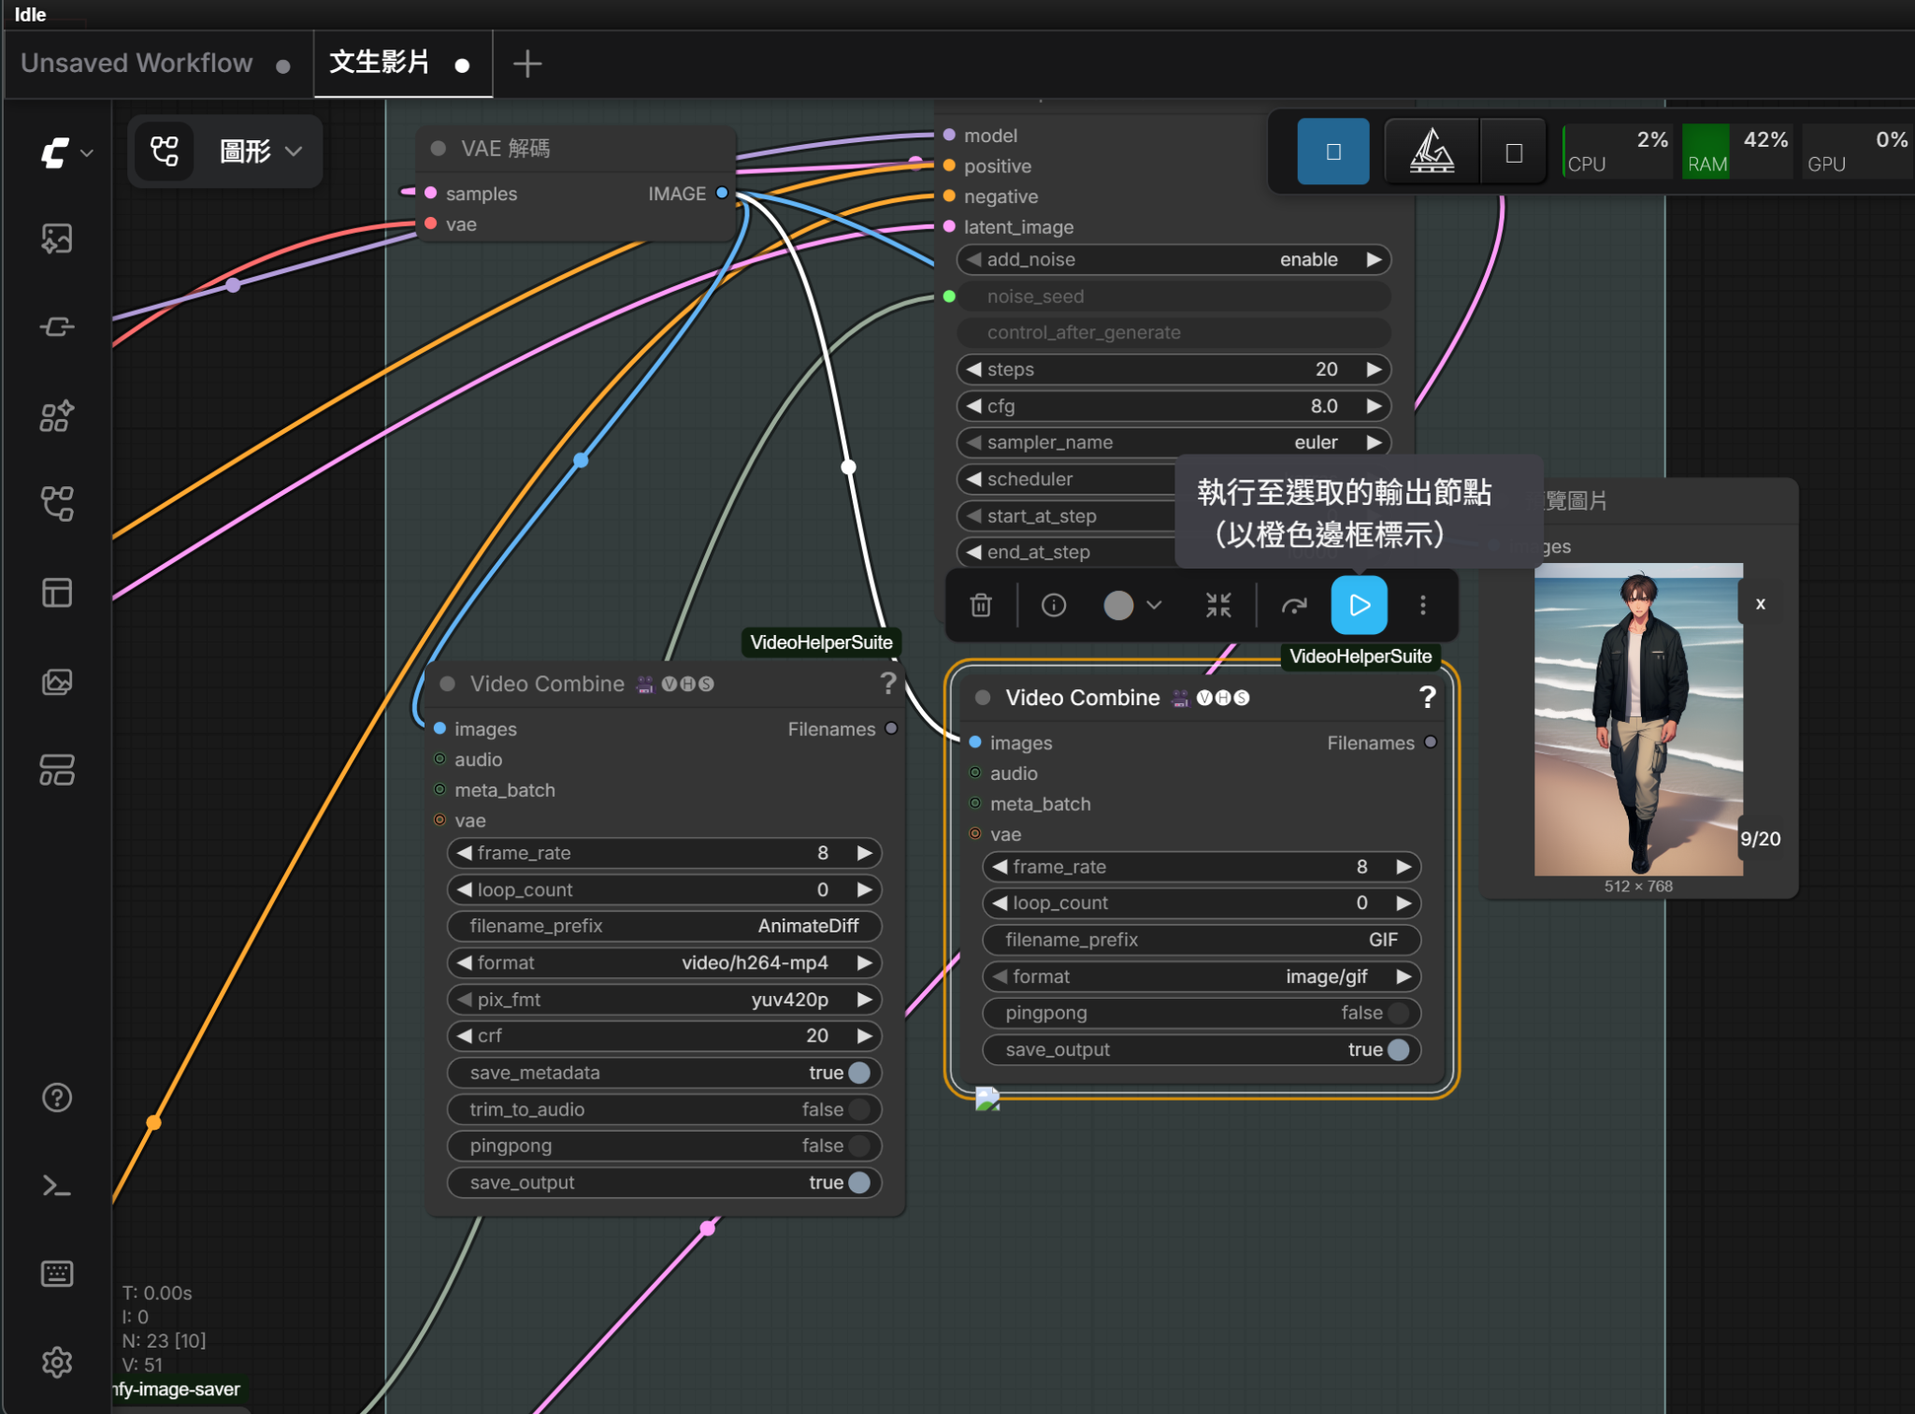
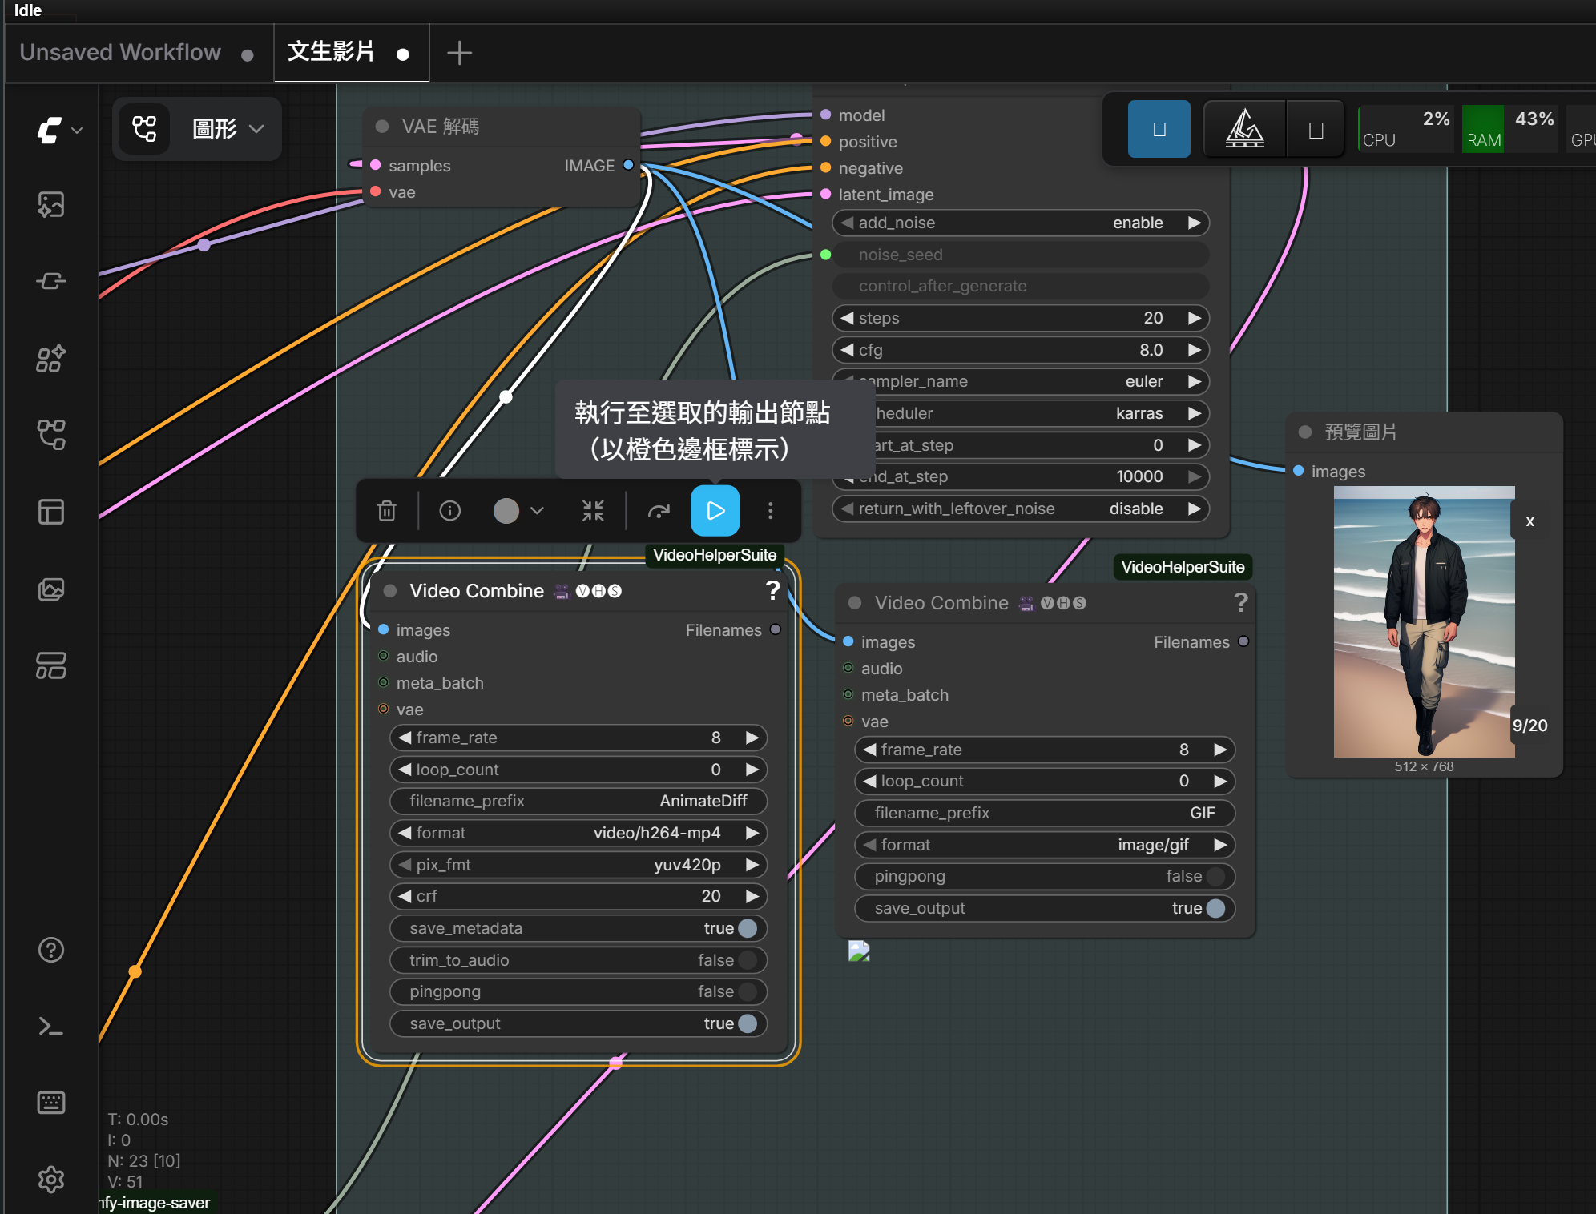
ComfyUI
如果生成結束後，沒有在colab資料夾裝的output出現成品，請按下兩個 Video Combine的執行鍵

Slide 31
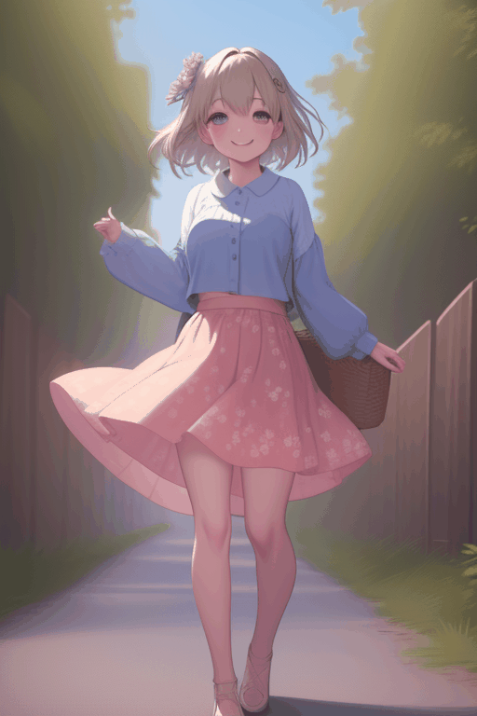
Sample
Prompt
"0" :"spring day, floral skirt, wind, hair accessories, smile",
"10" :"spring day, floral skirt, wind, hair accessories, smile",
"20" :"spring day, floral skirt, wind, hair accessories, smile",
"30" :"summer day, short-sleeved dress, straw hat",
"40" :"summer day, short-sleeved dress, straw hat",
"50" :"summer day, short-sleeved dress, straw hat",
"60" :"fall day, sweater, slim jeans, wind, fallen leaves",
"70" :"fall day, sweater, slim jeans, wind, fallen leaves",
"80" :"fall day, sweater, slim jeans, wind, fallen leaves",
"90" :"winter, down jacket, woolen hat, ear protection gloves, snowflakes",
"100" :"winter, down jacket, woolen hat, ear protection gloves, snowflakes",
"110" :"winter, down jacket, woolen hat, ear protection gloves, snowflakes"

Slide 32
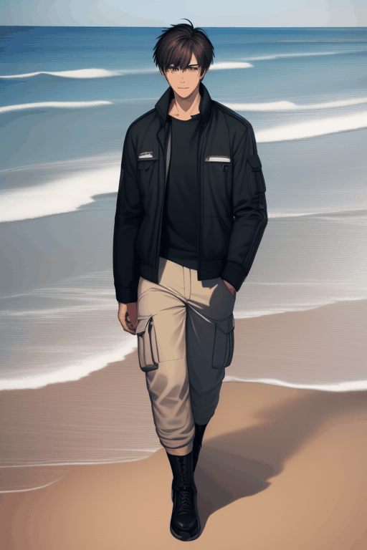
Sample
Prompt
"0" :"1boy, handsome, short hair, workwear jacket, cargo pants, morning beach, ocean waves, clear sky, walking",
"10" :"1boy, handsome, short hair, workwear jacket, cargo pants, morning beach, ocean waves, clear sky, walking",
"20" :"1boy, handsome, short hair, workwear jacket, cargo pants, morning beach, ocean waves, clear sky, walking",
"30" :"1boy, handsome, short hair, workwear vest, white t-shirt, cargo shorts, sunny beach, ocean, blue sky, wearing sunglasses",
"40" :"1boy, handsome, short hair, workwear vest, white t-shirt, cargo shorts, sunny beach, ocean, blue sky, wearing sunglasses",
"50" :"1boy, handsome, short hair, workwear vest, white t-shirt, cargo shorts, sunny beach, ocean, blue sky, wearing sunglasses",
"60" :"1boy, handsome, short hair, unbuttoned workwear shirt, cargo pants, sunset beach, golden hour, wind, dramatic lighting",
"70" :"1boy, handsome, short hair, unbuttoned workwear shirt, cargo pants, sunset beach, golden hour, wind, dramatic lighting",
"80" :"1boy, handsome, short hair, unbuttoned workwear shirt, cargo pants, sunset beach, golden hour, wind, dramatic lighting",
"90" :"1boy, handsome, short hair, dark workwear jacket, cargo pants, night beach, starry sky, moonlight, ocean reflections",
"100" :"1boy, handsome, short hair, dark workwear jacket, cargo pants, night beach, starry sky, moonlight, ocean reflections",
"110" :"1boy, handsome, short hair, dark workwear jacket, cargo pants, night beach, starry sky, moonlight, ocean reflections"

Slide 33
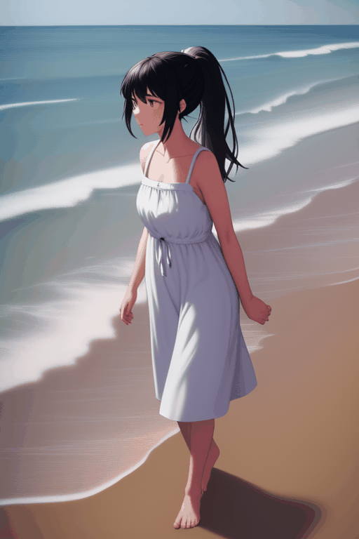
Sample
Prompt
"0" :"1girl, black hair, ponytail, opaque white cotton sundress, modest, morning beach, clear sky, soft morning light, ocean waves, walking",
"10" :"1girl, black hair, ponytail, opaque white cotton sundress, modest, morning beach, clear sky, soft morning light, ocean waves, walking",
"20" :"1girl, black hair, ponytail, opaque white cotton sundress, modest, morning beach, clear sky, soft morning light, ocean waves, walking",
"30" :"1girl, black hair, ponytail, opaque white cotton sundress, modest, sunny beach, noon, bright sunlight, clear blue sky, sparkling water",
"40" :"1girl, black hair, ponytail, opaque white cotton sundress, modest, sunny beach, noon, bright sunlight, clear blue sky, sparkling water",
"50" :"1girl, black hair, ponytail, opaque white cotton sundress, modest, sunny beach, noon, bright sunlight, clear blue sky, sparkling water",
"60" :"1girl, black hair, ponytail, opaque white cotton sundress, modest, sunset beach, golden hour, warm lighting, dramatic sky, ocean breeze",
"70" :"1girl, black hair, ponytail, opaque white cotton sundress, modest, sunset beach, golden hour, warm lighting, dramatic sky, ocean breeze",
"80" :"1girl, black hair, ponytail, opaque white cotton sundress, modest, sunset beach, golden hour, warm lighting, dramatic sky, ocean breeze",
"90" :"1girl, black hair, ponytail, opaque white cotton sundress, modest, night beach, starry sky, moonlight, dark ocean, glowing reflections",
"100" :"1girl, black hair, ponytail, opaque white cotton sundress, modest, night beach, starry sky, moonlight, dark ocean, glowing reflections",
"110" :"1girl, black hair, ponytail, opaque white cotton sundress, modest, night beach, starry sky, moonlight, dark ocean, glowing reflections"
Negative Prompt
(bad quality, worst quality:1.2), sheer, transparent, translucent, revealing, wet clothes

Slide 34
避免Colab閒置
03

Slide 35
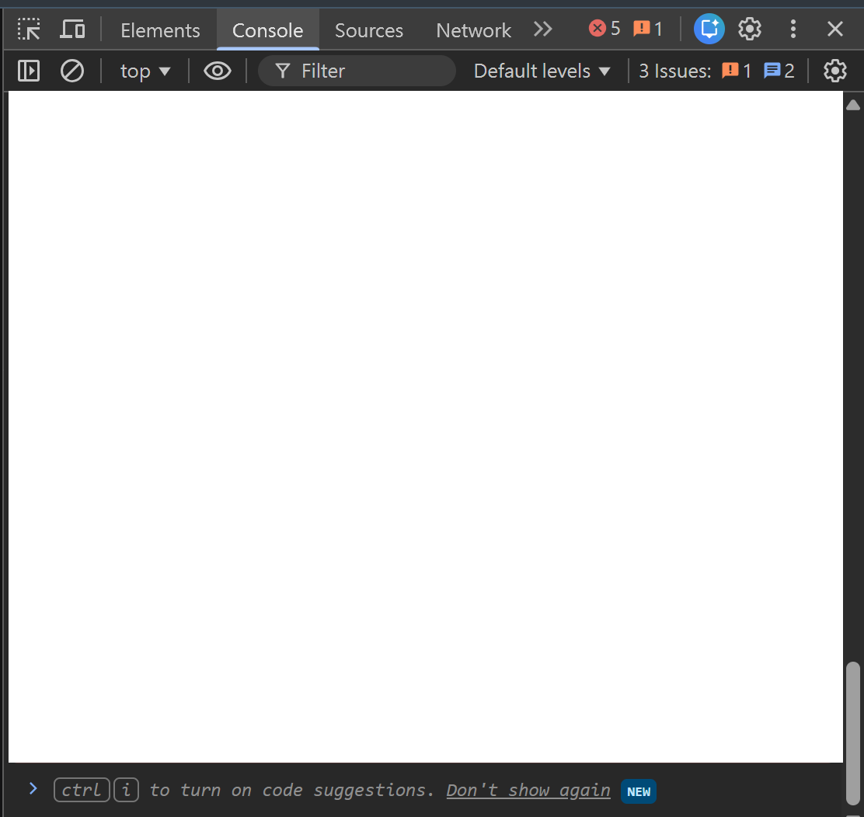
如何避免斷線
執行 Colab 中的整段程式碼
看到畫面上印出 Endpoint IP 和 ComfyUI 網址
在 Colab 的網頁按下鍵盤的 F12，切換到 Console 頁籤
複製並貼上防斷線腳本(下一張投影片)，按 Enter 執行
貼在這裡

Slide 36
防斷線腳本
function ClickConnect(){
console.log("正在點擊連線按鈕以防斷線...");
const colabConnectButton = document.querySelector("#top-toolbar colab-connect-button");
if (colabConnectButton) colabConnectButton.click();
}
setInterval(ClickConnect, 60000); // 60秒(60000毫秒)點擊一次
這段 JavaScript 的程式碼，會自動每60秒刷新 Colab網頁
為了避免 ComfyUI 網頁跑太久，而被 Colab 判定為閒置

Slide 37
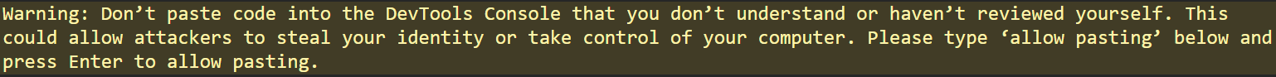
跳出瀏覽器安全警告
若出現警告，如下：
* 此警告是為了保護使用者的安全防護機制，會擋直接貼上的輸入
請在要貼程式碼的位置 > 的後面輸入：allow pasting，並按下enter
將防斷線腳本再次貼上

Slide 38
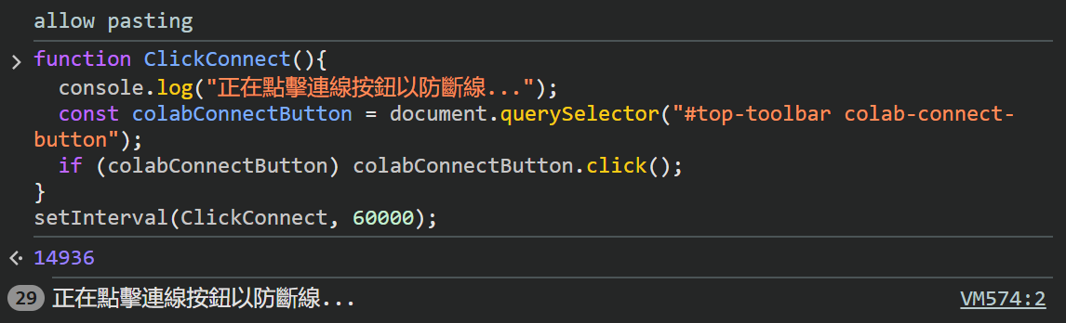
成功畫面
成功貼上後會跳出：14936(計時器的 ID )
60 秒後會跳出：正在點擊連線按鈕以防斷線...
每60秒，前面的數字會 +1

Slide 39
繳交資訊
04

Slide 40
Regulations
You should finish your homework on your own.
Do not share your codes with any living creatures.
Your HW will get 0 pt if you violate any of the above rules.
Professor & TAs preserve the rights to change the rules & grades.

Slide 41
助教聯絡資訊
05
章節07

Slide 42
助教聯絡資訊
TA Email
  賴秋彤 t114598033@ntut.org.tw
Email 標題(主旨)
  請按照此格式(X為作業編號)： [ai2026s-hwX-學號]

