Slide 1
TITLE: QUERIES AND RESULTS – ECOMMERCE DATABASE SUBMITTED BY: ADEYEYE OYINBUSOLA COURSE: DATA ANALYSIS (SQL)

Slide 2
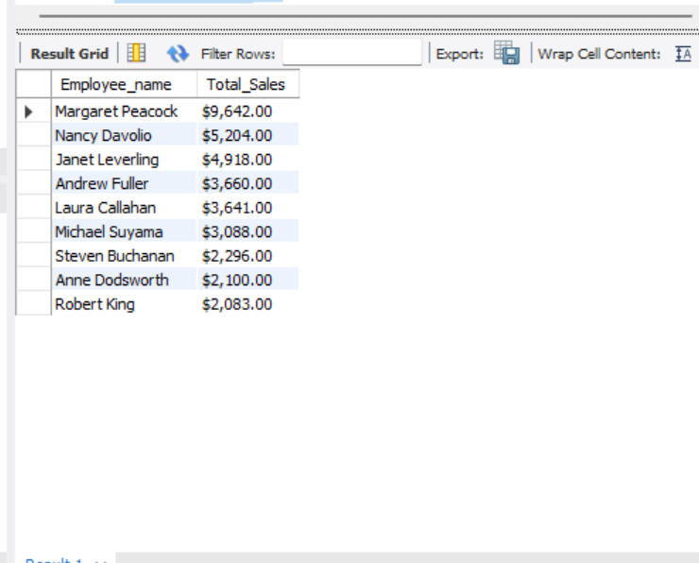
Query & Result
QUERY 1: Total Sales by Employee
SELECT
CONCAT(e.FirstName," ", e.LastName) AS Employee_name,
CONCAT('$', FORMAT(SUM(d.Quantity * d.UnitPrice),2)) AS Total_Sales
FROM Employees e
JOIN Orders o
ON e.EmployeeID = o.EmployeeID
JOIN OrderDetails d
ON o.OrderID = d.OrderID
GROUP BY Employee_name
ORDER BY Total_Sales DESC;

Slide 3
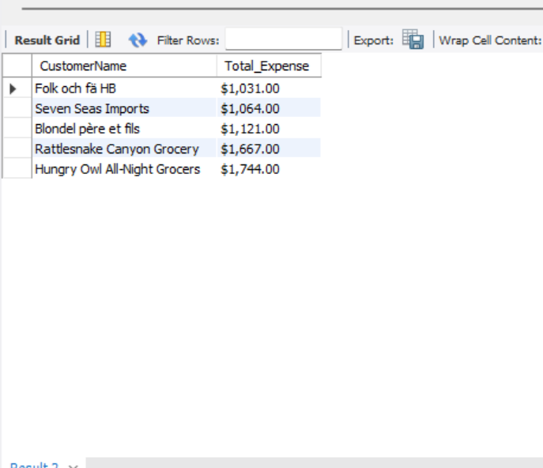
Query & Result
QUERY 2: Top 5 Customers by Sales.
SELECT c.CustomerName,
CONCAT('$', FORMAT(SUM(d.Quantity * d.UnitPrice),2)) AS Total_Expense
FROM Customers c
JOIN Orders o
ON c.CustomerID = o.CustomerID
JOIN OrderDetails d
ON o.OrderID = d.OrderID
GROUP BY c.CustomerID, c.CustomerName
ORDER BY Total_ExpenseLIMIT 5;

Slide 4
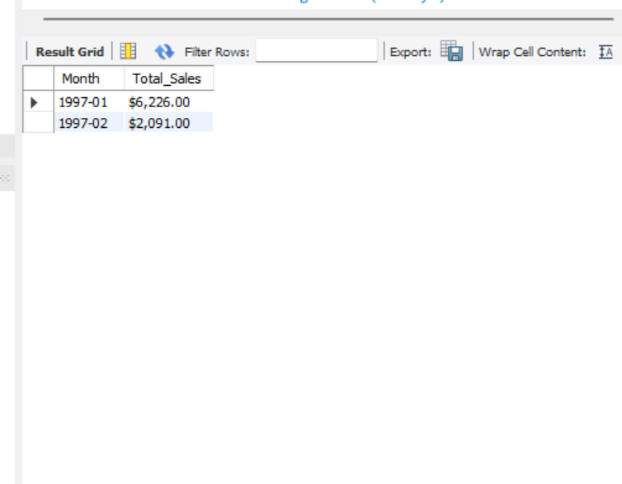
Query & Result
QUERY 3: Monthly Sales Trend
SELECT date_format(o.OrderDate, '%Y-%m') AS Month,
CONCAT('$',FORMAT(SUM(d.Quantity * d.UnitPrice),2)) AS Total_Sales
FROM Orders o
JOIN OrderDetails d
ON o.OrderID = d.OrderID
WHERE YEAR(o.OrderDate) = 1997
GROUP BY date_format(o.OrderDate, '%Y-%m’)
ORDER BY MONTH;

Slide 5
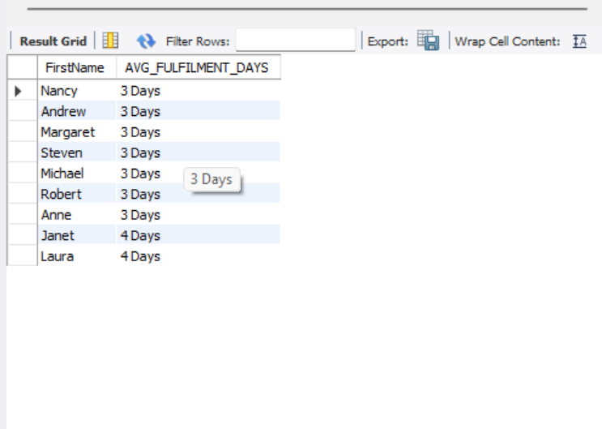
Query & Result
QUERY 4: Order Fulfilment Time
SELECT e.FirstName,
CONCAT(ROUND(AVG(
CASE
WHEN YEAR(o.OrderDate) = 1996 THEN 3
WHEN YEAR(o.OrderDate) = 1997 THEN 5
ELSE 0END),0),' ','Days') AS AVG_FULFILMENT_DAYS
FROM Employees e
JOIN Orders o
ON e.EmployeeID=O.EmployeeID
GROUP BY e.FirstName
ORDER BY AVG_FULFILMENT_DAYS;

Slide 6
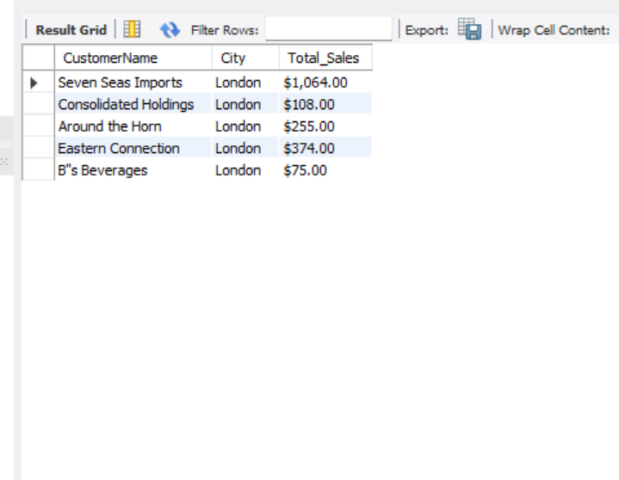
Query & Result
QUERY 5:Total Sales By Customers In London.
SELECT c.CustomerName, City,
CONCAT('$',FORMAT(
SUM(d.Quantity * d.UnitPrice),2))AS Total_Sales
FROM Customers c
JOIN Orders o
ON c.CustomerID=o.CustomerID
JOIN OrderDetails d
ON o.OrderID = d.OrderID
WHERE c.City = 'London’
GROUP BY c.CustomerName
ORDER BY Total_Sales;

Slide 7
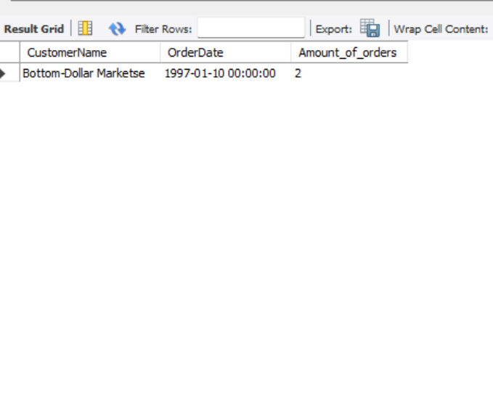
Query & Result
QUERY 6:Customers with Multiple Orders on the Same Date
SELECT c.CustomerName, o.OrderDate,
Count(o.OrderID) AS Amount_of_orders
FROM Customers c
JOIN Orders o
ON c.CustomerID=o.CustomerID
GROUP BY c.CustomerName, o.OrderDate
HAVING COUNT(o.OrderID)> 1
ORDER BY Amount_of_orders;

Slide 8
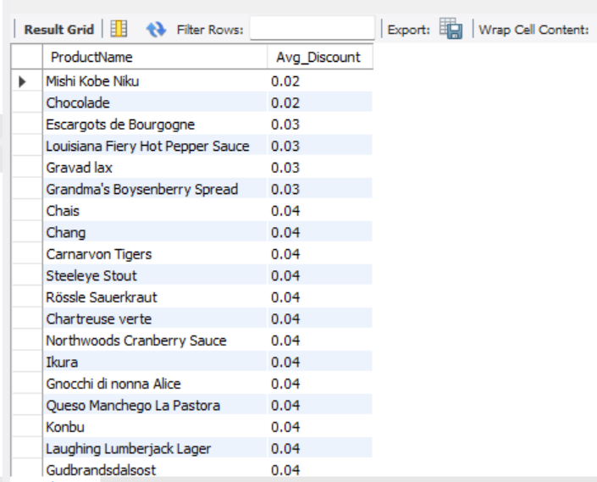
Query & Result
QUERY 7: Average Discount per Product
SELECT p.ProductName,
ROUND(AVG(d.Discount),2) AS Avg_Discount
FROM Products p
JOIN OrderDetails d
ON p.ProductID = d.ProductID
GROUP BY p.ProductName
ORDER BY Avg_Discount;

Slide 9
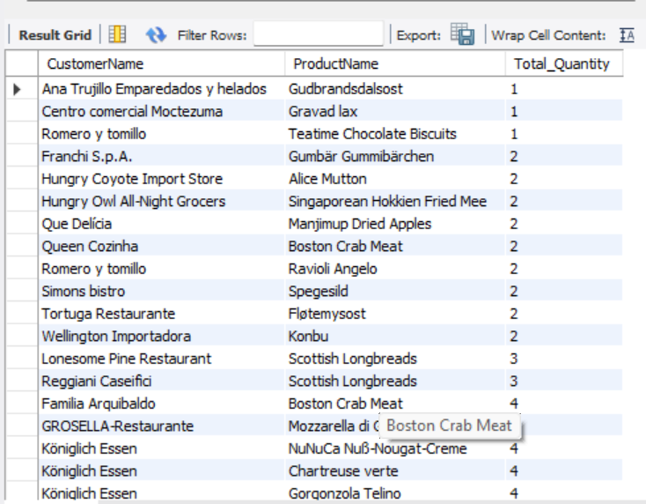
Query & Result
QUERY 8:Products Ordered by Each Customer.
SELECT c.CustomerName, p.ProductName,
SUM(d.Quantity) AS Total_Quantity
FROM Customers c
JOIN Orders o
ON c.CustomerID=o.CustomerID
JOIN OrderDetails d
ON o.OrderID = d.OrderID
JOIN Products p
ON d.ProductID = p.ProductID
GROUP BY c.CustomerName, p.ProductName
ORDER BY Total_Quantity;

Slide 10
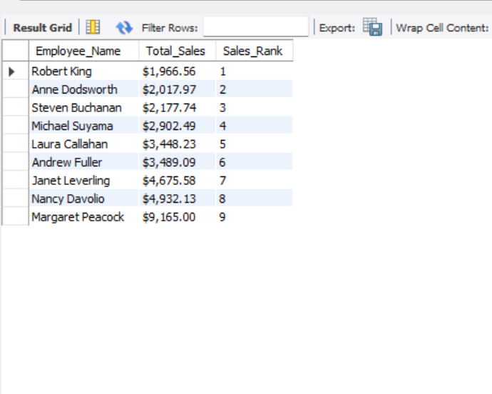
Query & Result
QUERY 9:Employee Sales Ranking.
SELECT CONCAT(e.FirstName," ", e.LastName) AS Employee_Name,
CONCAT('$', FORMAT(SUM(d.Quantity * d.UnitPrice * (1 - d.Discount)),2)) AS Total_Sales,
RANK() OVER (ORDER BY SUM(d.Quantity * d.UnitPrice * (1 - d.Discount))) AS Sales_Rank
FROM Employees e
JOIN Orders o
ON e.EmployeeID=o.EmployeeID
JOIN OrderDetails d
ON o.OrderID = d.OrderID
GROUP BY Employee_Name
ORDER BY Sales_Rank;

Slide 11
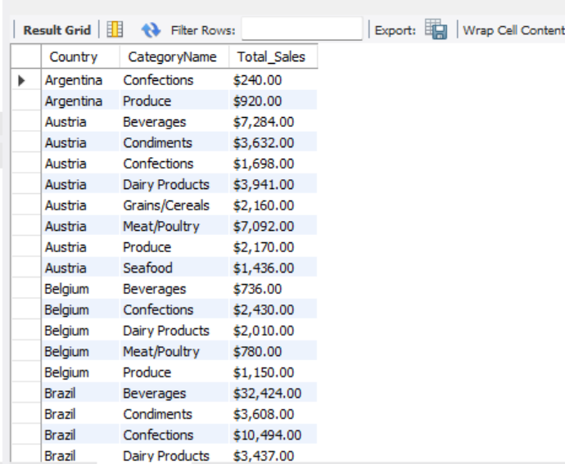
Query & Result
QUERY 10:Sales by Country and Category.
SELECT c.Country, ca.CategoryName,
CONCAT('$', FORMAT(SUM(p.Unit * p.Price),2)) AS Total_Sales
FROM Customers c
JOIN Orders o
ON c.CustomerID = o.CustomerID
JOIN OrderDetails d
ON o.OrderID = d.OrderID
JOIN Products p
ON d.ProductID = p.ProductID
JOIN Categories ca
ON p.CategoryID = ca.CategoryID
GROUP BY c.Country, ca.CategoryName
ORDER BY c.Country, ca.CategoryName;

Slide 12
QUERY 11:Year-over-Year Sales Growth
SELECT t1.ProductID,t1.ProductName,t1.Order_Year,t1.Total_Sales,t2.Total_Sales AS Previous_Year_Sales, ((t1.Total_Sales - t2.Total_Sales) / t2.Total_Sales) * 100 AS Percentage_Growth
FROM(SELECT p.ProductID, p.ProductName,YEAR(o.OrderDate) AS Order_Year,
SUM(d.Quantity * d.UnitPrice) AS Total_Sales
FROM Orders o
JOIN OrderDetails d
ON o.OrderID = d.OrderID
JOIN Products p
ON d.ProductID = p.ProductID
GROUP BY p.ProductID, p.ProductName, Order_Year) AS t1
JOIN(SELECT p.ProductID, p.ProductName,YEAR(o.OrderDate) AS Order_Year,
SUM(d.Quantity * d.UnitPrice) AS Total_Sales
FROM Orders o
JOIN OrderDetails d
ON o.OrderID = d.OrderID
JOIN Products p
ON d.ProductID = p.ProductID
GROUP BY p.ProductID, p.ProductName, Order_Year) AS t2
ON t1.ProductID = t2.ProductID AND t1.Order_Year = t2.Order_Year + 1
ORDER BY t1.ProductID, t1.Order_Year;
Query

Slide 13
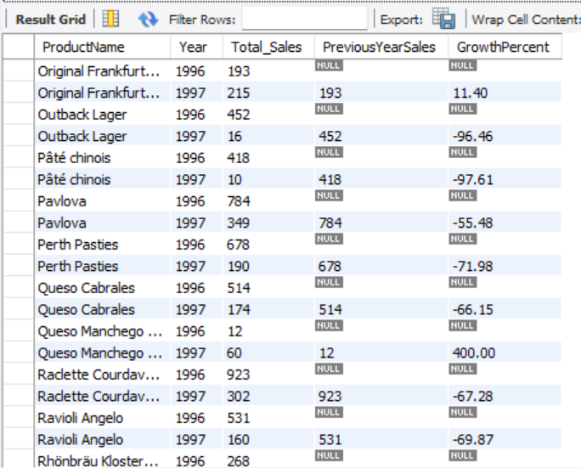
Result

Slide 14
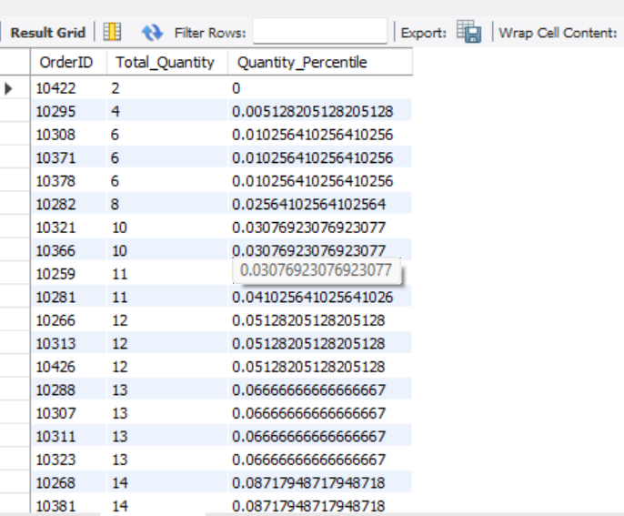
Query & Result
QUERY 12:Order Quantity Percentile.
SELECT o.OrderID,
SUM(d.Quantity) AS Total_Quantity
FROM Orders o
JOIN OrderDetails d
ON o.OrderID = d.OrderID
GROUP BY o.OrderID;
SELECT OrderID,Total_Quantity,
PERCENT_RANK() OVER (ORDER BY Total_Quantity) AS Quantity_Percentile
FROM (SELECT o.OrderID,SUM(d.Quantity) AS Total_Quantity
FROM Orders o
JOIN Orderdetails d
ON o.OrderID = d.OrderID
GROUP BY o.OrderID) AS Order_Totals
ORDER BY Total_Quantity;

Slide 15
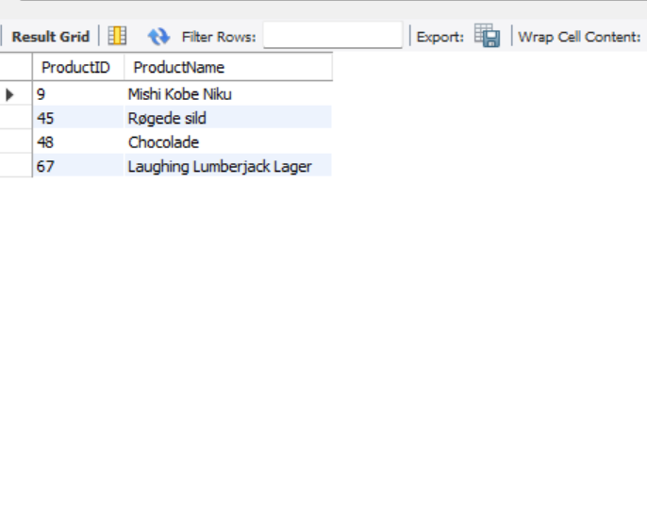
Query & Result
QUERY 13:Products Never Reordered
SELECT p.ProductID, p.ProductName
FROM Products p
JOIN OrderDetails d
ON p.ProductID = d.ProductID
GROUP BY p.ProductID, p.ProductName
HAVING COUNT(Distinct d.OrderID) = 1;

Slide 16
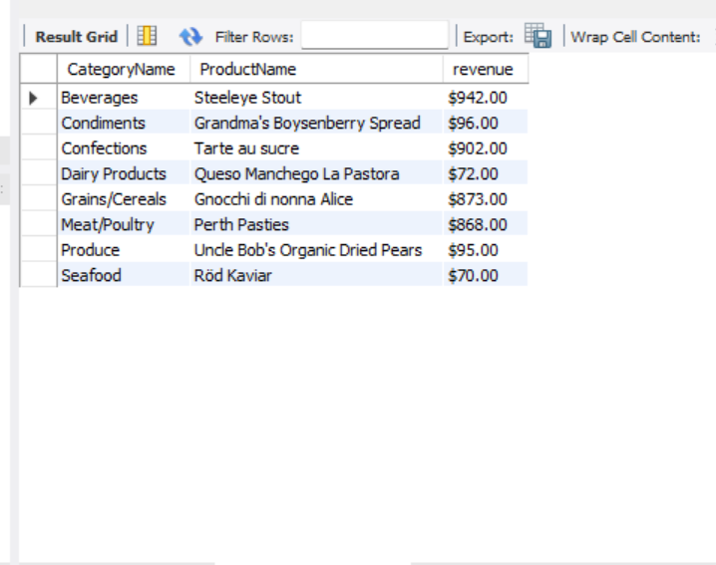
Query & Result
QUERY 14:Most Valuable Product by Revenue.
DROP VIEW IF EXISTS Product_revenue;
CREATE VIEW Product_revenue AS
SELECT p.ProductID,p.ProductName,ca.CategoryID,ca.CategoryName,
CONCAT('$', FORMAT(SUM(d.Quantity * d.UnitPrice),2)) AS Revenue
FROM OrderDetails d
JOIN Products p
ON d.ProductID = p.ProductID
JOIN Categories ca
ON p.CategoryID = ca.CategoryID
GROUP BY p.ProductID, p.ProductName, ca.CategoryID, ca.CategoryName;
SELECT * FROM Product_revenue;
SELECT pr.CategoryName, pr.ProductName, pr.revenue
FROM Product_revenue pr
WHERE pr.revenue = ( SELECT MAX(Revenue)
FROM Product_revenue
WHERE CategoryID = pr.CategoryID );

Slide 17
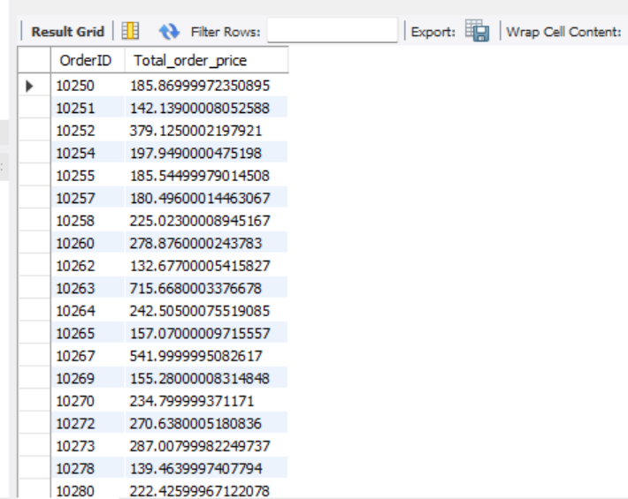
Query & Result
QUERY 15:Complex Order Details.
SELECT o.OrderID,
SUM(d.Quantity * d.UnitPrice * (1 - d.Discount)) AS Total_order_price
FROM Orders o
JOIN OrderDetails d
ON o.OrderID = d.OrderID
GROUP BY o.OrderID
HAVING Total_order_price > 100
AND MAX(d.Discount) >= 0.05;

Slide 18
THANK YOU! All SQL Queries and Resources are Available on my GitHub: WhitefoxxA/E-commerce_SQL_project: Course project submission: E-commerce SQL database queries with results.

