Slide 1
MOURYA CHANDRA ADARI
RAVI TEJA M L N
SURYA MANOHAR REDDY G
YUVA CHANDRA ADARI
CODE CRACKERS

Slide 2

Enhancing Communication: The Future of AI- Powered Sign Language Translation

Slide 3


Introduction to AI in Sign Language
is transforming communication by facilitating seamless translation of
This presentation explores the potential of AI-powered tools to enhance interactions between hearing and deaf communities, paving the way for a more inclusive
society.
.

Slide 4



Current Challenges in Communication
Despite advancements,
persist for the deaf community.
Limited access to interpreters and the
of sign language hinder effective interaction. Understanding these challenges is crucial for developing AI solutions that can bridge these gaps.

Slide 5
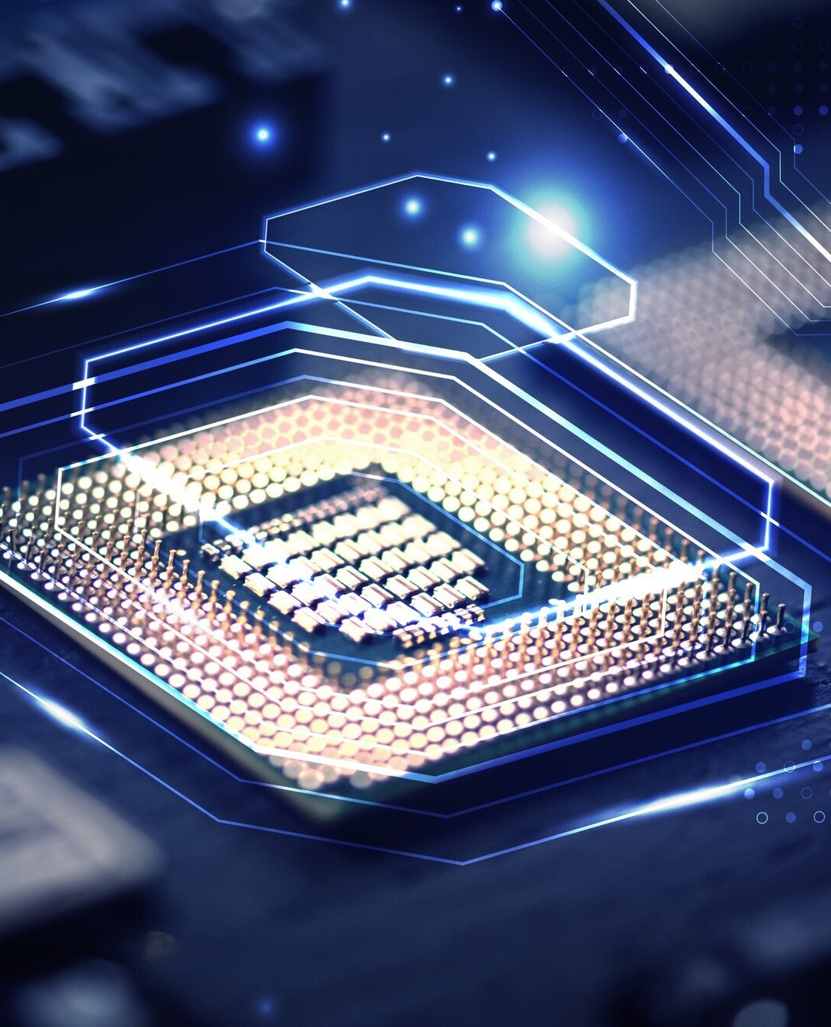




AI-Powered Solutions
Innovative are
emerging to translate sign language in real-time. These solutions utilize
and
to interpret gestures, making communication more accessible and efﬁcient for users in various settings.

Slide 6


Beneﬁts of AI Translation
AI-powered sign language translation offers numerous beneﬁts, including
, improved communication in professional settings, and
. By breaking down barriers, these tools foster a more inclusive environment for all.

Slide 7
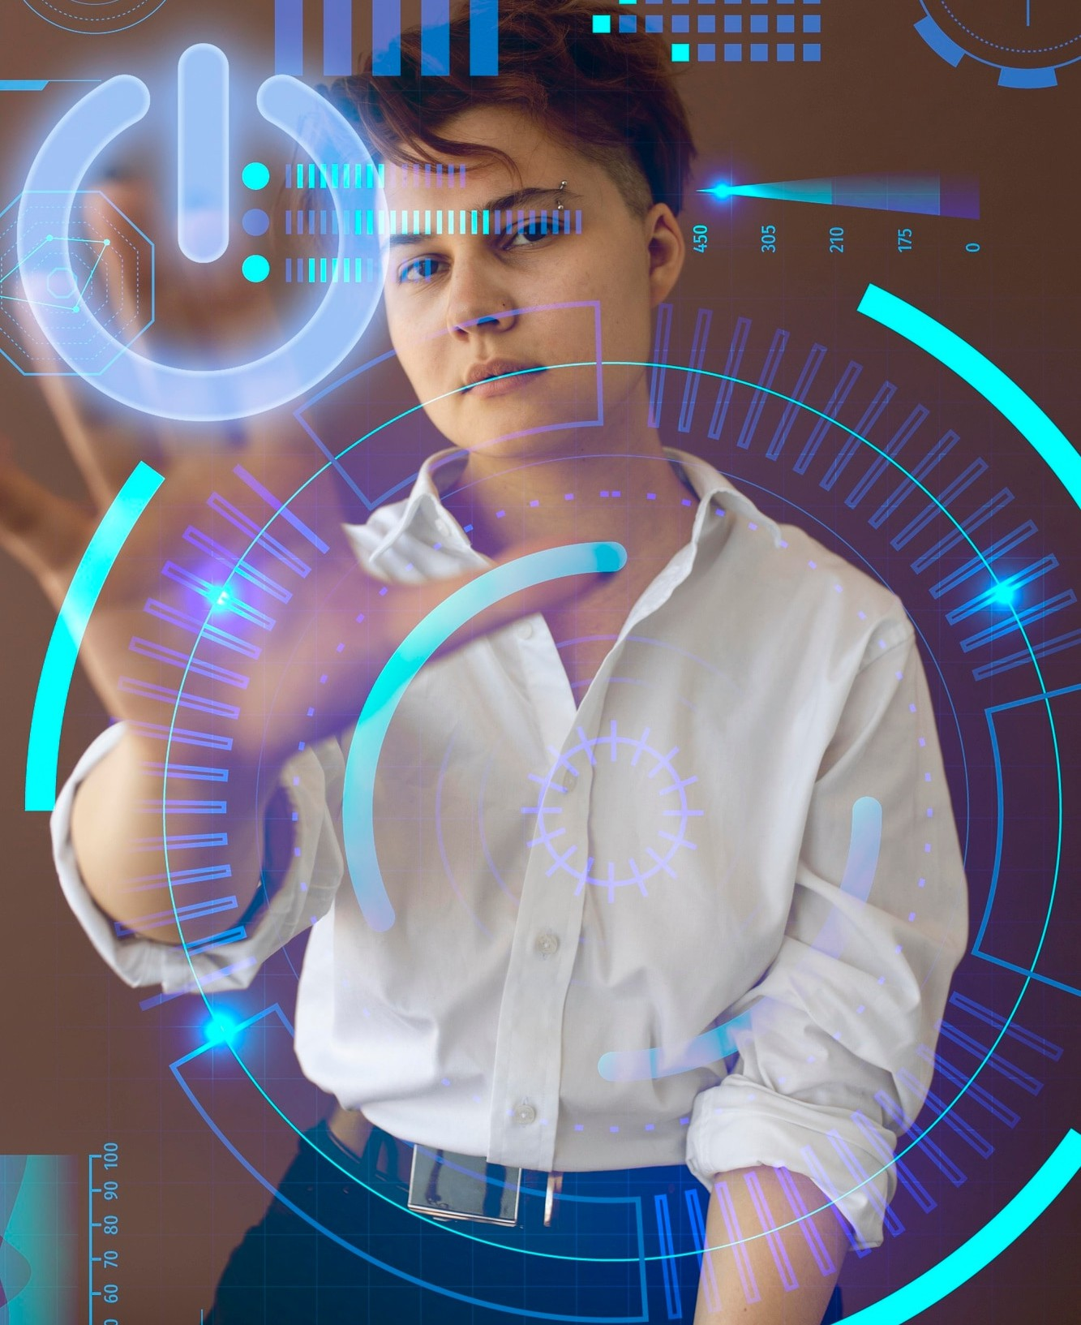



Future Developments
The future of AI in sign language translation looks promising, with ongoing advancements in
and
. Continued research and collaboration will drive innovation, leading to more accurate and user- friendly solutions.

Slide 8

Conclusion: A Uniﬁed Future
In conclusion, AI-powered sign language translation has the potential to revolutionize communication. By embracing these technologies, we can create a more world where everyone has the opportunity to connect and engage, regardless of their hearing abilities.

Slide 9
Thanks!
mouryaadari2931@gmail.com
+91 92477 22635
@mourya_chandra_2931

