Slide 1
Business Intelligence and Data Visualization
Layefa Mezeh
Md Samiul Hasan
Prashant Timilsina
Panopto link

Slide 2
Nigeria Systemic Shocks Analysis — Project Overview
BACKGROUND & MOTIVATION
Causal hypothesis: Drought → Food Prices → Civil Unrest → GDP Decline
DATA & METHODOLOGY
4 integrated datasets: WFP food prices, ACLED conflict, EM-DAT disasters, World Bank GDP
Master dataset: 8,269 rows, 28 variables, 14 states, Jan 2010 – Dec 2024, zero missing values
ETL methodology: Python/Jupyter Notebooks; drought augmented with Shiru et al. 2020 SPI indices
KEY FINDINGS
Causal chain confirmed: Drought precedes food price rises; conflict correlates with GDP decline across 14 years
1–3 month warning window: Drought data reliably precedes price spikes, enabling early business and aid planning
North–South divide: North 1,595 NGN/kg vs South 588 NGN/kg (2024) — conflict premium built into prices
Policy vs climate shocks: 2023 Naira cash crisis (policy-driven) distinguished from climate-conflict loops
GDP impact: Peaked $7,400 (2014) → fell to ~$1,084 after 2023 Naira devaluation
5 STAKEHOLDER DASHBOARDS
Business Owner ▪ Red Cross ▪ Government Planner ▪ WFP Analyst ▪ Future Entrepreneur
UWE Bristol ▪ Business Intelligence and Data Visualization

Slide 3
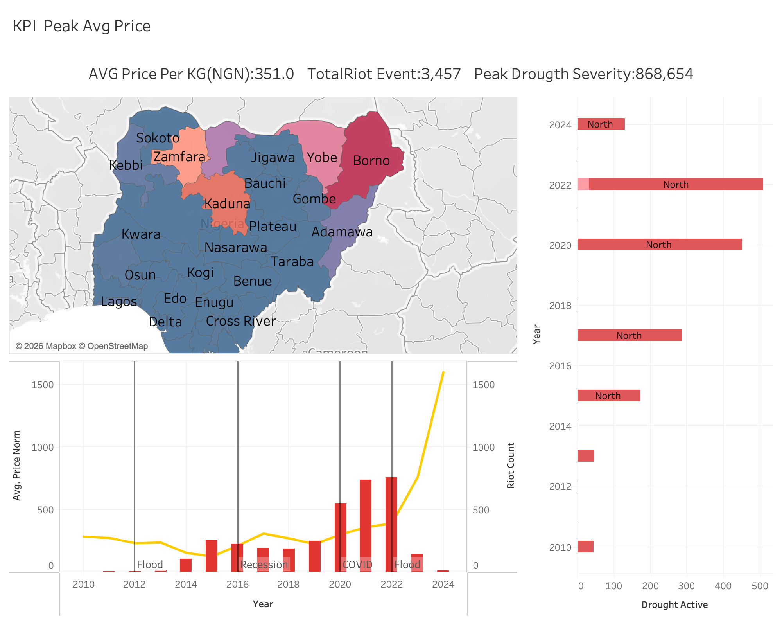

Slide 4
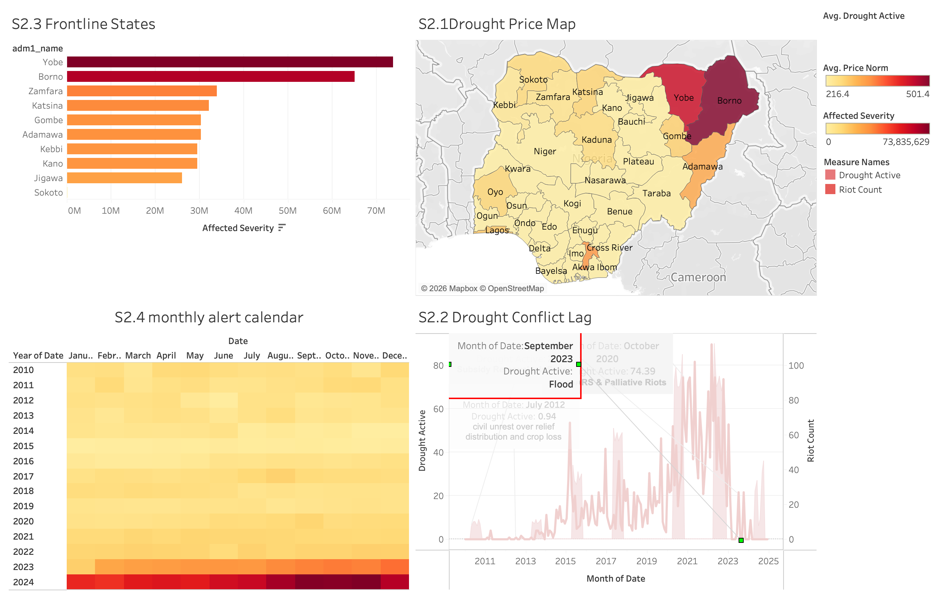

Slide 5
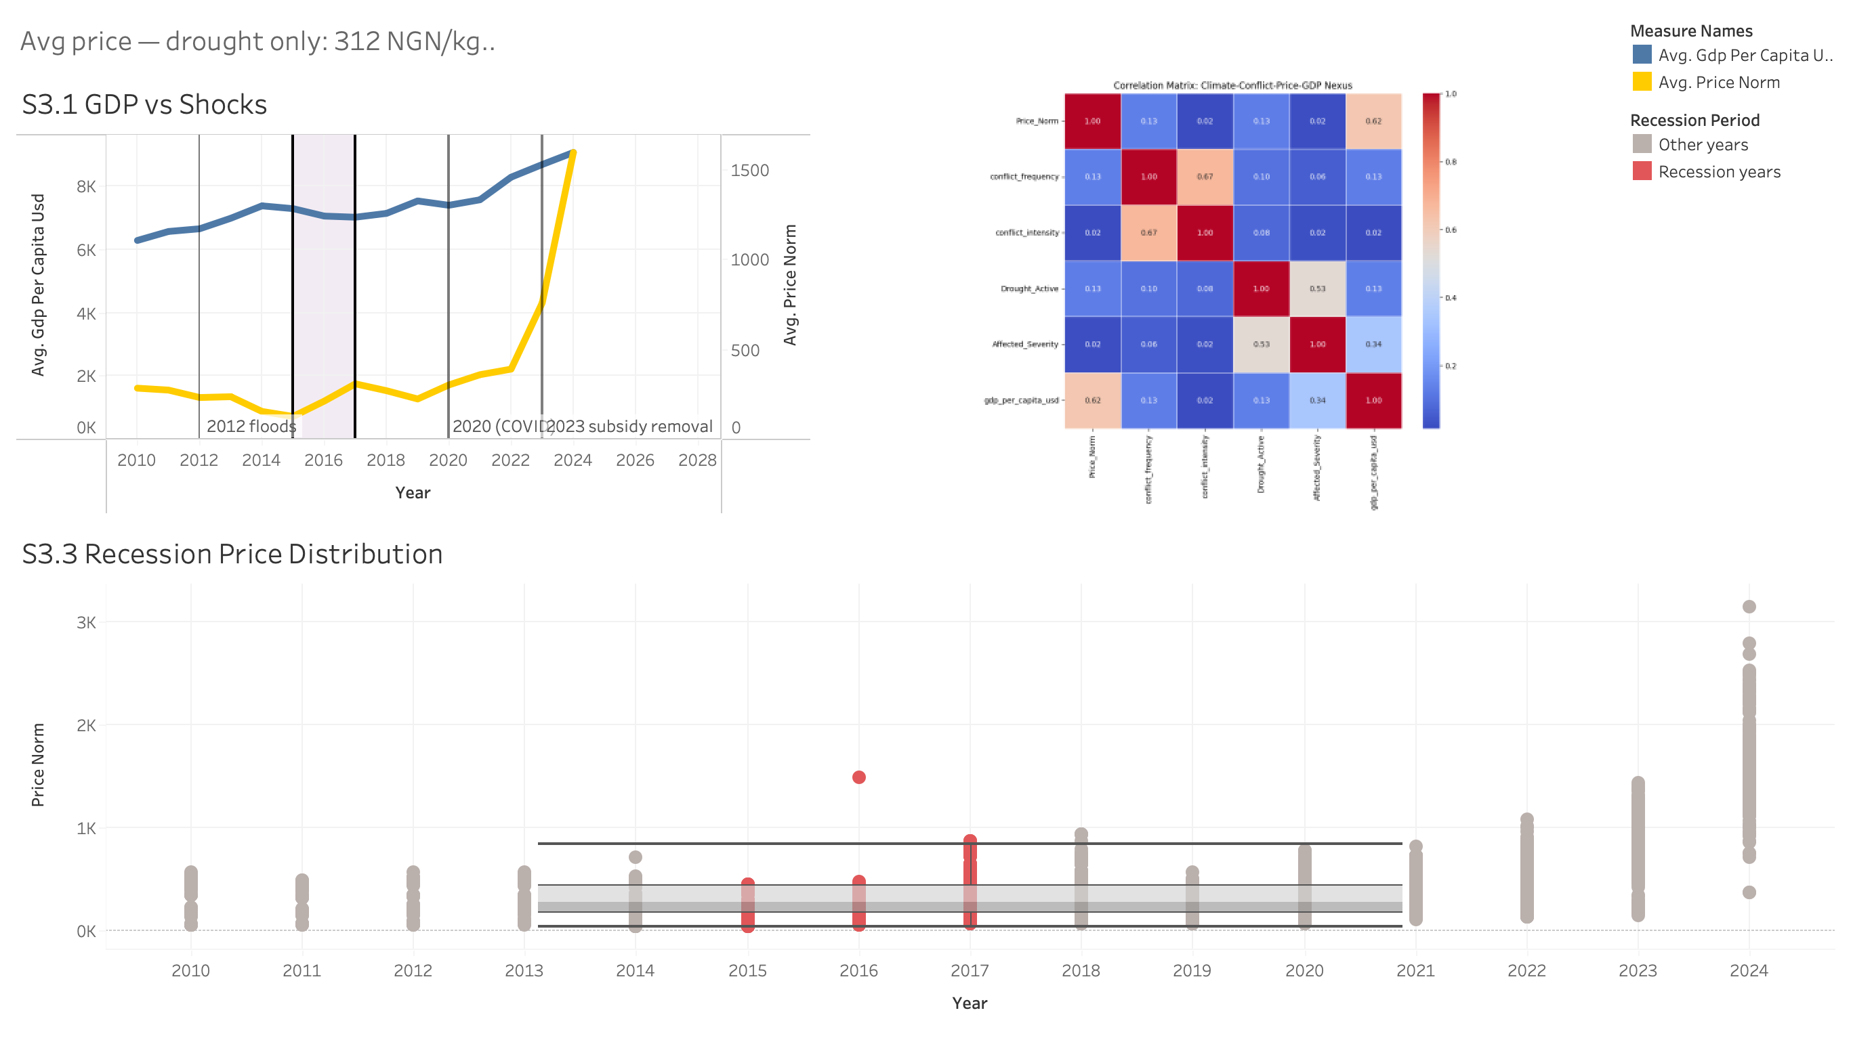

Slide 6
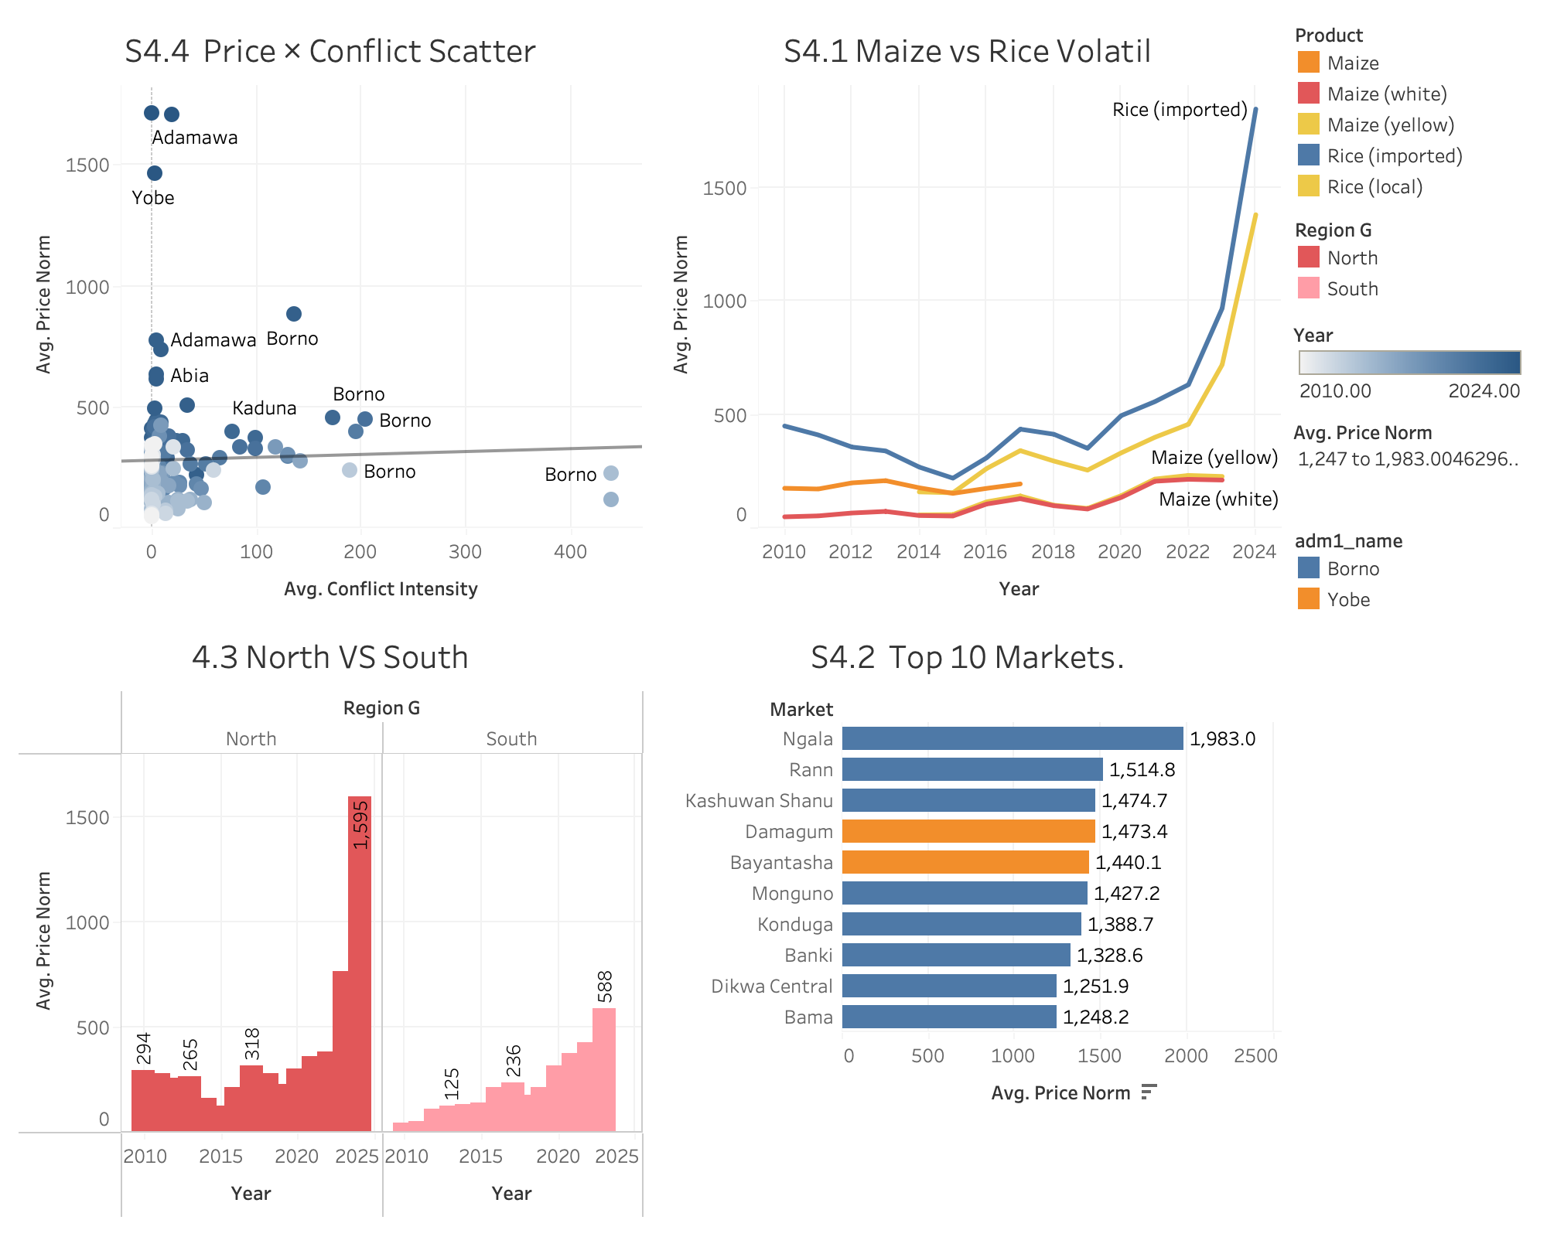

Slide 7
