Slide 1
CS-427
MDS Mini Project
Cryptanalysis of two schemes of Baba et al.
by Linear Algebra Methods
200010003 (B. Siddharth Prabhu)
200030017 (Devesh Kumar)

Slide 2
Introduction
We will be presenting information on two cryptosystems (El -Gamal and FACTOR based) and demonstrating how linear algebra can be used to break the cryptosystem outlined in the paper by Baba et al, which is based on the FACTOR problem.

Slide 3
El - Gamal Cryptosystem
It is a typical public key cryptosystem.It is based on the difficulty of computing discrete logarithms in a finite field. It consists of three main components: a key generation algorithm, an encryption algorithm, and a decryption algorithm.

Slide 4
Encryption
Structure - Assume G to be a cyclic group with generator ‘g’. Both parties set a private key using a number of their choice. (Alice -> x, Bob ->y)
Alice can generate g^{x} and Bob can generate g^{y}.
Alice sends the following to Bob (g^{x}, g^{xy}m).

Slide 5
Example for Encryption
Let the original message be “A”.
The generator be 2 and for modulus we will take 5. The ‘y’ chosen by Bob be 3. Then the value of g^{y}= 8%5=3.
And ‘x’ chosen by Alice be 2. The g^{x}=4%5=4
g^{xy}= g⁶ =3^6%5 =4
A -> 65*4=260

Slide 6
Decryption
Cipher text bob receives -> (g^{x}, g^{xy}m).
Now he can use his chosen number ‘y’ to find out (g^{x})^{y}=g^{xy}
Calculate the inverse (g^{xy})⁻¹
The inorder to get the actual message [(g^{xy})⁻¹(g^{xy})]*m=I*m = m
The process of using g^x and y to calculate the g^{xy} is called as key exchange.

Slide 7
Decryption Example
So Bob receives 260 as encrypted text and g^{x} as 4.
(g^{x})^{y} =4^3%5=4 =g^{xy}
Decrypting -> 260/4=65 =’A’

Slide 8
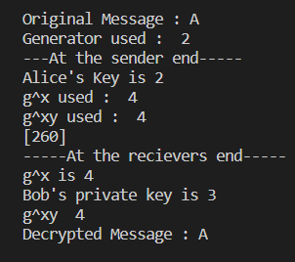
Code Sample Output

Slide 9
What is FACTOR ?
It is a function which can split a number ‘a*b’ into its components ‘a’ and ‘b’ in a one way, i.e. its inverse is easy to compute, while it, by itself, is computationally expensive.
FACTOR (g^{x}h^{y}) = f⁻¹(g^{x}h^{y}) => (g^{x}, h^{y})

Slide 10
Factor Method based Cryptosystem
A factor-based cryptosystem is a type of cryptographic system that relies on the difficulty of factoring large integers. In a factor-based cryptosystem, a message is encrypted using a public key. The recipient of the encrypted message uses a private key to decrypt it back into the original message.
The security of the system is based on the fact that it is difficult to determine the private key from the public key, which makes it difficult to decrypt the message without the correct key.

Slide 11
Encryption
Assume G to be a public cyclic group.
Alice chooses two integers (x₁, y₁) and Bob chooses two integers (x₂, y₂). Bob selects two elements from the group (g, h).
Key exchange -> Alice sends g^{x1}h^{y1} to Bob and Bob sends g^{x2}h^{y2} to Alice.
Key (K) = g^{(x1+x2)}h^{(y1+y2)}
Bob then sets the public key -> (G, g, h, g^{x2}h^{y2})
For encryption Alice uses C= (K, g^{x1}h^{y1}m) and sends this to Bob

Slide 12
Decryption
Bob then has the following - (K, g^{x1}h^{y1}m) and (G, g, h, g^{x2}h^{y2})
In Order to get the message back Bob uses the following algorithm
h^{y2}(f⁻¹(K))g^{x2}(g^{x1}h^{y1}m)
= h^{y2}(f⁻¹(g^{x2+x1}h^{y2+y1}))g^{x2}(g^{x1}h^{y1}m)
= h^{y2} [(h^{y2})⁻¹(g^{x1}h^{y1})⁻¹(g^{x2})⁻¹] g^{x2}g^{x1}h^{y1}m
= m

Slide 13
Ideas used in Cryptanalysis (Tsaban)
Let V be the linear subspace of M_{n}(F_{q}) generated by all g^{i}
dim(V) ≤ n - 1
Significance of f(m)h = hf(m) in a non-abelian system
Want: f in G. Such a solution exists in V
We can efficiently find basis for subspace of solutions in V (using L.I. g^{i} values)
Invertibility Lemma!
Notes:
1,g, … can form a basis (check+append 1 by 1). Can use characteristic equation.

Slide 14
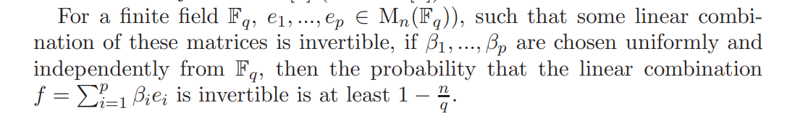
Invertibility Lemma
If such an f is found, done!

Slide 15
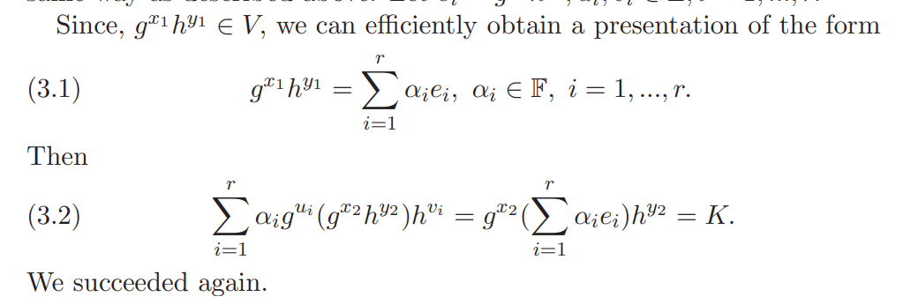
(Easier) Linear Decomposition Method
V = Linear subspace as <g>g^{x}h^{y}<h>
Consider a basis of V that can be efficiently be computed: e1, e2, … , ep
Consider that g^{x+x’}h^{y+y’} is also in V
Get g^{x’}h^{y’} , and hence the message
(Similar method to break the key exchange)

Slide 16
CS427, This Project, and Beyond
In terms of this course,
Basic Field Theory in the direction of Linear Algebra (in addition to whatever ideas of Field Theory we had already)
Linear Algebra: Linear Independence, Spans, Vector Spaces, Subspaces, Determinants
(While this project may not illustrate the second half of CS427 (Optimization), we hope it could establish how this course serves a multi-level purpose.)
Improvements (small scale):
Having our code work for larger, complex groups. Trying other attacks.
Future scope (general):
Newer cryptosystems on other mathematical structures, perhaps using tensor algebra, etc. (Useful for HE and ZKP)
Including Optimization techniques, for more efficient cryptanalysis or for quantum-safe cryptography. (+privacy-preserving ML)

Slide 17
References and Related Works
• (Primary Reference of the Paper): Baba et al. (2011). “A non-Abelian factorization problem and an associated cryptosystem”. IACR Cryptology ePrint Archive. 2011. 48.
• Ben-Zvi, Adi et al. “Cryptanalysis via Algebraic Spans.” Annual International Cryptology Conference (2018).
• Tsaban, Boaz. ‘Polynomial Time Cryptanalysis of Noncommutative-Algebraic Key Exchange Protocols’. CoRR, vol. abs/1210.8114, 2012, http://arxiv.org/abs/1210.8114 .

Slide 18
THANK YOU

