Slide 1
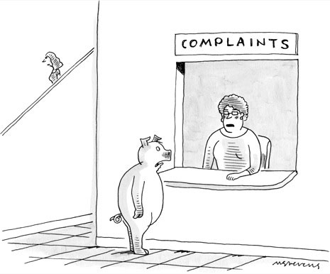

NYC 311 Call Data & Local Weather
By: Patrick White

Slide 2
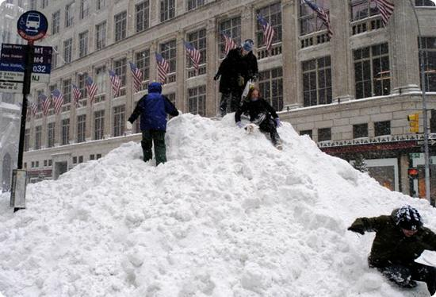
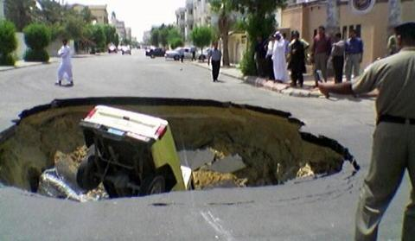
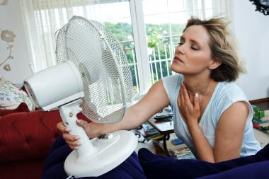

What Causes New Yorker's to call 311?
ANYTHING.
Top Complaints/Requests :
HEAT/HOT WATER
Street Condition
Street Light Condition
Blocked Driveway
PAINT/PLASTER
PLUMBING
Illegal Parking
UNSANITARY CONDITION
Water System
Noise
Traffic Signal Condition
Noise - Commercial
Sewer
Noise - Street/Sidewalk
Dirty Conditions
DOF Literature Request
ELECTRIC

Slide 3
Exploring the Data: Too much crap
[Unique Key,Closed Date,Agency,Agency Name,
Descriptor,Location Type,Incident Zip,
Incident Address,Street Name,Cross Street 1,
Cross Street 2,Intersection Street 1,
Intersection Street 2,Address Type,City,
Landmark,Facility Type,Status,Due Date,
Resolution Description,Resolution Action Updated Date,
Community Board,Borough,X Coordinate (State Plane),
Y Coordinate (State Plane),Park Facility Name,
Park Borough,School Name,School Number,
School Region,School Code,School Phone Number,
School Address,School City,School State,
School Zip,School Not Found,School or Citywide Complaint,
Vehicle Type,Taxi Company Borough,Taxi Pick Up Location,
Bridge Highway Name,Bridge Highway Direction,Road Ramp,
Bridge Highway Segment,Garage Lot Name,Ferry Direction,
Ferry Terminal Name,Latitude,Longitude,Location]
Source: https://nycopendata.socrata.com/

Slide 4
Exploring the Data: Keepers
  - Created_Date
  - Complaint_Type
Thats it.

Slide 5
Cleaning, Sanitizing, and Rearranging
Requirements:
Indexed by date column
Date column parsed as datetime data type
Dataframe contains the total number of complaints per complaint type for each day
Max temperature column as integer data type
Weather categories replaced by using get_dummies()

Slide 6
A few examples of generalized complaints
Building Conditions:
Heating/Hot water
Plumbing
Water Leaks
Living Conditions:
Unsanitary Conditions
Rodents
Dead Animal Removal
Signal/Sign Repair
Broken Traffic Signal
Street Sign Missin/Broken
General Request:
Other: Complaint
Schedule Bulk Item pickup
Sticker/Form Request
Street/Sidewalk Repair:
Pothole
Crumbling Sidewalk (Unsafe)
Plow request
Parking Enforcement:
Abandoned Vehicle
Towed Car information
Blocked Driveway

Slide 7

Modeling Process
Feature Selection:
  I tried a few ways, Complaint amount per type using only weather data, or weather data and the complaint type being analyzed, temperature estimates using only complaint amounts.
  Predicting temperature by using weather & complaint data created the closest fit but seemed to me to be a bad way to measure this. Predicting the temperature using categorical forecast data (Snowy, Sunny, etc.) seemed like it would unfairly help my model if I was trying to identify complaint levels as a product of varying temperatures

Slide 8
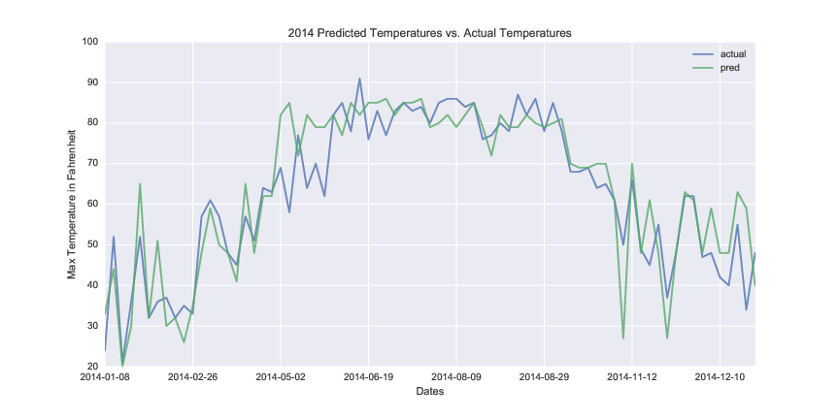
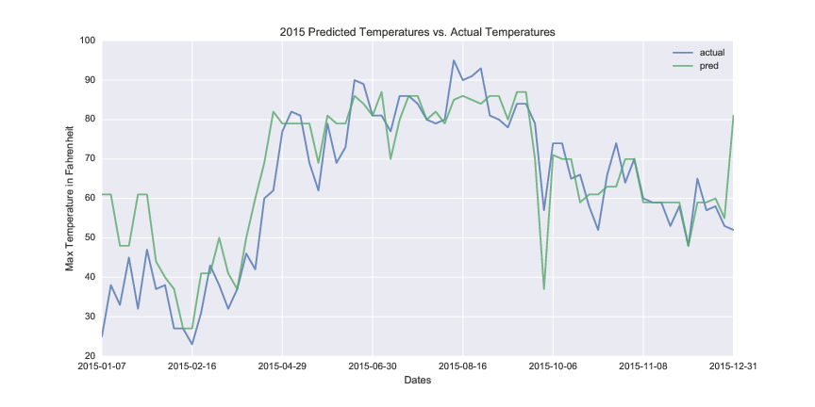
Visualizing The Data
Outside Influences
Late January Blizzard in 2015
Because of this blizzard the prediction for 2015's temperatures were too high
2014 & 2015 had similarly miserable summers, good for this project

Slide 9

Along the way..
Challenges
  Late in the game Project Reboot
  Large Data Set
  Small RAM amount
  Yak Shaving
Successes
  Old project still salvageable, and interesting!
  Massive reduction in dataset size from ~3GB to ~260MB
  Arrangement of weather and total complaints per type

Slide 10

THE FUTURE
Possible Extentions
I'd like to use the geo location data to try creating a heat map of expected complaint types and by what volume.
Turns out someone did this already
  What a Hundred Million Calls to 311 Reveal About New York

