Slide 1
DATA SCIENCE class xII: ensemble

Slide 2
Interview question
What are the assumptions of linear models?

Slide 3
agenda
Review of Bias/Variance Tradeoff
Ensemble
Workshop

Slide 4
Bias-variance trade off
Mean Squared Error – Is a measurement of error for a model. Formerly, it is written as :

Slide 5
Bias-variance trade off
However, we can decompose the MSE into 3 components:
E[MSE] = σ² + (Model Bias)² + Model Variance
σ^{2 –} Theoretical minimum noise in modeling. The data is noisy, and it can’t always be explained
Model Bias – How close the model is to the true relationship between the data
Model Variance – How much the model moves if it were re-trained on new data.

Slide 6
Bias-variance trade off
However, we can decompose the MSE into 3 components:
E[MSE] = σ² + (Model Bias)² + Model Variance
σ^{2 –} Theoretical minimum noise in modeling. The data is noisy, and it can’t always be explained
Model Bias – How close the model is to the true relationship between the data
Model Variance – How much the model moves if it were re-trained on new data.

Slide 7
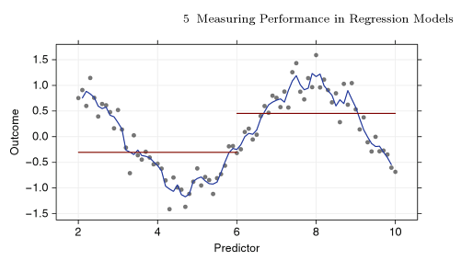
Bias-variance trade off
Simple models – often have low variance, but high bias
Complex Models – Often have low bias but high variance

Slide 8
Ensemble techniques
Our goal is to reduce the bias and the variance of a model using techniques such as Bagging, and Ensemble Models

Slide 9
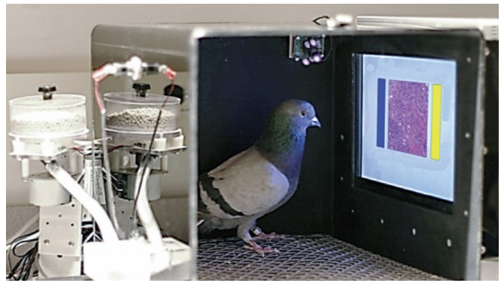
Ensemble techniques

