Slide 1
DATA SCIENCE class xI: review

Slide 2
agenda
Review what we’ve covered
Miscellaneous Topics
Workshop

Slide 3
Review
Basics: Python, Pandas, What is ML, Supervised vs Unsupervised Learning, Distributions, Bayes’ Theorem
Supervised Techniques: KNN, Linear Regression, Logistic Regression, Decision Trees, Naïve Bayes
Unsupervised Techniques: K means Clustering, DBScan, Spectral Clustering

Slide 4
Linear model assumptions
Linear Relationship
Normal
No collinearity
No Autocorrelation
Homoscedasticity

Slide 5
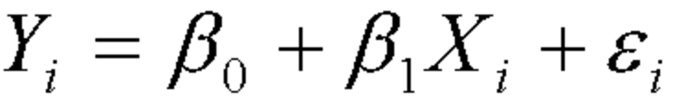
Linear relationship
Linear relationship means the betas have to multiply the Xs on their own, but the Xs can be anything they want (Squared, logs, double, etc)

Slide 6
Normal
Linear model assumptions that the error terms are normal.
Important if making forecast assumptions about the model and want to understand probability of a certain range.
Tests for normality:
Kolmogorov Smirnov
Shapiro-Wilk test
qqplot

Slide 7
No collinearity
Collinearity – This means that two or more predictor variables are correlated. This can have a negative impact on the model:
Incorrect beta estimates
Highly sensitive coefficient estimates
Does not impact accuracy of the model
Test:
Variance inflation factor
Correlation
Solution: Remove correlated variables, or use dimensionality reduction (PLS)

Slide 8
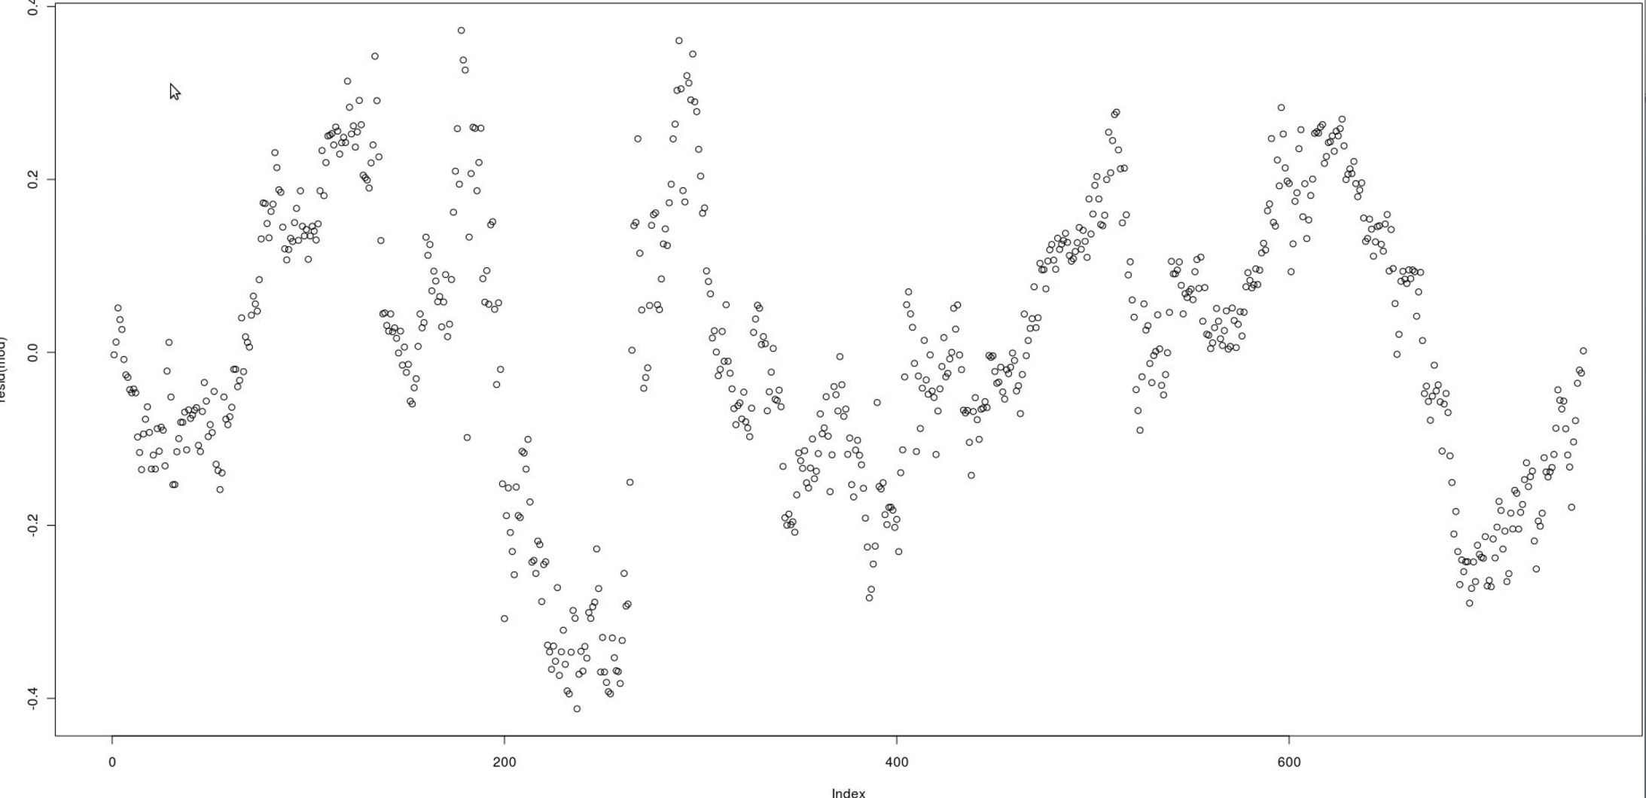
No autocorrelation
Autocorrelation – The residuals of successive data points are correlated with each other.
Can visualize autocorrelation by plotting index against the residuals and looking to see if there is a pattern
Test: Durbon Watson
If autocorrelation exists it will influence estimate of error term. Might suggest inclusion of lagged variables

Slide 9
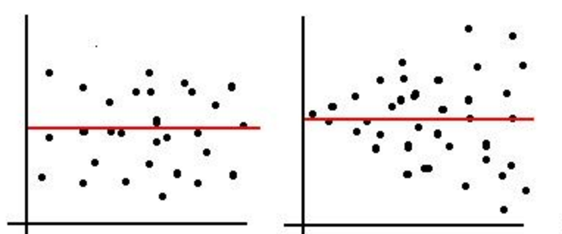
homoscedasticity
Homoscedasticity – Assumes that the variance of the residuals is the same, no matter the data point.
Estimates of coefficients might be
accurate, but error terms will not
be. Model also weighs larger
error terms with more weight.
Solution – May want to transform the data.

Slide 10
Other features of linear models
Interaction Terms – Sometime the effect of one predictor might change in the presence of another predictor.
Imagine you wanted to create a simple (unrealistic) model of visitors to your page, based the time of day (morning, afternoon, evening, night) and whether there was advertising during that period. You could write the equation:
Visitors = B0 + B1*time_of_day+B2*was_advertising

Slide 11
Other features of linear models
Visitors = B0 + B1*time_of_day+B2*was_ad
However, it is possible that advertising during the day has a different impact from advertising at night. Because of that, we may want to add an interaction term.
Visitors = B0 + B1*time_of_day + B2*was_ad + B3*time_of_day*was_ad

