Slide 1
DATA SCIENCE class x: naive bayes classification

Slide 2
agenda
Exit Tickets
Decision Tree Wrap-up
Bayes’ Theorem
Naïve Bayes
Workshop

Slide 3
Exit tickets
Dream final project
What do you do with features that are deemed unimportant by the tree
Decision tree seems less precise than a linear regression
Other packages? Scipy, nltk
Decision Tree at Venmo
What does cross validation do exactly?

Slide 4
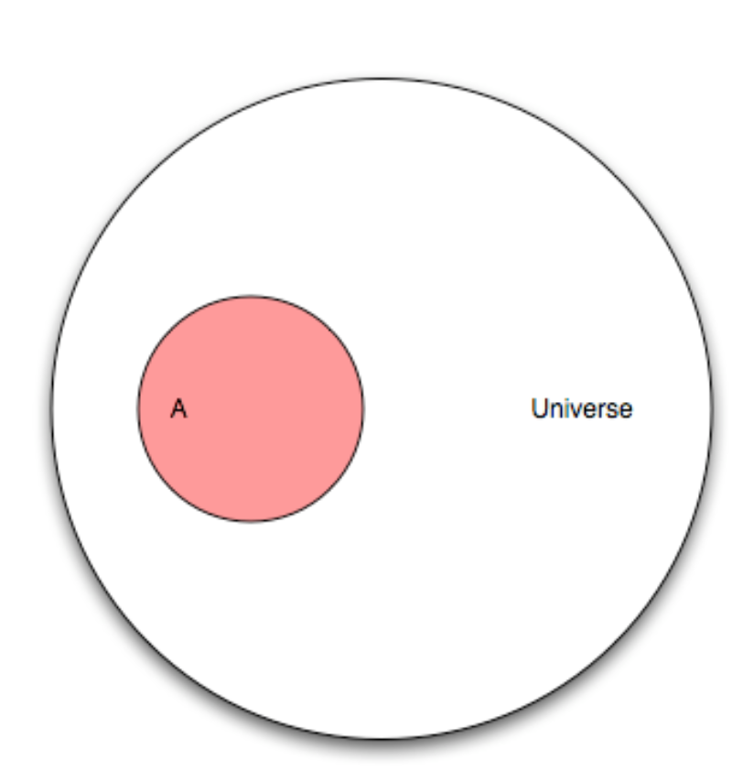
Naïve bayes classification
Universe – Set of all points.
A - One potential subset of the universe
A’ – Elements that don’t belong the subset of A

Slide 5
Naïve bayes classification
Let’s say our universe is a 100 person study. A are the people who tested positive for a disease, and it contains 25 people.
What is the probability of A?
|A| - Cardinality, or the # of elements
|A|/|U|

Slide 6
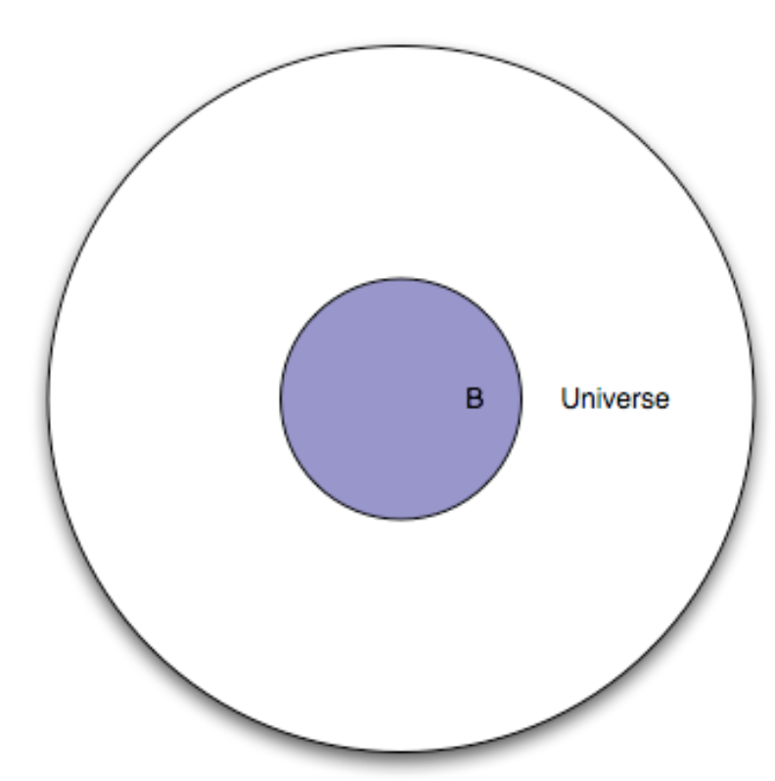
Naïve bayes classification
Let’s say we also tested people for disease, and B is the set of people who tested positive for it.
B’ – set of people who did not test positive for the disease

Slide 7
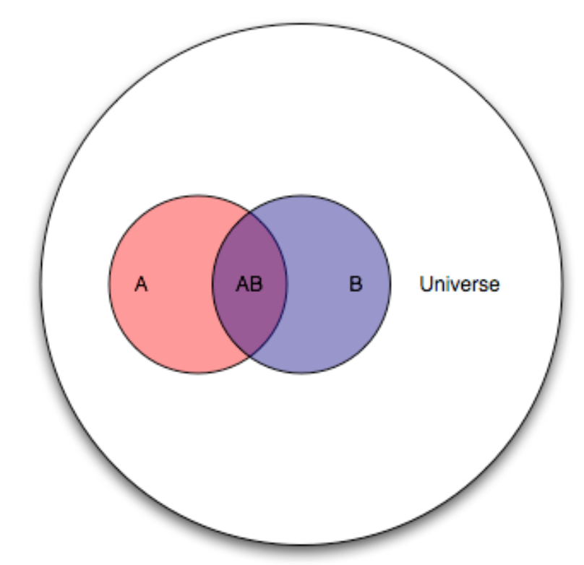
Naïve bayes classification
Since both sets of events occurred to the people in the universe, we can overlay them on top of each other.
What do the different segments mean?

Slide 8
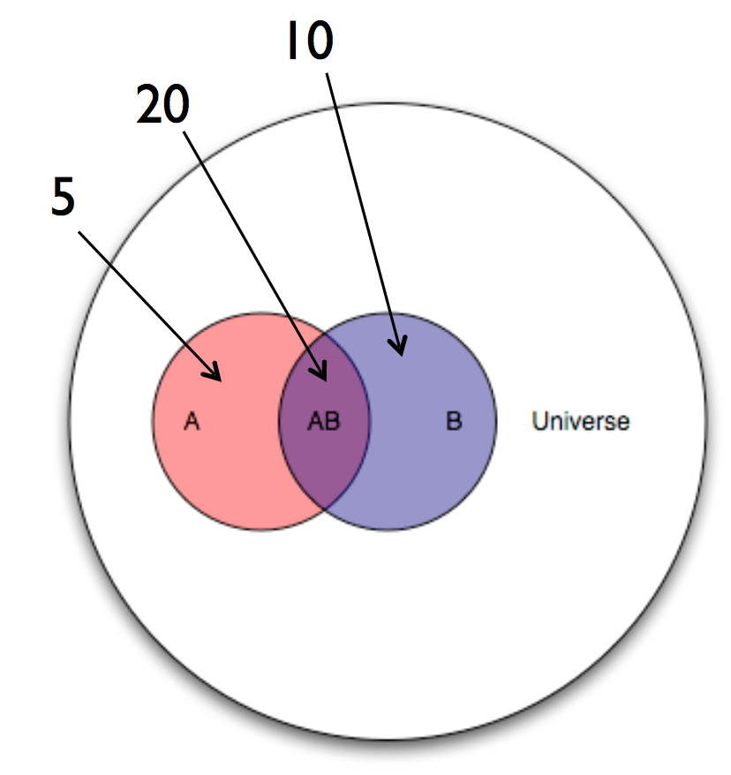
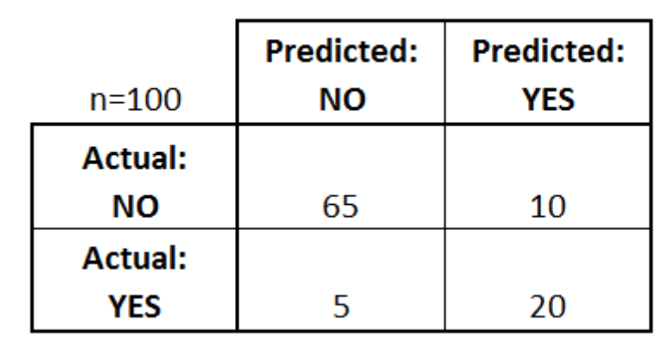
Naïve bayes classification
Now let’s put some numbers to it.
AB – known as the intersection of A and B
We can describe the results in a confusion matrix:

Slide 9
Naïve bayes classification
Questions:
What is the probability of developing cancer?
What is the probability of having cancer given a + test result?
Prob of a + test result given you have cancer?
Conditional Probability – Prob of one event given another. Written as
P(A|B) = P(AB)/P(B)

Slide 10
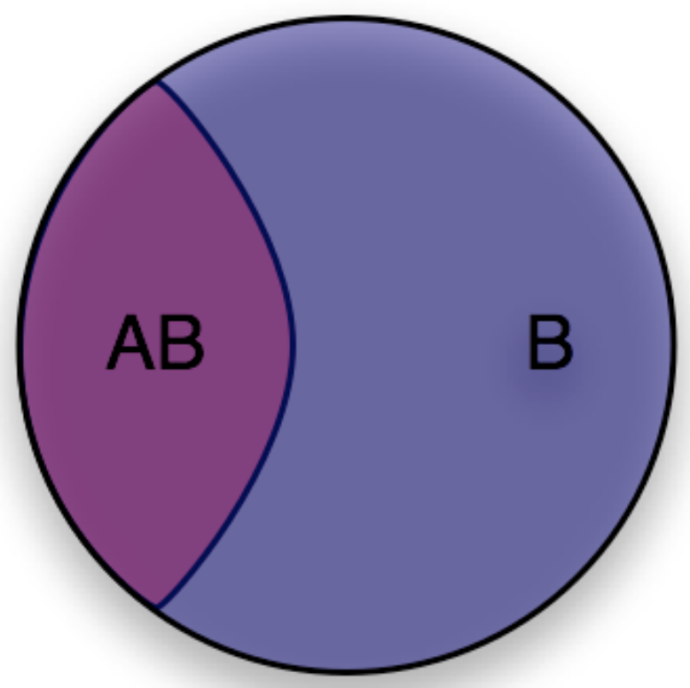
Naïve bayes classification
You can think of conditional probability as “changing the relevant universe.” P(A|B) is a way of saying “Given that my entire universe is now B, what is the probability of A?”

Slide 11
Bayes theorem
Reminder: P(A|B) = P(AB)/P(B)
Sometimes we don’t know P(AB). In this case, Bayes’ Theorem to the rescue!
PROOF:

Slide 12
Bayes theorem EXAMPLES
Example: We have 100 coins. 99 of them are fair coins, and 1 of them is a coin that always lands heads. Let’s say we picked a random coin and flipped it 10 times, and it was heads every time. What is the probability the coin was the unfair coin?

Slide 13
Bayes theorem EXAMPLES
Work in groups to answer these questions using Bayes’ Theorem.
Mike has 2 kids. We know at least one is a girl. What is the probability both are girls?
TB is a rare disease, 2/10,000 have it. If you get tested for TB and you have it, it comes by positive 99% of the time. If you don’t have TB and you get tested, it comes back negative 99% of the time. Given that you have come back + for TB, what is the chance that you have it?

Slide 14
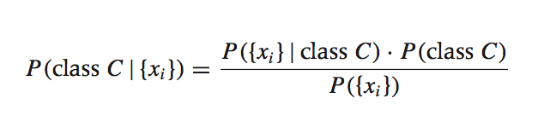
Naïve bayes classification
Remember that a data point X with n features can be broken down into x₁, …, x_{n}
Now suppose we have a dataset with features x₁, …, x_{n} and a class label C. What can we say about classification using Bayes’ theorem?
Bayes’ theorem can help us to determine the probability of an observation belonging to a class, given the data we observe.

Slide 15
Naïve bayes classification
This term is the prior probability of C. It represents the probability of an observation belonging to class C before the data is taken into account.

Slide 16
Naïve bayes classification
This term is the likelihood function. It represents the joint probability of observing features {x_{i}} given that the observation belongs to class C.

Slide 17
Naïve bayes classification
This term is the normalization constant. It doesn’t depend on C, and is generally ignored.

Slide 18
Naïve bayes classification
This term is the posterior probability of C. It represents the probability of an observation belonging to class C after the data is taken into account.
The idea of Bayesian inference, then, is to update our beliefs about the distribution of C using the data (“evidence”) at our disposal.

Slide 19
Naïve bayes classification
Let’s take a look at the likelihood, and see if we can interpret it:
This is asking us to calculate the probability that x₁, x₂, …, AND x_{n} happen, all at the same time! This might have never happened before.
For example, let’s say we are trying to classify people into Males & Female based on the first sentence of their OKCupid Profile. And you want to know:

Slide 20
Naïve bayes classification
It’s possible no one has said that exact sentence before, and our algorithm won’t know how to calculate the probability.

Slide 21
Naïve bayes classification
It’s possible no one has said that exact sentence before, and our algorithm won’t know how to calculate the probability.
Instead, we make a naïve assumption.
The Naïve assumption is that each of these words happened independently of each other. We then calculate
P(I was born to rock and roll|M) and P(I was born to rock and roll|F) and classify it as the class with the highest probability

Slide 22
Naïve bayes classification
Let’s go into more detail.
Sometimes it matters if a word occurred, and sometimes it matters how many times a word occurred. Depending on which you are interested in modeling, there are a couple of various approaches:
Multivariate Bernoulli – Recall, a Bernoulli distribution is one that predicts a models an individual coin flip with a 1 or 0. This is how we would model the presence or absence of a word
Multinomial Distribution – Recall that a Binomial models how many times something occurs. This is how we would model word counts

Slide 23
Multivariate bernoulli naïve bayes
Steps:
1. You need to vectorize all the words in all the documents, and convert each sentence into 1s and 0s.
 | THE | I | YOU | BORN | … | ROCK
I was born to rock rock | 0 | 1 | 0 | 1 | … | 1
You and I will be | 0 | 1 | 1 | 0 | 0 | 0

Slide 24
Multivariate bernoulli naïve bayes
Steps:
2. The algorithm needs to fit the data by calculating the probabilities relevant for each class. For example, it takes all the data corresponding to Males, and tries to calculate the probability of a word appearing. The probability is calculated as follows:
P(word_{i}|M) = 1 + # of documents with word_{i} in class M
2 + # of documents in class M
3. Plug the probabilities back into the likelihood function (details ommitted here) and choose the class with the highest probability

Slide 25
multinomial naïve bayes
Steps:
1. You need to vectorize all the words in all the documents, and convert each sentence into counts of each word
 | THE | I | YOU | BORN | … | ROCK
I was born to rock rock | 0 | 1 | 0 | 1 | … | 2
You and I will be | 0 | 1 | 1 | 0 | 0 | 0

Slide 26
Multinomial naïve bayes
Steps:
2. The algorithm needs to fit the data by calculating the probabilities relevant for each class. For example, it takes all the data corresponding to Males, and tries to calculate the probability of a word appearing. The probability is calculated as follows:
P(word_{i}|M) = 1 + # of times word_{i} appeared in class M
#unique_words + # total words in documents that belong to class M
3. Plug the probabilities back into the likelihood function (details omitted here) and choose the class with the highest probability

Slide 27
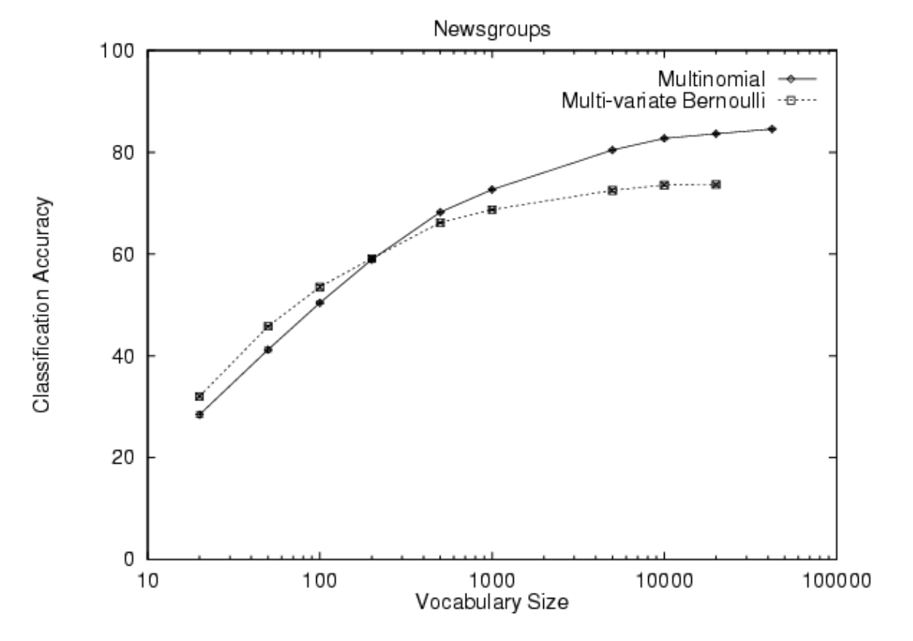
Multinomial vs multivariate bernoulli

Slide 28
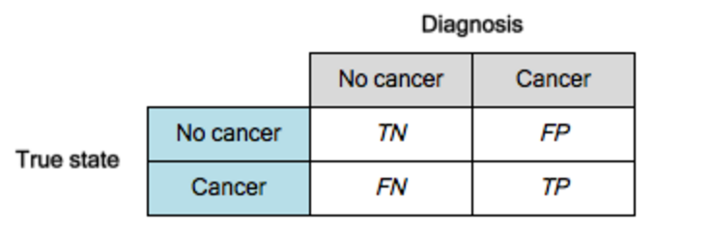
Classification evaluation metrics
A popular method of evaluating classification problems is looking at the F1 score., which varies from 0 to 1.
To understand it, let’s take a look a the chart below:

Slide 29
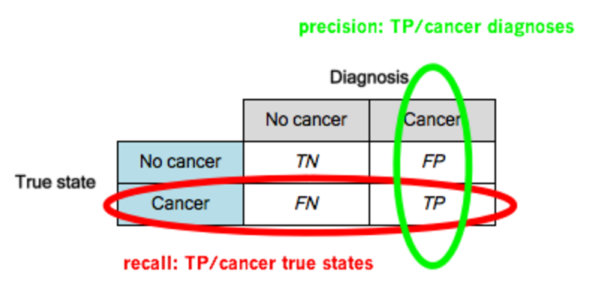
Classification evaluation metrics
A popular method of evaluating classification problems is looking at the F1 score.
To understand it, let’s take a look a the chart below:

Slide 30
Classification evaluation metrics
Precision can be defined as:
“What percent of the time that you said Yes to cancer, was it actually cancer?
Recall be can described as:
“What % of the cancers did you guess were actually cancer?

