Slide 1
DATA SCIENCE class Xv: natural language processing

Slide 2
agenda
Interview question
Exit ticket
Natural language processing
Natural Language Pipeline
Lab

Slide 3
Interview questions
What does a support vector machine do?
What is C in the support vector machine algorithm?
What is a kernel function?
What are Pipelines in sklearn?

Slide 4
Exit ticket questions
When should I use SVM?
When to use Pipelines in the real world?
Example when you used SVM and Pipelines?
Which type of kernel should we use?
Which classifier to try first?

Slide 5
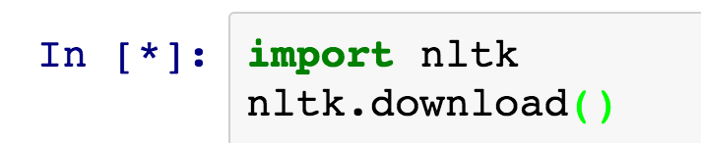
Installing nltk

Slide 6
Natural language processing
Natural language processing is the design and implementation of computational machinery that communicates with humans using natural language

Slide 7
Natural language processing
Common domains in NLP:
Machine translation – from one language to another
Message understanding systems (from newspapers, etc)
Front end for databases

Slide 8
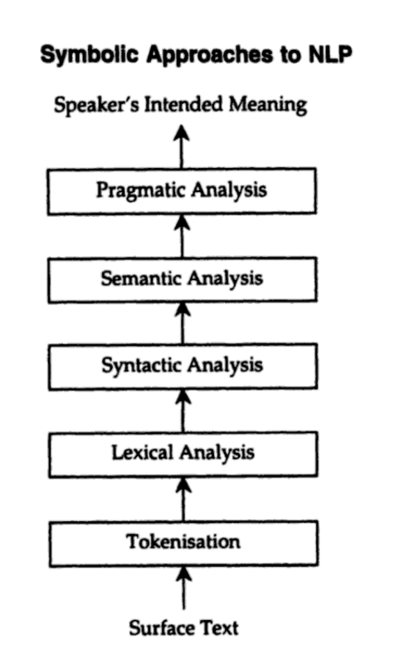
Natural language processing
Handbook on Natural Language Processing

Slide 9
Natural language processing - tokenization
Tokenization & Sentence Segmentation: This process involves splitting text into sentences, and then the sentences into individual words.
Difficulties:
Not all languages deliver words neatly delimited by spaces
What do with conjugations such as: I’m, they’re
How do you know when a sentence ends?
Corpus dependence

Slide 10
Natural language processing - tokenization
From Wall Street Journal (1988):
“Clairson International Corp. said it expects to report a net loss for its second quarter ended March 26 and doesn’t expect to meet analysts’ profit estimates of $3.9 to $4 million, or 76 cents a share to 79 cents a share, for its year ending Sept. 24.”
Couple of interesting features:
Use of periods
Use of apostrophes
How should we tokenize “76 cents a share”

Slide 11
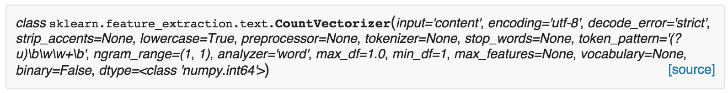
Natural language processing - tokenization
CountVectorizer()’s tokenizer defaults to a regular expression (?u)\b\w\w+\b which says find pairs of two or more word characters separated by non word characters.
This means it will:
Drop one letter words
Separate They’re -> (they) (re)

Slide 12
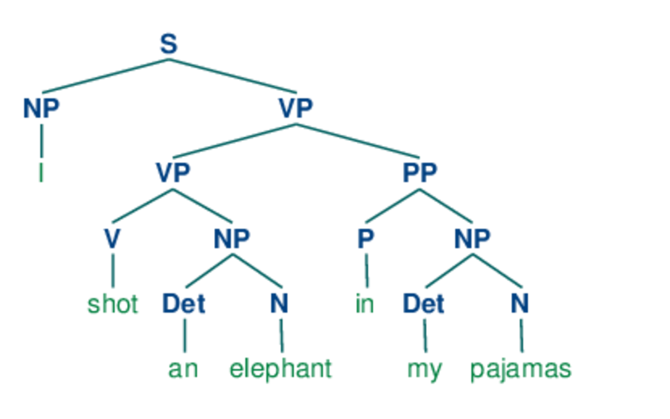
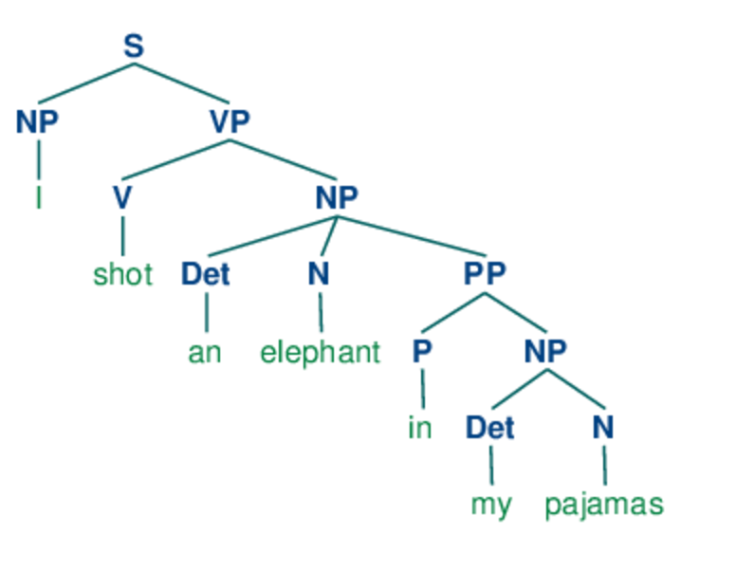
Natural language processing – syntactic analysis
I shot an elephant in my pajamas.

Slide 13
Natural language processing – Semantic analysis
Semantic Analysis: This involves understand the roles of the various words.
The thieves stole painting from the museum. They were subsequently sold.
The thieves stole painting from the museum. They were subsequently caught.
The thieves stole painting from the museum. They were subsequently found.

Slide 14
Natural language processing – for classification
Basic classification tasks – Grammatical Structure is not as important.
Tokenization – breaking up of stories into sentences, and sentences into words.
What do we now do with the words?

Slide 15
Natural language processing – for classification
Stemming and Lemmatization – Goal is to reduce inflectional forms and sometimes derivationally related forms of a word to a common base form.
Am, are, is -> be
Car, cars, car’s, cars’ -> car
Example:
The boy’s cars are different colors ->
The boy car be differ color

Slide 16
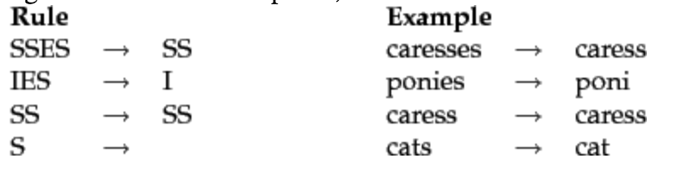
Natural language processing – for classification
Porter’s Stemmer – most common algorithm for stemming English

Slide 17
Natural language processing – stemming vs lemmatization
Stemming generally just cuts off the sends of words.
Lemmatizer (from nltk) – Doing things properly with the use of a vocabulary and morphological analysis of words
Stemmer: wolves -> wolv
Lemmatizer: wolves -> wolf

Slide 18
Natural language processing – n-grams
Tokenization breaks sentences up into individual words
N-grams – sequence of n consecutive items
Benefits: Simplicity, effective in modeling language

Slide 19
Natural language processing – tf-idf
Countvectorizer() counts the number of occurrences of every word. Some words may have really high counts (“and”, “the”, etc)
We may want to weigh lower the weight on some words that occur frequently, so we can use the TfidfVectorizer()
tf_{t,d}*idf_{t}
Idf_{t} = log(N/df_{t})

