Slide 1
Sparse Matrix Library
Xiaobai Jiang
Yuwei An
Shuting Zhang

Slide 2
Matrix API
Base Matrix(Virtual class)
print() // print the matrix data structure
show_matrix // print the matrix as general format
multiply // multiply with base matrix pointer or std::vector
add // add with base matrix pointer
subtract //subtract with base matrix pointer
transpose // return a new base matrix pointer with transpose data
getRows // get row number
getCols // get column number
set // set value at (i, j)
get // get value at (i, j)
Notes:
The solveLU function solves a linear system Ax = b using LU decomposition

Slide 3
Matrix Data Structure(derived from the Virtual class)
COO(Coordinate)
CSR(Compressed Sparse Row)
CSC: Compressed Sparse Column
Notes:
The solveLU function solves a linear system Ax = b using LU decomposition

Slide 4
Matrix Generator
Generate a sparse matrix as give data structure
BaseMatrix* generate_matrix(const std::string& format, int m, int n, int density)
BaseMatrix* generate_spd_matrix(const std::string& format, int n);
Generate a random sparse matrix
or Symmetric Positive Definite Matrix(SPD)
Notes:
The solveLU function solves a linear system Ax = b using LU decomposition

Slide 5
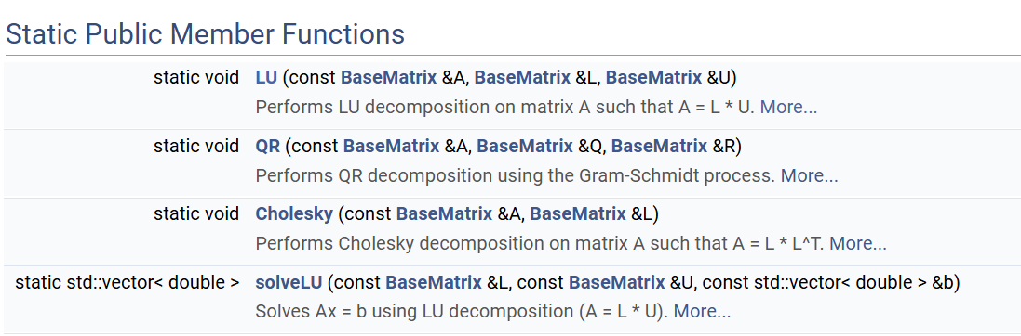
Matrix Decomposition
LU Decomposition
QR Decomposition
Cholesky Decomposition
Notes:
The solveLU function solves a linear system Ax = b using LU decomposition

Slide 6
What is Matrix Decomposition?
Definition: the process of breaking a matrix into a product of simpler matrices, which makes certain matrix computations more efficient
Applications
Solving linear systems
Eigenvalue problems
…

Slide 7
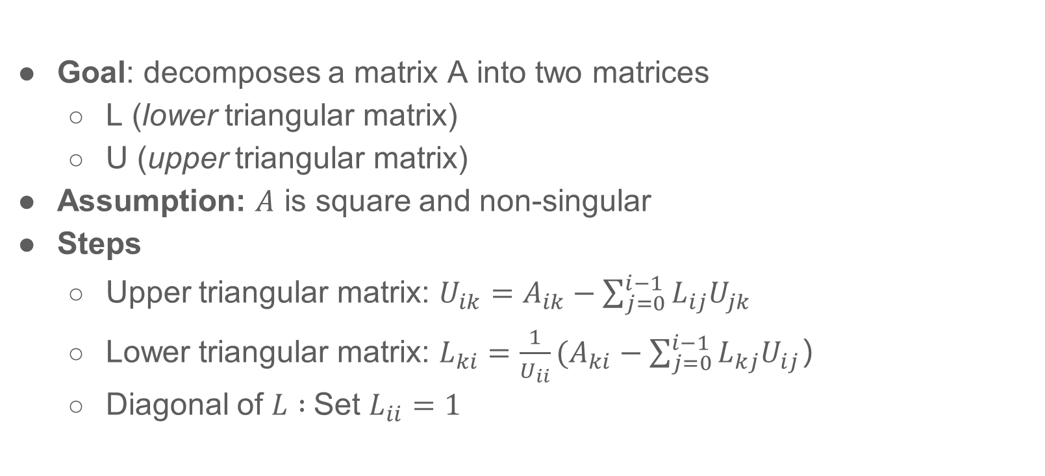

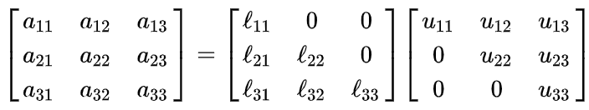
LU Decomposition: A = LU
Notes:
LU decomposition factors a square matrix A into a lower triangular matrix L and an upper triangular matrix U such that A = LU. My implementation uses the Doolittle method without pivoting.
To compute each value in U, we subtract the influence of previously computed L and U entries from the original matrix A.
To compute each value in L, we use the updated entries from A, subtract known contributions from L and U, and normalize by the diagonal element of U.

Slide 8
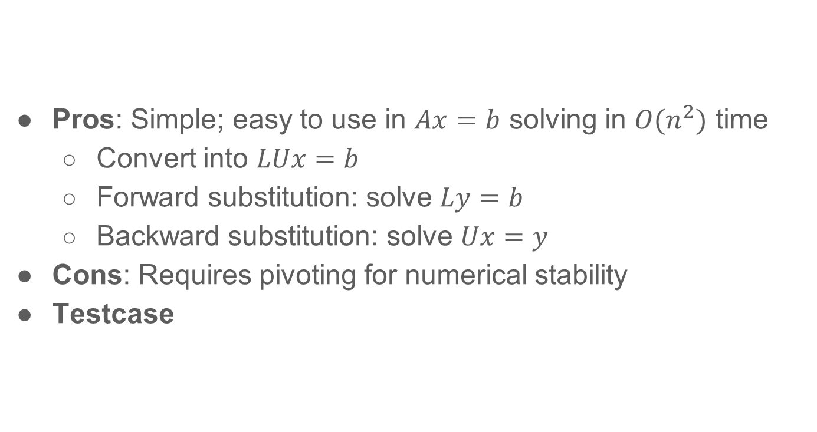
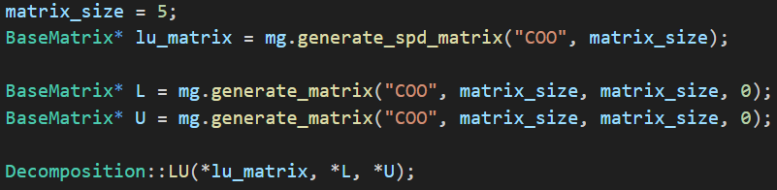
LU Decomposition

Slide 9
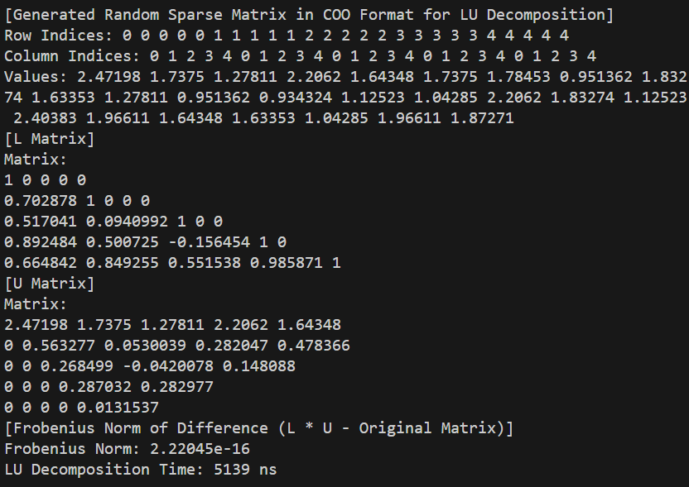

Slide 10
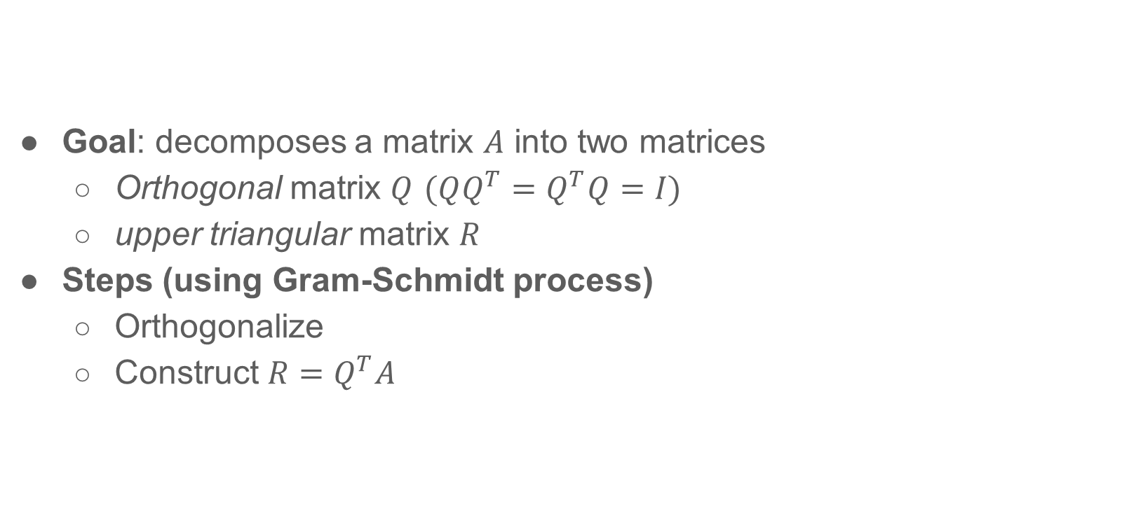

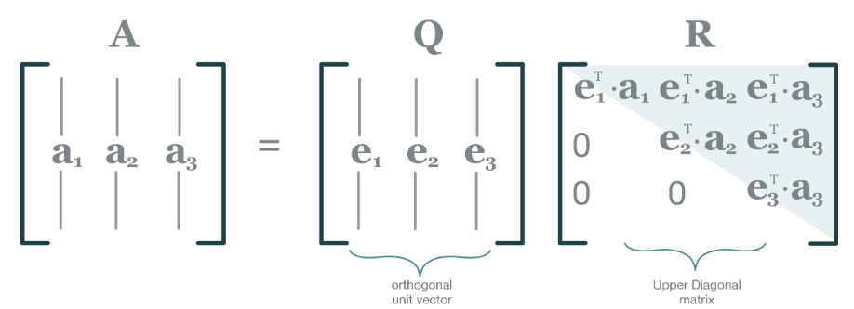



QR Decomposition: A = QR
1. First vector
2. Remove projections
3. Normalize
Notes:
An orthogonal matrix can be seen as a set of orthonormal basis vectors.
The first vector q1​ is just the normalized version of the first column a1
For each next column a_j​, we subtract its projections onto all the previous q_i​ vectors. This removes components in directions we've already handled. After removing these projections, we normalize the result to get q_j​.
This way, each new q_j​ is orthogonal to all the previous ones. R contains the coefficients that relate the original columns of A to the orthonormal basis in Q.

Slide 11
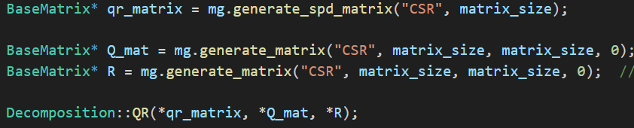
Pros: Numerically more stable than LU for least squares
Cons: Produces dense matrices even from sparse input
Testcase
QR Decomposition

Slide 12
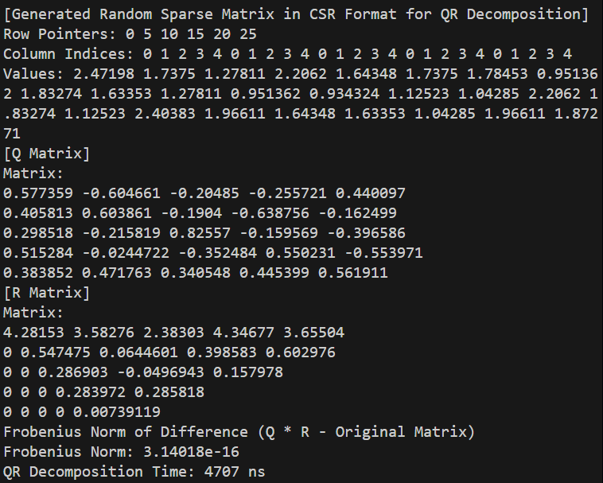

Slide 13

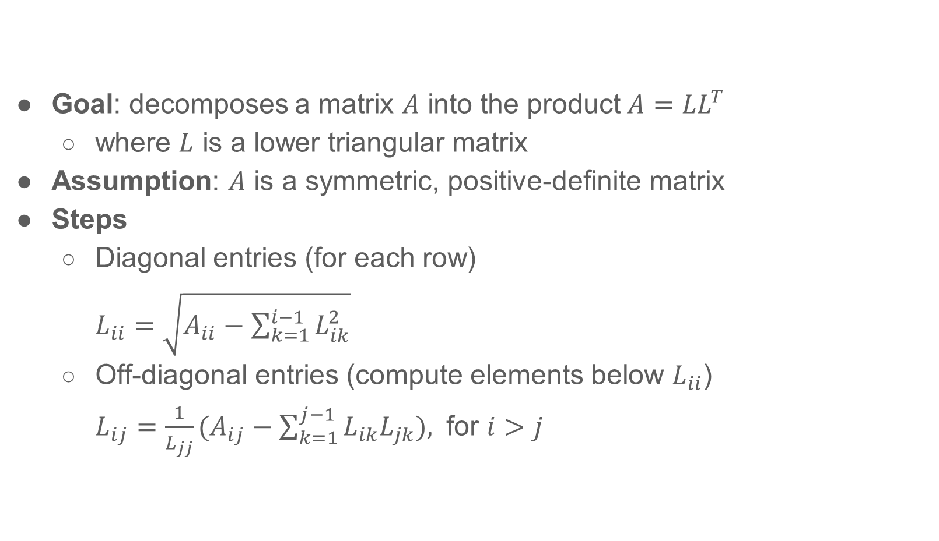
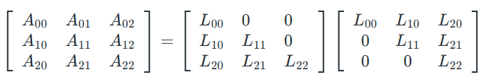
Notes:
We compute the matrix L one row at a time. For each diagonal element L_{ii}​, we subtract the sum of squares from the original value and take the square root. Then, for each element below the diagonal L_{ij} (where i > j), we subtract the dot product of previous entries and divide by L_{jj}

Slide 14
Cholesky Decomposition
Pros: Fast and memory efficient, numerically stable without pivoting
Cons: Only applies to symmetric, positive-definite matrices
Testcase

Slide 15
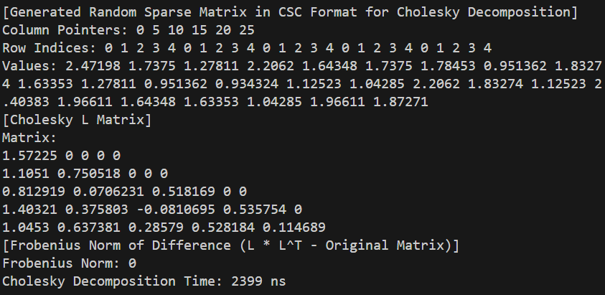

Slide 16
EigenSolver
Power Iteration
Inverse Iteration
QR Iteration
Lanczos Iteration
Arnoldi Iteration

Slide 17
Power Iteration
- Goal: Compute the largest magnitude eigenvalue and its eigenvector.
- Start with a random vector b₀.
- Iterate: bₖ₊₁ = A bₖ, then normalize.
- Stop when ||bₖ₊₁ - bₖ|| < tolerance.
- Estimate λ ≈ |Abₖ| / |bₖ| using Rayleigh quotient.
- Converges to the dominant eigenvalue (largest in magnitude).

Slide 18
Inverse Iteration Method
- Goal: Compute an eigenvalue close to a guess u (default: 0).
- Start with a random vector b₀.
- LU Decomposition: A = LU (precomputed).
- Iterate: Solve LU bₖ₊₁ = bₖ → bₖ₊₁ ≈ A⁻¹ bₖ.
if shift: bₖ₊₁ ≈ (A-u I)⁻¹ bₖ
- Normalize x and check || bₖ₊₁ - bₖ|| < tolerance.
- Estimate λ ≈ |Abₖ| / |bₖ| using Rayleigh quotient.
- Finds eigenvalue closest to initial guess (or 0 if no shift).

Slide 19
QR Iteration Method
Goal: compute all eigenvalues of a square matrix based on repeated QR decompositions and similarity transforms
Given a square matrix A₀ = A:
1. Compute QR decomposition: Aₖ = Qₖ Rₖ
2. Construct next iterate: Aₖ₊₁ = Rₖ Qₖ
3. Repeat until Aₖ becomes nearly diagonal or upper-triangular.

Slide 20
Why Does It Work?
- Aₖ₊₁ = Qₖᵀ Aₖ Qₖ is a similarity transform.
- Similar matrices share eigenvalues.
- As k → ∞, Aₖ → diagonal form.
- Diagonal elements ≈ eigenvalues.

Slide 21
Lanczos Iteration Method
- Goal: approximate eigenvalues of symmetric matrix A ∈ ℝⁿˣⁿ - Builds orthonormal basis Qₖ for Krylov subspace: Kₖ(A, q₀) = span{q₀, Aq₀, A²q₀, ..., Ak-1q₀} - Projects A to low-dim tridiagonal matrix: Tₖ = QₖT A Qₖ ∈ ℝᵏˣᵏ - A ≈ Qₖ Tₖ QₖT
-Eig(Tₖ) ≈ partial eig(A)
Efficient for large sparse symmetric matrices.

Slide 22

Lanczos Iteration Method
- Qₖ = [q₀, q₁, ..., qₖ₋₁] (n × k matrix with orthonormal cols) - Tₖ = tridiagonal matrix with αⱼ on diag, βⱼ on off-diag - Then: A ≈ Qₖ Tₖ QₖT ⇒ A Qₖ =Qₖ Tₖ
Main iteration: A qⱼ = βⱼ₋₁ qⱼ₋₁ + αⱼ qⱼ + βⱼ qⱼ₊₁ Implementation: w = A qⱼ - βⱼ₋₁ qⱼ₋₁ αⱼ = qⱼT w w ← w - αⱼ qⱼ βⱼ = ||w||, then qⱼ₊₁ = w / βⱼ Yields: tridiagonal T with α on diag, β on off-diagonals
Solve eigenvalue by QR Iteration on T

Slide 23
Arnoldi Iteration Method
- Goal: approximate eigenvalues of a general (non-symmetric) matrix A ∈ ℝⁿˣⁿ
- Builds orthonormal basis Qₖ for Krylov subspace: Kₖ(A, q₀) = span{q₀, Aq₀, A²q₀, ..., Ak-1q₀} - Projects A to low-dim upper Hessenberg matrix: Hₖ = QₖT A Qₖ ∈ ℝᵏˣᵏ - A ≈ Qₖ Hₖ QₖT - Eig(Hₖ) ≈ partial eig(A)

Slide 24
Arnoldi Iteration Method
- Qₖ = [q₀, q₁, ..., qₖ₋₁] (n × k matrix with orthonormal cols) - Hₖ = upper Hessenberg matrix (zero below subdiagonal) - Then: A ≈ Qₖ Hₖ QₖT ⇒ A Qₖ = Qₖ Hₖ
Main iteration: w = A qⱼ for i = 0 to j: hᵢⱼ = qᵢT w w ← w - hᵢⱼ qᵢ h_{i+1},j = ||w||, q_{i+1} = w / h_{i+1,j}
Solve eigenvalue by QR Iteration on H

Slide 25
Eigen Solver Summary
Method | Requirement | Return
Power Iteration | - | max magnitude eigen value
Inverse Iteration | invertible | eigen value close to a given value
QR Iteration | - | all eigen values
Lanczos Iteration | real symmetric | k eigen values
Arnoldi Iteration | - | k eigen values
Test case on Symmetric Positive Definite Matrix

Slide 26
Eigen Solver Test Case
Generate a spd matrix of 50, max_iter = 50, num_eigenvalues=10
[Testing Power Iteration]
Finish iteration in iter 6
Estimated dominant eigenvalue (Power Iteration): 792.356
Time taken: 0 ms
[Testing Inverse Iteration]
Finish iteration in iter 3
Estimated smallest eigenvalue (Inverse Iteration): 5.25056e-08
Time taken: 145 ms
[Testing QR Iteration]
[QR finished]
Time taken: 19478 ms
[QR eigenvalues (first 10)]
792.356 12.8577 11.9656 10.7768 9.66794 8.73318 8.41568 7.88438 7.15266 7.14658
[Testing Lanczos Iteration]
[Lanczos finished]
Time taken: 13 ms
[Lanczos eigenvalues (first 10)]
792.356 792.355 12.778 11.4522 9.91066 7.30989 4.48347 2.7544 1.04209 0.133806
[Testing Arnoldi Iteration]
[Arnoldi finished]
Time taken: 13 ms
[Arnoldi eigenvalues (first 10)]
792.356 12.8503 11.6539 10.3237 8.81115 6.48019 3.72511 2.11372 0.924672 0.123859

Slide 27
SVD(Singular Value Decomposition
Any real m×n matrix A can be factored as A=UΣVT Singular values σᵢ = √(eigenvalues of A Aᵀ) Orthonormal bases: columns of U span the column space; columns of V span the row space

Slide 28
Largest SVD Singular Value
Application: 1. In PCA, the top singular vector (associated with σ₁) defines the first principal component and the variance σ₁ stands the error distance
2. The adjacency matrix’s largest singular (or eigen) value relates to connectivity measures, community detection, and thresholds for diffusion processes.

Slide 29
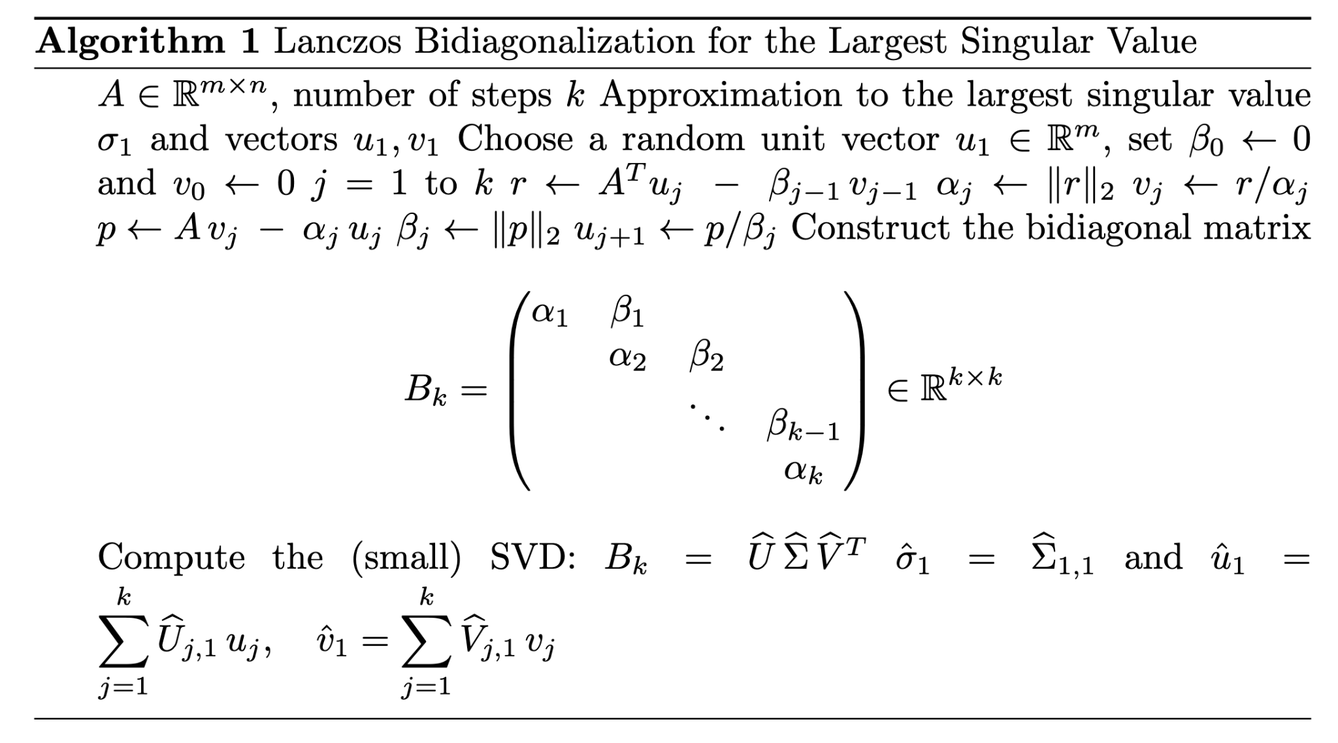
Lanczos Bidiagonalization
For sparse matrix, how to make full use of sparse matrix properties so to speed up the process of getting largest svd singular value
In application we apply the svd lib on the bidiagonalization matrix B

Slide 30
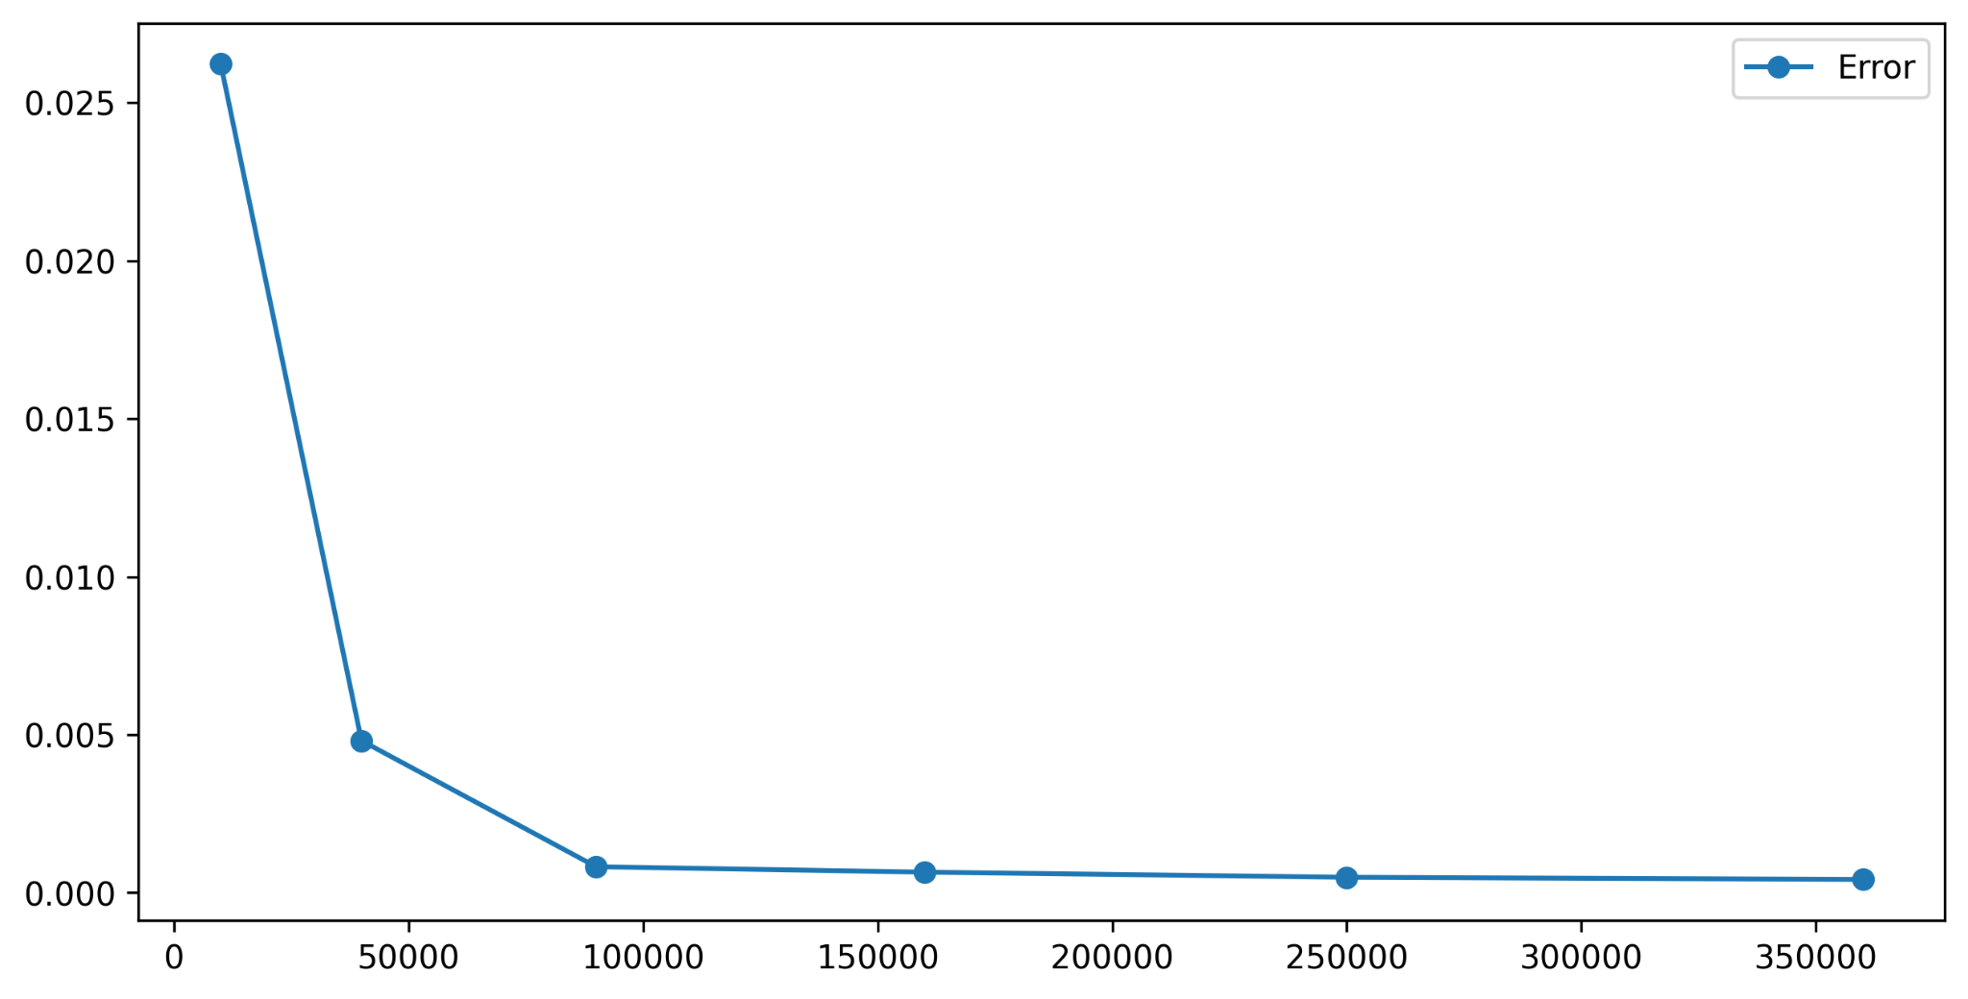
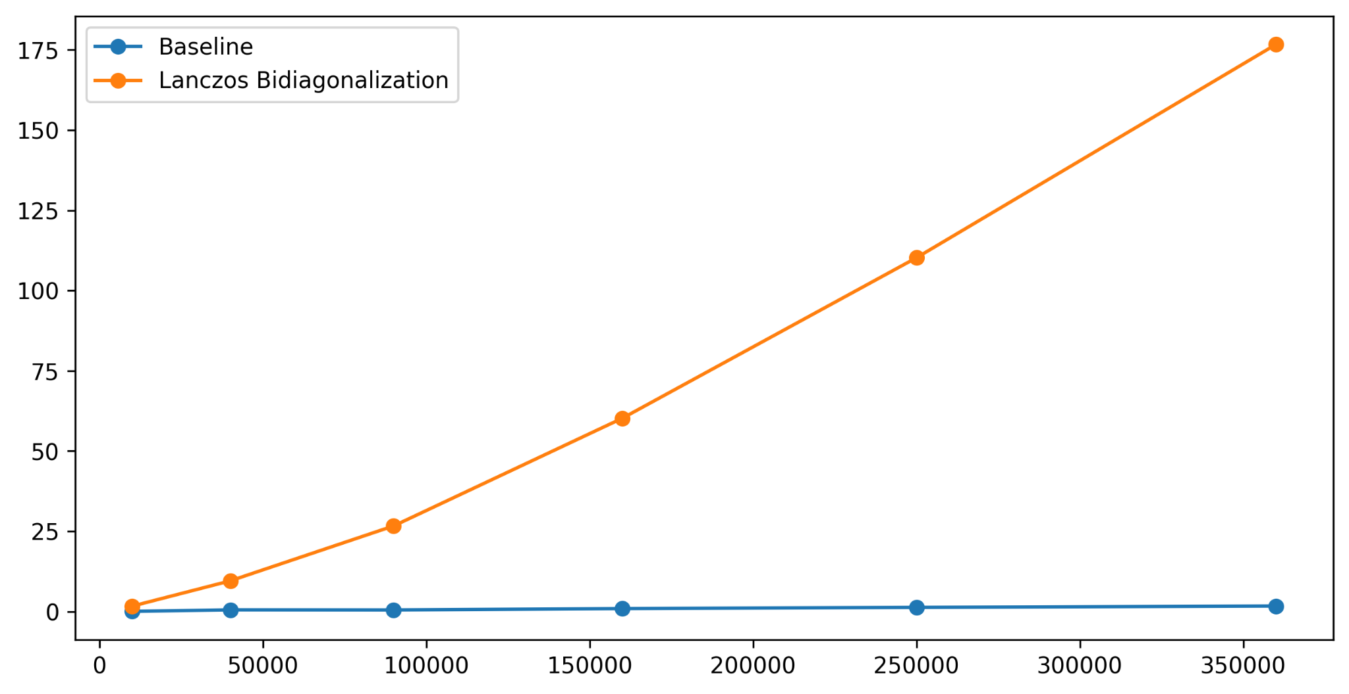
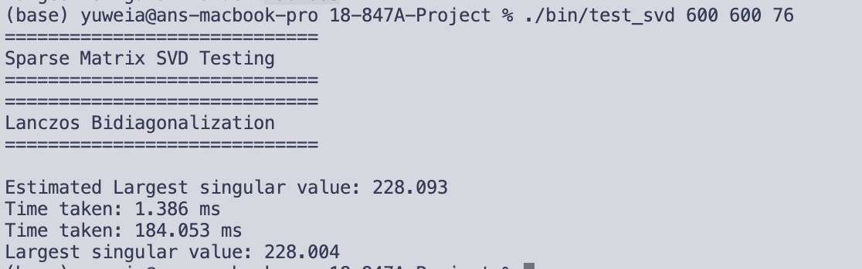
Performance
Faster and more acceptable with larger entries

