Slide 1
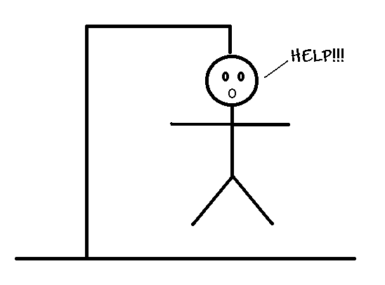
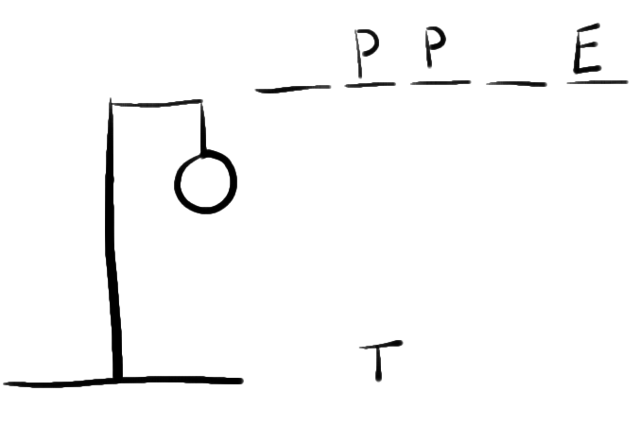
Hour of Code 2016
Python: Hangman
Whitworth University

Slide 2
Hangman – simple game
Display blanks for a word or phrase
Display a gallows
Ask the user for a letter
If the letter is in the phrase, fill in blank(s)
If the phrase is complete, the player wins
If not, add a body part to the gallows
Head, body, arm, arm, leg, leg
If there are no more body parts, the player loses

Slide 3
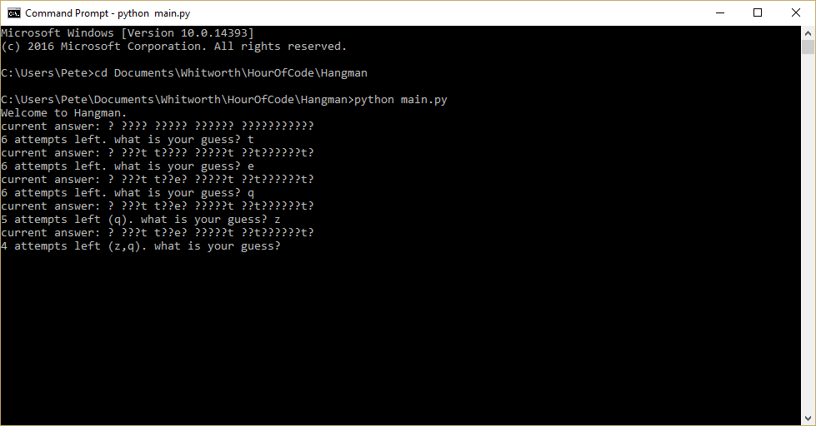
Hangman – Our version
Read phrases from a file
So that we can add easily
Choose a phrase at random
Show user prompt
Give the number of misses left, and the letters that were misses
If the letter is in the phrase, fill in blank(s)
If the phrase is complete, the player wins
If not, add a body part to the gallows
Head, body, arm, arm, leg, leg
If there are no more body parts, the player loses

Slide 4

Python primer
Python – simple scripting language
https://www.python.org/
Available on all platforms (Windows, Mac, Linux, …)
Many editors – scripts are just text files, so even Notepad is an editor
Executed using the Python program
We’re using Python 3.5

Slide 5
First Python program
Start any text editor
Notepad
Notepad++
Sublime
Visual Studio Code
IDLE
Type print(‘hello world’)
Save the file as hello.py
py is the extension generally for python scripts
Start command prompt
cd \your-directory
python hello.py

Slide 6
Getting user input
print outputs information
input gives the user a prompt, then gets their response
print('welcome to hangman')
response = input('what is your name? ')
print ('good luck in hangman, ' + response)

Slide 7
Giving code a name – Functions
Recall that our game has some tasks
Get a phrase for the user to guess
Prompt the user for a letter
Check to see if their guess is in the phrase
It’s useful to be able to separate each of these into their own code
We call those functions

Slide 8
Simple first function – get a phrase to use
def getphrase():
# we’ll read from a file later
return 'i love programming'
print('welcome to hangman')
response = input('what is your name? ')
print ('good luck in hangman, ' + response)
phrase = getphrase()
print('the phrase is: ' + phrase)

Slide 9
Need to keep track of the guess
? ???? ??????????
User inputs i
i ???? ????????i??
User inputs m
i ???? ??????mmi??
So let’s make guess start out with ? for all characters
The actual value for punctuation

Slide 10
Add in the variable to track the guess
...
phrase = getphrase()
print('the phrase is: ' + phrase)
guess = ''
for c in phrase:
if (c.isalpha()):
guess = guess + '?'
else:
guess = guess + c
print('current guess: ' + guess)

Slide 11
Let’s track the users guesses
We need to let the user guess until
They’ve figured out the answer
They’ve guessed 7 times
We need to also track letters that the user guesses that aren’t in the phrase
Python has a set which holds multiple values
Python supports way to repeat tasks: while
attempts = set()
while (phrase != guess and len(attempts) < 6):

Slide 12
And now we can prompt the user
Ask for a letter
If it’s in the phrase, change guess
If not, add it to attempts
attempts = set()
while len(attempts) < 6 and guess != phrase:
resp = input('what is your guess? ')
if phrase.find(resp) == -1:
attempts.add(resp)
else:
guess = updateguess(phrase, guess, resp)

Slide 13
updateguess?
def updateguess(phrase, guess, resp):
i = phrase.find(resp)
while (i != -1):
guess = guess[0:i] + resp + guess[i+1:]
i = phrase.find(resp, i+1)
return guess
...
attempts = set()
while len(attempts) < 6 and guess != phrase:
resp = input('what is your guess? ')
if phrase.find(resp) == -1:
attempts.add(resp)
else:
guess = updateguess(phrase, guess, resp)
print('current guess: ' + guess)

Slide 14
Now, let’s announce the winner
if guess == phrase:
print('Winner!')
else:
print('Sorry, you lose')

Slide 15
Finally, we need to read phrases from a file
Python allows us to read phrases from a file
We’ll also need to choose a random phrase from those phrases
Let’s update our getphrase()
def getphrase():
f = open('phrases.txt', 'r')
ps = f.readlines()
i = int(len(ps) * random.random())
f.close()
return ps[i]
it's like a trip to pluto
whitworth computer science rocks
little bobby tables
my code's compiling
i can show you, it's on github
i just typed import antigravity

Slide 16
And now we’re ready!

