Slide 1
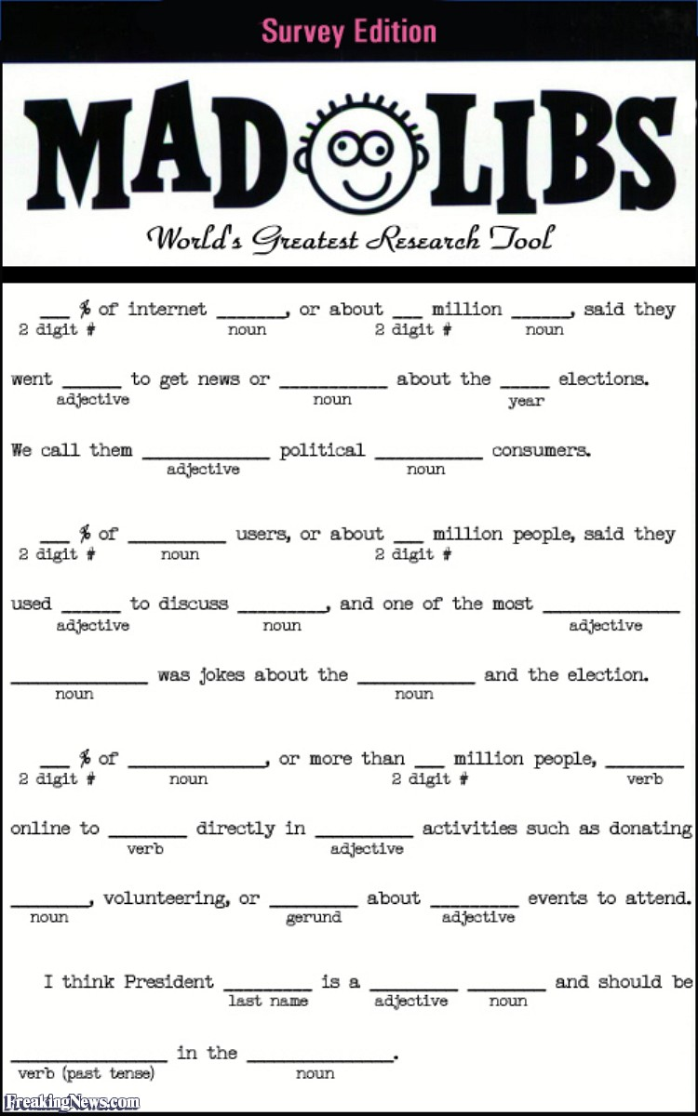
Hour of Code 2016
Python: Mad Libs
Whitworth University

Slide 2
Mad Libs – simple game
Get a story
Story will have <blanks> to fill in
Blanks are kinds of words/phrases
Ask the user to fill in each blank
Show the story with blanks filled in

Slide 3
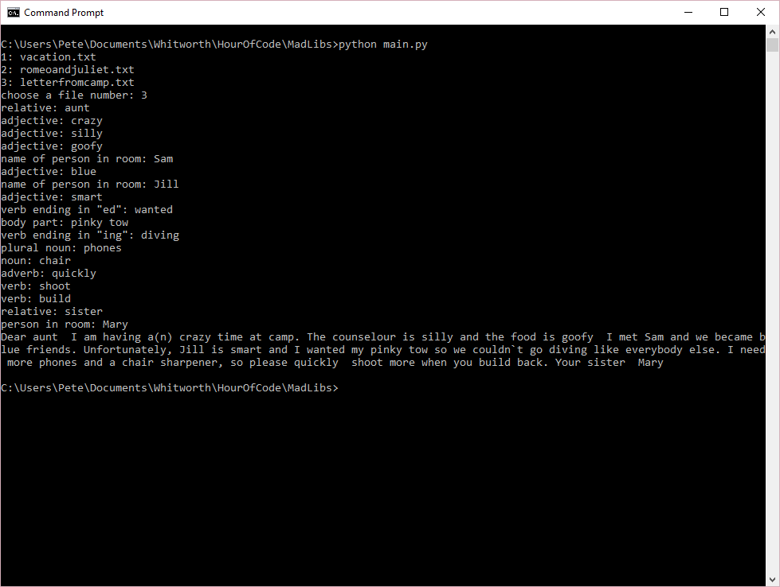
Hangman – Our version
Choose a story
List all kinds of phrases
Show final story

Slide 4

Python primer
Python – simple scripting language
https://www.python.org/
Available on all platforms (Windows, Mac, Linux, …)
Many editors – scripts are just text files, so even Notepad is an editor
Executed using the Python program
We’re using Python 3.5

Slide 5
First Python program
Start any text editor
Notepad
Notepad++
Sublime
Visual Studio Code
IDLE
Type print(‘hello world’)
Save the file as hello.py
py is the extension generally for python scripts
Start command prompt
cd \your-directory
python hello.py

Slide 6
Getting user input
print outputs information
input gives the user a prompt, then gets their response
print('welcome to mad libs')
name = input('what is your name? ')
print ('let\'s make a story, ' + name)

Slide 7
Giving code a name – Functions
Recall that our game has some tasks
Get a story to use
Prompt the user for kinds of phrases
Show the story
It’s useful to be able to separate each of these into their own code
We call those functions

Slide 8
Simple first function – get a story to use
def choosestory():
# we’ll read from a file later
return 'vacation.txt'
print('welcome to mad libs')
name = input('what is your name? ')
print ('let\'s make a story, ' + name)
storyfile = choosestory()
print('the story file is: ' + storyfile)

Slide 9
Read from files
We can store data in files, and Python allows us to read those files
We want to have story files, and we want a file that lists all possible files
A vacation is when you take a trip to some <adjective> place with your <adjective> family. Usually you go to some place that is near a/an <noun> or up on a/an <noun>. A good vacation place is one where you can ride <plural noun> or play <game> or go hunting for <plural noun>. I like to spend my time <verb ending in "ing"> or <verb ending in "ing">. When parents go on a vacation, they spend their time eating three <plural noun> a day, and fathers play golf, and mothers sit around <verb ending in "ing">. Last summer, my little brother fell in a/an <noun> and got poison <plant> all over his <part of the body>. My family is going to go to (the) <a place>, and I will practice <verb ending in "ing">. Parents need vacations more than kids because parents are always very <adjective> and because they have to work <number> hours every day all year making enough <plural noun> to pay for the vacation.
vacation.txt
romeoandjuliet.txt
letterfromcamp.txt

Slide 10
Let’s list story files from a file now
def choosestory():
madlibs = open('madlibs.txt')
files = madlibs.readlines()
for i, f in enumerate(files):
print(str(i+1) + ': ' + f.strip())
c = input('choose a file number: ')
madlibs.close()
return files[int(c)-1].strip()
print('welcome to mad libs')
name = input('what is your name? ')
print ('let\'s make a story, ' + name)
story = choosestory()
print('let\'s start ' + story)
vacation.txt
romeoandjuliet.txt
letterfromcamp.txt

Slide 11
Now let’s read the entire story, so we can find phrases
def readstory(s):
f = open(s)
story = f.read()
f.close()
return story
print('welcome to mad libs')
name = input('what is your name? ')
print ('let\'s make a story, ' + name)
storyname = choosestory()
print('let\'s start ' + storyname)
story = readstory(storyname)

Slide 12
Next step – find the phrases inside <XXX>
We’ve read the story, that has a lot of phrases inside <>’s
We want to find those
Regular Expressions find patterns inside strings
Check out http://www.regexpal.com/
A vacation is when you take a trip to some <adjective> place with your <adjective> family. Usually you go to some place that is near a/an <noun> or up on a/an <noun>. A good vacation place is one where you can ride <plural noun> or play <game> or go hunting for <plural noun>. I like to spend my time <verb ending in "ing"> or <verb ending in "ing">. When parents go on a vacation, they spend their time eating three <plural noun> a day, and fathers play golf, and mothers sit around <verb ending in "ing">. Last summer, my little brother fell in a/an <noun> and got poison <plant> all over his <part of the body>. My family is going to go to (the) <a place>, and I will practice <verb ending in "ing">. Parents need vacations more than kids because parents are always very <adjective> and because they have to work <number> hours every day all year making enough <plural noun> to pay for the vacation.

Slide 13
So let’s list the phrases
import re
def getresponses(story):
prog = re.compile('<.*?>')
m = prog.search(story)
while m != None:
print(m.string[m.start()+1:m.end()-1])
m = prog.search(story, m.end())
print('welcome to mad libs')
name = input('what is your name? ')
print ('let\'s make a story, ' + name)
storyname = choosestory()
print('let\'s start ' + storyname)
story = readstory(storyname)
getresponses(story)

Slide 14
Now we need to collect the user’s responses
Python as a list that can contain many values
We can change getresponses() to holds the user’s values
def getresponses(story):
rs = list()
prog = re.compile('<.*?>')
m = prog.search(story)
while m != None:
rs.append(input(m.string[m.start()+1:m.end()-1] + ': '))
m = prog.search(story, m.end())
return rs

Slide 15
Finally, we have all the inputs. Let’s show the story
def tellstory(story, responses):
prog = re.compile('<.*?>')
last = 0
r = 0
m = prog.search(story)
while m != None:
print(story[last:m.start()-1], end='')
print(' '+responses[r]+' ', end='')
r=r+1
last = m.end() + 1
m = prog.search(story, m.end())
print(story[last:])

Slide 16
And now we’re ready!

