Slide 1

Archinnection
Connecting architects with passion
By Dhruv, Gaurav Yadav, Aditya Kumar, Harsh
Under the supervision of
Internal: Mr. Deepak Kaushik External: Ms. Nikita
School of Engineering and Technology

Slide 2

Introduction
In today’s competitive architectural job market, securing a position can be very challenging. This presentation addresses these difficulties faced by architects in showcasing their work and experience effectively. We will guide them through creating a strong portfolio for sharing, highlighting key components and demonstrating various tools and platforms to help you stand out

Slide 3
Problem statement
1.
Intense Competition
The architecture field is highly competitive with numerous skilled professionals competing for limited positions. This makes it challenging for individual architects to differentiate themselves and grab the attention of employers.
2.
Limited Exposure
Architects mainly face difficulties in gaining exposure and reaching potential employers beyond their immediate network. Traditional job search methods are time consuming and may not give the desired results.
m

Slide 4
Our Objective
Refine Presentation
Our primary aim is to assist architects in refining their resume and portfolio presentation. This includes optimizing the layout, content and visual appeal of their professional documents.
Expand Reach
We aim to guide architects in expanding their reach by utilizing various online platforms and networking strategies.
Maximize Impact
Finally, we want to help architects to maximize the impacts of their portfolios. By showcasing their best work and experiences, architects can increase their chance of getting their dream job.

Slide 5
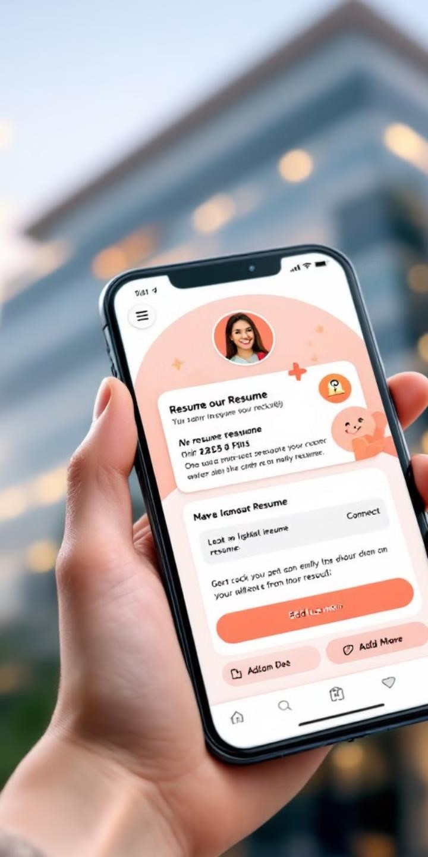
Creating a Resume-Sharing Platform
Centralized Hub
Targeted Exposure
A dedicated website where graduates can upload their resumes and portfolios.
The platform allows companies to access a curated talent pool.

Slide 6
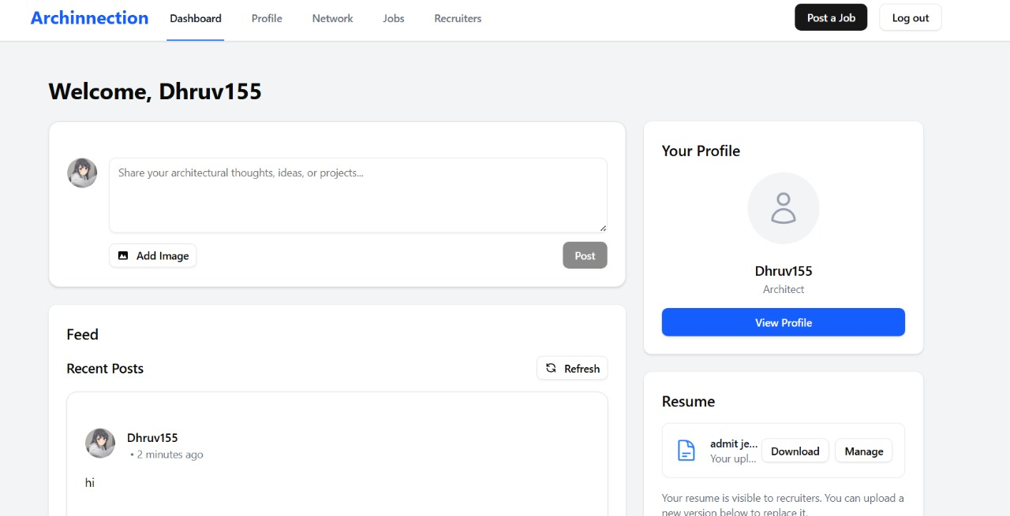
Key Features of the Website
1.
Easy Registration
Make an easy registration portal for architect graduates where they can just sign up using their basic information and upload their credentials like resumes or certificates.
2.
Advanced Search
Companies have options that they can filter candidates based on their location, experience and specialization.
3.
Portfolio Showcase
Graduates can present their design projects and skills through interactive portfolio that allows potential employers to explore the work and show creativity.

Slide 7



Benefits for Architecture Graduates
Increased Visibility
Graduates will have a broader reach and wider exposure to possible employers, therefore increasing the possibilities of jobs offers.
Networking Opportunities
Graduates have access to a community of fellow architects and industry professionals, providing networking, collaboration and knowledge sharing for career growth.
Career Advancement
Graduates are better off with more job opportunities for jobs and quicker entrance to work through increased visibility and networking with potential employers.

Slide 8
Methodology
User-Centric Design
1.
We conducted focused research with architects to build features that solve real-world pain points in their professional networking.
Next.js framework
We used Next.js to deliver fast-loading, SEO-optimized pages that scale efficiently as our platform and user base grow.
2.
Secure authentication
Implemented OAuth-based login with robust encryption to ensure user data is protected and access to the platform remains secure.
3.
Custom profiles
4.
Each user gets a visually-rich portfolio profile designed specifically for showcasing architectural projects, designs, and professional achievements.
Smart networking
5.
The platform recommends relevant architects, firms, or students based on user roles, interests, and activity to build valuable connections.

Slide 9

Future Works
1.Mobile App Development Build native iOS and Android apps to enhance accessibility and real-time engagement.
2. AI-Powered Project Matching Use AI to intelligently connect architects with relevant people, firms, and projects based on their portfolio and interests.
3. AR/VR Integration Allow immersive showcasing of architectural designs through augmented and virtual reality experiences.
4. Global Community Features Support international networking through multi-language support and region-specific content.

Slide 10
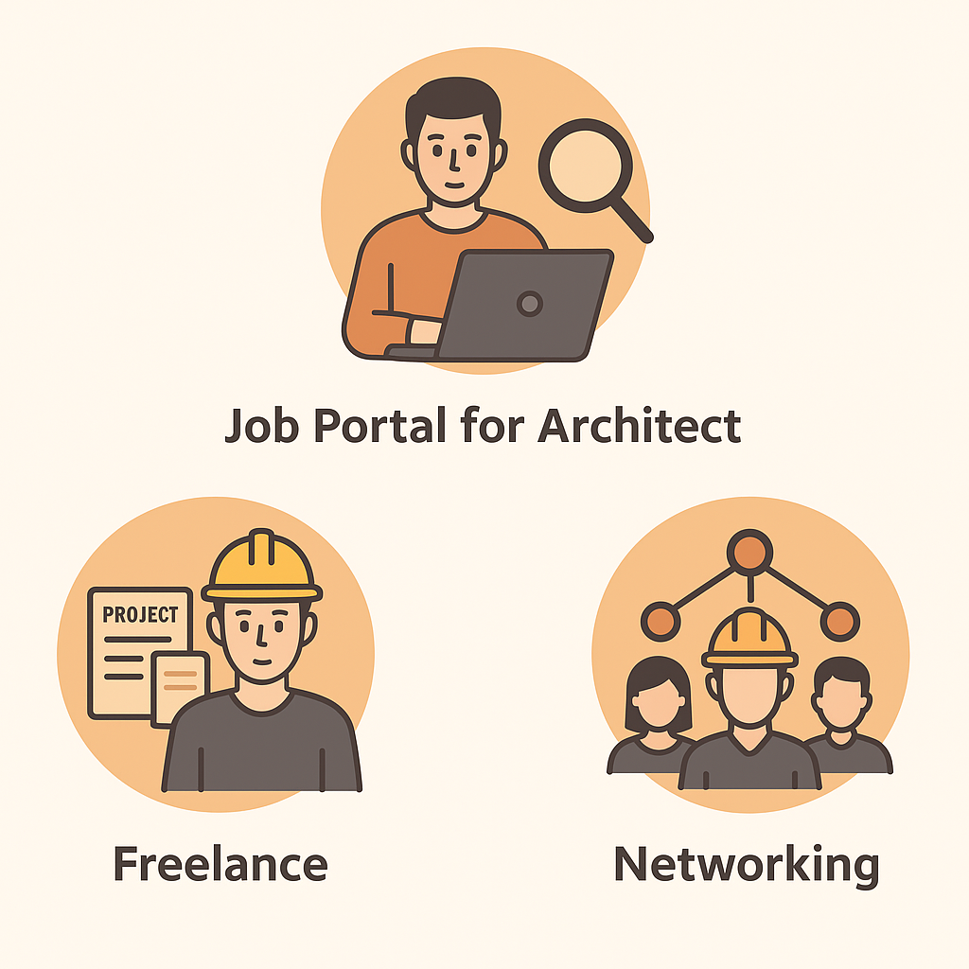
Applications
1.
Job Portal for Architect
This website helps architect to find job opportunities based on their skills
2.
Freelance
This website enables architects to find freelance or project based work
3.
Networking
This website makes collaboration or knowledge sharing between architects, designers and firms easier

Slide 11
Conclusion
The website aims to bridge the gap between talent and opportunity in the architectural field by providing a space for graduates to present their skills and connecting them with employers. It also provides enhancing opportunities for jobs and networking through facilities such as interactive portfolios and filtering options for employers. Next step include the design of a user-friendly and visually and engaging website, accompanied by a focused marketing strategy aimed at both graduates and employers for maximum reach and engagement

Slide 12
THANK YOU

