Slide 1
Trustworthy Sharing of Agricultural Data: Verifying a File’s Origin and Transformation History
Younghoo Cho
Department of Agricultural and Biological Engineering
Committee Members
Dr. Ziwen Yu (Chair) Dr. Yiannis Ampatzidis (Co-chair)
Dr. Sabine Grunwald Dr. Willingthon Pavan Dr. Ziynet Boz Dr. Kiley Graim
Ph.D. Dissertation Defense · July 1, 2026
Notes:
Good morning, everyone, and thank you for being here. My name is Younghoo Cho, and today I am defending my dissertation, Trustworthy Sharing of Agricultural Data: Verifying a File's Origin and Transformation History. I want to thank my advisor, Dr. Yu, my co-advisor, Dr. Ampatzidis, and the rest of my committee for their guidance throughout this work. Let me begin.

Slide 2
Overview
1
2
3
4
5
The trust problem
Verification and traceability
Transformation
Demonstration
Status and directions
Shared data cannot be trusted.
A data user confirms a file’s origin and traces where it has been.
A data user traces a changed file back to its declared sources.
All three functions run on one carbon credit, end to end.
What the platform establishes, and what comes next.
Notes:
We often hear about trust issues in agriculture, and many studies have proposed solutions for different situations. However, these efforts usually address individual cases without first defining what the trust problem actually is or identifying its underlying cause.
In this dissertation, I studied trust from the perspective of agricultural data sharing. I ask two questions: Why can't shared agricultural data always be trusted? And why is agriculture a more challenging environment for trustworthy data sharing than other sectors that have already addressed similar problems?
Through this literature review, I found that the core challenge is an infrastructure problem. To address it, I developed three infrastructure components. Chapter 3 introduces the first two components, Chapter 4 develops the third, and Chapter 5 integrates all three into a unified platform and demonstrates it through an end-to-end agricultural carbon credit scenario.
Finally, I'll discuss what this platform establishes and, just as importantly, what it is intentionally not designed to establish.

Slide 3
The trust problem in agricultural data sharing
The trust problem in agricultural data sharing.
We cannot watch the food grow, so we read the label.
The label is a record of what was done, and by whom.
We trust the food only if we trust the record.
We trust the record only if we know where it came from.
In agriculture, that record is data, passed along a chain of organizations.
Notes:
Let me start with a simple situation. We go to the store, and we want to buy organic. But how do we actually know it is organic? We cannot see how it was grown. So we check the label. And the label is really a record, a record of what was done to that food, by whom.
So here is the point. We do not trust the food directly. We trust the record behind it. And we can only trust that record if we know where it came from.
Now, in agriculture, that record is data, and it does not come from one place. It is built and passed along a whole chain of organizations. So the question is simple: what happens to that data once it leaves the farm?

Slide 4
Sharing leaves no record
Source
? ? ?
Data user
must act on the result it holds
the path in between is out of sight
A data passes through several organizations before it reaches the data user.
Some sharing steps are recorded.
Many are not, because no one is required to record them.
One missing step is enough to break the trail.
Then there is no way to tell where the data came from.
Notes:
Data moves from one organization to the next, on its way to you. Some of these steps do get recorded. But here is the real problem. Recording is not required in agriculture. No one is forced to do it. So some steps get logged, and some do not. And the moment one step is missing, there is no way to tell where the file came from. We are left with missing records, and no way to check the origin.

Slide 5
How trust works when participation is required
Regulator
Organization A
certified ✓
Organization B
certified ✓
Organization C
certified ✓
Healthcare and finance faced the same problem and closed it with four conditions.
Participation. Every organization that handles the data takes part, by mandate.
Coverage. The rules reach every step, from start to end, with no gaps.
Standards. Everyone sends data the same agreed way, so the records line up.
Infrastructure. Every record sits on one shared platform.
Notes:
Healthcare and finance faced the same data sharing trust problem, and they standardized data sharing to see the entire lifecycle. Where participation is required, trust is built on four things. Participation: every organization that touches the data must take part, by mandate. Coverage: the rules reach every step, from the very start to the very end, with no gaps. Standards: everyone sends data the same agreed way, so the records line up. And infrastructure: every record sits on one shared system. When all four of these hold at once, you can trust the data, because the system around it is closed and complete.

Slide 6
Why agriculture is different
 | Healthcare & Finance | Agriculture
Participation | Required | Voluntary
Coverage | Full | Partial
Standards | Shared | Fragmented
Infrastructure | Shared | None
Participation is voluntary, and the other three difficult with it.
Notes:
However, in agriculture, that first one is exactly the one that is missing. Participation is voluntary, and once it is, the other three break with it. Coverage becomes partial, because organizations can stay out. A farmer who does not want to share, or a small provider in the middle of the chain, simply does not join, and that step goes dark. Standards become fragmented, because no shared rule forces everyone to record data the same way. And there is no common infrastructure: each company keeps its data in its own system, its own cloud or database, with nothing linking them into one shared record. So the approaches that work so well in those other sectors do not transfer.

Slide 7
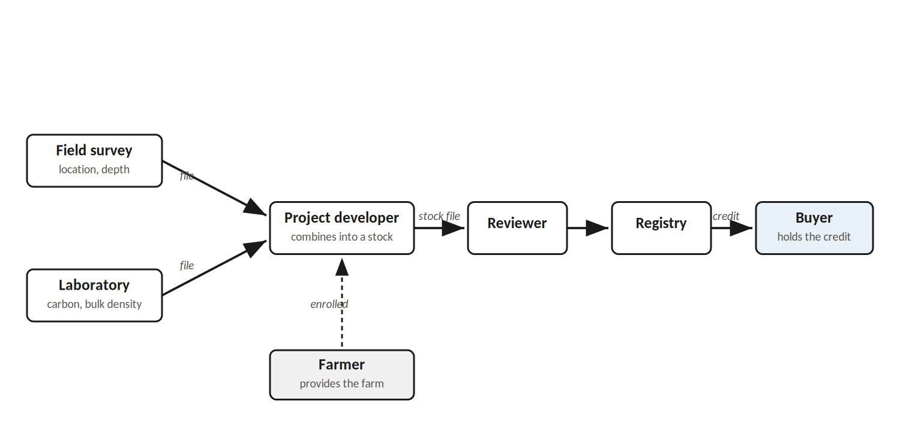
The agricultural carbon market
Companies buy carbon credits to claim net zero, and the money flows back to farmers.
The carbon market is also voluntary, so the data behind each credit cannot be standardized.
The same farm activity can yield a different credit, depending on who measures it and how.
Buyers cannot see how the credits were produced, and cannot verify what each credit is worth.
A credit that removed no carbon can still be sold as real. That risk is greenwashing.
Notes:
We see the same data sharing trust problem in the agricultural carbon market. Big companies buy carbon credits to claim net zero, and the money flows back to farmers for sustainable practices. On paper, it sounds ideal.
But this market is voluntary, so there is no single required method for collecting the field data or calculating the carbon reduction. Every project developer collects and computes it their own way. The same farm activity can produce a different credit, depending on who measures it, what data they collect, and what method they use to calculate.
The farmer gets paid, but cannot tell if the amount is right. And the buyer pays for a credit whose value rests entirely on trusting how that data was produced, data the buyer never sees. So a credit that reflects no real carbon reduction can still be sold as a real one, and that risk, of paying for credits that are not what they claim, is what we call greenwashing.

Slide 8
The cost of lost trust
REDD+ projects were credited for reductions they did not deliver.
Buyers lost trust, and the market decreased by 62% between 2022 and 2023.
The failure was not the carbon market.
What was missing was an infrastructure for transparent data sharing under voluntary participation.
West et al. 2023 · Forest Trends 2024
Notes:
The agricultural carbon market already shows this problem. Take REDD+, one of the largest carbon credit programs. Independent reviews found its projects were credited for reductions they never delivered. Buyers lost trust and left, and the voluntary carbon market decreased by sixty-two percent between 2022 and 2023.
But the lesson is not that the carbon market failed, or that voluntary participation failed. We cannot change that agriculture is voluntary, and voluntary participation will always bring many different methods and no single standard. That diversity is not the problem. The problem is that there was no infrastructure to make voluntary data sharing transparent. This is not only the carbon market. It is the basic condition across agriculture. So the real question is this: how do we make data sharing transparent while participation stays voluntary?

Slide 9
Making the transparent data sharing
The goal is the same one healthcare and finance reached: user can follow the full life of the data.
But the base is different. No fixed format, no fixed records, no single authority.
Instead, every sharing step is written to one shared record that any user can read.
The record has no gaps: where the data came from, how it changed, where it went.
Notes:
So we still need a way to make data sharing transparent, and we can, even under voluntary participation. The goal is the same one healthcare and finance reached: any user can follow the full lifecycle of the data. But we reach it on a different base. We do not fix the data format, we do not fix how records are kept, and we do not rely on a single authority. Instead, every step is recorded on one shared record that any user can read. So the records has no gaps between data sharing

Slide 10
Three functions for trust under voluntary participation
The reviewed work points to three functions for trust.
Verification. Confirm where the data came from.
Traceability. Follow where the data has been.
Transformation. Trace changed data back to its sources.
And the based on voluntary participation.
Notes:
Transparent data sharing needs three functions.
The first is verification: confirm where the data came from, so the user can see its origin. The second is traceability: follow where data has been, across every organization that handled it. And the third is transformation: when data is changed into something new, trace it back to the data it was made from.
And the based on voluntary participation.

Slide 11
Why a permissioned blockchain
Participation is voluntary, so trust cannot rely on any authority. It must come from the record.
Distributed ledger. Every organization keeps the same copy. (no single authority needed)
Immutable record. A committed record cannot be changed. (records stay reliable to verify and trace)
Identity (ID). Each record names the organization that acted. (who acted is known)
Permissioned. Joining is voluntary, but members are not anonymous. (known identity under voluntary participation)
Known identity carries verification, traceability, and transformation together.
§ 3.3.2 · Androulaki et al. 2018
Notes:
A permissioned blockchain gives the record four features that make this possible.
First, it is a distributed ledger, so every organization keeps the same copy, and no single one holds the truth alone. No single authority is needed. Second, it is immutable, so a committed record cannot be changed afterward, which keeps records reliable for verification and transformation. Third, it carries identity, so each record names the organization that acted, which is what makes tracing possible.
And fourth, it is permissioned, which is the key one for agriculture. To see why, compare the alternatives. A private blockchain runs under a single authority, which does not fit voluntary participation. A public blockchain lets anyone join but keeps them anonymous, so it cannot confirm who the data came from. A permissioned blockchain sits in between: joining stays open and voluntary, but every member is known. So anyone can take part, and we still know where each piece of data came from and who handled it. That is what keeps the sharing transparent.

Slide 12
Research Questions
Challenge
Hypothesis
Chapter
There is no evidence to locate where a file came from, because sharing records are not logged.
A tailored architecture and ID schema on blockchain can realize the basic transparency functions.
Chapter 3
Verification and traceability
Once a file is transformed into a different format, there is no evidence of its original status.
Modifying the ID schema can record and trace the transformation.
Chapter 4
Transformation
A platform is needed to solve a real trust issue.
The architecture and ID schema can build a platform for transparent data sharing in a real case.
Chapter 5
DEMETER
Notes:
That sets up the three research questions, one for each chapter. The first challenge is there is no evidence to locate where a file came from, because the sharing is never logged. The hypothesis is that a tailored architecture and ID schema on a blockchain can deliver the basic transparency functions. That is Chapter 3, verification and traceability.
The second challenge goes one level deeper. Once a file is transformed into a different format, there is no evidence of its original status at all. The hypothesis is that modifying the ID schema can record and trace that transformation. That is Chapter 4. And the third question is a platform is needed to solve a real trust issue, DEMETER, in Chapter 5.

Slide 13
Fundamental basis and restrictions
Institutional basis
Participation is voluntary.
Any user can join the platform.
Trust comes from the record, not from a single authority.
The platform covers the simplest case: data moves from one organization to the next.
Technical basis
The unit of sharing is the file.
The platform shares one file.
Notes:
Before the chapters, I want to set two ground rules.
The first is institutional: participation is voluntary. This means three things. Anyone can join, and every member is known. Trust comes from the record, not from a single authority. And each organization sends data its own way. So the platform covers the simplest kind of data sharing: data moves from one organization to the next.
The second is technical: the unit of sharing is the file. The platform shares one file at a time, each one a complete file that does not change after it is shared.

Slide 14
Contributions
1 · Conceptual reframe
Trust is enhanced by a transparent data sharing mechanism, supported by verification, traceability, and transformation.
2 · Chapter 3
A data user confirms an unchanged file’s origin and recovers its transfer path.
3 · Chapter 4
A data user traces a changed file back to its declared sources.
4 · Chapter 5 · DEMETER
The three funcitons are integrated on one shared record and demonstrated on real data.
§ 1.3 · § 6.2
Notes:
Here is what this dissertation contributes.
First, a conceptual reframe: trust is enhanced by a transparent data sharing mechanism, supported by verification, traceability, and transformation.
Second, from Chapter 3, a data user confirms an unchanged file's origin and recovers its transfer path.
Third, from Chapter 4, a data user traces a changed file back to its declared sources.
And fourth, from Chapter 5, the three are integrated on one shared record, and demonstrated on real data. That platform is DEMETER.

Slide 15
Chapter 3
Realizing Verification and Traceability Functions
Notes:
Let me start with Chapter 3, which realizes the first two functions, verification and traceability.

Slide 16
Architecture
Two kinds of ID realize the two functions.
ID schema
File ID. Identifies each file, for verification.
Record. Logs each transfer with the organization, with the time, for traceability.
File ID
A File ID is the SHA-256 hash of the file’s full content, written as 64 hex characters.
Any user can read the File ID and compare it. One changed character gives a different ID.
The file never leaves the organization that holds it. Only the File ID and the records are shared.
§ 3.3.4
Notes:
The architecture rests on two kinds of ID, one for each function. The File ID identifies each file, for verification. The record logs each transfer, for traceability. Two IDs, two functions.
The File ID is the key piece. It is a fingerprint of the file's content. Computed straight from the file itself, so if even one character changes, the ID comes out completely different. That is what makes verification work.
And one more thing, the privacy property. The file never leaves the organization that holds it. Only the File ID and the records are shared. So even organizations that compete can verify each other, without ever exposing their data.

Slide 17
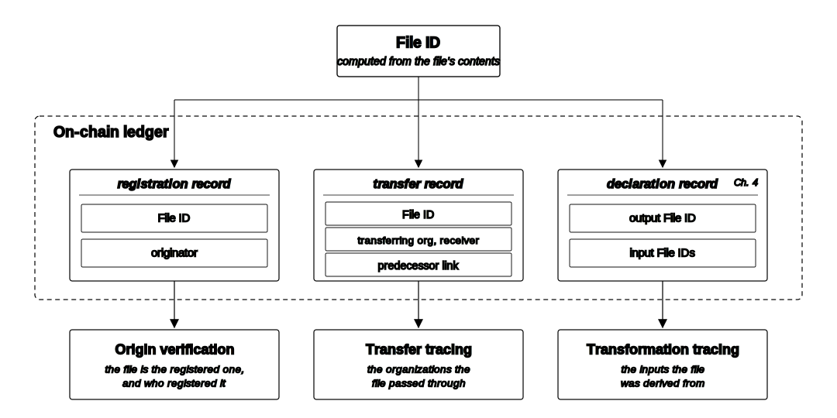
Architecture
Three record types support the three functions, over one shared File ID
Chapter 3 builds the first two functions. Chapter 4 builds the third, all keyed to one File ID.
Notes:
At the top is the File ID, computed from the file. On the shared ledger sit three kinds of record, each powering one function.
The registration record carries the File ID and the originator, which gives origin verification: the file is the registered one, and who registered it. The transfer record carries the transferring organization, the receiver, and a link back to the previous record, which gives transfer tracing: the path the file passed through. And the declaration record, from Chapter 4, carries an output File ID and its input File IDs, which gives transformation tracing: what the file was derived from.
The one thing to hold onto: all of it is keyed to one File ID. Chapter 3 builds the first two functions. Chapter 4 builds the third, on the same key.

Slide 18
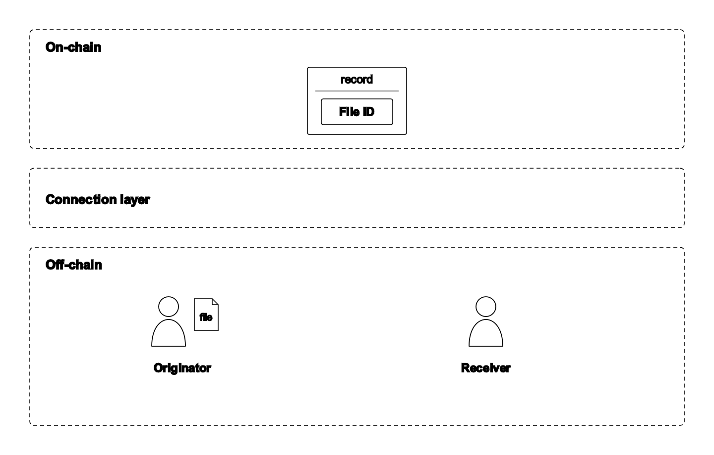
Architecture
Three layers separate what is shared from what is kept.
On-chain. The shared ledger holds the records; every organization keeps the same copy.
Connection layer. A contract checks each write and links the records to the off-chain files.
Off-chain. Each organization keeps its own files; only File IDs and records go on-chain.
Notes:
The system is organized in three layers, and the reason is the privacy point from before. On-chain is the shared ledger: it holds the records, and every organization keeps the same copy. The connection layer in the middle is where a contract checks each write and links the records to the actual files. And off-chain, at the bottom, each organization keeps its own files on its own systems.
So the file you see on the left, sitting with its originator, never leaves that organization. This three-layer split is what lets organizations that do not trust each other still share one reliable provenance record, without handing over their data.

Slide 19
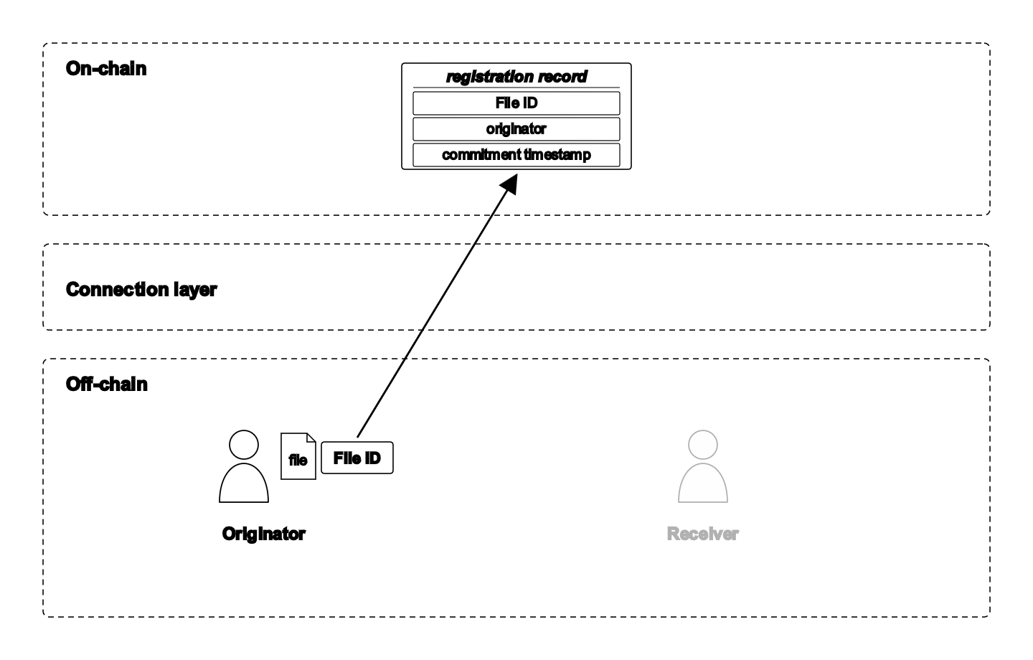
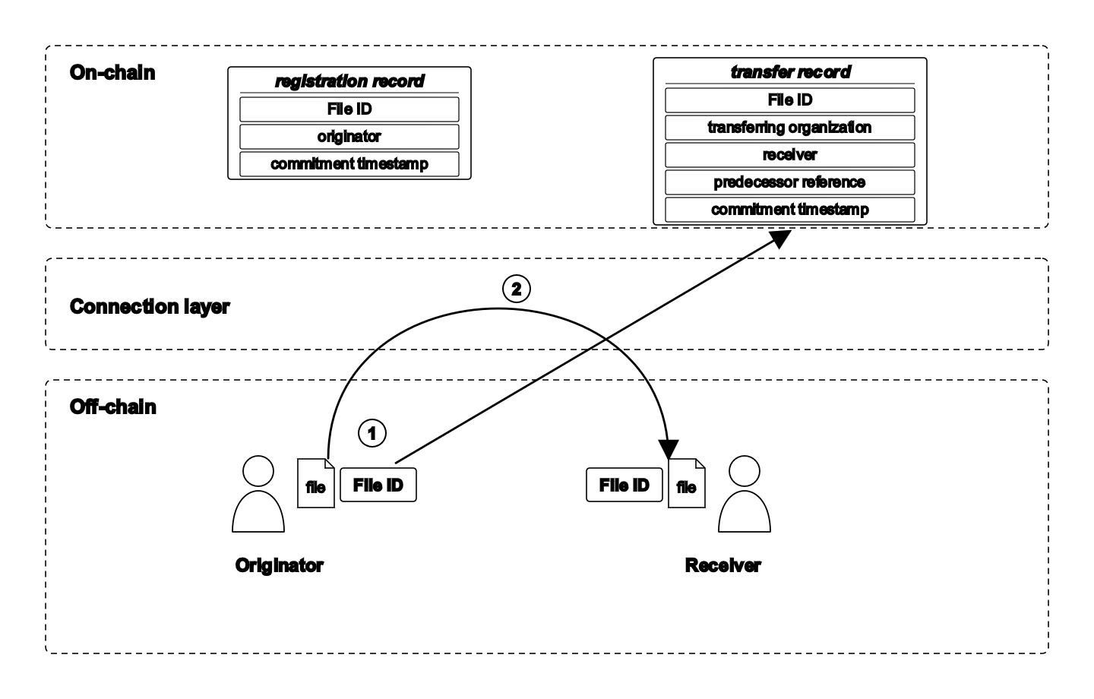
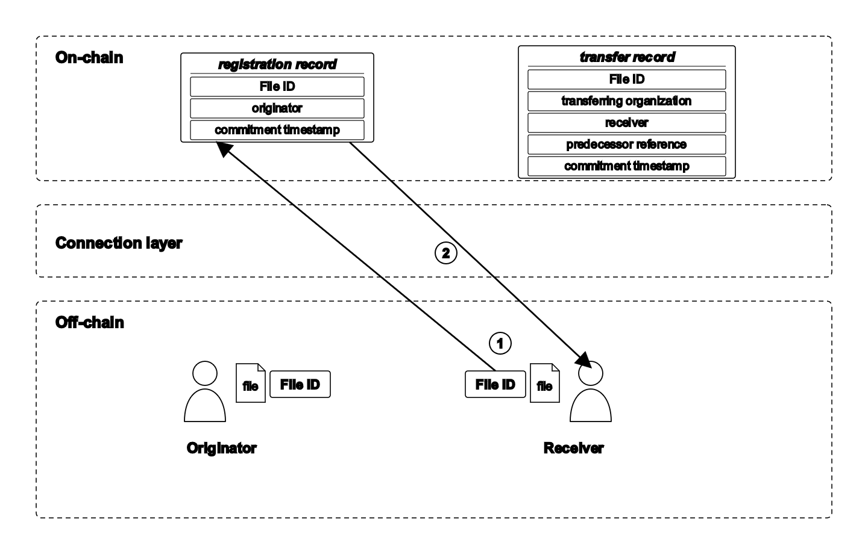
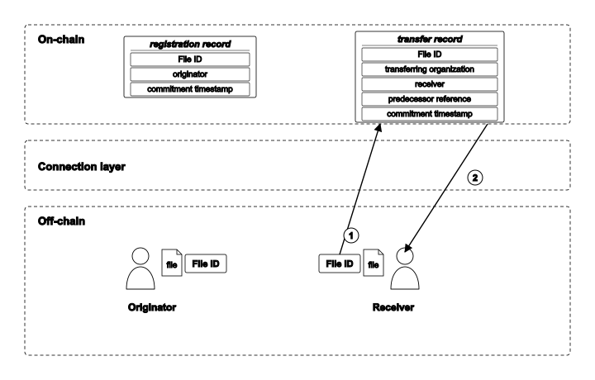
Architecture
Registration. Compute a file's File ID and write it with your identity.
Transfer. Record passing the file on, linked to the previous record.
Origin verification. Recompute the File ID and check it against the registration.
Transfer tracing. Follow the linked records backward to the origin.
Registration
Transfer
Origin verification
Transfer tracing
Notes:
On that structure, there are four basic operations, each building on the same three layers. Registration: an organization computes a file's File ID and writes it, with its own identity, to the ledger. Transfer: a sending organization records that it passed the file to the next one, linked back to the previous record, so the steps form a chain. Origin verification: a data user recomputes the File ID from the file in hand and checks it against the registration record. And transfer tracing: a data user follows the linked transfer records backward, step by step, to the origin.
These four are the entire vocabulary of Chapter 3. Everything in the results is just some combination of these four.

Slide 20
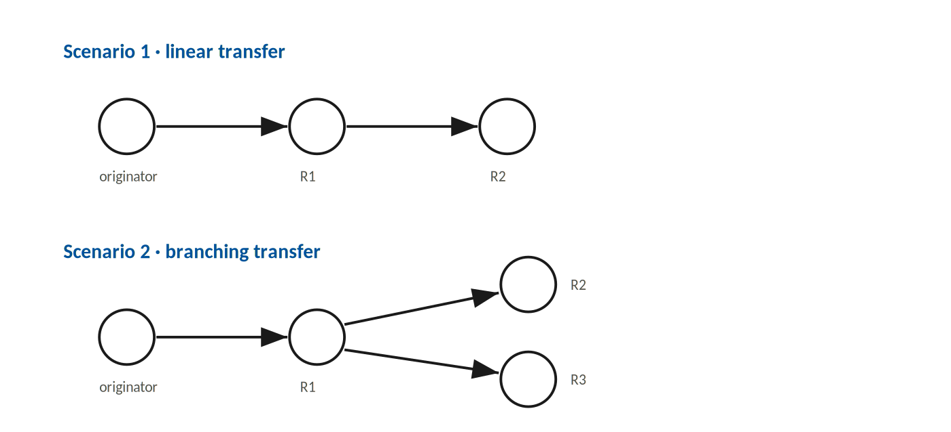
Results
Can verification and traceability be realized under voluntary participation?
Linear. A receiver two steps away confirms its file and recovers the order of organizations.
Branching. Two receivers each recover their own path, without the other’s record.
Both recover correctly from one File ID.
§ 3.6.2 · § 3.7
Notes:
In the results, in the linear case on top, a file moves from the originator, to receiver one, to receiver two. A receiver two steps away, using only the shared record, confirmed the file it held was the registered one, and recovered the correct order of organizations the file passed through. It needed nothing from anyone, just the record.
In the branching case below, one file goes to two receivers along different paths. Each receiver recovered its own path independently, without needing the other's record.
The bottom line: both scenarios recovered correctly from one File ID.

Slide 21
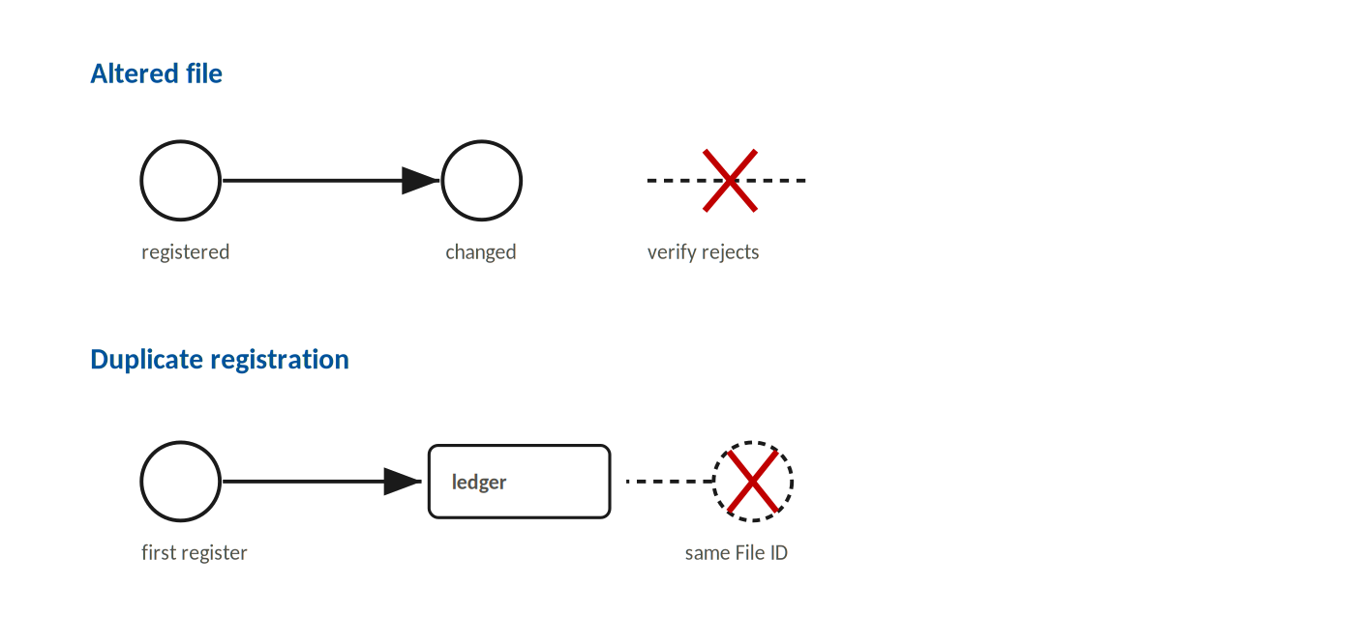
Results
The infrastructure refuses what it cannot trust.
Altered file. A changed file no longer matches its registered File ID, so verification rejects it.
Duplicate registration. A File ID already on the ledger cannot be registered again.
§ 3.7.3
Notes:
Failed scenarios.
First, an altered file. If a file is changed after registration, it no longer matches its registered File ID, so verification rejects it. Second, a duplicate registration. A File ID already on the ledger cannot be registered again, so each file keeps one, and only one, origin. No one can register the same content later and claim to be its source.

Slide 22
Chapter 3 Summary
A three-layer architecture separates shared records from local files.
An ID schema assigns a File ID and records each transfer.
Verification and traceability are realized with no central authority.
Notes:
To summarize Chapter 3 in three lines. A three-layer architecture separates the shared records from the local files, so organizations can cooperate without exposing data. An ID schema assigns a File ID to each file, and records each transfer. And with just those two pieces, verification and traceability are realized, with no central authority anywhere in the design. That is the foundation. Chapter 4 builds directly on top of it.

Slide 23
Chapter 4
Realizing the Transformation Function
Notes:
Chapter 4 realizes the third function, transformation.

Slide 24
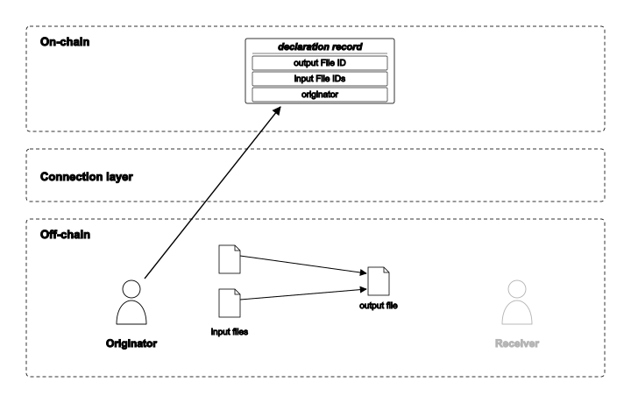
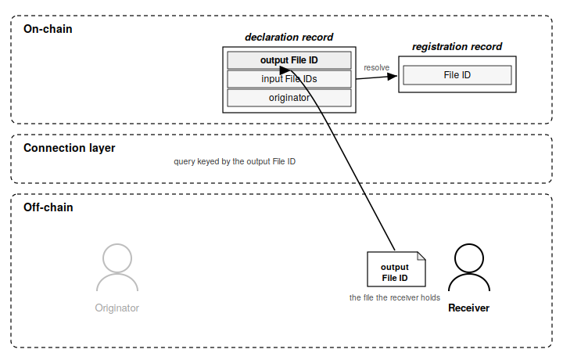
Architecture
A transformed file gets a new File ID, linked to the files it came from.
Declare. The originator records that an output File ID came from its input File IDs.
Chain query. From an output, the data user follows the declarations back to the registered roots.
Declare (originator writes the link)
Chain query (data user reads it back)
§ 4.3.3 · § 4.5
Notes:
Chapter 3 reads a File ID that has not changed. But real data does not sit still. It gets transformed, combined, reformatted. And a transformed file gets a new File ID that matches none of its sources, because the content is different. So the link to where it came from is lost. We need a way to put that link back.
That is done with two operations, one in each diagram. First, declare, on the left. The originator of the transformation records, on the ledger, that an output File ID came from a specific set of input File IDs. The input files become an output file off-chain, and a declaration record on-chain ties them together, under the originator's identity. Second, chain query, on the right. Starting from any output, the data user follows the declarations backward, one step at a time, to the registered roots.
So the structure is simple. The originator writes the link forward, and any data user can read it back.

Slide 25
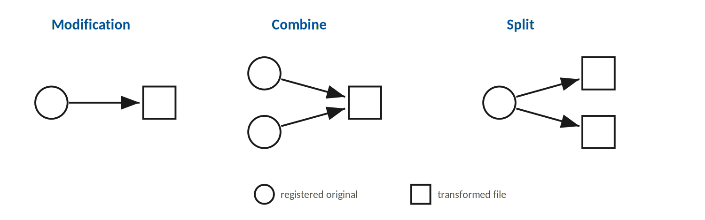
Results
Modification. One file becomes another.
Combine. Several files merge into one.
Split. One file produces several.
§ 4.6
Notes:
The question for this chapter is whether a transformed file can be traced back to its declared sources. Every step is declared by its originator, and we tested the three shapes transformations. Modification, where one file becomes another. Combine, where several files merge into one, which is exactly what producing a carbon stock from raw measurements looks like. And split, where one file produces several outputs.

Slide 26
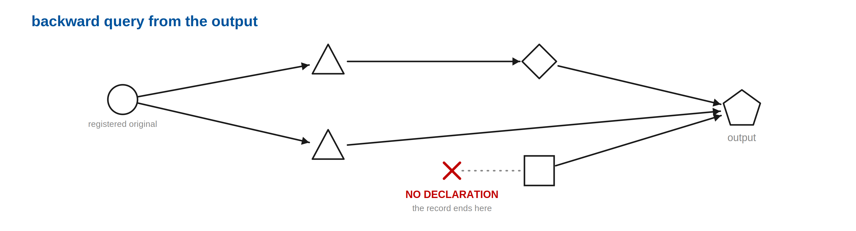
Results
A missing declaration is shown as a gap, not filled in.
Participation is voluntary, so a step in the chain may never be declared.
When a step was never declared, the query stops there and reports that the record ends, instead of guessing a link across the gap.
§ 4.6
Notes:
This is the honest boundary of the chapter. Because participation is voluntary, a step in the chain may never be declared by whoever performed it. So the question is, what does the query do when it hits that gap.
It does not guess. The backward query traces through the declared steps as far as they go, and when it reaches a file that was never declared, it stops there and reports that the record ends. It does not invent a link across the gap to make the chain look complete.

Slide 27
Chapter 4 Summary
A new File ID incorporated into the ID schema lets a data user trace a transformation to its declared sources.
The function was tested across the three transformation shapes: modification, combine, and split.
A restriction: the chain proves the declared derivation, not the true derivation. A missing step is reported.
Notes:
A new File ID, incorporated into the same ID schema from Chapter 3, lets a data user trace a transformation back to its declared sources. We tested it across all three shapes, modification, combine, and split, and it resolved in each. And there is one honest restriction, stated plainly: the chain proves the declared derivation, not the true derivation. If a step was never declared, it is reported, not crossed. Hold on to that restriction, because it becomes the boundary of the entire platform in the conclusion.

Slide 28
Chapter 5
DEMETER: Demonstration on the Agricultural Carbon Market
Notes:
Chapter 5 brings the two functions together, and demonstrates the full platform, DEMETER, on the agricultural carbon market.

Slide 29
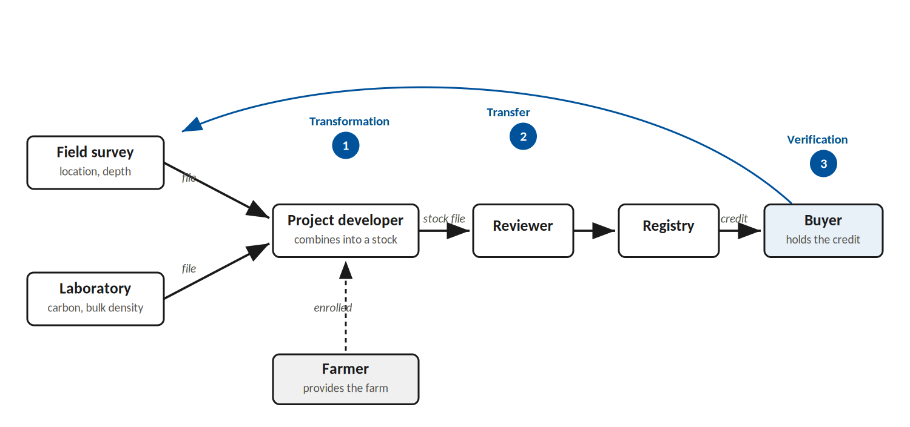
Demonstration
Why the agricultural carbon market is the case
1 Transformation. The project developer combines field and lab data into a carbon stock.
2 Transfer. The credit passes from developer to reviewer to registry to buyer.
3 Verification. The buyer checks the credit against the record.
The credit is both transformed and transferred, so this one case exercises all three functions.
Notes:
So, why this case? Because it exercises everything at once. Let me bring back the carbon credit from the start of the talk and trace it on this diagram.
The credit is built from field data and laboratory data, and that raw measurement is transformed into a carbon stock. Right there, at the project developer, that is the transformation function, marked one. Then the credit is passed on, from the project developer, through a reviewer, to a registry, and finally to a buyer who holds it. That movement across organizations is transfer, the traceability function, marked two. And the buyer, at the very end, wants to verify what they hold. That is verification, marked three.
So a single carbon credit is both transformed and transferred, which means this one case exercises all three functions, on the same record. And this is not an arbitrary example. It is the clearest real case where data becomes a commodity, and where trust in that data is exactly what is in doubt.

Slide 30
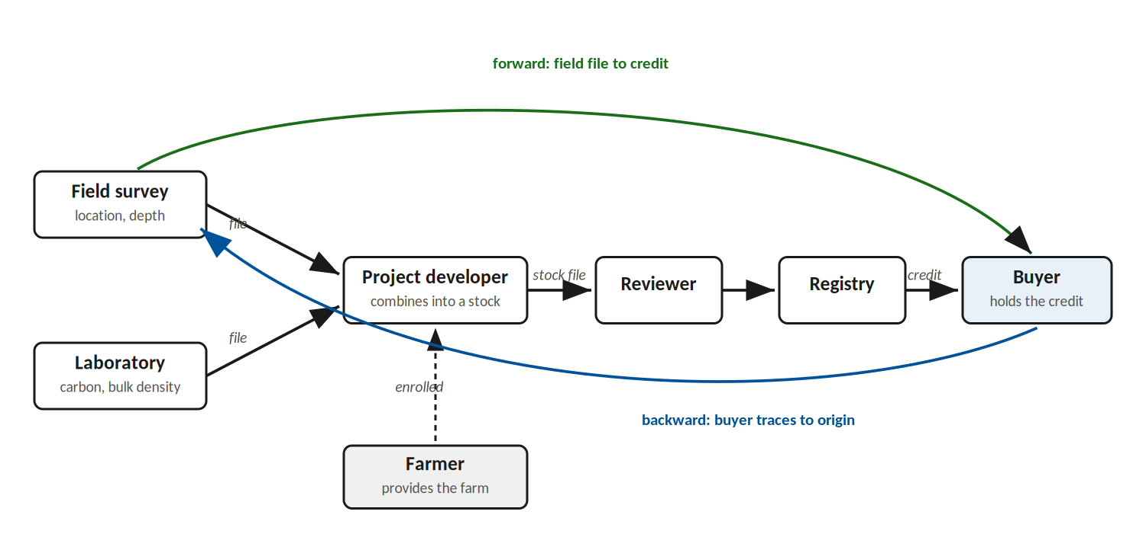
Demonstration
Two directions of the same trace
The same records answer a query from either end.
Backward. A buyer recovers the field and laboratory files the credit was built from.
Forward. A farmer traces the credit it became from the registered field file.
Notes:
Because all of it sits on one shared record, the same records answer a query from either end.
Follow the blue arrow first, the backward direction. A buyer holding a credit can recover the field and laboratory files it was built from, tracing from the credit back to the origin. Now the green arrow, the forward direction. Starting from the field file the project developer first registered, the trace finds the credit that file became.
So a buyer tracing back to what they bought, and a regulator tracing an input forward, use the same records. One record, two directions, two stakeholders served.

Slide 31
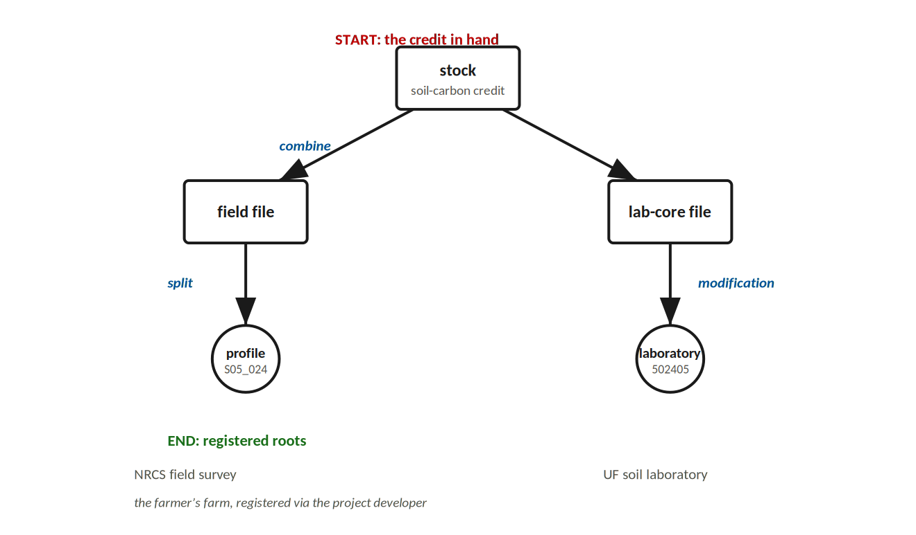
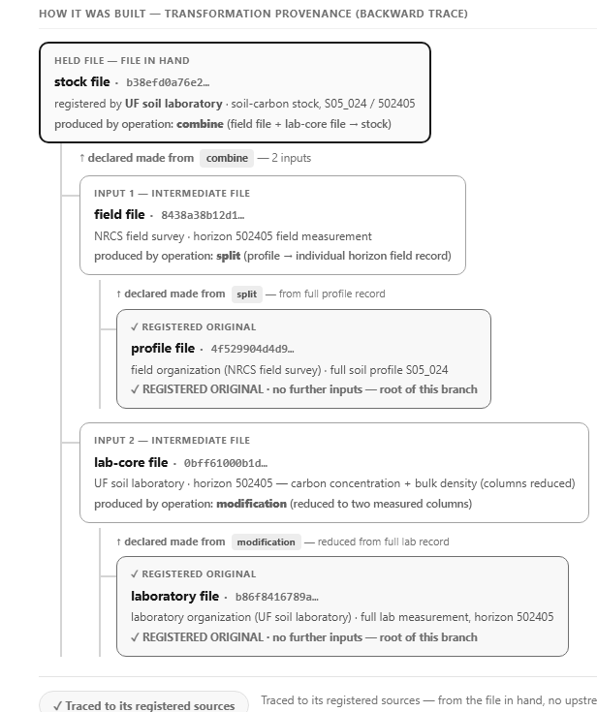
Demonstration
What a query recovers
From the credit in hand, the buyer traces how it was built, back to the registered files.
The stock combines a field file and a lab-core file.
The field file came from a registered soil profile, by a split.
The lab-core file came from a registered lab measurement, by a modification.
From one File ID, with no upstream organization contacted, the credit resolves to its registered roots.
Notes:
Let me make the backward direction concrete, on real data. The buyer starts from the credit in hand, the soil-carbon stock, and asks how it was built.
Reading down the tree: the stock combines a field file and a laboratory file. The field file came, by a split, from a registered soil profile. The laboratory file came, by a modification, from a registered laboratory measurement. Those two registered files are the roots.
This runs on the actual Florida Soil Characterization Data, with real profile and horizon identifiers. And the result is the line at the bottom. From one File ID, with no upstream organization contacted, the credit resolves back to the registered field and laboratory files it was made from. That, on one real credit, is the whole dissertation working end to end.

Slide 32
Chapter 5 Summary
DEMETER demonstrates the platform on a real carbon credit, addressing verification, traceability, and transformation in one case.
The platform fits complex data sharing, where files are transferred and transformed through different paths.
A stakeholder sees the full lifecycle of the data, which improves transparency and trust.
Notes:
So, Chapter 5 in three lines. DEMETER demonstrates the full platform on a real carbon credit, addressing verification, traceability, and transformation together in one case, not three separate toy examples. It shows that the design holds up on genuinely complex data sharing, where files are transferred and transformed through several different paths and still resolve correctly. And the outcome for a stakeholder is simple to state, and it is the whole point. They can finally see the full lifecycle of the data, and that visibility is what improves transparency, and with it, trust.

Slide 33
Conclusions
Agricultural data is shared under voluntary participation, with no record of where a file came from or how it changed, so it cannot be trusted.
Reframes trust. It comes from a transparent record a data user can read, not from forcing every organization to take part.
Verification and traceability. Confirms an unchanged file’s origin and recovers its transfer path.
Transformation. Traces a changed file back to its declared sources, and reports an undeclared step instead of crossing it.
DEMETER. Integrates both on one shared record and demonstrates them on real data.
The boundary is deliberate. The platform establishes attribution, not the truth of the data. Validation sits above this layer.
§ 6.1 · § 6.2
Notes:
Let me conclude by returning to exactly where we started. Agricultural data is shared under voluntary participation, with no record of where a file came from or how it changed, so it cannot be trusted. This work makes four contributions to that problem.
It reframes trust: trust comes from a transparent record that a data user can read, not from forcing every organization to take part. From Chapter 3, verification and traceability confirm an unchanged file's origin and recover its transfer path. From Chapter 4, transformation traces a changed file back to its declared sources, and reports an undeclared step instead of crossing it. And DEMETER integrates both on one shared record, demonstrated on real data.
Now, the boundary is deliberate, and I want to end on it plainly, because it is the most honest thing I can say about this work. The platform establishes attribution. It establishes who declared what, and how the files connect to each other. It does not establish the truth of the underlying data itself. Validation of the actual measurements sits in a layer above this one. What this dissertation provides is the evidence layer underneath that, the traceable record that makes validation, and real accountability, possible in the first place. In an industry where data is becoming the commodity, that record is what the people in the chain have been missing.

Slide 34
Future work
Three services can build on this layer.
Content validation. Re-execute a declared transformation, turning a declared link into a verified one.
System interoperability. Reconcile the different vocabularies organizations use, so records line up across them.
Usage-rights enforcement. Act on the terms attached to the data, not only record them.
§ 6.2
Notes:
And that boundary points directly to the future work. Three services can build on this layer. Content validation: re-execute a declared transformation, which turns a declared link into a verified one, and begins to close the gap between declared and true that I described in Chapter 4. System interoperability: reconcile the different vocabularies that different organizations use, so their records line up cleanly across organizational lines. And usage-rights enforcement: act on the terms attached to the data, not only record that they exist. Each of these sits on top of the provenance layer that this dissertation builds, which is why getting that layer right was the necessary first step.

Slide 35
Publications
The work is in the publication pipeline
Agricultural carbon market paper
Published
Cross-sectoral data-sharing review (Ch 2)
Under review
Data verification paper (Ch 3)
In revision
Transformation integrity paper (Ch 4)
In revision
DEMETER platform paper (Ch 5)
In revision
DEMETER patent
Planned
Notes:
For completeness, the work is moving through the publication pipeline. The agricultural carbon market paper is published. The cross-sectoral data-sharing review is under review. The three core papers, on verification, on transformation, and on the DEMETER platform, are in revision. And a patent on DEMETER is planned.

Slide 36
Acknowledgments
• Dr. Ziwen Yu and Dr. Yiannis Ampatzidis, and the committee: Dr. Grunwald, Dr. Pavan, Dr. Boz, and Dr. Graim.
• Soil data provided by Dr. Sabine Grunwald (Florida Soil Characterization Data), used with permission.
• Supported by the University of Florida, IFAS, Agricultural and Biological Engineering Department, through the 2022 ABE Pathfinder Fellowship and the project “Enhancing the Trustworthiness of Partnerships in Digital Farming.”
Notes:
I want to thank my advisor, Dr. Yu, and my co-advisor, Dr. Ampatzidis, and the rest of my committee, Dr. Grunwald, Dr. Pavan, Dr. Boz, and Dr. Graim, for their guidance. The soil data was provided by Dr. Grunwald, the Florida Soil Characterization Data, used with permission. And this work was supported by the University of Florida, IFAS, and the Agricultural and Biological Engineering department, through the 2022 Pathfinder Fellowship.

Slide 37
Thank you
Questions?
Notes:
Thank you. I would be glad to take your questions.

Slide 38
Backup · The two closest works
The dissertation differs along two structural axes
• Decomposition: it separates verification and traceability from transformation, where both closest works combine them into one.
• Non-participation: a non-participating organization is left as a visible absence, where both works instead require every organization to join the network.
• Domain and the deferred system-interoperability function are further differences, but matters of scope.
§ 2.6.3 · Marchioro et al. 2025; AgriTrust (Bergier 2025)
Notes:
[Backup · Closest works] "How does this differ from Marchioro or AgriTrust." Two axes: it separates verification from transformation tracing where they combine them, and it treats non-participation as a visible absence where they require every organization to join.

Slide 39
Backup · Why Hyperledger Fabric
Within the permissioned category, the platform choice turns on how the record is made available
• Corda shares each transaction only with the organizations involved in it, so there is no single shared record every organization can read.
• Quorum and Besu attach an execution fee to every write, overhead a record-keeping workload does not need.
• Fabric fits for three reasons the others do not combine: it replicates one ledger across a channel (a later data user can read a record written by organizations it never dealt with); it ties each write to the submitting organization through a certificate; and it runs general-purpose programs on the ledger, which the validation rules depend on.
§ 3.3.3 · Androulaki et al. 2018
Notes:
[Backup · Why Hyperledger Fabric] "Why Fabric over other permissioned ledgers." It replicates one ledger across a channel, so a later data user can read records written by organizations it never dealt with; it ties each write to a certificate; and it runs the general-purpose contracts the rules depend on. Corda shares per-transaction only; Quorum and Besu charge a fee per write.

Slide 40
Backup · Identifier collision
A reused sample identifier is ambiguous; a content File ID is not
• LAB_NUM 842 appears in two profiles, S05_024 and S05_025.
• Identifier matching returns both, ambiguous. DEMETER traces by the content File ID named in the stock’s declaration and returns exactly one.
• Across the dataset, 2 of 8,153 laboratory identifiers are reused across profiles, and 273 horizons carry none.
• The verification demo’s own seed pedon is S05_024, LAB_NUM 842. The demonstration runs on this exact collision case.
§ 5.2.2, § 5.3 · Tables 5-1, D-3, D-4
Notes:
[Backup · Identifier collision] "What if a sample identifier is reused." LAB_NUM 842 appears in two profiles; identifier matching returns both, ambiguous; tracing by the content File ID returns exactly one. The demo runs on this exact collision case.

Slide 41
Backup · Threat model
What is stopped, and what is made attributable
Stopped automatically
1 tampering after registration, recomputed File ID no longer matches
2 re-registering the same file, one registration per File ID
Not blocked, but attributable
3 registering an altered file under a new identifier
4 declaring a false derivation 5 choosing not to record (non-participation)
→ whatever is recorded is stamped with certificate identity + timestamp; absence is visible
The guarantee: no single organization can alter a committed record, every record is attributable, and absence is visible. Tolerating malicious ordering is left to future work.
Notes:
[Backup · Threat model] "What does it stop, and what does it not." Stopped automatically: tampering after registration, and re-registering the same file. Not blocked but made attributable: registering an altered file under a new identifier, declaring a false derivation, and choosing not to record. The guarantee is that no single organization can alter a committed record, every record is attributable, and absence is visible. Malicious ordering is left to future work.

Slide 42
Backup · Contract operations
• Registration: register a file’s File ID under the originator’s certificate.
• Transfer: record a hand-off naming the transferring organization, receiver, and predecessor.
• Origin verification: confirm a File ID matches a registration.
• Transfer tracing: follow predecessor references back to the registration root.
• Declaration: link an output File ID to its input File IDs.
• Transformation tracing: resolve a declared derivation back to registered originals.
Appendix B
Notes:
[Backup · Chaincode operations] The six operations: registration, transfer, origin verification, transfer tracing, declaration, transformation tracing.

Slide 43
Backup · Soil carbon stock
The demonstration follows the units the dataset records; it does not re-derive the magnitude
SOC (Mg C/ha) = (C% / 100) × bulk density × |bottom depth − top depth| × 100
• For the followed horizon, the recorded inputs give a stock of about 9.86 Mg C/ha.
• Split and modification do not change the stock; what they add is a traceable stock, not a different one.
• The field-survey / laboratory partition follows columns that genuinely exist in the data; the NRCS / UF organizational roles are a demonstration modeling assignment grounded in the FSCD metadata.
§ 5.2.1 · Batjes 1996 · Appendix D
Notes:
[Backup · Soil carbon stock] The SOC formula; the followed horizon gives about 9.86 Mg C per hectare. The demo follows the units the dataset records and does not re-derive the magnitude. The field-survey versus laboratory partition follows columns that genuinely exist in the data; the NRCS and UF organizational roles are a demonstration modeling assignment grounded in the FSCD metadata, not a per-horizon attribution in the raw data.

Slide 44
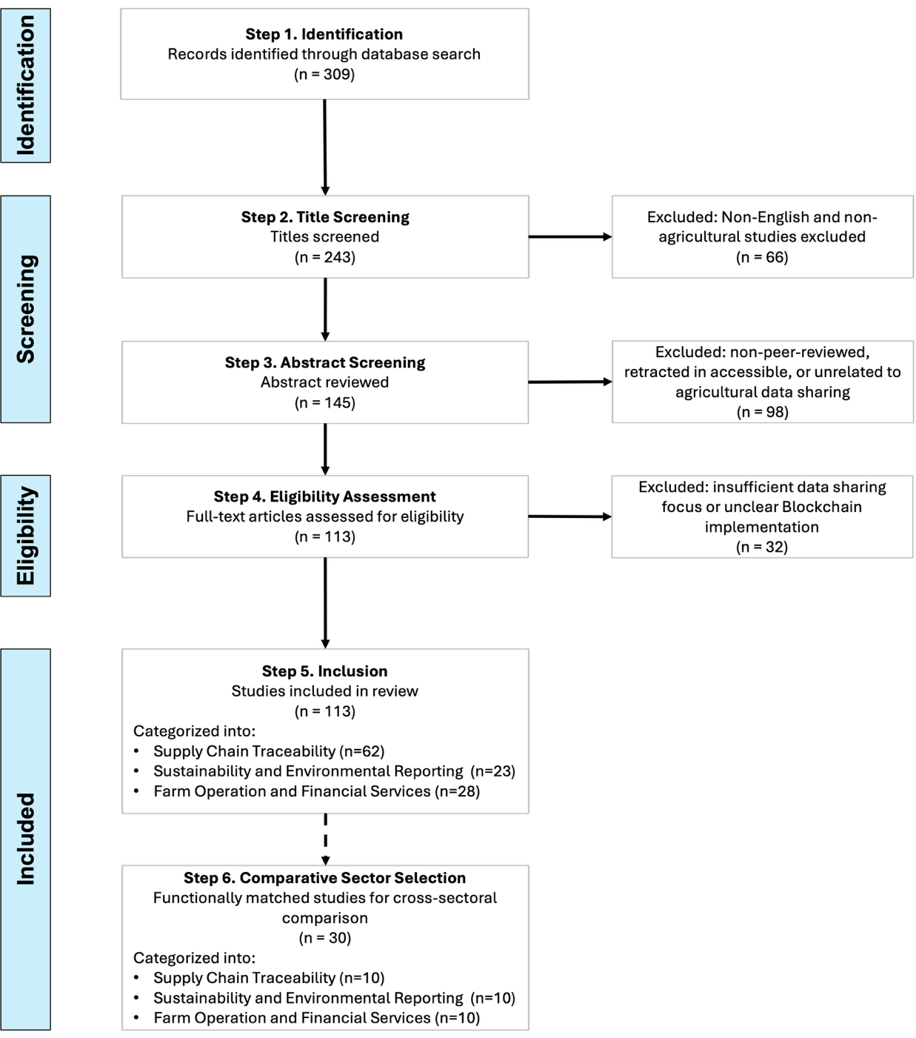
Backup · Literature selection
A scoping review organized the field into three function classes
• 113 agricultural blockchain articles retained after PRISMA-ScR screening.
• Three function classes: data verification, transformation integrity, system interoperability.
• The first two are rarely built so an outside data user can verify and trace them.
§ 2.2 · Fig 2-1, Table 2-1
Notes:
[Backup · Literature selection] 113 agricultural blockchain articles after PRISMA-ScR screening, organized into three function classes: data verification, transformation integrity, and system interoperability. The first two are rarely built as inspections an outside data user can perform.

