Slide 1

Brand identity & app experience
EduHackers / Presentation concept / September 2026
01
Notes:
Visuals are AI-generated presentation mockups using the user-selected Vossie wordmark. This is a brand and product concept, not a working application. Sample prices, routes, people, earnings and timings are illustrative. No affiliation with Plato or Uber is implied.

Slide 2
A marketplace for campus life
Good things.
Brighter campus.
A familiar place to discover student businesses, buy everyday essentials and arrange collection or delivery.
The wider concept connects unmet demand with student entrepreneurs and incubation support.
02
Notes:
Source: EduHackers_Full_Marketplace_Research_Dossier(2).pdf, executive summary and sections 14–18, 33. User-supplied research hypotheses, not validated market results. Brand promise and tagline are creative positioning.

Slide 3
The design direction
How it works
How it feels
Uber-inspired task flows: location first, clear choices, dispatch requests, live status and one obvious next action.
Plato-inspired restraint: warm ivory, soft blue, rounded lettering, quiet packaging and generous space.
Vossie brings these references together in an original campus marketplace identity.
03
Notes:
Source: EduHackers_Developer_UX_Workflow_Wireframes_Research_Dossier(2).pdf, pages 11–14. Proposed seller dispatch, courier delivery and operations flows. Latest user instruction: Uber-inspired functionality and canvases, Plato-inspired visuals. These are design references, not claims about current Uber or Plato product specifications.

Slide 4
The primary wordmark
Rounded lowercase lettering
A distinctive joined “ss”
A clear marketplace descriptor
Use the supplied artwork. Keep its proportions and letter spacing intact.
04
Notes:
Visuals are AI-generated presentation mockups using the user-selected Vossie wordmark. This is a brand and product concept, not a working application. Sample prices, routes, people, earnings and timings are illustrative. No affiliation with Plato or Uber is implied. User selected this variant in the conversation.

Slide 5

The app icon
A symbol from the name
The joined “ss” carries the character of the wordmark into a compact icon.
Navy on ivory is the primary treatment. “Vossie” appears as the device label beneath the app.
Production export: supply a square master and let each platform apply its icon mask.
05
Notes:
Visuals are AI-generated presentation mockups using the user-selected Vossie wordmark. This is a brand and product concept, not a working application. Sample prices, routes, people, earnings and timings are illustrative. No affiliation with Plato or Uber is implied. Proposed icon use. Final small-size optical review and platform exports remain production work.

Slide 6
The colour palette
Colour | HEX | Role
Warm ivory | #FAF8F2 | Main canvas and packaging
Vossie navy | #29475B | Logo, text and primary actions
Powder blue | #AFCBDE | Selected states and soft panels
Slate blue | #567487 | Supporting copy
Pale sage | #DDE5D9 | Optional quiet accent
A Vossie palette inspired by the requested softer direction; these are not official Eduvos colour specifications.
06
Notes:
HEX values are proposed design tokens for this brand concept.

Slide 7
Colour in use
Ivory leads.
Navy gives clarity.
Blue adds emphasis.
Use navy for reading and actions.
Keep powder blue as a surface colour.
Pair every status colour with a label.
The soft palette should still produce a clear interface at small sizes.
07
Notes:
Design guidance. Accessibility testing is required on implemented UI; no compliance certification is claimed.

Slide 8
Typography
Aa
DejaVu Sans
A clear supporting typeface for this presentation and the proposed interface system.
Headings / Bold
Body copy / Regular
Prices and status / Bold emphasis
The logo is custom artwork.
Do not recreate it by typing
the brand name in a font.
08
Notes:
Presentation uses installed DejaVu Sans. Generated UI mockups approximate rounded sans typography; exact UI typesetting is a subsequent design implementation step.

Slide 9
Logo rules
Space and scale
Consistent artwork
Leave at least one “o” height of clear space around the full wordmark. Use the icon when the descriptor becomes too small to read.
Keep the joined letters intact. Avoid stretching, extra effects, busy backgrounds or new monograms.
Proposed starting sizes: full lockup 180 px digital / 35 mm print. Icon 32 px. Review proofs at actual size.
09
Notes:
Proposed usage rules and starting minimum sizes; these require optical validation after creating production vector masters.

Slide 10
The voice
Friendly, direct and useful
Moment | Example copy
Discovery | What do you need?
Unavailable item | Sold out for now. Find an alternative.
Collection | Your order is ready to collect.
Delay | Your delivery is taking longer. View the latest update.
Campus campaign | Made by students. Found on Vossie.
10
Notes:
Proposed original copy examples. No unsupported delivery or protection guarantees.

Slide 11
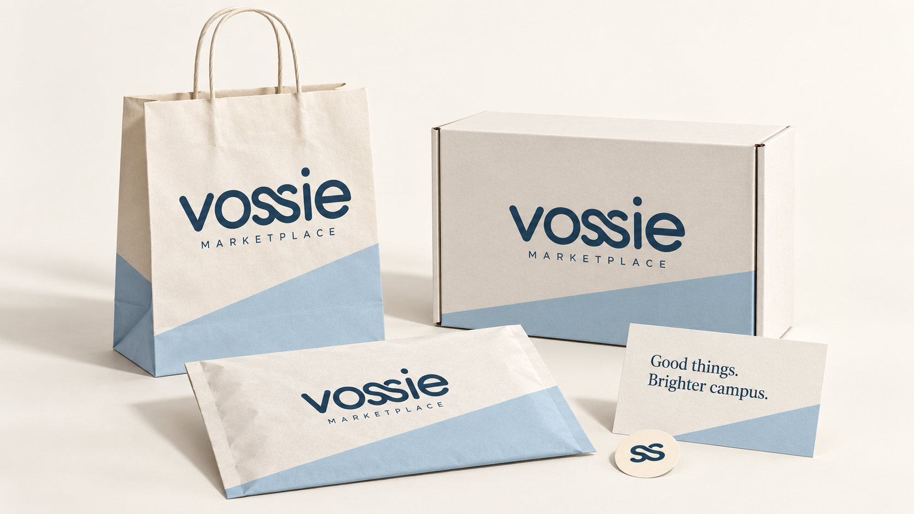
Delivery packaging
11
Notes:
Visuals are AI-generated presentation mockups using the user-selected Vossie wordmark. This is a brand and product concept, not a working application. Sample prices, routes, people, earnings and timings are illustrative. No affiliation with Plato or Uber is implied. Bag, mailer, envelope, seal and insert concept.

Slide 12
Packaging details
The visual system
The practical layer
Ivory surfaces, navy wordmark and one powder-blue panel. A small seal carries the joined “ss”.
Choose packaging by item size and protection needs. Keep order labels separate from brand artwork.
Production brief
Supplier dielines, print proofs, material selection and closure tests follow this concept. Food items need suitable food-contact packaging. Do not print unnecessary student details.
12
Notes:
Visuals are AI-generated presentation mockups using the user-selected Vossie wordmark. This is a brand and product concept, not a working application. Sample prices, routes, people, earnings and timings are illustrative. No affiliation with Plato or Uber is implied. Concept artwork is not a print-ready dieline or material certification.

Slide 13

Campus brand applications
13
Notes:
Visuals are AI-generated presentation mockups using the user-selected Vossie wordmark. This is a brand and product concept, not a working application. Sample prices, routes, people, earnings and timings are illustrative. No affiliation with Plato or Uber is implied. Tote, courier apparel, campaign cards and stickers illustrate the identity across campus touchpoints.

Slide 14
App navigation
Area | Purpose
Home | Campus, destination, search and everyday tasks
Activity | Current orders, live status and order history
Account | Profile, verification, support and role switching
Seller mode | Requests, shop availability and order preparation
Courier mode | Offers, active delivery and earnings
One student identity. Additional verification unlocks seller and courier roles.
14
Notes:
Source: EduHackers_Developer_UX_Workflow_Wireframes_Research_Dossier(2).pdf, pages 11–14. Proposed seller dispatch, courier delivery and operations flows. Latest user instruction: Uber-inspired functionality and canvases, Plato-inspired visuals. Proposed navigation structure incorporating latest user direction.

Slide 15
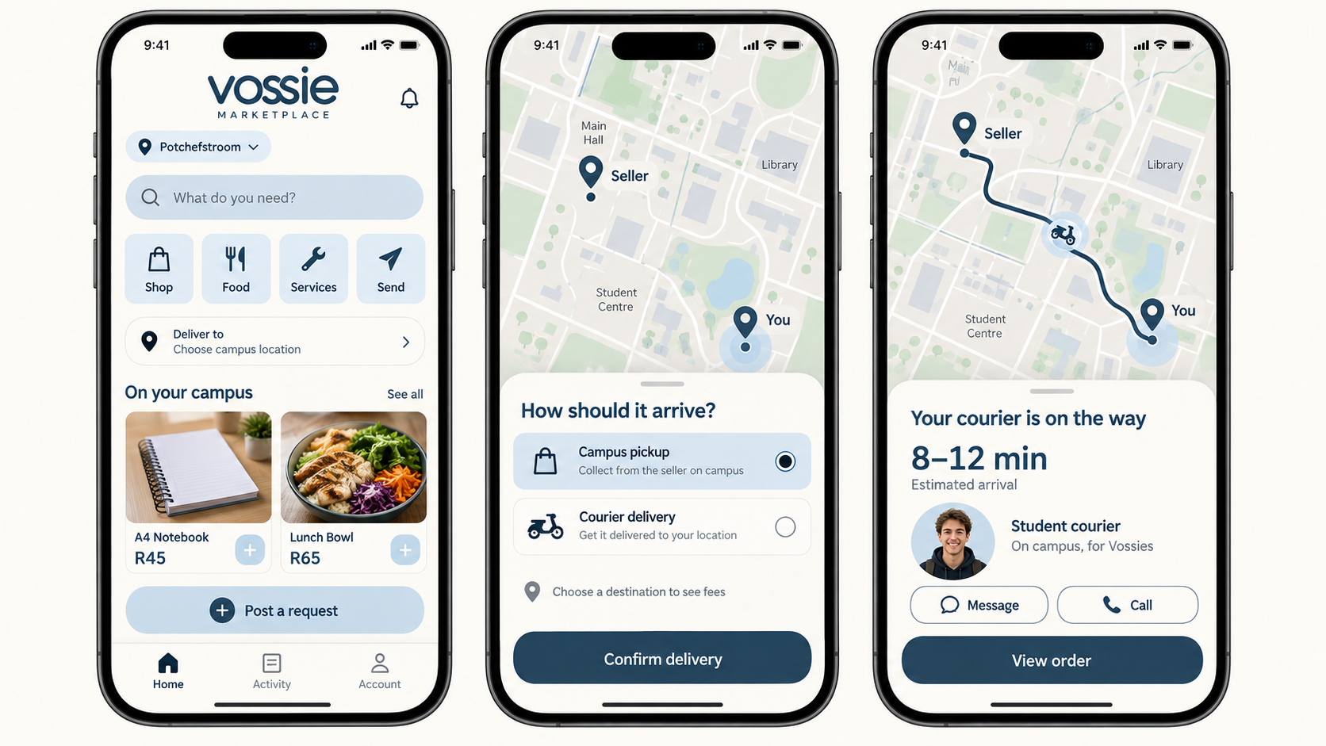
The buyer experience
15
Concept UI. Prices, map, route and arrival time are illustrative.
Notes:
Visuals are AI-generated presentation mockups using the user-selected Vossie wordmark. This is a brand and product concept, not a working application. Sample prices, routes, people, earnings and timings are illustrative. No affiliation with Plato or Uber is implied. Source: EduHackers_Developer_UX_Workflow_Wireframes_Research_Dossier(2).pdf, pages 11–14. Proposed seller dispatch, courier delivery and operations flows. Latest user instruction: Uber-inspired functionality and canvases, Plato-inspired visuals. The “Send” entry is an exploratory addition, subject to scope confirmation. Destination and fulfilment must be selected before confirmation.

Slide 16
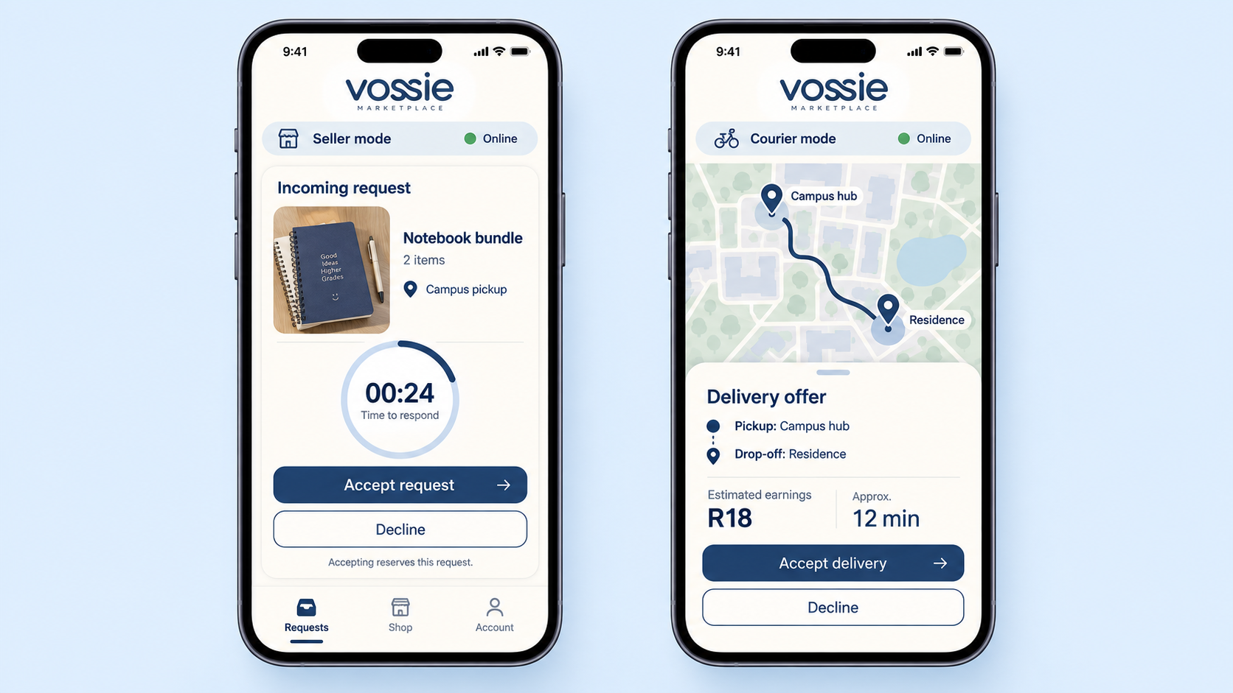
Seller and courier dispatch
16
Concept UI. Countdown, route, earnings and timing are illustrative.
Notes:
Visuals are AI-generated presentation mockups using the user-selected Vossie wordmark. This is a brand and product concept, not a working application. Sample prices, routes, people, earnings and timings are illustrative. No affiliation with Plato or Uber is implied. Source: EduHackers_Developer_UX_Workflow_Wireframes_Research_Dossier(2).pdf, pages 11–14. Proposed seller dispatch, courier delivery and operations flows. Latest user instruction: Uber-inspired functionality and canvases, Plato-inspired visuals. Dispatch locks on first valid acceptance. Server owns countdown and acceptance state.

Slide 17
The journey behind the screens
Stage | What the student sees
Discover | Local availability and a clear item or service choice
Confirm | Destination, fulfilment, complete fees and payment
Match | Seller acceptance, then courier allocation if required
Track | Current stage, estimated arrival and support
Receive | Collection code or recipient PIN, then completion
Hub transfers can sit between preparation and final delivery, with clear status updates.
17
Notes:
Source: EduHackers_Developer_UX_Workflow_Wireframes_Research_Dossier(2).pdf, pages 11–14. Proposed seller dispatch, courier delivery and operations flows. Latest user instruction: Uber-inspired functionality and canvases, Plato-inspired visuals. Protected payment, fee architecture and payout rules remain research and implementation decisions.

Slide 18
When the plan changes
Situation | Interface response
Seller declines or times out | Offer an alternative and explain the next step
No courier available | Show waiting status and available fulfilment options
Tracking signal is lost | Show the last update time and a text status
Package needs correction | Explain the pause, reason and next action
Order needs help | Keep order details and a support route together
A calm design must explain uncertainty as clearly as success.
18
Notes:
Source: EduHackers_Developer_UX_Workflow_Wireframes_Research_Dossier(2).pdf, pages 11–14. Proposed seller dispatch, courier delivery and operations flows. Latest user instruction: Uber-inspired functionality and canvases, Plato-inspired visuals. These are proposed recovery behaviours; policies and state transitions require validation.

Slide 19
The wider marketplace
Student opportunity
Operations workspace
Unmet requests help student businesses decide what to offer. Sellers receive practical guidance in their own workspace.
Hub staff manage package custody. Authorised teams handle transfers, disputes, finance and incubation support.
The same visual language extends across roles, while each workspace shows only the information that role needs.
19
Notes:
Source: EduHackers_Full_Marketplace_Research_Dossier(2).pdf, executive summary and sections 14–18, 33. User-supplied research hypotheses, not validated market results. Source: EduHackers_Developer_UX_Workflow_Wireframes_Research_Dossier(2).pdf, pages 11–14. Proposed seller dispatch, courier delivery and operations flows. Latest user instruction: Uber-inspired functionality and canvases, Plato-inspired visuals.

Slide 20
From concept to launch assets
Included here | Next production step
Chosen logo and app icon direction | Vector masters and small-size icon exports
Colour and typography guidance | Exact UI tokens and contrast checks
Packaging and campus mockups | Supplier dielines and print proofs
App canvases and navigation | Editable prototype, real data and state validation
The slides are editable. Mockups and logo artwork are raster images, not production vectors or working screens.
20
Notes:
Visuals are AI-generated presentation mockups using the user-selected Vossie wordmark. This is a brand and product concept, not a working application. Sample prices, routes, people, earnings and timings are illustrative. No affiliation with Plato or Uber is implied.

Slide 21
Source and concept notes
Project foundations
EduHackers Full Marketplace Research Dossier (2)
Executive summary and marketplace / incubation scope
EduHackers Developer UX Workflow Wireframes Research Dossier (2)
Pages 11–14: role modes, seller dispatch, courier and hub flows
Creative direction
Your selected Vossie wordmark and icon; the supplied Plato packaging reference; your direction to combine Uber-style functionality with Plato-style visuals. All application mockups are illustrative concepts.
21
Notes:
Source: EduHackers_Full_Marketplace_Research_Dossier(2).pdf, executive summary and sections 14–18, 33. User-supplied research hypotheses, not validated market results. Source: EduHackers_Developer_UX_Workflow_Wireframes_Research_Dossier(2).pdf, pages 11–14. Proposed seller dispatch, courier delivery and operations flows. Latest user instruction: Uber-inspired functionality and canvases, Plato-inspired visuals. Visuals are AI-generated presentation mockups using the user-selected Vossie wordmark. This is a brand and product concept, not a working application. Sample prices, routes, people, earnings and timings are illustrative. No affiliation with Plato or Uber is implied.

