Slide 1

PROJECT1：
TRIES AND AVL TREES
GROUP 10: 胡亮泽 刘俊灏 徐雨豪 毛晨炀

Slide 2

INDEX
模版名称：蓝色系模版
模版编号：TCB001
适用范围：本模版用于月底分析报表、分析。
制作课件：
1、图表的大小要与“图表专用”板式中的框体大小相符或一致。
2、在设计表格时，要去掉表格的左右边框，“点击表格”—“设计”—“边框”下拉键—“左边框”——“右边框”。
1
Introduction of the problem
2
Key data structure
3
Key algorithm
4
Testing results
5
Conclusion and comments
6
Problems and possible improvements

Slide 3

Introduction of the problem
In this problem, we are requested to compare the two structures that are AVL tree and tries tree. We should compare the performances of a sequence of insertions and search-deletions on these two structures. Insert and delete in different way. Strings will have different behaviors.
We use the struct TrieNode and struct AvlNode to build the trees. And use the function insert and delete with the rotation to finish the aim. In deletion of Trie ,we use the lazy deletion as a matter of convenience .Use clock() to calculate the time cost.

Slide 4

Key data structure
AVL
struct Avlnode
{
char s[100];/*最长字符串含100字母*/
Avltree left;
Avltree right;
int height;
};

Slide 5
Key data structure
TRIE
struct Trienode
{
int eow;/*end of word,0表示非词尾，1表示词尾*/
Tposition next[26];
};

Slide 6
Key algorithm
Avltree Ainsert( char *s,Avltree T )/*插入*/
{
if( T==NULL )
{
T=( struct Avlnode * )malloc( sizeof( struct Avlnode ) );
if( T==NULL )
{
printf("Out of space!!!\n");
exit(0);
}
else
{
strcpy(T->s,s);
T->height=0;
T->left=T->right=NULL;
}
}

Slide 7
Key algorithm
else if( strcmp( s,T->s )<0 )
{
T->left = Ainsert( s,T->left );
if( Aheight(T->left)-Aheight(T->right)==2 )
if( strcmp( s,T->left->s )<0 )
T=singlerotatewithleft( T );
else
T=doublerotatewithleft( T );
}
else if( strcmp( s,T->s )>0 )
{
T->right=Ainsert( s,T->right );
if( Aheight(T->right)-Aheight(T->left)==2 )
if( strcmp( s,T->right->s )>0 )
T=singlerotatewithright( T );
else
T=doublerotatewithright( T );
}

Slide 8
Key algorithm
else /*说明要插入的内容已经存在，可以直接返回*/
{
return T;
}
T->height=max( Aheight( T->left ),Aheight( T->right) )+1;
return T;
}

Slide 9
Key algorithm
Avltree Adelete( char *s,Avltree T )/*删除*/
{
Avlposition TmpCell;
if( T==NULL )
return NULL;
else
{
if( strcmp(s,T->s)<0 )
{
T->left=Adelete( s,T->left );
if( Aheight(T->right)-Aheight(T->left)==2 )
{
if( Aheight(T->right->left)>Aheight(T->right->right) )
T=doublerotatewithright( T );
else
T=singlerotatewithright( T );
}
}

Slide 10
Key algorithm
else if( strcmp( s,T->s )>0 )
{
T->right=Adelete( s,T->right );
if( Aheight(T->left)-Aheight(T->right)==2 )
{
if( Aheight(T->left->right)>Aheight(T->left->left))
T=doublerotatewithleft( T );
else
T=singlerotatewithleft( T );
}
}
else if ( T->left&&T->right )
{
TmpCell=Afindmin( T->right );
strcpy( T->s,TmpCell->s );
T->right=Adelete(T->s,T->right);
}

Slide 11
Key algorithm
else
{
TmpCell=T;
if( T->left == NULL )
T = T->right;
else if( T->right==NULL )
T = T->left;
free( TmpCell );
}
if( T!=NULL )
T->height=max(Aheight(T->left),Aheight(T->right))+1;
}
return T;
}

Slide 12
Key algorithm
int wordtonumber( char ch )/*将字母转换成序号*/
{
if( ch>='a'&&ch<='z' )
return ch-'a';
else if( ch>='A'&&ch<='Z' )
return ch-'A';
else
{
printf("Illegal character!!!\n");
return -1;
}
}

Slide 13
Key algorithm
void Tinsert( char *s,Ttree T )/*字典树插入*/
{
int i=0,n,j;
while( s[i] )
{
n=wordtonumber( s[i] );
if( T->next[n]==NULL )
{
T->next[n]=( Ttree )malloc( sizeof( struct Trienode ) );
T=T->next[n];
if( T==NULL )
{
printf("Out of sapce!!!\n");
exit(0);
}
for( j=0;j<26;j++)
T->next[j]=NULL;
}
else
T=T->next[n];
i++;
}
T->eow=1;
}

Slide 14
Key algorithm
Tposition Tfind( char *s,Ttree T )/*字典树查找*/
{
int i=0,n;
while( s[i] )
{
n=wordtonumber( s[i] );
if( T->next[n]==NULL )
return NULL;
else
{
T=T->next[n];
i++;
}
}
if( T->eow==1 )
return T;
else
return NULL;
}

Slide 15
Key algorithm
void Tdelete( char *s,Ttree T )/*字典树删除*/
{
Tposition p;
p=Tfind( s,T );
if( p!=NULL )
p->eow=0;/*只删除最后一个字母的词尾标志即可*/
}

Slide 16
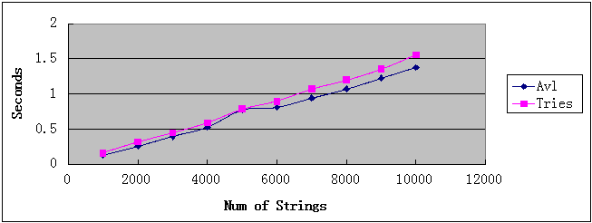
Testing results
Insert N strings in increasing order and delete them in the same order;

Slide 17
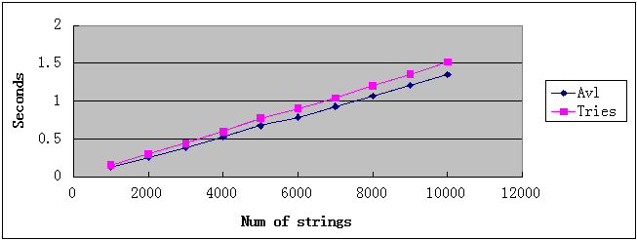
Testing results
Insert N strings in increasing order and delete them in the reverse order

Slide 18
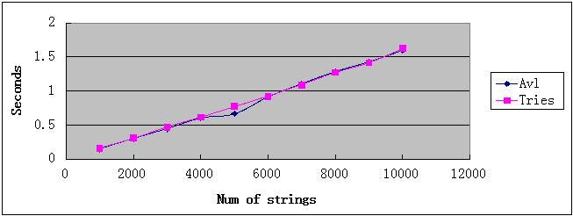
Testing results
Insert N strings in random order and delete them in random order.

Slide 19
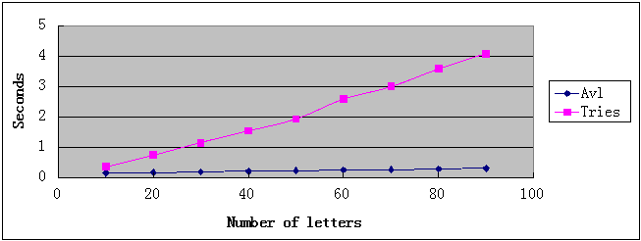
Testing results
Insert N strings in increasing order and delete them in the same order

Slide 20

Testing results
Insert N strings in increasing order and delete them in the reverse order

Slide 21

Testing results
Insert N strings in random order and delete them in random order.

Slide 22
Testing results

Slide 23
Conclusion and comments
the running times of AVL tree is faster than Tries in most cases.
It is clear that the running times of AVL tree almost didn’t vary when the lengths of string vary.
Through the project , we could find that both of AVL and Tries are excellent algorithms.AVL tree is very fast and has a very stable search time and suitable for a lot of cases . But AVL is not very easy to implement and Tries is suitable for some cases such as string is not very long .
So facing with a problem , we would better have a serious thought and choose a good algorithm.

Slide 24

Problems and possible improvements
惰性删除
Trie的删除算法
count

Slide 25
Problems and possible improvements
惰性删除——
操作简单，时间复杂度低
重复插入相同或含有相同首部单词容易
空间复杂度高，无法彻底删除无用节点

Slide 26
Problems and possible improvements
count删除——
理论上降低空间复杂度（从count变量和节点大小比较）
重新插入相同或带有相同部首单词时间复杂度大大增加
操作复杂，每次需花费O(N)进行count更新
删除算法复杂
实际应用中价值有待商榷

Slide 27
Problems and possible improvements
测试文档
输出重复

Slide 28

Problems and possible improvements
旋转内存访问失败
运行结果前后不一

Slide 29
Problems and possible improvements
Trie插入失败
节点删除后未定义
第一次测试完后无法正常测试
没有rewind

