Slide 1
Logistic Regression I

Slide 2
Outline
Introduction to maximum likelihood estimation (MLE)
Introduction to Generalized Linear Models
The simplest logistic regression (from a 2x2 table)—illustrates how the math works…
Step-by-step examples
Dummy variables
  Confounding and interaction

Slide 3
Introduction to Maximum Likelihood Estimation
a little coin problem….
You have a coin that you know is biased towards heads and you want to know what the probability of heads (p) is.
YOU WANT TO ESTIMATE THE UNKNOWN PARAMETER p

Slide 4
Data
You flip the coin 10 times and the coin comes up heads 7 times. What’s you’re best guess for p?
Can we agree that your best guess for is .7 based on the data?

Slide 5
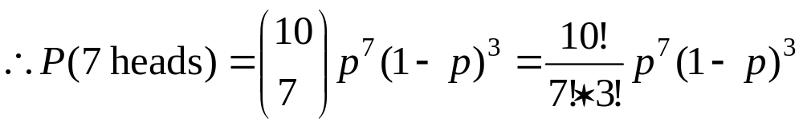
The Likelihood Function
What is the probability of our data—seeing 7 heads in 10 coin tosses—as a function p?
The number of heads in 10 coin tosses is a binomial random variable with N=10 and p=(unknown) p.
This function is called a LIKELIHOOD FUNCTION.
It gives the likelihood (or probability) of our data as a function of our unknown parameter p.

Slide 6
The Likelihood Function
We want to find the p that maximizes the probability of our data (or, equivalently, that maximizes the likelihood function).
THE IDEA: We want to find the value of p that makes our data the most likely, since it’s what we saw!

Slide 7
Maximizing a function…
Here comes the calculus…
Recall: How do you maximize a function?
Take the log of the function
  --turns a product into a sum, for ease of taking derivatives. [log of a product equals the sum of logs: log(a*b*c)=loga+logb+logc and log(a^{c})=cloga]
Take the derivative with respect to p.
--The derivative with respect to p gives the slope of the tangent line for all values of p (at any point on the function).
3. Set the derivative equal to 0 and solve for p.
--Find the value of p where the slope of the tangent line is 0— this is a horizontal line, so must occur at the peak or the trough.

Slide 8
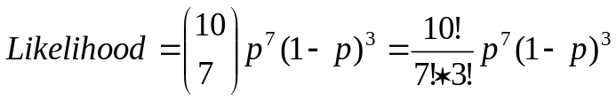
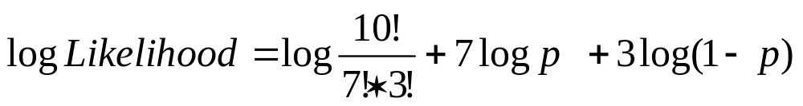
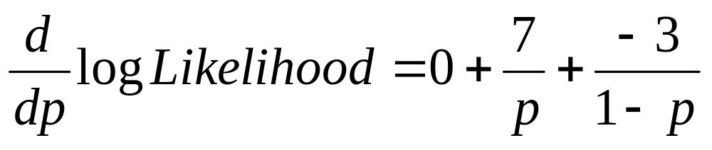
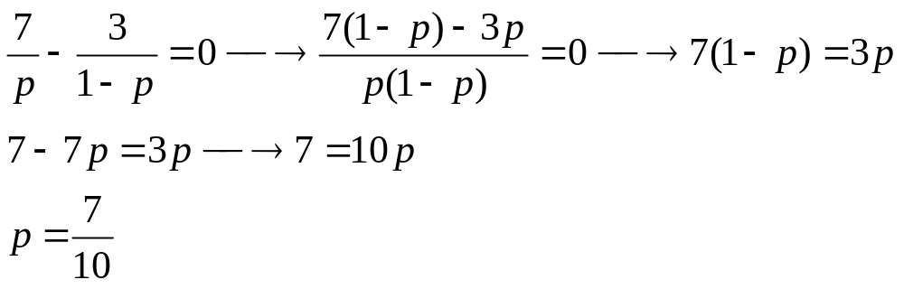
1. Take the log of the likelihood function.
Jog your memory→
*derivative of a constant is 0
*derivative 7f(x)=7f '(x)
*derivative of log x is 1/x
*chain rule
2. Take the derivative with respect to p.
3. Set the derivative equal to 0 and solve for p.

Slide 9
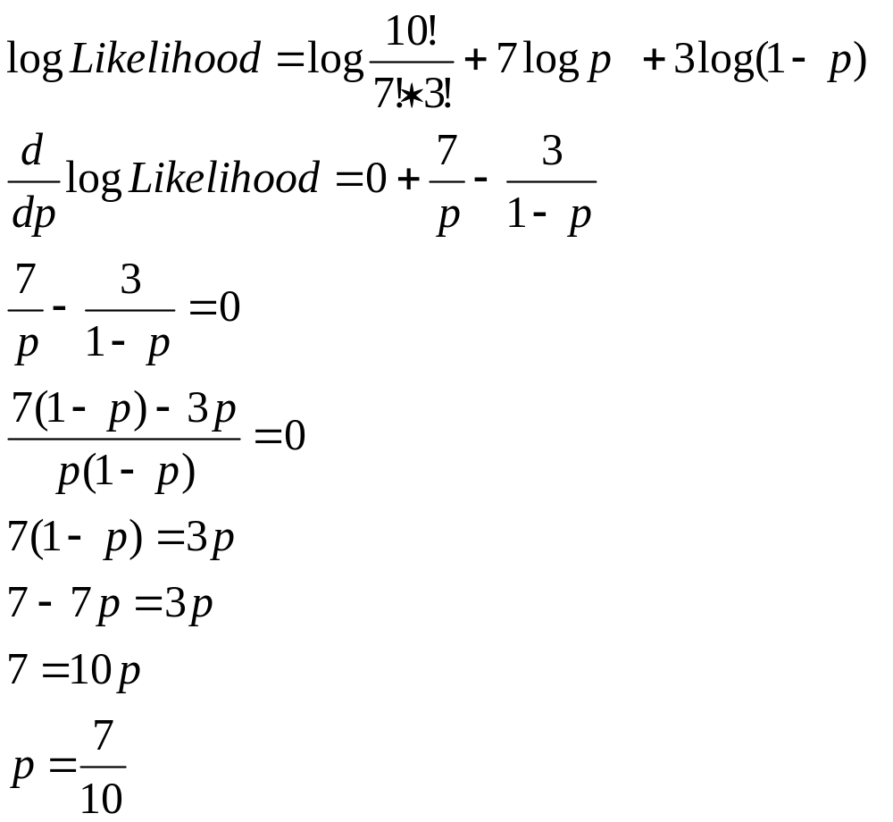
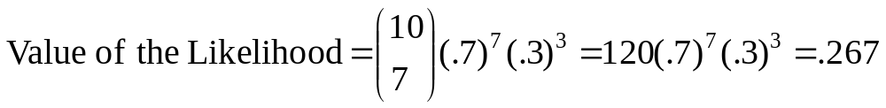
RECAP:
The actual maximum value of the likelihood might not be very high.
Here, the –2 log likelihood (which will become useful later) is:

Slide 10
Thus, the MLE of p is .7
So, we’ve managed to prove the obvious here!
But many times, it’s not obvious what your best guess for a parameter is!
MLE tells us what the most likely values are of regression coefficients, odds ratios, averages, differences in averages, etc.
{Getting the variance of that best guess estimate is much trickier, but it’s based on the second derivative, for another time ;-) }

Slide 11
Generalized Linear Models
Twice the generality!
The generalized linear model is a generalization of the general linear model
SAS uses PROC GLM for general linear models
SAS uses PROC GENMOD for generalized linear models

Slide 12
Recall: linear regression
Require normally distributed response variables and homogeneity of variances.
Uses least squares estimation to estimate parameters
  Finds the line that minimizes total squared error around the line:
  Sum of Squared Error (SSE)= Σ(Y_{i}-(α + βx))²
  Minimize the squared error function:
  derivative[Σ(Y_{i}-(α + βx))²]=0→ solve for α,β

Slide 13
Why generalize?
General linear models require normally distributed response variables and homogeneity of variances. Generalized linear models do not. The response variables can be binomial, Poisson, or exponential, among others.

Slide 14
Example : The Bernouilli (binomial) distribution
y
Lung cancer; yes/no
n
Smoking (cigarettes/day)

Slide 15
Could model probability of lung cancer…. p= α + β₁*X
The probability of lung cancer (p)
1
]
But why might this not be best modeled as linear?
[
0
Smoking (cigarettes/day)

Slide 16
Alternatively…
log(p/1- p) = α + β₁*X
Logit function

Slide 17
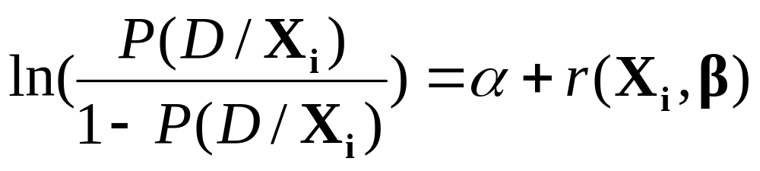
The Logit Model
Bolded variables represent vectors
Linear function of risk factors and covariates for individual i:
β₁x₁ + β₂x₂ + β₃x₃ + β₄x₄ …
Baseline odds
Logit function (log odds)

Slide 18
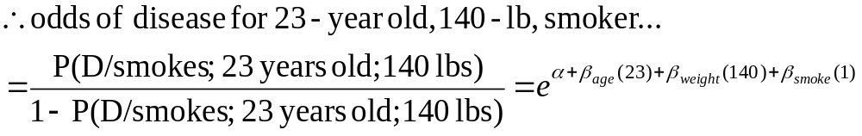
Example
Linear function of risk factors and covariates for individual i:
β₁x₁ + β₂x₂ + β₃x₃ + β₄x₄ …
Logit function (log odds of disease or outcome)
Baseline odds

Slide 19
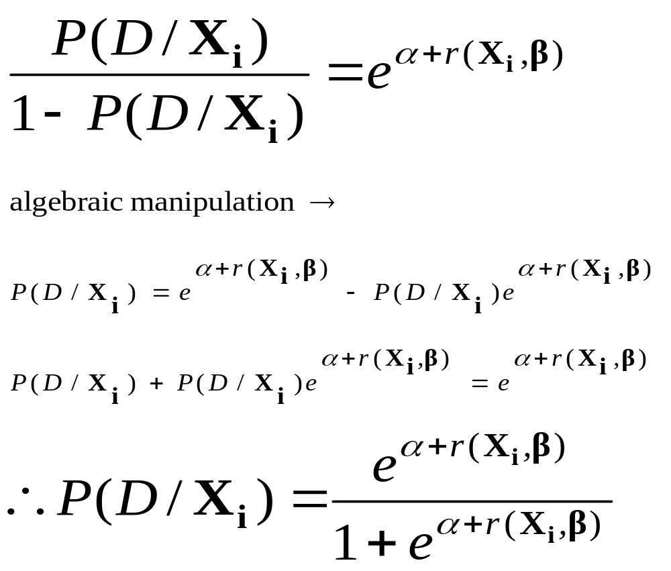
Relating odds to probabilities
odds
algebra
probability

Slide 20
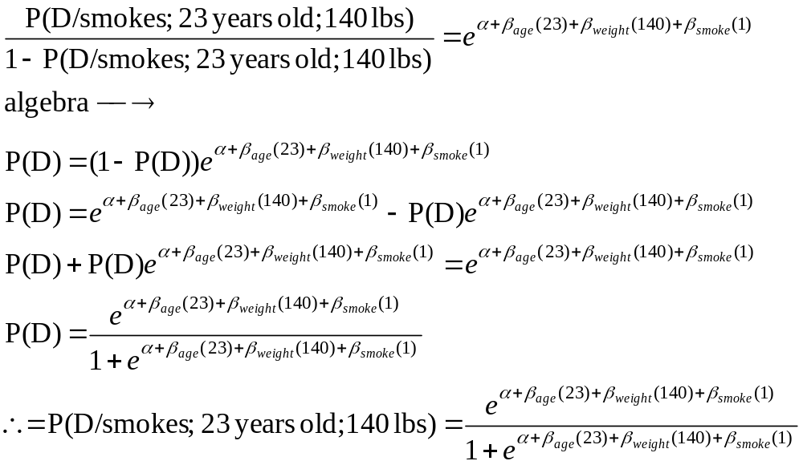
Relating odds to probabilities
odds
algebra
probability

Slide 21
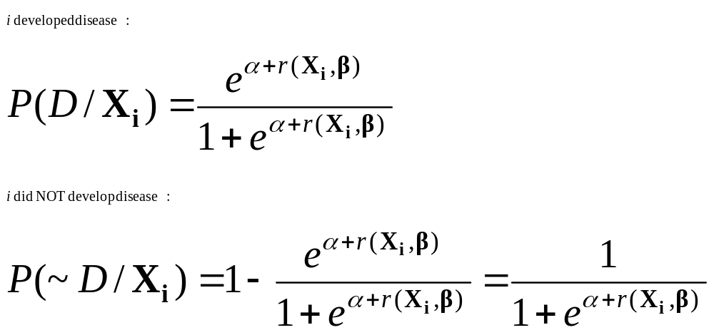
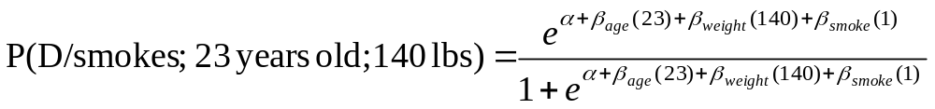
Individual Probability Functions
Probabilities associated with each individual’s outcome:
Example:

Slide 22
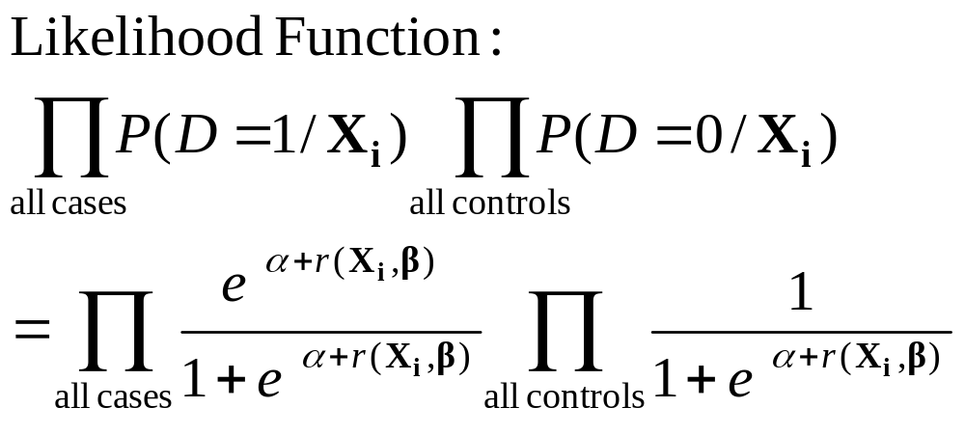
The Likelihood Function
The likelihood function is an equation for the joint probability of the observed events as a function of β

Slide 23
Maximum Likelihood Estimates of β
Take the log of the likelihood function to change product to sum:
Maximize the function (just basic calculus):
Take the derivative of the log likelihood function
Set the derivative equal to 0
Solve for β

Slide 24
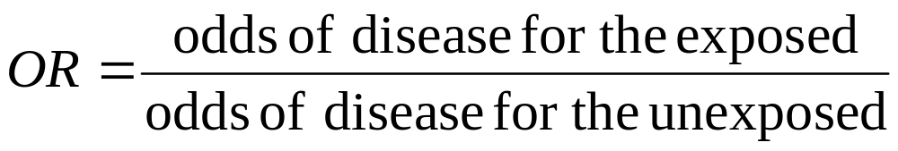
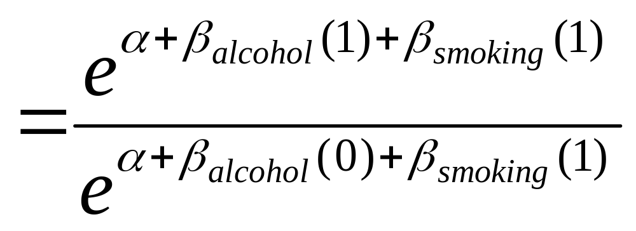
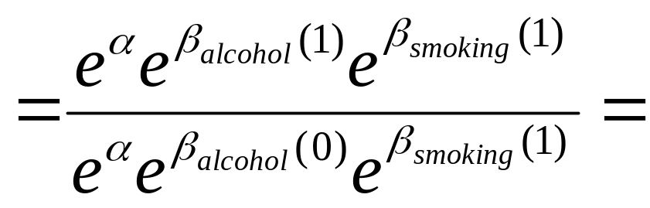
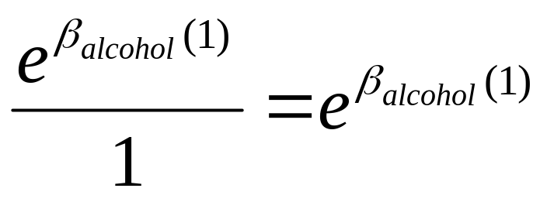
“Adjusted” Odds Ratio Interpretation

Slide 25
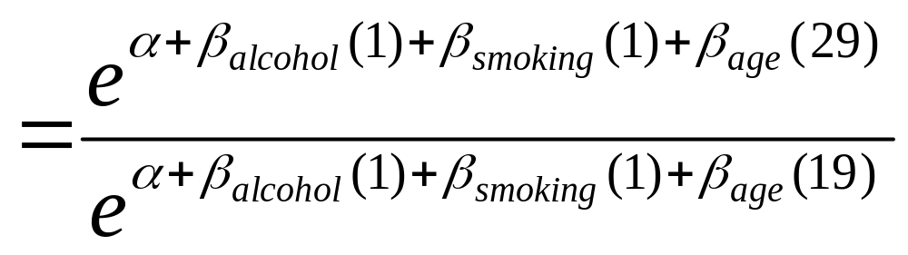
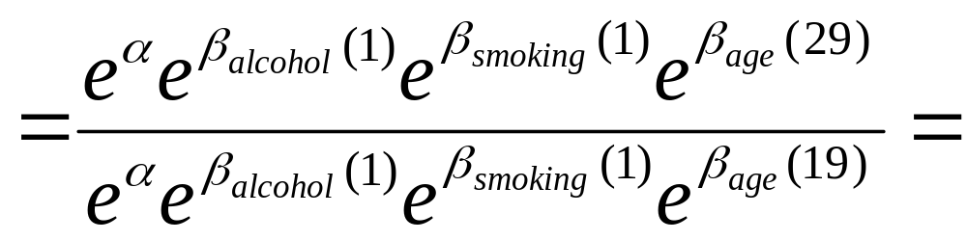
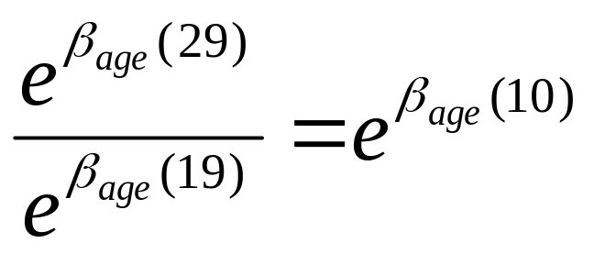
Adjusted odds ratio, continuous predictor

Slide 26
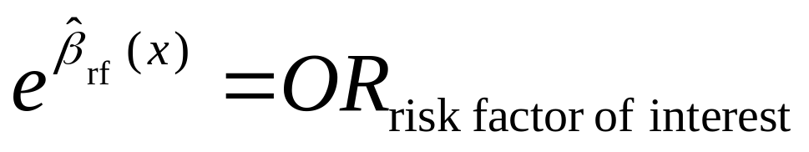
Practical Interpretation
The odds of disease increase multiplicatively by e^{ß} for every one-unit increase in the exposure, controlling for other variables in the model.

Slide 27
Simple Logistic Regression

Slide 28
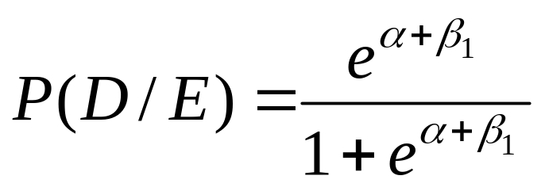
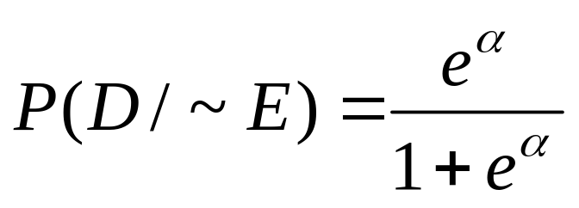
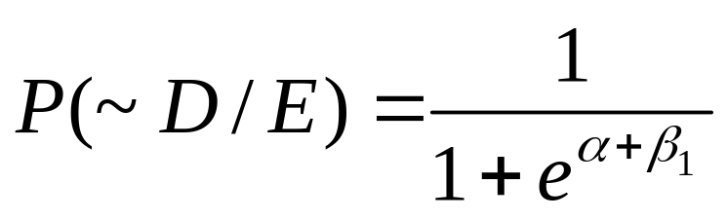
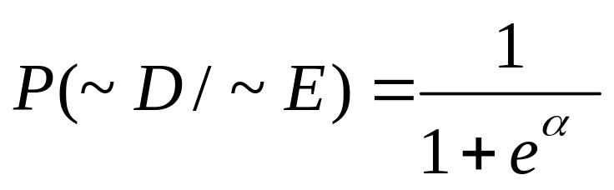
2x2 Table
(courtesy Hosmer and Lemeshow)
Exposure=1
Exposure=0
Disease = 1
Disease = 0

Slide 29
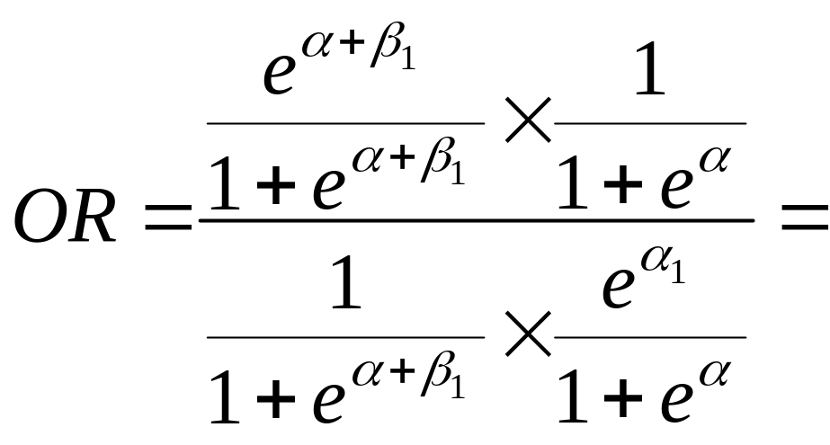
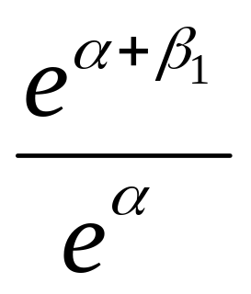
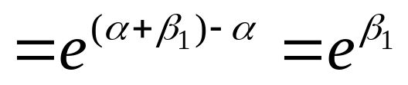
Odds Ratio for simple 2x2 Table
(courtesy Hosmer and Lemeshow)

Slide 30
Example 1: CHD and Age (2x2)
(from Hosmer and Lemeshow)
=>55 yrs
<55 years
CHD Present
21
22
6
51
CHD Absent

Slide 31
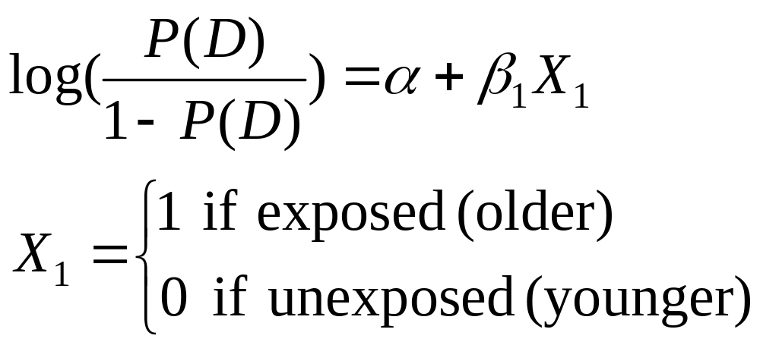
The Logit Model

Slide 32
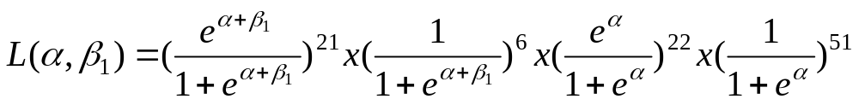
The Likelihood

Slide 33
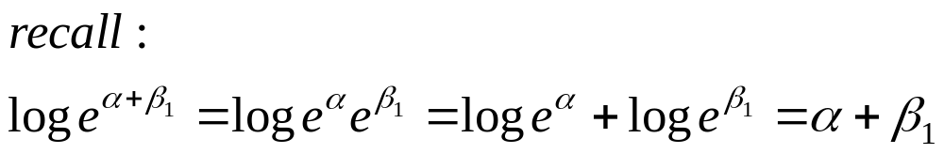
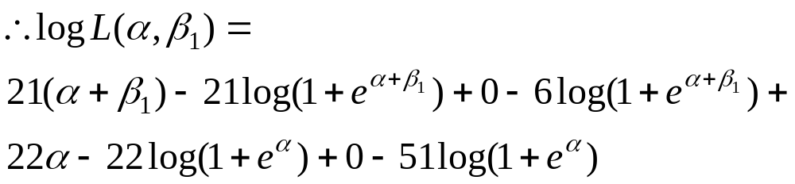
The Log Likelihood

Slide 34
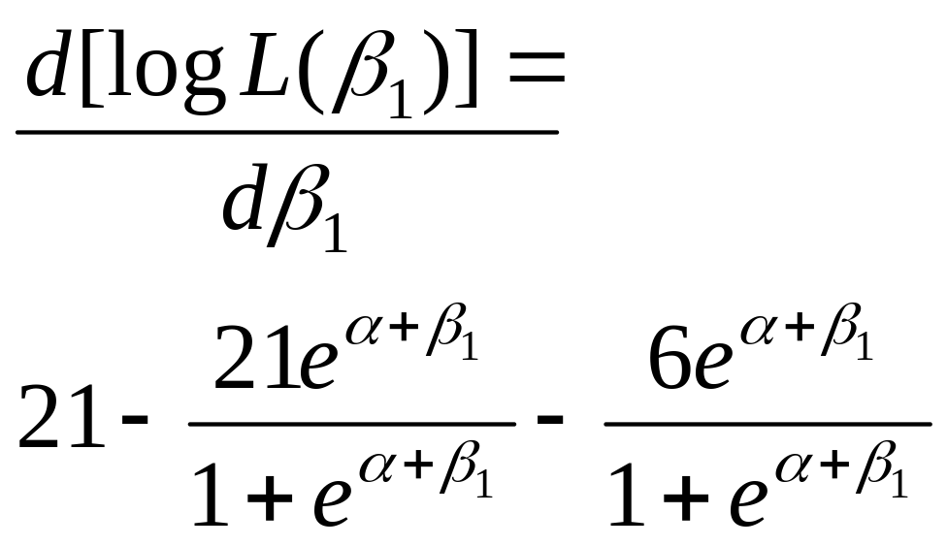
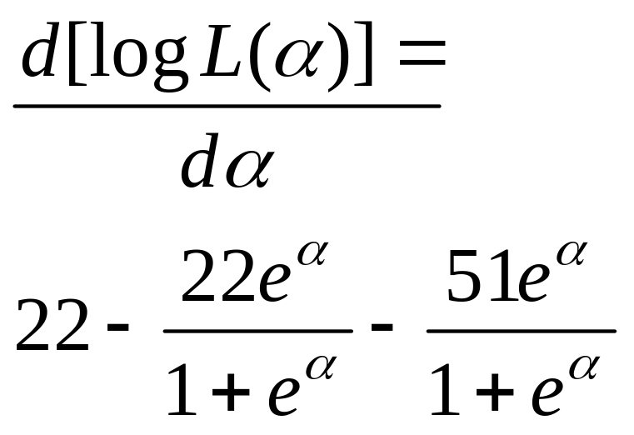
Derivative(s) of the log likelihood

Slide 35
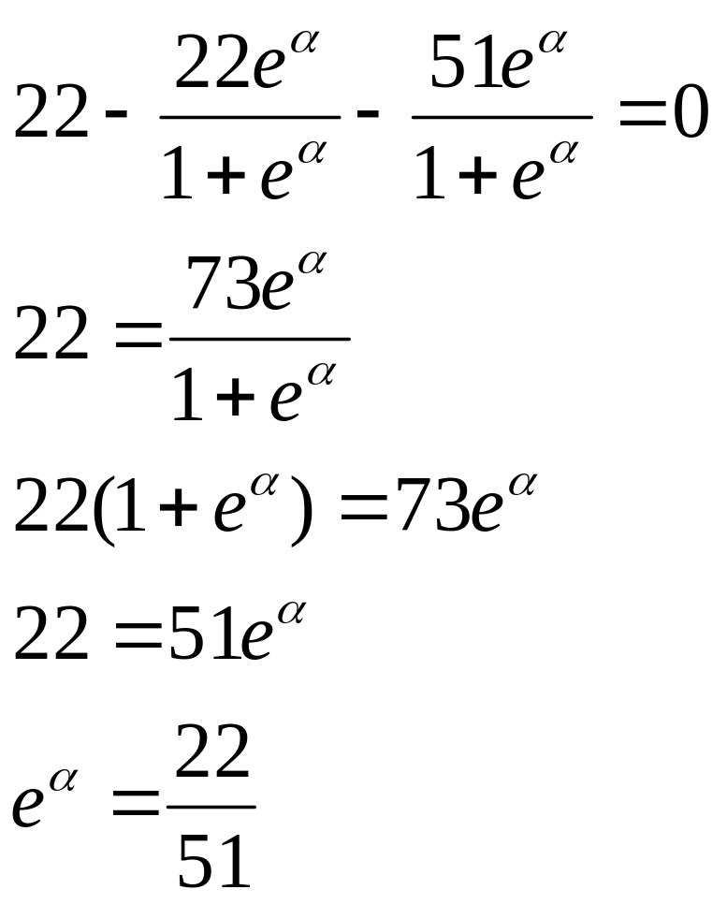
Maximize α
=Odds of disease in the unexposed (<55)

Slide 36
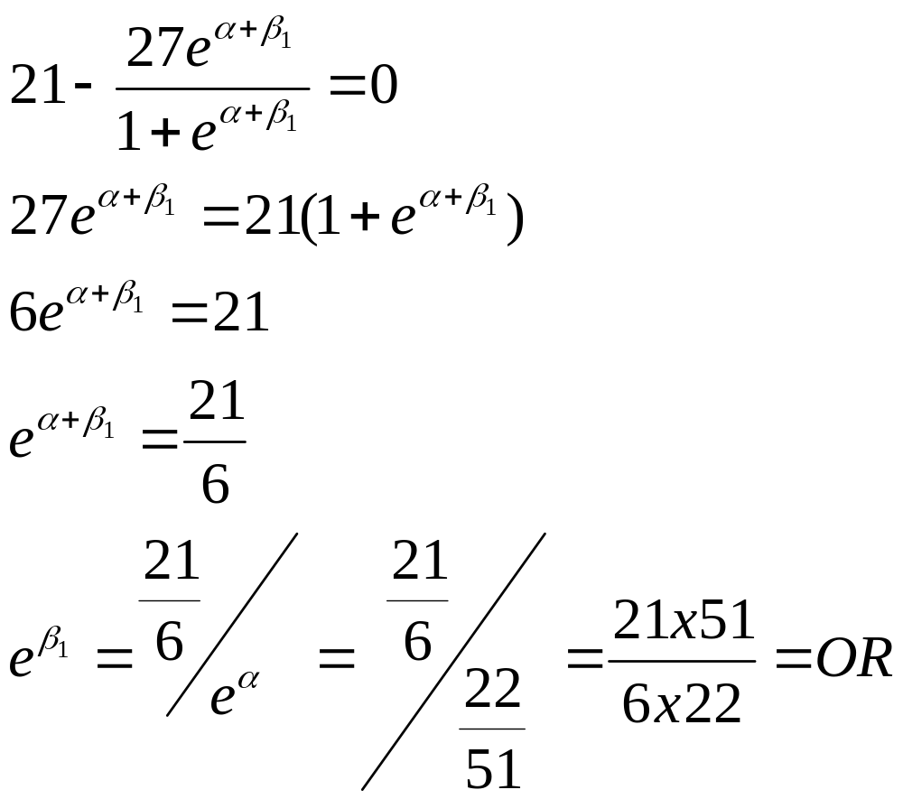
Maximize β₁

Slide 37
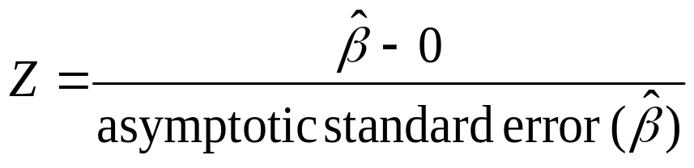
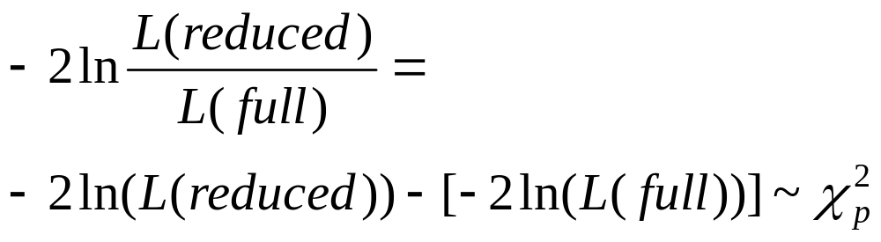
Hypothesis Testing
H₀: β=0
Null value of beta is 0 (no association)
1. The Wald test:
  2. The Likelihood Ratio test:
  Reduced=reduced model with k parameters; Full=full model with k+p parameters

Slide 38
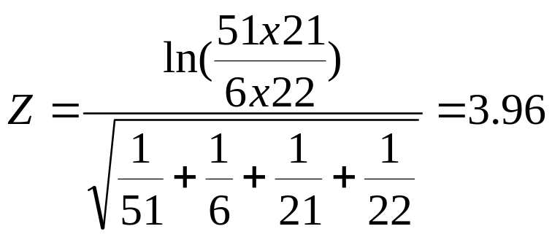
Hypothesis Testing
H₀: β=0
1. What is the Wald Test here?
  2. What is the Likelihood Ratio test here?
  Full model = includes age variable
  Reduced model = includes only intercept
    Maximum likelihood for reduced model ought to be (.43)⁴³x(.57)⁵⁷ (57 cases/43 controls)…does MLE yield this?…

Slide 39
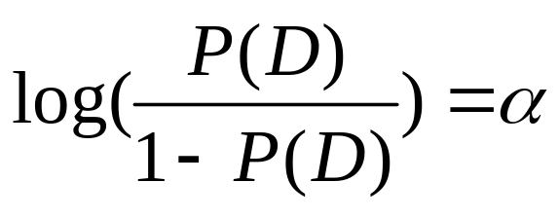
The Reduced Model

Slide 40
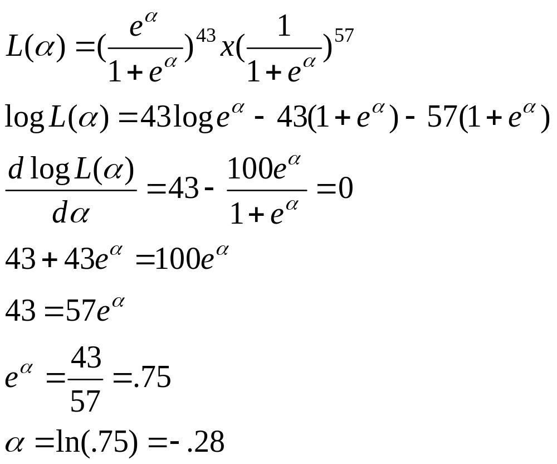
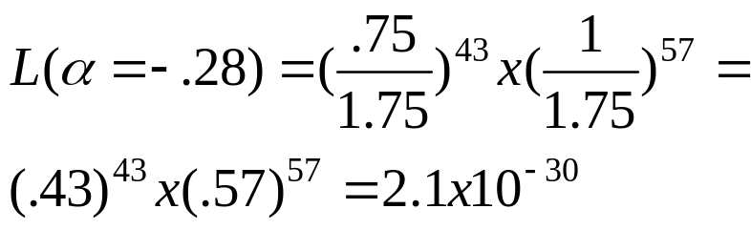
Likelihood value for reduced model
= marginal odds of CHD!

Slide 41
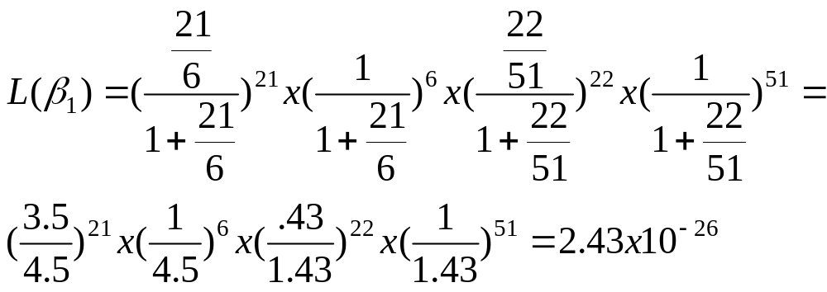
Likelihood value of full model

Slide 42
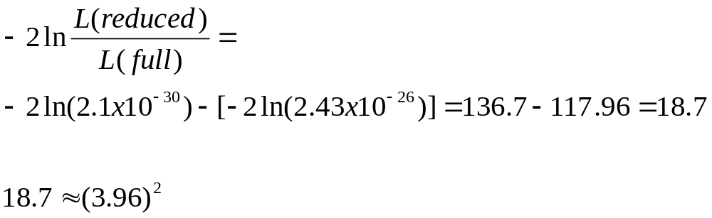
Finally the LR…

Slide 43
Example 2:
>2 exposure levels
*(dummy coding)
CHD status
White
Black
Hispanic
Other
Present
5
20
15
10
Absent
20
10
10
10
(From Hosmer and Lemeshow)

Slide 44
SAS CODE
data race;
input chd race_2 race_3 race_4 number;
datalines;
0 0 0 0 20
1 0 0 0 5
0 1 0 0 10
1 1 0 0 20
0 0 1 0 10
1 0 1 0 15
0 0 0 1 10
1 0 0 1 10
end;
run;
proc logistic data=race descending;
weight number;
model chd = race_2 race_3 race_4;
run;
Note the use of “dummy variables.”
“Baseline” category is white here.

Slide 45
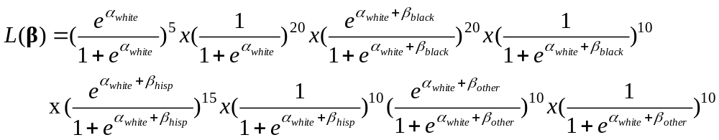
What’s the likelihood here?
In this case there is more than one unknown beta (regression coefficient)—so this symbol represents a vector of beta coefficients.

Slide 46
SAS OUTPUT – model fit
Intercept
Intercept and
Criterion Only Covariates
AIC 140.629 132.587
SC 140.709 132.905
-2 Log L 138.629 124.587
Testing Global Null Hypothesis: BETA=0
Test Chi-Square DF Pr > ChiSq
Likelihood Ratio 14.0420 3 0.0028
Score 13.3333 3 0.0040
Wald 11.7715 3 0.0082

Slide 47
SAS OUTPUT – regression coefficients
Analysis of Maximum Likelihood Estimates
Standard Wald
Parameter DF Estimate Error Chi-Square Pr > ChiSq
Intercept 1 -1.3863 0.5000 7.6871 0.0056
race_2 1 2.0794 0.6325 10.8100 0.0010
race_3 1 1.7917 0.6455 7.7048 0.0055
race_4 1 1.3863 0.6708 4.2706 0.0388

Slide 48
SAS output – OR estimates
The LOGISTIC Procedure
Odds Ratio Estimates
Point 95% Wald
Effect Estimate Confidence Limits
race_2 8.000 2.316 27.633
race_3 6.000 1.693 21.261
race_4 4.000 1.074 14.895
Interpretation:
8x increase in odds of CHD for black vs. white
6x increase in odds of CHD for hispanic vs. white
4x increase in odds of CHD for other vs. white

Slide 49
Example 3: Prostrate Cancer Study (same data as from lab 3)
Question: Does PSA level predict tumor penetration into the prostatic capsule (yes/no)? (this is a bad outcome, meaning tumor has spread).
Is this association confounded by race?
Does race modify this association (interaction)?

Slide 50
What’s the relationship between PSA (continuous variable) and capsule penetration (binary)?

Slide 51
Capsule (yes/no) vs. PSA (mg/ml)
psa vs. capsule
capsule
1.0
0.9
0.8
0.7
0.6
0.5
0.4
0.3
0.2
0.1
0.0
0
10
20
30
40
50
60
70
80
90
100
110
120
130
140
psa

Slide 52
Mean PSA per quintile vs. proportion capsule=yes
→ S-shaped?
proportion
with
capsule=yes
0.70
0.68
0.66
0.64
0.62
0.60
0.58
0.56
0.54
0.52
0.50
0.48
0.46
0.44
0.42
0.40
0.38
0.36
0.34
0.32
0.30
0.28
0.26
0.24
0.22
0.20
0.18
0
10
20
30
40
50
PSA (mg/ml)

Slide 53
logit plot of psa predicting capsule, by quintiles
→ linear in the logit?
Est. logit
0.17
0.16
0.15
0.14
0.13
0.12
0.11
0.10
0.09
0.08
0.07
0.06
0.05
0.04
0
10
20
30
40
50
psa

Slide 54
psa vs. proportion, by decile…
proportion
with
capsule=yes
0.9
0.8
0.7
0.6
0.5
0.4
0.3
0.2
0.1
0
10
20
30
40
50
60
70
PSA (mg/ml)

Slide 55
logit vs. psa, by decile
Estimated logit plot of psa predicting capsule in the data set kristin.psa
Est. logit
0.44
0.42
0.40
0.38
0.36
0.34
0.32
0.30
0.28
0.26
0.24
0.22
0.20
0.18
0.16
0.14
0.12
0.10
0.08
0.06
0.04
0
10
20
30
40
50
60
70
psa
m = numer of events M = number of cases

Slide 56
model: capsule = psa
Testing Global Null Hypothesis: BETA=0
Test Chi-Square DF Pr > ChiSq
Likelihood Ratio 49.1277 1 <.0001
Score 41.7430 1 <.0001
Wald 29.4230 1 <.0001
Analysis of Maximum Likelihood Estimates
Standard Wald
Parameter DF Estimate Error Chi-Square Pr > ChiSq
Intercept 1 -1.1137 0.1616 47.5168 <.0001
psa 1 0.0502 0.00925 29.4230 <.0001

Slide 57
Model: capsule = psa race
Analysis of Maximum Likelihood Estimates
Standard Wald
Parameter DF Estimate Error Chi-Square Pr > ChiSq
Intercept 1 -0.4992 0.4581 1.1878 0.2758
psa 1 0.0512 0.00949 29.0371 <.0001
race 1 -0.5788 0.4187 1.9111 0.1668
No indication of confounding by race since the regression coefficient is not changed in magnitude.

Slide 58
Model: capsule = psa race psa*race
Standard Wald
Parameter DF Estimate Error Chi-Square Pr > ChiSq
Intercept 1 -1.2858 0.6247 4.2360 0.0396
psa 1 0.0608 0.0280 11.6952 0.0006
race 1 0.0954 0.5421 0.0310 0.8603
psa*race 1 -0.0349 0.0193 3.2822 0.0700
Evidence of effect modification by race (p=.07).

Slide 59
STRATIFIED BY RACE:
---------------------------- race=0 ----------------------------
Standard Wald
Parameter DF Estimate Error Chi-Square Pr > ChiSq
Intercept 1 -1.1904 0.1793 44.0820 <.0001
psa 1 0.0608 0.0117 26.9250 <.0001
---------------------------- race=1 ----------------------------
Analysis of Maximum Likelihood Estimates
Standard Wald
Parameter DF Estimate Error Chi-Square Pr > ChiSq
Intercept 1 -1.0950 0.5116 4.5812 0.0323
psa 1 0.0259 0.0153 2.8570 0.0910

Slide 60
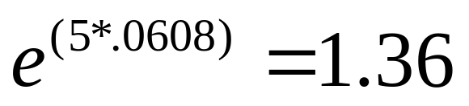
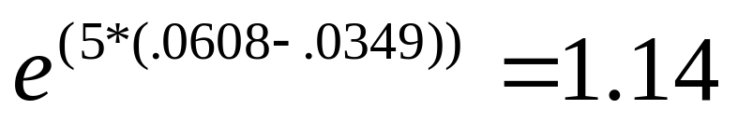
How to calculate ORs from model with interaction term
Standard Wald
Parameter DF Estimate Error Chi-Square Pr > ChiSq
Intercept 1 -1.2858 0.6247 4.2360 0.0396
psa 1 0.0608 0.0280 11.6952 0.0006
race 1 0.0954 0.5421 0.0310 0.8603
psa*race 1 -0.0349 0.0193 3.2822 0.0700
Increased odds for every 5 mg/ml increase in PSA:
If white (race=0):
If black (race=1):

