Slide 1




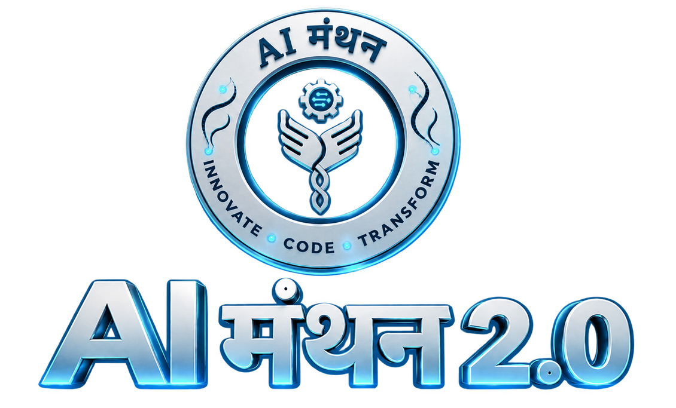
Acropolis Institute of Technology and Research, Indore
Department of Information Technology
AI for Career Development
GRIMOIRE
Learn. Interview. Get Hired.
Team BotS
Team Leader: Aditya Bajantri

Slide 2
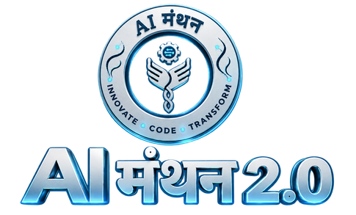

BotS
GRIMOIRE: Autonomous AI Career Platform
Proposed Solution
How It Addresses the Problem
Innovation and Uniqueness
AI career coach from skill gap to job offer
Diagnoses gaps with a smart test
Builds a week-by-week roadmap
Voice mock interviews with live code review
Webcam feedback on posture and eye contact
Tamper-proof badges and a public portfolio
Problem: students finish courses but freeze in interviews
Human mock interviews cost ₹3,000+ per hour
GRIMOIRE practises the real interview, voice plus code
Roadmap adapts when scores drop
Verified proof of work replaces keyword resumes
One platform: learn, practise, get verified
Multimodal: voice, vision and code together
Ed25519-signed credentials employers can trust
Link-checked learning resources
Working prototype already built
Students don't fail from lack of knowledge. They fail from lack of practice under pressure.
AI – मंथन 2.0
2

Slide 3
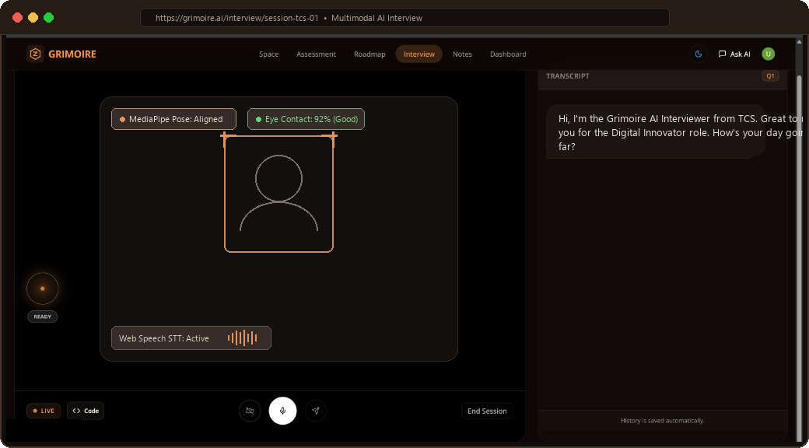
BotS
TECHNICAL APPROACH
Technologies Used
Frontend
Backend
AI / LLM
Vision & Speech
Data
Next.js, React, TypeScript, Tailwind
Python, FastAPI, WebSockets
Groq (Llama 3), Gemini, Ollama
MediaPipe, OpenCV, Web Speech API
ChromaDB, Redis, Firestore, PostgreSQL
Methodology: Student Journey
Working Prototype: Step 4 (AI Mock Interview Room)
1. Diagnostic Assessment: Skill-gap test & personalized baseline score
2. Adaptive Learning Plan: AI-curated roadmap with live resource verification
3. Contextual Doubt Solver: Multi-modal AI assistant for voice & code queries
4. Multimodal Mock Interview: Real-time voice STT/TTS, vision posture & coding simulator
5. Verifiable Credential: Ed25519 tamper-proof digital cryptographic badge
AI – मंथन 2.0
3

Slide 4
BotS
FEASIBILITY AND VIABILITY
Feasibility
Challenges and Risks
Strategies to Overcome
Full-stack prototype already working
Built on open-source tools and free-tier AI APIs
Estimated cost under ₹5 per session
Scales through campus training cells
Modular agents: each can be upgraded alone
Plan: pilot in colleges, then scale
AI API limits and cost
Multi-model failover: Groq, Gemini, local Ollama
Webcam privacy
Consent first. Only posture and eye-contact scores are used
Wrong or dead study links
Deterministic search plus link checks
Weak internet in Tier-2/3 colleges
Offline fallback and browser-based speech
AI – मंथन 2.0
4

Slide 5
BotS
IMPACT AND BENEFITS
Target Audience
Social
Economic
Engineering and STEM students
Tier-2 and Tier-3 colleges
Training and placement cells
Recruiters who want proof of skills
Mentoring for students who cannot afford it
More confidence before real interviews
About ₹5 per session vs ₹3,000+ per hour
Faster, better-matched hiring
Institutional
Environmental
Standard placement training without outside agencies
Progress data for colleges
Fully online coaching, no travel
Paperless verified credentials
Estimated ₹5 per session vs ₹3,000+ per hour for a human mock interview
AI – मंथन 2.0
5

Slide 6
BotS
RESEARCH AND REFERENCES
Concepts and Research
Tools and Documentation
Retrieval-Augmented Generation (Lewis et al., 2020)
arxiv.org/abs/2005.11401
Ed25519 signatures: RFC 8032
rfc-editor.org/rfc/rfc8032
Bloom's Taxonomy for adaptive difficulty
Anderson & Krathwohl, 2001
GRIMOIRE prototype
Working build, demo on request
Google MediaPipe
ai.google.dev/edge/mediapipe
ChromaDB vector database
docs.trychroma.com
Groq inference API
console.groq.com/docs
FastAPI and Next.js
fastapi.tiangolo.com, nextjs.org/docs
Web Speech API (MDN)
developer.mozilla.org
AI – मंथन 2.0
6

Slide 7
BotS
Thank You
Team BotS | Aditya Bajantri
AI – मंथन 2.0
7

