Slide 1

Sliding-Window QPS (SW-QPS): A Perfect Parallel Iterative Switching Algorithm for Input-Queued Switches
Jingfan Meng
Long Gong, Jun (Jim) Xu
Notes:
Hello everyone! I am Jingfan Meng from Georgia Tech. Today, I present Sliding Window QPS, a perfect scheduling algorithm for input-queued crossbar switches.
15s

Slide 2
Input-Queued Crossbar Switches
Background & Motivation
SB-QPS
SW-QPS
Conclusion
Packets
Input 1
VOQ 1
Crossbar
Output 1
Segment
Assemble
VOQ N
Input N
VOQ 1
Output N
Segment
Assemble
VOQ N
Segment variable-size packets into fixed-size
Reassemble packets before they leave
All the (input/output) ports and the crossbar operate at the same speed;
This speed is normalized at 1.
Notes:
First, let me introduce the background of input-queued switches. In such a switch, each input port holds N Virtual Output Queues, or VOQs. For example, VOQ1 of input 1 holds all packets from input 1 to output 1, so there the head-of-line packet will not block other packets going to different output ports.
We further assume that we only deal with fixed-size packet segments in the crossbar, and that all input ports, output ports and the crossbar works at normalized speed 1, so there is no speed-up at the crossbar.
50s

Slide 3
Crossbar Scheduling: Constraint
Background & Motivation
SB-QPS
SW-QPS
Conclusion
Which input connects to which output?
Input 1
VOQ 1
Crossbar
Output 1
Input 1
Output 1
VOQ N
Input 2
Output 2
?
Input N
VOQ 1
Output N
VOQ N
Input N
Output N
During each switching cycle, or time slot
Each input can only connect to a single output
Each output can only be connected by a single input
Notes:
The crossbar structure poses a constraint that each input or output port can connect to at most one port on the other side of the crossbar, so the mission of our scheduler is to decide on which input connects to which output for the best performance.
25s

Slide 4

Crossbar Scheduling: Model
Background & Motivation
SB-QPS
SW-QPS
Conclusion
Abstraction
N$×$ N Crossbar Switch
Bipartite Graph
Valid schedule
Matching
Input 1
VOQ 1
Crossbar
Output 1
Input 1
Output 1
VOQ N
Input 2
Output 2
Input N
VOQ 1
Output N
VOQ N
Input N
Output N
Notes:
To capture this constraint, we model the crossbar as a bipartite graph. The input ports and output ports are two disjoint vertex sets, and there is an edge between input i and output port j if and only if the VOQ j of input i is not empty.
Under such a model, each valid crossbar schedules corresponds to a matching in this bipartite graph. So we will refer to this constaint “the matching” constraint in this presentation.
40s

Slide 5
Crossbar Scheduling: (Informal) Formulation
Background & Motivation
SB-QPS
SW-QPS
Conclusion
objective maximize throughput; and/or
minimize (mean) delay
subject to
Throughput: the average number of packets that exit an output port during each time slot
Matching Constraint
Timing Constraint
Delay: the number of time slots elapsed since the arrival of a packet to its eventual departure from the switch
The connections between the input and output ports should be a valid matching.
For example, at 40 Gbps, 64-byte packets require one matching every 12.8 ns.
Implementation Constraint
The algorithm should be simple to implement in hardware.
Notes:
The goal of crossbar scheduling is to compute “high-quality” matchings that can maximize the throughput and minimize the queueing delay.
The throughput is the number of packets that leaves the switch and delay is the time a packet spends in the switch.
Besides the matching constraint, there are some other constraints for crossbar scheduling. An ideal scheduler should be fast enough for high-speed links and simple enough for low cost implementation.
35s

Slide 6
Crossbar Scheduling: Tradeoff
Background & Motivation
SB-QPS
SW-QPS
Conclusion
Quality of the matching
Time to compute the matching
Notes:
However, there is a well-known tradeoff between the quality of the matching and the amount of time needed to compute the matching.
15s

Slide 7


Existing Research Work: Maximum Matching Quality
Background & Motivation
SB-QPS
SW-QPS
Conclusion
objective maximize throughput and minimize delay
subject to
matching constraint
The connections between the input and output ports should be a valid matching.
Maximum Weighted Matching (MWM) [McKeown99a]
100% throughput and near-optimal empirical delay
$\text{centralized} O(N^{2.5}\log{W})$ time
Q
T
Notes:
For example, if we care only about the matching quality and has no time constraint on computing a high quality matching. MWM is a good choice with 100% throughput and low empirical day. But the high time complexity of MWM stops it from being widely implemented in switches.
25s
First, let’s only consider the objective of maximizing the throughput, since it is much simpler.
For this optimization problem, many optimal solutions or policies, have been proposed and proved by various researchers.
For example, …
You might think that maximum cardinality matching should also be among those optimal policies, since it maximizes the instantaneous throughput every switching cycle, or in other words, it tries to transmit
as many as possible packets for each switching cycle. Suprisingly, it have been proved that MCM cannot attain 100%.

Slide 8



Existing Research Work : Parallel Iterative Schedulers
Background & Motivation
SB-QPS
SW-QPS
Conclusion
objective maximize throughput and minimize delay
subject to
iSLIP [McKeown99b]
widely used
matching constraint
timing constraint
QPS-1 [Gong20]
O(1) complexity
implementation constraint
Their throughput and (high load) delay performances are much worse than MWM.
Q
T
Notes:
On the other side, under strict timing constrains, we may choose parallel iterative schedulers. For example, iSLIP is widely used and QPS-1 has only O(1) time complexity. However, because these schedulers are parallel and heuristic in nature, the quality of the produced matchings are far from optimal.
30s
Now let’s consider the objective of minimizing the mean delay. As expected, this problem is much more complicated. To the best of my knowledge, no optimal policy have been found until today.
The best policy along this objective is Fair-Frame. It provably attains 100% and achieves a mean delay no larger than O(log N). We note that here “The Best Policy” is placed in double quotation marks because it is only the best theoretical result that has been proved.
As we will show later, empirically, the average queueing delay of Fair-Frame is much higher than that of MWM.

Slide 9





Comparison of Scheduling Schemes
Background & Motivation
SB-QPS
SW-QPS
Conclusion
MWM [McKeown99a] | 100% |  | $$O(N^{2.5}\log{W})$$ centralized
1
iSLIP [McKeown99b] | ~80% |  | $$O(\log^{2}N)$$ parallel
4
QPS-1 [Gong20] | ~65% |  | $$O(1)$$ parallel
5
SB-QPS this work | ~85% |  | $$O(1)$$ parallel
3
SW-QPS this work | ~90% |  | $$O(1)$$ parallel
2
throughput
(average) delay
(rank: 1 is lowest)
complexity
Notes:
Here we compare the existing works that fall in this tradeoff of matching quality and time complexity. MWM is good on quality, iSLIP and QPS-1 are good on time complexity. In this work, we propose two parallel iterative schedulers that achieve the better of both worlds. Our final result, SW-QPS, achieves 90% empirical throughput with only O(1) time complexity. In the following part of this presentation, I will describe the design ideas from QPS-1 to SB-QPS and then to SW-QPS.
45s

Slide 10

QPS-1 : Propose and Accept
Background & Motivation
SB-QPS
SW-QPS
Conclusion
QPS-1 [Gong20] computes each matching with the following two stages:
1
1
1. Each input port proposes to exactly one output port.
1
1
2
2
2
2
3
3
2. Each output port accepts exactly one input port.
3
3
4
4
4
4
input
output
input
output
Our schemes also follow this paradigm, but we use batching to alleviate proposal conflicts.
Notes:
We first introduce QPS-1, because our schemes are based on this simple scheduler.
QPS-1 computes one matching in one round of two stages: a proposing stage and an acceptance stage.
In the proposing stage, each input port randomly selects one output port and propose to it.
However, multiple input ports may propose to the same output, resulting in a conflict (like output port 4 in this figure).
Therefore, in the acceptance stage, output port 4 accepts only one proposal and the result is a matching.
From this figure, we see conflicts in proposals results in loss of throughput, and our schemes solves this issue by batching the conflicts.
55s

Slide 11
SB-QPS: Batching the Conflicts to maximize throughput
Background & Motivation
SB-QPS
SW-QPS
Conclusion
Small Batch Joint Calendar (output view)
t | 1 | 2 | 3 | 4 | … | T
o1 |  | i2 |  |  | …
o2 |  | i1 |  |  | …
o3 | i2 |  |  | i1 | …
o4 | i3 |  |  |  | …
1
1
2
2
3
3
4
4
input
output
i2
i4
T time slots, T matchings, T rounds of proposing/accepting.
Notes:
In SB-QPS, we compute a batch of T matchings with T rounds of proposals and acceptances. This batch of T matchings is call the joint calendar, and each port has a local view on it. In this case of proposal conflicts, output 4 may try to accommodate both proposals at different time slots of the joint calendar without losing any of them.
However, there is a caveat.
In this case, input 2 has already connected to output 1 at time slot 2, but output 4 cannot foresee this conflict with only its own view of the joint calendar.
We now present how SB-QPS avoids this conflict in detail.
55s

Slide 12
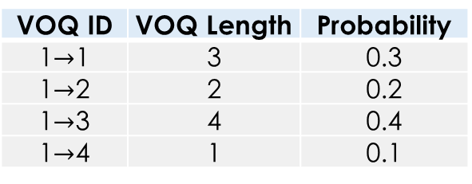
Proposing: Queue Proportional Sampling (QPS)
Background & Motivation
SB-QPS
SW-QPS
Conclusion
VOQ ID | VOQ Length | Probability
1$→$1 | 3 | 0.3
1$→$2 | 2 | 0.2
1$→$3 | 4 | 0.4
1$→$4 | 1 | 0.1
4
1
3
2
Input 1
VOQ 1
Crossbar
Output 1
VOQ 4
Input N
1. Sample a VOQ
VOQ 1
Output 4
2. Propose to Output 1
VOQ 4
Notes:
We focus on proposing stage of input 1. Here are the lengths of each VOQ at input 1. The target of proposal is sampled from this wheel, which has 4 sectors corresponding to each VOQ and the area of each sector is proportional to the VOQ length.
Now we see, VOQ 1 is selected.
So input 1 proposes to output 1 in the following format.
30s

Slide 13
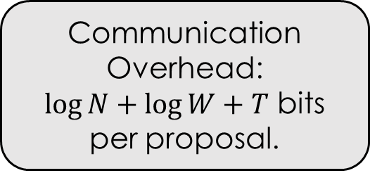
Proposal Format
Background & Motivation
SB-QPS
SW-QPS
Conclusion
Input ID | VOQ Length | Availability
1 | 3
1010…1
1-N
0-W
{0,1} x T
Communication Overhead:
$\log{N}+\log{W}+T$ bits per proposal.
Joint Calendar (input view)
t | 1 | 2 | 3 | 4 | … | T
i1 |  | o2 |  | o3 | …
32 bits when N = 64, W = 1023, T = 16
1 0 1 0 … 1
Notes:
The proposal contains the id of the input port, the corresponding VOQ length, and the availability information, which encodes whether input 1 is available or occupied at each time slot of the joint calendar.
Here, N is the number of input ports, W is the maximum VOQ length and T is the batch size.
We claim that our communication overhead is small under typical values of these parameters.
35s

Slide 14
Accepting: First Fit Accepting (FFA)
Background & Motivation
SB-QPS
SW-QPS
Conclusion
1
1
Joint Calendar (output view)
t | 1 | 2 | 3 | 4 | … | T
o1 |  | i2 |  |  | …
o2 |  | i1 |  |  | …
o3 | i2 |  |  | i1 | …
o4 | i3 |  |  |  | …
2
2
i1
3
3
4
4
i3
1 1 1 1 … 1
0 0 1 1 … 1
input
output
(input view)
i4
i2
Input ID | VOQ len | Availability
1 |  | 1010…1
2 |  | 0011…1
3 |  | 0111…1
4 |  | 1111…1
Sort in decreasing order of VOQ length.
Match at first commonly available time slot.
3
8
5
6
Notes:
We now describe the acceptance stage of SB-QPS using this conflicting case. Here are the proposals from each input port.
Output 4 first sorts the received proposals in descending order of VOQ length. It accommodates input 2 first because it has a longer VOQ.
Input 2 is accommodated to the first commonly available time slot of both input 2 and output 4, which is time slot 3. The first fit can be found with a single instruction if the availability fits in one machine word.
Input 4 is added after input 2, and its first fit is time slot 2.
Other outputs also add their received proposals to the first fit of their joint calendar in parallel, and we can see there is no conflict in the joint calendar.
70s

Slide 15
SW-QPS: Avoiding the Batching Delay
Background & Motivation
SB-QPS
SW-QPS
Conclusion
T rounds of proposing & accepting
T matchings in Joint Calendar
 |  |  |  |  |  |  |  | . . .
1 | 2 | 3 | 4 | … | T
 |  |  |  | …
SB-QPS
P A P A P A P A…P A
Batching delay (significant under low loads)
SW-QPS
(sliding window)
1
2 | 3 | 4 | … | T
 |  |  | …
T+1
…
P A
P A
One round
One matching is scheduled.
Notes:
SB-QPS achieves high throughput with low complexity, but it suffers from a large batching delay, which is significant under low loads. Recall that SB-QPS computes a batch of T matchings in T rounds. Even if a packet is matched in the first round, it has to wait for this batch to complete before it is scheduled.
To eliminate this batching delay, we propose SW-QPS, which is the final result of this research.
In SW-QPS, the proposing and accepting stages are exactly the same as in SB-QPS, but after each round, we regard the first matching in the joint calendar as completed. This matching is immediately scheduled without waiting for the rest of the batch. Then, a new empty matching is appended to the joint calendar and we do another round of proposing and accepting and so on.
70s

Slide 16
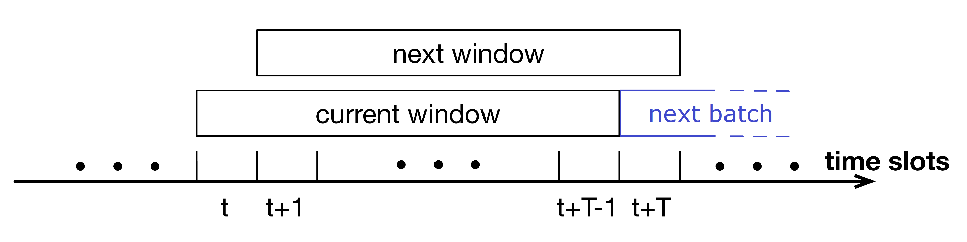
SW-QPS: Timeline
Background & Motivation
SB-QPS
SW-QPS
Conclusion
Remarks:
SW-QPS uses the same proposing and accepting schemes as in SB-QPS and produces one matching in each time slot.
The time complexity of each round (each matching) is O(1) if the T-bit availability fits in a machine word.
Notes:
From this figure, we can see that the joint calendar of SW-QPS slides on the timeline, just as the name suggests. It produces one matching in each time slot, which is much smoother than SB-QPS, which is shown in blue color.
25s

Slide 17
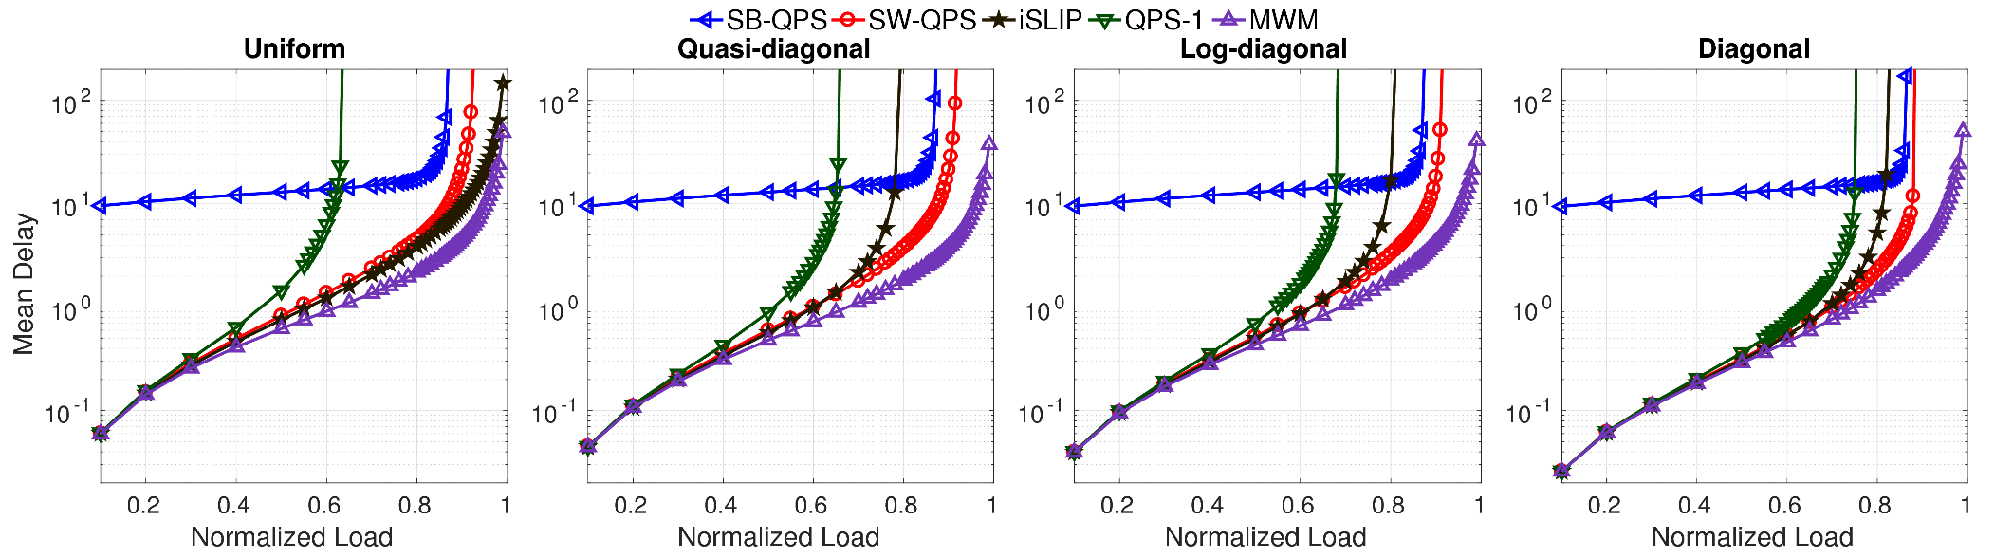
SW-QPS: Empirical Performance
Background & Motivation
SB-QPS
SW-QPS
Conclusion
Assumptions:
Independent Bernoulli arrival process
N=64 input and output ports, batch size T=16
maximum number of processed proposals = 3 per round
Notes:
Here, we show the mean delay under different loads in simulation. We simulated four generated traffic patterns modeled as a Bernoulli arrival process. We use 64 input ports, 64 output ports and a batch size of 16. We further constrain that each output port can process up to three proposals in each round as a hardware implementation constraint.
We can see SW-QPS eliminates the batching delay of SB-QPS, performs better than QPS-1 and is better than iSLIP under all patterns except uniform.
60s

Slide 18
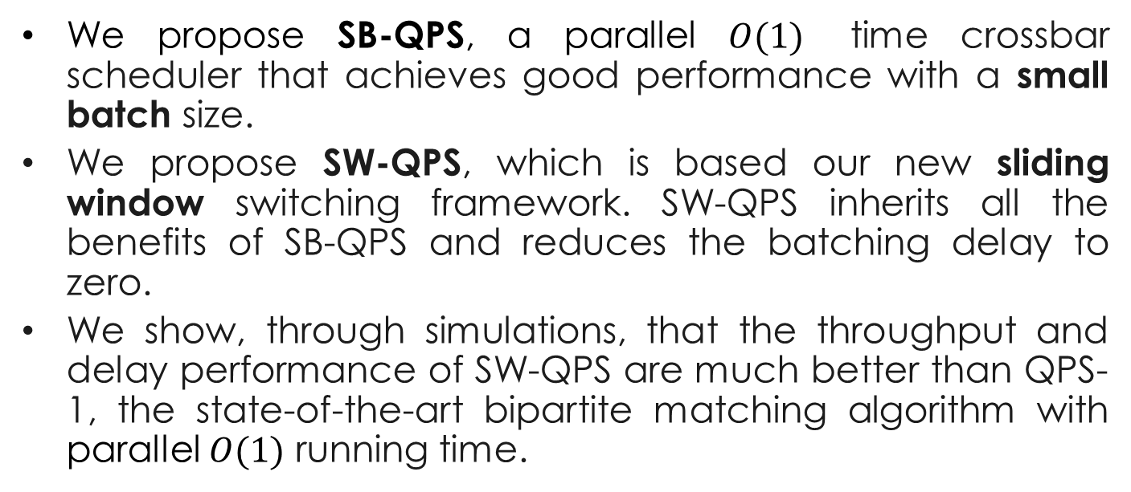
Conclusion
Background & Motivation
SB-QPS
SW-QPS
Conclusion
We propose SB-QPS, a parallel $O(1)$ time crossbar scheduler that achieves good performance with a small batch size.
We propose SW-QPS, which is based our new sliding window switching framework. SW-QPS inherits all the benefits of SB-QPS and reduces the batching delay to zero.
We show, through simulations, that the throughput and delay performance of SW-QPS are much better than QPS-1, the state-of-the-art bipartite matching algorithm with parallel $O(1)$ running time.
Notes:
In conclusion, we propose SW-QPS, a parallel iterative scheduler for input-queued crossbar switches that achieves high throughput, low mean delay empirically with just O(1) complexity.
Thank you.
45s

Slide 19
References
Background & Motivation
SB-QPS
SW-QPS
Conclusion
[Gong17] L. Gong, P. Tune, L. Liu, S. Yang, and J. Xu. Queue-proportional sampling: A better approach to crossbar scheduling for input-queued switches. Proceedings of the ACM SIGMETRICS, 1(1):3:1–3:33, June 2017.
[Gong20] L. Gong, J. Xu, L. Liu, and S. T. Maguluri. QPS-r: A cost-effective crossbar scheduling algorithm and its stability and delay analysis. In Proceedings of the EAI VALUETOOLS, 2020.
[McKeown99a] N. McKeown, A. Mekkittikul, V. Anantharam, and J. Walrand. Achieving 100% Throughput in an Input-Queued Switch. IEEE Trans. Commun., 47(8):1260–1267, Aug. 1999.
[McKeown99b] N. McKeown. The iSLIP Scheduling Algorithm for Input-queued Switches. IEEE/ACM Trans. Netw., 7(2):188–201, Apr. 1999.
Notes:
In this preliminary work, we ..

