Slide 1
Queue-Proportional Sampling: A Better Approach to Crossbar Scheduling for Input-Queued Switches
Long Gong, Paul Tune, Liang Liu, Sen, Jun (Jim) Xu
Notes:
Good afternoon, professors. I am Long Gong, and my advisor is Prof. Jim Xu.
Today, my topic is Queue- …
There are five parts in my presentation.

Slide 2
Contents
1
Background
2
Related Work
3
Proposed Algorithm
4
Simulation Results
5
Conclusion
Notes:
In the first part, I will give some background on input-queued crossbar switches. Then we will talk about some related work. After that, I will describe the details of queue-proportional sampling scheme, followed by some simulations results. Finally, I will summarize this presentation. First, Let’s come into the background part.

Slide 3
Contents
1
Background
2
Related Work
3
Proposed Algorithm
4
Simulation Results
5
Conclusion

Slide 4
Input-Queued Crossbar Switches
Packets
Input 1
VOQ 1
Crossbar
Output 1
Segment
Assemble
VOQ N
Input N
VOQ 1
Output N
Segment
Assemble
VOQ N
Segment variable-size packets into fixed-size
Reassemble packets before they leave
Notes:
Nowadays, most high-speed switching systems, such as Internet routers and data-center switches, employ a single crossbar to interconnect input ports and output ports.
To solve the HOL blocking issue, each input port has N virtual output queues (VOQs). The VOQ j at input port I serves as a buffer for packets going from input port I to output port j.
For example, here the VOQ 1 at input port 1 buffers the packets that want to go from input port 1 to output port 1.
In this work, we also adopt the standard assumption. That is all incoming packets are segmented into fixed-size before they are put into the corresponding VOQs and then reassembled
Before leaving the switch.

Slide 5
Scheduling for Input-Queued Crossbar Switches
Abstraction
Which input connects to which output?
Input 1
VOQ 1
Crossbar
Output 1
Input 1
Output 1
VOQ N
Input 2
Output 2
?
Input N
VOQ 1
Output N
VOQ N
Input N
Output N
Constraints (Physical Limits of the Crossbar)
Each input can only connect to a single output
Each output can only be connected by a single input
Notes:
Due to the physical limits of a crossbar fabric, in an input-queued switch, each input port can only connect to a single output port and vice versa in each switching cycle, or time slot.
Hence, input-queued switches need to decide which input port connects to which output port per time slot. More specially, they need to compute a one-to-one matching between input ports and output ports

Slide 6
Scheduling for Input-Queued Crossbar Switches: Formulation
Model: Weighted Complete Bipartite Graph
Problem: Compute a one-to-one matching between input and output ports
Input 1
Output 1
Quality of the matching
Time to compute the matching
Input 2
Output 2
Challenge: “high quality” matchings (i.e., high through-put & low delay) at high speed
Input N
Output N
Notes:
Generally, a NXN crossbar switch is modeled as a weighted bipartite graph, where the two disjoint sets of vertices are the input ports and output ports, respectively. The weight is some function of the length of the corresponding VOQs.
The problem is to compute high-quality matchings that result in high switch throughput and low delay at high speed.
Unfortunately, there exists a tradeoff between the quality of the matchings and the time to compute them.

Slide 7
Contents
1
Background
2
Related Work
3
Proposed Algorithm
4
Simulation Results
5
Conclusion
Notes:
Next, let’s see some related work.

Slide 8

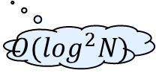

Existing Scheduling for Input- Queued Crossbar Switches
Empirically optimal
Quality of the matching
Time to compute the matching
Maximum Weighted Matching (MWM)
$$O(N^{3})$$
Good delay performance
Quality of the matching
Time to compute the matching
iSLIP [McKeown99]
Quality of the matching
$$O(\log^{2}N)$$
Close to MWM
Time to compute the matching
$$O(N)$$
Serena [Giaccone03]
Notes:
Now, let’s see how the tradeoff was handled in existing work.
Maximum Weighted Matching with suitable weight measure, is known to produce the empirically optimal matchings in terms of queuing delay for a large variety of traffic patterns. However, each such matching decision takes O(N^3) time to compute, which is too time-consuming to be used. Researchers have been searching for alternatives that have performance close to MWM but with much lower time complexity.
iSLIP is one such algorithm, which is an iterative algorithm with good delay performance. It has a per-port complexity of (log N)^2 (log N iterations with each iteration having O(log N) circuit depth). Although it achieved great commercial success, iSLIP generally can not achieve 100% except under uniform traffic, thus it could have very high delay even infinite delay under heavy non-uniform traffic.
Serena is also such algorithm, which is a centralized algorithm with linear time complexity . It can achieve 100% throughput and excellent delay performance.

Slide 9






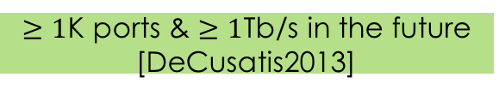
Why Need New Scheduling Algorithms
Reality
Achieve Better Tradeoff
$≥1$K ports & $≥1$Tb/s in the future [DeCusatis2013]
Improve
Quality of the matching
Decrease
Badly Need
Time to compute the matching
Switches Can Connect A Large Number of Ports and Operate at Very High Speed
Notes:
You might be wondering why we still need to design new scheduling algorithms considering we already have such good ones like iSLIP and Serena.
Thanks to the big success of Big Data, video streaming, online social networking, and etc, the volumes of network traffic are growing relentlessly.
Driven by the surge of the traffic, it is expected that a switch would have more than 1000 ports and the line rate of each port could be larger than 1 Tb/s.
Therefore, switches that are capable of connecting a large number of ports and operating at very high speed is badly needed.
In this work, we aim at achieving better tradeoff. Clearly, we can either improve the quality of the matchings or decrease the computational complexity. In this work, we proposed a solution to improve the performance with very low computational overhead.

Slide 10
Contents
1
Background
2
Related Work
3
Proposed Algorithm
4
Simulation Results
5
Conclusion
Notes:
Now, Let’s see how our scheme works.

Slide 11
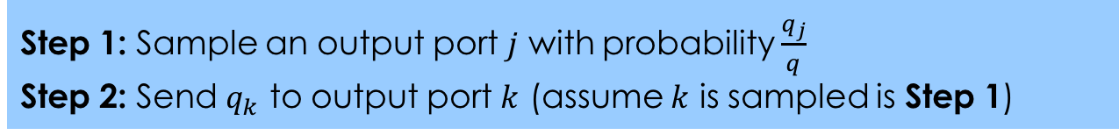
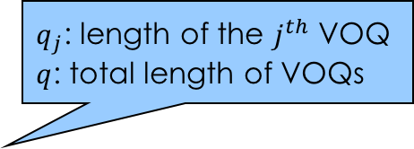
Queue-Proportional Sampling (QPS): Overview
$q_{j}$: length of the $j^{th}$ VOQ
$q$: total length of VOQs
Proposing (at any input port)
Accepting (at any output port)
Step 1: Sample an output port $j$ with probability $\frac{q_{j}}{q}$
Step 2: Send $q_{k}$ to output port $k$ (assume $k$ is sampled is Step 1)
Accept the one with the largest VOQ length if receiving one or more proposals
Note that, besides the “longest VOQ first” accepting strategy, we also investigate “proportional” accepting
Notes:
Our strategy is called Queue-proportional sampling, which is a general add-on approach to boost the performance of existing scheduling algorithms, such as iSLIP and Serena.
This strategy is extremely simple. It has two stages. The first one is called proposing. In this stage, each input port first samples out an output port with the probability proportional to the corresponding VOQ length, then the input port sends a proposal requests together with the VOQ length to the output port that is sampled.
The second stage is accepting. In this stage, each output port upon receiving one or more proposals, it accepts the one with the largest VOQ length. Note that, besides the “longest VOQ first”, we also investigate other accepting strategies, such as proportional accepting.

Slide 12
Queue-Proportional Sampling (QPS): Example
VOQ ID | VOQ Length
1 | 3
2 | 7
3 | 6
4 | 2
Sample a VOQ
2
3
Input 1
6
7
VOQ 1
Crossbar
Output 1
VOQ 4
Proposals
Input ID | VOQ Length
1 | 3
4 | 1
Input N
VOQ 1
Output 4
VOQ 4
Notes:
Now, let’s see a concrete example, with N=4. For the proposing, let’s focus on input port 1, the lengths of all VOQs are shown in the table.
First of all, it samples out a output port with probability proportional to the corresponding VOQ lengths. It samples output 1. Then, it sends the length of VOQ 1 to output 1.
For the accepting, let’s focus on output 1, assuming besides the proposal from input port 1, it also gets a proposal from input port 4. Output 1 accepts the proposal from input port 1, since it has a longer VOQ.

Slide 13

Queue-Proportional Sampling (QPS): O(1) Data Structure
VOQs at Input Port i
Main Data Structure
Array of linked lists
Each link list => VOQ
$$q_{j}$$
VOQ j
B | j
E | j
A | j
F | j
One-to-one correspondence
Auxiliary Data Structure
Array of all packets
“Packets” in All of VOQs at Input Port i
G |  | B |  | A |  | C | D
Notes:
It may look at first that one may need up to O(N) time complexity to finish the QPS. However, it is possible to implement QPS efficiently with only O(1) time complexity.
Now let’s see the O(1) data structures.
Although the O(1) data structures are fairly simple and straightforward, we did not find any similar ones in the literature.
The data structures have one main data structure and one auxiliary. The main data structure is just an array of linked lists, where each linked list corresponds to a VOQ. Besides the pointers for forming the linked list, each entry in the linked list has a pointer points to the actual packet (shown as a letter), a index recording which VOQ the packet is located. It also holds a pointer that points to the corresponding entry in the auxiliary data structure.
The auxiliary data structure is just one array, where each entry corresponds to a packet in the input port. More specially, each entry in the array is a pointer points to the corresponding entry in the linked list of the corresponding VOQ. Hence there is one-to-one correspondence between entries in the main data structure and the entries in the auxiliary data structure.
Now, we use an example to show how the data structure works. Assume there are q entries in the auxiliary data structure.
First of all, we sample an entry from the auxiliary array by simply generating a uniformly distributed random variable in the range from 0 to q – 1. For example, the entry A is sampled. Then we find the entry in the linked list. However, it is not a head of line packet. We then get the head of line packet of the same VOQ, which is the packet B. Assume the proposal is accepted, which means we need eventually delete entry B from the linked list. Clearly, we also need to remove B from the auxiliary data structure. Now, there comes another problem, we can not afford to move forward all entries after B, however, we can easily fill this hole by moving the last entry into it.
It is clear that all these steps can be finished in O(1) time complexity.

Slide 14
Queue-Proportional Sampling (QPS): O(1) Data Structure
VOQs at Input Port i
Main Data Structure
Array of linked lists
Each link list => VOQ
$$q_{j}$$
VOQ j
E | j
A | j
F | j
One-to-one correspondence
Auxiliary Data Structure
Array of all packets
“Packets” in All of VOQs at Input Port i
G |  | D |  | A |  | C

Slide 15
QPS-Augmented Schemes
iSLIP
Request
Grant
Accept
Notes:
We let’s see how iSLIP and SERENA are augmented by our QPS.
ISLIP is an iterative crossbar scheduling algorithm. Each iteration contains three stages: request, accept and grant.
In the request stage, each input port sends requests to all output ports whose corresponding VOQs are not empty.
In the grant stage, each output port, upon receiving requests from multiple input ports, grants to one in a round-robin order.
Finally, in the accept stage, each input port, upon receiving accepts from multiple output ports, accepts one in a round-robin order, enforced similarly through an accept pointer.

Slide 16
QPS-Augmented Schemes
QPS-iSLIP
Only those un-matched ports in QPS
QPS
Request
Accept
Grant
SERENA
Arrival graph
Full matching
Merge
Final
Matching
Matching in the previous time slot
Notes:
QPS-augmented iSLIP, namely QPS-iSLIP can be viewed as adding a 0^{th} iteration. In this iteration, QPS is executed to generate a starter matching.
SERENA is an excellent adaptive scheduling algorithm. It first derives a full matching from the arrival graph, and then merge this full matching with
the matching used in the previous time slot. Since the only difference between SERENA and QPS augmented SERENA, namely QPS-SERENA is that
QPS-SERENA replaces the arrival graph with a starter matching generated by QPS, here I will not present the details of each steps in SERENA. If
you are interested, you can refer to our paper.

Slide 17
QPS-Augmented Schemes
QPS-iSLIP
Only those un-matched ports in QPS
QPS
Propose
Accept
Grant
QPS-SERENA
QPS
(Arrival graph)
Full matching
Merge
Final
Matching
Matching in the previous time slot

Slide 18
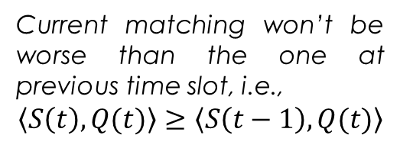
QPS-Serena: Stable?
Stability of Serena
Property P
Non-degenerative
At any time slot, there is a positive probability to achieve the weights of MWM
Current matching won’t be worse than the one at previous time slot, i.e.,
$$\left\langle S\left(t\right), Q(t)\right\rangle ≥\left\langle S\left(t−1\right), Q(t)\right\rangle$$
QPS-Serena does not satisfy
Notes:
For a scheduling algorithm, the stability is one of the most desired features.
It was proven that Serena is stable under any i.i.d. admissible traffic. Its stability comes from its two properties. Property P and Non-degenerative.
Therefore, there is a positive probability that Serena can achieve the same weights as MWM; and it guarantees that current matchings decision would not be worse that the previous one.
Although QPS-Serena also shares the non-degenerative property, but it generally does not satisfy the property p.

Slide 19
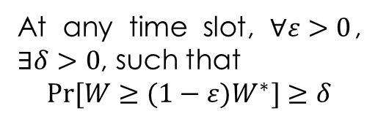
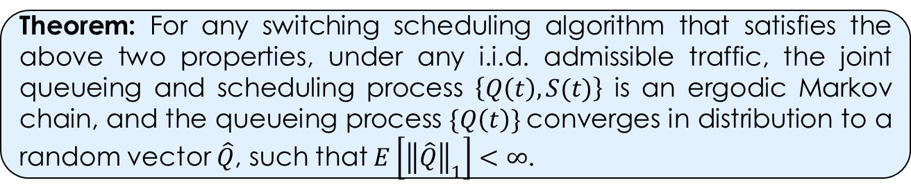
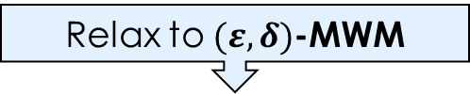
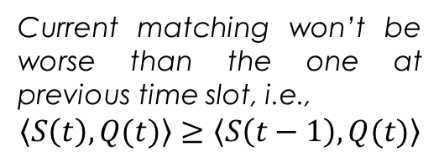
QPS-Serena: Stable!
Stability of QPS-Serena
Property P
Non-degenerative
Relax to $(ε,δ)$-MWM
Current matching won’t be worse than the one at previous time slot, i.e.,
$$\left\langle S\left(t\right), Q(t)\right\rangle ≥\left\langle S\left(t−1\right), Q(t)\right\rangle$$
At any time slot, $∀ε>0$, $∃δ>0$, such that
$$Pr⁡[W≥(1−ε)W^{∗}]≥δ$$
Theorem: For any switching scheduling algorithm that satisfies the above two properties, under any i.i.d. admissible traffic, the joint queueing and scheduling process $\left\{Q\left(t\right), S(t)\right\}$ is an ergodic Markov chain, and the queueing process $\{Q\left(t\right)\}$converges in distribution to a random vector $\hat{Q}$, such that $E\left[{\left\|\hat{Q}\right\|}_{1}\right]<∞$.
Notes:
To prove the stability of QPS-Serena, we derive a stronger theorem that accepts a relaxed property p. That is (epsilon, delta)-MWM property. More precisely, it states that at any time slot, for any epsilon bigger than zero, there exists a delta bigger than 0 such that the probability of the event that weight of the scheduling algorithm is at least (1-epsilon) of that of MWM is at least delta.

Slide 20
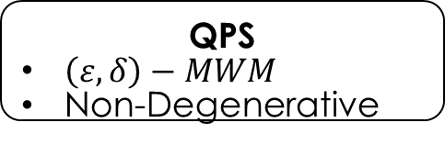
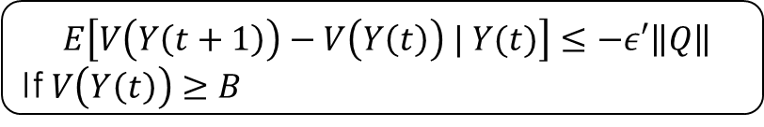
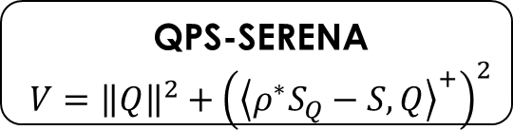
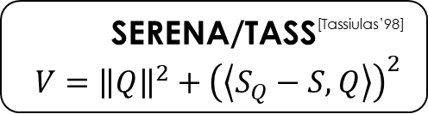

Basic Steps of Stability Proof based on Lyapunov Function
Abstract Key Properties
MWM ^{[McKeown’99]}
No Abstraction
SERENA/TASS^{[Tassiulas’98]}
Property P
Non-Degenerative
QPS
$\left(ε,δ\right)−MWM$
Non-Degenerative
Design Appropriate Lyapunov Function
MWM ^{[McKeown’99]}
$${V=\left\|Q\right\|}^{2}$$
SERENA/TASS^{[Tassiulas’98]}
$$V={\left\|Q\right\|}^{2}+{\left(\left\langle S_{Q}−S, Q\right\rangle \right)}^{2}$$
QPS-SERENA
$$V={\left\|Q\right\|}^{2}+{\left({\left\langle ρ^{∗}S_{Q}−S, Q\right\rangle }^{+}\right)}^{2}$$
Derive the Negative Drift
$E\left[V\left(Y\left(t+1\right)\right)−V\left(Y\left(t\right)\right) | Y(t)\right]≤−ε′\left\|Q\right\|$
If $V\left(Y\left(t\right)\right)≥B$
Notes:
In the following slides, I will give some intuitions for our stability proof. Since our proof is based on Lyapunov analysis.
First, let’s see some basic steps in applying Lyapunov function to establish the stability of a scheduling algorithm or policy.
First, we need design an approximate Lyapunov function, and then derive the proper negative drift.
However, usually, to make the proof more applicable, we might also abstract certain key properties of your algorithm/policy. And
Then prove with only those key properties. Like what we did for our QPS-SERENA.
Note that use of Lyapunov function for establishing stability is somewhat classical. And Usually difficulty lies in finding an appropriate candidate function as the Lyapunov function.

Slide 21

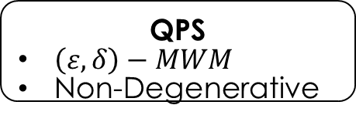
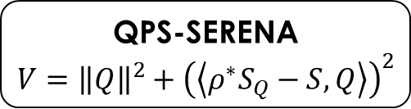
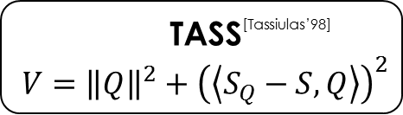
Basic Steps of Stability Proof based on Lyapunov Function
Abstract Key Properties
MWM ^{[McKeown’99]}
No Abstraction
TASS^{[Tassiulas’98]}
Property P
Non-Degenerative
QPS
$\left(ε,δ\right)−MWM$
Non-Degenerative
Design Appropriate Lyapunov Function
MWM ^{[McKeown’99]}
$${V=\left\|Q\right\|}^{2}$$
TASS^{[Tassiulas’98]}
$$V={\left\|Q\right\|}^{2}+{\left(\left\langle S_{Q}−S, Q\right\rangle \right)}^{2}$$
QPS-SERENA
$$V={\left\|Q\right\|}^{2}+{\left(\left\langle ρ^{∗}S_{Q}−S, Q\right\rangle \right)}^{2}$$
$$E\left[{\left\|Q(t+1)\right\|}^{2}−{\left\|Q(t)\right\|}^{2}| Q(t)\right]≤−ε\sqrt{V_{mwm}\left(Q\left(t\right)\right)}+2\sqrt{\left\langle S_{Q\left(t\right)}−S\left(t\right), Q\left(t\right)\right\rangle }+C$$

Slide 22
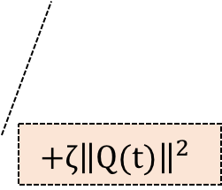

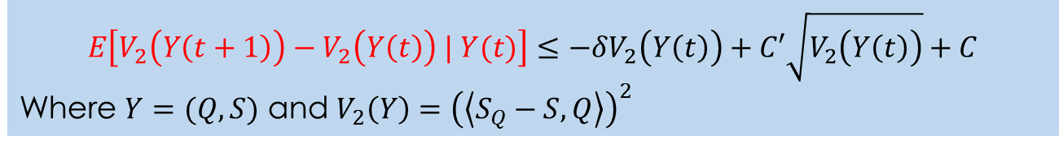

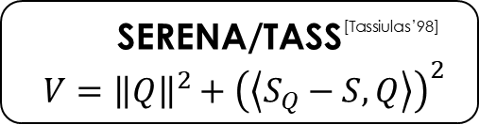
“Intuition” behind the Lyapunov Function
Design Appropriate Lyapunov Function
MWM ^{[McKeown’99]}
$${V=\left\|Q\right\|}^{2}$$
SERENA/TASS^{[Tassiulas’98]}
$$V={\left\|Q\right\|}^{2}+{\left(\left\langle S_{Q}−S, Q\right\rangle \right)}^{2}$$
QPS-SERENA
$$V={\left\|Q\right\|}^{2}+{\left({\left\langle ρ^{∗}S_{Q}−S, Q\right\rangle }^{+}\right)}^{2}$$
$$E\left[{\left\|Q(t+1)\right\|}^{2}−{\left\|Q(t)\right\|}^{2}| Q(t)\right]≤−ε\left\|Q\right\|+2\sqrt{\left\langle S_{Q\left(t\right)}−S\left(t\right), Q\left(t\right)\right\rangle }+C$$
$$E\left[V_{2}\left(Y\left(t+1\right)\right)−V_{2}\left(Y\left(t\right)\right) | Y(t)\right]≤−δV_{2}\left(Y\left(t\right)\right)+C′\sqrt{V_{2}\left(Y\left(t\right)\right)}+C$$
Where $Y=(Q,S)$ and $V_{2}\left(Y\right)={\left(\left\langle S_{Q}−S, Q\right\rangle \right)}^{2}$
$$+ζ{\left\|Q(t)\right\|}^{2}$$
Notes:
In the proof of the stability of MWM, a simple function, square of the 2-norm of the vector of VOQ length is used.
By simple calculation, we can get this drift condition, for MWM, clearly the second term on the right-hand size is always zero. Therefore, we can easily get the desired negative drift.
However, in SERENA, this term can be positive, since it can only guarantee with a probability less than 1. To make a negative drift, in the stability proof of SERENA,
Another term v_2 was added to the Lyapunov function. Using the two properties of SERENA, we can easily get the drift of V_2.
Combine the two drift, we can get the desired negative drift. Unfortunately, as QPS-SERENA does not satisfy the property P, which is a key property of SERENA. If still
Using such a Lyapunov function, we could get a positive term of the square of VOQ length vector. Thus, we cannot get the desired negative drift by combining the two
drift. Inspired by the trick of the stability proof for SERENA, we modify the second term of the Lyapunov function for SERENA.

Slide 23

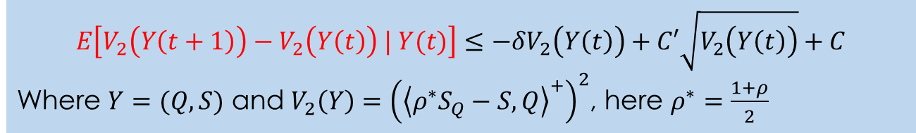
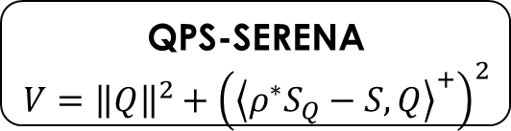

Basic Steps of Stability Proof based on Lyapunov Function
Design Appropriate Lyapunov Function
MWM ^{[McKeown’99]}
$${V=\left\|Q\right\|}^{2}$$
TASS^{[Tassiulas’98]}
$$V={\left\|Q\right\|}^{2}+{\left(\left\langle S_{Q}−S, Q\right\rangle \right)}^{2}$$
QPS-SERENA
$$V={\left\|Q\right\|}^{2}+{\left({\left\langle ρ^{∗}S_{Q}−S, Q\right\rangle }^{+}\right)}^{2}$$
$$E\left[{\left\|Q(t+1)\right\|}^{2}−{\left\|Q(t)\right\|}^{2}| Q(t)\right]≤−ε\left\|Q\right\|+2\sqrt{{\left\langle ρ^{∗}S_{Q\left(t\right)}−S\left(t\right), Q\left(t\right)\right\rangle }^{+}}+C$$
$$E\left[V_{2}\left(Y\left(t+1\right)\right)−V_{2}\left(Y\left(t\right)\right) | Y(t)\right]≤−δV_{2}\left(Y\left(t\right)\right)+C′\sqrt{V_{2}\left(Y\left(t\right)\right)}+C$$
Where $Y=(Q,S)$ and $V_{2}\left(Y\right)={\left({\left\langle ρ^{∗}S_{Q}−S, Q\right\rangle }^{+}\right)}^{2}$, here $ρ^{∗}=\frac{1+ρ}{2}$
Notes:
By doing so, we
Deviation ……..

Slide 24
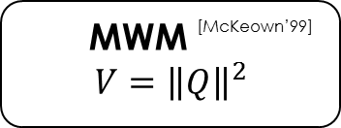
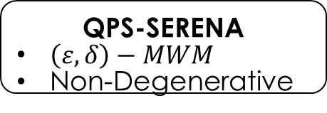
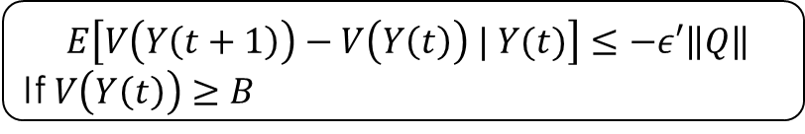
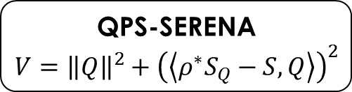
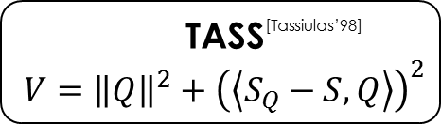
MWM ^{[McKeown’99]}
No Abstraction
TASS^{[Tassiulas’98]}
Property P
Non-Degenerative
QPS-SERENA
$\left(ε,δ\right)−MWM$
Non-Degenerative
MWM ^{[McKeown’99]}
$${V=\left\|Q\right\|}^{2}$$
TASS^{[Tassiulas’98]}
$$V={\left\|Q\right\|}^{2}+{\left(\left\langle S_{Q}−S, Q\right\rangle \right)}^{2}$$
QPS-SERENA
$$V={\left\|Q\right\|}^{2}+{\left(\left\langle ρ^{∗}S_{Q}−S, Q\right\rangle \right)}^{2}$$
$E\left[V\left(Y\left(t+1\right)\right)−V\left(Y\left(t\right)\right) | Y(t)\right]≤−ε′\left\|Q\right\|$
If $V\left(Y\left(t\right)\right)≥B$

Slide 25
Contents
1
Background
2
Related Work
3
Proposed Algorithm
4
Simulation Results
5
Conclusion
Notes:
After talking about the proposed algorithms. Let’s evaluate its performance.

Slide 26
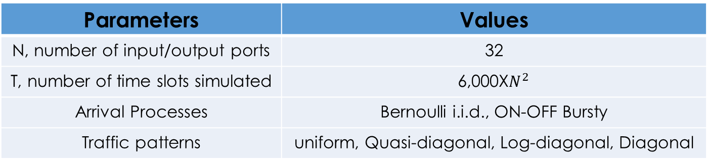
Simulation Setup
Parameters | Values
N, number of input/output ports | 32
T, number of time slots simulated | 6,000X$N^{2}$
Arrival Processes | Bernoulli i.i.d., ON-OFF Bursty
Traffic patterns | uniform, Quasi-diagonal, Log-diagonal, Diagonal
Notes:
Here are the parameters for our simulations. We simulate 32 times 32 switches. Every simulation run lasts for 6,000 times N square time slots.
We evaluated Bernoulli i.i.d. and ON-OFF bursty arrival processes.
We used four traffic patterns: uniform, quasi-diagonal, log-diagonal and diagonal.

Slide 27
Maximum Achievable Throughput
QPS-iSLIP vs. iSLIP
improvement
0 | 0.1768 | 0.1261 | 0.0489
Traffic | Uniform | Quasi-diagonal | Log-Diagonal | Diagonal
iSLIP | 100.00% | 81.70% | 83.85% | 83.47%
QPS-iLSIP | 100.00% | 99.38% | 96.46% | 88.35%

Slide 28
Maximum Achievable Throughput
QPS-iSLIP vs. iSLIP
improvement
0 | 0.1768 | 0.1261 | 0.0489
Traffic | Uniform | Quasi-diagonal | Log-Diagonal | Diagonal
iSLIP | 100.00% | 81.70% | 83.85% | 83.47%
QPS-iLSIP | 100.00% | 99.38% | 96.46% | 88.35%
iLQF | 100.00% | 99.41% | 96.47% | 89.32%

Slide 29
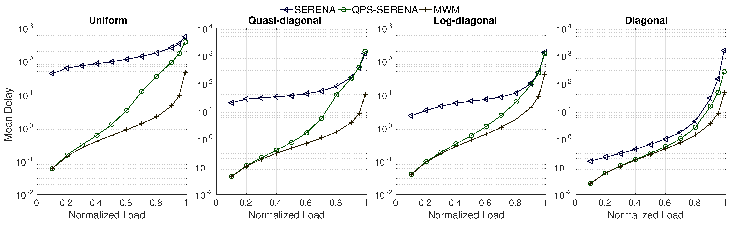
Mean Delay (Bernoulli i.i.d.)
QPS-SERENA vs. SERENA
Notes:
First, let’s compare the mean delay between QPS-Serena and Serena under Bernoulli i.i.d arrivals. It can be seen that QPS-Serena improves the performance of Serena in huge margins.
In real networks, packet arrivals are more likely to be bursty ….

Slide 30
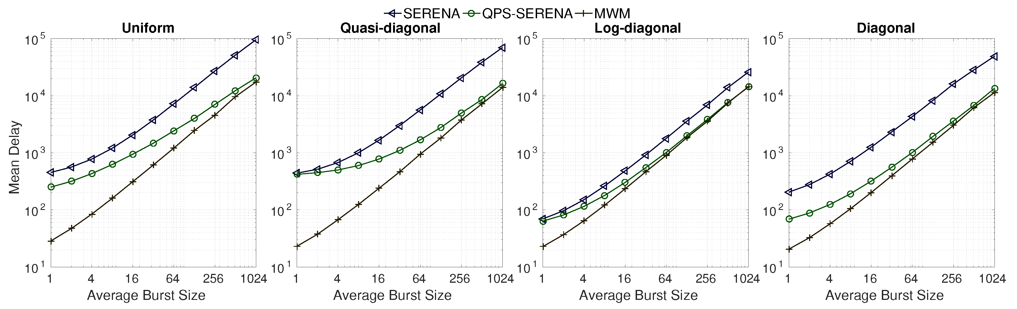
Mean Delay (Burst)
QPS-SERENA vs. SERENA
Notes:
This slide shows the mean delay of QPS-Serena and Serena under burst arrivals.
Lower delay
Gap shrinks rapidly

Slide 31
Contents
1
Background
2
Related Work
3
Proposed Algorithm
4
Simulation Results
5
Conclusion
Notes:
Finally, let’s summarize this presentation.

Slide 32
Conclusion
Proposed a simple yet effective approach to crossbar scheduling
Designed an simple data structure that can carry out QPS in O(1) per port
Derived a novel and stronger theorem for proving the stability of crossbar scheduling
Simulation results demonstrated that QPS can boost the performance (throughput or delay or both) of iSLIP and Serena
Notes:
Are there any questions ?

Slide 33
Head-of-Line Blocking
3 | 2 | 1
A | B | C
 | A | B | C
 |  | A | B | C
A
1
3 | 2 | 1
B
2
3 | 2 | 1
C
3
Notes:
In the first time slot, the entire queue at B, C is stuck waiting for A to complete, since the entire queue is held hostage by the progress of the head of the queue, or line, thus it is called HOL blocking.

Slide 34
QPS-iSLIP: Overview
Input Port
Output Port
QPS
iSLIP (Multiple Iterations)
Request
Grant
Accept
VOQ
Not
Empty
Round
Robin
(Grant
pointer)
Round
Robin
(Accept
pointer)

Slide 35
QPS-iSLIP: Example
Starter Matching
Request
Grant
2
1
1
4
1
1
1
1
2
4
2
4
2
2
2
3
2
2
2
2
2
3
2
3
4
3
3
1
3
3
3
3
4
1
4
1
3
4
4
3
4
4
4
4
3
3
3
3
Accept
2
1
1
4
2
2
2
3
4
3
3
1
3
4
4
3

Slide 36
QPS-Serena: Overview
Starter Matching
(QPS)
Merge
Populate
Generate a starter matching with Queue-Proportional Sampling (QPS)
Populate the starter matching to a full matching by pairing unmatched input and output ports in a round robin manner
Merge the populated full matching with the matching in previous time slot
Notes:
Now, let’s see how our QPS can be used to augment Serena.
First of all, we use QPS to generate a starter matching.
Then, we populate this matching into a full one by pairing all unmatched input ports and output ports in a round-robin manner.
Finally, we merge this full matching with the matching used in previous time slot by cherry-picking heavier edges among the two matchings.

Slide 37
QPS-Serena: Example
Matching in Previous Time Slot
Starter Matching
1
1
1
1
1
1
Populate
2
2
2
2
2
2
3
3
3
3
3
3
4
4
4
4
4
4
Merge
VOQ | Length
(1,1) | 3
(2,2) | 8
(2,4) | 9
(3,2) | 2
(3,3) | 1
(4,3) | 7
(4,4) | 4
1
1
1
1
Pick heavier sub-matching in each cycle
2
2
2
2
3
3
3
3
4
4
4
4
Notes:
For example, by using QPS, we generate a starter matching. Here, the orange nodes represent the input ports while the green ones stand for output ports.
Then, we populate it into full matching by pairing unmatched input/output ports in a round-robin manner, that is the first unmatched input port pairs with the first unmatched output port, the second with the second, and so on so forth until all ports are matched.
Now, we assume the matching used in the previous time slot looks like this. Then we merge the two full matchings.
The merge procedure works as follows.
It first creates a new bipartite graph by only using edges from the two matchings. It was proven that such a bipartite graph could be decomposed into certain cycles.
And each such cycle contains the same number of edges from the two matchings in an alternating manner. Picking heavier sub-matching in each such cycle finishes the merge procedure.

Slide 38
QPS-iSLIP: Example
Starter Matching
Request
Grant
2
1
1
4
2
1
1
4
2
1
1
4
2
2
2
3
2
2
2
3
2
2
2
3
4
3
3
1
4
3
3
1
4
3
3
1
3
4
4
3
3
4
4
3
3
4
4
3
Accept
2
1
1
2
1
1
2
2
1
2
2
4
One More Iteration
2
2
1
4
1
3
3
1
3
3
1
1
3
4
4
3
4
4
3
3

Slide 39
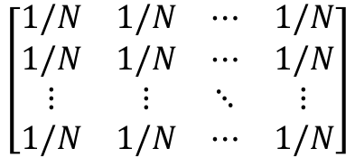
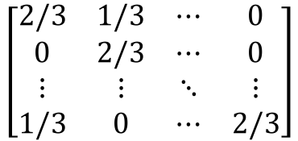
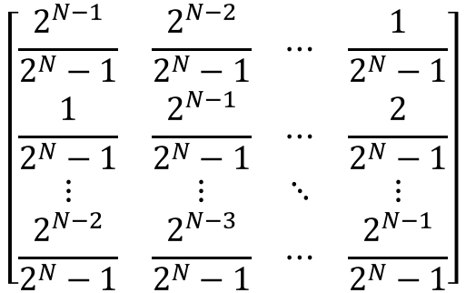
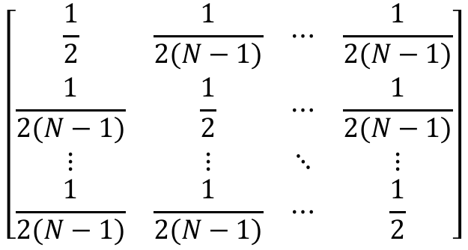
Four Traffic Patterns
Uniform
Quasi-diagonal
$$\left[\begin{matrix}1/N & 1/N & ⋯ & 1/N \\ 1/N & 1/N & ⋯ & 1/N \\ ⋮ & ⋮ & ⋱ & ⋮ \\ 1/N & 1/N & ⋯ & 1/N\end{matrix}\right]$$
$$\left[\begin{matrix}\frac{1}{2} & \frac{1}{2(N−1)} & ⋯ & \frac{1}{2(N−1)} \\ \frac{1}{2(N−1)} & \frac{1}{2} & ⋯ & \frac{1}{2(N−1)} \\ ⋮ & ⋮ & ⋱ & ⋮ \\ \frac{1}{2(N−1)} & \frac{1}{2(N−1)} & ⋯ & \frac{1}{2}\end{matrix}\right]$$
Log-diagonal
$$\left[\begin{matrix}\frac{2^{N−1}}{2^{N}−1} & \frac{2^{N−2}}{2^{N}−1} & ⋯ & \frac{1}{2^{N}−1} \\ \frac{1}{2^{N}−1} & \frac{2^{N−1}}{2^{N}−1} & ⋯ & \frac{2}{2^{N}−1} \\ ⋮ & ⋮ & ⋱ & ⋮ \\ \frac{2^{N−2}}{2^{N}−1} & \frac{2^{N−3}}{2^{N}−1} & ⋯ & \frac{2^{N−1}}{2^{N}−1}\end{matrix}\right]$$
Diagonal
$$\left[\begin{matrix}2/3 & 1/3 & ⋯ & 0 \\ 0 & 2/3 & ⋯ & 0 \\ ⋮ & ⋮ & ⋱ & ⋮ \\ 1/3 & 0 & ⋯ & 2/3\end{matrix}\right]$$
Notes:
The traffic patterns

Slide 40




ON-OFF Bursty Arrivals
$$p$$
ON
OFF
$$1−p$$
$$1−q$$
$$q$$
Notes:
In an OFF state, an incoming packet’s destination (output port) is generated according to the corresponding traffic pattern. In an ON state, all incoming packet arrivals to an input port would be destined to the same output port thus simulating a burst of packets.
By adjusting p, we can control the desired average burst size; By adjusting q, we can control the load of the traffic.

Slide 41
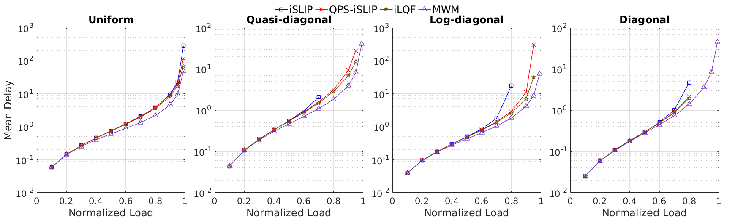
Mean Delay (Bernoulli i.i.d.)
QPS-iSLIP vs. iSLIP

Slide 42
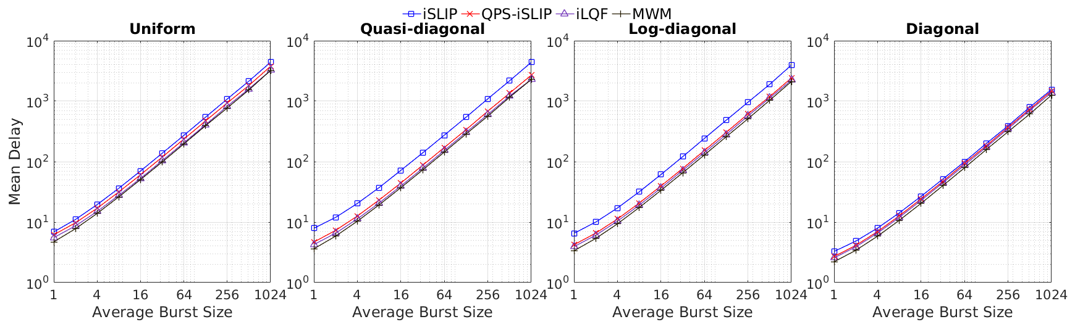
Mean Delay (Burst)
QPS-iSLIP vs. iSLIP

Slide 43
Q1: Starvation Issue
We believe the primary mission of a crossbar scheduling algorithm is to deliver excellent performance under admissible workloads; such “grace under fire” (proportional fairness and lack of starvation even when severely overloaded) is a secondary consideration and can be better achieved through other “knobs or levers" orthogonal to switching such as congestion control, packet scheduling, or traffic policing/shaping.

Slide 44
Q2: Why Only Synthetic?
There are two reasons for that.
First, almost all work on input-queued switch scheduling in the literature (e.g., references [2,3,10,16,17,27] in this work) used roughly the same set of synthetic traffic loads (as used in this work) for performance evaluations, since it is not known whether we can meaningfully combine N ``scalar” (per-port) packet-level traces into an “N-dimensional” switch-wide traffic workload, in a principled manner.
Second, it appears to us the only additional information we can glean from trace-driven simulation, in this crossbar scheduling context, is how the scheduling algorithm reacts to the (TCP/UDP) flow dynamics -- most notably skewness and burstiness -- that are captured in the trace(s). In our simulation studies, we have thoroughly evaluated the impact of both skewness and burstness on the delay performances of QPS-augmented algorithms, using the 4 different traffic patterns and the bursty ON-OFF traffic arrivals respectively.

Slide 45
Q2: Why Only Simulations?
We were not able to perform such an analysis, for the following two reasons:
There is theoretical delay analysis on neither of the underlying algorithms (iSLIP and SERENA), as both are very hard to analyze.
The interactions (resulting in complicated dependency structures) between QPS and the underlying algorithms further complicate the task of analyzing the delay performances of the QPS-augmented algorithms.
This said, we believe this is an interesting topic that can be pursued in our future work.

Slide 46
Input-Queued Crossbar Switches
Packet
Line Card 1
BUS
Packet
BUS
CPU
Line Card 1
CPU
Line Card 2
Line Card 2
CPU
Add More CPU
Line Card N
CPU
Line Card N
Bus, Shared CPU
Bus, Shared CPUs
CPU
BUS
FE
Line Card 1
Line Card 1
CPU
FE
Line Card 1
Line Card 2
FE
CPU
Line Card N
Line Card 1
Crossbar, per-line-card
Forwarding Engine
Bus, per-line-card CPUs
Notes:
Proposed as a powerful approach to overcome the current Internet “ossification”, network virtualization has attracted more and more attentions and has been considered as a promising solution for future Internet.
However, challenges come together with network virtualization. As one of the major challenges, virtual network embedding, which aims at efficient resource provisioning in network virtualization.

Slide 47
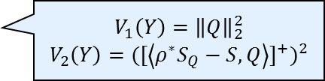





Stability of QPS-Serena: Proof Sketch
Design Lyapunov Function
$$V_{1}\left(Y\right)={\left\|Q\right\|}_{2}^{2}$$
$$V_{2}\left(Y\right)={({[\left\langle ρ^{∗}S_{Q}−S,Q\right\rangle ]}^{+})}^{2}$$
$$V\left(Y\right)=V_{1}\left(Y\right)+V_{2}(Y)$$
Bound Drift of $V_{1}$
Bound Drift of $V_{2}$
$$E\left[V_{1}\left(Y\left(t+1\right)\right)−V_{1}\left(Y\left(t\right)\right)| V_{1}(Y\left(t\right))\right]$$
$$E\left[V_{2}\left(Y\left(t+1\right)\right)−V_{2}\left(Y\left(t\right)\right)| V_{2}(Y\left(t\right))\right]$$
$$E\left[V\left(Y\left(t+1\right)\right)−V\left(Y\left(t\right)\right)| V(Y\left(t\right))\right]<−ε{\left\|Q\right\|}_{2}$$
Theorem: For any switching scheduling algorithm that satisfies the above two properties, under any i.i.d. admissible traffic, the joint queueing and scheduling process $\left\{Q\left(t\right), S(t)\right\}$ is an ergodic Markov chain, and the queueing process $\{Q\left(t\right)\}$converges in distribution to a random vector $\hat{Q}$, such that $E\left[{\left\|\hat{Q}\right\|}_{1}\right]<∞$.

