Slide 1
Queue-Proportional Sampling: A Better Approach to Crossbar Scheduling for Input-Queued Switches
Presenter: Long Gong
Advisor: Jun (Jim) Xu
Notes:
Good afternoon, professors. I am Long Gong, and my advisor is Prof. Jim Xu.
Today, my topic is Queue- …
There are five parts in my presentation.

Slide 2
Contents
1
Background
2
Related Work
3
Proposed Algorithm
4
Simulation Results
5
Miscellaneous
Notes:
In the first part, I will give some background on input-queued crossbar switches. Then we will talk about some related work. After that, I will describe the details of queue-proportional sampling scheme, followed by some simulations results. Finally, I will summarize this presentation. First, Let’s come into the background part.

Slide 3
Contents
1
Background
2
Related Work
3
Proposed Algorithm
4
Simulation Results
5
Miscellaneous

Slide 4
Input-Queued Crossbar Switches
Packets
Input 1
VOQ 1
Crossbar
Output 1
Segment
Assemble
VOQ N
Input N
VOQ 1
Output N
Segment
Assemble
VOQ N
Segment variable-size packets into fixed-size
Reassemble packets before they leave
Notes:
Nowadays, most high-speed switching systems, such as Internet routers and data-center switches, employ a single crossbar to interconnect input ports and output ports.
To solve the HOL blocking issue, each input port has N virtual output queues (VOQs). The VOQ j at input port I serves as a buffer for packets going from input port I to output port j.
For example, here the VOQ 1 at input port 1 buffers the packets that want to go from input port 1 to output port 1.
In this work, we also adopt the standard assumption. That is all incoming packets are segmented into fixed-size before they are put into the corresponding VOQs and then reassembled
Before leaving the switch.

Slide 5
Scheduling for Input-Queued Crossbar Switches
Abstraction
Which input connects to which output?
Input 1
VOQ 1
Crossbar
Output 1
Input 1
Output 1
VOQ N
Input 2
Output 2
?
Input N
VOQ 1
Output N
VOQ N
Input N
Output N
Constraints (Physical Limits of the Crossbar)
Each input can only connect to a single output
Each output can only be connected by a single input
Notes:
Due to the physical limits of a crossbar fabric, in an input-queued switch, each input port can only connect to a single output port and vice versa in each switching cycle, or time slot.
Hence, input-queued switches need to decide which input port connects to which output port per time slot. More specially, they need to compute a one-to-one matching between input ports and output ports

Slide 6
Scheduling for Input-Queued Crossbar Switches: Formulation
Model: Weighted Complete Bipartite Graph
Problem: Compute a one-to-one matching between input and output ports
Input 1
Output 1
Quality of the matching
Time to compute the matching
Input 2
Output 2
Challenge: “high quality” matchings (i.e., high through-put & low delay) at high speed
Input N
Output N
Notes:
Generally, a NXN crossbar switch is modeled as a weighted bipartite graph, where the two disjoint sets of vertices are the input ports and output ports, respectively. The weight is some function of the length of the corresponding VOQs.
The problem is to compute high-quality matchings that result in high switch throughput and low delay at high speed.
Unfortunately, there exists a tradeoff between the quality of the matchings and the time to compute them.

Slide 7
Contents
1
Background
2
Related Work
3
Proposed Algorithm
4
Simulation Results
5
Miscellaneous
Notes:
Next, let’s see some related work.

Slide 8

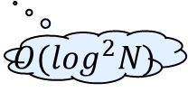

Existing Scheduling for Input- Queued Crossbar Switches
Empirically optimal
Quality of the matching
Time to compute the matching
Maximum Weighted Matching (MWM)
$$O(N^{3})$$
Good delay performance
Quality of the matching
Time to compute the matching
iSLIP [McKeown99]
Quality of the matching
$$O(\log^{2}N)$$
Optimal throughput
Time to compute the matching
$$O(N)$$
Serena [Giaccone03]
Notes:
Now, let’s see how the tradeoff was handled in existing work.
Maximum Weighted Matching with suitable weight measure, is known to produce the empirically optimal matchings in terms of queuing delay for a large variety of traffic patterns. However, each such matching decision takes O(N^3) time to compute, which is too time-consuming to be used. Researchers have been searching for alternatives that have performance close to MWM but with much lower time complexity.
iSLIP is one such algorithm, which is an iterative algorithm with good delay performance. It has a per-port complexity of (log N)^2 (log N iterations with each iteration having O(log N) circuit depth). Although it achieved great commercial success, iSLIP generally can not achieve 100% except under uniform traffic, thus it could have very high delay even infinite delay under heavy non-uniform traffic.
Serena is also such algorithm, which is a centralized algorithm with linear time complexity . It can achieve 100% throughput and excellent delay performance.

Slide 9






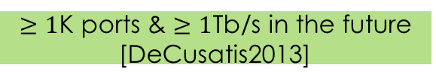
Why Need New Scheduling Algorithms
Reality
Achieve Better Tradeoff
$≥1$K ports & $≥1$Tb/s in the future [DeCusatis2013]
Improve
Quality of the matching
Decrease
Badly Need
Time to compute the matching
Switches Can Connect A Large Number of Ports and Operate at Very High Speed
Notes:
You might be wondering why we still need to design new scheduling algorithms considering we already have such good ones like iSLIP and Serena.
Thanks to the big success of Big Data, video streaming, online social networking, and etc, the volumes of network traffic are growing relentlessly.
Driven by the surge of the traffic, it is expected that a switch would have more than 1000 ports and the line rate of each port could be larger than 1 Tb/s.
Therefore, switches that are capable of connecting a large number of ports and operating at very high speed is badly needed.
In this work, we aim at achieving better tradeoff. Clearly, we can either improve the quality of the matchings or decrease the computational complexity. In this work, we proposed a solution to improve the performance with very low computational overhead.

Slide 10
Contents
1
Background
2
Related Work
3
Proposed Algorithm
4
Simulation Results
5
Miscellaneous
Notes:
Now, Let’s see how our scheme works.

Slide 11
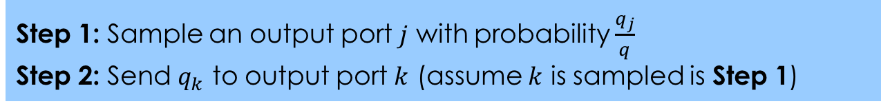
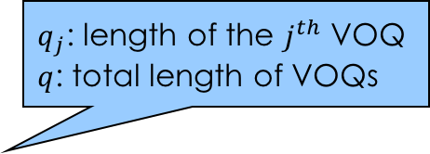
Queue-Proportional Sampling (QPS): Overview
$q_{j}$: length of the $j^{th}$ VOQ
$q$: total length of VOQs
Proposing (at any input port)
Accepting (at any output port)
Step 1: Sample an output port $j$ with probability $\frac{q_{j}}{q}$
Step 2: Send $q_{k}$ to output port $k$ (assume $k$ is sampled is Step 1)
Accept the one with the largest VOQ length if receiving one or more proposals
Note that, besides the “longest VOQ first” accepting strategy, we also investigate “proportional” accepting
Notes:
Our strategy is called Queue-proportional sampling, which is a general add-on approach to boost the performance of existing scheduling algorithms, such as iSLIP and Serena.
This strategy is extremely simple. It has two stages. The first one is called proposing. In this stage, each input port first samples out an output port with the probability proportional to the corresponding VOQ length, then the input port sends a proposal requests together with the VOQ length to the output port that is sampled.
The second stage is accepting. In this stage, each output port upon receiving one or more proposals, it accepts the one with the largest VOQ length. Note that, besides the “longest VOQ first”, we also investigate other accepting strategies, such as proportional accepting.

Slide 12
Queue-Proportional Sampling (QPS): Example
VOQ ID | VOQ Length
1 | 3
2 | 7
3 | 6
4 | 2
Sample a VOQ
2
3
Input 1
6
7
VOQ 1
Crossbar
Output 1
VOQ 4
Proposals
Input ID | VOQ Length
1 | 3
4 | 1
Input N
VOQ 1
Output 4
VOQ 4
Notes:
Now, let’s see a concrete example, with N=4. For the proposing, let’s focus on input port 1, the lengths of all VOQs are shown in the table.
First of all, it samples out a output port with probability proportional to the corresponding VOQ lengths. It samples output 1. Then, it sends the length of VOQ 1 to output 1.
For the accepting, let’s focus on output 1, assuming besides the proposal from input port 1, it also gets a proposal from input port 4. Output 1 accepts the proposal from input port 1, since it has a longer VOQ.

Slide 13

Queue-Proportional Sampling (QPS): O(1) Data Structure
VOQs at Input Port i
Main Data Structure
Array of linked lists
Each link list => VOQ
$$q_{j}$$
VOQ j
B | j
E | j
A | j
F | j
One-to-one correspondence
Auxiliary Data Structure
Array of all packets
“Packets” in All of VOQs at Input Port i
G |  | B |  | A |  | C | D
Notes:
It may look at first that one may need up to O(N) time complexity to finish the QPS. However, it is possible to implement QPS efficiently with only O(1) time complexity.
Now let’s see the O(1) data structures.
Although the O(1) data structures are fairly simple and straightforward, we did not find any similar ones in the literature.
The data structures have one main data structure and one auxiliary. The main data structure is just an array of linked lists, where each linked list corresponds to a VOQ. Besides the pointers for forming the linked list, each entry in the linked list has a pointer points to the actual packet (shown as a letter), a index recording which VOQ the packet is located. It also holds a pointer that points to the corresponding entry in the auxiliary data structure.
The auxiliary data structure is just one array, where each entry corresponds to a packet in the input port. More specially, each entry in the array is a pointer points to the corresponding entry in the linked list of the corresponding VOQ. Hence there is one-to-one correspondence between entries in the main data structure and the entries in the auxiliary data structure.
Now, we use an example to show how the data structure works. Assume there are q entries in the auxiliary data structure.
First of all, we sample an entry from the auxiliary array by simply generating a uniformly distributed random variable in the range from 0 to q – 1. For example, the entry A is sampled. Then we find the entry in the linked list. However, it is not a head of line packet. We then get the head of line packet of the same VOQ, which is the packet B. Assume the proposal is accepted, which means we need eventually delete entry B from the linked list. Clearly, we also need to remove B from the auxiliary data structure. Now, there comes another problem, we can not afford to move forward all entries after B, however, we can easily fill this hole by moving the last entry into it.
It is clear that all these steps can be finished in O(1) time complexity.

Slide 14
Queue-Proportional Sampling (QPS): O(1) Data Structure
VOQs at Input Port i
Main Data Structure
Array of linked lists
Each link list => VOQ
$$q_{j}$$
VOQ j
E | j
A | j
F | j
One-to-one correspondence
Auxiliary Data Structure
Array of all packets
“Packets” in All of VOQs at Input Port i
G |  | D |  | A |  | C

Slide 15
QPS-Serena: Overview
Starter Matching
(QPS)
Merge
Populate
Generate a starter matching with Queue-Proportional Sampling (QPS)
Populate the starter matching to a full matching by pairing unmatched input and output ports in a round robin manner
Merge the populated full matching with the matching in previous time slot
Notes:
Now, let’s see how our QPS can be used to augment Serena.
First of all, we use QPS to generate a starter matching.
Then, we populate this matching into a full one by pairing all unmatched input ports and output ports in a round-robin manner.
Finally, we merge this full matching with the matching used in previous time slot by cherry-picking heavier edges among the two matchings.

Slide 16
QPS-Serena: Example
Matching in Previous Time Slot
Starter Matching
1
1
1
1
1
1
Populate
2
2
2
2
2
2
3
3
3
3
3
3
4
4
4
4
4
4
Merge
VOQ | Length
(1,1) | 3
(2,2) | 8
(2,4) | 9
(3,2) | 2
(3,3) | 1
(4,3) | 7
(4,4) | 4
1
1
1
1
Pick heavier sub-matching in each cycle
2
2
2
2
3
3
3
3
4
4
4
4
Notes:
For example, by using QPS, we generate a starter matching. Here, the orange nodes represent the input ports while the green ones stand for output ports.
Then, we populate it into full matching by pairing unmatched input/output ports in a round-robin manner, that is the first unmatched input port pairs with the first unmatched output port, the second with the second, and so on so forth until all ports are matched.
Now, we assume the matching used in the previous time slot looks like this. Then we merge the two full matchings.
The merge procedure works as follows.
It first creates a new bipartite graph by only using edges from the two matchings. It was proven that such a bipartite graph could be decomposed into certain cycles.
And each such cycle contains the same number of edges from the two matchings in an alternating manner. Picking heavier sub-matching in each such cycle finishes the merge procedure.

Slide 17
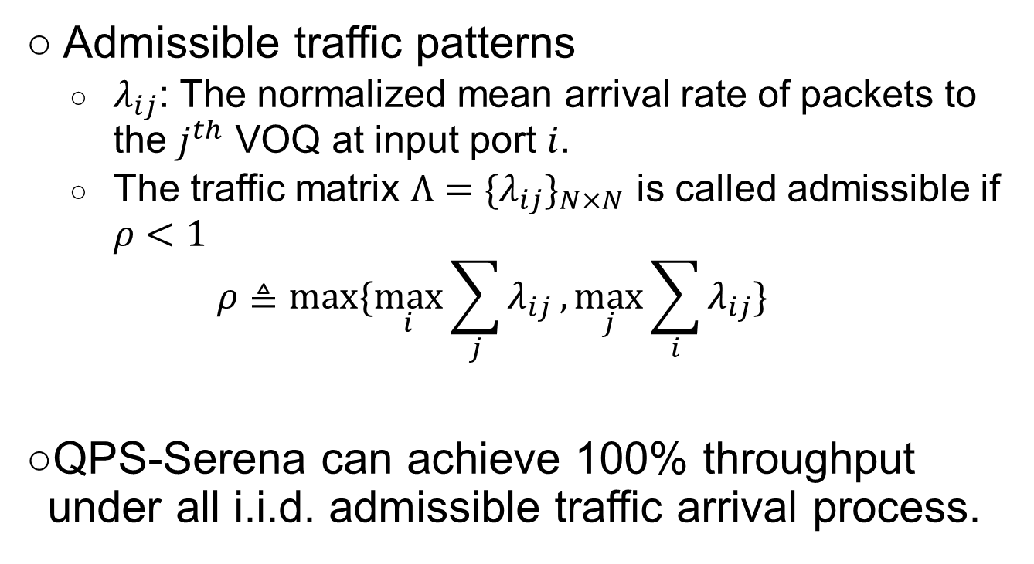
Stability of QPS-Serena
Admissible traffic patterns
$λ_{ij}$: The normalized mean arrival rate of packets to the $j^{th}$ VOQ at input port $i$.
The traffic matrix $Λ={\{λ_{ij}\}}_{N×N}$ is called admissible if $ρ<1$
$$ρ≜max⁡\{\max_{i}{\sum_{j}{λ_{ij}}},\max_{j}{\sum_{i}{λ_{ij}}}\}$$
QPS-Serena can achieve 100% throughput under all i.i.d. admissible traffic arrival process.
Notes:
For a scheduling algorithm, the stability is one of the most desired features.
It was proven that Serena is stable under any i.i.d. admissible traffic. Its stability comes from its two properties. Property P and Non-degenerative.
Therefore, there is a positive probability that Serena can achieve the same weights as MWM; and it guarantees that current matchings decision would not be worse that the previous one.
Although QPS-Serena also shares the non-degenerative property, but it generally does not satisfy the property p.

Slide 18
Contents
1
Background
2
Related Work
3
Proposed Algorithm
4
Simulation Results
5
Miscellaneous
Notes:
After talking about the proposed algorithms. Let’s evaluate its performance.

Slide 19
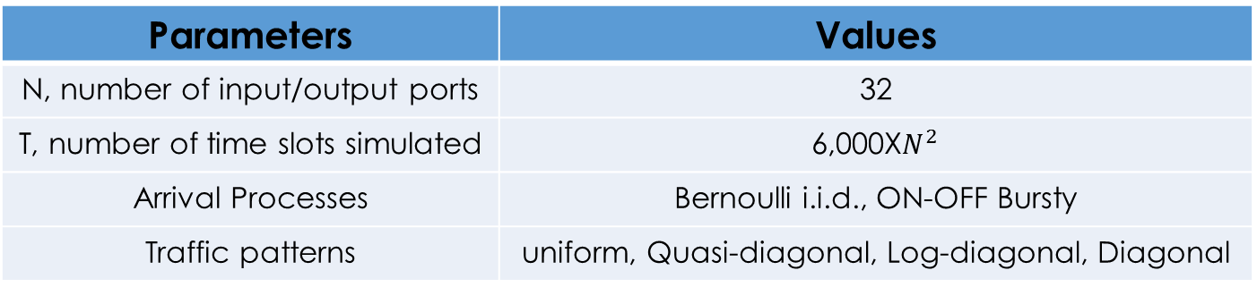
Simulation Setup
Parameters | Values
N, number of input/output ports | 32
T, number of time slots simulated | 6,000X$N^{2}$
Arrival Processes | Bernoulli i.i.d., ON-OFF Bursty
Traffic patterns | uniform, Quasi-diagonal, Log-diagonal, Diagonal
Notes:
Here are the parameters for our simulations. We simulate 32 times 32 switches. Every simulation run lasts for 6,000 times N square time slots.
We evaluated Bernoulli i.i.d. and ON-OFF bursty arrival processes.
We used four traffic patterns: uniform, quasi-diagonal, log-diagonal and diagonal.

Slide 20
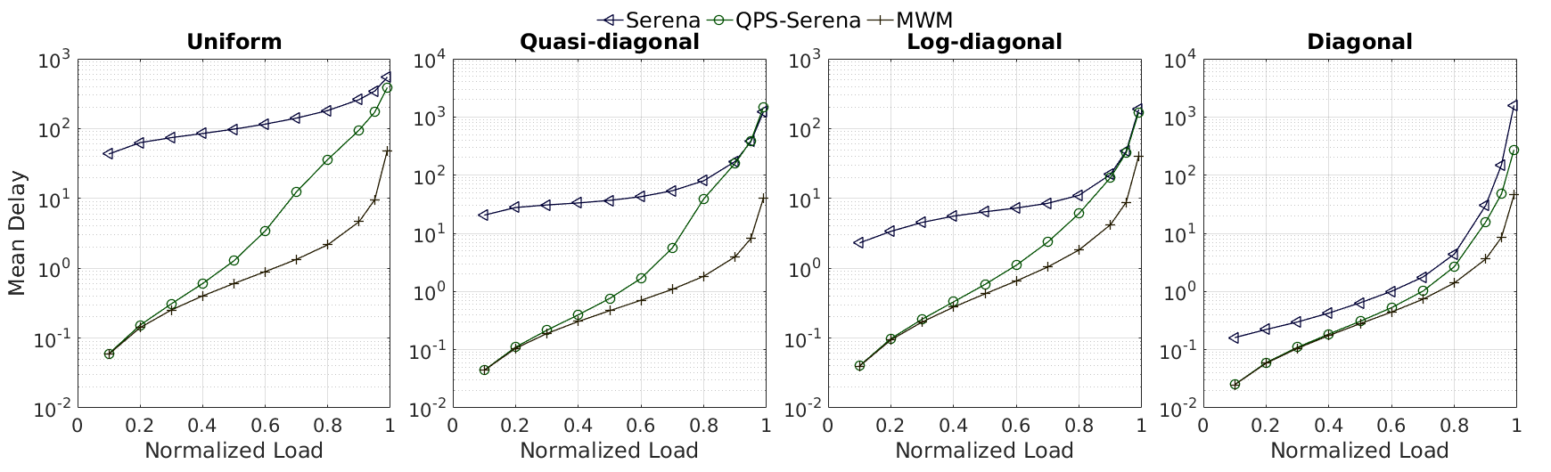
Mean Delay (Bernoulli i.i.d.)
QPS-Serena vs. Serena
Notes:
First, let’s compare the mean delay between QPS-Serena and Serena under Bernoulli i.i.d arrivals. It can be seen that QPS-Serena improves the performance of Serena in huge margins.
In real networks, packet arrivals are more likely to be bursty ….

Slide 21
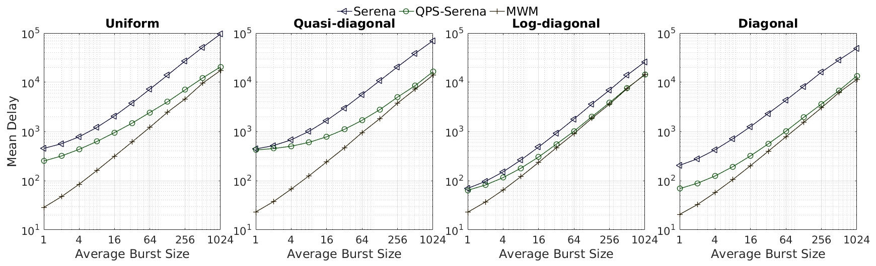
Mean Delay (Burst)
QPS-Serena vs. Serena
Notes:
This slide shows the mean delay of QPS-Serena and Serena under burst arrivals.
Lower delay
Gap shrinks rapidly

Slide 22
Contents
1
Background
2
Related Work
3
Proposed Algorithm
4
Simulation Results
5
Miscellaneous
Notes:
Finally, let’s summarize this presentation.

Slide 23
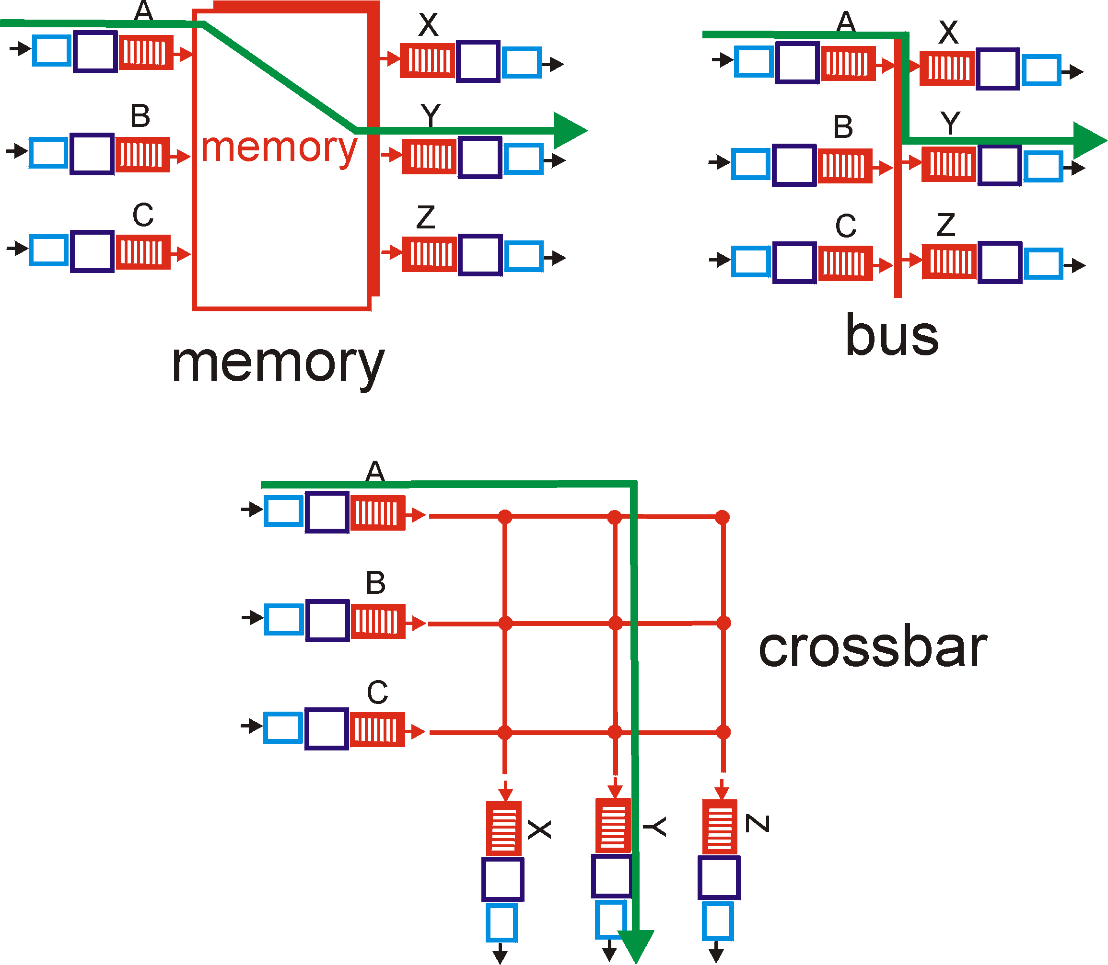
Three types of switching fabrics
This slide was downloaded from Internet!

Slide 24
Switching Via Memory
First generation routers:
traditional computers with switching under direct control of CPU
packet copied to system’s memory
speed limited by memory bandwidth (2 bus crossings per datagram)
Input
Port
Memory
Output
Port
System Bus
This slide was downloaded from Internet!

Slide 25
Switching Via a Bus
datagram from input port memory
to output port memory via a shared bus
bus contention: switching speed limited by bus bandwidth
1 Gbps bus, Cisco 1900: sufficient speed for access and enterprise routers (not regional or backbone)
This slide was downloaded from Internet!

Slide 26
Switching Via An Interconnection Network
overcome bus bandwidth limitations
Banyan networks, other interconnection nets initially developed to connect processors in multiprocessor
Advanced design: fragmenting datagram into fixed length cells, switch cells through the fabric.
Segmentation and Reassembly (SAR)
Discuss overheads
Cisco 12000: switches Gbps through the interconnection network
This slide was downloaded from Internet!

Slide 27
Router Architecture Overview
Input Port Functions
lookup,
forwarding
queueing
line
termination
link
layer
protocol
(receive)
switch
fabric
physical layer:
bit-level reception
data link layer:
e.g., Ethernet
see chapter 5
decentralized switching:
given datagram dest., lookup output port using forwarding table in input port memory (“match plus action”)
goal: complete input port processing at ‘line speed’
queuing: if datagrams arrive faster than forwarding rate into switch fabric
This slide was downloaded from Internet!

Slide 28
Router Architecture Overview
Output Ports
datagram
buffer
queueing
switch
fabric
link
layer
protocol
(send)
line
termination
buffering required when datagrams arrive from fabric faster than the transmission rate
scheduling discipline chooses among queued datagrams for transmission
This slide was downloaded from Internet!

Slide 29
Router Architecture Overview
Output Port Queuing
switch
fabric
switch
fabric
at t, packets more
from input to output
one packet time later
buffering when arrival rate via switch exceeds output line speed
queueing (delay) and loss due to output port buffer overflow!
This slide was downloaded from Internet!

Slide 30
Router Architecture Overview
Input Port Queuing
fabric slower than input ports combined -> queueing may occur at input queues
queueing delay and loss due to input buffer overflow!
Head-of-the-Line (HOL) blocking: queued datagram at front of queue prevents others in queue from moving forward
switch
fabric
switch
fabric
output port contention:
only one red datagram can be transferred. lower red packet is blocked
one packet time later: green packet experiences HOL blocking
This slide was downloaded from Internet!

Slide 31
Head of Line blocking
1
2
3
This slide was downloaded from Internet!

Slide 32
Virtual Output Queueing
This slide was downloaded from Internet!

Slide 33
QPS-iSLIP: Overview
Input Port
Output Port
QPS
iSLIP (Multiple Iterations)
Request
Grant
Accept
VOQ
Not
Empty
Round
Robin
(Grant
pointer)
Round
Robin
(Accept
pointer)

Slide 34
QPS-iSLIP: Example
Starter Matching
Request
Grant
2
1
1
4
1
1
1
1
2
4
2
4
2
2
2
3
2
2
2
2
2
3
2
3
4
3
3
1
3
3
3
3
4
1
4
1
3
4
4
3
4
4
4
4
3
3
3
3
Accept
2
1
1
4
2
2
2
3
4
3
3
1
3
4
4
3

Slide 35
QPS-iSLIP: Example
Starter Matching
Request
Grant
2
1
1
4
2
1
1
4
2
1
1
4
2
2
2
3
2
2
2
3
2
2
2
3
4
3
3
1
4
3
3
1
4
3
3
1
3
4
4
3
3
4
4
3
3
4
4
3
Accept
2
1
1
2
1
1
2
2
1
2
2
4
One More Iteration
2
2
1
4
1
3
3
1
3
3
1
1
3
4
4
3
4
4
3
3

Slide 36
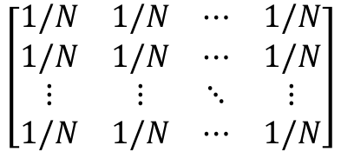
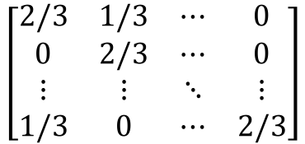
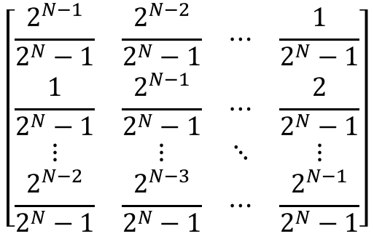
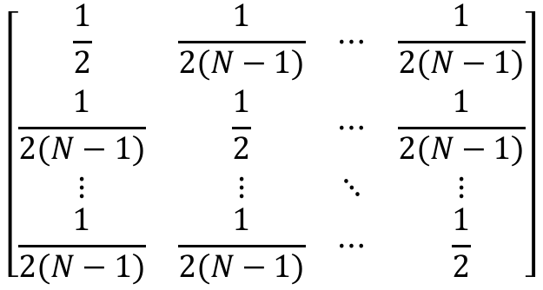
Four Traffic Patterns
Uniform
Quasi-diagonal
$$\left[\begin{matrix}1/N & 1/N & ⋯ & 1/N \\ 1/N & 1/N & ⋯ & 1/N \\ ⋮ & ⋮ & ⋱ & ⋮ \\ 1/N & 1/N & ⋯ & 1/N\end{matrix}\right]$$
$$\left[\begin{matrix}\frac{1}{2} & \frac{1}{2(N−1)} & ⋯ & \frac{1}{2(N−1)} \\ \frac{1}{2(N−1)} & \frac{1}{2} & ⋯ & \frac{1}{2(N−1)} \\ ⋮ & ⋮ & ⋱ & ⋮ \\ \frac{1}{2(N−1)} & \frac{1}{2(N−1)} & ⋯ & \frac{1}{2}\end{matrix}\right]$$
Log-diagonal
$$\left[\begin{matrix}\frac{2^{N−1}}{2^{N}−1} & \frac{2^{N−2}}{2^{N}−1} & ⋯ & \frac{1}{2^{N}−1} \\ \frac{1}{2^{N}−1} & \frac{2^{N−1}}{2^{N}−1} & ⋯ & \frac{2}{2^{N}−1} \\ ⋮ & ⋮ & ⋱ & ⋮ \\ \frac{2^{N−2}}{2^{N}−1} & \frac{2^{N−3}}{2^{N}−1} & ⋯ & \frac{2^{N−1}}{2^{N}−1}\end{matrix}\right]$$
Diagonal
$$\left[\begin{matrix}2/3 & 1/3 & ⋯ & 0 \\ 0 & 2/3 & ⋯ & 0 \\ ⋮ & ⋮ & ⋱ & ⋮ \\ 1/3 & 0 & ⋯ & 2/3\end{matrix}\right]$$
Notes:
The traffic patterns

Slide 37




ON-OFF Bursty Arrivals
$$p$$
ON
OFF
$$1−p$$
$$1−q$$
$$q$$
Notes:
In an OFF state, an incoming packet’s destination (output port) is generated according to the corresponding traffic pattern. In an ON state, all incoming packet arrivals to an input port would be destined to the same output port thus simulating a burst of packets.
By adjusting p, we can control the desired average burst size; By adjusting q, we can control the load of the traffic.

Slide 38
Maximum Achievable Throughput
QPS-iSLIP vs. iSLIP
improvement
0 | 0.1768 | 0.1261 | 0.0489
Traffic | Uniform | Quasi-diagonal | Log-Diagonal | Diagonal
iSLIP | 100.00% | 81.70% | 83.85% | 83.47%
QPS-iLSIP | 100.00% | 99.38% | 96.46% | 88.35%
iLQF | 100.00% | 99.41% | 96.47% | 89.32%

Slide 39
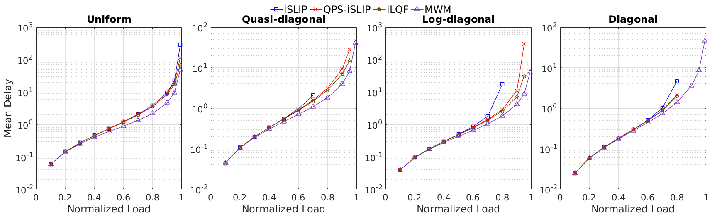
Mean Delay (Bernoulli i.i.d.)
QPS-iSLIP vs. iSLIP

Slide 40
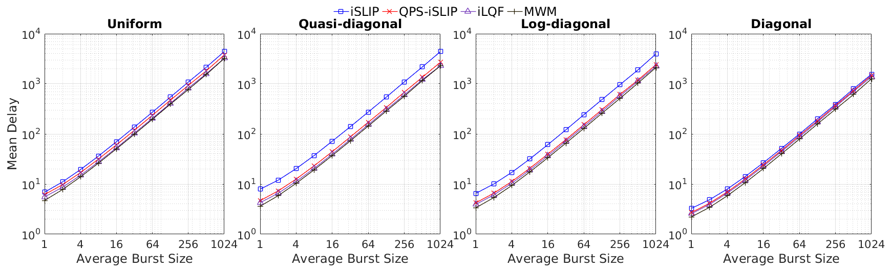
Mean Delay (Burst)
QPS-iSLIP vs. iSLIP

