Slide 1
Long-Read Nanopore ITS Profiling of Sample SC
LONG-READ NANOPORE ITS · SAMPLE SC
Community Structure, Ecological Guilds, and Metabolic Potential
An explainer walkthrough of FUNGuild, FungalTraits, and PICRUSt2 functional predictions in Sonneratia alba rhizosphere & sediment
PROJECT METADATA
AT-A-GLANCE DATA SNAPSHOT
SAMPLE ID
103,015
raw reads delivered
SC (barcode13 / N701-1) · single sample, n = 1
HOST TREE
52,404
preprocessed reads (primers verified, Q ≥ 12)
Sonneratia alba (labeled SC for suspected S. caseolaris; updated after botanical consultation)
48,988
reads in 41 core ITS OTUs
SAMPLE TYPE
Cut rhizosphere root tissue + surrounding intertidal sediment (with litter)
40,364
reads in 34 fungal core OTUs
PLATFORM
28,587
reads in 27 PICRUSt2-predicted OTUs
Oxford Nanopore (ONT) full-length ITS1–5.8S–ITS2 amplicon

Slide 2




Four Key Concepts for Reading the Figures
PART 1 · INTRODUCTION & FOUNDATIONS · BIOINFORMATICS 101
A quick reference guide before we look at any data
What is an OTU?
Reads ≠ cells or biomass
Polished ITS sequences sharing ≥98% identity are grouped into an operational cluster (OTU_1, OTU_2…). An OTU is a sequence group, not automatically a verified species.
If one OTU has 9,715 reads and another 970, its DNA was sequenced ~10× more often, not 10× more fungus. Copy number and PCR efficiency vary, so we report read proportions.
What are ecological guilds?
What is NSTI in PICRUSt2?
FungalTraits (genus) and FUNGuild (genus or family) match a taxon to published lifestyles: saprotroph, pathotroph, symbiotroph. They list capacities, not measured disease or decay.
Nearest Sequenced Taxon Index: the branch distance from your OTU to the closest sequenced fungal genome. Low (<0.20) = close relative; ~1.0+ = functions extrapolated from a distant one.

Slide 3

From Raw Reads to High-Confidence Fungal Clusters
PART 1 · INTRODUCTION & FOUNDATIONS · THE PIPELINE
Primer verification, rescuing long amplicons (>900 bp), consensus polishing, and eukaryote filtering
1
Delivered raw ONT reads
2
Strict primer & quality gate
3
Consensus, polishing & ITSx
4
Conservative fungal core
103,015
52,404
41 OTUs
34 OTUs
raw basecalled reads
reads retained
48,988 reads (93.48% of all)
40,364 reads
Reads of 300–2,000 bp. We bypassed the provider’s 400–900 bp cutoff so true sequences could be rebuilt.
ITS1 + ITS4 ends, ≥200 bp, mean Q ≥ 12. 13,021 kept reads are >900 bp, matching the ~1,100–1,150 bp gel band.
amplicon_sorter + 2× Racon polishing; ITSx sets ITS boundaries. Validation reads map uniquely at 93.18%.
UNITE + ITSx screen separates 7 non-fungal/uncertain OTUs (8,624 reads, 16.46%), e.g. rhizosphere nematodes.
Why filter? Universal ITS1–ITS4 primers also amplify non-fungal soil eukaryotes. Guild and PICRUSt2 analyses therefore run only on the 34-OTU conservative fungal core.

Slide 4
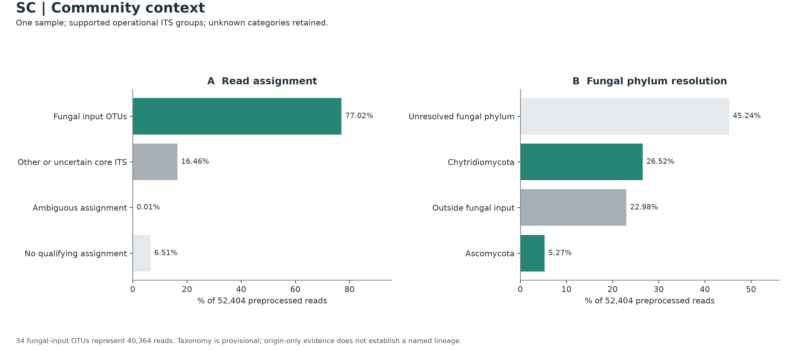
Community Context & Taxonomic Resolution
PART 2 · WHO IS IN YOUR SAMPLE? · FIGURE 01
Accounting for all 52,404 preprocessed reads across core OTUs and fungal phyla
A
Read assignment
read → OTU gate: ≥85% identity, ≥90% span
77.02%
Fungal input OTUs
16.46%
Other / uncertain core
0.01%
Ambiguous (4 reads)
6.51%
No qualifying match
B
Fungal phylum
OTU → UNITE: ≥90% id, ≥90% query, ≥80% ref
45.24%
Unresolved phylum
52,404
Shared denominator in both panels: all preprocessed reads = 100% (93.48% core OTUs + 0.01% ambiguous + 6.51% unassigned).
26.52%
Chytridiomycota
22.98%
Outside fungal input
5.27%
Ascomycota

Slide 5
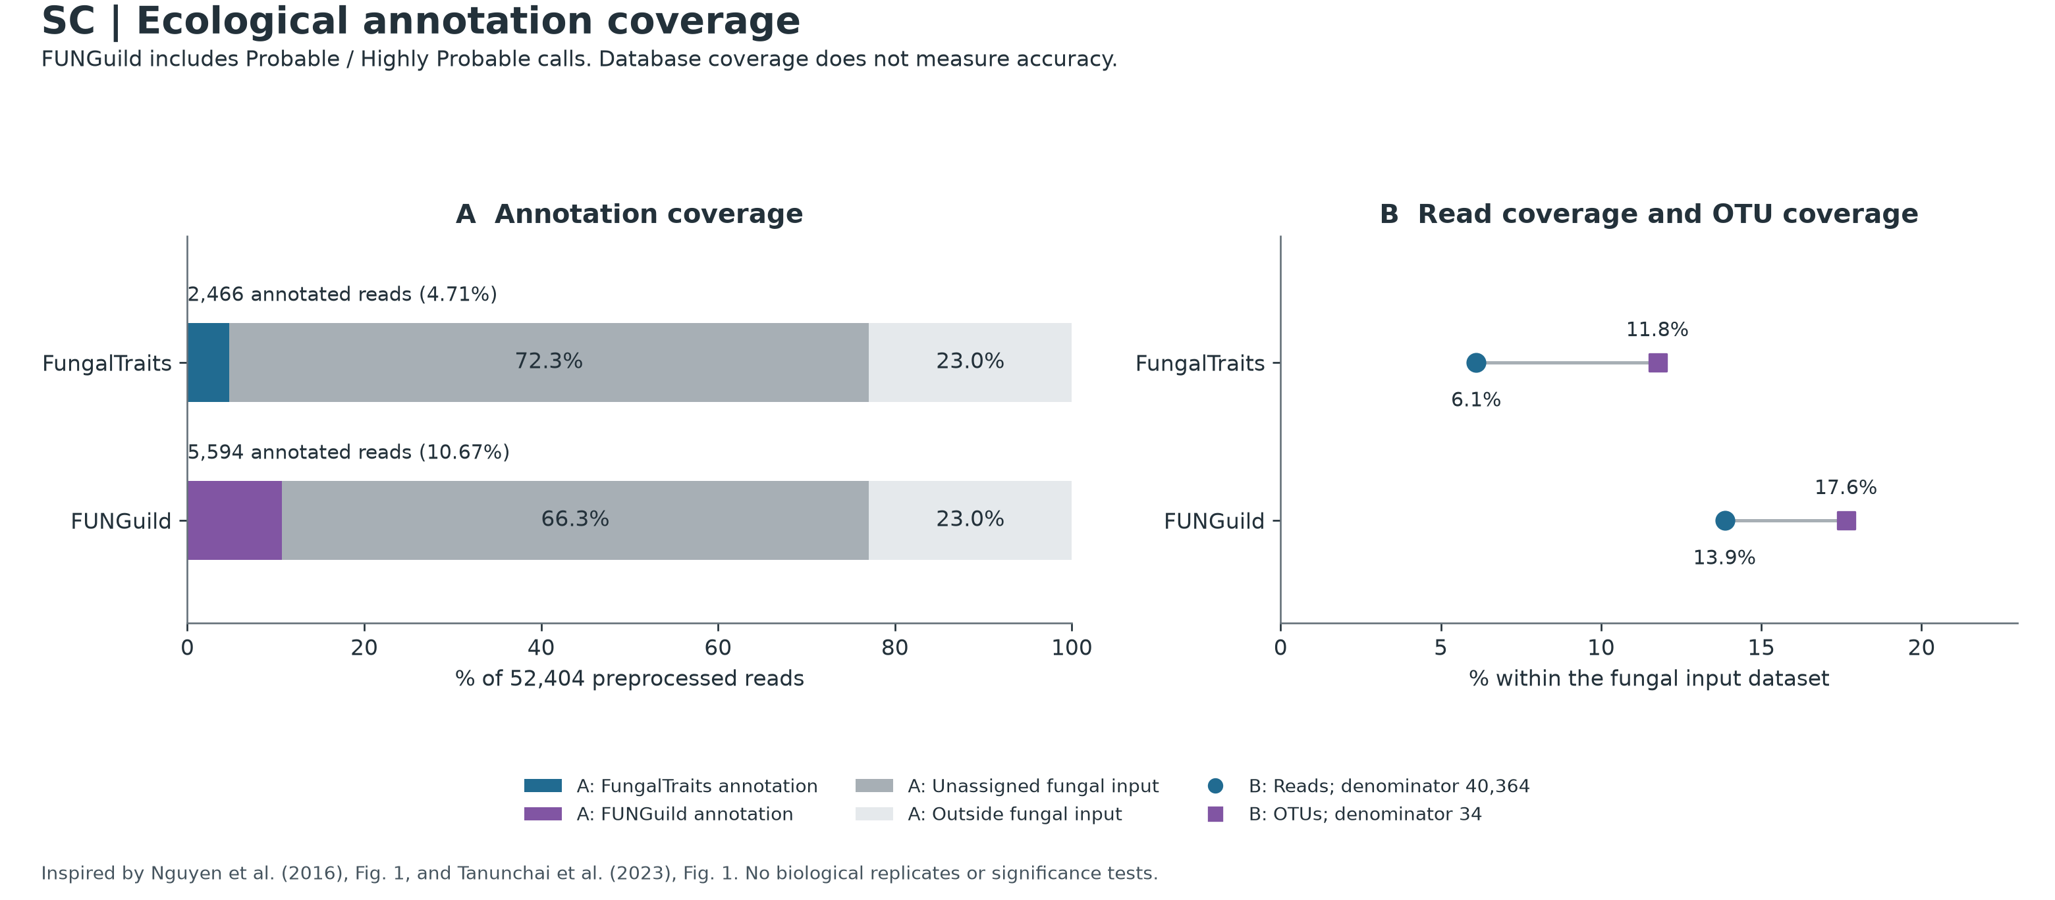
Ecological Annotation Coverage
PART 3 · WHAT ARE THEY DOING? · FIGURE 02
How much of your mangrove fungal community can literature databases explain today?
A
Annotated reads
% of all 52,404 preprocessed reads
4.71%
FungalTraits
10.67%
FUNGuild
Unassigned fungal-core reads: 72.3% (FT), 66.3% (FG); outside fungal input: 23.0%
B
Within fungal input
40,364 fungal reads · 34 fungal OTUs
6.1%
FungalTraits
of reads · 4 of 34 OTUs (11.8%)
Why so low? FungalTraits matches by genus, FUNGuild by genus or family; the abundant OTUs (e.g. OTU_1, 9,715 reads) lack a genus-level match.
Read the bars: unassigned segments stay visible, so a 4% guild is not mistaken for 40–85% of the community.
13.9%
FUNGuild
of reads · 6 of 34 OTUs (17.6%)

Slide 6
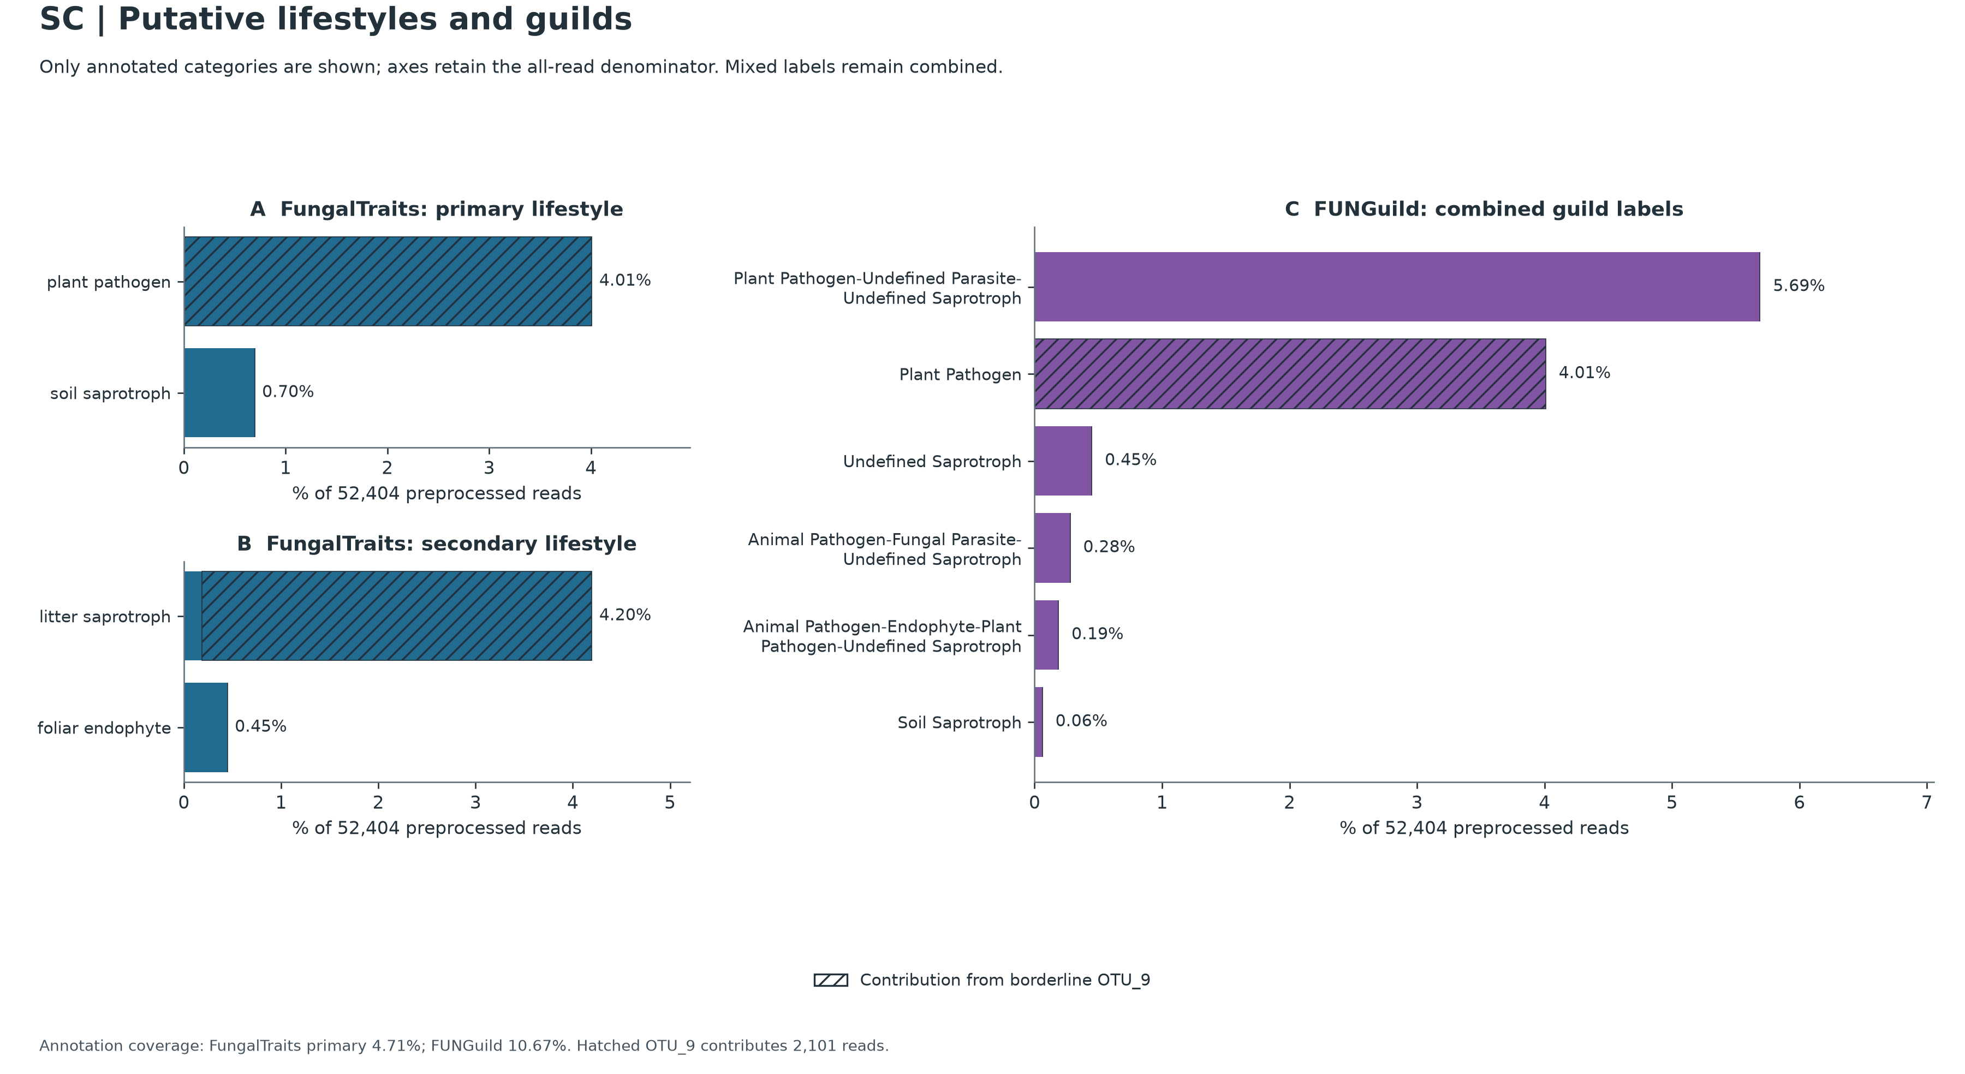

Putative Lifestyles & Guild Composition
PART 3 · WHAT ARE THEY DOING? · FIGURE 03
FungalTraits lifestyles, FUNGuild trophic modes, and the role of OTU_9
A
FungalTraits: primary
4.01%
plant pathogen
100% OTU_9
0.70%
soil saprotroph
3 solid OTUs
B
FungalTraits: secondary
4.20%
litter saprotroph
0.19% solid + 4.01% hatched
0.45%
foliar endophyte
OTU_19, solid
C
FUNGuild: combined labels
5.69%
Plant Pathogen–Parasite–Saprotroph
chytrid family, OTU_7
Hatched = OTU_9 (Gibellulopsis, 2,101 reads = 4.01%), flagged “?” in the chimera audit (Slide 08). All axes keep the 52,404-read denominator.
4.01%
Plant Pathogen
100% OTU_9

Slide 7
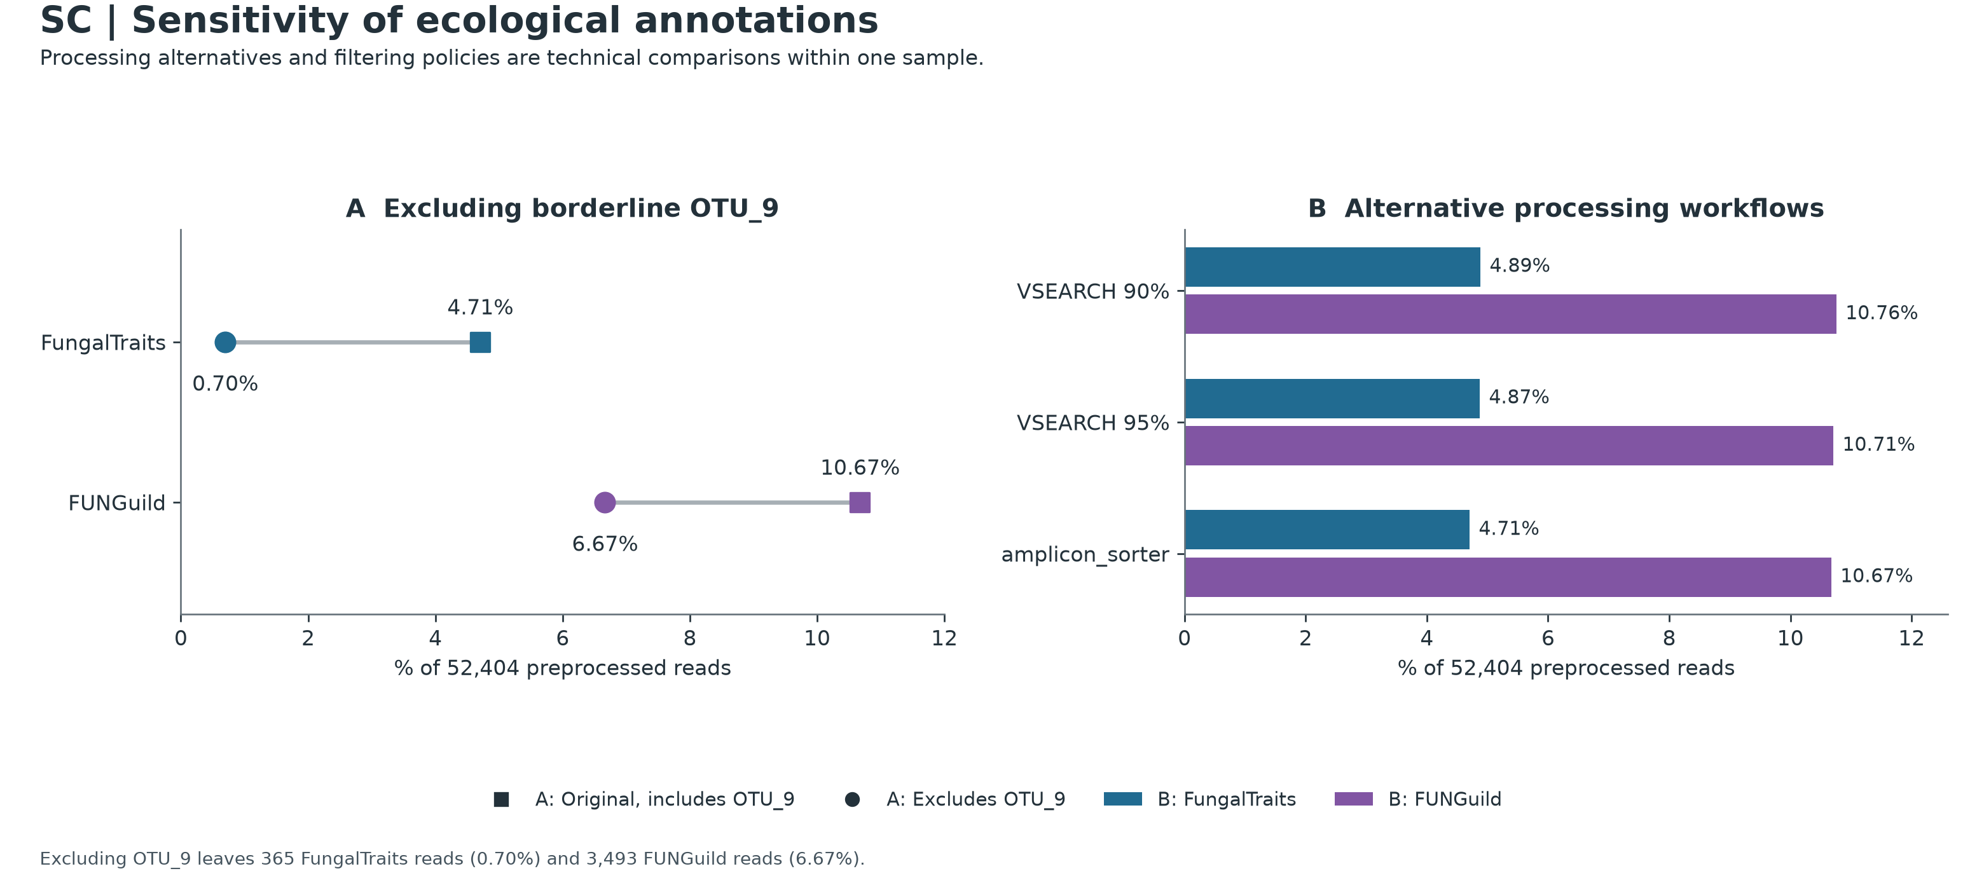
Sensitivity Analysis & Pipeline Stability
PART 3 · WHAT ARE THEY DOING? · FIGURE 04
Testing the impact of omitting OTU_9 and comparing three independent clustering workflows
A
Drop OTU_9
annotated reads, with vs. without OTU_9
FungalTraits
4.71% → 0.70%
FUNGuild
10.67% → 6.67%
B
Three workflows
% annotated reads, same input reads
 | FT | FG
VSEARCH 90% | 4.89 | 10.76
VSEARCH 95% | 4.87 | 10.71
amplicon_sorter | 4.71 | 10.67
85%
of FungalTraits-annotated reads come from OTU_9 alone (2,101 / 2,466), which is why the next slide examines it closely.

Slide 8
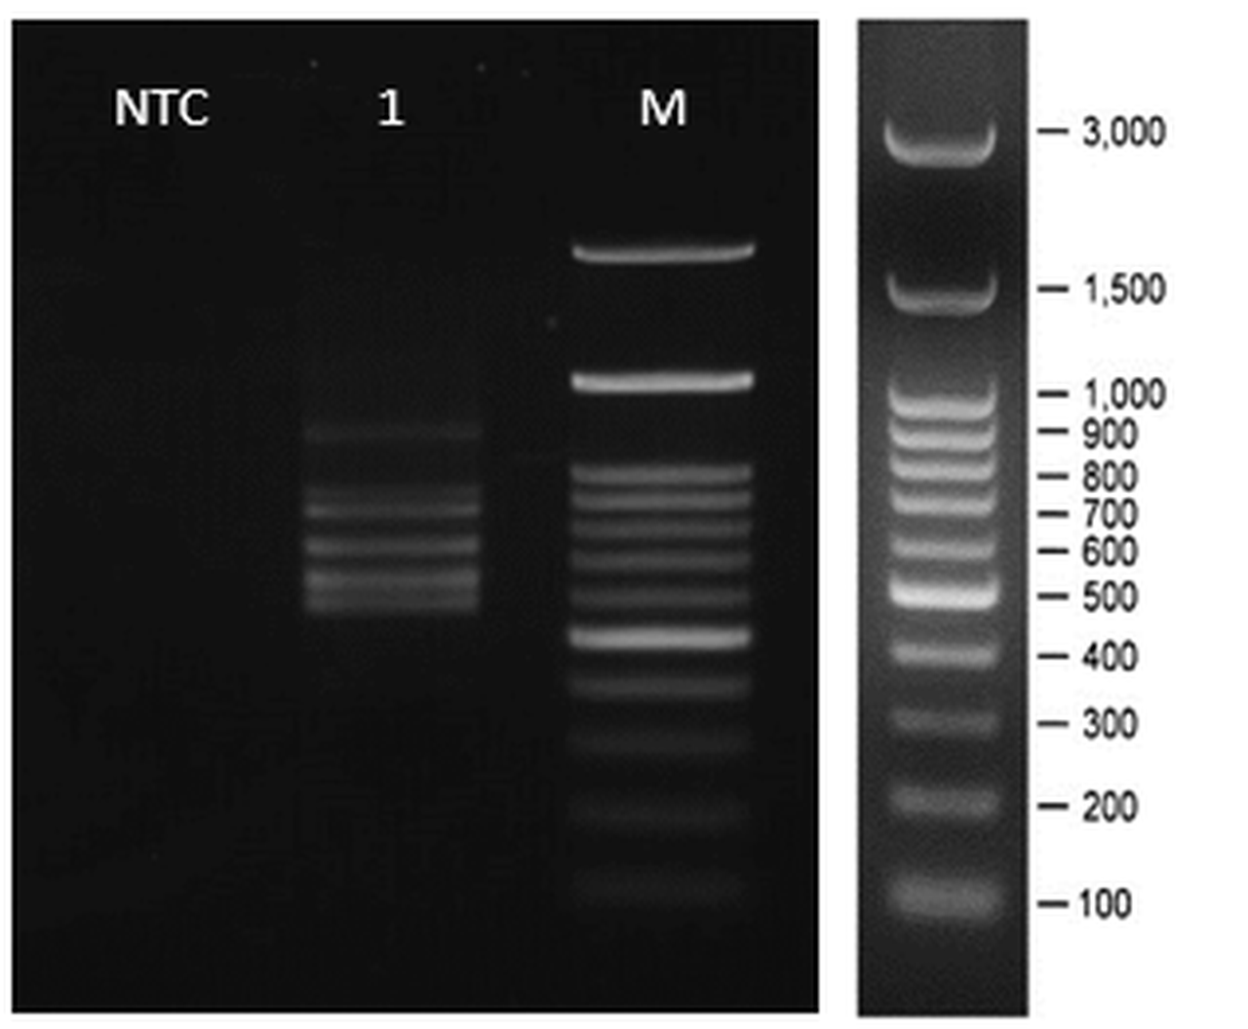


Demystifying OTU_9 (Gibellulopsis)
PART 3 · WHAT ARE THEY DOING? · SPECIAL SPOTLIGHT
Amplicon structure, gel-band size match, chimera audit, and plausible rhizosphere ecology
PCR gel, lane 1: multi-band profile with an upper band at ~1,100–1,150 bp, between the 1,000 and 1,500 bp ladder marks. 1% TBE agarose; M = 100 bp ladder.
Identity, structure & ecology
Why UCHIME-ref said “?”
UNITE: Gibellulopsis (Plectosphaerellaceae), 2,101 reads = 4.01%
99.55% identity (446/448 bp) to G. piscis DQ825985
Two amplicons, 520 bp and 1,131 bp; the 1,131 bp length matches the ~1,100–1,150 bp gel band
FungalTraits: primary plant pathogen, secondary litter saprotroph
De novo screen: passed (N, score 0.0317)
Reference DQ825985 lacks 22 bp at the 5′ end of ITS1; related V. dahliae EF377335 has it and shares 2 SNPs
Misses VSEARCH’s positive thresholds (mindiffs ≥ 3, mindiv ≥ 0.8%)
Verdict: reference truncation, not a PCR mosaic; kept and hatched
SCHEMATIC · not to scale
00012 · 520 bp
00039 · 1,131 bp
~600 bp 18S insertion (removed by ITSx) + ITS block (470 bp ITS, 98.9% identical)
UCHIME-ref alignment, 5′ end of ITS1
OTU_9
DQ825985
EF377335
dashed box = 22 bp missing from DQ825985

Slide 9
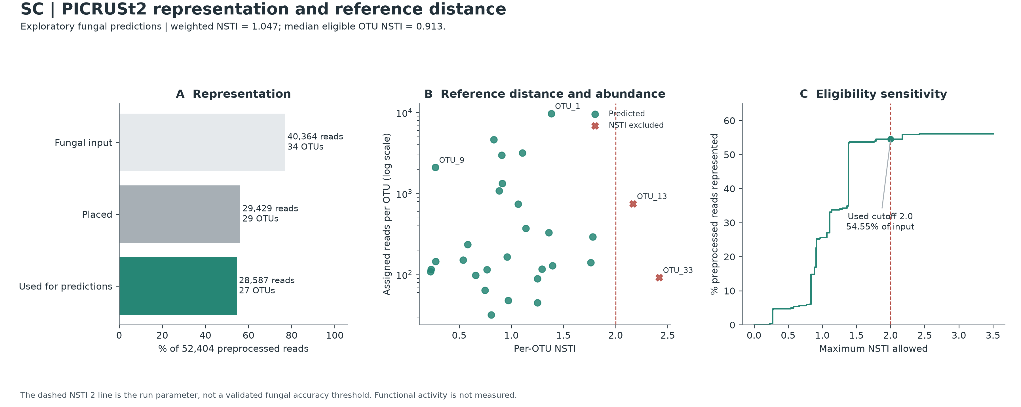
Fungal PICRUSt2 Diagnostics & Reference Distance
PART 4 · WHAT IS THEIR METABOLIC POTENTIAL? · FIGURE 05
Read retention (54.55%) and evolutionary distance (weighted NSTI = 1.047) come before any pathway
A
Representation funnel
% of 52,404 preprocessed reads
Fungal input
34 OTUs
77.02%
Placed on tree
29 OTUs
56.16%
Used for predictions
27 OTUs
54.55%
B
Distance vs. abundance
C
Eligibility curve
5 OTUs (10,935 reads) failed alignment, including the OTU_2 / OTU_5 pair (9,600 reads)
2 OTUs above NSTI 2.0 removed (OTU_13, OTU_33; 842 reads)
Weighted NSTI 1.047 (median 0.913). OTU_9 sits at 0.271, chytrid OTU_1 at 1.383; red × = excluded beyond 2.0.
0% retained at NSTI ≤ 0.20, 4.72% at ≤ 0.50, then a jump from 34.9% to 53.5% at ≈1.38 where OTU_1 enters.

Slide 10
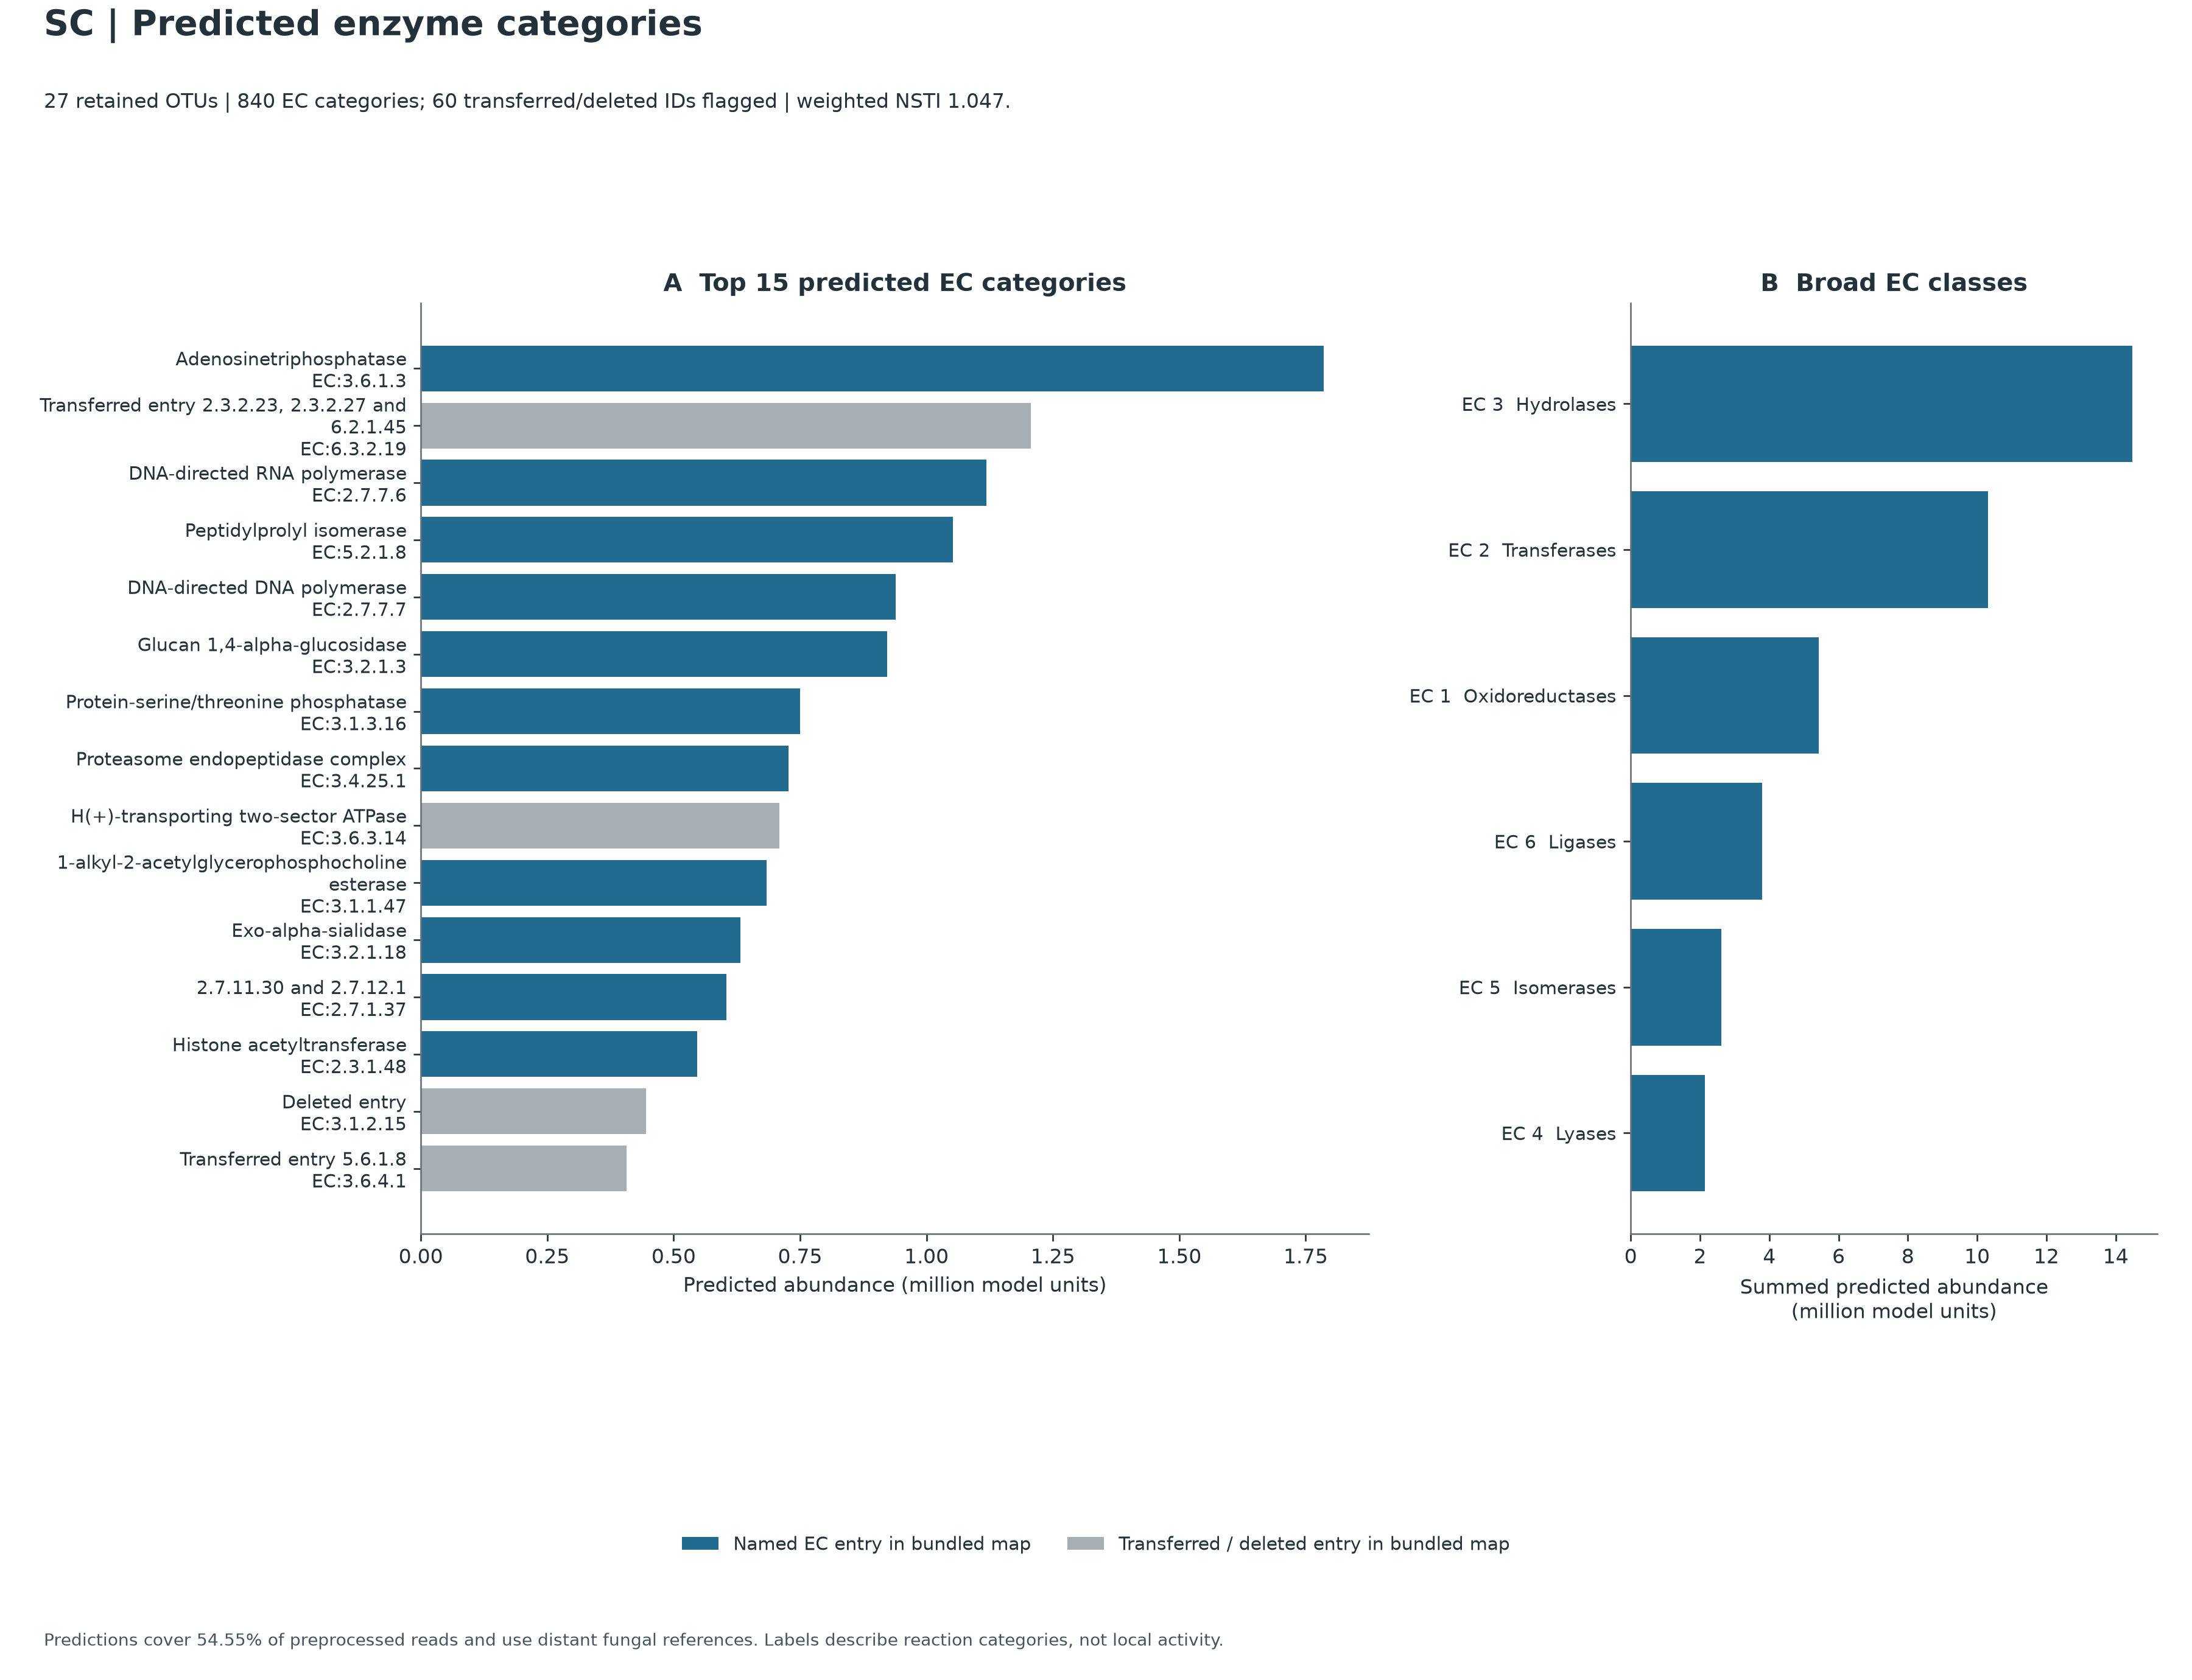
Predicted Enzyme Profiles (840 EC Categories)
PART 4 · WHAT IS THEIR METABOLIC POTENTIAL? · FIGURE 06
Core housekeeping machinery, database nomenclature status, and detrital polysaccharide hydrolases
A
Top 15 ECs: housekeeping leads
11 blue = named ECs (ATPase #1, RNA pol #3, DNA pol #5, glucan 1,4-α-glucosidase #6); 4 gray = transferred/deleted IDs (ranks 2, 9, 14, 15), so the number was retired, not the gene.
B
Six broad EC classes
EC 3 hydrolases lead (14.48M units, 238 ECs), then EC 2 transferases 10.32M, EC 1 oxidoreductases 5.42M, EC 6 ligases 3.80M, EC 5 isomerases 2.62M, EC 4 lyases 2.14M.
TABLE CALLOUT
ec_predicted_profiles.tsv · ranks 17–23
RANK | EC | DESCRIPTION
17 | EC:2.4.1.16 | Chitin synthase
18 | EC:2.5.1.18 | Glutathione transferase
19 | EC:5.3.1.4 | L-arabinose isomerase
23 | EC:3.2.1.14 | Chitinase
Notes:
SPEAKER NOTES — PLAIN-ENGLISH ELABORATION
– Interpreting Predicted Enzymes: The dominance of ATPases, polymerases, chaperones, and proteasome/phosphatase enzymes in Panel A reflects universal eukaryotic housekeeping genes present in every sequenced fungal reference genome.
– Polysaccharide & Chitin Turnover Potential: The presence of Glucan 1,4-alpha-glucosidase (EC:3.2.1.3, Rank 6 on the chart) and lower-rank L-arabinose isomerase (EC:5.3.1.4) and Chitinase (EC:3.2.1.14) in the companion table reflects conserved fungal capacities for breaking down starch/glucans, plant hemicellulose pentoses, and fungal/arthropod chitin—functions plausibly relevant to saprotrophic turnover in litter-bearing mangrove sediment.
ON-SLIDE CALLOUT REFERENCE (exact values)
– Panel A (Top 15 Predicted EC Categories — Plotted in PNG): Ranks the 15 largest Enzyme Commission (EC) predictions (million model units).
– Blue bars (11 of Top 15): Active named EC entries in PICRUSt2's bundled description map, led by housekeeping enzymes—EC:3.6.1.3 (Adenosinetriphosphatase, Rank 1), EC:2.7.7.6 (DNA-directed RNA polymerase, Rank 3), EC:5.2.1.8 (Peptidylprolyl isomerase, Rank 4), EC:2.7.7.7 (DNA-directed DNA polymerase, Rank 5)—and polysaccharide hydrolase EC:3.2.1.3 (Glucan 1,4-alpha-glucosidase, Rank 6).
– Gray bars (4 of Top 15 — Ranks 2, 9, 14, 15): Older EC IDs labeled Transferred entry ... or Deleted entry (EC:3.1.2.15 at Rank 14). Across all 840 ECs, 58 are transferred and 2 are deleted IUBMB catalog identifiers—meaning the catalog number was later merged or retired after PICRUSt2 froze its fungal map, not that the gene is missing.
– Panel B (Broad EC Classes — Plotted in PNG): Sums all 840 predicted ECs into 6 IUBMB biochemical classes (EC 1–EC 6):
– EC 3 Hydrolases (14.48M units, 238 ECs — #1 class, including ATPases cataloged under EC 3.6.x in older IUBMB maps alongside glycosidases, phosphatases, peptidases, and esterases)
– EC 2 Transferases (10.32M units, 228 ECs)
– EC 1 Oxidoreductases (5.42M units, 208 ECs)
– EC 6 Ligases (3.80M, 54 ECs), EC 5 Isomerases (2.62M, 38 ECs), and EC 4 Lyases (2.14M, 74 ECs).
– [Table Callout — From Companion TSV, Not Plotted in PNG] Ranks 17–23 in tables/ec_predicted_profiles.tsv:
– Just below the Top-15 plot cutoff, the full 840-EC table includes conserved fungal enzymes involved in cell-wall and detrital processing: Chitin synthase (EC:2.4.1.16, Rank 17), Glutathione transferase (EC:2.5.1.18, Rank 18), L-arabinose isomerase (EC:5.3.1.4, Rank 19), and Chitinase (EC:3.2.1.14, Rank 23).

Slide 11
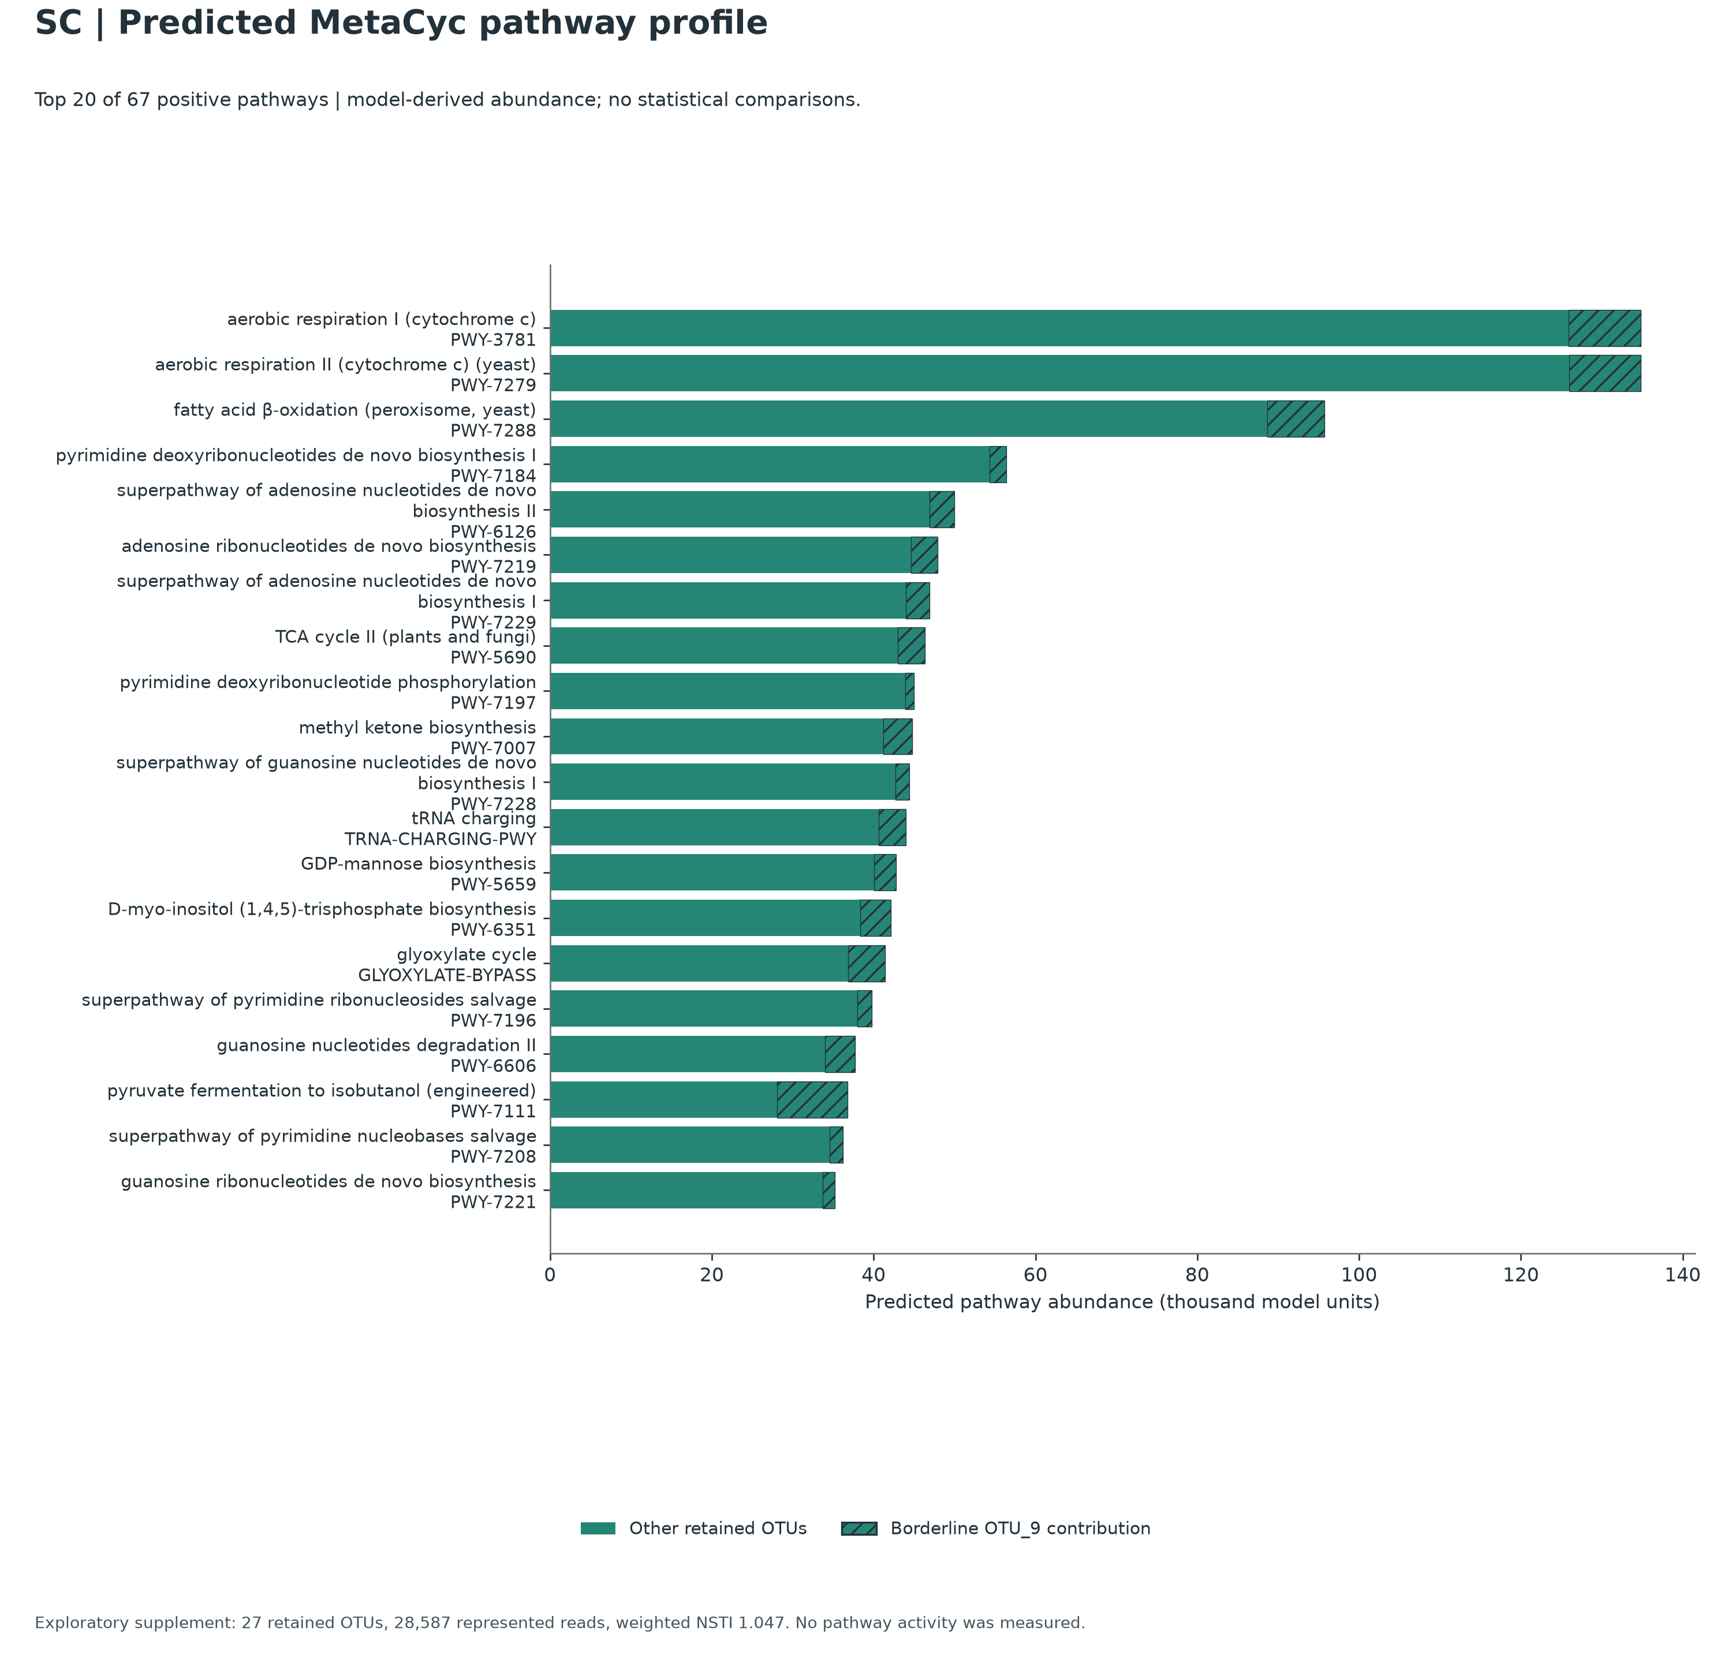

Predicted MetaCyc Metabolic Pathway Profile
PART 4 · WHAT IS THEIR METABOLIC POTENTIAL? · FIGURE 07
Top 20 of 67 reconstructed fungal pathways: core eukaryotic bioenergetics and conserved metabolism
solid = 26 other OTUs
hatched = OTU_9 (2.4–11.1%; 23.6% at rank 18)
1–12
Core energy, nucleotide & fatty-acid metabolism
Aerobic respiration I & II, peroxisomal β-oxidation, de novo pyrimidine/purine biosynthesis, fungal TCA cycle II, tRNA charging.
13–15
Cell wall, signaling & the C2 carbon shunt
GDP-mannose biosynthesis (cell-wall mannoproteins), inositol trisphosphate signaling, and the glyoxylate cycle for acetate/fatty-acid carbon.
16–20
Nucleoside salvage & branched-chain fermentation
Pyrimidine/guanosine salvage; rank 18 is named “(engineered)” only because MetaCyc curated it that way: the enzymes are ordinary fungal ones.
Universal core metabolism, not marine adaptation: 81.5–87.1% of the glyoxylate, GDP-mannose and inositol pathway signal projects from one soil chytrid genome (Spipu1).
Notes:
SPEAKER NOTES — PLAIN-ENGLISH ELABORATION
– How Conserved Pathways Relate to Sediment & Rhizosphere Life (Ranks 13–15): GDP-mannose biosynthesis (PWY-5659) supplies precursors for cell-wall mannoproteins; inositol trisphosphate biosynthesis (PWY-6351) supports eukaryotic membrane/stress signaling; and the glyoxylate cycle (GLYOXYLATE-BYPASS, paired with Rank 3 fatty-acid beta-oxidation) allows fungi to assimilate 2-carbon compounds (such as acetate and fatty acids) without losing carbon as CO₂.
– Crucial Caveat Against Over-Claiming: As shown on Slide 12, 81.5%–87.1% of the predicted abundance of GLYOXYLATE-BYPASS, PWY-5659, and PWY-6351 is projected from a single terrestrial soil chytrid reference genome (Spizellomyces punctatus Spipu1). Therefore, these pathways represent universal core fungal metabolic machinery that is plausibly useful in organic-rich intertidal sediment—not habitat-specific marine halotolerance genes discovered in Sonneratia alba strains.
– Why Does Rank 18 Say (engineered) (PWY-7111)? MetaCyc names pathway entries after the experimental organism or engineered system in which the complete pathway record was curated. Wild fungi naturally possess the component enzymes (involved in valine/isoleucine biosynthesis and Ehrlich fusel-alcohol metabolism, particularly in Gibellulopsis reference relative Veral1), so PICRUSt2 scores the shared enzyme reactions—it does not indicate engineered organisms in the sample.
ON-SLIDE CALLOUT REFERENCE (exact values)
– Horizontal bar chart ranking the Top 20 MetaCyc pathways (thousand model units) out of 67 positive pathways predicted.
– Solid green segments: Combined contribution from the 26 other retained fungal OTUs.
– Hatched green segments: Stratified contribution from OTU_9 (Gibellulopsis, 2.4%–11.1% across most top pathways, and 23.6% at Rank 18).
– Pathway Groups on the Chart:
– Ranks 1–12 (Core Energy, Nucleotide & Fatty-Acid Metabolism): Aerobic respiration I & II (PWY-3781, PWY-7279), peroxisomal fatty-acid beta-oxidation (PWY-7288), de novo pyrimidine/purine nucleotide biosynthesis & phosphorylation (PWY-7184, PWY-6126, PWY-7219, PWY-7229, PWY-7197, PWY-7228), fungal TCA cycle II (PWY-5690), methyl ketone biosynthesis (PWY-7007, Rank 10), and TRNA-CHARGING-PWY (Rank 12).
– Ranks 13–15 (Cell Wall, Signaling & C2 Carbon Shunt): GDP-mannose biosynthesis (PWY-5659, Rank 13), D-myo-inositol (1,4,5)-trisphosphate biosynthesis (PWY-6351, Rank 14), and the glyoxylate cycle (GLYOXYLATE-BYPASS, Rank 15).
– Ranks 16–20 (Nucleoside Salvage & Branched-Chain Fermentation): Pyrimidine/guanosine salvage and degradation (PWY-7196, PWY-6606, PWY-7208, PWY-7221) plus pyruvate fermentation to isobutanol (engineered) (PWY-7111) at Rank 18.

Slide 12
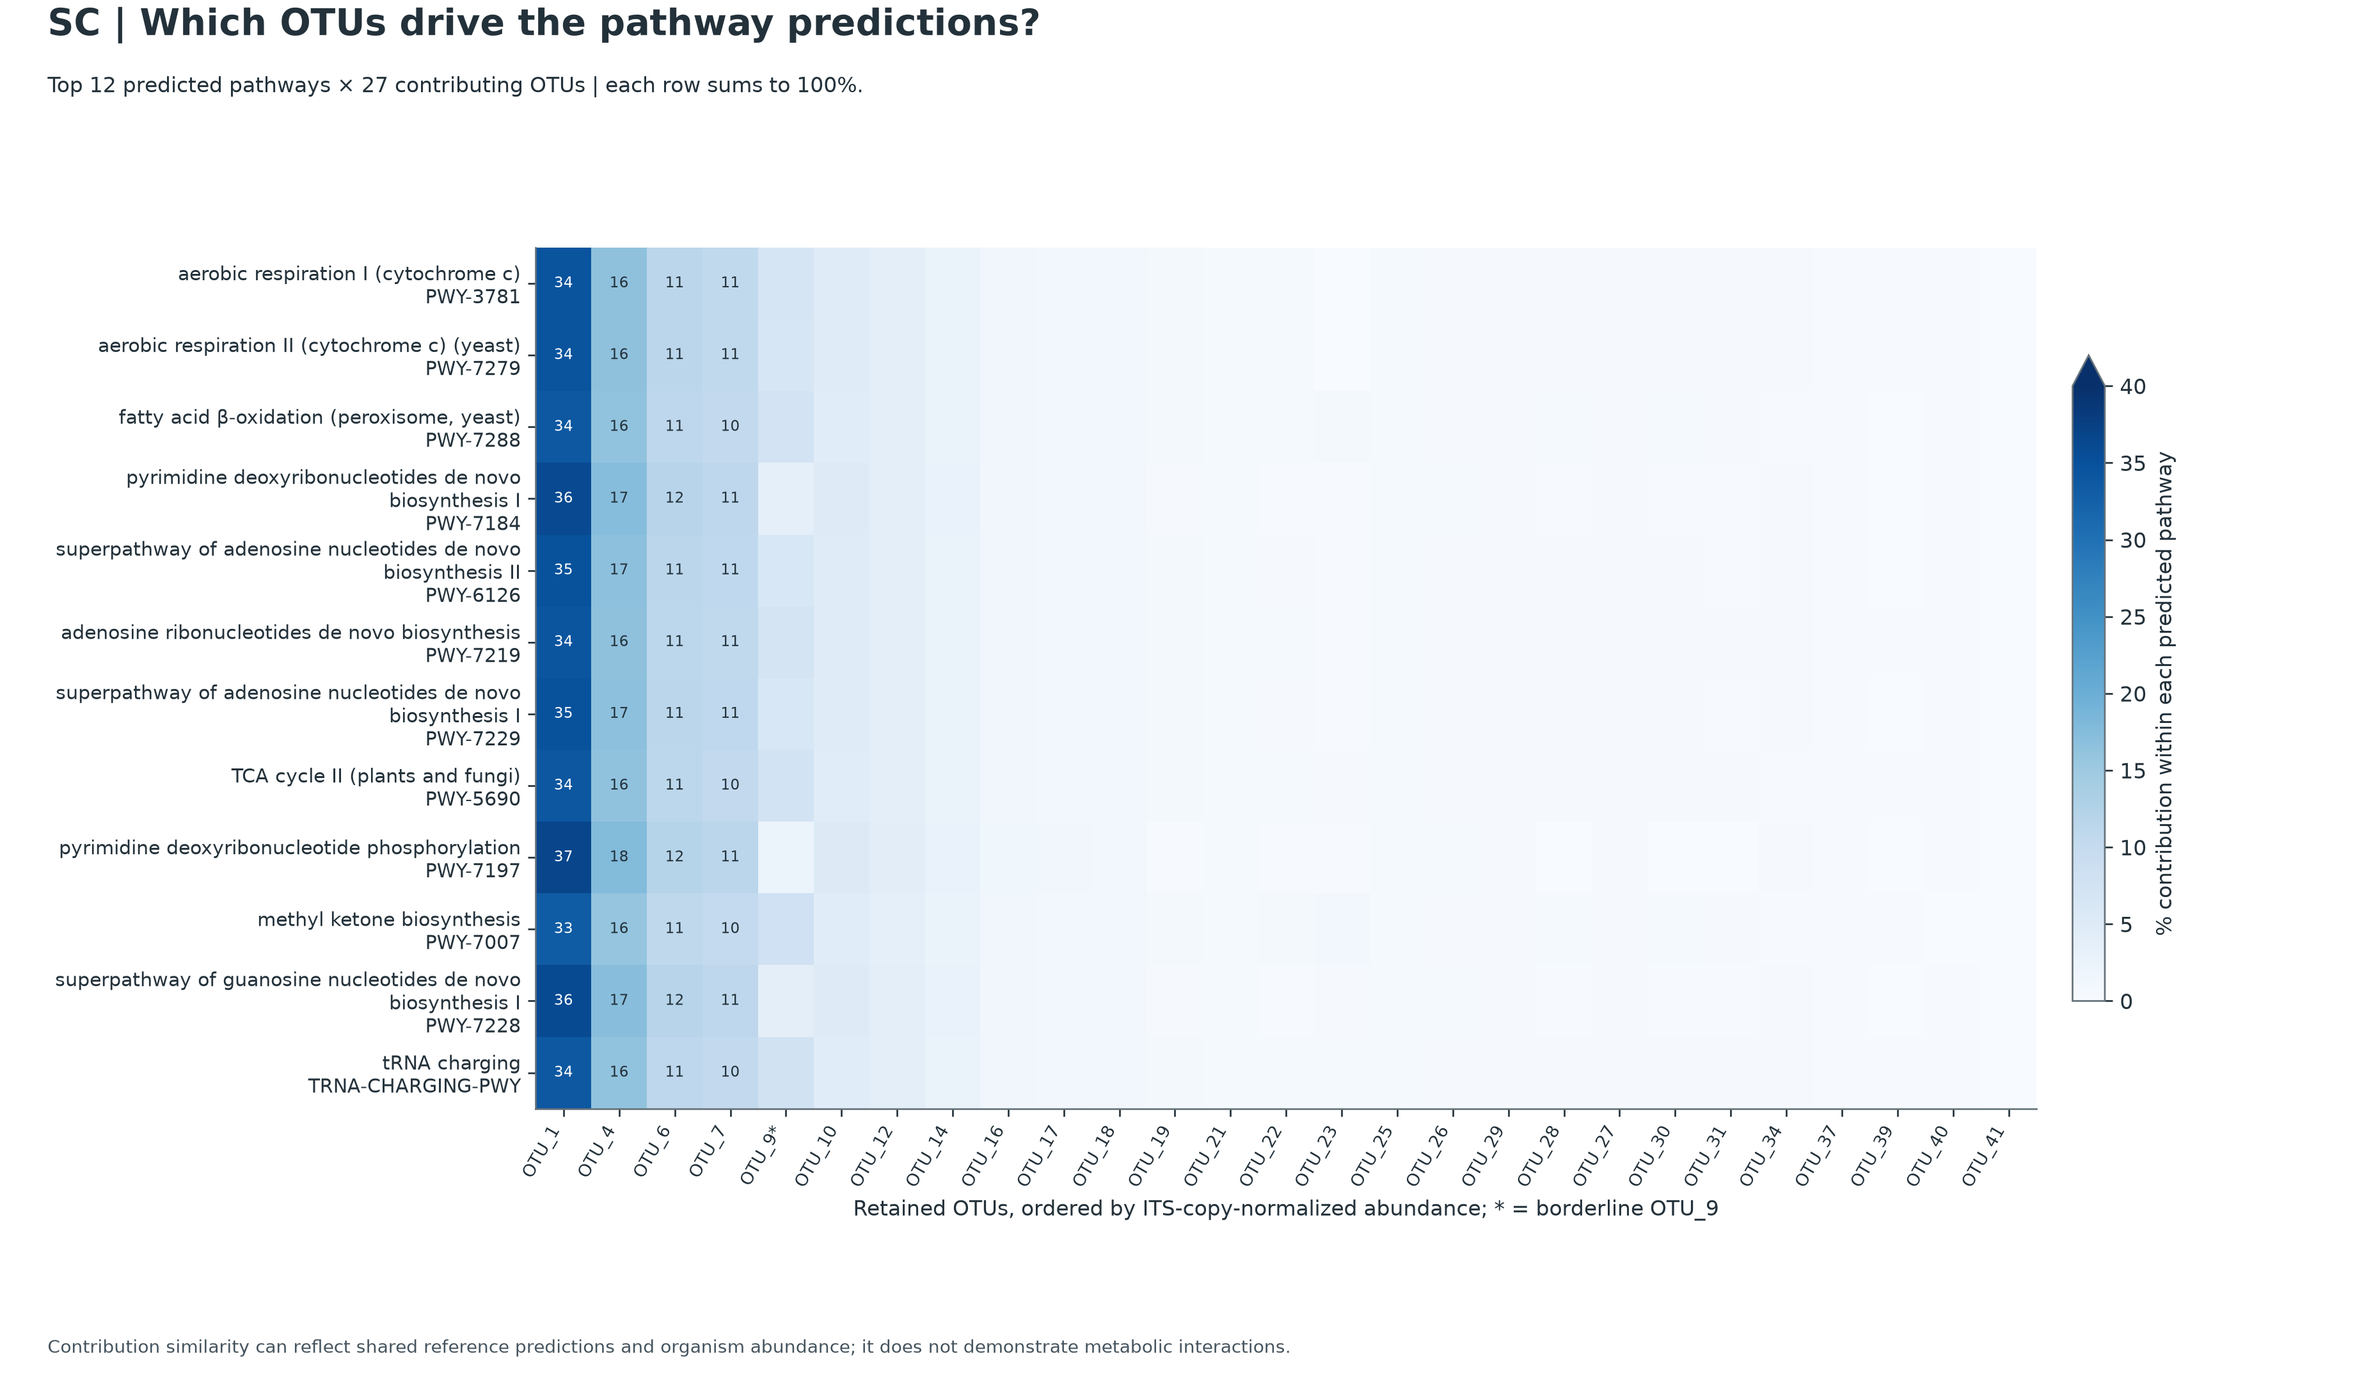
Which OTUs Drive the Predictions?
PART 4 · WHAT IS THEIR METABOLIC POTENTIAL? · FIGURE 08
Stratified heatmap of the top 12 MetaCyc pathways across all 27 retained fungal OTUs
Columns 1–4 carry ≈72% of predicted reads
OTU_1
33–37%
Chytridiomycota
OTU_4
16–18%
unresolved phylum
OTU_6
11–12%
unresolved phylum
OTU_7
10–11%
Chytridiomycota
then OTU_9* (Gibellulopsis) at 2.4–8.1%
TABLE CALLOUT
marker_predicted_and_nsti.tsv
Predicted ITS copy number = 1 for all 29 placed OTUs
14 of 27 OTUs (86.4% of predicted reads) share one nearest genome: Spizellomyces punctatus (Spipu1)
Each row sums to 100%; cells ≥10% are printed; * marks OTU_9 (borderline chimera call). Similar columns reflect shared reference predictions, not metabolic interaction.
Notes:
SPEAKER NOTES — PLAIN-ENGLISH ELABORATION
– Why Columns 1–4 Look Like Uniform Vertical Stripes (34, 16, 11, 11): Because OTU_1, OTU_4, OTU_6, and OTU_7 all inherit their predicted enzyme counts primarily from the same nearest chytrid reference genome (Spipu1) with ITS_count = 1, their relative contributions to nearly every housekeeping pathway simply mirror their share of total predicted reads (34.0%, 16.3%, 11.1%, and 10.4%, summing to 71.8%).
– This directly explains the footnote printed at the bottom of Figure 08: "Contribution similarity can reflect shared reference predictions and organism abundance; it does not demonstrate metabolic interactions." Note also that placement near Spipu1 for OTU_4 and OTU_6 only identifies the closest genome on PICRUSt2's sparse fungal tree (NSTI = 0.83–1.11), not a confirmed taxonomic phylum assignment.
ON-SLIDE CALLOUT REFERENCE (exact values)
– Heatmap Layout (Plotted in PNG): Rows list the Top 12 MetaCyc pathways; columns list all 27 retained OTUs ordered left-to-right by ITS-copy-normalized abundance (* marks OTU_9* in column 5). Each row sums to 100%, with cell values ≥10% printed directly on the plot.
– Top 4 Columns Carry ~72% of Predicted Reads (70%–78% Across Every Top-12 Pathway Row):
– OTU_1 (33%–37% printed in column 1) — Chytridiomycota (Lobulomycetales, 9,715 reads)
– OTU_4 (16%–18% printed in column 2) — Unresolved fungal phylum (4,650 reads)
– OTU_6 (11%–12% printed in column 3) — Unresolved fungal phylum (3,180 reads)
– OTU_7 (10%–11% printed in column 4) — Chytridiomycota (Spizellomycetaceae, 2,982 reads)
(followed in column 5 by Ascomycota OTU_9, Gibellulopsis, 2,101 reads, contributing 2.4%–8.1%).*
– [Table Callout — From Companion TSV, Not Plotted in PNG] Reference Genomes & NSTI (tables/marker_predicted_and_nsti.tsv & tables/otu_annotation_and_nsti.tsv):
– Predicted ITS copy number = 1 for all 29 placed OTUs (draft fungal genome assemblies collapse repetitive rDNA arrays, so copy-normalized abundance order equals raw read count order).
– 14 of the 27 retained OTUs (24,696 / 28,587 reads = 86.4% of predicted reads—including OTU_1 [NSTI = 1.38], OTU_4 [0.83], OTU_6 [1.11], and OTU_7 [0.91]) share the exact same closest sequenced reference genome: Spizellomyces punctatus (Spipu1)!

Slide 13



Ecological Synthesis for Sample SC
PART 5 · SYNTHESIS & NEXT STEPS · SYNTHESIS
Connecting sequence observations to plausible roles in cut rhizosphere roots and intertidal sediment
Abundant chytrids & unresolved lineages
Root- & litter-associated ascomycetes
Conserved core fungal metabolism
OBSERVED IN SAMPLE SC
OBSERVED IN SAMPLE SC
OBSERVED IN SAMPLE SC
Chytridiomycota 26.52% (13,895 reads) outnumber Ascomycota (5.27%) about 5 : 1; 45.24% are unresolved-phylum fungi; 16.46% are non-fungal (incl. nematodes).
Gibellulopsis OTU_9 (4.01%; its 1,131 bp consensus matches the ~1,100–1,150 bp gel band) plus minor saprotrophs and endophytes (OTU_19, 31, 41, 23).
840 ECs (EC 3 hydrolases lead) and 67 MetaCyc pathways across 54.55% of preprocessed reads; weighted NSTI = 1.047.
PLAUSIBLE ECOLOGICAL CONTEXT
PLAUSIBLE ECOLOGICAL CONTEXT
PLAUSIBLE ECOLOGICAL CONTEXT
Zoosporic chytrids (Lobulomycetales OTU_1, Spizellomycetaceae OTU_7) fit waterlogged, tidal mud rich in submerged detritus, pollen and chitin.
The “plant pathogen” label comes from crop literature; the secondary “litter saprotroph” label fits an asymptomatic endophyte or saprotroph just as well.
86.4% of predictions project from a terrestrial chytrid (Spizellomyces punctatus, Spipu1): baseline metabolism, not marine-adaptation genes.
Notes:
SPEAKER NOTES — PLAIN-ENGLISH ELABORATION
– 3 thematic summary pillars separating Observed Sequence Evidence from Plausible Ecological Interpretation in this single-sample dataset:
• Pillar 1: Abundant Zoosporic Chytrids & Unresolved Fungal Lineages
– Observed in Sample SC: Chytridiomycota (26.52%, 13,895 reads) outnumber Ascomycota (5.27%, 2,764 reads) by 5-to-1, alongside 45.24% (23,705 reads) unresolved-phylum fungal reads and 16.46% (8,624 reads) non-fungal/uncertain eukaryotic amplicons (including rhizosphere nematodes).
– Plausible Ecological Context: The high proportion of zoosporic chytrids (Lobulomycetales OTU_1, Spizellomycetaceae OTU_7) is consistent with waterlogged, tidally inundated Sonneratia alba mud, where flagellated fungi colonize submerged particulate detritus, algae, pollen, and chitin while remaining underrepresented at genus rank in reference databases.
• Pillar 2: Root- and Litter-Associated Ascomycetes
– Observed in Sample SC: Detection of Gibellulopsis (OTU_9, 4.01%, whose 1,131 bp intron-bearing consensus matches the size of the ~1,100–1,150 bp upper band on the PCR gel) alongside minor saprotrophs/endophytes (Wardomycopsis OTU_19, Microascus OTU_31, Alloconiothyrium aptrootii OTU_41, Herpotrichiellaceae OTU_23).
– Plausible Ecological Context: While database lookup assigns Gibellulopsis a primary plant_pathogen label from crop literature, its secondary litter_saprotroph annotation is equally consistent with an asymptomatic root-associated endophyte or saprotroph in cut rhizosphere roots and litter-containing sediment.
• Pillar 3: Conserved Core Fungal Metabolism (Weighted NSTI = 1.047)
– Observed in PICRUSt2 Output: 840 predicted ECs (led by EC 3 Hydrolases, including Rank 6 glucanase EC:3.2.1.3 and lower-rank chitinase/cell-wall/antioxidant enzymes) and 67 MetaCyc pathways (aerobic respiration, fatty-acid beta-oxidation, glyoxylate cycle, GDP-mannose, and inositol signaling) across 54.55% of preprocessed reads.
– Plausible Ecological Context: Projected largely (86.4%) from terrestrial chytrid reference Spizellomyces punctatus (Spipu1), these predictions reflect conserved baseline fungal pathways for C2 lipid/acetate assimilation and polysaccharide/chitin breakdown rather than direct detections of marine-specific adaptation genes.

Slide 14


Key Takeaways and Next Steps
PART 5 · SYNTHESIS & NEXT STEPS · TAKEAWAYS
What you can conclude confidently today, and how to build on this single-sample baseline
SUPPORTED BY THIS DATASET
RECOMMENDED NEXT STEPS
Full-length ONT consensus recovery
Replication, controls & compartment separation
n ≥ 3–5 trees per site/zone, extraction and PCR negatives; split washed roots, rhizosphere mud and bulk sediment.
1
13,021 long reads >900 bp kept; 7 non-fungal OTUs separated; 34 fungal OTUs (40,364 reads).
Chytrid & unresolved-lineage dominance
2
Chytridiomycota 26.52% and unresolved-phylum fungi 45.24% dominate; Ascomycota is 5.27%.
Targeted culturing & gel-band / salinity assays
Isolate root ascomycetes, bait chytrids across NaCl gradients, or sequence the ~1,130 bp gel band directly.
Transparent guild coverage & OTU_9 check
3
Guild databases cover 4.71% / 10.67% of reads; OTU_9 is non-chimeric (“?” = reference truncation).
Shotgun metagenomics or RNA-Seq
Measure true mangrove-adapted functional genes and in situ transcription beyond sparse-reference predictions.
Exploratory functional supplement
4
PICRUSt2: 27 OTUs, 54.55% of reads, NSTI 1.047, 86.4% from Spipu1: hypotheses, not measurements.
Notes:
SPEAKER NOTES — PLAIN-ENGLISH ELABORATION
– Two-column split: "Conclusions Directly Supported by This Dataset" vs. "Recommended Next Steps":
• Left Column: What You Can Conclude Confidently
– Full-Length ONT Consensus Recovery: Rebuilding consensus OTUs from primer-verified Q≥12 reads retained 13,021 long reads >900 bp (consistent with the ~1,100–1,150 bp upper band on the PCR gel), separated 7 co-amplified non-fungal/uncertain OTUs (including rhizosphere nematodes), and defined 34 conservative fungal OTUs (40,364 reads).
– Chytrid & Unresolved-Lineage Dominance: In this composite cut-root and sediment sample, Chytridiomycota (26.52%) and unresolved-phylum fungi (45.24%) account for the vast majority of fungal reads, while Ascomycota account for 5.27%.
– Transparent Guild Coverage & OTU_9 Verification: Existing trait databases annotate 4.71% (FungalTraits) and 10.67% (FUNGuild) of preprocessed reads (6.1% and 13.9% of fungal reads). Sequence alignment confirms OTU_9 (Gibellulopsis, 99.55% match to G. piscis) is non-chimeric (? caused by reference 5' truncation) and drives 100% of the single-guild plant pathogen bar while also carrying a secondary litter_saprotroph annotation.
– Exploratory Functional Supplement: PICRUSt2 predictions (27 OTUs, 54.55% of preprocessed reads, Weighted NSTI = 1.047, 86.4% mapped to reference Spipu1) provide hypothesis-generating profiles of conserved fungal hydrolases and core metabolic pathways, not direct measurements of in situ gene expression or marine adaptation.
• Right Column: Recommended Future Work
– Biological Replication, Controls & Compartment Separation: Collect multi-tree replicates (n ≥ 3–5 per site/zone) alongside DNA extraction and PCR negative controls, separating washed surface-sterilized roots, rhizosphere mud, and bulk sediment to test which taxa are true root endophytes versus sediment dwellers.
– Targeted Culturing & Gel-Band / Salinity Assays: Isolate root-associated ascomycetes and bait zoosporic chytrids across estuarine NaCl gradients (or excise and sequence the ~1,130 bp gel band directly) to experimentally verify salinity tolerance and intron structure.
– Shotgun Metagenomics or Metatranscriptomics (RNA-Seq): Because fungal ITS PICRUSt2 relies on sparse reference genomes, direct shotgun metagenomics or RNA-Seq is the definitive way to measure true mangrove-adapted functional genes and active transcription in situ.

