Slide 1
Long-Read Nanopore ITS Profiling of Sample SC
LONG-READ NANOPORE ITS · SAMPLE SC
Community Structure, Ecological Guilds, and Metabolic Potential
An explainer walkthrough of FUNGuild, FungalTraits, and PICRUSt2 functional predictions in Sonneratia alba rhizosphere & sediment
PROJECT METADATA
AT-A-GLANCE DATA SNAPSHOT
SAMPLE ID
103,015
raw reads delivered
SC (barcode13 / N701-1) · single sample, n = 1
HOST TREE
52,404
preprocessed reads (primers verified, Q ≥ 12)
Sonneratia alba (labeled SC for suspected S. caseolaris; updated after botanical consultation)
48,988
reads in 41 core ITS OTUs
SAMPLE TYPE
Cut rhizosphere root tissue + surrounding intertidal sediment (with litter); habitat confirmed 1 Nov 2026
40,364
reads in 34 fungal core OTUs
PLATFORM
28,587
reads in 27 PICRUSt2-predicted OTUs
Oxford Nanopore (ONT) full-length ITS1–5.8S–ITS2 amplicon
Notes:
SPEAKER NOTES — PLAIN-ENGLISH ELABORATION
– Welcome to the sequence-level reanalysis of your fungal amplicon dataset! Using Oxford Nanopore long-read sequencing with universal ITS1 and ITS4 primers, we captured the complete internal transcribed spacer (ITS1–5.8S–ITS2) region in single reads.
– Sequencing ITS1 and ITS2 together provides stronger sequence resolution for environmental fungi than short-read amplicons, and allows us to reconstruct polished consensus sequences required for guild and functional exploration.
– Because your sample represents a composite interface—cut rhizosphere root tissue combined with surrounding intertidal mud and litter beneath a seaward Sonneratia alba mangrove—the dataset captures both root-associated fungi and waterlogged sediment-dwelling fungi.
– This walkthrough explains each of the 8 descriptive figures prepared from your dataset, showing how to read every panel, what sequence groups were detected, and how to interpret database predictions with appropriate scientific caution.
– Provenance: the Sonneratia alba rhizosphere/sediment habitat was confirmed by the project owner on 1 November 2026. Record the collection and host-identification details in the thesis methods.

Slide 2




Four Key Concepts for Reading the Figures
PART 1 · INTRODUCTION & FOUNDATIONS · BIOINFORMATICS 101
A quick reference guide before we look at any data
What is an OTU?
Reads ≠ cells or biomass
Polished ITS sequences sharing ≥98% identity are grouped into an operational cluster (OTU_1, OTU_2…). An OTU is a sequence group, not automatically a verified species.
If one OTU has 9,715 reads and another 970, its DNA was sequenced ~10× more often, not 10× more fungus. Copy number and PCR efficiency vary, so we report read proportions.
What are ecological guilds?
What is NSTI in PICRUSt2?
FungalTraits (genus) and FUNGuild (genus or family) match a taxon to published lifestyles: saprotroph, pathotroph, symbiotroph. They list capacities, not measured disease or decay.
Nearest Sequenced Taxon Index: the branch distance from your OTU to the closest sequenced fungal genome. Low (<0.20) = close relative; ~1.0+ = functions extrapolated from a distant one.
Notes:
SPEAKER NOTES — PLAIN-ENGLISH ELABORATION
– 4 distinct visual cards (2×2 grid), each with an intuitive icon/badge:
• Card 1: What is an OTU? (Operational Taxonomic Unit)
– Plain Meaning: Wild environmental fungi do not carry species labels, and noisy individual Nanopore reads must first be polished into accurate consensus sequences. We group polished ITS sequences that share ≥98% identity into operational clusters called OTUs (OTU_1, OTU_2, etc.)—each OTU represents an operational sequence group, not automatically a verified biological species.
• Card 2: Reads ≠ Number of Cells or Fungal Biomass!
– Plain Meaning: If one OTU has 9,715 reads and another has 970, it means that DNA template was amplified and sequenced ~10× more often—NOT that there is 10× more fungal biomass in the mud. Fungi vary in ribosomal gene copy numbers per cell and PCR amplification efficiency, so we always report read proportions within the sequenced library.
• Card 3: What are Ecological Guilds (FUNGuild & FungalTraits)?
– Plain Meaning: These are curated literature lookup tables that match a fungus's resolved genus (or family in FUNGuild) to published lifestyle records—such as saprotroph (organic matter/litter decomposer), pathotroph (capable of host infection), or symbiotroph (endophyte/mycorrhizal partner). They indicate literature-reported capacities of matched taxa, not direct measurements of disease or decay rates in your sample.
• Card 4: What is NSTI in PICRUSt2?
– Plain Meaning: NSTI (Nearest Sequenced Taxon Index) measures evolutionary branch distance between your amplicon OTU and the closest sequenced fungal genome in PICRUSt2's reference tree. A low NSTI (<0.20) means a close genome relative exists; a high NSTI (~1.0+) means functions are extrapolated from a distant evolutionary relative.

Slide 3

From Raw Reads to High-Confidence Fungal Clusters
PART 1 · INTRODUCTION & FOUNDATIONS · THE PIPELINE
Primer verification, rescuing long amplicons (>900 bp), consensus polishing, and eukaryote filtering
1
Delivered raw ONT reads
2
Strict primer & quality gate
3
Consensus, polishing & ITSx
4
Conservative fungal core
103,015
52,404
41 OTUs
34 OTUs
raw basecalled reads
reads retained
48,988 reads (93.48% of all)
40,364 reads
Reads of 300–2,000 bp. We bypassed the provider’s 400–900 bp cutoff so true sequences could be rebuilt.
ITS1 + ITS4 ends, ≥200 bp, mean Q ≥ 12. 13,021 kept reads are >900 bp, a size class like the ~1,100–1,150 bp gel band.
amplicon_sorter + 2× Racon polishing; ITSx sets ITS boundaries. Validation reads map uniquely at 93.18%.
UNITE + ITSx screen separates 7 non-fungal/uncertain OTUs (8,624 reads, 16.46%), including two nematode-matching OTUs.
Why filter? Universal ITS1–ITS4 primers also amplify non-fungal soil eukaryotes. Guild and PICRUSt2 analyses therefore run only on the 34-OTU conservative fungal core.
Notes:
SPEAKER NOTES — PLAIN-ENGLISH ELABORATION
– Horizontal process flow diagram with 4 progressive steps:
– Delivered Raw ONT Reads (103,015 reads): Starting raw basecalled reads (300–2,000 bp), bypassing the service provider's 400–900 bp length cutoff and TaxID-only k-mer table so true sequence representatives could be reconstructed.
– Strict Primer & Quality Gate (52,404 reads retained): Retained reads with canonical ITS1 and ITS4 terminal primers, no internal tandem-primer artifacts, trimmed length ≥200 bp, and mean read quality Q ≥ 12. Notably, 13,021 retained reads were originally >900 bp—retaining long amplicons in a size class similar to the ~1,100–1,150 bp upper band visible on your PCR agarose gel (Report/data/electrophoresis.PNG), which a 900 bp ceiling discards.
– Consensus Discovery, 2× Racon Polishing & ITSx Normalization (41 core OTUs, 48,988 reads): Using amplicon_sorter (amplicon_sorter_strict), consensuses were polished twice with Racon on training reads (41,743 reads) and trimmed to standardized ITS boundaries via ITSx. Across the 10,661 held-out validation reads, 93.18% (9,934 reads) mapped uniquely (0.01% ambiguous); across all 52,404 preprocessed reads, 93.48% (48,988 reads) mapped uniquely to the 41 core OTUs (0.01% [4 reads] ambiguous; 6.51% [3,412 reads] unmapped).
– Conservative Fungal Core Extraction (34 fungal OTUs, 40,364 reads): Screened against the all-eukaryote UNITE database and ITSx origin models. Because universal ITS1–ITS4 primers also amplify non-fungal soil eukaryotes, this step separated 7 non-fungal/uncertain core OTUs (8,624 reads, 16.46%)—including two OTUs with full-query UNITE matches within Nematoda (one a Cervidellus match)—before running fungal guild and PICRUSt2 analyses.

Slide 4
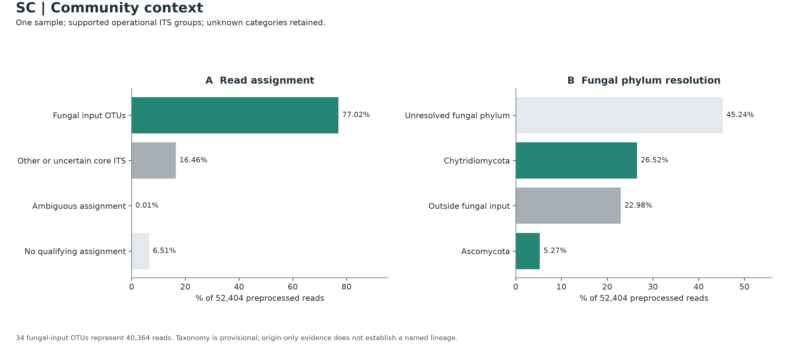
Community Context & Taxonomic Resolution
PART 2 · WHO IS IN YOUR SAMPLE? · FIGURE 01
Accounting for all 52,404 preprocessed reads across core OTUs and fungal phyla
A
Read assignment
read → OTU gate: ≥85% identity, ≥90% span
77.02%
Fungal input OTUs
16.46%
Other / uncertain core
0.01%
Ambiguous (4 reads)
6.51%
No qualifying match
B
Fungal phylum
OTU → UNITE: ≥90% id, ≥90% query, ≥80% ref
45.24%
Unresolved phylum
52,404
Shared denominator in both panels: all preprocessed reads = 100% (93.48% core OTUs + 0.01% ambiguous + 6.51% unassigned).
26.52%
Chytridiomycota
22.98%
Outside fungal input
5.27%
Ascomycota
Notes:
SPEAKER NOTES — PLAIN-ENGLISH ELABORATION
– Why There Are Two Different Thresholds in Panel A vs. Panel B: Panel A maps noisy individual Nanopore reads back to our own polished OTU consensus sequences (requiring ≥85% read identity and ≥90% aligned length). Panel B compares those polished OTU consensus sequences against the external UNITE reference database to assign taxonomy names (requiring ≥90% sequence identity, ≥90% query coverage, and ≥80% reference coverage).
– Chytridiomycota (26.52%) in Context: Over a quarter of preprocessed reads belong to Chytridiomycota (led by Lobulomycetales OTU_1 with 9,715 reads and Spizellomycetaceae OTU_7 with 2,982 reads). Because chytrids disperse via motile flagellated zoospores in water films, a high chytrid share is consistent with waterlogged, tidally inundated mangrove sediment where zoosporic fungi colonize submerged plant detritus, algae, pollen, and chitin.
– What "Unresolved Fungal Phylum" (45.24%) Represents: This category combines two situations: (1) OTUs that pass full-length UNITE alignment at high identity (>97%) against sequenced environmental fungi that still lack a formal phylum name in UNITE (such as OTU_6, 3,180 reads, 99.2% identical to an Incertae_sedis environmental fungus), and (2) divergent fungal lineages (such as OTU_2/OTU_5 at 9,600 reads and OTU_4 at 4,650 reads) whose ribosomal ITSx profile is fungal, but whose rapidly evolving ITS1/ITS2 spacers fall below the strict ≥90% full-length UNITE taxonomy gate.
ON-SLIDE CALLOUT REFERENCE (exact values)
– Shared Denominator (52,404 preprocessed reads): Both panels express percentages out of all 52,404 preprocessed reads (93.48% assigned to core OTUs + 0.01% ambiguous + 6.51% unassigned = 100%).
– Panel A (Read Assignment — Read-to-OTU Mapping Gate: ≥85% identity & ≥90% span):
– Fungal input OTUs (green): 77.02% (40,364 reads) across the 34 conservative fungal core OTUs.
– Other or uncertain core ITS (medium gray): 16.46% (8,624 reads) across 7 non-fungal/uncertain core OTUs (including two with nematode matches).
– Ambiguous assignment: 0.01% (4 reads) with tied alignment scores between two OTUs.
– No qualifying assignment (light gray): 6.51% (3,412 reads) below the read-to-OTU mapping threshold (≥85% identity / ≥90% span).
– Panel B (Fungal Phylum Resolution — OTU-to-UNITE Taxonomy Gate: ≥90% identity, ≥90% query cov, ≥80% ref cov):
– Unresolved fungal phylum (light gray): 45.24% (23,705 reads) — confirmed fungal ITS sequences (ITSx fungal origin) that cannot be conservatively assigned a named phylum under the UNITE database taxonomy thresholds.
– Chytridiomycota (green): 26.52% (13,895 reads) — zoosporic aquatic/semi-aquatic fungi.
– Outside fungal input (medium gray): 22.98% (12,040 reads) — combines the non-fungal/uncertain core (8,624), ambiguous (4), and unassigned (3,412) reads from Panel A (77.02% + 22.98% = 100%).
– Ascomycota (green): 5.27% (2,764 reads) — filamentous micro-ascomycetes.

Slide 5
Thesis Draft: Community Composition
PART 2 · WHO IS IN YOUR SAMPLE? · THESIS & MANUSCRIPT NARRATIVE
Community context and taxonomic resolution: Results and Discussion drafts to adapt for a thesis or manuscript
RESULTS PARAGRAPH · OBJECTIVE SEQUENCE FINDINGS
DISCUSSION & ECOLOGICAL INTERPRETATION
Oxford Nanopore ITS1–ITS4 amplicon sequencing of the Sonneratia alba cut rhizosphere root and sediment composite (sample SC) yielded 103,015 raw reads. Primer matching, quality filtering, and trimming retained 52,404 preprocessed reads (Q ≥ 12; trimmed length ≥ 200 bp). De novo clustering with amplicon_sorter resolved 41 supported ITS operational taxonomic units (OTUs), accounting for 48,988 reads (93.48% of preprocessed reads; 0.01% ambiguous; 6.51% unmapped). UNITE all-eukaryote taxonomy together with ITSx origin evidence separated 7 other or uncertain core OTUs (8,624 reads, 16.46%); two of these have full-query nematode matches (688 reads). The conservative fungal input comprised 34 OTUs and 40,364 reads (77.02% of preprocessed reads). Chytridiomycota was the largest classified fungal phylum (26.52%, 13,895 reads across 5 OTUs), followed by Ascomycota (5.27%, 2,764 reads across 6 OTUs). Another 45.24% of preprocessed reads (23,705 reads across 23 fungal-origin OTUs) lacked a named phylum under the study's conservative UNITE assignment criteria (≥ 90% identity, ≥ 90% query coverage, and ≥ 80% reference coverage).
Chytridiomycota outnumbered Ascomycota by about five to one in sequenced reads. This pattern fits the confirmed intertidal, waterlogged setting: motile chytrid zoospores can exploit water films, and chytrid lineages may colonize submerged detritus, pollen, and chitin. These are ecological interpretations of the sequence profile, not measurements of decomposition or a test of what caused the read ratio. The large unresolved fungal-origin fraction makes this sample especially interesting for tropical mangrove mycology. Some OTUs match environmental fungal references yet lack a named phylum; others do not meet the conservative full-query assignment gates. Database gaps are a plausible contributor, while partial ITSx boundaries and the lack of controls prevent declaring every unresolved sequence a novel lineage or excluding every technical explanation.
Draft for adaptation: add literature and dataset citations before reuse. The right-hand card is interpretation, not measurement.
Notes:
SPEAKER NOTES — PLAIN-ENGLISH ELABORATION
– How to use this slide: The left card reports measured read and OTU counts under the study's stated gates; the right card is interpretation. Keep that separation when adapting the text. Add literature and dataset citations before reusing it outside the deck, and record the collection and host-identification details in the methods.
– OTU counts recomputed from the repository table: tables/otu_annotation_and_nsti.tsv gives 5 Chytridiomycota OTUs (13,895 reads), 6 Ascomycota OTUs (2,764 reads), and 23 unresolved-phylum fungal OTUs (23,705 reads), which sum to the 34 fungal OTUs. An earlier plan draft listed 7, 12, and 15; those were corrected here.
– Not verifiable from the repository: The nematode figure (two OTUs, 688 reads) comes from the plan and the 41-OTU taxonomy table (taxonomy_and_quality.tsv, not in this repo). RESULTS.md confirms two full-query Nematoda matches, one of them a Cervidellus match. Check the 688 against that table before citing it.

Slide 6
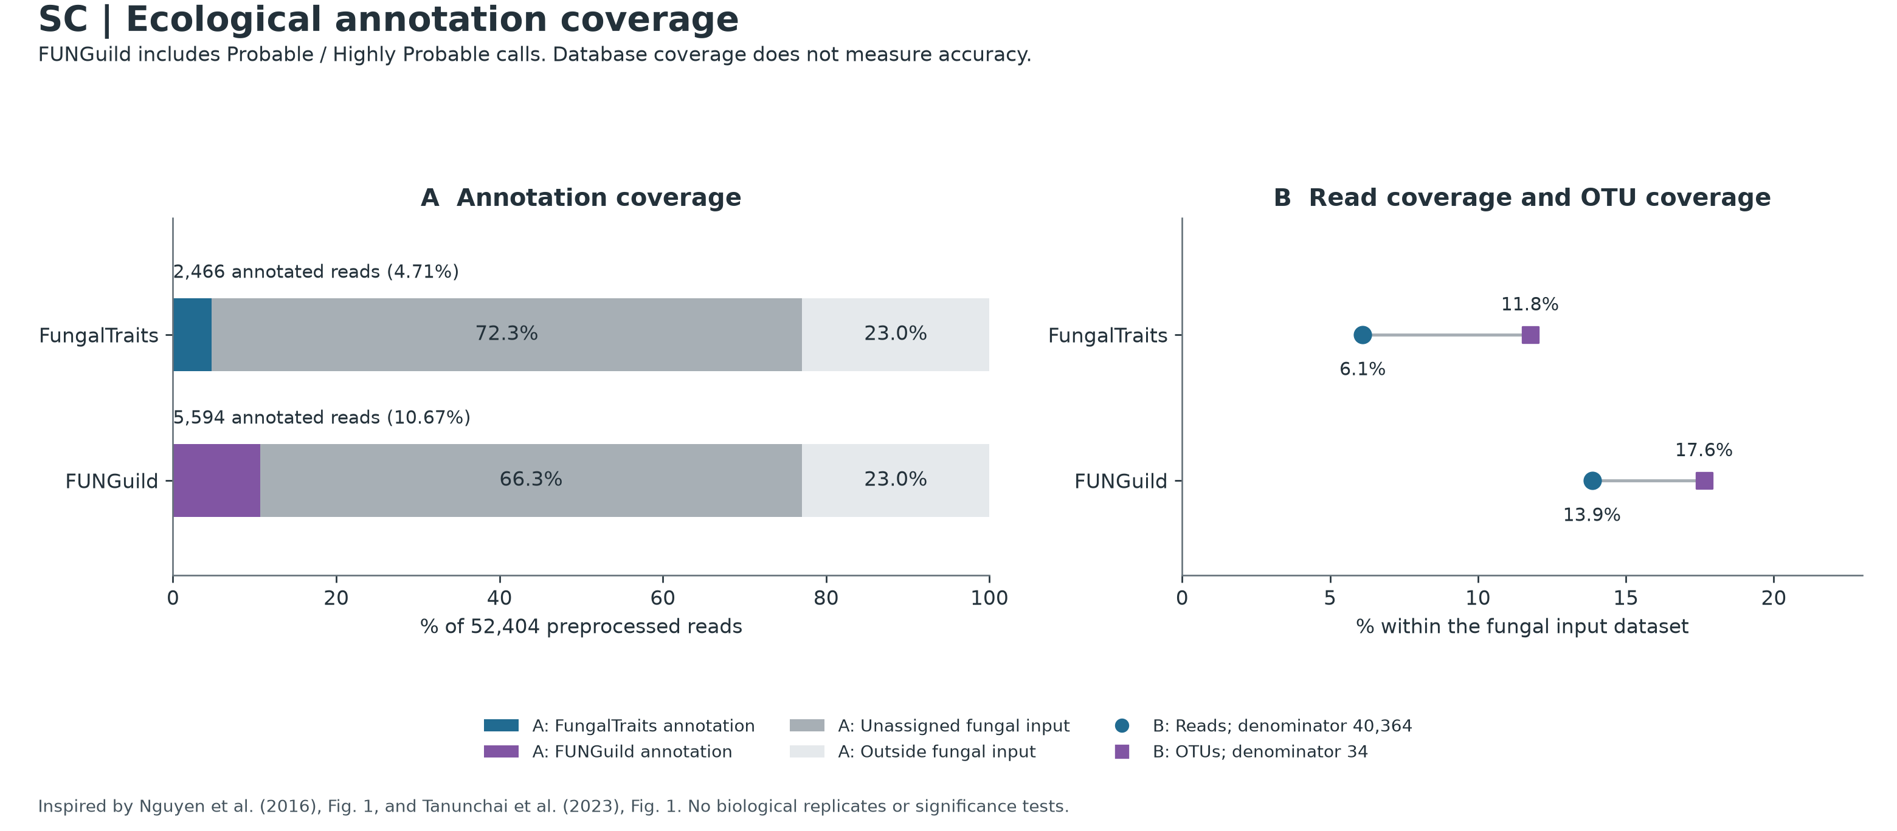
Ecological Annotation Coverage
PART 3 · WHAT ARE THEY DOING? · FIGURE 02
How much of your mangrove fungal community can literature databases explain today?
A
Annotated reads
% of all 52,404 preprocessed reads
4.71%
FungalTraits
10.67%
FUNGuild
Unassigned fungal-core reads: 72.3% (FT), 66.3% (FG); outside fungal input: 23.0%
B
Within fungal input
40,364 fungal reads · 34 fungal OTUs
6.1%
FungalTraits
of reads · 4 of 34 OTUs (11.8%)
Why so low? FungalTraits matches by genus, FUNGuild by genus or family; the abundant OTUs (e.g. OTU_1, 9,715 reads) lack a genus-level match.
Read the bars: unassigned segments stay visible, so a 4% guild is not mistaken for 40–85% of the community.
13.9%
FUNGuild
of reads · 6 of 34 OTUs (17.6%)
Notes:
SPEAKER NOTES — PLAIN-ENGLISH ELABORATION
– Why Coverage Is Low (6.1%–13.9% of Fungal Reads): FungalTraits looks up traits strictly by genus name, and FUNGuild looks up traits by genus or family name. Because the most abundant OTUs in Sample SC (such as Lobulomycetales OTU_1 at 9,715 reads and unresolved-phylum fungal OTUs) do not have genus-level matches in UNITE, literature trait tables have no entry for >86% of your fungal reads.
– Why FUNGuild Annotates More Reads Than FungalTraits (10.67% vs. 4.71%): FUNGuild permits family-level matching—assigning guilds to family Spizellomycetaceae (OTU_7, 2,982 reads) and family Herpotrichiellaceae (OTU_23, 146 reads)—whereas FungalTraits requires a resolved genus. Higher coverage therefore reflects broader rank matching rather than higher specificity.
– How to Interpret These Percentages: Keeping the unassigned bars visible in Panel A prevents a common pitfall where a guild comprising 4% of total reads is misread as 40%–85% of the community simply because only the annotated fraction was plotted.
ON-SLIDE CALLOUT REFERENCE (exact values)
– Panel A (Annotation Coverage — Denominator: All 52,404 Preprocessed Reads):
– FungalTraits (blue): Annotates 4.71% (2,466 reads); 72.3% (37,898 reads) are unassigned fungal-core reads, and 23.0% (12,040 reads) lie outside the fungal input.
– FUNGuild Probable/Highly Probable (purple): Annotates 10.67% (5,594 reads); 66.3% (34,770 reads) are unassigned fungal-core reads, and 23.0% (12,040 reads) lie outside the fungal input.
– Panel B (Read Coverage vs. OTU Coverage — Denominator: 40,364 Fungal Reads / 34 Fungal OTUs):
– FungalTraits: Matches 4 of 34 fungal OTUs (11.8%), accounting for 6.1% of fungal reads (leaving 93.9% of fungal reads unannotated).
– FUNGuild: Matches 6 of 34 fungal OTUs (17.6%), accounting for 13.9% of fungal reads (leaving 86.1% of fungal reads unannotated).

Slide 7
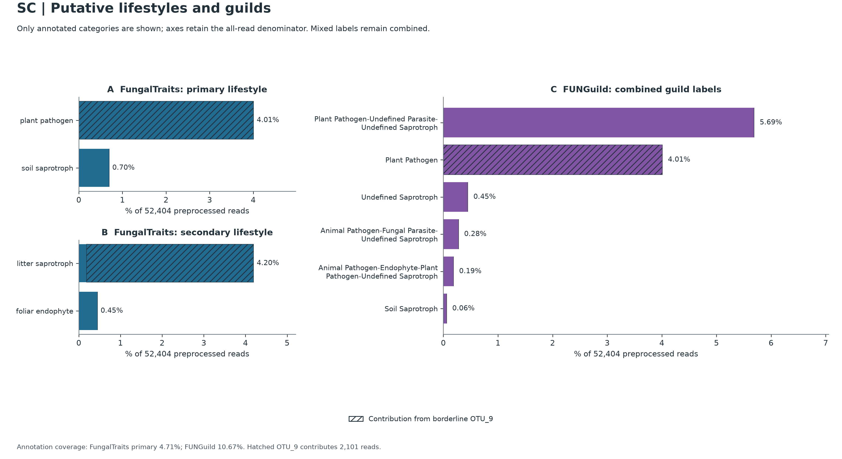

Putative Lifestyles & Guild Composition
PART 3 · WHAT ARE THEY DOING? · FIGURE 03
FungalTraits lifestyles, FUNGuild trophic modes, and the role of OTU_9
A
FungalTraits: primary
4.01%
plant pathogen
100% OTU_9
0.70%
soil saprotroph
3 solid OTUs
B
FungalTraits: secondary
4.20%
litter saprotroph
0.19% solid + 4.01% hatched
0.45%
foliar endophyte
OTU_19, solid
C
FUNGuild: combined labels
5.69%
Plant Pathogen–Parasite–Saprotroph
chytrid family, OTU_7
Hatched = OTU_9 (Gibellulopsis, 2,101 reads = 4.01%), flagged “?” in the chimera audit (Slide 09). All axes keep the 52,404-read denominator.
4.01%
Plant Pathogen
100% OTU_9
Notes:
SPEAKER NOTES — PLAIN-ENGLISH ELABORATION
– Broad Chytrid Guild Labels (5.69% in Panel C): FUNGuild assigns family Spizellomycetaceae (OTU_7) a combined multi-guild label because described members of this chytrid family span saprotrophs on plant/pollen detritus and parasites of soil/aquatic organisms. Retaining the combined label avoids counting the same 2,982 reads multiple times.
– Understanding the "Plant Pathogen" Bar (4.01%): Rather than indicating a broad community of plant pathogens—or proving that the sampled Sonneratia alba tree was diseased—the hatching shows that 100% of the single-guild plant pathogen bar in Panels A and C comes from one taxon (OTU_9, Gibellulopsis), which Panel B simultaneously lists with secondary lifestyle litter saprotroph. Primary and secondary FungalTraits fields describe alternative capacities of the same organism and are never added together.
ON-SLIDE CALLOUT REFERENCE (exact values)
– All x-axes retain the 52,404-read denominator so bar lengths reflect true shares of preprocessed reads.
– The Diagonal Hatching Key: Hatched segments indicate the contribution of OTU_9 (Gibellulopsis, 2,101 reads = 4.01%), tracked separately because of an automated ? reference-chimera flag audited on Slide 09.
– Panel A (FungalTraits Primary Lifestyle): plant pathogen at 4.01% (2,101 reads — 100% hatched, entirely OTU_9) and soil saprotroph at 0.70% (365 reads — solid, contributed by Wardomycopsis OTU_19 [235], Microascus OTU_31 [98], and Alloconiothyrium aptrootii OTU_41 [32]).
– Panel B (FungalTraits Secondary Lifestyle): litter saprotroph at 4.20% (2,199 reads — a small solid 0.19% [98-read] left segment from Microascus OTU_31 plus 4.01% [2,101 reads] hatched from OTU_9) and foliar endophyte at 0.45% (235 reads — solid, Wardomycopsis OTU_19).
– Panel C (FUNGuild Combined Guild Labels): Led by Plant Pathogen-Undefined Parasite-Undefined Saprotroph (5.69%, 2,982 reads — solid purple, family-level match to chytrid Spizellomycetaceae OTU_7) and Plant Pathogen (4.01%, 2,101 reads — 100% hatched, OTU_9), followed by four smaller Ascomycota saprotroph/endophyte/mixed categories (0.45%, 0.28%, 0.19%, 0.06%).

Slide 8
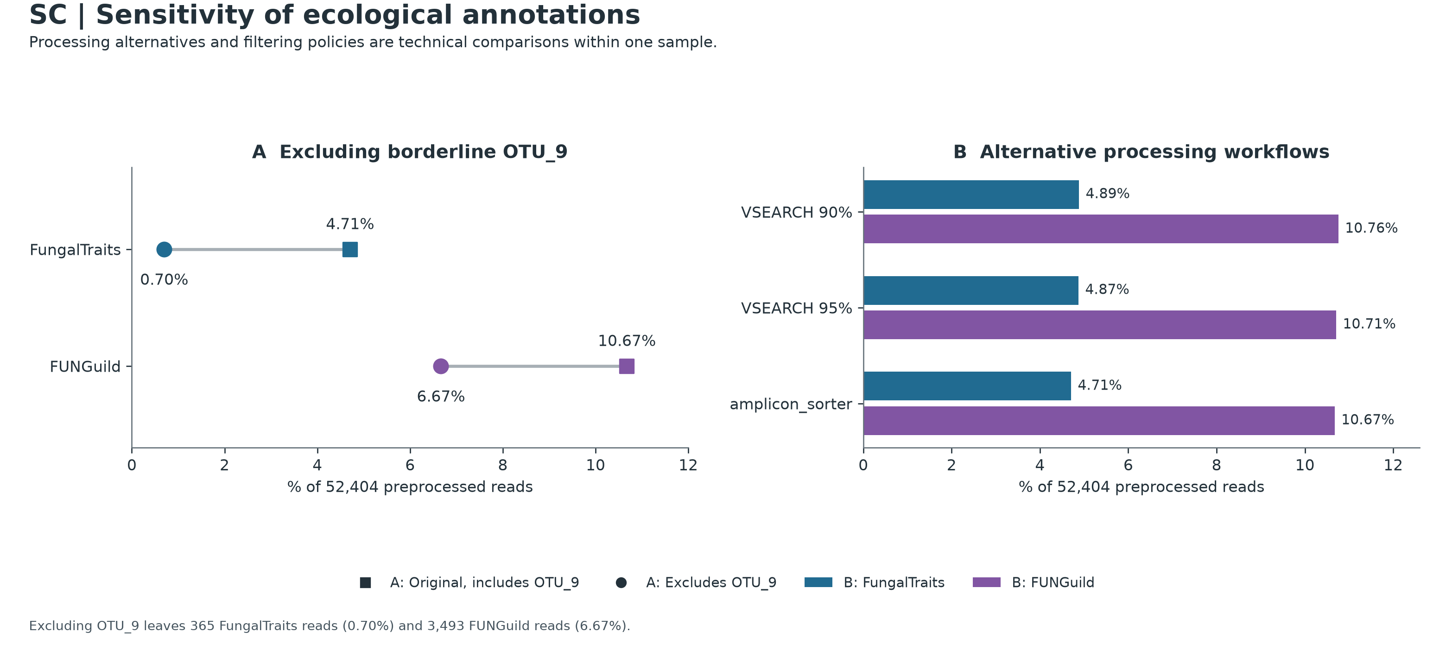
Sensitivity Analysis & Pipeline Stability
PART 3 · WHAT ARE THEY DOING? · FIGURE 04
Testing the impact of omitting OTU_9 and comparing three independent clustering workflows
A
Drop OTU_9
annotated reads, with vs. without OTU_9
FungalTraits
4.71% → 0.70%
FUNGuild
10.67% → 6.67%
B
Three workflows
% annotated reads, same input reads
 | FT | FG
VSEARCH 90% | 4.89 | 10.76
VSEARCH 95% | 4.87 | 10.71
amplicon_sorter | 4.71 | 10.67
85%
of FungalTraits-annotated reads come from OTU_9 alone (2,101 / 2,466), which is why the next slide examines it closely.
Notes:
SPEAKER NOTES — PLAIN-ENGLISH ELABORATION
– Technical Stability Across Algorithms (Panel B): Although greedy VSEARCH clustering splits noisy ONT reads into more low-support clusters (72–77 OTUs vs. 41 in amplicon_sorter), the resulting guild totals remain virtually unchanged (~4.7–4.9% FungalTraits; ~10.7–10.8% FUNGuild). This confirms that the guild summary is stable across clustering methods within this sample.
– Why OTU_9 Sensitivity Matters (Panel A): Because only 4 to 6 OTUs receive database guild assignments, OTU_9 alone accounts for 85% of FungalTraits-annotated reads (2,101 / 2,466). That makes our next slide—a closer examination of OTU_9—important for interpreting the guild charts.
ON-SLIDE CALLOUT REFERENCE (exact values)
– Panel A (Excluding Borderline OTU_9): Dumbbell comparison showing how total annotated read coverage shifts if OTU_9 (2,101 reads) is omitted: FungalTraits drops from 4.71% (2,466 reads) to 0.70% (365 reads, all soil saprotrophs), and FUNGuild drops from 10.67% (5,594 reads) to 6.67% (3,493 reads).
– Panel B (Alternative Processing Workflows): Compares annotated read percentages across three independent discovery pipelines run on the same reads: VSEARCH 90% (4.89% / 10.76%), VSEARCH 95% (4.87% / 10.71%), and our primary amplicon_sorter workflow (4.71% / 10.67%).

Slide 9
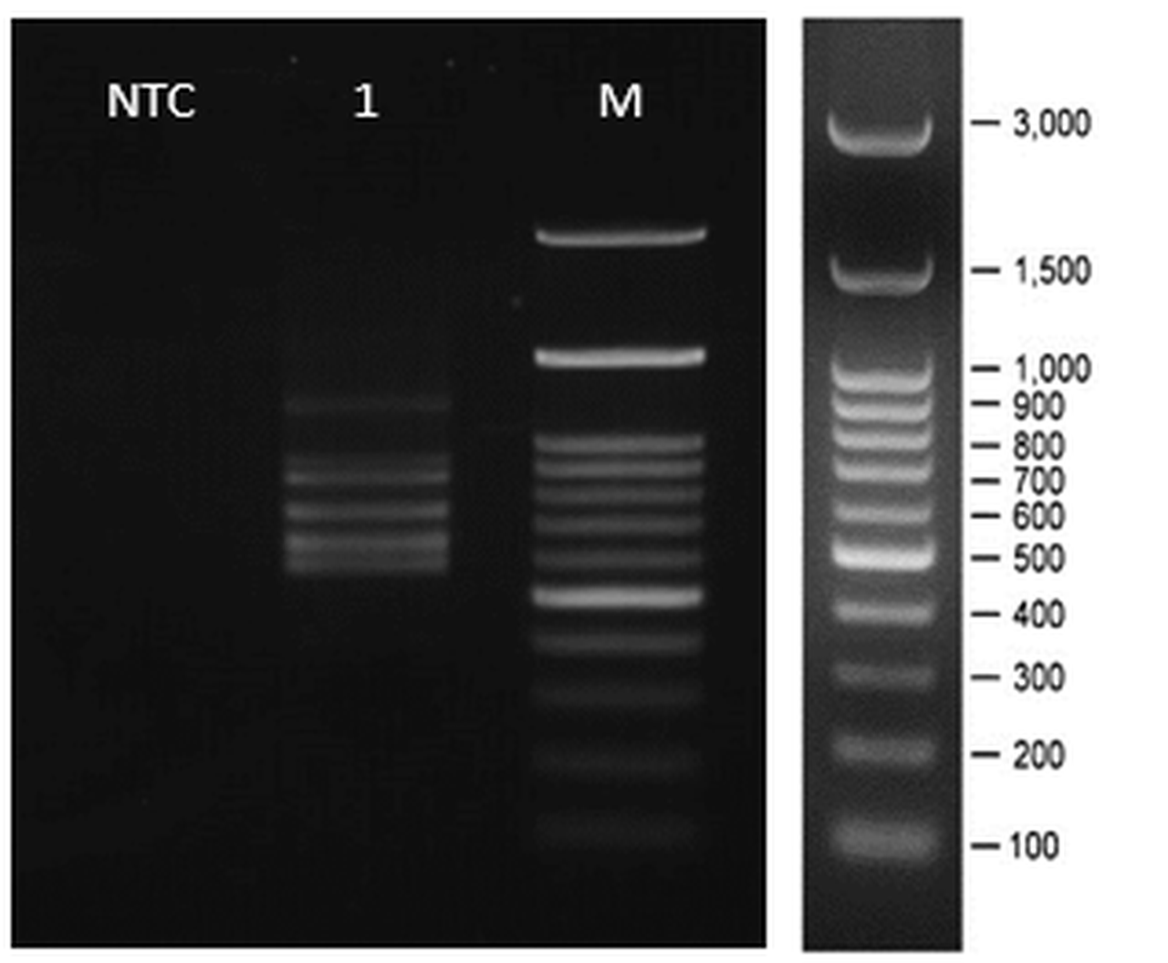


Demystifying OTU_9 (Gibellulopsis)
PART 3 · WHAT ARE THEY DOING? · SPECIAL SPOTLIGHT
Amplicon structure, gel-band size match, chimera audit, and plausible rhizosphere ecology
PCR gel, lane 1: multi-band profile with an upper band at ~1,100–1,150 bp, between the 1,000 and 1,500 bp ladder marks. Band size alone does not establish OTU identity.
Identity, structure & ecology
Why UCHIME-ref said “?”
UNITE: Gibellulopsis (Plectosphaerellaceae), 2,101 reads = 4.01%; genus-level assignment
99.55% identity (446/448 bp) to G. piscis DQ825985; species not confirmed
Two amplicons, 520 bp and 1,129 bp; the longer length is similar to the ~1,100–1,150 bp gel band, which is not proof of identity
FungalTraits: primary plant pathogen, secondary litter saprotroph
De novo screen: passed (N, score 0.0317)
Reference DQ825985 lacks 22 bp at the 5′ end of ITS1; related V. dahliae EF377335 has it and shares 2 SNPs
Misses VSEARCH’s positive thresholds (mindiffs ≥ 3, mindiv ≥ 0.8%)
Plausible explanation: a truncated 5′ reference. A mosaic is not ruled out; OTU_9 is kept and hatched
SCHEMATIC · not to scale
00012 · 520 bp
00039 · 1,129 bp
extra ~610 bp vs 00012: insertion proposed, identity and position untested (ITS regions 98.9% identical)
UCHIME-ref alignment, 5′ end of ITS1
OTU_9
DQ825985
EF377335
dashed box = 22 bp missing from DQ825985
Notes:
SPEAKER NOTES — PLAIN-ENGLISH ELABORATION
– Why Retained with Hatching: Under the pipeline's pre-specified rule (excluding positive Y chimeras while retaining N and ?), OTU_9 was kept in the fungal core and highlighted with hatching so its exact contribution remains transparent on every guild and pathway plot.
– Biological Interpretation Limits: Because this dataset comes from a single composite sample of cut roots and surrounding litter-bearing sediment without host-symptom records or separate root vs. mud replicates, DNA sequence data alone cannot prove whether Gibellulopsis was acting as a weak vascular pathogen, an asymptomatic root endophyte, or a saprotroph on decaying root/leaf litter—though its dual plant_pathogen / litter_saprotroph trait profile shows why single-label pathogen summaries should not be over-interpreted.
ON-SLIDE CALLOUT REFERENCE (exact values)
– Left Card (Sequence Identity, Amplicon Structure & Ecology):
– UNITE Match: Gibellulopsis (Ascomycota: Plectosphaerellaceae, 2,101 reads = 4.01% of preprocessed reads), aligning at 99.55% identity (446/448 bp, 2 SNPs) to Gibellulopsis piscis (DQ825985). The study assigns the OTU to genus Gibellulopsis; the species is not confirmed.
– Two Amplicon Lengths (520 bp & 1,129 bp): OTU_9 merges a 520 bp consensus (00012) and a longer stored 1,129 bp consensus (00039) whose extracted 470 bp ITS regions are 98.9% identical. The roughly 610 bp difference suggests an insertion (a Group I intron is a testable possibility, not a confirmed structure; its identity and location are untested). The 1,129 bp length is similar in size to the ~1,100–1,150 bp upper band on the PCR gel, but gel-band size alone does not establish OTU identity.
– Literature Guilds: FungalTraits lists primary plant_pathogen and secondary litter_saprotroph.
– Right Card (Why UCHIME-Ref Emitted ? Instead of N or Y):
– De Novo Chimera Screen: Passed (N, score 0.0317).
– Reference Chimera Screen (?): OTU_9 matches Gibellulopsis piscis (DQ825985) across 446/448 bp, but GenBank record DQ825985 is missing 22 bp at the 5' end of ITS1. A related Plectosphaerellaceae sequence (Verticillium dahliae EF377335, 80.9% overall identity) includes that 22 bp 5' segment and shares 2 SNPs (LY = 2, div = 0.5%).
– Thresholds: Fails VSEARCH's positive chimera requirements (mindiffs ≥ 3 and mindiv ≥ 0.8%), triggering a borderline ? flag. A truncated 5' reference is a plausible explanation for the borderline alignment, but it does not prove the absence of a mosaic.

Slide 10
Thesis Draft: Guilds & OTU_9
PART 3 · WHAT ARE THEY DOING? · THESIS & MANUSCRIPT NARRATIVE
Ecological annotation and Gibellulopsis: Results and Discussion drafts to adapt for a thesis or manuscript
RESULTS PARAGRAPH · OBJECTIVE SEQUENCE FINDINGS
DISCUSSION & ECOLOGICAL INTERPRETATION
Ecological guild annotation of the 34 conservative fungal OTUs using FungalTraits (v1.2) and FUNGuild (v1.1) covered a minority of the community. FungalTraits assigned primary lifestyles to 4 OTUs (11.76% of fungal OTUs), representing 2,466 reads (4.71% of 52,404 preprocessed reads; 6.11% of 40,364 fungal-core reads). FUNGuild assigned probable or highly probable guilds to 6 OTUs (17.65% of fungal OTUs), representing 5,594 reads (10.67% of preprocessed reads; 13.86% of fungal-core reads). Thus 86.14% of fungal-core reads lacked a probable/highly probable FUNGuild label; accepted genus or family placements and database entries were insufficient to annotate most OTUs. FungalTraits primary lifestyles comprised putative plant pathogen (4.01% of preprocessed reads) and soil saprotroph (0.70%) labels. All of its primary plant pathogen reads came from OTU_9 (Gibellulopsis, 2,101 reads), which also had a secondary litter saprotroph label. Omitting OTU_9 from the existing annotation summary reduced FungalTraits coverage from 4.71% to 0.70%. Across VSEARCH 90%, VSEARCH 95%, and amplicon_sorter workflow settings, aggregate FungalTraits coverage was similar (4.71%–4.89%).
Low annotation coverage (<14% of fungal-core reads) reflects the limits of matching this sample's taxonomic placements to literature trait databases: FungalTraits uses genus-level matching, while FUNGuild can also match families. OTU_9's closest listed UNITE hit is a Gibellulopsis piscis reference at 99.55% identity, but the study assigns the OTU to Gibellulopsis rather than confirming a species. In this cut-root and sediment setting, a root-associated endophytic or litter-saprotrophic role is a useful ecological hypothesis; neither the sequence nor its trait labels establish host infection, tissue localization, or a change of lifestyle. The reference-chimera screen marked OTU_9 borderline ('?'), not positive ('Y'). A short 5′ reference relative to the study sequence offers a plausible explanation for the borderline alignment, but does not prove the absence of a mosaic. Showing both its primary plant pathogen and secondary litter saprotroph labels avoids equating one database category with disease in the host.
Draft for adaptation: add literature and dataset citations before reuse. The right-hand card is interpretation, not measurement.
Notes:
SPEAKER NOTES — PLAIN-ENGLISH ELABORATION
– How to use this slide: Results sentences give counts under stated denominators (52,404 preprocessed reads, 40,364 fungal-core reads, or 34 fungal OTUs); never swap them. Discussion sentences are hypotheses. Add citations for FungalTraits (Põlme et al. 2020) and FUNGuild (Nguyen et al. 2016) before reuse.
– Checked against the tables: 4 and 6 mapped OTUs, 2,466 and 5,594 reads, and the 4.71%–4.89% workflow range all match tables/guild_coverage.tsv, tables/guild_borderline_sensitivity.tsv, and RESULTS.md.
– Mixed FUNGuild labels: only OTU_9 supplies the single-label FUNGuild "Plant Pathogen" bar. OTU_7 (Spizellomycetaceae) and OTU_31 (Microascus) carry separate combined labels that also contain plant pathogen; mixed labels stay combined and are not counted twice.

Slide 11
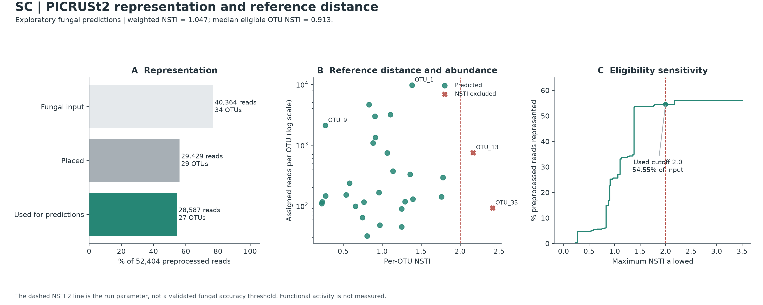
Fungal PICRUSt2 Diagnostics & Reference Distance
PART 4 · WHAT IS THEIR METABOLIC POTENTIAL? · FIGURE 05
Read retention (54.55%) and evolutionary distance (weighted NSTI = 1.047) come before any pathway
A
Representation funnel
% of 52,404 preprocessed reads
Fungal input
34 OTUs
77.02%
Placed on tree
29 OTUs
56.16%
Used for predictions
27 OTUs
54.55%
B
Distance vs. abundance
C
Eligibility curve
5 OTUs (10,935 reads) failed alignment, including the OTU_2 / OTU_5 pair (9,600 reads)
2 OTUs above NSTI 2.0 removed (OTU_13, OTU_33; 842 reads)
Weighted NSTI 1.047 (median 0.913). OTU_9 sits at 0.271, chytrid OTU_1 at 1.383; red × = excluded beyond 2.0.
0% retained at NSTI ≤ 0.20, 4.72% at ≤ 0.50, then a jump from 34.9% to 53.5% at ≈1.38 where OTU_1 enters.
Notes:
SPEAKER NOTES — PLAIN-ENGLISH ELABORATION
– Unlike bacterial 16S PICRUSt2 (backed by tens of thousands of reference genomes, where NSTI < 0.15 is common), PICRUSt2's fungal fungi_ITS database relies on a small reference tree, and the tool's developers caution that fungal predictions have limited accuracy.
– Accordingly, Figures 06–08 should be treated strictly as an exploratory, hypothesis-generating supplement covering 54.55% of preprocessed reads at Weighted NSTI = 1.047—not as measurements of actual gene content, transcription, or enzyme activity.
ON-SLIDE CALLOUT REFERENCE (exact values)
– Panel A (Representation Funnel — % of 52,404 preprocessed reads):
– Fungal input: 34 OTUs (40,364 reads = 77.02%).
– Placed on fungal reference tree: 29 OTUs (29,429 reads = 56.16%) — 5 divergent OTUs (10,935 reads, including the unresolved-phylum OTU_2/OTU_5 pair [9,600 reads] with a partial 5.8S HMM match) failed the alignment gate (--min_align 0.5).
– Used for predictions: 27 OTUs (28,587 reads = 54.55% of preprocessed reads / 27.75% of raw reads) after removing 2 OTUs above NSTI = 2.0.
– Panel B (Reference Distance vs. Abundance, Log Scale): Plots each placed OTU's read count (10² to 10⁴) against its per-OTU NSTI. Labeled landmarks include Ascomycota OTU_9 on the upper left (2,101 reads, NSTI = 0.271), dominant chytrid OTU_1 at the top (9,715 reads, NSTI = 1.383), and the two red × markers excluded past the dashed 2.0 cutoff (OTU_13 at 2.17 and OTU_33 at 2.42, 842 reads total). Overall weighted NSTI is 1.047 (median 0.913).
– Panel C (Eligibility Sensitivity Curve): Shows read retention across hypothetical NSTI cutoffs: 0% at NSTI ≤ 0.20, 4.72% at NSTI ≤ 0.50, and a large vertical step from 34.9% to 53.5% at NSTI ≈ 1.38 where OTU_1 enters.

Slide 12
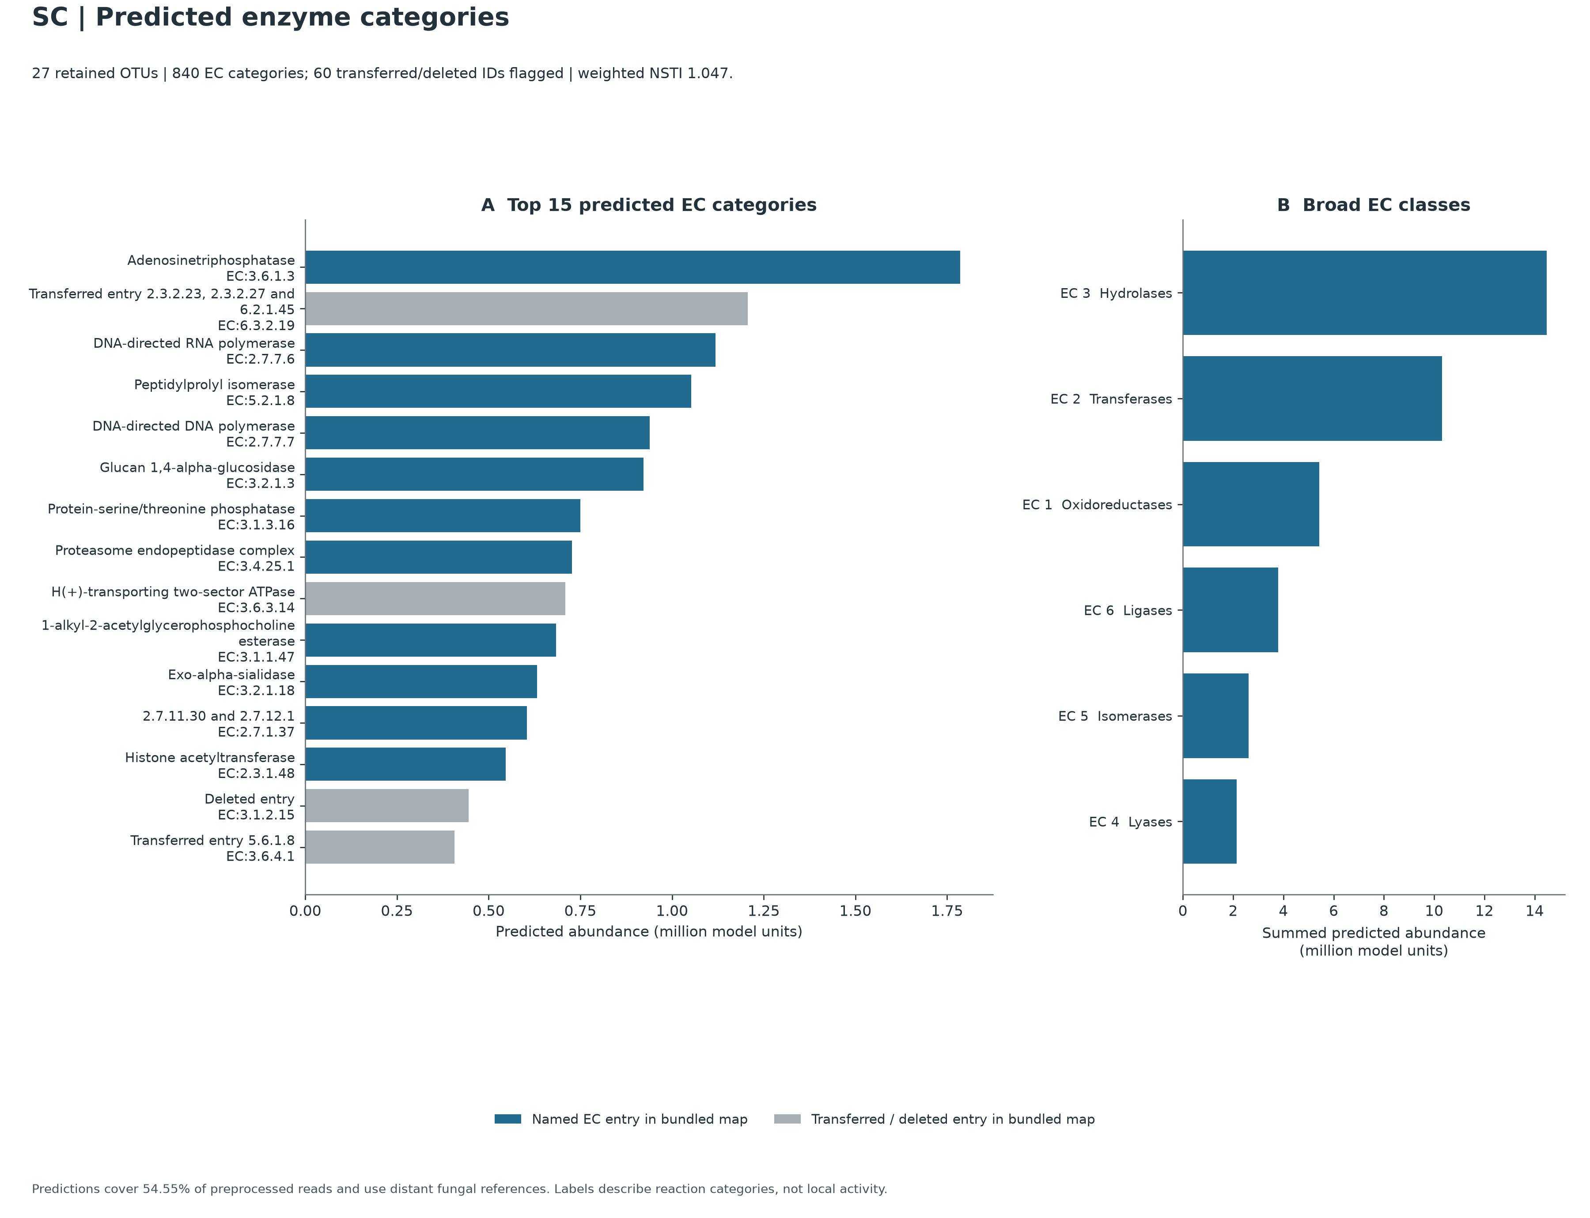
Predicted Enzyme Profiles (840 EC Categories)
PART 4 · WHAT IS THEIR METABOLIC POTENTIAL? · FIGURE 06
Core housekeeping machinery, database nomenclature status, and detrital polysaccharide hydrolases
A
Top 15 ECs: housekeeping leads
11 blue = named ECs (ATPase #1, RNA pol #3, DNA pol #5, glucan 1,4-α-glucosidase #6); 4 gray = transferred/deleted IDs (ranks 2, 9, 14, 15), so the number was retired, not the gene.
B
Six broad EC classes
EC 3 hydrolases lead (14.48M units, 238 ECs), then EC 2 transferases 10.32M, EC 1 oxidoreductases 5.42M, EC 6 ligases 3.80M, EC 5 isomerases 2.62M, EC 4 lyases 2.14M.
TABLE CALLOUT
ec_predicted_profiles.tsv · ranks 17–23
RANK | EC | DESCRIPTION
17 | EC:2.4.1.16 | Chitin synthase
18 | EC:2.5.1.18 | Glutathione transferase
19 | EC:5.3.1.4 | L-arabinose isomerase
23 | EC:3.2.1.14 | Chitinase
Notes:
SPEAKER NOTES — PLAIN-ENGLISH ELABORATION
– Interpreting Predicted Enzymes: The dominance of ATPases, polymerases, chaperones, and proteasome/phosphatase enzymes in Panel A reflects universal eukaryotic housekeeping genes present in every sequenced fungal reference genome.
– Polysaccharide & Chitin Turnover Potential: The presence of Glucan 1,4-alpha-glucosidase (EC:3.2.1.3, Rank 6 on the chart) and lower-rank L-arabinose isomerase (EC:5.3.1.4) and Chitinase (EC:3.2.1.14) in the companion table reflects conserved fungal capacities for breaking down starch/glucans, plant hemicellulose pentoses, and fungal/arthropod chitin—functions plausibly relevant to saprotrophic turnover in litter-bearing mangrove sediment.
ON-SLIDE CALLOUT REFERENCE (exact values)
– Panel A (Top 15 Predicted EC Categories — Plotted in PNG): Ranks the 15 largest Enzyme Commission (EC) predictions (million model units).
– Blue bars (11 of Top 15): Active named EC entries in PICRUSt2's bundled description map, led by housekeeping enzymes—EC:3.6.1.3 (Adenosinetriphosphatase, Rank 1), EC:2.7.7.6 (DNA-directed RNA polymerase, Rank 3), EC:5.2.1.8 (Peptidylprolyl isomerase, Rank 4), EC:2.7.7.7 (DNA-directed DNA polymerase, Rank 5)—and polysaccharide hydrolase EC:3.2.1.3 (Glucan 1,4-alpha-glucosidase, Rank 6).
– Gray bars (4 of Top 15 — Ranks 2, 9, 14, 15): Older EC IDs labeled Transferred entry ... or Deleted entry (EC:3.1.2.15 at Rank 14). Across all 840 ECs, 58 are transferred and 2 are deleted IUBMB catalog identifiers—meaning the catalog number was later merged or retired after PICRUSt2 froze its fungal map, not that the gene is missing.
– Panel B (Broad EC Classes — Plotted in PNG): Sums all 840 predicted ECs into 6 IUBMB biochemical classes (EC 1–EC 6):
– EC 3 Hydrolases (14.48M units, 238 ECs — #1 class, including ATPases cataloged under EC 3.6.x in older IUBMB maps alongside glycosidases, phosphatases, peptidases, and esterases)
– EC 2 Transferases (10.32M units, 228 ECs)
– EC 1 Oxidoreductases (5.42M units, 208 ECs)
– EC 6 Ligases (3.80M, 54 ECs), EC 5 Isomerases (2.62M, 38 ECs), and EC 4 Lyases (2.14M, 74 ECs).
– [Table Callout — From Companion TSV, Not Plotted in PNG] Ranks 17–23 in tables/ec_predicted_profiles.tsv:
– Just below the Top-15 plot cutoff, the full 840-EC table includes conserved fungal enzymes involved in cell-wall and detrital processing: Chitin synthase (EC:2.4.1.16, Rank 17), Glutathione transferase (EC:2.5.1.18, Rank 18), L-arabinose isomerase (EC:5.3.1.4, Rank 19), and Chitinase (EC:3.2.1.14, Rank 23).

Slide 13
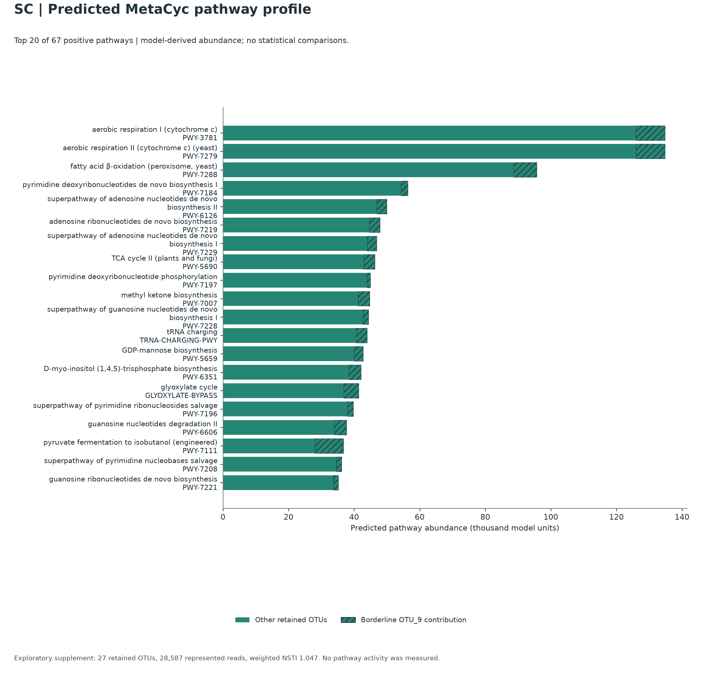

Predicted MetaCyc Metabolic Pathway Profile
PART 4 · WHAT IS THEIR METABOLIC POTENTIAL? · FIGURE 07
Top 20 of 67 reconstructed fungal pathways: core eukaryotic bioenergetics and conserved metabolism
solid = 26 other OTUs
hatched = OTU_9 (2.4–11.1%; 23.6% at rank 18)
1–12
Core energy, nucleotide & fatty-acid metabolism
Aerobic respiration I & II, peroxisomal β-oxidation, de novo pyrimidine/purine biosynthesis, fungal TCA cycle II, tRNA charging.
13–15
Cell wall, signaling & the C2 carbon shunt
GDP-mannose biosynthesis (cell-wall mannoproteins), inositol trisphosphate signaling, and the glyoxylate cycle for acetate/fatty-acid carbon.
16–20
Nucleoside salvage & branched-chain fermentation
Pyrimidine/guanosine salvage; rank 18 is named “(engineered)” only because MetaCyc curated it that way: the enzymes are ordinary fungal ones.
Core metabolism, not marine adaptation: OTUs whose nearest reference is the soil chytrid Spipu1 supply ~84–93% of each top-12 pathway. That is reference proximity, not transfer from one genome.
Notes:
SPEAKER NOTES — PLAIN-ENGLISH ELABORATION
– How Conserved Pathways Relate to Sediment & Rhizosphere Life (Ranks 13–15): GDP-mannose biosynthesis (PWY-5659) supplies precursors for cell-wall mannoproteins; inositol trisphosphate biosynthesis (PWY-6351) supports eukaryotic membrane/stress signaling; and the glyoxylate cycle (GLYOXYLATE-BYPASS, paired with Rank 3 fatty-acid beta-oxidation) allows fungi to assimilate 2-carbon compounds (such as acetate and fatty acids) without losing carbon as CO₂.
– Crucial Caveat Against Over-Claiming: As shown on Slide 14, OTUs whose nearest sequenced reference genome is Spizellomyces punctatus (Spipu1) supply about 84%–93% of the predicted abundance of each of the top-12 pathways (recomputed from tables/top_pathways_otu_contribution_percent.tsv). An earlier draft reported 81.5%–87.1% for GLYOXYLATE-BYPASS, PWY-5659, and PWY-6351 (ranks 13–15), but the stratified rows for those ranks are not in the repository tables, so re-check that figure before citing it. A nearest-genome concentration is not a literal transfer of pathways from Spipu1. These pathways therefore represent conserved core fungal metabolic machinery that is plausibly useful in organic-rich intertidal sediment, not habitat-specific marine halotolerance genes discovered in Sonneratia alba strains.
– Why Does Rank 18 Say (engineered) (PWY-7111)? MetaCyc names pathway entries after the experimental organism or engineered system in which the complete pathway record was curated. Wild fungi naturally possess the component enzymes (involved in valine/isoleucine biosynthesis and Ehrlich fusel-alcohol metabolism, particularly in Gibellulopsis reference relative Veral1), so PICRUSt2 scores the shared enzyme reactions—it does not indicate engineered organisms in the sample.
ON-SLIDE CALLOUT REFERENCE (exact values)
– Horizontal bar chart ranking the Top 20 MetaCyc pathways (thousand model units) out of 67 positive pathways predicted.
– Solid green segments: Combined contribution from the 26 other retained fungal OTUs.
– Hatched green segments: Stratified contribution from OTU_9 (Gibellulopsis, 2.4%–11.1% across most top pathways, and 23.6% at Rank 18).
– Pathway Groups on the Chart:
– Ranks 1–12 (Core Energy, Nucleotide & Fatty-Acid Metabolism): Aerobic respiration I & II (PWY-3781, PWY-7279), peroxisomal fatty-acid beta-oxidation (PWY-7288), de novo pyrimidine/purine nucleotide biosynthesis & phosphorylation (PWY-7184, PWY-6126, PWY-7219, PWY-7229, PWY-7197, PWY-7228), fungal TCA cycle II (PWY-5690), methyl ketone biosynthesis (PWY-7007, Rank 10), and TRNA-CHARGING-PWY (Rank 12).
– Ranks 13–15 (Cell Wall, Signaling & C2 Carbon Shunt): GDP-mannose biosynthesis (PWY-5659, Rank 13), D-myo-inositol (1,4,5)-trisphosphate biosynthesis (PWY-6351, Rank 14), and the glyoxylate cycle (GLYOXYLATE-BYPASS, Rank 15).
– Ranks 16–20 (Nucleoside Salvage & Branched-Chain Fermentation): Pyrimidine/guanosine salvage and degradation (PWY-7196, PWY-6606, PWY-7208, PWY-7221) plus pyruvate fermentation to isobutanol (engineered) (PWY-7111) at Rank 18.

Slide 14
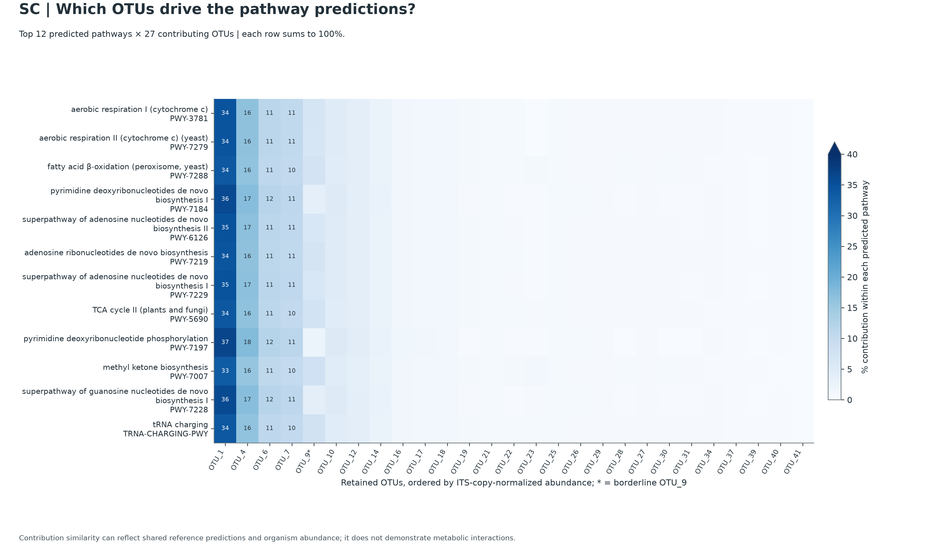
Which OTUs Drive the Predictions?
PART 4 · WHAT IS THEIR METABOLIC POTENTIAL? · FIGURE 08
Stratified heatmap of the top 12 MetaCyc pathways across all 27 retained fungal OTUs
Columns 1–4 carry ≈72% of predicted reads
OTU_1
33–37%
Chytridiomycota
OTU_4
16–18%
unresolved phylum
OTU_6
11–12%
unresolved phylum
OTU_7
10–11%
Chytridiomycota
then OTU_9* (Gibellulopsis) at 2.4–8.1%
TABLE CALLOUT
marker_predicted_and_nsti.tsv
Predicted ITS copy number = 1 for all 29 placed OTUs
14 of 27 OTUs (86.4% of predicted reads) have one nearest genome, Spizellomyces punctatus (Spipu1): a reference concentration, not pathway transfer
Each row sums to 100%; cells ≥10% are printed; * marks OTU_9 (borderline chimera call). Similar columns reflect shared reference predictions, not metabolic interaction.
Notes:
SPEAKER NOTES — PLAIN-ENGLISH ELABORATION
– Why Columns 1–4 Look Like Uniform Vertical Stripes (34, 16, 11, 11): OTU_1, OTU_4, OTU_6, and OTU_7 all have the same nearest sequenced reference genome (Spipu1) and ITS_count = 1, so their contributions to nearly every housekeeping pathway closely track their share of total predicted reads (34.0%, 16.3%, 11.1%, and 10.4%, summing to 71.8%). PICRUSt2 infers traits across its reference tree, so this is a nearest-genome concentration, not a literal transfer of pathways from Spipu1.
– This directly explains the footnote printed at the bottom of Figure 08: "Contribution similarity can reflect shared reference predictions and organism abundance; it does not demonstrate metabolic interactions." Note also that placement near Spipu1 for OTU_4 and OTU_6 only identifies the closest genome on PICRUSt2's sparse fungal tree (NSTI = 0.83–1.11), not a confirmed taxonomic phylum assignment.
ON-SLIDE CALLOUT REFERENCE (exact values)
– Heatmap Layout (Plotted in PNG): Rows list the Top 12 MetaCyc pathways; columns list all 27 retained OTUs ordered left-to-right by ITS-copy-normalized abundance (* marks OTU_9* in column 5). Each row sums to 100%, with cell values ≥10% printed directly on the plot.
– Top 4 Columns Carry ~72% of Predicted Reads (70%–78% Across Every Top-12 Pathway Row):
– OTU_1 (33%–37% printed in column 1) — Chytridiomycota (Lobulomycetales, 9,715 reads)
– OTU_4 (16%–18% printed in column 2) — Unresolved fungal phylum (4,650 reads)
– OTU_6 (11%–12% printed in column 3) — Unresolved fungal phylum (3,180 reads)
– OTU_7 (10%–11% printed in column 4) — Chytridiomycota (Spizellomycetaceae, 2,982 reads)
(followed in column 5 by Ascomycota OTU_9, Gibellulopsis, 2,101 reads, contributing 2.4%–8.1%).*
– [Table Callout — From Companion TSV, Not Plotted in PNG] Reference Genomes & NSTI (tables/marker_predicted_and_nsti.tsv & tables/otu_annotation_and_nsti.tsv):
– Predicted ITS copy number = 1 for all 29 placed OTUs (draft fungal genome assemblies collapse repetitive rDNA arrays, so copy-normalized abundance order equals raw read count order).
– 14 of the 27 retained OTUs (24,696 / 28,587 reads = 86.4% of predicted reads—including OTU_1 [NSTI = 1.38], OTU_4 [0.83], OTU_6 [1.11], and OTU_7 [0.91]) have the same closest sequenced reference genome: Spizellomyces punctatus (Spipu1)!

Slide 15
Thesis Draft: Predicted Functions
PART 4 · WHAT IS THEIR METABOLIC POTENTIAL? · THESIS & MANUSCRIPT NARRATIVE
PICRUSt2 diagnostics and predicted functions: Results and Discussion drafts to adapt for a thesis or manuscript
RESULTS PARAGRAPH · OBJECTIVE SEQUENCE FINDINGS
DISCUSSION & ECOLOGICAL INTERPRETATION
Exploratory fungal PICRUSt2 profiling placed 29 of 34 fungal OTUs on the reference tree (56.16% of preprocessed reads); five OTUs, including the unresolved OTU_2/OTU_5 complex, failed alignment. The default nearest sequenced taxon index cutoff (NSTI ≤ 2.0) retained 27 OTUs representing 28,587 reads (54.55% of preprocessed reads; 27.75% of raw reads). Their abundance-weighted NSTI was 1.047 (median eligible OTU NSTI = 0.913). The pipeline reported 840 predicted enzyme categories (ECs) and 67 predicted MetaCyc pathways. Broad predicted EC totals were led by EC 3 Hydrolases (14.48 million model units; 238 ECs), EC 2 Transferases (10.32 million), and EC 1 Oxidoreductases (5.42 million). The leading EC predictions included ATPases and polymerases; leading pathways included aerobic respiration I and II (ranks 1–2), peroxisomal fatty-acid β-oxidation (rank 3), and TCA cycle II (rank 8). Pathway ranks 13–15 were GDP-mannose biosynthesis (PWY-5659), D-myo-inositol trisphosphate biosynthesis (PWY-6351), and the glyoxylate cycle (GLYOXYLATE-BYPASS). Fourteen of the 27 retained OTUs, representing 24,696 of 28,587 predicted-input reads (86.4%), had Spizellomyces punctatus (Spipu1) as their closest sequenced reference genome.
The weighted NSTI of 1.047 and concentrated nearest-reference assignments show how far this sample sits from the fungal genome references. PICRUSt2 infers traits across a reference tree; the 86.4% figure identifies a nearest-genome concentration, not a literal transfer of pathways from Spipu1. Predicted glucan 1,4-α-glucosidase (EC:3.2.1.3, rank 6) and chitinase (EC:3.2.1.14, rank 23) give a plausible detrital-processing hypothesis in mangrove sediment. Predicted L-arabinose isomerase (EC:5.3.1.4, rank 19) belongs to sugar isomerization, not the hydrolase group. The glyoxylate cycle and fatty-acid β-oxidation suggest possible carbon-use routes, but do not establish activity, hypoxic survival, or marine adaptation. Given the developers' caution about fungal predictive accuracy, these profiles should guide targeted experiments rather than serve as evidence of measured gene content, expression, or enzyme activity.
Draft for adaptation: add literature and dataset citations before reuse. The right-hand card is interpretation, not measurement.
Notes:
SPEAKER NOTES — PLAIN-ENGLISH ELABORATION
– How to use this slide: These are exploratory predictions. Keep the sentence that PICRUSt2 results are hypothesis-generating when you adapt the text, and cite the PICRUSt2 paper and the developers' fungal FAQ.
– Edited for accuracy: the plan listed "TCA cycle II" among the leading pathways without a rank; the table puts aerobic respiration I and II at ranks 1–2, peroxisomal β-oxidation at 3, and TCA cycle II (PWY-5690) at 8, and the text now says so. Ranks 13–15 and EC ranks 6, 19, and 23 match tables/metacyc_predicted_profiles.tsv and tables/ec_predicted_profiles.tsv.
– Spipu1: 14 of 27 retained OTUs (24,696 / 28,587 reads) list Spipu1 as the closest reference genome in tables/marker_predicted_and_nsti.tsv. That statement is about nearest-reference assignment only.

Slide 16



Ecological Synthesis for Sample SC
PART 5 · SYNTHESIS & NEXT STEPS · SYNTHESIS
Connecting sequence observations to plausible roles in cut rhizosphere roots and intertidal sediment
Abundant chytrids & unresolved lineages
Root- & litter-associated ascomycetes
Conserved core fungal metabolism
OBSERVED IN SAMPLE SC
OBSERVED IN SAMPLE SC
OBSERVED IN SAMPLE SC
Chytridiomycota 26.52% (13,895 reads) outnumber Ascomycota (5.27%) about 5 : 1; 45.24% are unresolved-phylum fungi; 16.46% are non-fungal (incl. two nematode matches).
Gibellulopsis OTU_9 (4.01%; its longer 1,129 bp consensus is similar in size to the ~1,100–1,150 bp gel band) plus minor saprotrophs and endophytes (OTU_19, 31, 41, 23).
840 ECs (EC 3 hydrolases lead) and 67 MetaCyc pathways across 54.55% of preprocessed reads; weighted NSTI = 1.047.
PLAUSIBLE ECOLOGICAL CONTEXT
PLAUSIBLE ECOLOGICAL CONTEXT
PLAUSIBLE ECOLOGICAL CONTEXT
Zoosporic chytrids (Lobulomycetales OTU_1, Spizellomycetaceae OTU_7) fit waterlogged, tidal mud rich in submerged detritus, pollen and chitin.
The “plant pathogen” label comes from crop literature; the secondary “litter saprotroph” label fits an asymptomatic endophyte or saprotroph just as well.
14 of 27 OTUs (86.4% of reads) have the terrestrial chytrid Spizellomyces punctatus (Spipu1) as nearest reference: baseline metabolism, not marine-adaptation genes.
Notes:
SPEAKER NOTES — PLAIN-ENGLISH ELABORATION
– 3 thematic summary pillars separating Observed Sequence Evidence from Plausible Ecological Interpretation in this single-sample dataset:
• Pillar 1: Abundant Zoosporic Chytrids & Unresolved Fungal Lineages
– Observed in Sample SC: Chytridiomycota (26.52%, 13,895 reads) outnumber Ascomycota (5.27%, 2,764 reads) by 5-to-1, alongside 45.24% (23,705 reads) unresolved-phylum fungal reads and 16.46% (8,624 reads) non-fungal/uncertain eukaryotic amplicons (including two nematode-matching OTUs).
– Plausible Ecological Context: The high proportion of zoosporic chytrids (Lobulomycetales OTU_1, Spizellomycetaceae OTU_7) is consistent with waterlogged, tidally inundated Sonneratia alba mud, where flagellated fungi colonize submerged particulate detritus, algae, pollen, and chitin while remaining underrepresented at genus rank in reference databases.
• Pillar 2: Root- and Litter-Associated Ascomycetes
– Observed in Sample SC: Detection of Gibellulopsis (OTU_9, 4.01%, whose longer 1,129 bp consensus is similar in size to the ~1,100–1,150 bp upper band on the PCR gel; size alone does not establish identity) alongside minor saprotrophs/endophytes (Wardomycopsis OTU_19, Microascus OTU_31, Alloconiothyrium aptrootii OTU_41, Herpotrichiellaceae OTU_23).
– Plausible Ecological Context: While database lookup assigns Gibellulopsis a primary plant_pathogen label from crop literature, its secondary litter_saprotroph annotation is equally consistent with an asymptomatic root-associated endophyte or saprotroph in cut rhizosphere roots and litter-containing sediment.
• Pillar 3: Conserved Core Fungal Metabolism (Weighted NSTI = 1.047)
– Observed in PICRUSt2 Output: 840 predicted ECs (led by EC 3 Hydrolases, including Rank 6 glucanase EC:3.2.1.3 and lower-rank chitinase/cell-wall/antioxidant enzymes) and 67 MetaCyc pathways (aerobic respiration, fatty-acid beta-oxidation, glyoxylate cycle, GDP-mannose, and inositol signaling) across 54.55% of preprocessed reads.
– Plausible Ecological Context: Fourteen of the 27 retained OTUs (86.4% of predicted-input reads) have the terrestrial chytrid Spizellomyces punctatus (Spipu1) as their nearest sequenced reference, so these predictions reflect conserved baseline fungal pathways for C2 lipid/acetate assimilation and polysaccharide/chitin breakdown rather than direct detections of marine-specific adaptation genes.

Slide 17


Key Takeaways and Next Steps
PART 5 · SYNTHESIS & NEXT STEPS · TAKEAWAYS
What you can conclude confidently today, and how to build on this single-sample baseline
SUPPORTED BY THIS DATASET
RECOMMENDED NEXT STEPS
Full-length ONT consensus recovery
Replication, controls & compartment separation
n ≥ 3–5 trees per site/zone, extraction and PCR negatives; split washed roots, rhizosphere mud and bulk sediment.
1
13,021 long reads >900 bp kept; 7 non-fungal OTUs separated; 34 fungal OTUs (40,364 reads).
Chytrid & unresolved-lineage dominance
2
Chytridiomycota 26.52% and unresolved-phylum fungi 45.24% dominate; Ascomycota is 5.27%.
Targeted culturing & gel-band / salinity assays
Isolate root ascomycetes, bait chytrids across NaCl gradients, and repeat the PCR to sequence the longer band afresh (Slide 18).
Transparent guild coverage & OTU_9 check
3
Guild databases cover 4.71% / 10.67% of reads; OTU_9 keeps a borderline “?” chimera flag.
Shotgun metagenomics or RNA-Seq
Measure true mangrove-adapted functional genes and in situ transcription beyond sparse-reference predictions.
Exploratory functional supplement
4
PICRUSt2 covers 54.55% of reads at NSTI 1.047; Spipu1 is nearest reference for 86.4%: hypotheses only.
Notes:
SPEAKER NOTES — PLAIN-ENGLISH ELABORATION
– Two-column split: "Conclusions Directly Supported by This Dataset" vs. "Recommended Next Steps":
• Left Column: What You Can Conclude Confidently
– Full-Length ONT Consensus Recovery: Rebuilding consensus OTUs from primer-verified Q≥12 reads retained 13,021 long reads >900 bp (a length class similar to the ~1,100–1,150 bp upper band on the PCR gel), separated 7 co-amplified non-fungal/uncertain OTUs (including two with nematode matches), and defined 34 conservative fungal OTUs (40,364 reads).
– Chytrid & Unresolved-Lineage Dominance: In this composite cut-root and sediment sample, Chytridiomycota (26.52%) and unresolved-phylum fungi (45.24%) account for the vast majority of fungal reads, while Ascomycota account for 5.27%.
– Transparent Guild Coverage & OTU_9 Verification: Existing trait databases annotate 4.71% (FungalTraits) and 10.67% (FUNGuild) of preprocessed reads (6.1% and 13.9% of fungal reads). OTU_9 (genus Gibellulopsis; 99.55% match to G. piscis) carries a borderline ? reference-chimera flag (a truncated 5' reference is a plausible explanation, not proof of no mosaic) and supplies 100% of the single-guild plant pathogen bar while also carrying a secondary litter_saprotroph annotation.
– Exploratory Functional Supplement: PICRUSt2 predictions (27 OTUs, 54.55% of preprocessed reads, Weighted NSTI = 1.047, 14 of 27 retained OTUs, 86.4% of predicted-input reads, have Spipu1 as nearest reference) provide hypothesis-generating profiles of conserved fungal hydrolases and core metabolic pathways, not direct measurements of in situ gene expression or marine adaptation.
• Right Column: Recommended Future Work
– Biological Replication, Controls & Compartment Separation: Collect multi-tree replicates (n ≥ 3–5 per site/zone) alongside DNA extraction and PCR negative controls, separating washed surface-sterilized roots, rhizosphere mud, and bulk sediment to test which taxa are true root endophytes versus sediment dwellers.
– Targeted Culturing & Gel-Band / Salinity Assays: Isolate root-associated ascomycetes and bait zoosporic chytrids across estuarine NaCl gradients and repeat the ITS1/ITS4 PCR with a negative control to sequence the longer band afresh (the historical gel photograph cannot itself be excised); see Slide 18.
– Shotgun Metagenomics or Metatranscriptomics (RNA-Seq): Because fungal ITS PICRUSt2 relies on sparse reference genomes, direct shotgun metagenomics or RNA-Seq is the definitive way to measure true mangrove-adapted functional genes and active transcription in situ.

Slide 18
Experimental Validation Blueprint
PART 6 · ACTION & DEFENSE · EXPERIMENTAL BLUEPRINT
Proposed follow-ups for amplicon structure, root associates, and salinity responses
Test the longer OTU_9-associated amplicon
Test putative root associates
Sediment chytrid baiting & salinity
OBJECTIVE
Does the stored 1,129 bp consensus 00039 contain an insertion relative to the 520 bp consensus 00012? Establish its identity and location. A Group I intron is a testable possibility, not a confirmed structure.
PROPOSED EXPERIMENT
Repeat ITS1/ITS4 PCR with a negative control; run a fresh gel. The photographed historical gel cannot be excised.
Excise and purify the fresh band; sequence the whole product with overlapping bidirectional coverage (add internal primers if needed).
Align to 00039, 00012, and references; document insertion boundaries before assigning an intron type. Band size alone does not establish identity.
OBJECTIVE
Can culturable Gibellulopsis (OTU_9) or Wardomycopsis (OTU_19) be recovered from root tissue rather than adhering sediment?
PROPOSED EXPERIMENT
Collect replicate root and adjacent sediment samples separately, with collection and processing controls.
Wash roots and surface-sterilize with a lab-validated procedure; include a final-rinse or tissue-imprint control for carryover.
Culture root sections on suitable medium with lab-approved antibacterial supplement; identify isolates by ITS sequencing and compare with the target OTUs. Recovery alone does not prove an in-plant lifestyle.
OBJECTIVE
Recover zoosporic fungi and test isolate growth across a defined salt gradient.
PROPOSED EXPERIMENT
Bait replicate fresh sediment subsamples in defined brackish medium with pollen or chitin; include uninoculated and substrate controls, document sporangia, and sequence any isolates.
Compare replicate isolates on a constant base medium with 0%, 2%, 4%, and 6% added NaCl, recording total salinity and growth endpoints. These are added-NaCl values, not in situ tolerance limits.
Protocol status: study-design starting points. Choose exact sterilization, medium, incubation, and control conditions from a cited method and the local lab SOP before bench work.
Notes:
SPEAKER NOTES — PLAIN-ENGLISH ELABORATION
– Length discrepancy to settle: The plan and this slide use 1,129 bp for consensus 00039; the earlier explainer draft said 1,131 bp. The consensus FASTA is not in this repository, so confirm the length against the stored sequence before submitting the thesis.
– Why replication matters here: SC is a single unreplicated sample without controls, so every experiment above also doubles as the first biological replication step.
– Order of work: the amplicon check (Card 1) is cheapest and tells you whether OTU_9 is one organism with an insertion or two products; Cards 2 and 3 need fresh field sampling.

Slide 19
Thesis Defense Cheat Sheet
PART 6 · ACTION & DEFENSE · THESIS DEFENSE CHEAT SHEET
Evidence-based answers to four likely examiner questions
1
Your sample is unreplicated (n = 1). How can you draw scientific conclusions?
Likely concern: Claiming regional generalizability or seasonal stability.
SC describes one confirmed cut-root and sediment sample under defined processing gates. We make no site-wide or seasonal claim. A read-ID train/held-out split gave 93.18% unique assignment of held-out reads, and VSEARCH at two thresholds plus amplicon_sorter gave similar aggregate guild-annotation coverage. These checks show technical consistency within this sample; biological replication remains future work.
2
Why is your ecological guild coverage below 11% of preprocessed reads?
Likely concern: Treating unannotated reads as lacking ecological roles.
FungalTraits annotated 4.71% and probable/highly probable FUNGuild annotated 10.67% of all 52,404 preprocessed reads, or 6.11% and 13.86% of fungal-core reads. Chytridiomycota plus unresolved-phylum fungi account for 71.75% of preprocessed reads (93.15% of fungal-core reads). Many OTUs lack an accepted genus or family match in the trait tables; unresolved classification does not mean they are functionless or necessarily uncultured. We retain conservative assignment gates rather than inflate coverage.
3
FUNGuild shows 4% Plant Pathogens. Is the mangrove tree dying or diseased?
Likely concern: Diagnosing disease from a trait label.
The sequence data cannot diagnose disease in the host. OTU_9 (Gibellulopsis) supplies all of the FungalTraits primary plant-pathogen reads and the exact single-label FUNGuild “Plant Pathogen” bar; OTU_7 and OTU_31 have separate combined FUNGuild labels that also include plant pathogen. OTU_9’s secondary litter-saprotroph label and this root/sediment setting make alternative ecological roles plausible, but host symptoms and root localization were not measured.
4
PICRUSt2 was designed for bacterial 16S. Can you trust it for fungal ITS?
Likely concern: Treating inferred pathways as verified fungal activity.
We used the fungal ITS reference and present PICRUSt2 only as an exploratory supplement. Weighted NSTI is 1.047, and 14 of 27 retained OTUs representing 86.4% of predicted-input reads have Spipu1 as their nearest sequenced reference. PICRUSt2 infers functions across the tree rather than copying that one genome. Its developers caution that fungal predictions have limited accuracy. These pathways motivate experiments; they are not direct measurements of genes, transcription, or enzyme activity.
Notes:
SPEAKER NOTES — PLAIN-ENGLISH ELABORATION
– Edited for accuracy: the plan named OTU_7 alone as having a combined FUNGuild label that includes plant pathogen. tables/otu_annotation_and_nsti.tsv shows OTU_31 (Microascus, 98 reads, Probable) does too, so Box 3 names both.
– Rehearsal tip: answer in two sentences (what the data show, then what they do not show), and only then give the supporting numbers. The numbers in Boxes 2 and 4 were recomputed from the tables: (13,895 + 23,705) / 52,404 = 71.75% and / 40,364 = 93.15%.
– Where to look if pushed: Slide 08 (workflow concordance), Slide 09 (OTU_9 audit), Slide 11 (NSTI diagnostics), and Slide 14 (reference-genome concentration).

