Slide 1
From Sample to Species
Amplicon sequencing using Oxford Nanopore Technology
Biological sample
DNA + marker PCR
Nanopore sequencing
Taxonomic report
By the end you can: choose a marker · follow an ONT amplicon library prep · read a taxonomy report critically
ICONLITE Workshop 2026 · Technical Workshop Session
Notes:
Say: Today we follow one sample all the way from collection to a taxonomic species report. At every step, we ground our experimental decisions in three core biological questions: Who is there? What might they be doing? Why is it necessary to know them? [Time: 1.5 min]

Slide 2
Why do we need amplicon sequencing?
Many environmental microbes are not readily cultured
Mixed communities are hard to resolve by eye
Marker sequencing scales to many samples
Used in water, soil, gut and eDNA monitoring
Culture-based
Reports what grows on the chosen media and conditions
Targeted molecular ID
One marker gene identifies an isolate or specimen
Community profiling
The same marker across a mixed sample lists many taxa at once
Ask: can we identify all microorganisms in a water sample just by culturing them?
Notes:
Say: If I culture a water sample, I learn about what grows on my medium, not about who is there. Advanced: culture and sequencing answer different questions and are complementary, not competing. [Time: 2 min]

Slide 3
Barcoding vs. metabarcoding vs. metagenomics
 | DNA barcoding | DNA metabarcoding | Shotgun metagenomics
Question | What is this organism? | Who is in this mixed community? | Who is there, and what genes do they carry?
Input | One isolate or specimen | Mixed-community DNA | Mixed-community DNA
Target | One marker, PCR-amplified | Chosen marker, PCR-amplified | All DNA, no marker-specific PCR
Strength | Simple and inexpensive | Many samples at low cost | Broader content, incl. gene function
Limitation | One organism per reaction | Primer bias; marker-limited resolution | Higher cost, DNA and compute needs
Notes:
Say: Same sequencer, three different questions. Advanced: metabarcoding is cheap per sample but sees only what the primers amplify; shotgun sees more but costs more DNA, sequencing depth and compute. [Time: 2.5 min]

Slide 4
Choosing the right molecular marker
Marker | Target group | Typical amplicon | Watch-outs
16S rRNA | Bacteria, Archaea | V-regions or full-length (~1.5 kb) | Region and database limit species calls
ITS1 / ITS2 / ITS1–ITS4 | Fungi | Length-variable (hundreds of bp) | Length bias in PCR; hard alignments
18S rRNA | Eukaryotes | Variable regions to near full-length | Low species resolution in many groups
COI | Animals | Barcode region (~0.66 kb) | Primer mismatch; not universal
12S rRNA (mitochondrial) | Vertebrates, fish | Short (~0.17 kb, MiFish-type) | Short targets; reference gaps
No marker is universal. Species-level discrimination depends on biology and on the reference database.
Notes:
Say: Pick the marker from the biological question first. Advanced: amplicon lengths shown are typical orders of magnitude; confirm against the primer set actually used. Annotated rDNA map is deferred to the handbook (Ch. 4). [Time: 2.5 min]

Slide 5
Short-read vs. long-read amplicons
Short amplicons: partial variable regions, robust on fragmented eDNA
Full-length 16S (~1.5 kb): more informative sites, can sharpen species calls
Trade-offs: accuracy, read length, throughput, cost, analysis
16S rRNA gene (~1.5 kb); hypervariable regions V1–V9 in blue
Short amplicon, e.g. V3–V4 (~0.45 kb)
Full-length 16S amplicon (~1.5 kb)
Schematic only; region boundaries approximate (E. coli numbering)
Notes:
Say: The same gene, two windows. Advanced: neither is better in general; fragmented eDNA favours short targets, isolate or community work may favour full-length. [Time: 1.5 min]

Slide 6
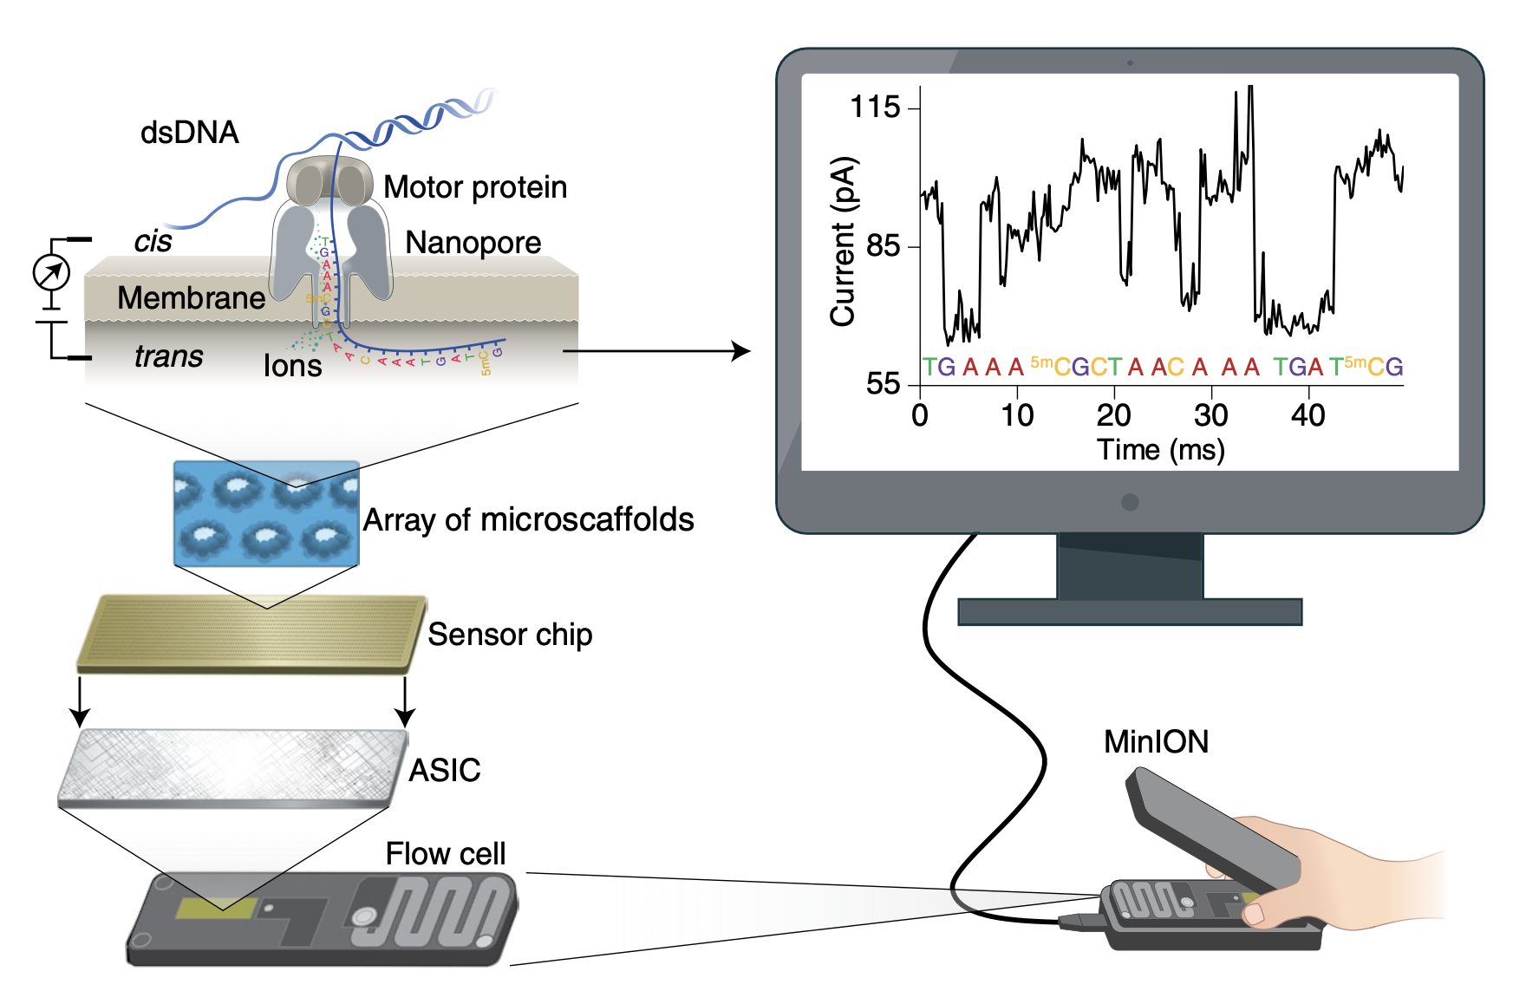
How does nanopore sequencing work?
A pore sits in a membrane; ions flow through it
A motor protein feeds DNA through at a controlled rate
Current changes with the bases in the pore
A neural-network basecaller decodes signal to bases
Data stream in real time
Schematic only: signal depends on several bases at once
Notes:
Say: Think of reading a printed tape through a keyhole while measuring current. A motor protein ratchets single-stranded DNA through the pore at ~400 bases/sec, and the ionic current shifts with the bases residing in the reader constriction. Basecalling neural networks decode these continuous current shifts into sequence in real time. [Time: 3 min]

Slide 7
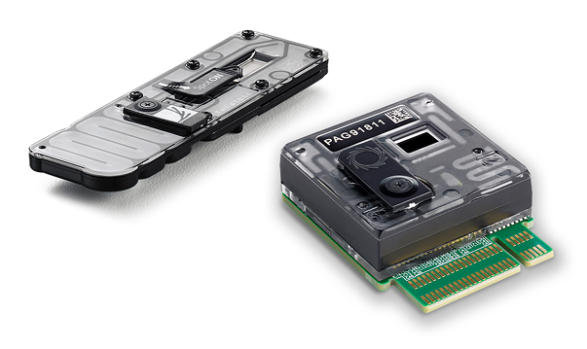
ONT platforms and applications
MinION, GridION and PromethION share the same nanopore principle
Scale and throughput differ
Use cases: amplicons, eDNA, genomes, targeted sequencing
Platform | Scale | Flow cells | Typical use
MinION | Portable | 1 | Field work, pilot amplicon runs, teaching
GridION | Benchtop, onboard compute | Up to 5 in parallel | Routine multi-sample amplicon and genome runs
PromethION | High-throughput | Many (model-dependent) | Large genomes, many barcoded amplicon pools
Same chemistry and workflow logic across platforms; this workshop uses PromethION
Notes:
Say: Choose the device by how many samples and how much data you need. Advanced: exact output specifications change with chemistry and software; cite current ONT pages in the handbook. Instrument images: ONT media-resources page (nanoporetech.com/about/for-the-media); credit Oxford Nanopore Technologies. See Asset Register. [Time: 2 min]

Slide 8
From sample to library: the big picture
Collect sample → extract DNA → check quality
Marker PCR → verify and quantify
Library prep → sequencing
Run controls through every stage
Sample collection
DNA extraction + QC
Marker PCR
Verify + quantify
Library prep (PCR-free kit)
Sequencing
Controls:
Extraction blank
PCR no-template control
Positive / mock community
“PCR-free” describes the library kit, not how the amplicons were made
Notes:
Say: Library prep starts after PCR. Advanced: ONT calls the kit PCR-free, which means no PCR during library prep; your amplicons were still made by PCR. Controls: extraction blank, PCR no-template control, positive or mock community. [Time: 3 min]

Slide 9
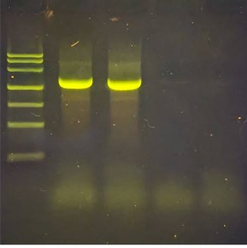
H1 · Preparing and evaluating PCR amplicons
Gel: one clean band at the expected size
Qubit dsDNA for concentration
Convert mass to fmol
Input: 200 fmol per sample (≈130 ng at 1 kb)
mass (ng) ≈ fmol × bp × 660 / 10⁶
200 fmol × 1,500 bp
≈ 198 ng
Amplicon | 200 fmol = | 130 ng =
500 bp | 66 ng | 394 fmol
1,500 bp | 198 ng | 131 fmol
Source: ONT, Ligation sequencing amplicons – Native Barcoding Kit 24 V14 (SQK-NBD114.24), PromethION, rev. NBA_9168_v114_revU_15Jul2026
Notes:
Say: Protocols count molecules, so convert mass to molarity. A clean amplicon gel shows one sharp band at the target size (~1.5 kb) without non-specific bands or primer-dimers. 200 fmol of a 1,500 bp amplicon corresponds to ~198 ng. [Time: 3 min]

Slide 10
H2 · End-prep: getting DNA ready for ligation
Repairs ends and adds a 3′ dA-tail
DNA Control Sample is for troubleshooting; may be omitted
Then bead clean-up, elute, Qubit
Reagent (per sample) | Volume
Amplicon DNA (200 fmol) | 11.5 µL
Diluted DNA Control Sample (optional) | 1 µL
Ultra II End-prep Reaction Buffer | 1.75 µL
Ultra II End-prep Enzyme Mix | 0.75 µL
Total | 15 µL
Amplicon ends
Repaired ends + 3′ dA-tail
20 °C · 5 min
65 °C · 5 min
Then: 1× bead clean-up → elute 10 µL → Qubit
Source: ONT, Ligation sequencing amplicons – Native Barcoding Kit 24 V14 (SQK-NBD114.24), PromethION, rev. NBA_9168_v114_revU_15Jul2026
Notes:
Say: Each enzymatic step is a gate for the next. Advanced: the control (1 µL) can be replaced by 1 µL more sample. Clean-up: 15 µL AXP, two 200 µL 80% ethanol washes, elute in 10 µL water, quantify 1 µL. [Time: 2.5 min]

Slide 11
H3 · Native barcoding and multiplexing
One unique barcode per sample (up to 24)
Ligate 20 min at room temperature
Stop with EDTA, then pool
0.4× bead clean-up, SFB washes
Sample 1
NB01
Pooled library
0.4× AXP · SFB ×2
elute 35 µL
Sample 2
NB02
Sample 3
NB03
Sample 4
NB04
Sample 5
NB05
Sample 6
NB06
7.5 µL end-prepped DNA + 2.5 µL barcode + 10 µL Blunt/TA mix = 20 µL; +4 µL EDTA
Record each barcode before pooling
Source: ONT, Ligation sequencing amplicons – Native Barcoding Kit 24 V14 (SQK-NBD114.24), PromethION, rev. NBA_9168_v114_revU_15Jul2026
Notes:
Say: The barcode is the sample’s name tag inside the pool. Advanced: pooled volume is 24 µL per sample; 0.4× AXP is about 9.6 µL per sample (58 µL for six). A sample-to-barcode worksheet is in Appendix B. [Time: 3 min]

Slide 12
H4 · Sequencing adapters and final clean-up
Barcode = sample ID; adapter = loads onto the pore
Never use ethanol for the post-adapter washes
SFB keeps all sizes; LFB favours ≥ ~3 kb
Final library goes in 32 µL EB
Adapter
Barcode
Amplicon insert
Barcode
Adapter
Schematic, not to scale
Reaction | Volume
Pooled barcoded DNA | 30 µL
Native Adapter | 5 µL
NEBNext Quick Ligation Buffer (5×) | 10 µL
Quick T4 DNA Ligase | 5 µL
Total · 20 min room temp. | 50 µL
SFB – all sizes
Choose for ~1.5 kb 16S
LFB – long fragments
Enriches ≥ ~3 kb
Source: ONT, Ligation sequencing amplicons – Native Barcoding Kit 24 V14 (SQK-NBD114.24), PromethION, rev. NBA_9168_v114_revU_15Jul2026
Notes:
Say: Ethanol after adapter ligation near-zeroes pore occupancy per ONT troubleshooting. Advanced: load 100 fmol for <1 kb, 35–50 fmol for 1–10 kb, 300 ng for >10 kb; if yield is lower, load everything. [Time: 2.5 min]

Slide 13
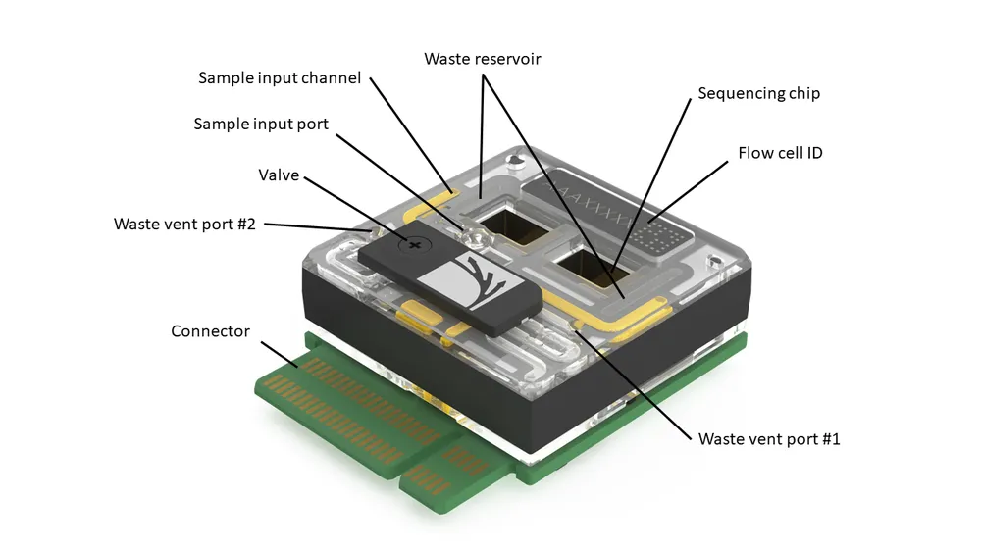
H5 · Priming and loading the PromethION flow cell
Flow cell to room temperature (20 min); check pores first
Draw back only a little buffer to clear the bubble; never let air reach the array
Mix Library Beads just before use; light shield on after loading
Check pores
Prime 500 µL
Wait 5 min
Prime 500 µL
Load 200 µL
Light shield on
Priming mix | Volume
Flow Cell Flush | 1,170 µL
Flow Cell Tether | 30 µL
Total | 1,200 µL
Loading mix | Volume
Sequencing Buffer | 100 µL
Library Beads (or Solution) | 68 µL
DNA library | 32 µL
Total | 200 µL
Source: ONT, Ligation sequencing amplicons – Native Barcoding Kit 24 V14 (SQK-NBD114.24), PromethION, rev. NBA_9168_v114_revU_15Jul2026
Notes:
Say: Slow and steady beats fast. Advanced: PromethION loading mix is 200 µL; the MinION/GridION variant differs, so do not mix procedures. Wait at least 10 min after loading before starting the run. Replace with real flow cell photos. [Time: 3 min]

Slide 14
H6 · MinKNOW: from library to data
Set flow cell position and sample ID
Choose kit SQK-NBD114.24
Enable basecalling + barcode demultiplexing
Outputs: POD5 and FASTQ
Insert real MinKNOW screenshot (annotated)
Kit: SQK-NBD114.24
Position + sample ID
Basecalling + demux
Output: POD5 + FASTQ
Notes:
Say: Record the settings; future you will need them. Advanced: software and model versions belong in the handbook version register. Insert a real, annotated MinKNOW screenshot from your own run, or use ONT documentation images with permission, or CC BY screenshots from protocols.io SOPs with credit. See Asset Register. [Time: 2 min]

Slide 15
H7 · From FASTQ to biological interpretation
Check read-length and quality distributions
wf-16s defaults: 800–2,000 bp reads
Alignment (minimap2) vs k-mer (Kraken2)
FASTQ per barcode
QC: length + quality
Length filter
minimap2 or Kraken2
Report + tables
Insert real wf-16s report screenshot (QC, abundance table, bar plot)
Source: EPI2ME wf-16s documentation, epi2me.nanoporetech.com/epi2me-docs/workflows/wf-16s
Notes:
Say: Use a finished run, not live analysis. Advanced: wf-16s default classifier is minimap2 (95% identity, 90% coverage); Kraken2 uses Bracken. ITS needs min_len lowered to 300 and an ITS-containing database. [Time: 3 min]

Slide 16
H8 · Mini lab exercise: five decisions
Q1
DNA mass for 200 fmol of an amplicon of a given length?
Q2
Assign unique barcodes to six samples
Q3
SFB or LFB for a 1.5 kb amplicon?
Q4
Final PromethION loading volume?
Q5
Likely impact of one lab mistake?
Answer by hands, printed worksheet or polling
Notes:
ANSWER KEY. Q1: e.g. 800 bp at 200 fmol = 200 × 800 × 660 / 10^6 ≈ 106 ng. Q2: any six distinct barcodes, e.g. NB01–NB06, logged before pooling. Q3: SFB (LFB enriches ≥ ~3 kb). Q4: 200 µL total with 32 µL library. Q5: e.g. ethanol wash after adapter ligation leads to pore occupancy near 0 (ONT troubleshooting). Deliver by hands, worksheet or polling. [Time: 3 min]

Slide 17
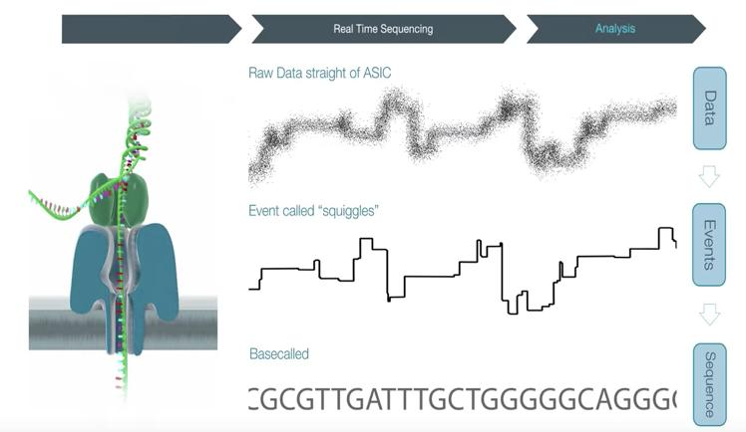
From raw signal to FASTQ reads
POD5 holds raw signal
Basecalling gives bases plus per-base quality
Demultiplexing sorts reads by barcode
Raw current (POD5)
Basecalling (Dorado)
FASTQ reads + quality
Demultiplex by barcode
Per-sample FASTQ
Basecalling gives sequence, not species
Notes:
Say: A FASTQ record is four lines. Advanced: Phred Q = −10·log10(error probability); the record shown is a generic template, not a real read. [Time: 2.5 min]

Slide 18
Read QC and taxonomic classification
Filter by read length and quality
Watch primer artifacts and off-target reads
Both approaches depend on the reference database
 | Alignment (minimap2) | k-mer matching (Kraken2 + Bracken)
Principle | Align reads to references; apply identity and coverage thresholds | Match read k-mers to a taxon index; Bracken re-estimates abundance
Strength | Finer resolution (per ONT docs) | Fastest option
Watch out | Slower on large databases; thresholds shape “unclassified” | Confidence setting and database content drive calls
Source: EPI2ME wf-16s documentation, epi2me.nanoporetech.com/epi2me-docs/workflows/wf-16s
Notes:
Say: Neither tool is “better”. Advanced: wf-16s default thresholds are 95% identity and 90% coverage; reads failing them become “unclassified”. Kraken2 confidence default is 0.0; databases carry dated taxonomy snapshots. [Time: 3 min]

Slide 19
Reading community profiles critically
Abundance tables → bar plots → Sankey/sunburst
Alpha diversity: within a sample; beta: between samples
Relative abundance ≠ absolute cells
Chart here is simulated
Ask: if taxon A has 2× the reads of B, were there 2× as many cells?
Notes:
Say: Twice the reads does not mean twice the cells. Advanced: 16S copy-number variation, extraction and PCR bias; compositional data. wf-16s reports alpha-diversity metrics; beta diversity needs additional analysis. [Time: 2.5 min]

Slide 20
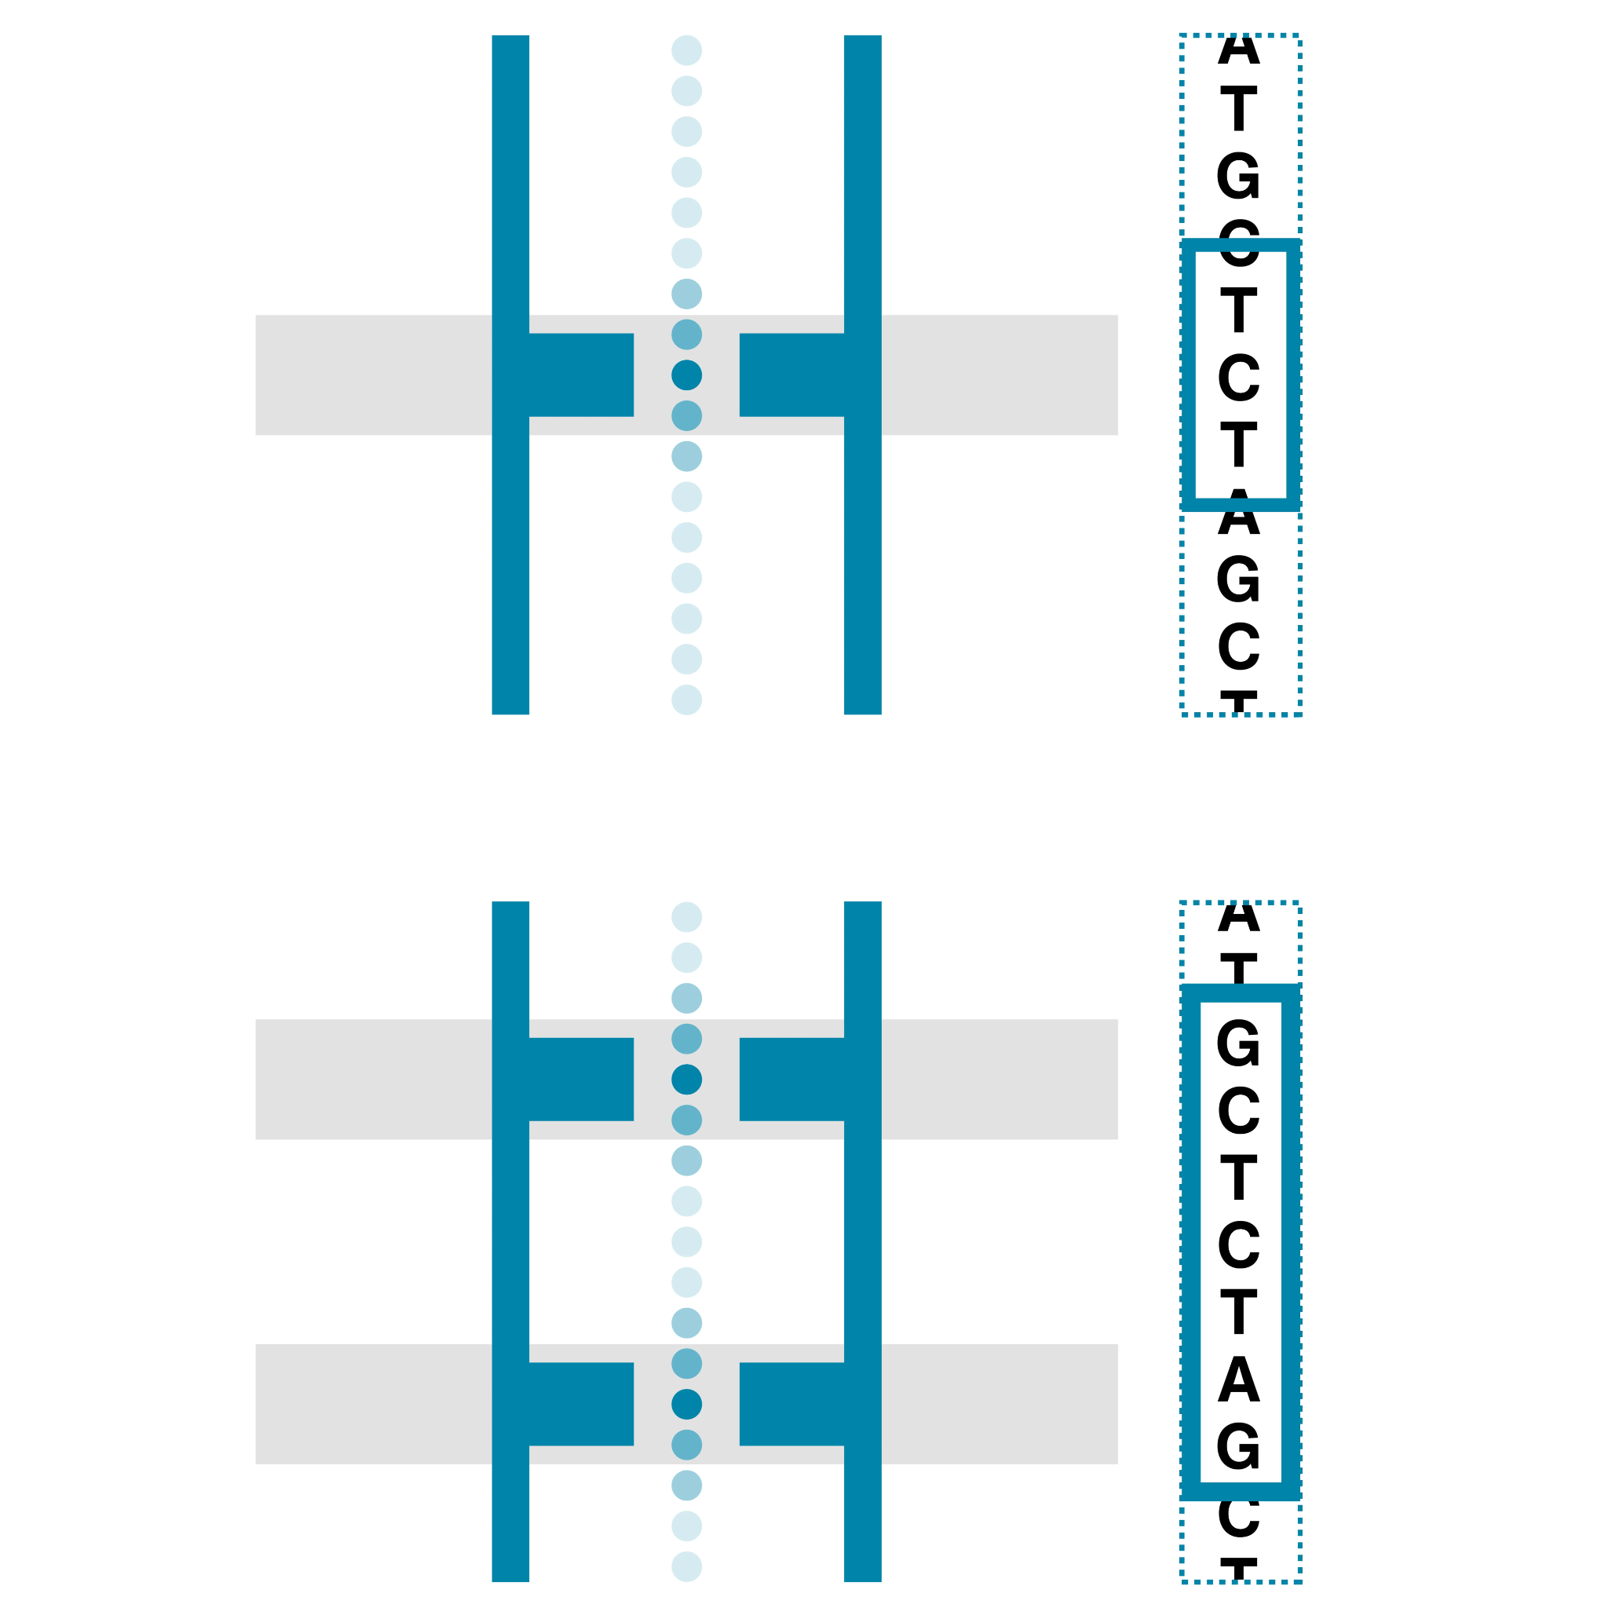
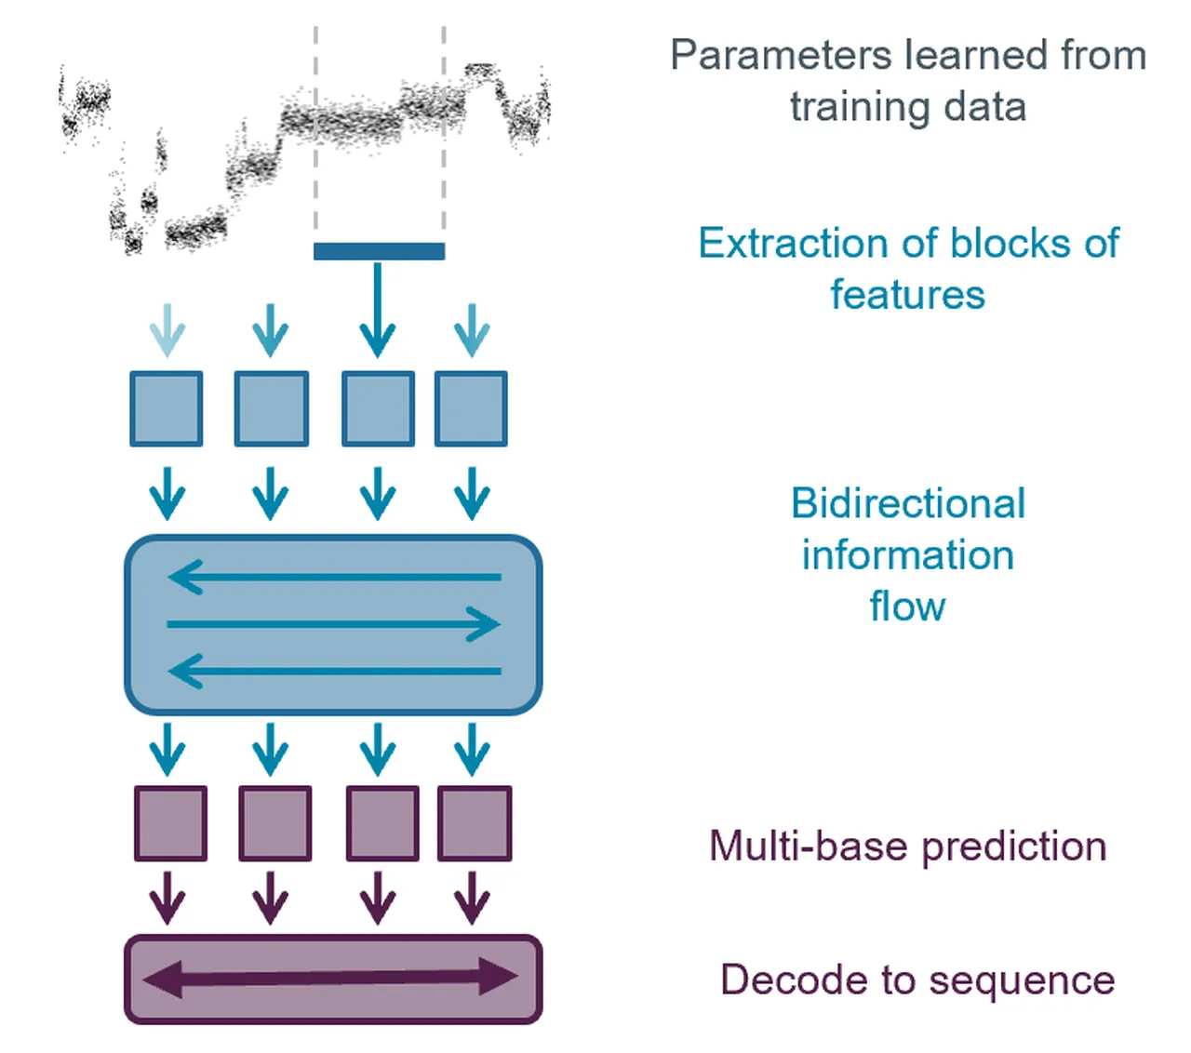
Pore Architecture & Accuracy: R9.4.1 vs. R10.4.1
R9.4.1: single reader head (~4–5 bp in sensing region); homopolymer runs prone to indel errors
R10.4.1: dual reader heads spaced vertically along the pore lumen
Dual sensing breaks homopolymer ambiguity (>10 bp)
Modal simplex raw read accuracy now exceeds Q20 (>99%)
Dorado neural basecaller: CNN feature extraction + Transformer sequence modeling + CTC decoding
Dual reader heads and deep learning models eliminate the historical homopolymer bottleneck
Notes:
Say: Nanopore accuracy has transformed over recent chemistries. R10.4.1 pores feature two reader heads spaced vertically along the pore lumen, reading each base twice and breaking homopolymer ambiguity. Together with Dorado's deep neural network models, modal simplex accuracy exceeds 99% (Q20+), providing high-confidence amplicon identification. [Time: 3.5 min]

Slide 21
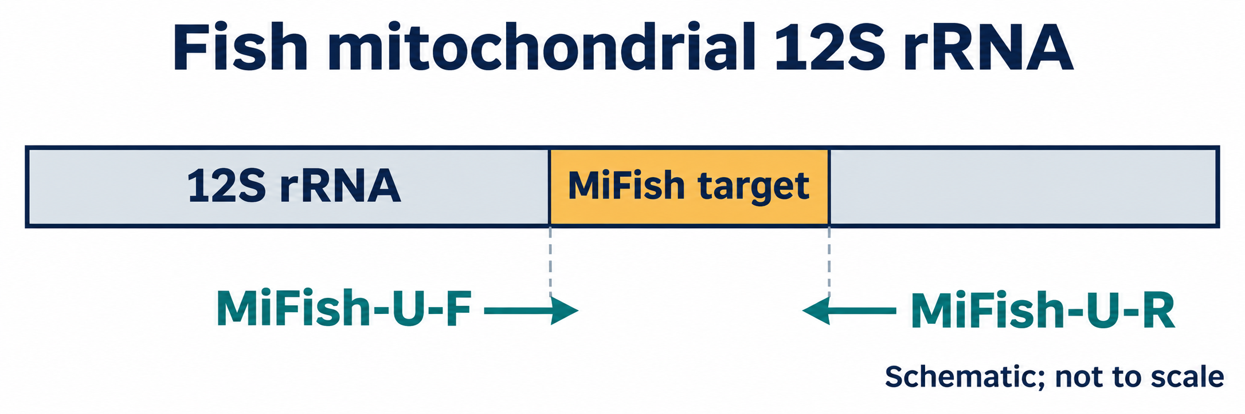
Adapting Workflows for Environmental DNA (eDNA)
Fish eDNA metabarcoding targets short fragments (~163–185 bp MiFish 12S)
Bead clean-up ratio: 0.4× beads discard <1 kb DNA; must derive ratio from amplicon size (≥1.0×)
Flow cell loading target: 100 fmol for <1 kb amplicons (vs. 35–50 fmol for 16S)
Bioinformatics filters: default wf-16s length window (800–2,000 bp) drops short eDNA
Reference database: swap bacterial 16S for curated fish mitochondrial 12S databases
Direct bridge to Pak Hilman's session: Fish eDNA in Anthropogenic Ecosystems
A single protocol does not fit all targets: chemistry and bioinformatic filters must match fragment biology
Notes:
Say: When adapting this workflow to environmental DNA—such as fish eDNA metabarcoding in Pak Hilman's session—we must adjust several key parameters. A 0.4× bead cleanup completely discards short ~170 bp 12S amplicons, and wf-16s default length filters (800–2,000 bp) would reject them. Method selection must be driven by the biological sample. [Time: 3.5 min]

Slide 22
Strengths, limitations and pitfalls
Strengths
Real-time data
Long reads possible
Portable to high-throughput
Barcoding multiplexes samples
Limitations and pitfalls
Primer bias, PCR artifacts
Contamination, barcode misassignment
Marker and database limits
Reads ≠ abundance; detection ≠ confirmation
Negative control has reads?
Yes → flag taxa; suspect contamination or barcode crossover
No → proceed; still check database and replicates
Notes:
Say: Always ask what the negative control shows. Advanced: barcode misassignment and index crosstalk are modelled as low-level leakage; interpret rare taxa in light of controls. [Time: 3 min]

Slide 23
Key takeaways and discussion
1 · Target
Amplicon sequencing reads selected genetic markers
2 · Choose
Marker, primers and platform set the scope
3 · Prepare
Lab prep and computation both shape data quality
4 · Interpret
Assignments need biological context
Sample
Marker + primers
Library + run
QC + database
Interpretation
Taxa (with care)
Discussion: what changes for fish eDNA with a short 12S amplicon?
Notes:
Say: Revisit the pipeline from slide 1 and mark the decisions. Discussion: fish eDNA with 12S short amplicons changes bead ratio, read-length filters and reference database; wf-16s defaults are tuned for full-length 16S. [Time: 2 min]

