Slide 1

DECENTRALIZED SMART GRIDS

Slide 2





INTRODUCTION
Welcome to the Switch liberation army and we are here to the rescue. Nigeria is in a state of energy emergency from our national grid which is in ruins down to our current metering systems. And the world has moved on from our current major energy sources and are racing to achieve a carbon net of zero while adequately meeting global energy demand for a sustainable future. These current energy problems has now created a need for smarter technologies in the global energy sphere especially in Nigeria.
Using Nsukka and its large population as our case study, our bold idea presents a solution that focuses on the Electricity Generation, Transmission, and Accessibility Problems faced in the Country. Electricity Generation is known to aid Economic Development and right now, the situation of this country is far from good especially where we rely on off-grid petroleum products to generate of own power.
NIGERIA ENERGY MIX
45%
40%
4%
0%
11%
Nwosu Paul & Nwarueze Chiamaka RESEARCH@2022 STSE

Slide 3
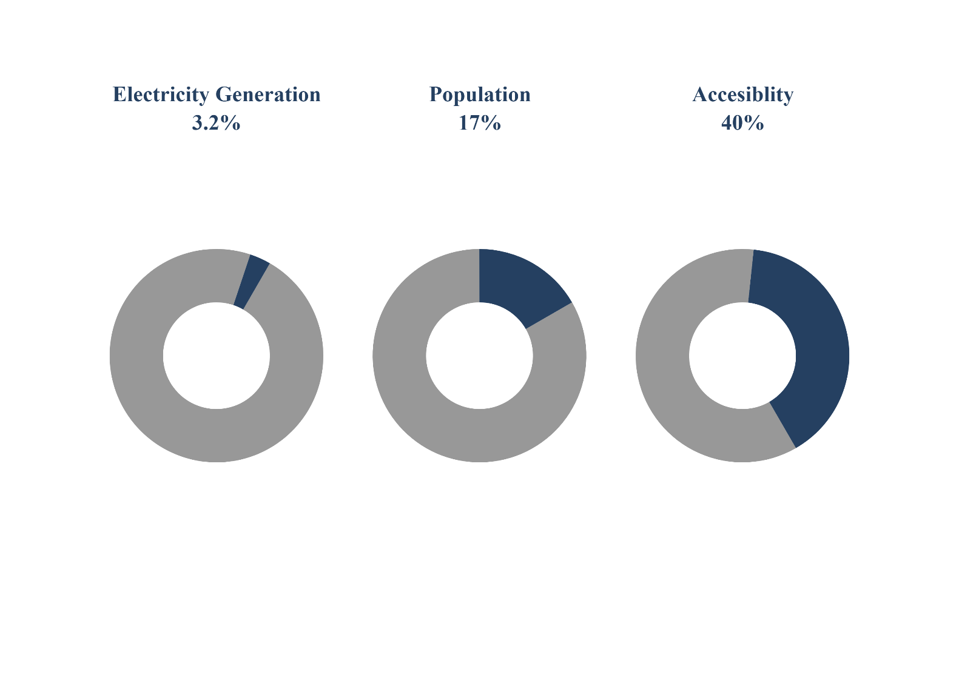

PROBLEM STATEMENT
Source: International Energy Agency
NIGERIA
Our solution focuses in communities located in Nigeria.
We address the following issues:
Electricity Generation
Accessibility and Transmission
Reduction of Carbon Footprint
Diversification of the Electricity Mix
More than 2/3 of people living in Nigeria do not have access to electricity.
The main challenge will be to increase electrification at a rate faster than population increase.
Nigeria’s generating capacity is far lower than other developing countries.
The main challenge will be to ramp up electrical supply to meet demand, and also increase the role of renewables in the electricity mix.
Accounting for about 17% of the world population, it is not without shock to find out that Nigeria suffering from unreliable power supply.
The main challenge will be to meet the energy needs of a growing population at grass root level.
Nwosu Paul & Nwarueze Chiamaka RESEARCH@2022 STSE

Slide 4
























THE NIGERIA POWER GRID DESIGN: A FAILED STRUCTURE
6/10 houses in Nigeria has a fuel generator as an alternative source
Transmission losses
Keys:
Transmission lines
Natural Gas : 78%
Distribution lines
Houses that completely rely on alternative source of power
SOURCES OF ELECTRICITY GENERATION
Transformer
Coal: 0%
Transmission losses
Fuel Generators
Industries
Renewables: 0%
Houses
Transmission losses
Hydro: 22%
Poor Integration of Renewable sources
Nwosu Paul & Nwarueze Chiamaka RESEARCH@2022 STSE

Slide 5




OUR SOLUTION
A DECENTRALIZED SMART GRID
(DCS GRID)
MICRO GRID
INTELLIGENT GRID
SMART NET METERING
ENERGY EFFICIENT
Energy Efficient Components.
Reduced Carbon footprints.
Bi-directional meters.
Switch billing and earning system.
Generation
Accessibility
Switch Solar systems and services
Predictive Analytics

Slide 6
OUR ROAD MAP
SOCIAL OUTREACHES ON THE USES AND IMPORTANCE OF SWITCH SOLAR SYSTERM AND SERVICES.
IDEA PROTOTYPING AND TESTING
FIRST MVP SELL AND INSTALLIATION
(PROOF OF CONCEPT)
SETUP OF SMART GRID SYSTERMS AND ENERGY CHANNELS
ENSURING WE MAKE AS MUCH POSITIVE IMPACT AS POSSIBLE
CUSTOMER DISCOVERY STAGE
SECURING INVESTMENT AND PARNTERSHIP FOR GOALS.

Slide 7
OUR TARGET CUSTOMERS
HOUSEHOLDS,
LODGINGS,
HOSTELS,
MEDIUM SCALE BUSINESSES,
THE PRODUCTION CHAINS,
AND WOMEN.

Slide 8
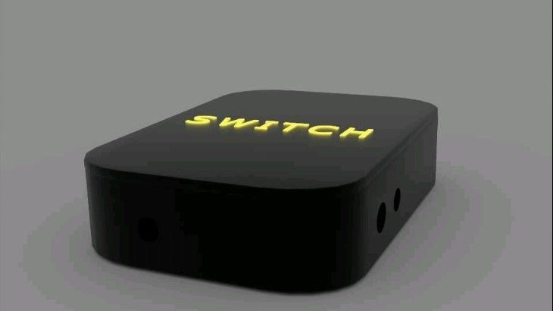
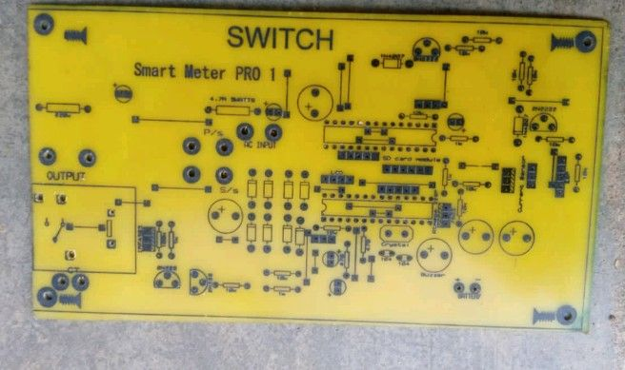
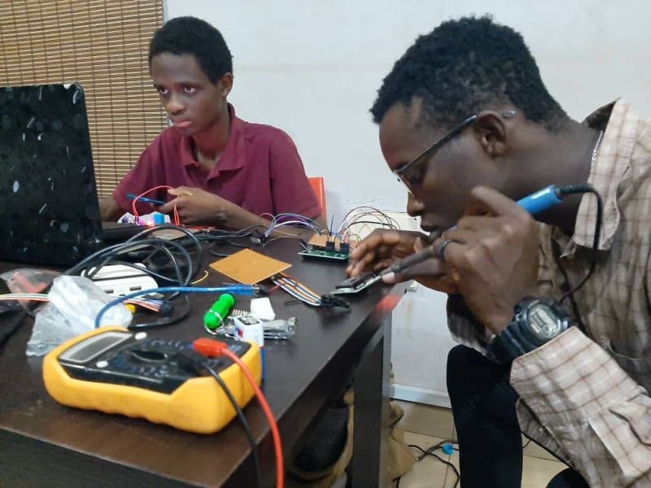
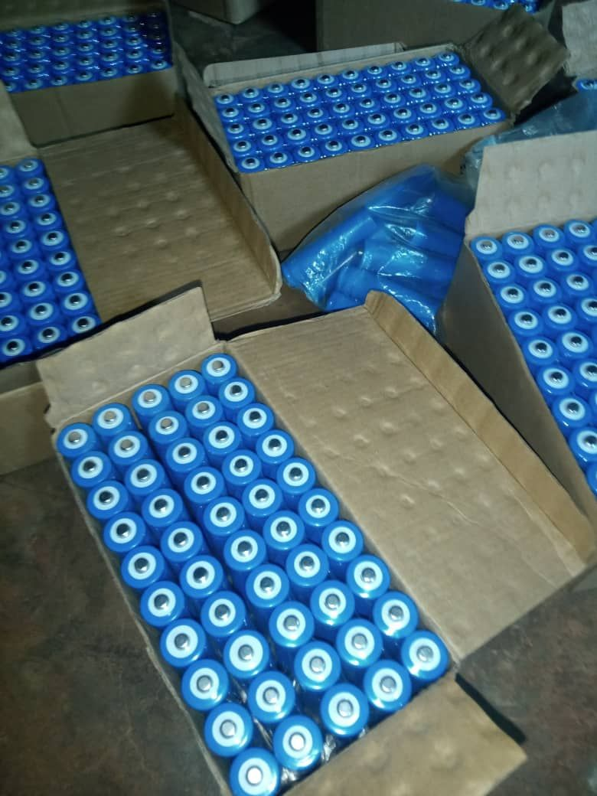
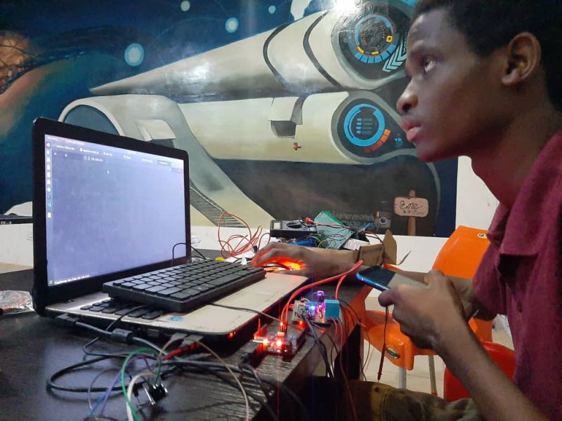
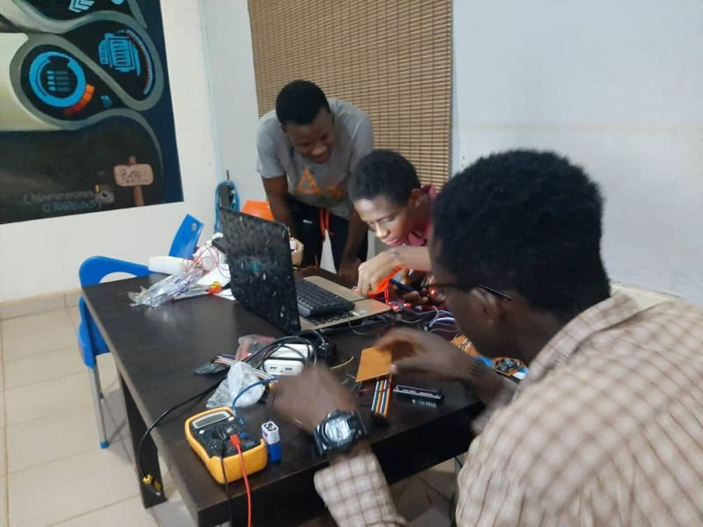
OUR SMART METER MVP
SMART METER MODEL
SMART METER ASSEMBLY
SWITCH BATTERIES

Slide 9
1
OUR COMPETITION AND OUR mvp features
A
REAL TIME ANALYTICS
RENSOURCE
B
SMART IOT WEB APP
DAYSTAR POWER,
ENERGY
SOLUTIONS
LUMOS
C
NET METERING
C
Scalable design

Slide 10
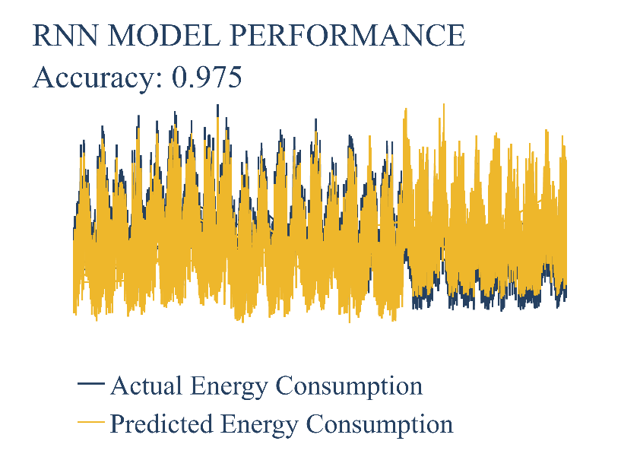
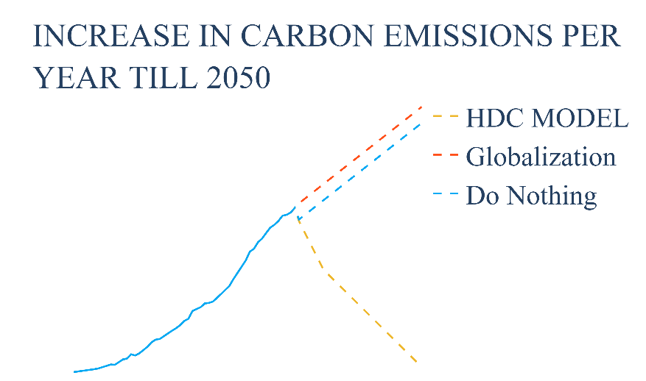
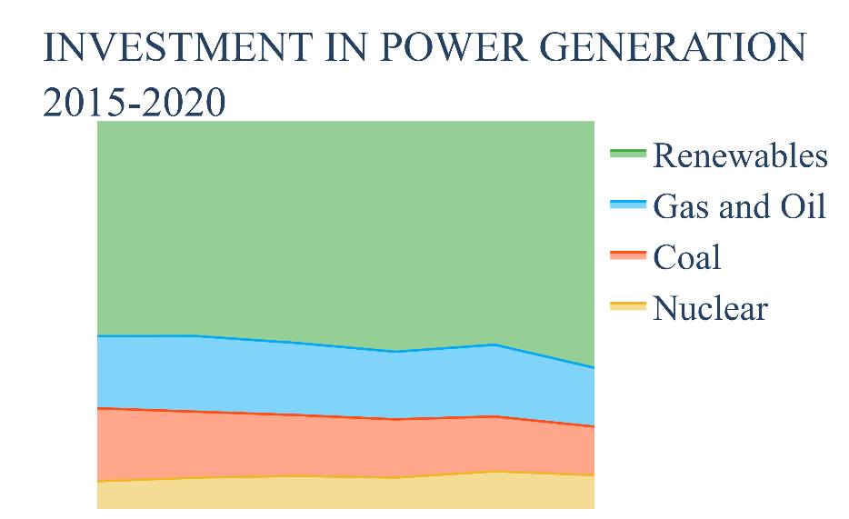
KEY PERFORMANCE INDICATORS
Feasibility of Model and Technology
The Machine learning model used (Recurrent Neural Network Time Series) has been tested, and its performance is beyond expectation. Using the Electric consumption Dataset obtained from some of the buildings in UI, we were able to develop a predictive model. Another useful concept is how data analytics plays an important role in finding trends within the data, since the data is in form of time series, it is possible to locate trends such as seasonality, special events, holidays, and surges
1
Carbon Emissions Reduction
One of the major aims is to make sure that the model is able to lead to reduction in carbon emissions. Smart grids are designed in such away that they reduce carbon emissions compared to the traditional grid. The design proposed takes it a step further, by focusing on micro grids that in itself are smart, carbon emissions can be reduced from two fronts.
2
3
Availability of Market
The future is bright for renewable sources all over the World and even in Africa, but conscious effort is needed, a report from IEA says, “Investments in China present the highest divergence. India, Southeast Asia and sub-Saharan Africa would need to more than double renewable investments” (WIE, 2020).
Nwosu Paul & Nwarueze Chiamaka RESEARCH@2022 STSE

Slide 11
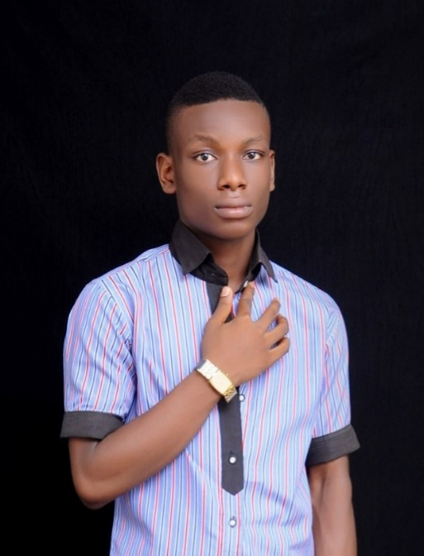



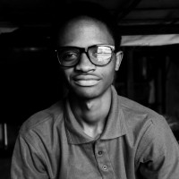
OUR TEAM
ISSAC
NEWTON
HARDWARE PROGRAMMER
(CO-FOUNDER)
IFEANYI CHRISTWIN
DATA SCIENTIST AND BACKEND ENGR
(FOUNDER)
GLORY AMADIFE
CHIEF BUSINESS OFFICER
(CO-FOUNDER)
MMERICHUKWU ANOSIKE
WEB AND BUSINESS DEVELOPER
(CO-FOUNDER)
JUDE GODSDELIGHT
HARDWARE SPECIALIST
(CO-FOUNDER)

