Slide 1
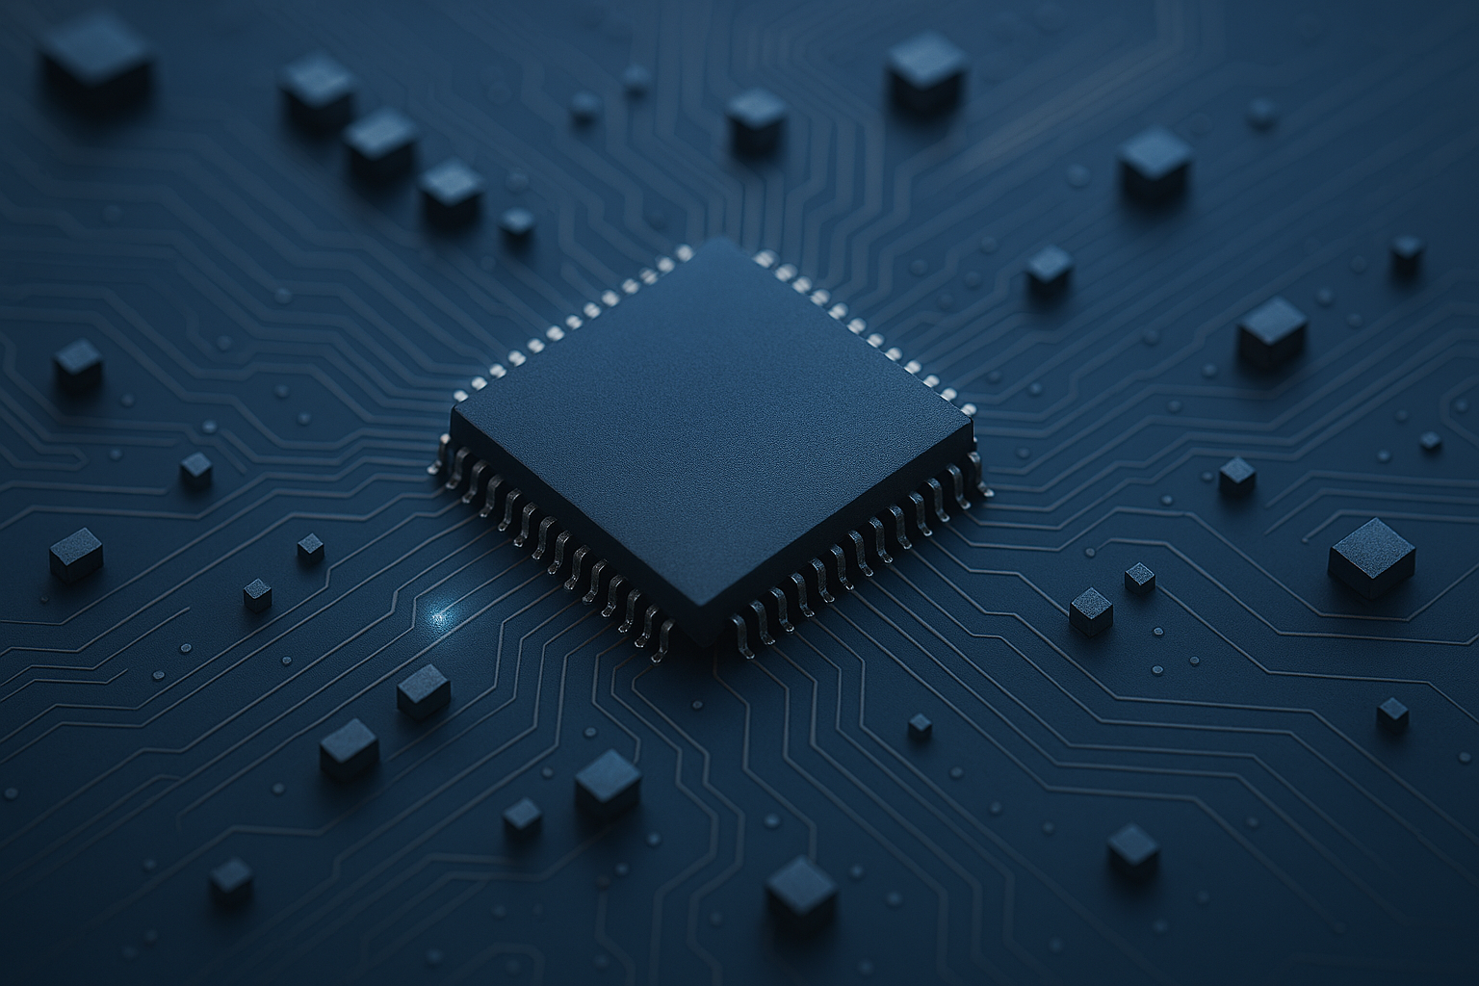

Embedded System Project (521423S)
Specifications
Siva Ariram
Antti Tikanmäki
Marko Kauppinen
Jaakko Huikari

Slide 2
Design phases
In practice:
Requirement specification, Technical specification, test plan, Schedule
Schematics, component ordering
Layout and manufacturing files, PCB ordering
Populating the board and electrical testing
Programming software and testing
Final demonstration and Final report

Slide 3
Requirement specification
1: choose application and study parameters related to it!
General functionality
How should the device interact with the environment
  E.g. sense temperature with certain accuracy and alarm with buzzer if too warm
  What is operating environment? Special requirements?
User interfaces
  What kind of information is shown to user?
  how many characters on the screen?
  Or some menu system?
  How user controls the device?
Software interfaces to other systems (like PC)
  What kind of information is sent to remote device
  Do we need to use some standard
  How many times in second?
  What is latency from measurement to sending out data?

Slide 4
Requirement specification
List of features
  Figure out what is the purpose and required functions of your device
  Refine features
  Organize to groups and hierarchy – Mindmap is good tool for this
Numerical requirement
  storage, power, time of operation
  Resolution, measurement ranges
  Operating conditions (min, max values)
  Frequency (samples per second?)
Limit the search of used components
  You need to have numerical requirements when selecting for example temperature sensor from >1500 options available in Digikey
  Use components that are in stock!
Use numbering and hierarchy:
  Req_1: User interface,
  Req_1.1: operating buttons, …
  Req_2: Measuring temperature

Slide 5
Requirement specification
Internal interfaces
  Sensors, Actuators, Storage
Amount of data
  Where to store?
Physical size
  case, design
Electrical requirements
  Power source (battery, AC/DC adapter)
  Operating voltages, try to have only one!
Operating time
  One day, one week?
Price target (<100€)
Include formulas and calculations to documentation!

Slide 6
Requirement specification
  Examples:
  logging 10 hours of motor temperatures from 4 places twice in a second
  Store measurements to SD card with XX digits
  -> You will find requirements for memory, storage, power usage, calculation speed, size of device,…
  If device must measure temperature between -40 + 80, all components should work on these conditions

Slide 7
Example of hierarchy
REQ NO | Description | Parameters
1 | User interface
1.1 | display - shows current value of sensor | update every 0.1s, 6 channels, digits:2
1.1.2 | display size | 20mm x 40mm
1.2 | User can change configuration of device
1.2.1 | user can change update speed | min 0.01s, max 5s
1.3 | User can start/stop measurement
2 | Device measures Temperatures | 6 channels
2.1 | Device stores measurements to memory | update 1s

Slide 8
Technical specification
Technical solution for requirement specifications
In practice done in parallel with Requirement Specification
Decide software and hardware partition
  iterative process where you plan your system components
  What is done with hardware what is done with software
    For example: decoder chip or software
Use block diagrams to plan how different components communicate
  In hardware, in software, and between
Use state/flow diagrams to plan how the system is working

Slide 9
Technical specification
Practical hints
Avoid complexity and exploit available solutions
  Use web search to find similar projects (forums, hobbyists, etc)
  Study application notes
  Use Digikey-search to find suitable components (remember requirements)
  Study electrical component datasheets (how to communicate, voltages, currents, external components etc.)
  Try to find available libraries (communication interfaces, …)
  Favor complete electrical solutions (motor/led drivers, fixed voltage regulators,…)
  Check package availability for electrical components (not BGA or too small QFP)

Slide 10
Technical specification
Processor selection
  (in this course) Prefer 32bit STM32xxx
  Check support for debugging tools (STLINK/2-1 and SWD serial wire debug (in STM), …)
  Support for your required peripherals (SPI, I2C, USB, ADC, ….) in MCU
    1 or 2 uart? Special functionalities like CAN?
  Check that supports C/C++
  Available Libraries and software documentations
  Program memory size
    enough space for your code, constant tables (e.g. gui bitmaps) and external libraries
Internal vs external data memory
  sufficient amount of memory (follows from requirements), i.e. arrays in memory
  data transfer (serial / parallel bus)
  bus speed and delay
  flash vs ram

Slide 11
Technical specification
Software components
  Divide such that they are easy to implement and test separately
  Avoid complex I/O solutions if can be implemented with microcontroller I/O units
    e.g. motor control PWM through timers, sensors with SPI/I2C or ADC
  Estimate timings for algorithms against MCU performance
    Check instruction set summary if necessary
Power
  Approximate power consumption (create table in docs)
  Ensure batteries meet the system life-time (e.g. one week)
  Does your selected components support sleep mode?
  Selected clock speed affect to power consumption
Casing (optional) for device can be made in this course
  Design suitable casing and board size
  Ensure all electrical components fit the board
  If electronics is complex, it might be good to split device to several boards in prototype phase
  Possible to print in FABLAB (STL-format)
  you can use for example FreeCAD or Autodesk Fusion 360 to design it
  Or use plastic cases

Slide 12
Examples of Requirements to TechSpec
REQ NO | Description | Parameters
1 | User interface
1.1 | display shows current value of sensors | update 0.1s, 6 channels, digits:2
1.1.2 | display size | 20mm x 40mm
1.2 | User can change configuration of device
1.2.1 | user can change update speed | min 0.01s, max 5s
1.3 | User can start/stop measurement
2 | Device measures Temperatures | 6 channels
2.1 | Device stores measurements to memory | update 1s
Req1.1:
- find display that can show Y line and X characters
-> display with SPI control -> we need processor with SPI (or use bitbang)
- Where display is used? Outdoor/indoor? Do we need backlight? Is there code libraries available for it? What is the quality of documentation (for example only in chinese)
Req1.1.2:
- Case or design of device defines that display is 20mm x 40mm.
-> limit the search to these devices

Slide 13
Software tech plan
Study tools available
Find drivers or datasheets describing protocols, registers, etc.
Study how drivers work if source is available
Study how you are going to implement UI
Find examples how to use drivers
Hierarchy of SW parts
Decide if using threads, interrupts, polls etc. for each functionality
Decide timing of each part of the software
Draw preliminary plan of software parts on your tech spec!
In final report, show gantt diagram how many ms each part of SW is using

Slide 14
Test plan
Testing is always done in parallel with implementation during whole process
  As each sub-functionality is ready, will be tested and marked on test report.
How to verify that each requirement is filled
  Calibration? Reference measurement?
  Example: temperature measurement with reference device, whole range of measurement area. Long term drifting?
How to test that technical solutions works as expected
If minimum and maximum requirement exist, how to measure in these conditions?
Use same reference numbering as in previous documents
Sometimes if something larger changes during development,
-> some test needs to be done again
In real world, testing team is usually separate so you have to define what is tested and how
Some tests might need some statistical analysis, you must define how tests are represented in test plan.
  For example: power consumption and time-plot

Slide 15
Schedule
Reserve weekly hours that you are able/will spend on this project
Deadlines for each phase to complete project in time
  Define what needs to be done before DL
Continuously update LOG of used hours to learn how much time each job is taking in practice in design process
  Give enough details to understand better where time is spend:
    Just single term like “documentation” is bad, write down more details
Keep your time schedule
  If schedule is missed, do rescheduling
Report progress in week-reports
  Short list of what has been done, and what are action points for upcoming week
  Even if nothing is done during the week, report it still to keep work in progress
Share work equally to team members!

Slide 16
Deadlines
22.01 Topic and Group (Moodle)
12.02 Phase 1 completed - Technical specifications and Test plan, Schedule
12.03 Phase 2 completed - Schematics and component orders
27.03 Phase 3 completed – Layout and manufacturing files, PCB ordering
10.04 Phase 4 completed – Populating the board and electrical testing
08.05 Phase 5 completed - Software
31.5. Phase 6 completed – All functionalities operating, Documentation ready

Slide 17
Discussion

Slide 18
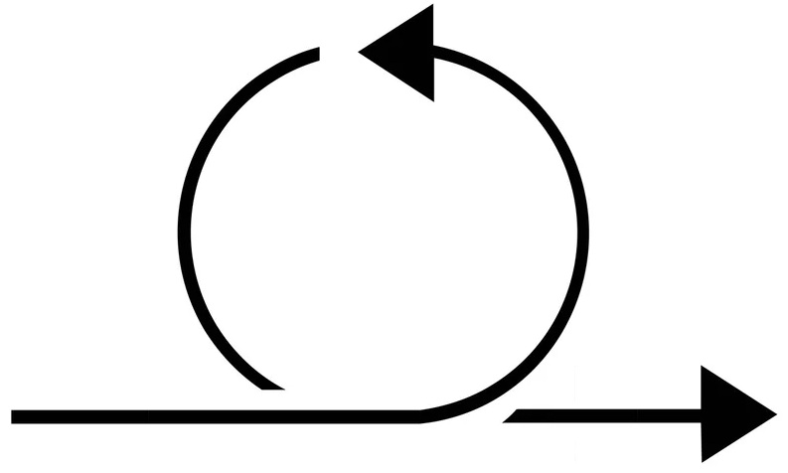
Steps from phase 1. forward
Seach for available
viable component
options
Refining the specs,
fixing the specs
Acquisition of deeper technical
understanding of the problem and
solution
Iteration
loops
Sufficient
understanding,
technical
specifications,
final component
selection,
Requirement
specifications

Slide 19
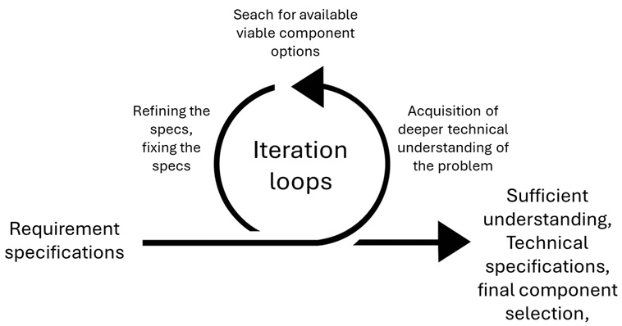
Requirement specifications
Vision of a device/ the outcome
General functionality
User interfaces
List of features
Physical size
Electrical/ power supply requirements
Functionality on higher-level
  Measurement of variable X
  Control of actuator Y
  Computing of outcome Z
  Displaying of data
  Data transfer etc.
Outlining by diagrams
What are the functions of the device/ system?

Slide 20
Acquisition of deeper technical understanding of the problem and solution
From a set of abstract ideas towards
physical solution
How to implement the functions?
Acquisition of further knowledge
  Physical understanding
  Physical phenomenon converted into
an electrical signal (sensor)
  Actual technical solution option
    Electronic/ electromechanical
  Finding and choosing the most suitable solution
  Course materials, tutorials, web resources etc.
  Key topics to start with: power delivery system, sensors, development
  board resources, peripheral communication systems (SPI, I2C, USB etc.)
Subdivide the problem/ function into a subset of operations
Analyse the problem-solution complex on different domains
  Draw diagrams
    Power, signals, timing, communication etc.

Slide 21
Seach for available viable component options
Search for available components
performing required functions
Manufacturers, suppliers (Digikey e.g.)
Several options to choose from
  Critical comparison of
  characteristics
    Availability
    Functionality
    Performance
    Price etc.
  Final component choices
Which actual available components
performs required functions?

Slide 22
Refining the specifications
Increased understanding of the
Problem-solution complex
  What is possible and how its done
  What is sensible in practice
  Which component are available
  Resources available
  Do performance requirements match etc.
Possible need to revise initial specifications
  Requirements might become stricter or looser
  Features modified, added or removed etc.
Is there a need to revise the current specifications?

Slide 23
Sufficient understanding achieved, technical specifications and final component selection completed
Problem and solution understood and confined
Sufficient technical understanding achieved
  Technical details covered
  Technical questions answered
Ready to move to next phase
  Schematics and layout design

Slide 24
Electronic components suppliers, component selection and search engines
Digikey, as an example
Vast selection of components available
Search engine (web page)
  By the key parameters of your requirements
Find potentially suitable component options
Study datasheets to select the best suited
  Compare characteristics vs. requirements
  Note also availability, ”active” status and delivery times
Datasheet and further info also from manufacturers
Component order (in phase 2.)
Create an account
Find suitable comps (note availability, status, deliv. times)
Add components into a shopping cart
Send a shoppnig cart link to course staff

Slide 25
How to read electronic components’ datasheets (1)
Detailed information
  About the component in question
  Performance, capabilities, limits vs. operation environment
  Physical characteristics, pins, packages
  How to use it properly (effectively, safely etc.)
  Typical applications etc.
Used to verify that characteristics meet requirements
  Power supply requirements
  Accuracy, precision
  Response speed, data rate
  Communication and interfacing capabilities and protocols.
  Power consumption/ dissipation (battery powered applications)
  Package/ physical constraints etc.
Large quantity of information, some of it is more and some less important
to you and your application
Learn to identify the key characteristics to your application
  Search for component specific tutorials
  Web search tip: ”how to read linear regulator datasheets” e.g.

Slide 26
How to read electronic components’ datasheets (2)
Typical key parameters to verify (component specific)
  Absolute maximum values
  Performance parameters
  Power consumption
  Timing constraints (delays, sampling and settling times)
  Time requirement for measurement, data transfer and data processing
  Environmental requirements for proper operation etc.
Example of a datasheets
  LDO (low-dropout) voltage regulator, MCP1700
  MEMS (micro-electro-mechanical sys.) motion sensor, MPU6050

Slide 27
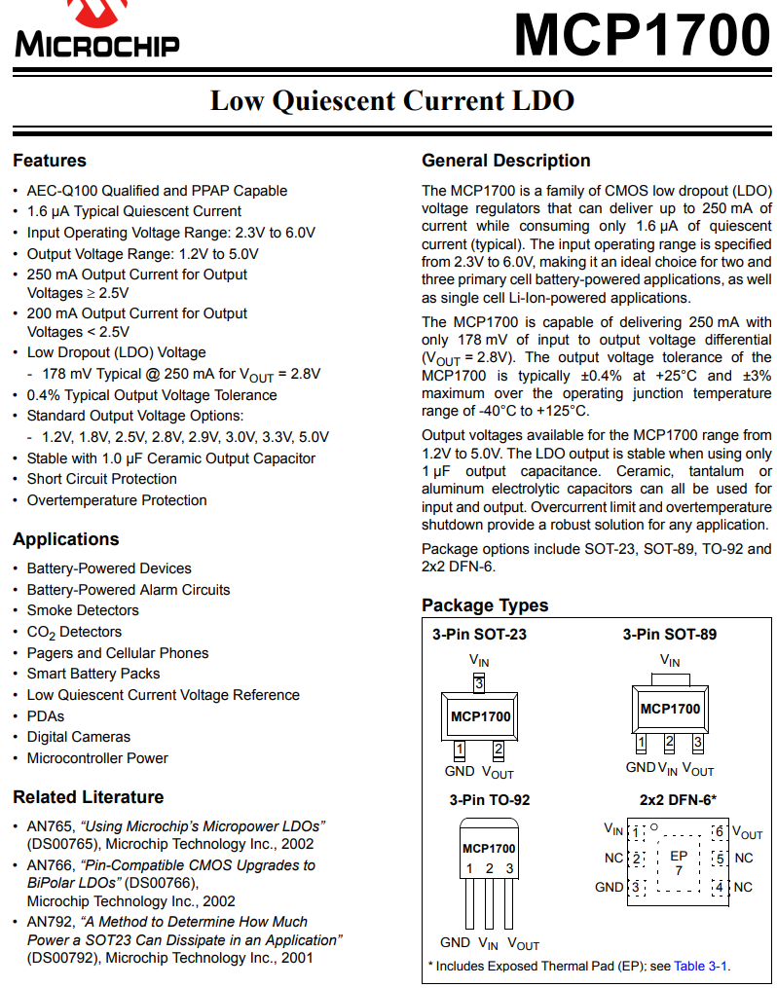
General
description
Voltages
Applications
Output
current
Performance
Operation
temperatures
Portable
applications
Detector,
sensors
Package
options
Additional
information

Slide 28
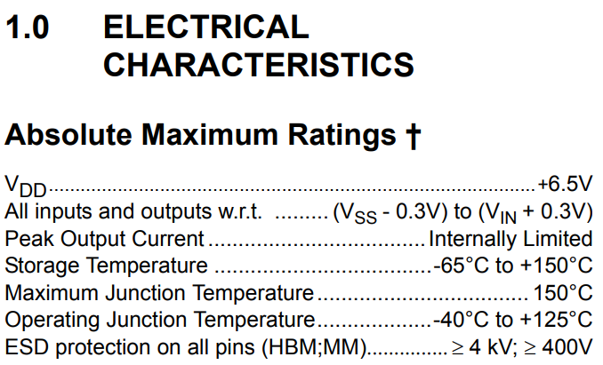
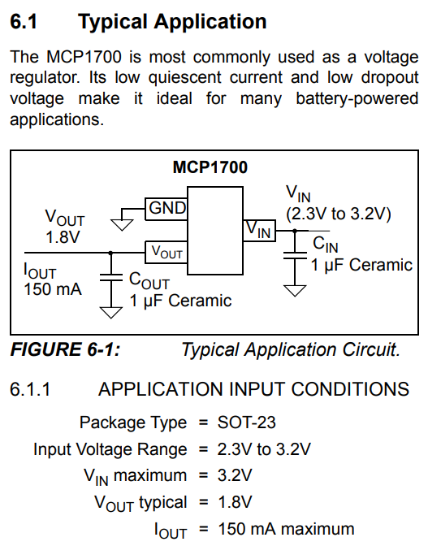

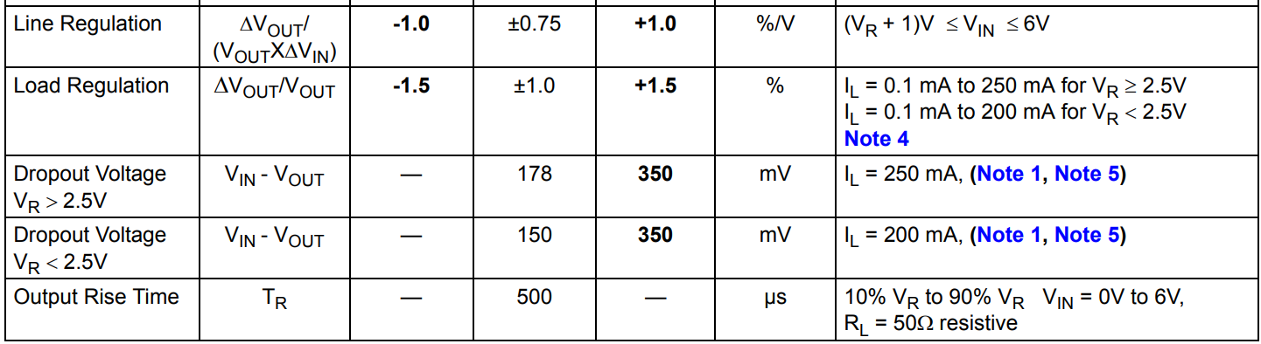
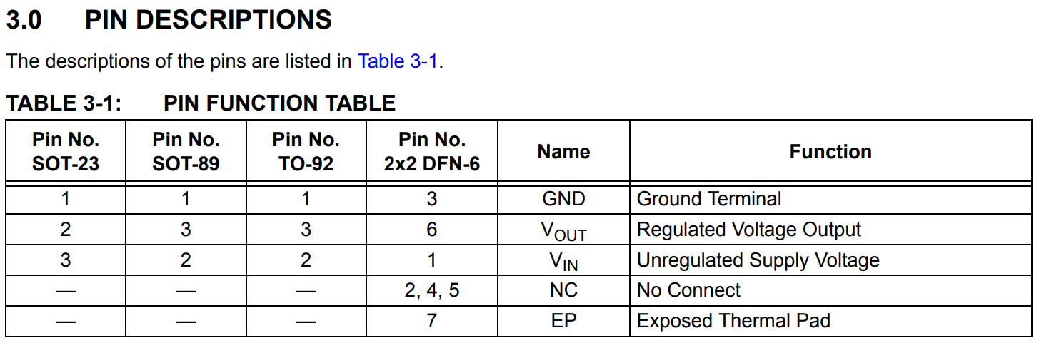

Slide 29

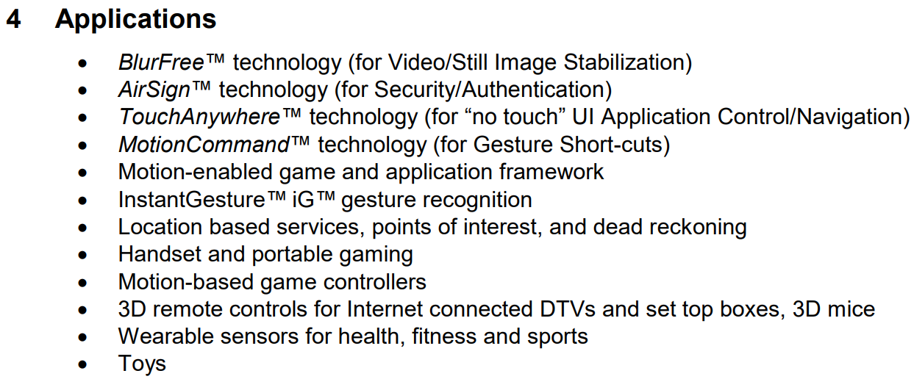
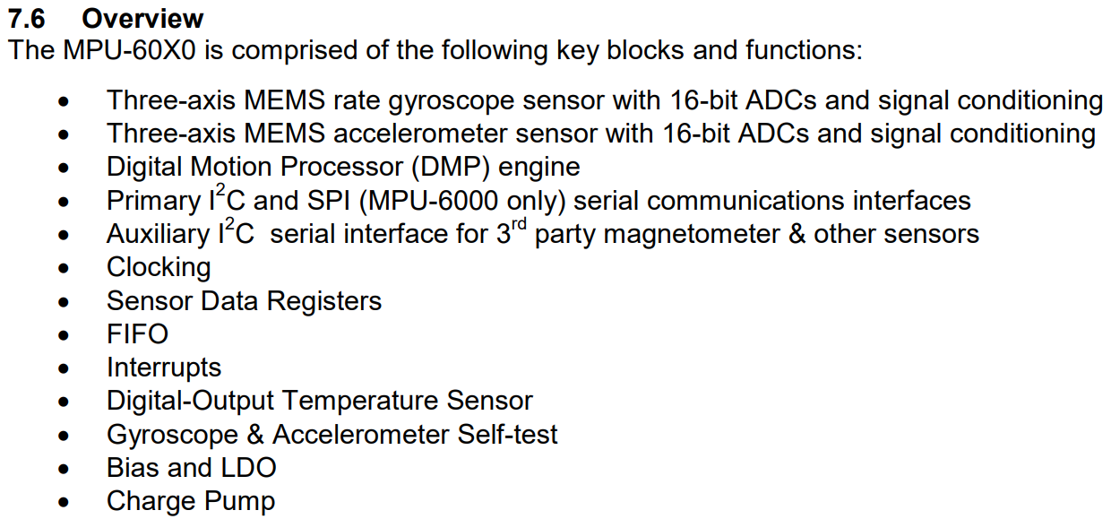

Slide 30
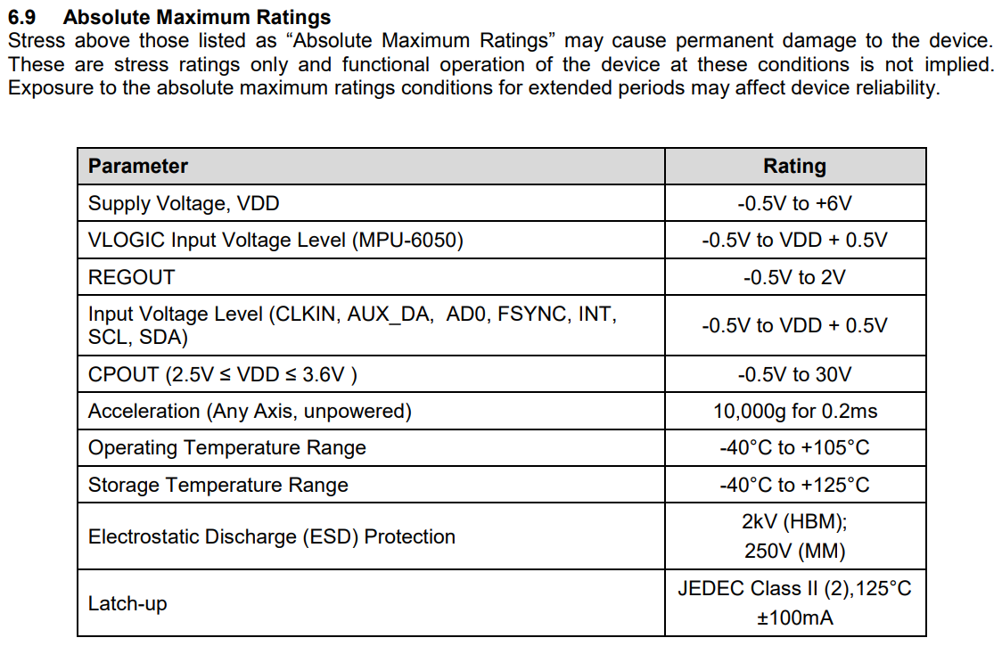
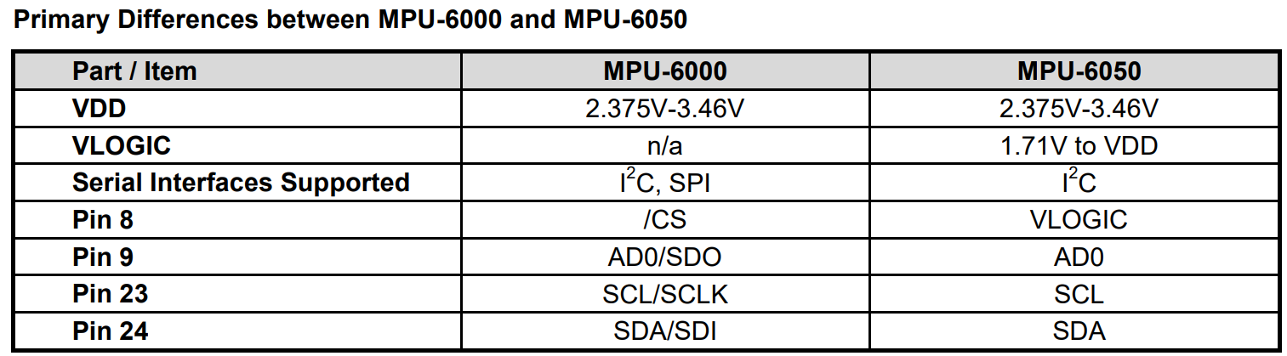
Comparison between two models available

Slide 31
General tips
Take notes
  Chronological order, on a date level
  Capture the progress of thinking and development
  Good ideas, but also not that good ones
  Also unsuitable components along the way
Read datasheets, seriously
  Be prepared to read them several times more
  Print and make notes on them
  Carelessness in this phase => extra work later on
Web search topics, for example
  embedded systems example projects/ real world examples
  embedded systems typical functions/ features
  how to read electrical component X datasheet
Ask the course staff for help in case you get stuck
  Rather sooner than later
  But give it a serious attempt first

