Slide 1

WhyR 2018

Slide 2
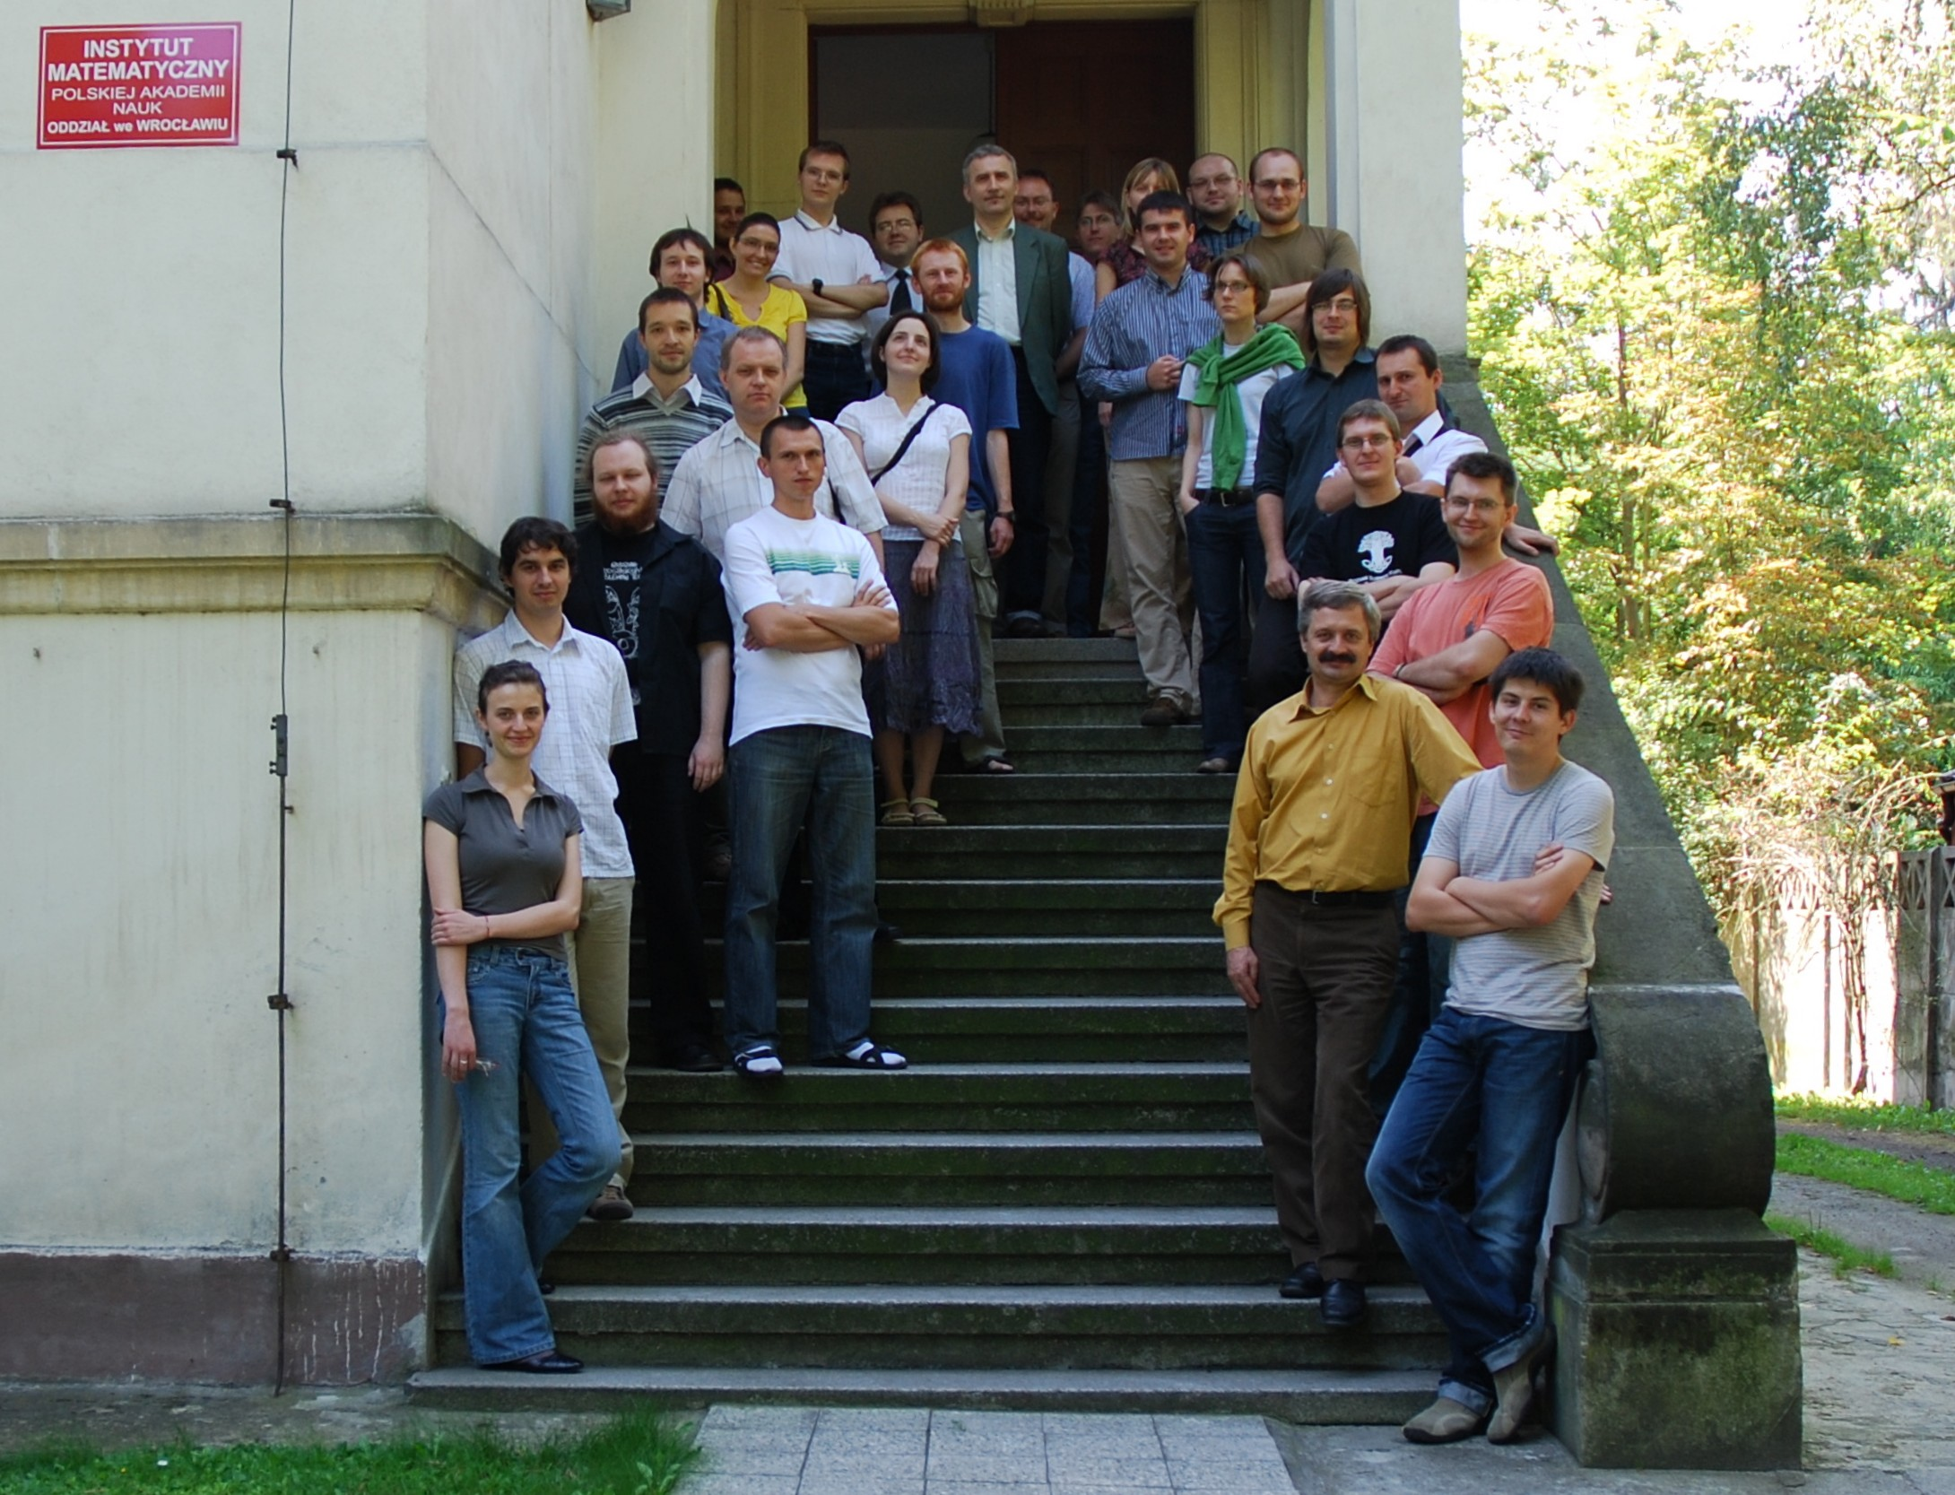
WZUR 2008
Wrocławski Zlot Użytkowników R

Slide 3
Deep dive into mlr ecosystem (mlr-related talks, workshops, the mlr-hackathon).
Strong focus on machine learning in R (deep learning, interpretative machine learning).
Network-oriented conference (special interest groups, birds of a feather meetings).

Slide 4
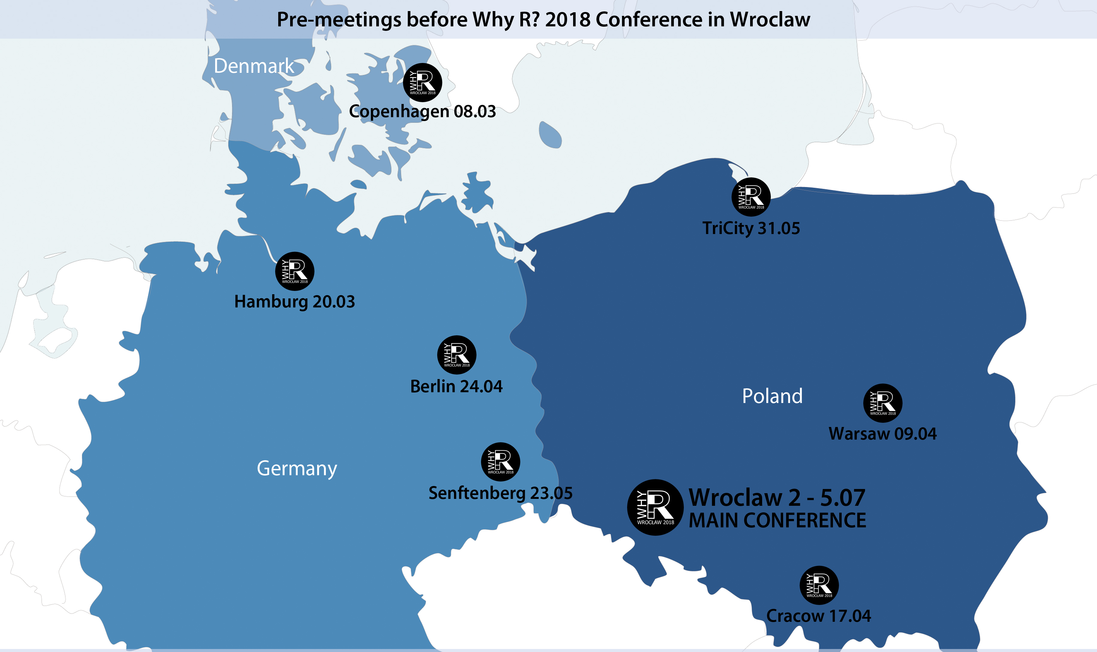
https://www.facebook.com/whyRconf/ http://whyr2018.pl

Slide 5


