Slide 1


Predicting churn of HackerNews visitors
Hiflylabs team’s solution for the 2020 Why R? Hackathon
Bence Molnar, Bence Farsang, Daniel Szokolics, Gerold Csendes, Kristof Rabay

Slide 2



Why churn prediction?
Churn modeling is heavily used in online business
The value of HackerNews is its user base → vital to keep them from churning
A well-tuned model helps:
Understanding patterns of churning
Identifying high-risk churners
Intervening to stop the churn

Slide 3
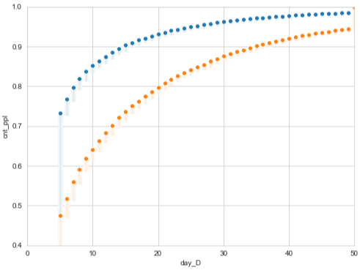
Churn definition
At first, we agreed on the definition of churn. The decision was based on the average time between the activities of a given user.
30 days of inactivity is easily interpretable and has an ideal return ratio.
Based on our definition, if we classify somebody as a churned user, they have 88% chance to churn forever.
Return ratio and churn definition
Orange: user ratio
Blue: activity ratio associated with the users
The ratio of non-returning users for a given definition
Inactivity period to classify as churned

Slide 4




Data: the more the better
Churner definition:
Active for 3 months, inactive the following month
Decided to put time and effort into training on as much data as we can
Cross validation:
Separate tables were created for different dates in order to cross validate our results.
Item IDs are increasing integers. The later an activity is recorded, the higher the ID gets
Features created
Historical trends in the user activities
NLP features from comments
Comment and story popularities
Time since last activities
Time since registration date
Collected 6 million items covering 2+ years of activities
Found users registered back in 2010. Overall a couple 100K users were identified

Slide 5
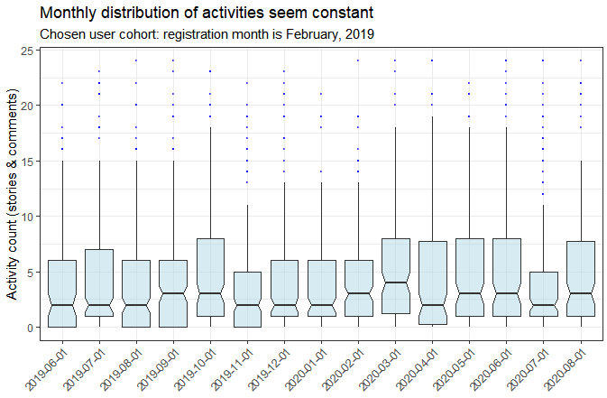
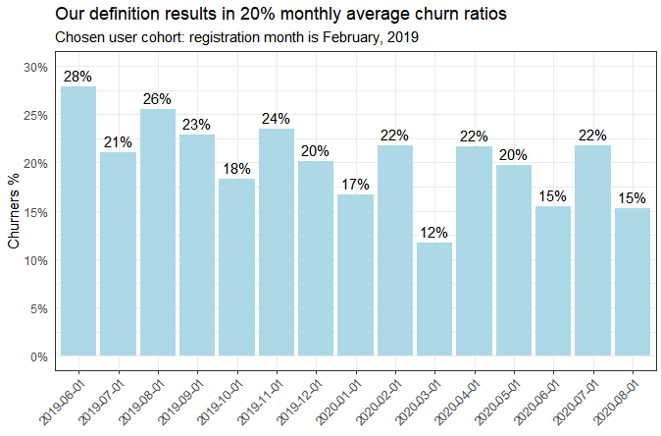
Concurrently registered users’ monthly activities show stability

Slide 6
Our chosen ML approach
Deep Learning
Trees ensemble
Tried a Random Forest and a Logistic Regression
Higher accuracy achieved with RF
Wanted to focus on interpretability, business usage
Chosen approach: logistic regression
Accuracy
SVM
Decision Tree
Regression
Interpretability

Slide 7
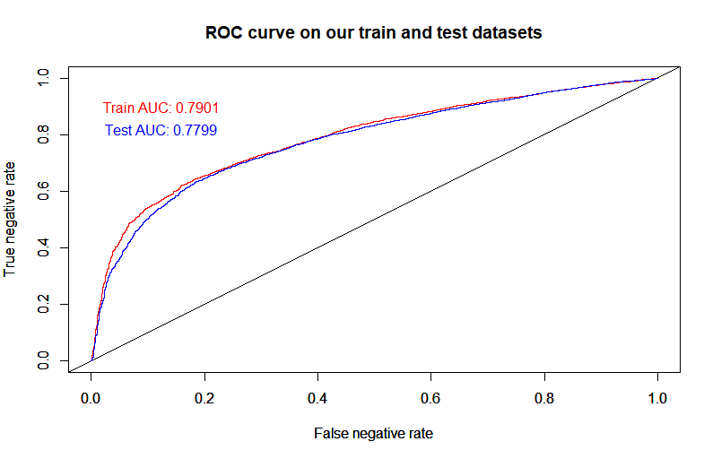
Evaluating our logistic regression model
Train & Test AUCs similar
Prediction accuracy is higher than in usual churn prediction cases
Focus on decreasing false negatives (prediction: stays – actually: churns)

Slide 8
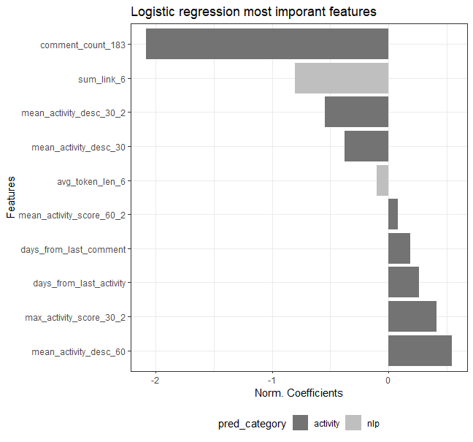
Predictors of our logistic regression model
Visualizing top 10 most important predictors (based on normalized betas).
Activivity and nlp based predictors are most relevant.
Activity decreases churn.
Elaborate interactions (e.g. length of comment, references in comment) decrease churn as well.
Other NLP based variables may be important too (e.g. topic activity, comment sentiment etc..).
Notes:
So we want to show which variables from the feature engineering were important.
In the graph you can see the top 10 predictors in the model, which were selected by VarImp function.
We wanted to show the direction of impact on Churn, so we multiplied VarImp value by beta coefficient’s sign.
The comment_count_183 variable reduces the Churn mostly and on the other hand days_from_last_activity the mean increasing variable.
For the modeling we used predictors that decribe users activity and predictors from comment analysis.
We want to create more NLP based variables (like Sentiment analysis and topic modelling on the comments), but unfortunately we didn’t have enought resources to made it on the 2,5 years data
(which means around 3 million comments)

Slide 9
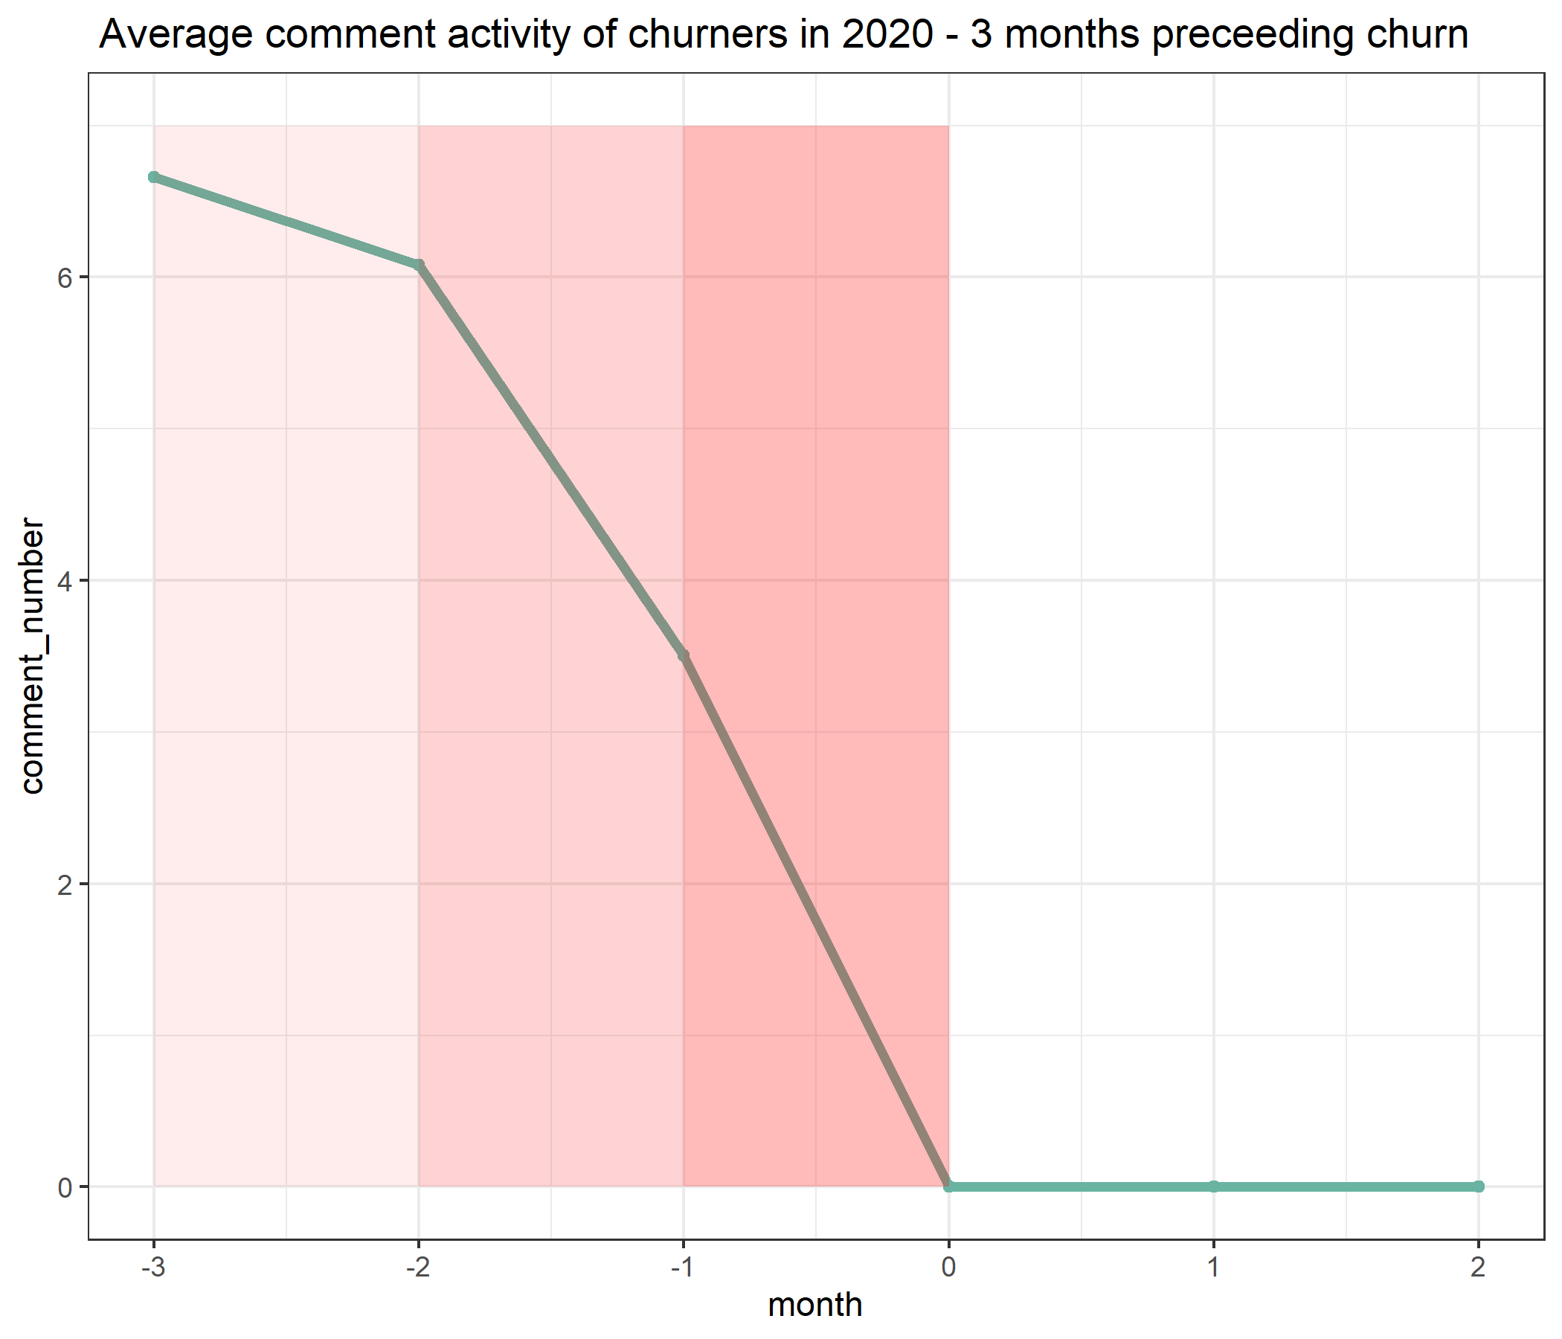
Churn prevention
Business goal: prevent users from churning
Churners show a decreasing trend in their number of interactions (e.g. comments)
Suspect churn if there is a decrease in trend
Detect churn if interaction decreases through two months
Prevent churn after detection
Potential churn treatment:
Personalized newsletter
Gamification
Suspect
Detect
Prevent

