Slide 1
“Revealing the content”
Why R? 2020 Hackathon
Gauss Team

Slide 2
Task
Based on the data of articles content find out what are the key topics described in articles

Slide 3
Topic modeling exploration
We have slightly cleaned the data (import data issues).
We have used model called Top2Vec which is based on:
Doc2Vec,
UMAP,
HDBSCAN.
We have received 73 topics and reduced them to 20.

Slide 4
Identified topics
People and ideas (0)
Compilers (1)
US Politics and administration (2)
Literature, culture, philosophy (3)
Wordpress (4)
Weird letters (5)
Github repositories (6)
Deployments and databases (7)
Linux (8)
JavaScript (9)
People words (10)
Software (11)
Renewable energy (12)
Machine Learning (13)
Weird words (14)
Hardware (15)
Medicine (16)
Texts with codes (17)
Government committees (18)
Programming words (19)
Keywords connected to the topics can be found in the repository with solution. (*) means topic number

Slide 5
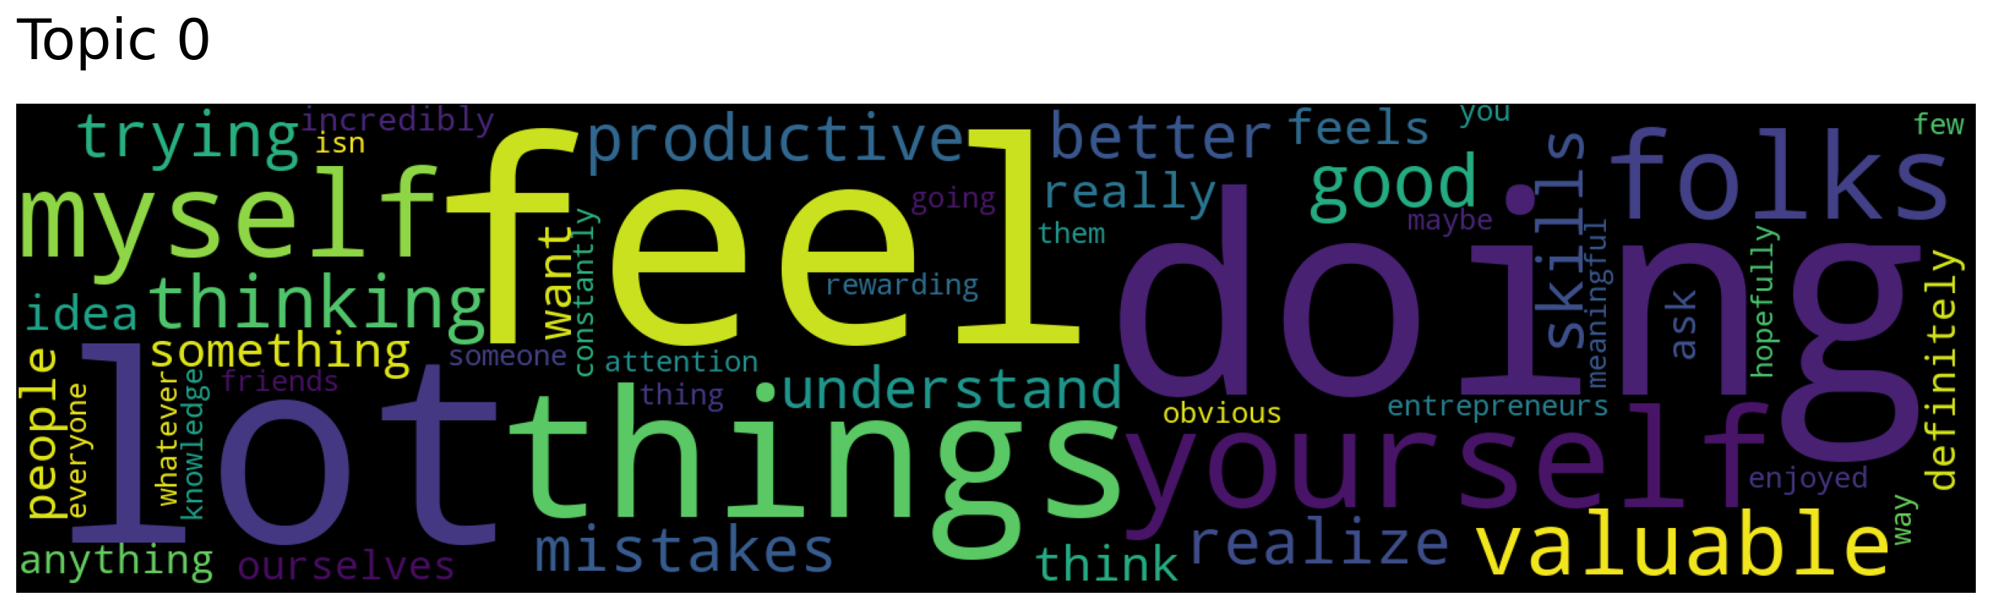
People and ideas
Key words:
feel, doing, yourself, things, myself
Number of articles:
538

Slide 6
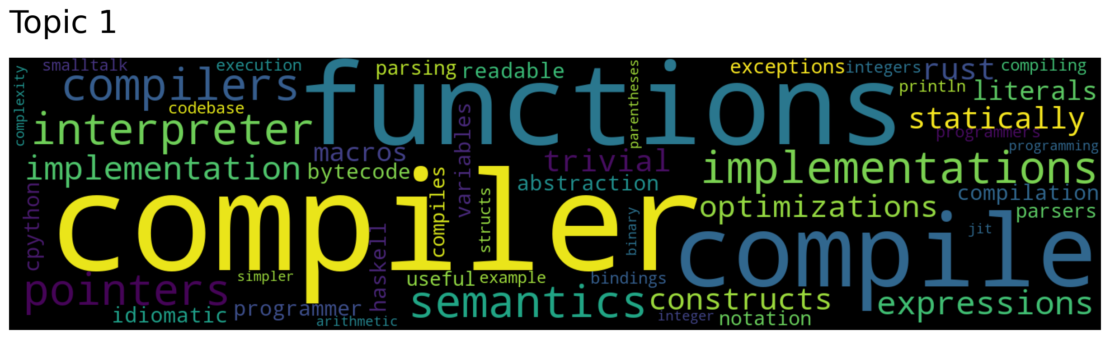
Compilers
Key words:
Compiler, function, exception, parsing, expressions, pointers
Number of articles:
472

Slide 7
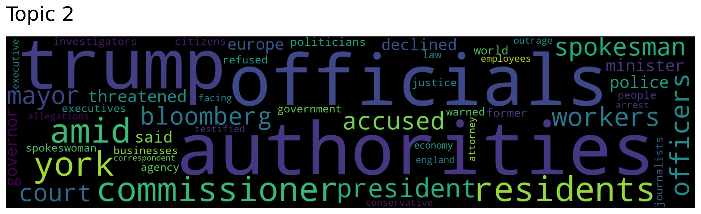
US Politics and administration
Key words:
Trump, officials, authorities, bloomberg, president, minister
Number of articles:
455

Slide 8
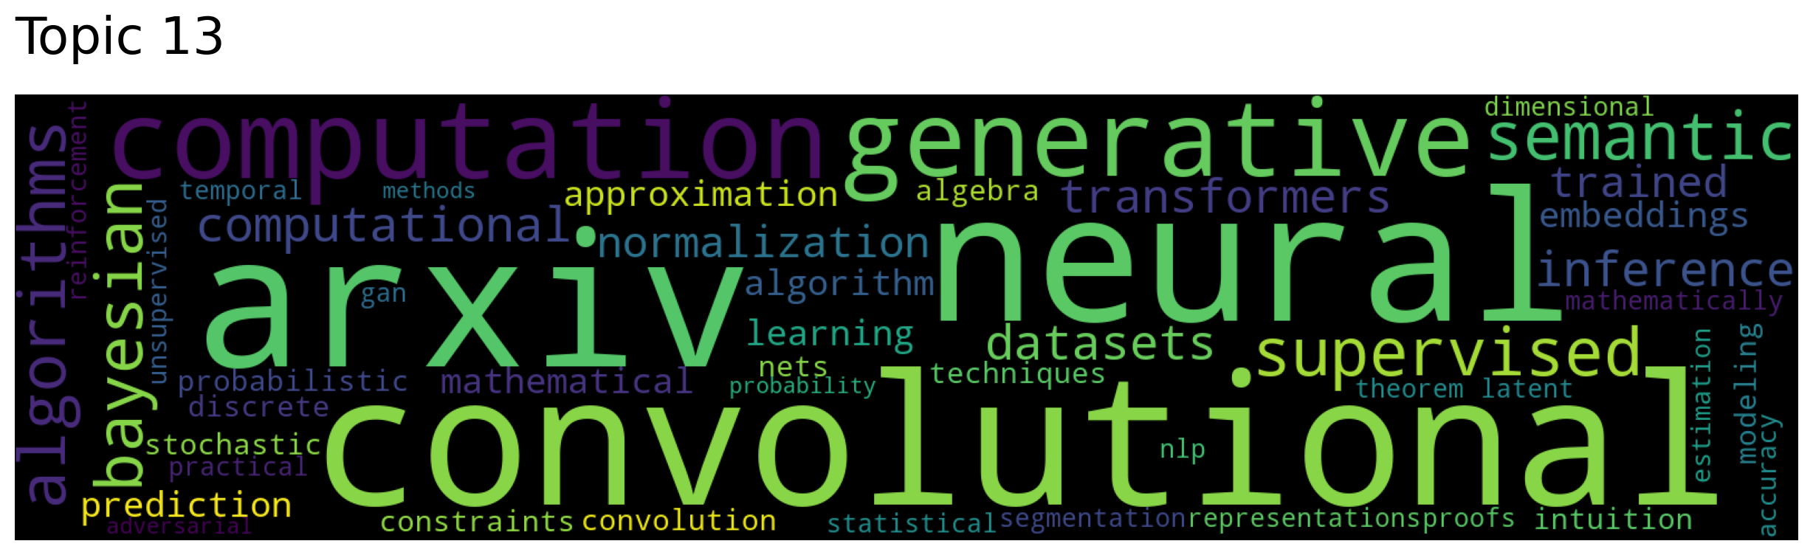
Machine Learning
Key words:
neural, convolutional, supervised, datasets, bayesian, arxiv
Number of articles:
232

Slide 9
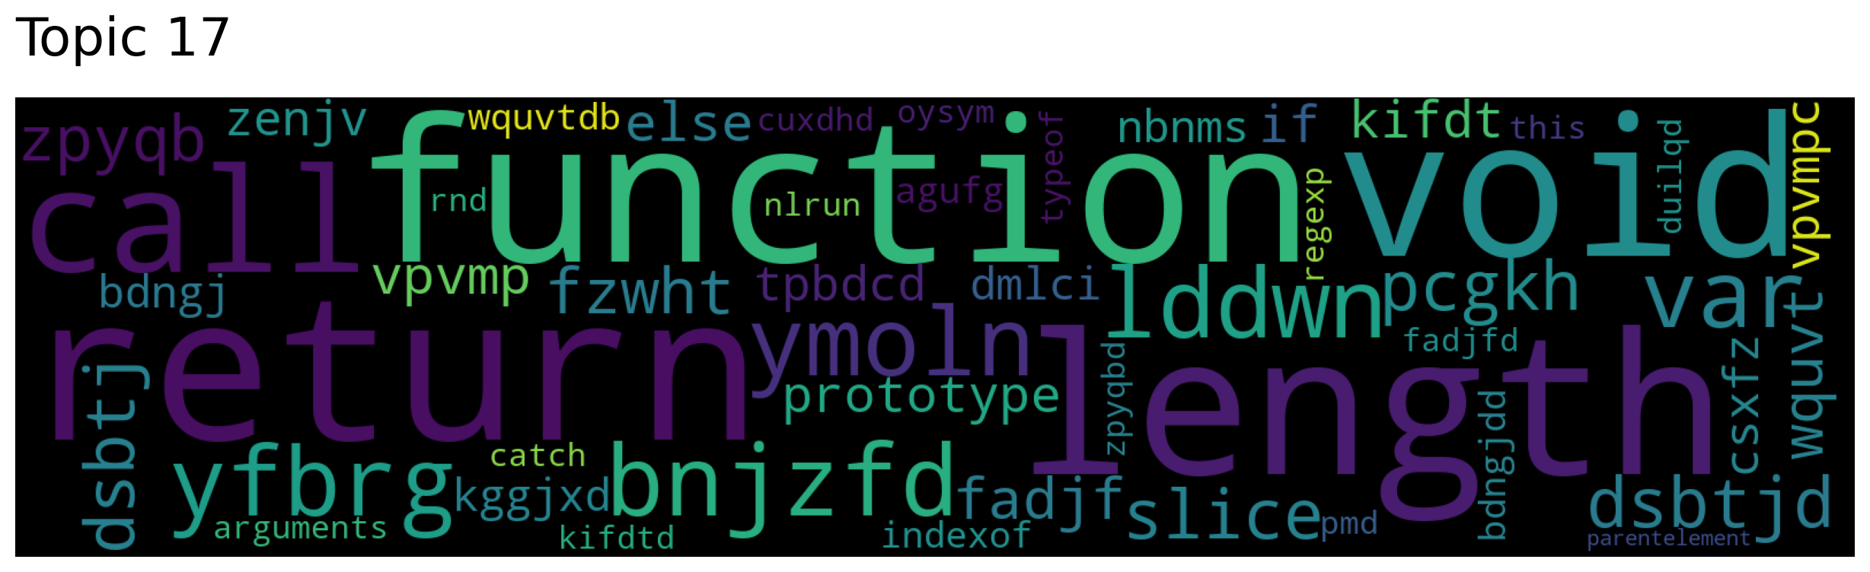
Texts with codes
Key words:
length, return, void, function, call, typeof, slice, else, this, if
Number of articles:
184

Slide 10
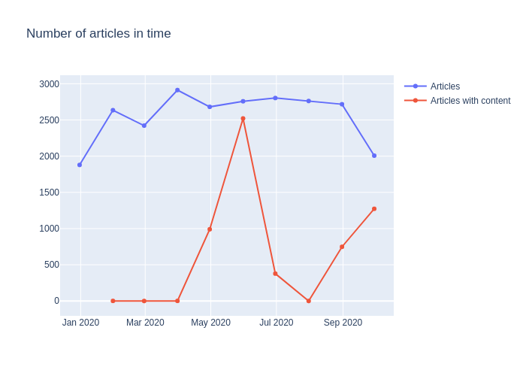
Number of articles in time
Analysis of articles in time
All
With content
Conclusions:
There is approximately constant number of articles in time
We had access to articles with content mostly from May to June
We skipped analysis of topics in time due to unreliable data and go further with analysis of topics as a whole

Slide 11
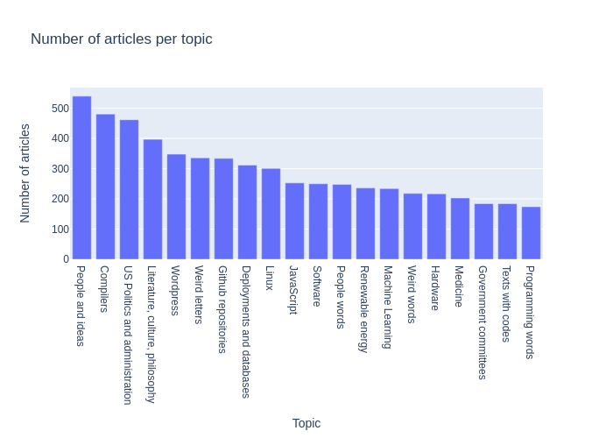
Number of articles per topic
Conclusions:
The most popular topic was “People and ideas”.
The least popular topic was “Programming words”.
There is no surprise in the first place because Hacker News is general about people who share their thoughts.
Topics are not highly skew distributed, which means that our model did good job and not classified big part of articles to one group.

Slide 12
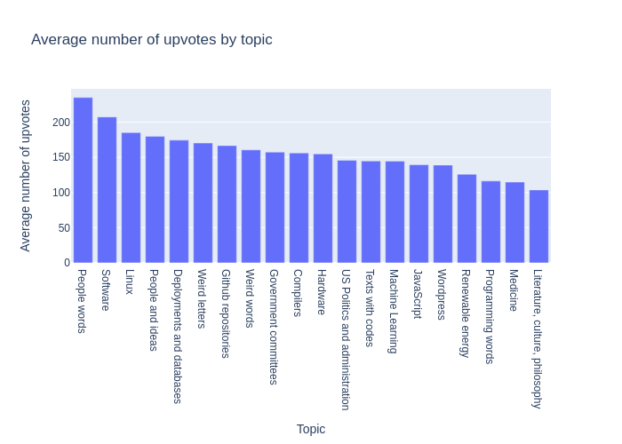
Average number of upvotes
Conclusions:
The most upvoting topic is “People words” (10) and “Software” (11).
The least upvoting topic is “Literature, culture, philosophy” (3) and “Medicine” (16).
What is interesting here that the least upvoting topic is “Literature, culture, philosophy” was 4th most popular writing topic.

Slide 13
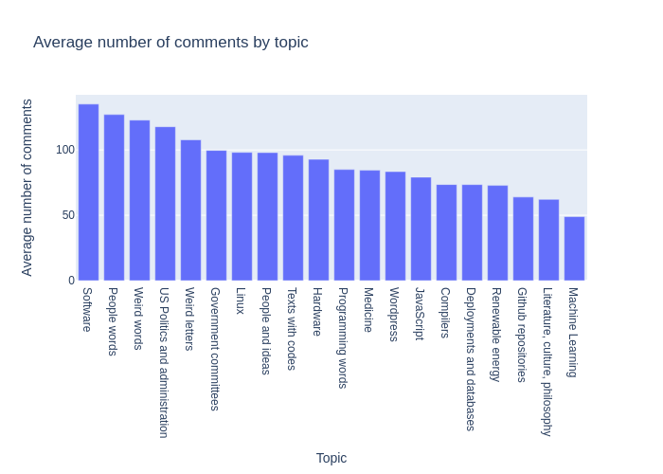
Average number of comments
Conclusions:
The most commented topic is also “Software” (11) and “People words” (10).
The least commented topic is surprisingly “Machine Learning” (13) and “Literature, culture, philosophy” (3)
The interesting fact here is that “Machine Learning” is commonly known to be a hot topic and we cannot see that in the data.

Slide 14
Wide horizons of writers
Number of people who write in one topic:
2619
Top 3 most popular single topic:
People and ideas
Github repositories
Deployments and databases
Number of people who write in two or more topics:
610
Top 3 most popular 2-topic combination:
Compilers and People and ideas
Literature, culture, philosophy and US Politics and administration
People and ideas and Wordpress
Conclusions:
Most of the people write only in one category.
Surprisingly we have here “Github repositories” and “Deployments and databases” which was quite low in previous rankings of popularity ...
… moreover the most popular combination of topics are two most popular topics in general.
It may be useful to engage them to write also in other categories.

Slide 15
Recommendations
We have built simple recommendation model for people who write only in one category.
Methodology:
Recommend category which is popular for people who write in my category and another one
Conclusions:
Mostly recommended category is “US Politics and administration” and “People and ideas”
There are some intuitional recommendations such as:
Hardware -> Compilers (Close connection)
Github repositories -> People and ideas (Idea of sharing knowledge)
My category -> Recommended category
Compilers -> People and ideas
Deployments and databases -> People and ideas
Github repositories -> People and ideas
Government committees -> Wordpress
Hardware -> Compilers
JavaScript -> Wordpress
Linux -> Wordpress
Literature, culture, philosophy -> US Politics and administration
Machine Learning -> People and ideas
Medicine -> Literature, culture, philosophy
People and ideas -> Compilers
People words -> People and ideas
Programming words -> US Politics and administration
Renewable energy -> US Politics and administration
Software -> US Politics and administration
Texts with codes -> US Politics and administration
US Politics and administration -> Literature, culture, philosophy
Weird letters -> US Politics and administration
Weird words -> US Politics and administration
Wordpress -> People and ideas

Slide 16
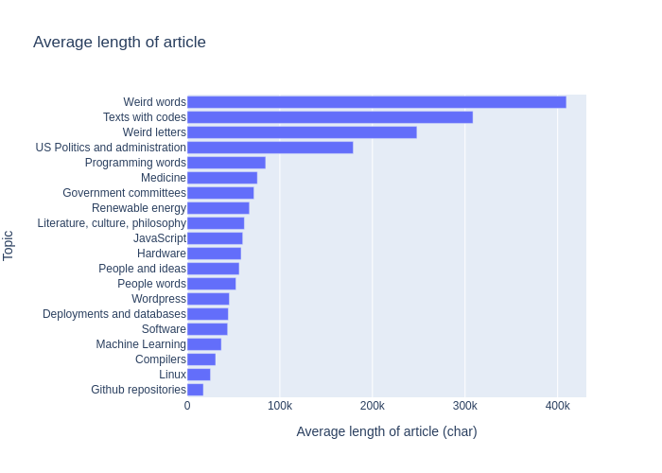
Average length of article
Conclusions:
The most popular category is “Weird words”, “Texts with codes” and “Weird letters”.
After investigation it turned out that these “articles” are in reality raw websites which contains a lot of code.
Average article length may be a quite good outlier detector or quality checker.

Slide 17
Data had different quality…
… but even though we have created model which gave us results …
… which turned out to be meaningful …
… and was a very good base for further analysis …
… during which we get insight of Hacker News user preferences ...

Slide 18
Github repository: https://github.com/kornelro/whyr_hack

