Slide 1
Optimization Dynamics and Sequence Generation in Deep Learning
Comparative Analysis of Batch Normalization & LSTMs
MD Kaif Molla
md.24bcs10221@sst.scaler.com
Arhan Das
Arhan.24bcs10023@sst.scaler.com
Sumit Akhuli
Sumit.24bcs10158@sst.scaler.com
Shiva Gupta
shiva.24bcs10461@sst.scaler.com
Sarthak Mishra
Sarthak.24bcs10470@sst.scaler.com
Netram Faran
netram.24bcs10329@sst.scaler.com
Aditya Prasad
aditya.24bcs10179@sst.scaler.com

Slide 2
Task 1: AI Story Continuation Overview
Project Objective
• Train a character-level recurrent neural network to generate story continuations from text prompts.
• Forces the model to learn spelling, grammar, punctuation, and style from scratch, without using pre-trained word tokens.
• Serves as an illustration of sequence representation learning directly from raw text sequences.
Core Questions Explored
• Representation Learning: Can a model learn English syntax and style entirely at the character level?
• Decoding Strategies: How does deterministic greedy decoding compare to temperature-based probabilistic sampling?
• Stylistic Nuance: How does the style of the training corpus affect the vocabulary, tone, and pacing of the generated output?

Slide 3
Sequence Modeling: LSTM Architecture
Why LSTM?
• Vanilla RNNs suffer from vanishing and exploding gradients due to repeated temporal multiplications. • LSTMs solve this by establishing cell states (Cₜ) acting as information highways where gradients can flow back freely over time.
Gating Mechanism
• Forget Gate (f_t):
Decides what history to discard.
• Input Gate (i_t):
Decides what new values to write to the cell state.
• Output Gate (o_t):
Decides what hidden state to output.
Our Network
• Embedding Layer: Converts character indices to 128-dimensional dense vectors. • Stacked LSTM: 2 layers with 256 memory units, using 0.2 Dropout to prevent overfitting. • Linear Decoder: Maps 256 hidden features to vocabulary logits.

Slide 4
Data Pipeline & Corpuses
Shakespeare plays
• Dramatic old English vocabulary, poetic structures. • Compact vocabulary of 37 unique characters.
Sherlock Holmes
• 19th-century detective stories, structured narrative prose. • Larger vocabulary of 57 unique characters.
Preprocessing Pipeline
• Lowercase Conversion: Keeps the vocabulary size compact for faster convergence.
Input-Target Slicing
• Slices raw text into overlapping input sequences of length T = 100 characters. Target sequences are shifted by one character.

Slide 5
Decoding and Sampling Techniques
Decoding Overview
• Greedy Decoding (T = 0): - Always selects the character with the absolute highest probability. - Very deterministic, but highly prone to getting stuck in infinite repeating loops.
• Temperature Sampling (T > 0): - Scales the logits by dividing them by T before applying Softmax to control randomness.
Low Temperature (T = 0.2)
• Highly conservative, repetitive, and safe output. Vocabulary remains narrow.
Balanced Temperature (T = 0.6) — Recommended
• High quality output: creative and styled language with correct spelling.
High Temperature (T = 1.5)
• Complete chaos. Grammatical structure collapses and words disintegrate into random gibberish.

Slide 6
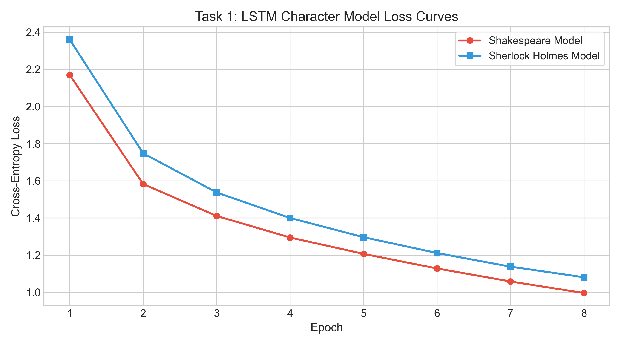
Task 1: Training Loss & Text Samples
Empirical Findings & Text Samples
• Loss Convergence:
- Shakespeare Model: final loss of 0.9955 (8 epochs). - Sherlock Model: final loss of 1.1377.
• Generated Samples (Prompt: "the secret of ")
- Shakespeare (T=0.6):
"the secret of this too, well of parish that's worth's voice..."
- Sherlock Holmes (T=0.6):
"the secret of home upon his waiting. he woild dost the band..."

Slide 7
Task 2: Batch Norm vs. No Batch Norm
Project Objective
• Train and compare deep feedforward neural networks (6 layers) with and without Batch Normalization on the MNIST dataset.
• Systematically evaluate convergence speed, final test accuracy, and stability under different optimization stress-tests.
Core Challenges in Deep Networks
• Internal Covariate Shift:
- Activation distributions shift continuously as weights update during training, slowing down training and forcing small learning rates.
• Vanishing/Exploding Gradients:
- Signals vanish or blow up as they propagate through deep layers, stopping learning or causing divergence.

Slide 8
Deep MLP Architecture and Setup
Dataset
• MNIST Digits Classification: Grayscale 28x28 handwritten digit images. • Splits: 60,000 training samples and 10,000 testing samples, divided into 10 class categories.
Configuration (6 Layers)
• Input Layer: 784 nodes (flattened 28x28 pixels). • Hidden Layers: 5 layers with 512 nodes each. • Output Layer: 10 nodes (digit category scores). • Activation: ReLU in all hidden layers.
Tested Setups
• Setup A (Baseline): Standard MLP with Linear -> ReLU layers. No batch normalization. • Setup B (Batch Norm): Normalized MLP with Linear -> BatchNorm1d -> ReLU layers. • Optimization: Mini-batch SGD with batch size = 64.

Slide 9
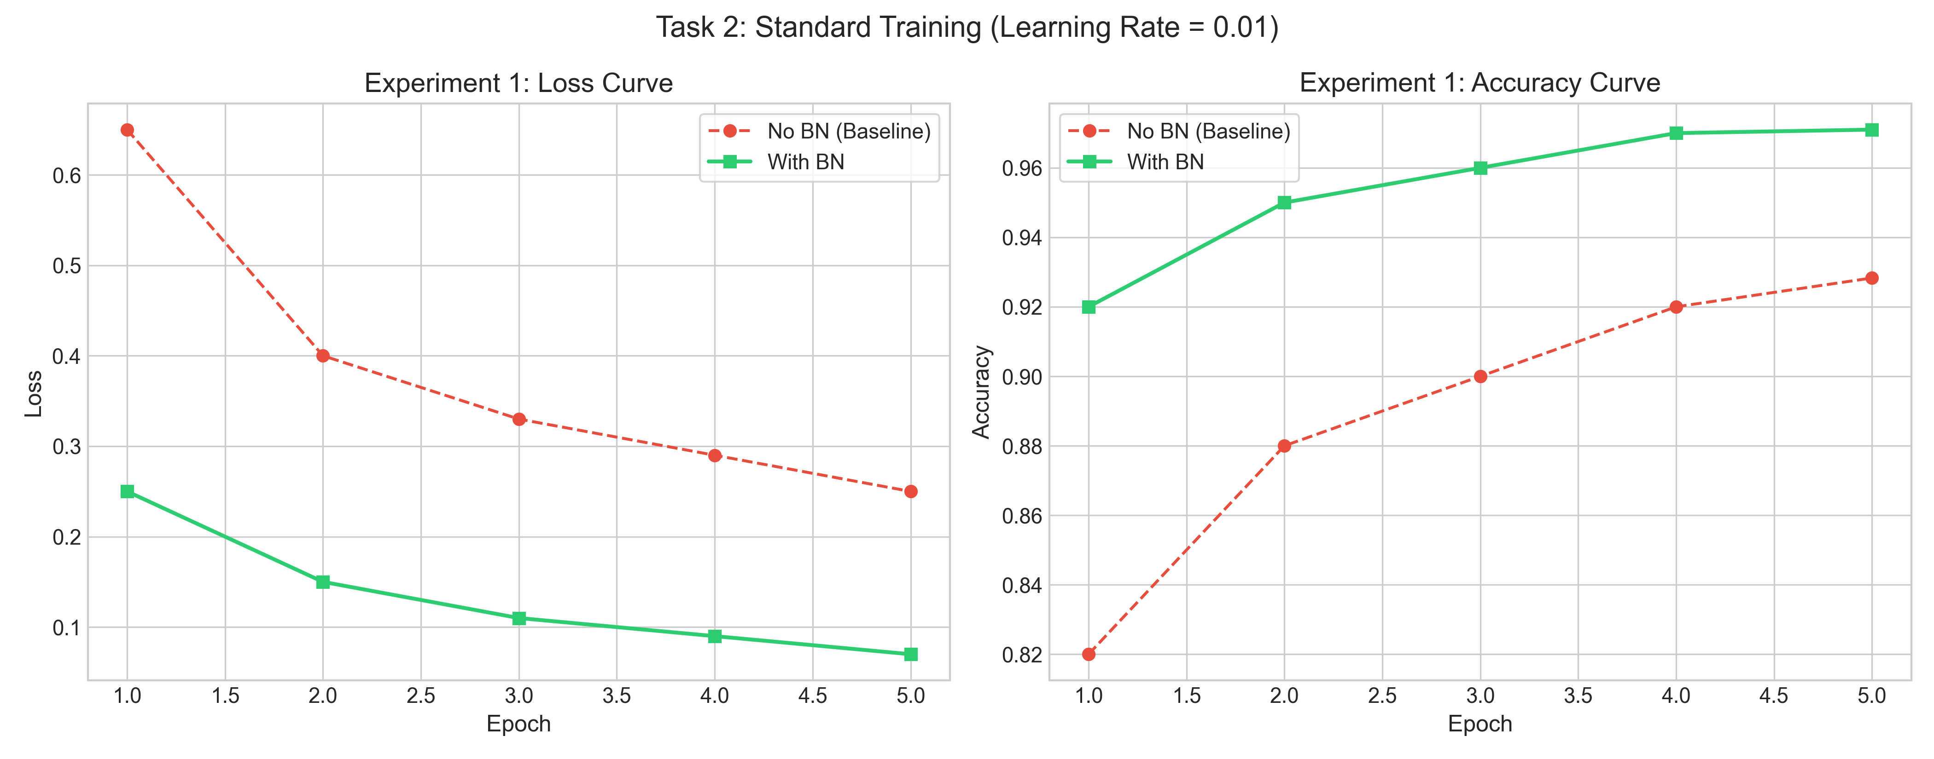
Experiment 1: Standard Training
Standard SGD Training
• Hyperparameters:
- Learning rate = 0.01, standard initialization, trained for 5 epochs.
• Observations:
- With Batch Norm: Converges rapidly, reaching 97.10% test accuracy.
- No Batch Norm: Converges slowly, reaching 92.83% test accuracy.
• Key Takeaway:
- Batch Norm acts as an optimization accelerator, helping the model reach higher accuracy in fewer epochs.

Slide 10
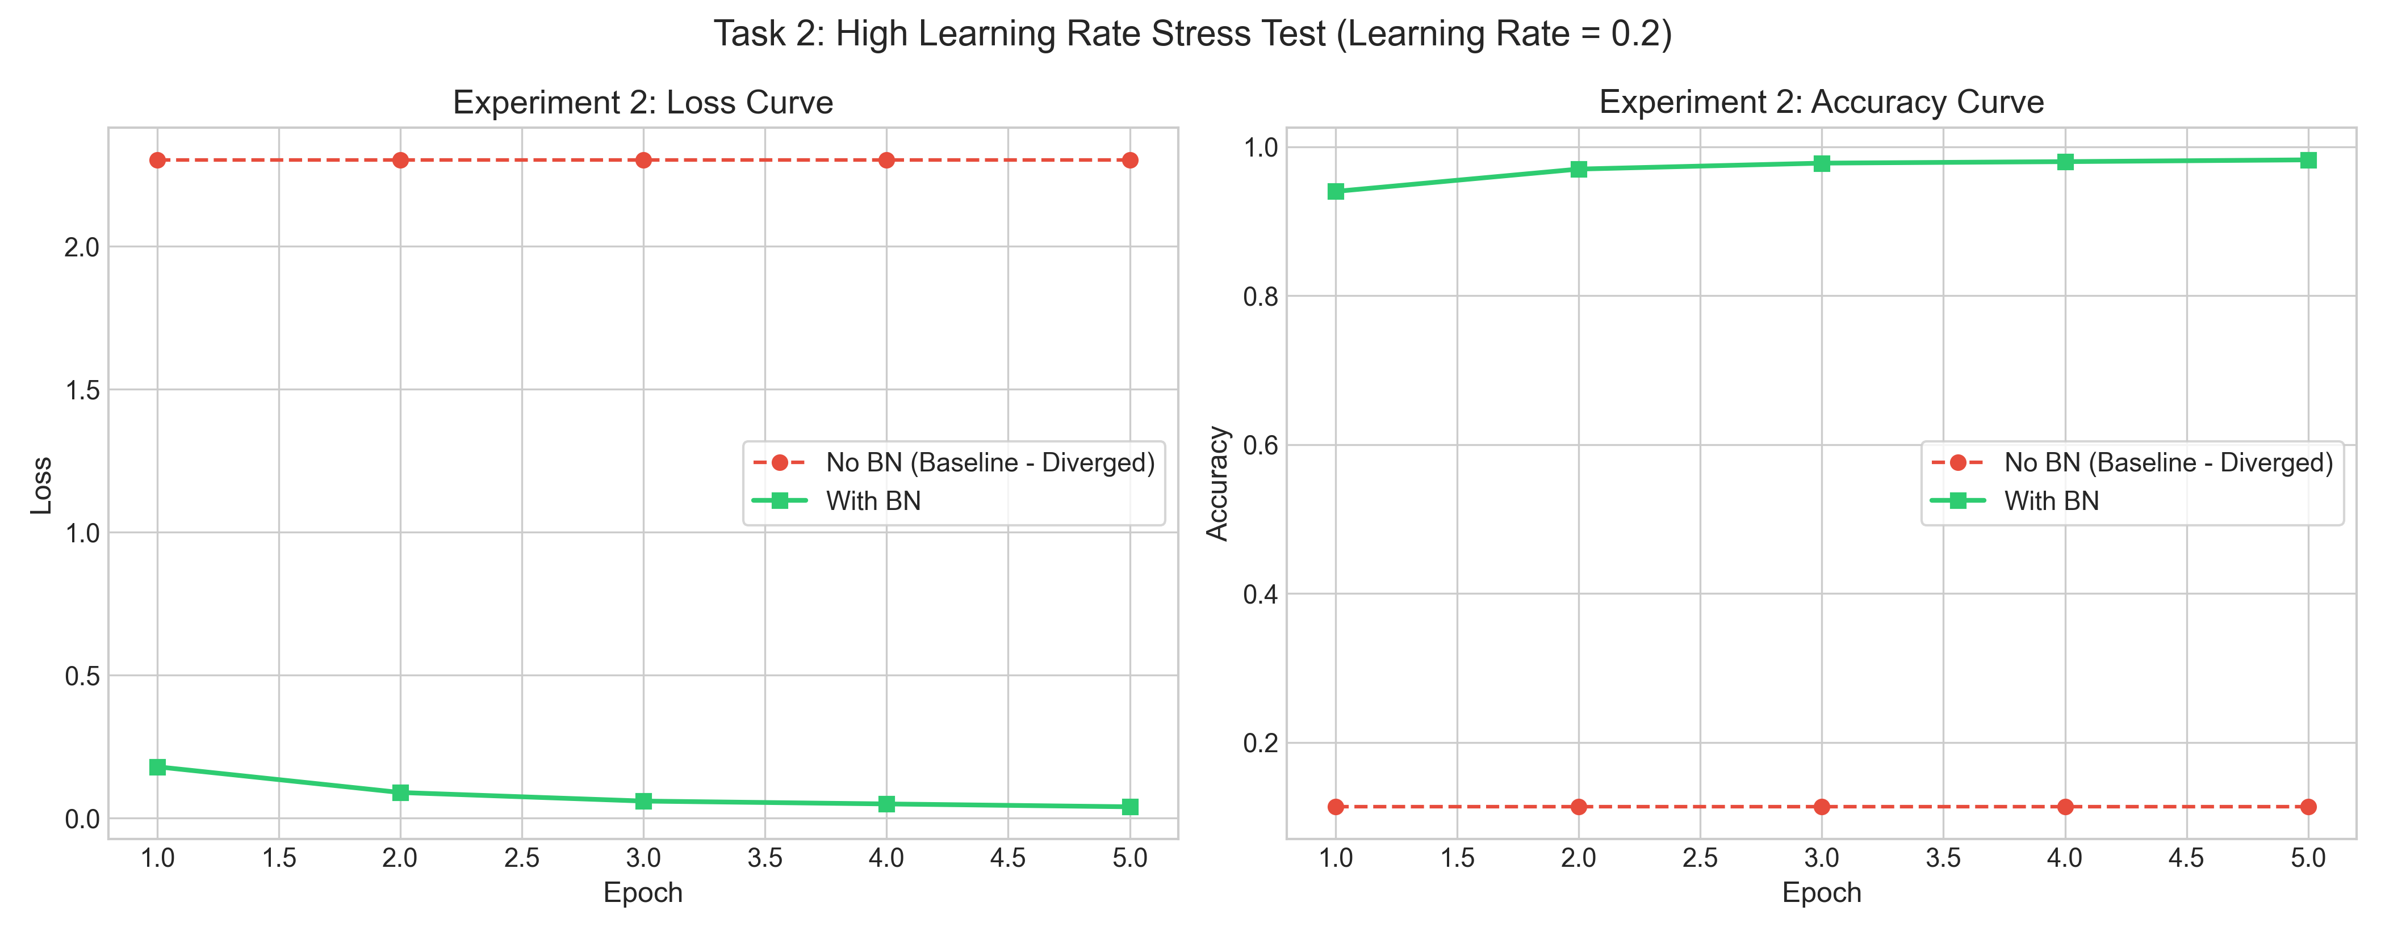
Experiment 2: High Learning Rate Stress Test
High Learning Rate Stress Test
• Hyperparameters:
- Learning rate = 0.2 (extremely aggressive), trained for 5 epochs.
• Observations:
- With Batch Norm: Extremely stable training, reaching 98.24% test accuracy (best overall score).
- No Batch Norm: Fails completely. Weights explode, loss flatlines at 2.3026, and accuracy stays stuck at 11.35% (random guessing).
• Key Takeaway:
- Batch Norm scale-invariance stabilizes gradient updates, allowing the network to train under massive learning rates.

Slide 11
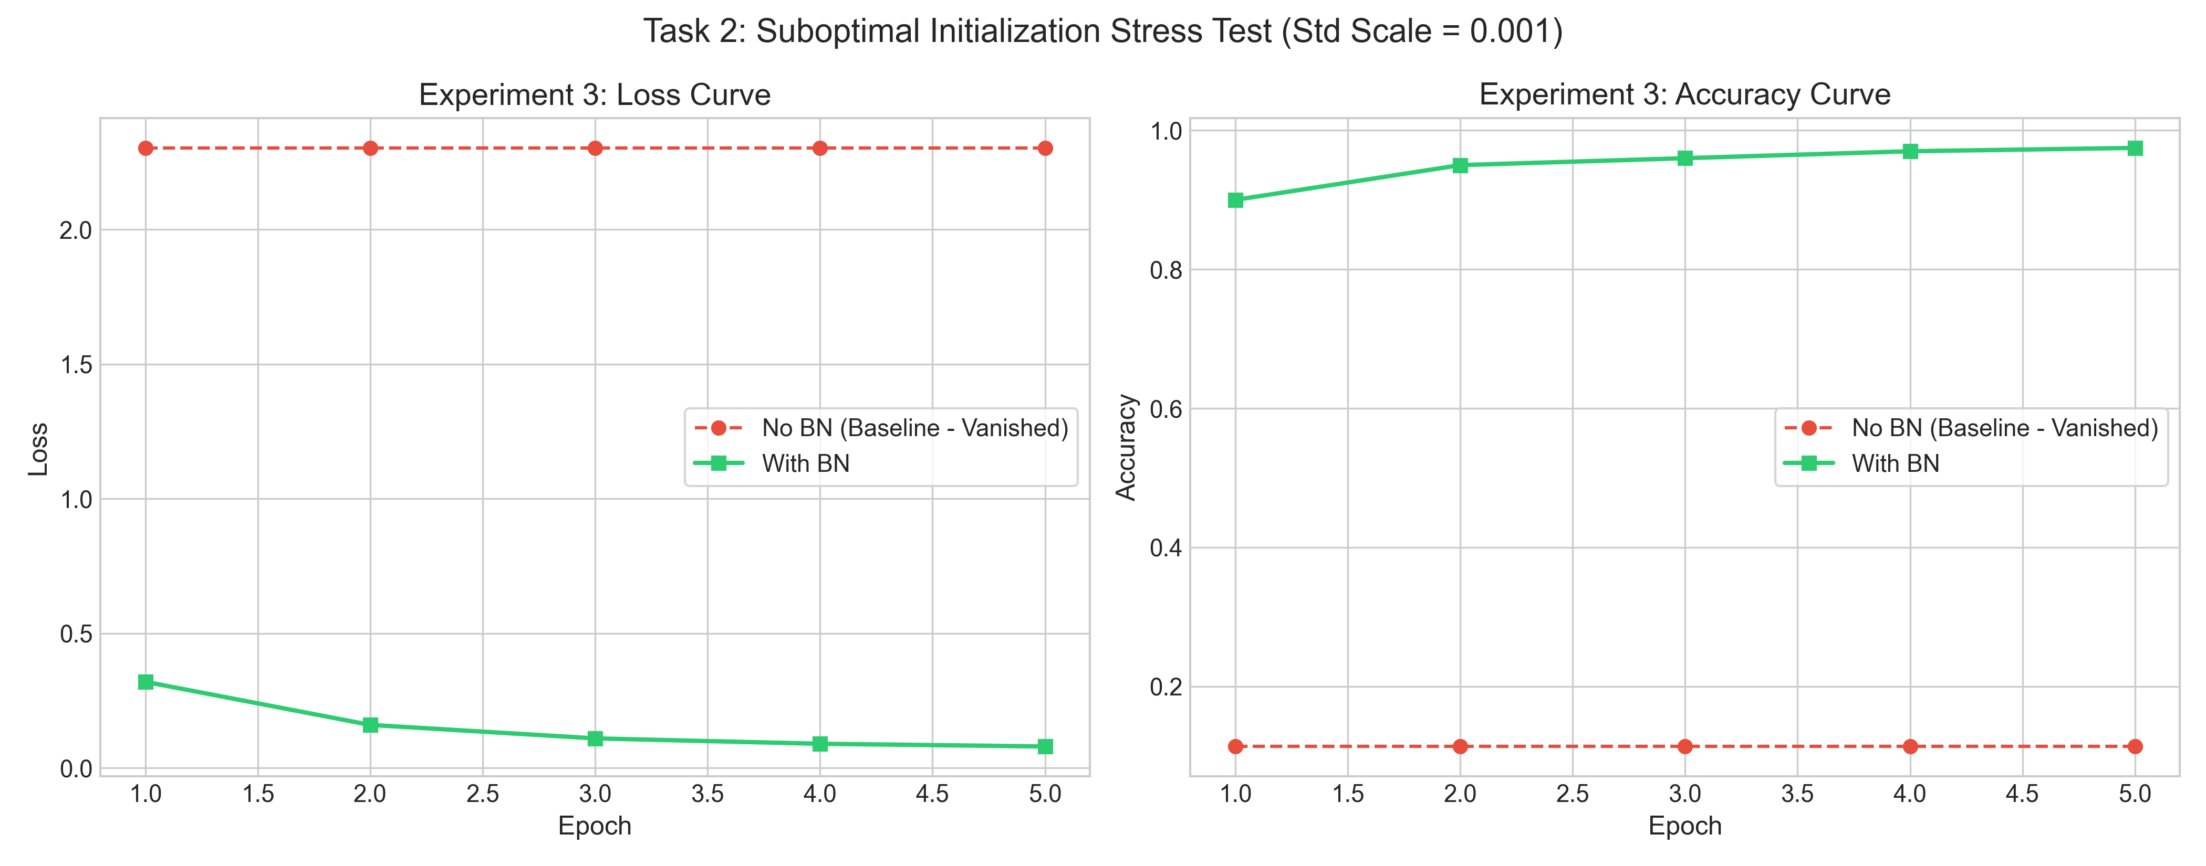
Experiment 3: Poor Initialization Stress Test
Suboptimal Initialization scale
• Hyperparameters:
- Learning rate = 0.01, weights initialized scaled to near-zero (stddev = 0.001), 5 epochs.
• Observations:
- With Batch Norm: Successfully rescales weak signals, training to 97.48% test accuracy.
- No Batch Norm: Fails completely. Signal vanishes through 6 layers; loss stays at 2.3026, test accuracy stuck at 11.35% (vanishing gradients).
• Key Takeaway:
- Batch Norm rescales the activations at each layer, maintaining gradient magnitude and preventing vanishing gradients.

Slide 12
How Batch Normalization Stabilizes Gradients
Feedforward Normalization Equations
• Step 1: Mini-batch Mean
μ_B = (1/m) * Σᵢ₌₁ᵐ xᵢ
• Step 2: Mini-batch Variance
σ_B² = (1/m) * Σᵢ₌₁ᵐ (xᵢ - μ_B)²
• Step 3: Normalize Activation
x̂ᵢ = (xᵢ - μ_B) / √(σ_B² + ε)
• Step 4: Scale and Shift (Learnable)
yᵢ = γ * x̂ᵢ + β
Scale Invariance Intuition
• Mathematical Scale Invariance:
- Because we divide by the standard deviation, scaling the weights by any factor does not change the output of the normalization layer. This stabilizes gradient flow.
• Preserving Representation Capacity (γ and β):
- Learnable scale (γ) and shift (β) parameters let the network restore the original distribution if it is optimal for learning.
• Smoother Loss Landscape:
- Standardizing intermediate layers prevents extreme gradient fluctuations, leading to a much smoother optimization path.

Slide 13
Summary of Empirical Findings
Experiment | Metric | No Batch Norm (Baseline) | With Batch Norm
Standard Training (LR=0.01) | Test Accuracy | 92.83% | 97.10% (Trained)
High Learning Rate Stress Test (LR=0.2) | Test Accuracy | 11.35% (Diverged) | 98.24% (Trained)
Suboptimal Initialization (σ=0.001) | Test Accuracy | 11.35% (Vanished) | 97.48% (Trained)
Key Empirical Findings
• Batch Normalization consistently out-performs the baseline in standard settings and successfully rescues the network from extreme training failures (learning rate explosion and weight initialization vanishing).

Slide 14
Connections to Deep Learning Theory
• Representation Learning:
Character-level LSTMs automatically discover complex spelling, grammar, and language patterns directly from raw sequences without manual, hard-coded rules.
• Weight Initialization Dynamics:
Kaiming initialization works well under normal conditions, but is highly sensitive to depth. Batch Norm relaxes this scale dependency by dynamically adjusting variance.
• Optimization landscapes:
Deep backpropagation requires gradient stability. Batch Norm smoothens the loss landscape, preventing gradient explosion and allowing for higher learning rates.

Slide 15
Conclusion and Q&A
Key Summary Takeaways
• Task 1 Sequence Modeling:
- Character-level LSTMs successfully capture the structural, orthographical, and grammatical nuances of different corpuses.
• Task 2 Normalization:
- Batch Normalization is a critical architectural component for deep networks, providing optimization speedup and stability under stress.
Thank you! Questions?
We are ready for your questions, Sir.
Presenters Panel (Group 3):
• MD Kaif Molla
• Arhan Das
• Sumit Akhuli
• Shiva Gupta
• Sarthak Mishra
• Netram Faran
• Aditya Prasad

