Slide 1
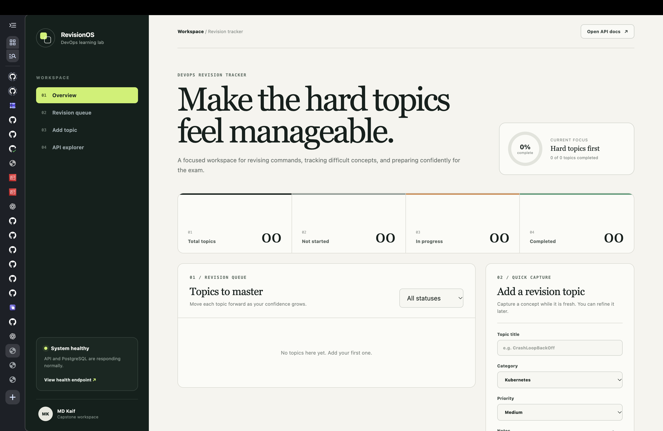
FINAL CAPSTONE PROJECT
DevOps Revision
Tracker
A production-style revision workspace delivered with CI/CD, Terraform, Kubernetes, monitoring, and GitOps.
Presented by
MD Kaif Molla
github.com/WhySeriousKaif/devops-heros
MD Kaif Molla | DevOps Revision Tracker
01

Slide 2
What was built
One repository connects application delivery, cloud infrastructure, operational visibility, and GitOps.
Application
React frontend, FastAPI backend, PostgreSQL, health and metrics endpoints.
Delivery
Pytest, Gitleaks, Trivy, Docker build, GHCR publishing, and deployment verification.
Infrastructure
Terraform provisions VPC networking, an EKS cluster, and managed worker nodes in Mumbai.
Operations
Helm packages the workloads. Prometheus, Grafana, alert rules, and Kubernetes logs provide evidence.
GitOps
Argo CD continuously reconciles the Helm release from the Git repository.
MD Kaif Molla | DevOps Revision Tracker
02

Slide 3
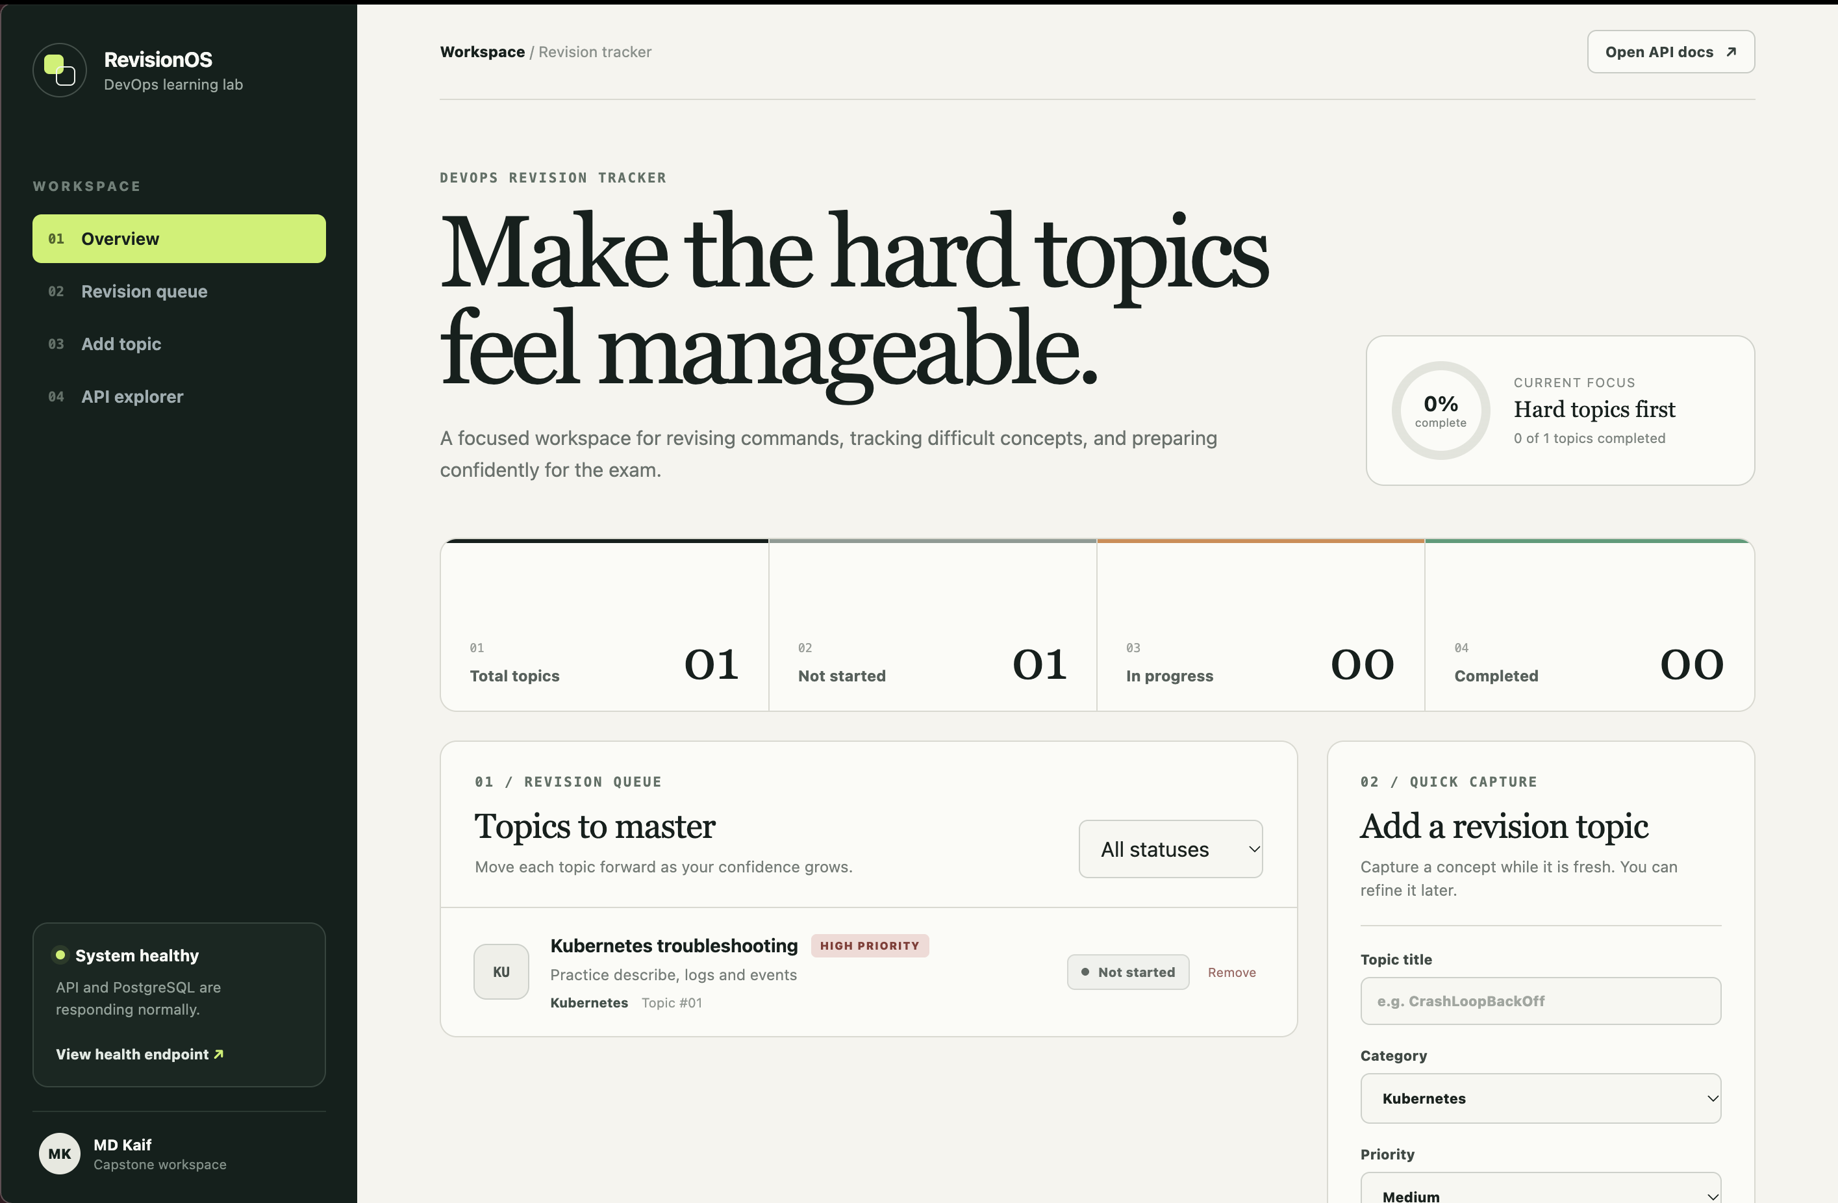
Application experience
RevisionOS is a focused workspace for creating, prioritizing, and tracking revision topics.
Live application dashboard served through the deployed frontend.
MD Kaif Molla | DevOps Revision Tracker
03

Slide 4
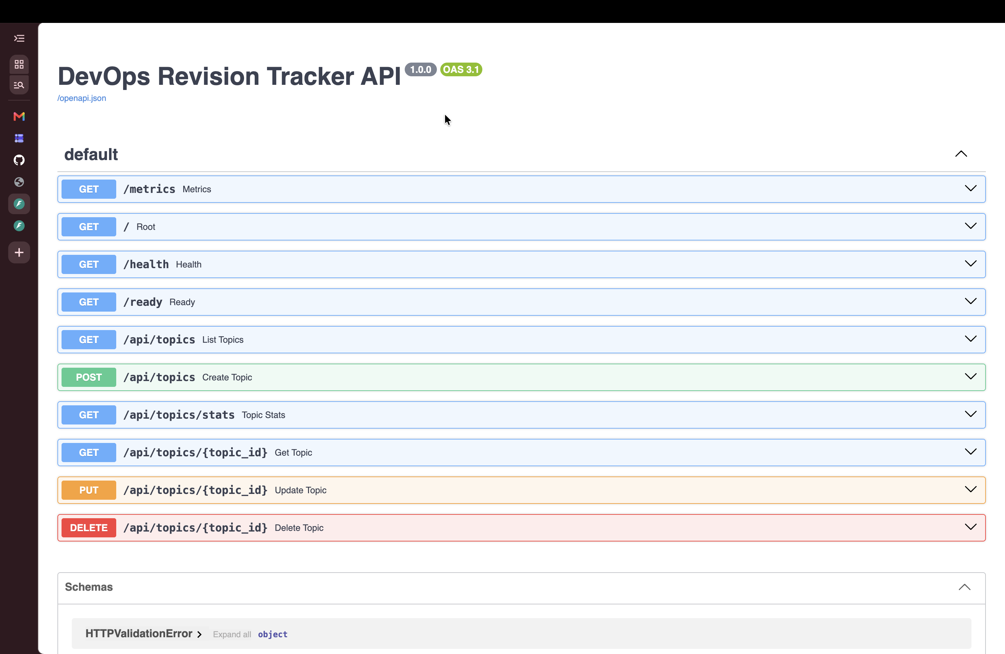
API contract
FastAPI exposes documented CRUD operations together with health, readiness, and metrics endpoints.
The Swagger interface provides a visible contract for every application endpoint.
MD Kaif Molla | DevOps Revision Tracker
04

Slide 5
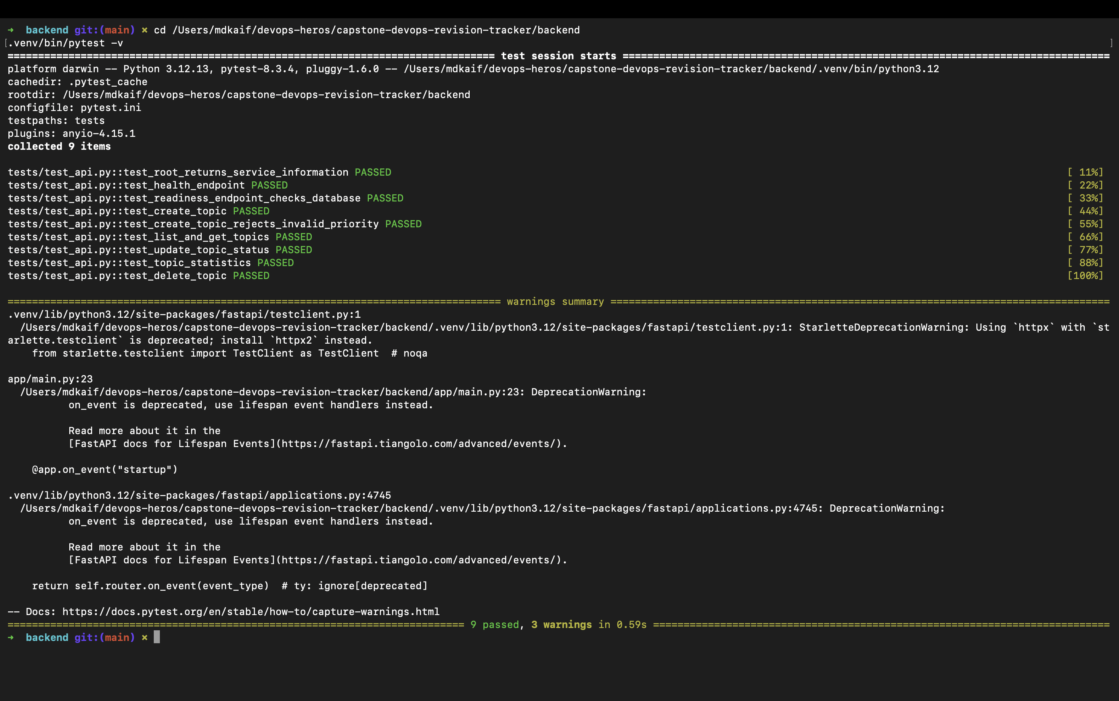
Automated testing
Core API behavior is verified before image creation and deployment.
Nine automated tests passed successfully.
MD Kaif Molla | DevOps Revision Tracker
05

Slide 6
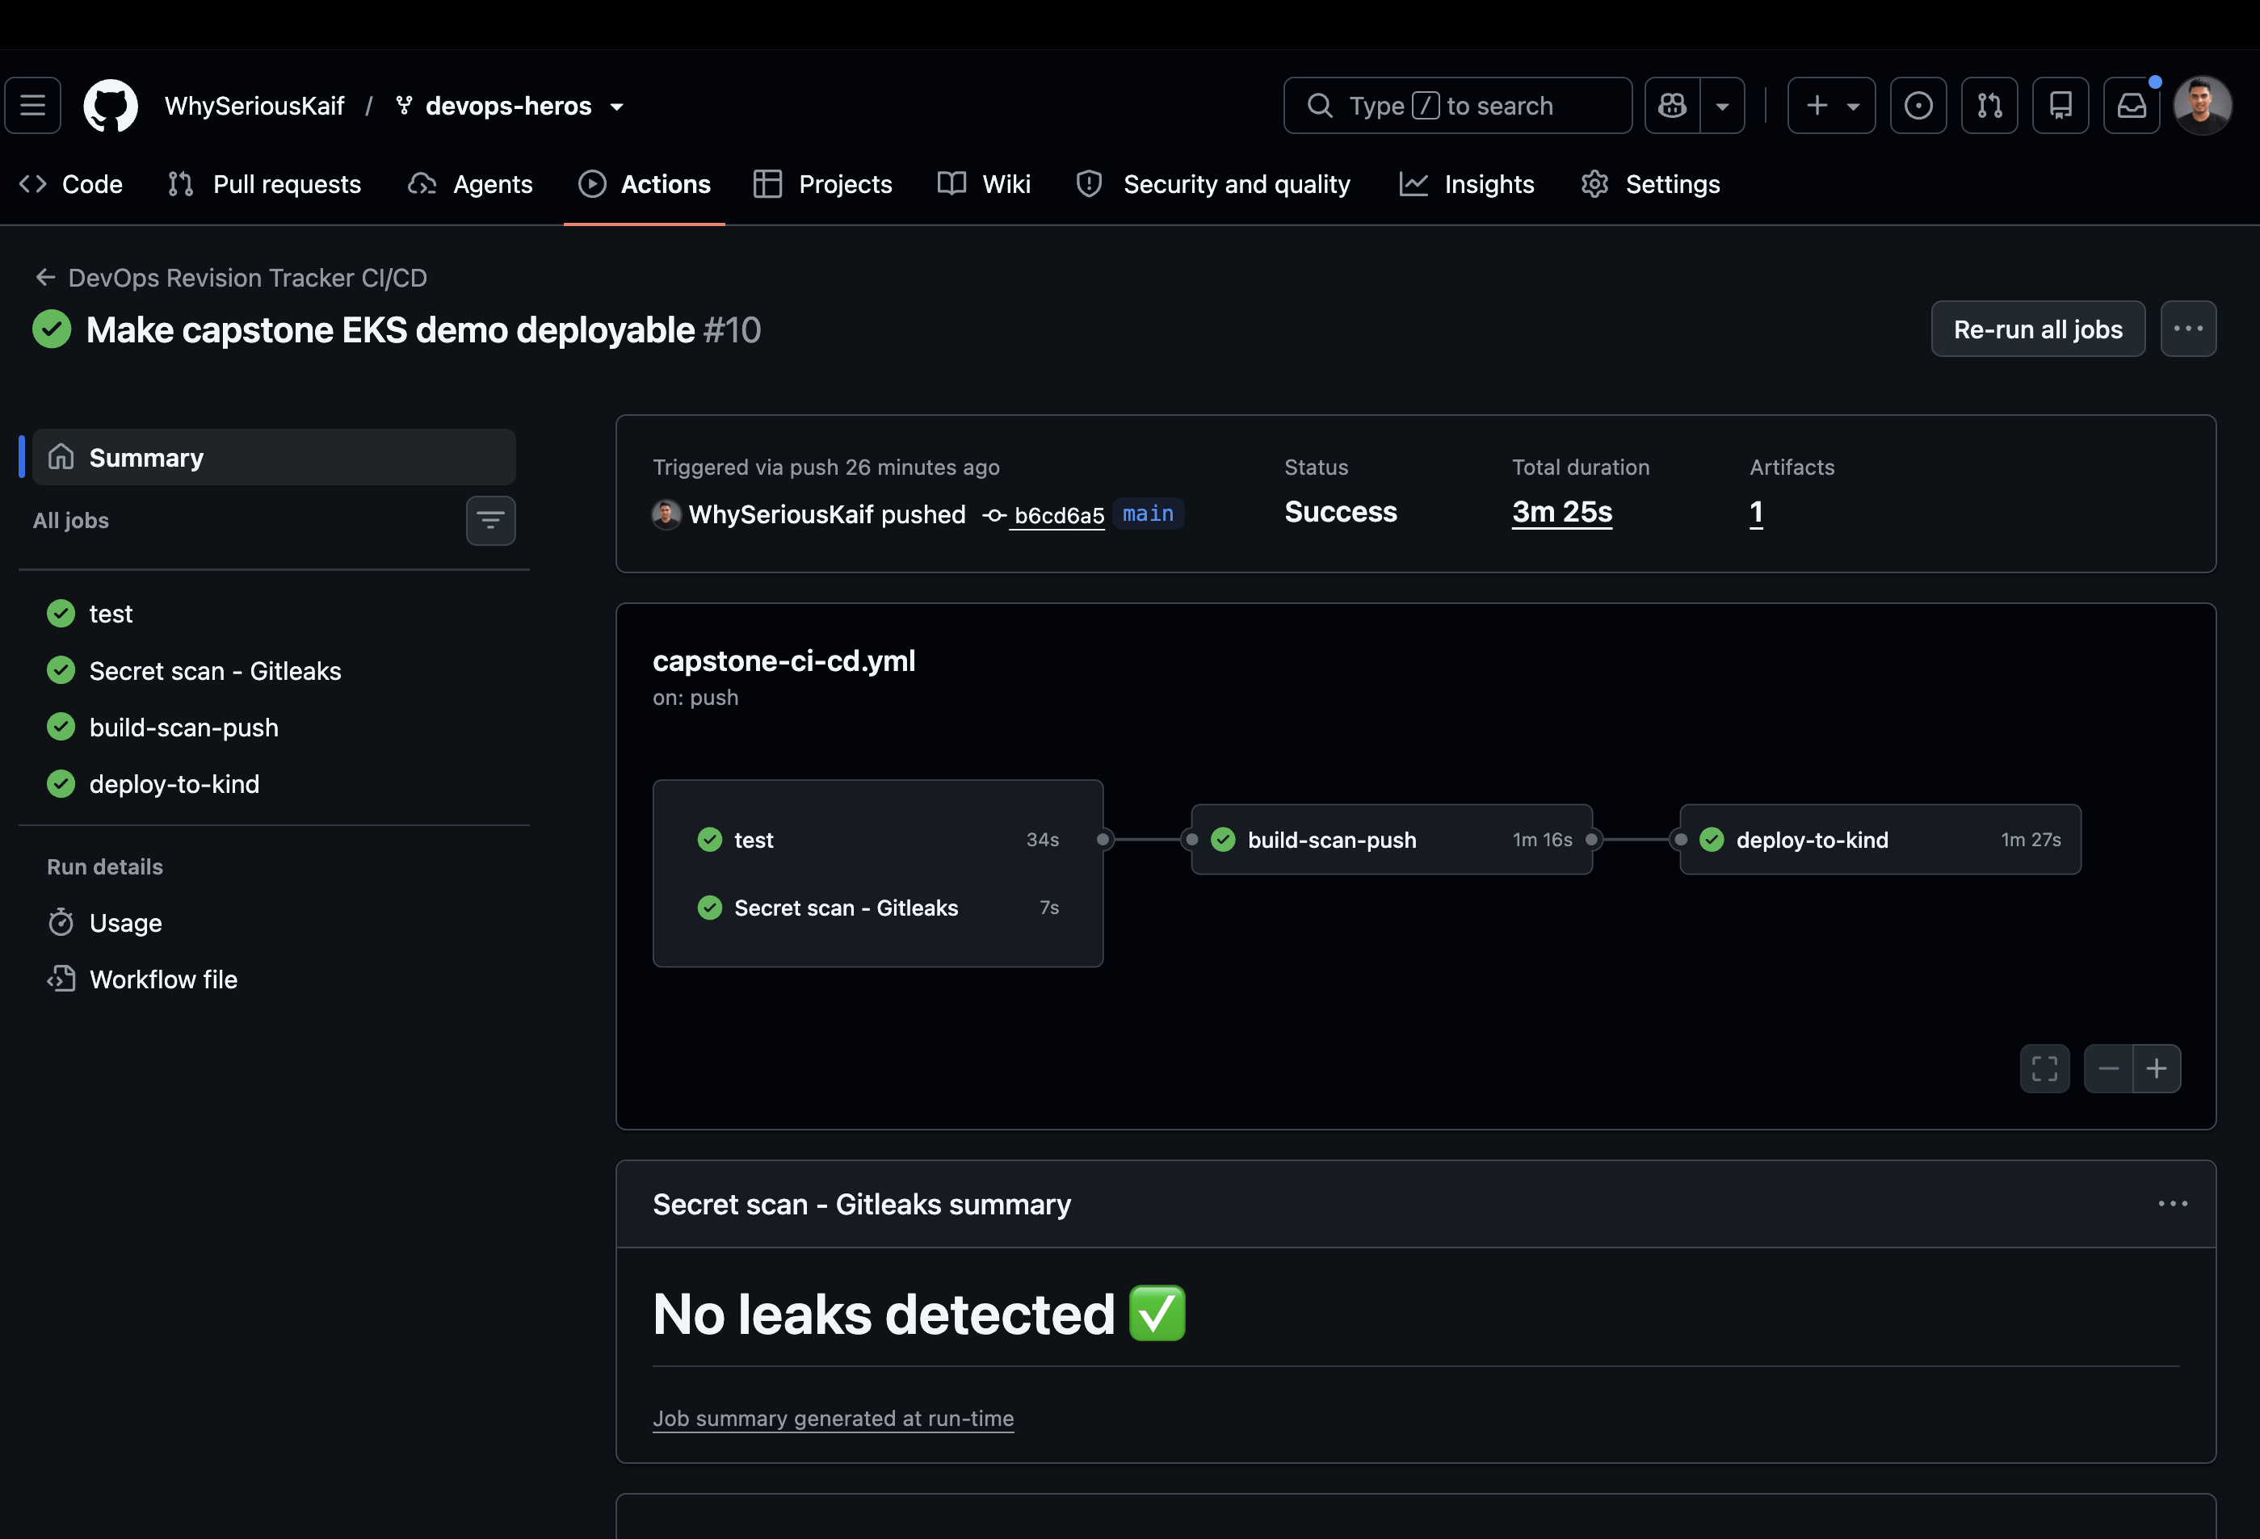
CI/CD delivery pipeline
A GitHub Actions push runs testing, secret scanning, container scanning, publishing, and deployment verification.
The final capstone workflow completed successfully across all jobs.
MD Kaif Molla | DevOps Revision Tracker
06

Slide 7
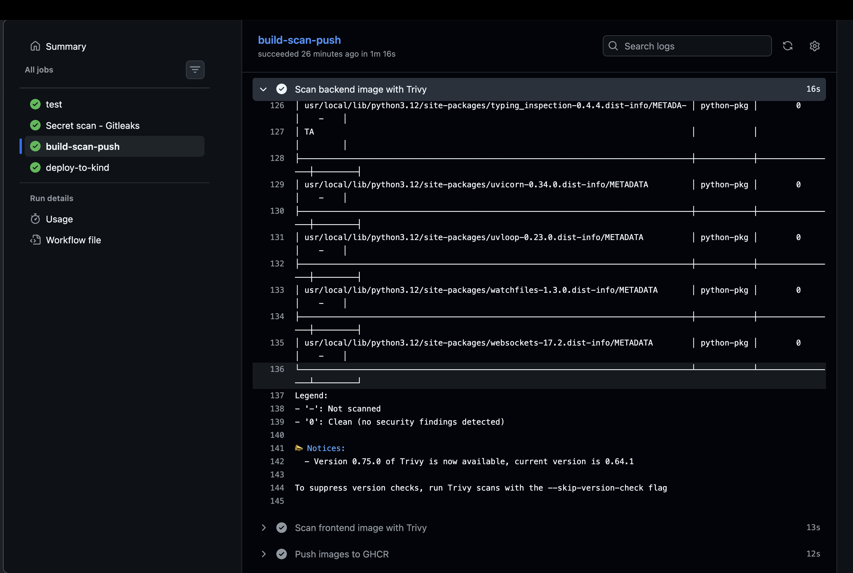
Container security gate
Trivy checks the backend image before it is allowed to move through the delivery pipeline.
Backend image scan reports zero detected vulnerabilities.
MD Kaif Molla | DevOps Revision Tracker
07

Slide 8
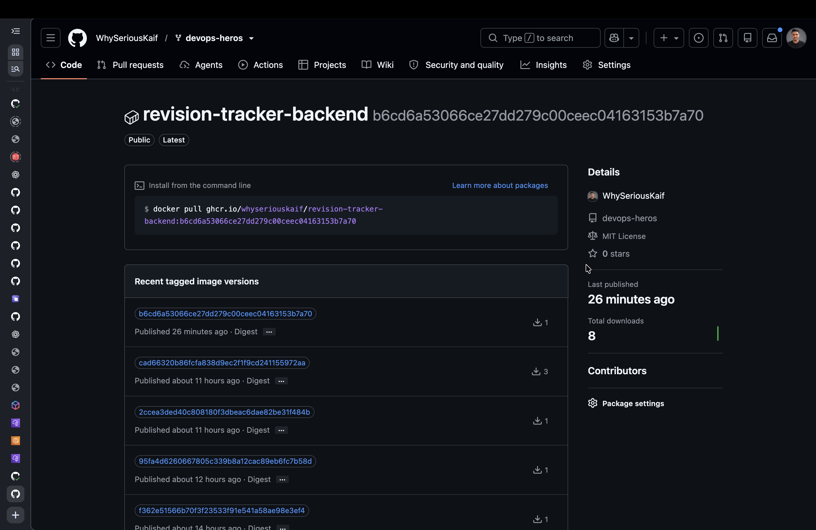
Published container images
Versioned backend and frontend artifacts are stored in GitHub Container Registry for deployment.
The backend image is published with the commit SHA tag used by deployment.
MD Kaif Molla | DevOps Revision Tracker
08

Slide 9
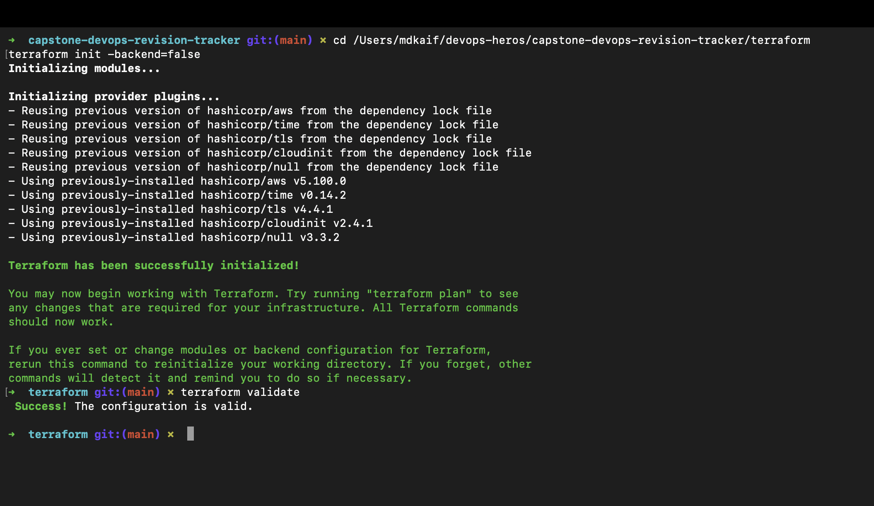
Terraform validation
The infrastructure project defines the AWS provider, variables, VPC, EKS, security, and output values as code.
Terraform initialization and validation completed successfully.
MD Kaif Molla | DevOps Revision Tracker
09

Slide 10
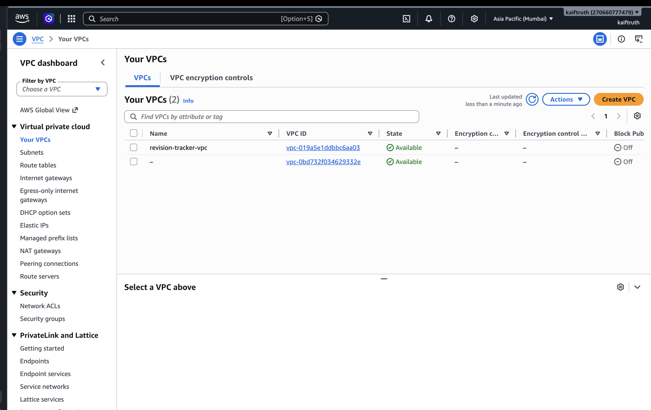
AWS VPC infrastructure
Terraform provisioned a dedicated VPC for the capstone workload in ap-south-1.
The revision-tracker-vpc is available in the AWS Console.
MD Kaif Molla | DevOps Revision Tracker
10

Slide 11
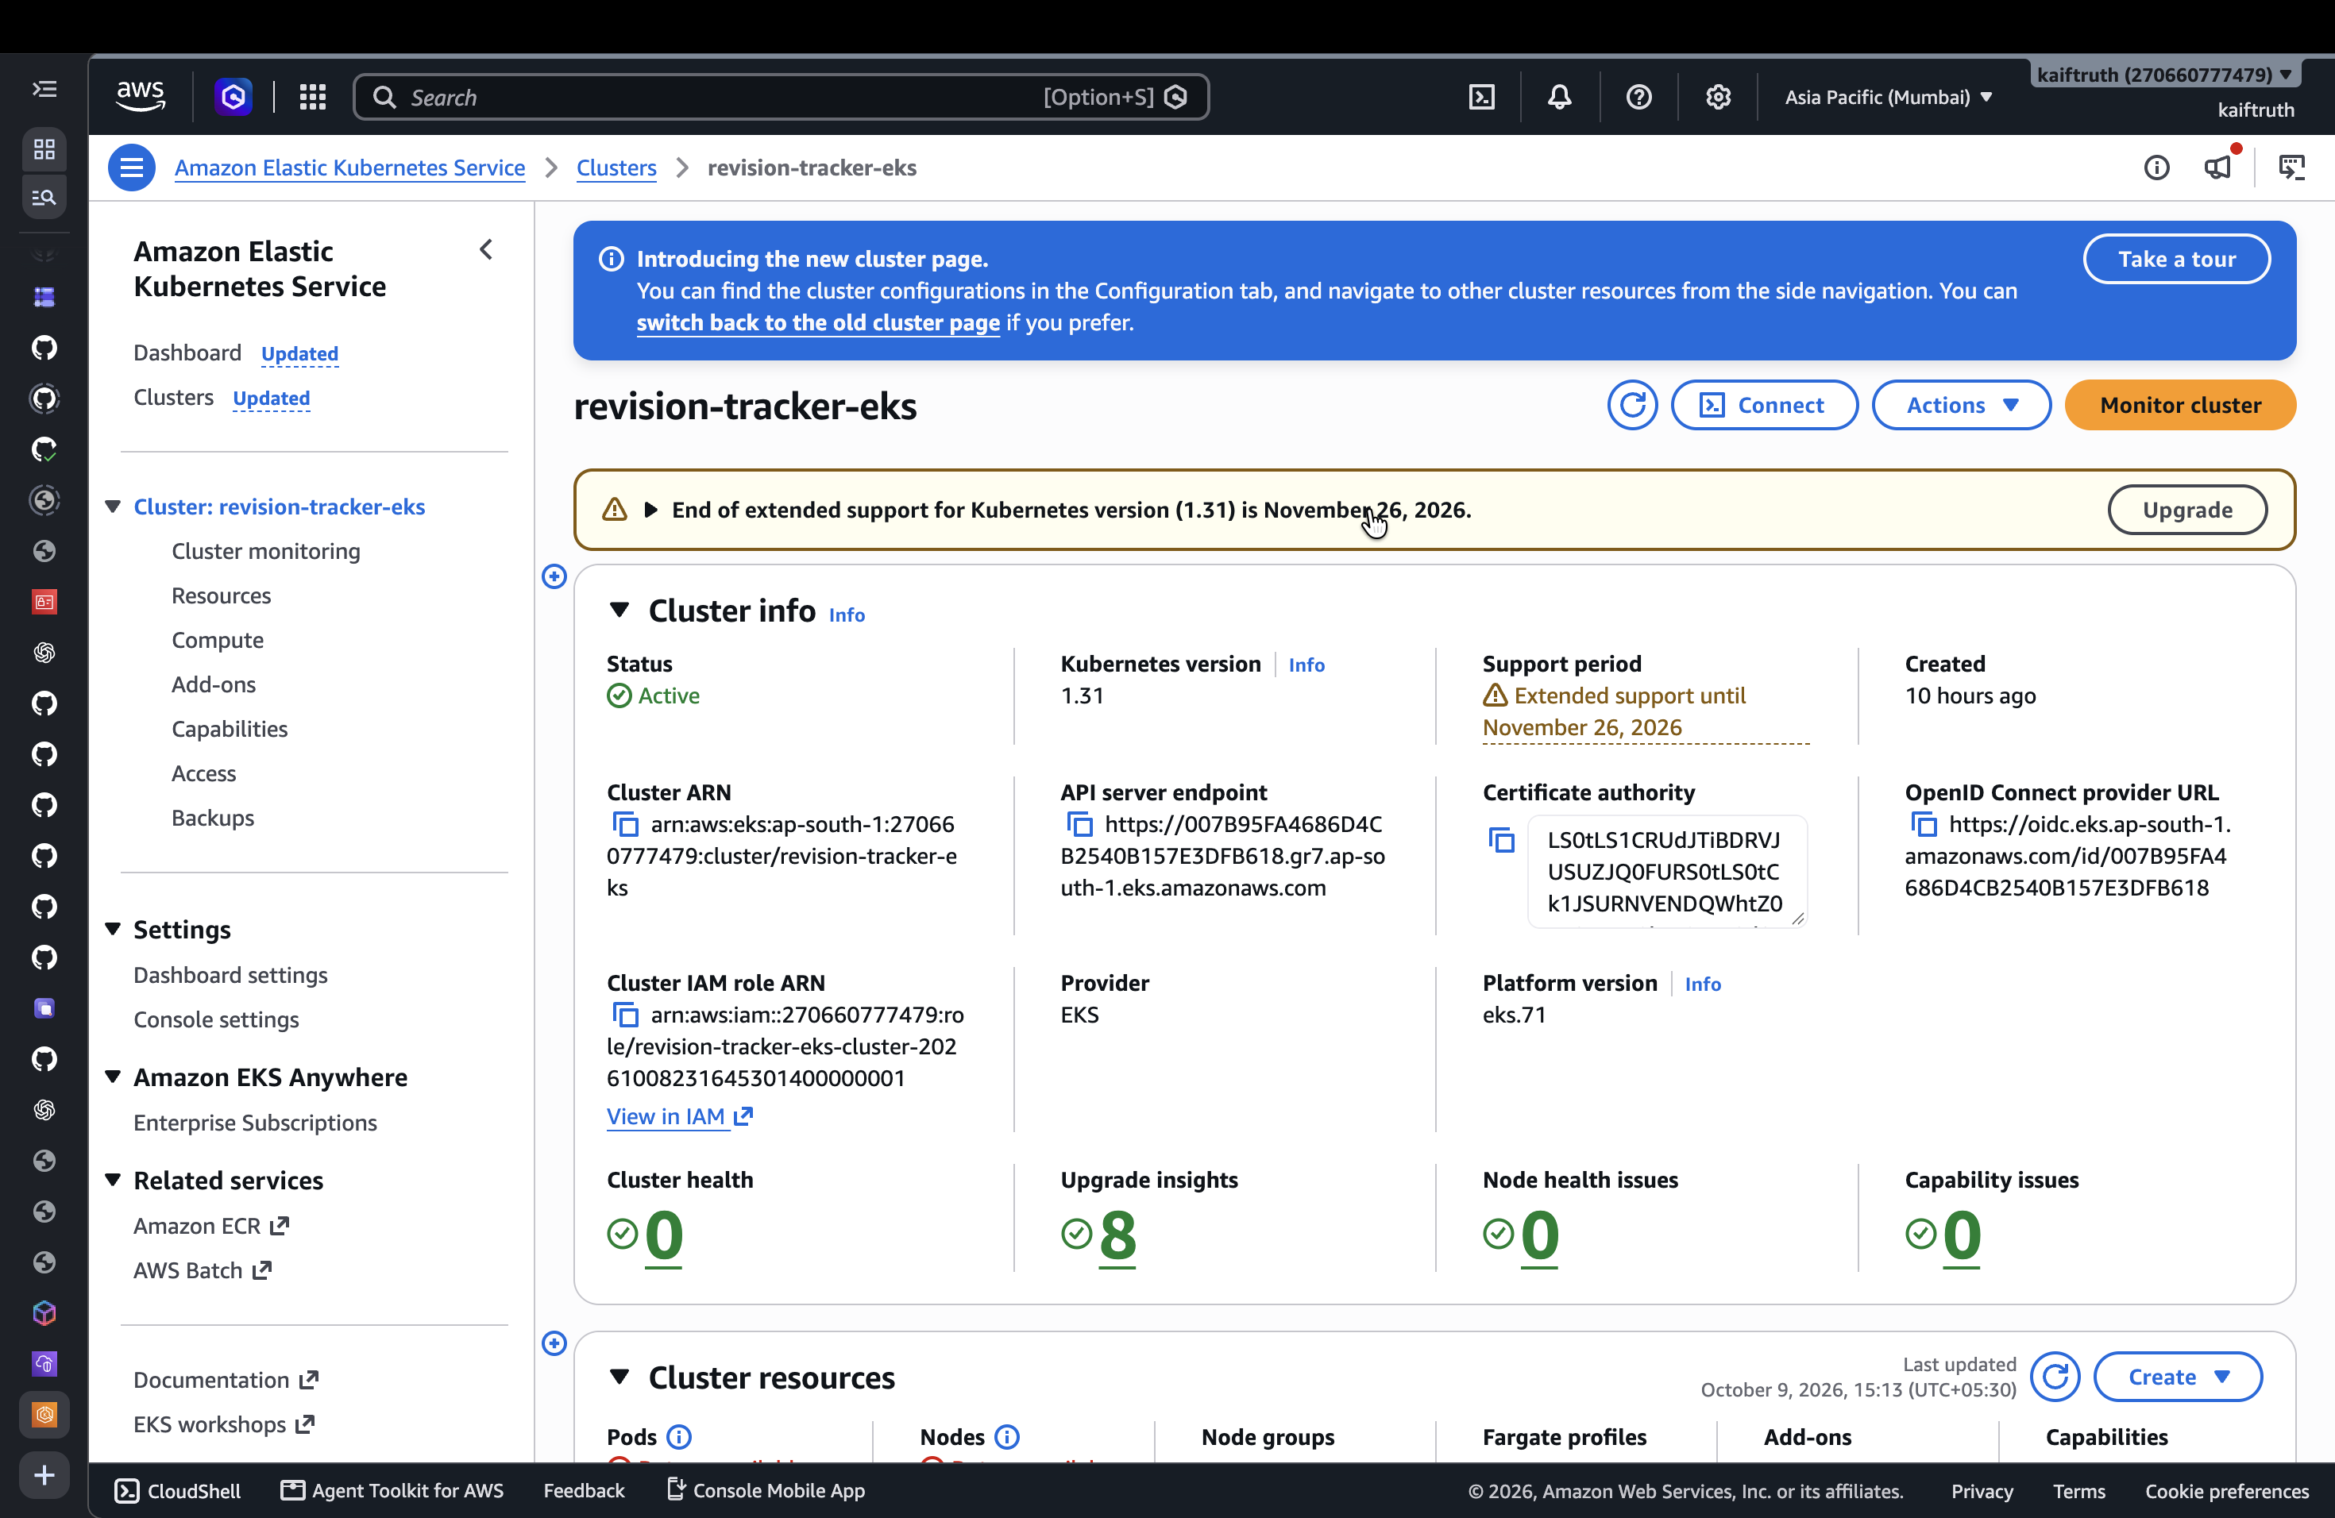
EKS cluster and worker nodes
The managed Kubernetes control plane and node group are active and ready to run the Helm release.
revision-tracker-eks is Active in the AWS Console.
MD Kaif Molla | DevOps Revision Tracker
11

Slide 12
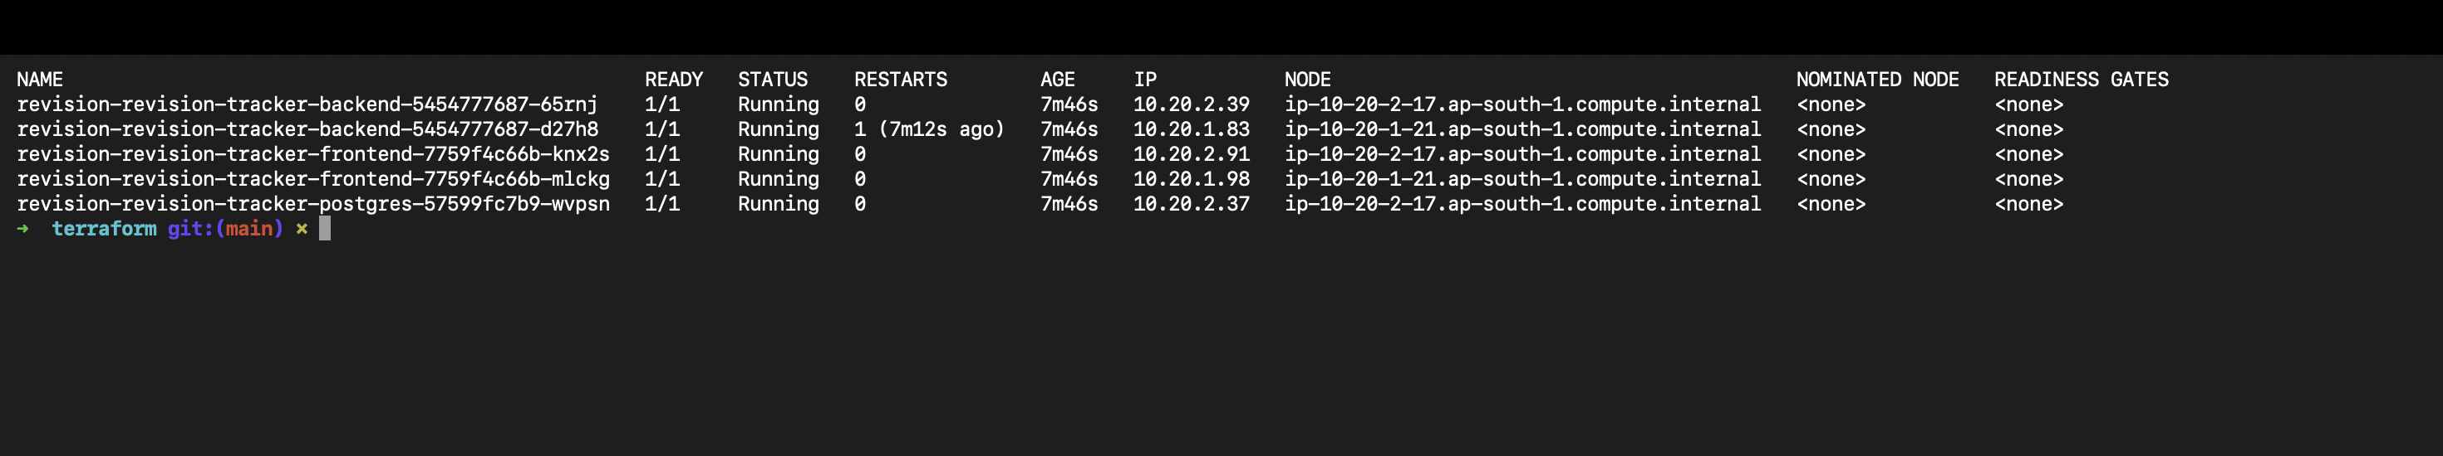
Kubernetes workload health
Frontend, backend, and PostgreSQL workloads run as healthy pods in the revision-tracker namespace.
All five application pods are Running and Ready.
MD Kaif Molla | DevOps Revision Tracker
12

Slide 13
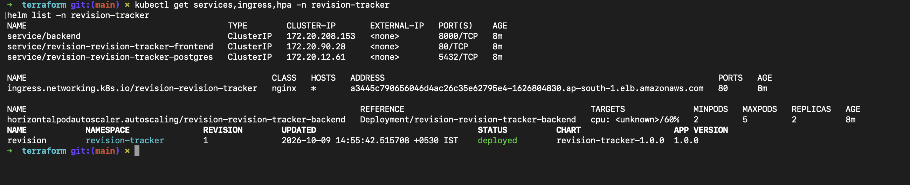
Ingress, services, autoscaling, and Helm
The EKS deployment exposes the app through ingress while Helm tracks the installed release and HPA configuration.
The ingress address, services, HPA, and Helm release are all present.
MD Kaif Molla | DevOps Revision Tracker
13

Slide 14
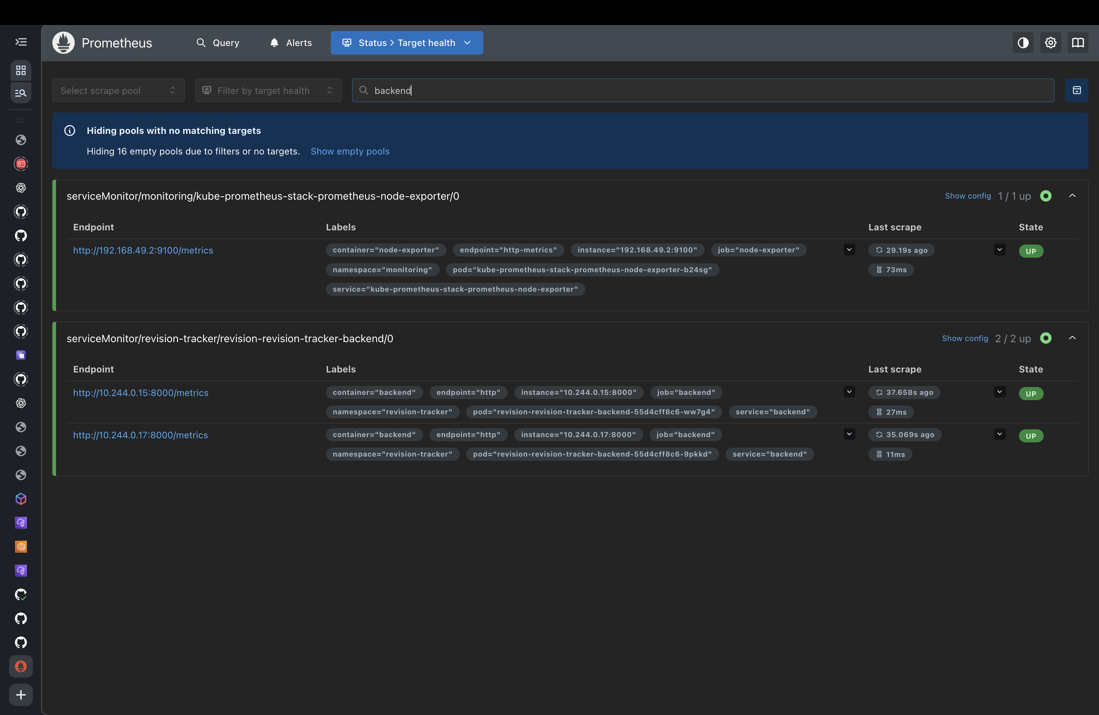
Prometheus target health
Prometheus discovers and scrapes both backend replicas through the ServiceMonitor.
Both backend endpoints are UP.
MD Kaif Molla | DevOps Revision Tracker
14

Slide 15
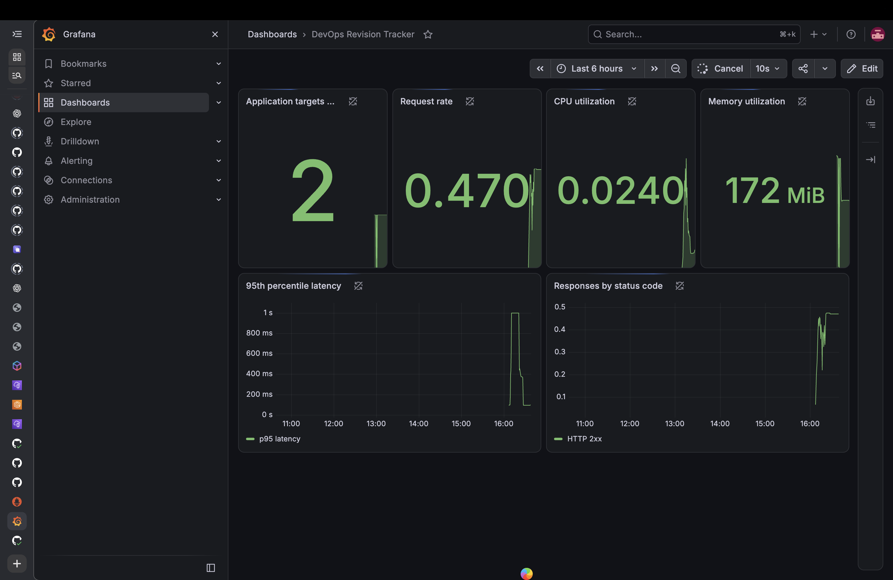
Grafana operational dashboard
Grafana turns Prometheus metrics into live application target, request rate, CPU, memory, latency, and response views.
The dashboard shows two application targets and live service telemetry.
MD Kaif Molla | DevOps Revision Tracker
15

Slide 16
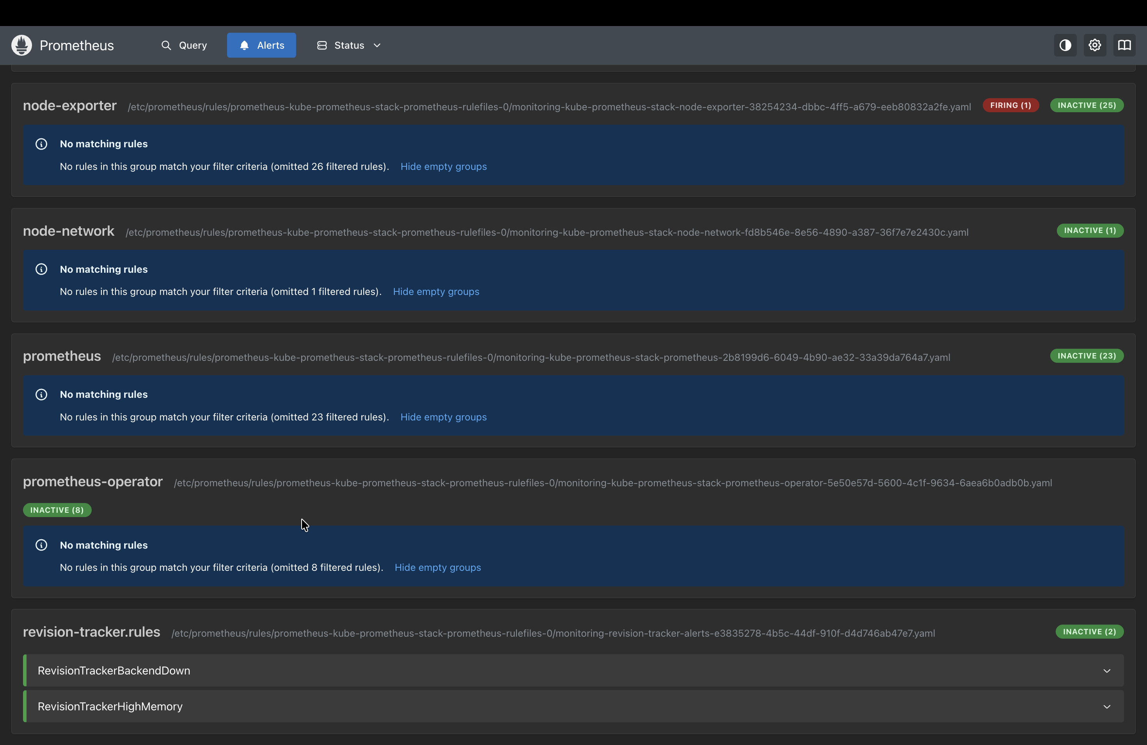
Alert rules and runtime logs
Prometheus alert rules provide proactive availability and memory signals. Kubernetes logs provide request-level evidence.
Custom backend-down and high-memory alert rules are installed and inactive while the app is healthy.
MD Kaif Molla | DevOps Revision Tracker
16

Slide 17
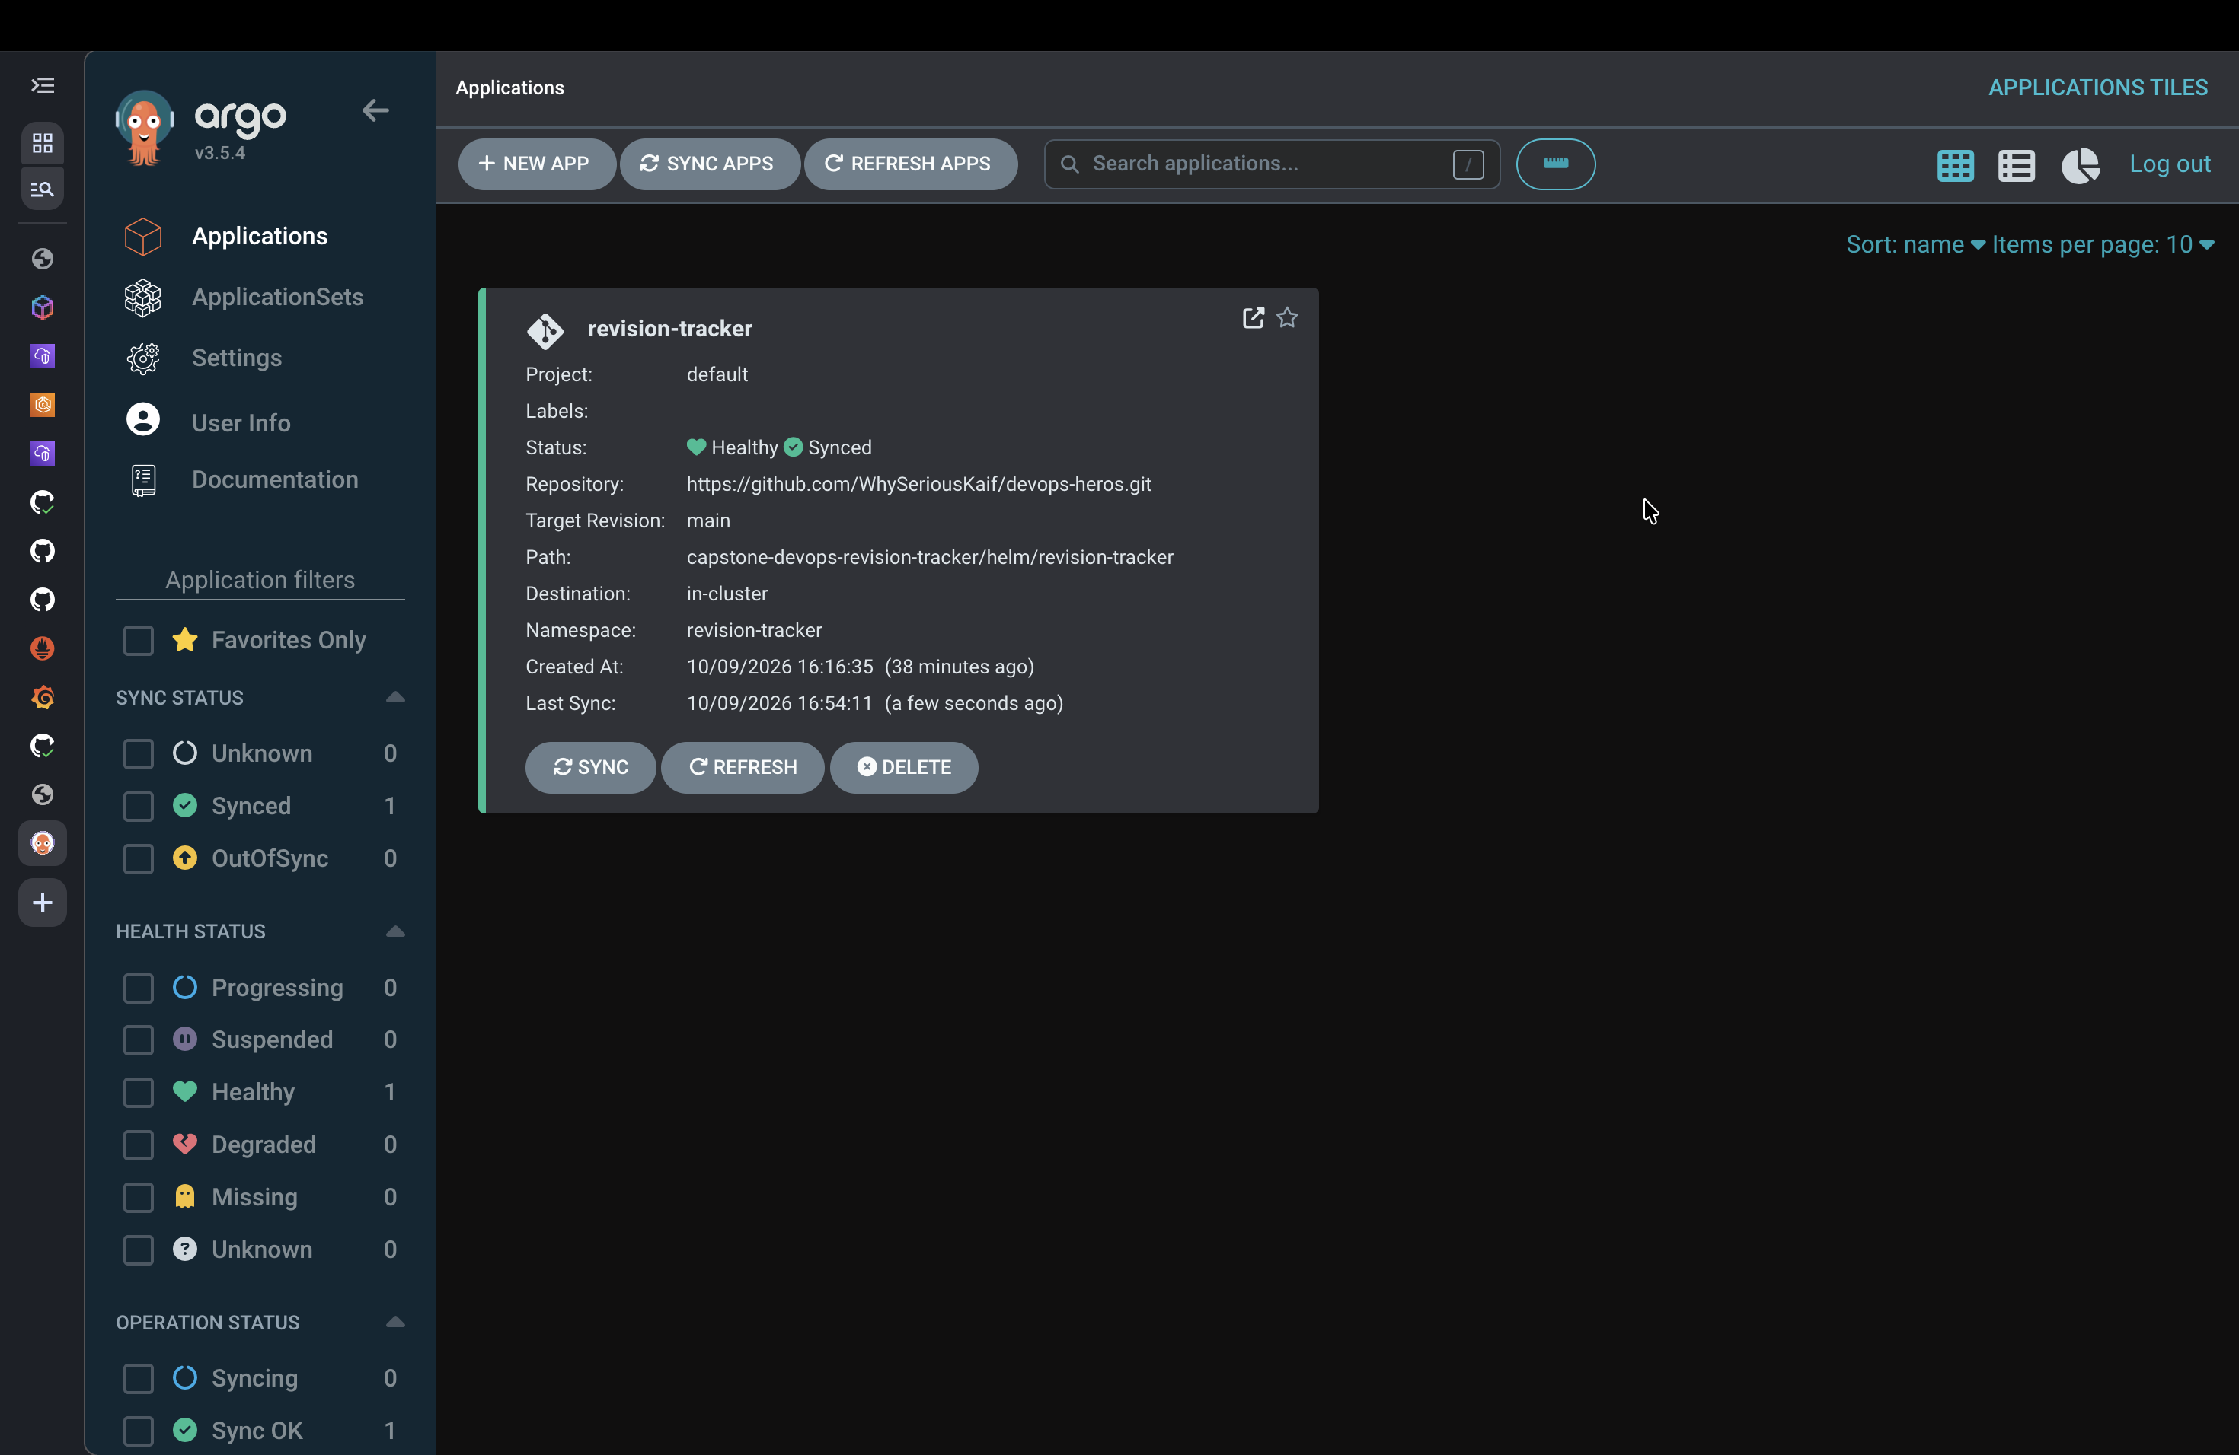
GitOps reconciliation with Argo CD
Argo CD watches the Helm chart in Git and maintains the deployed application in a Healthy and Synced state.
The GitOps application is Healthy and Synced in the revision-tracker namespace.
MD Kaif Molla | DevOps Revision Tracker
17

Slide 18
Verified outcomes
The project demonstrates a complete DevSecOps lifecycle with evidence from source code to a running cloud workload.
9 tests passed
Application behavior was verified before build and deployment.
Security gates passed
Gitleaks and Trivy were part of the successful GitHub Actions workflow.
EKS workload healthy
Five application pods, ingress, services, autoscaling, and Helm release were verified.
2 targets scraped
Prometheus reports both backend replicas as UP and Grafana displays live telemetry.
Healthy and Synced
Argo CD reconciles the desired Helm state directly from Git.
Thank you
MD Kaif Molla
MD Kaif Molla | DevOps Revision Tracker
18

