Slide 1
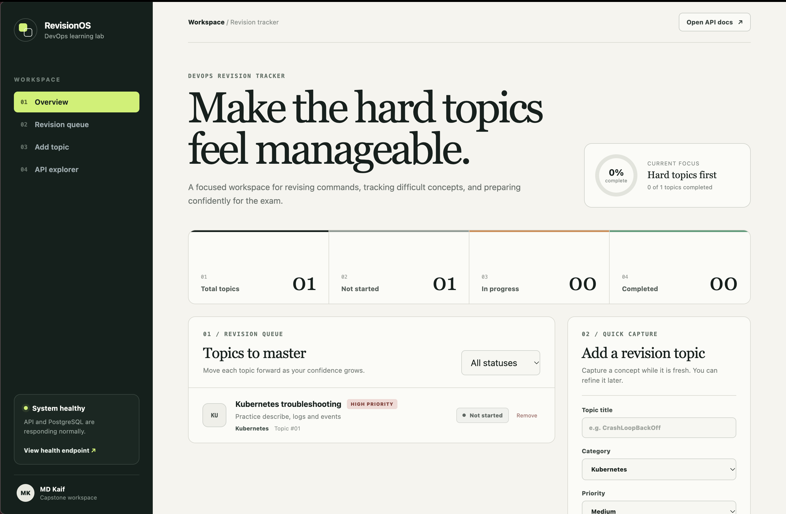
CAPSTONE PROJECT
DevOps Revision
Tracker
A three-tier application with automated delivery, Kubernetes observability, and GitOps reconciliation
MD Kaif
github.com/WhySeriousKaif/devops-heros

Slide 2
System architecture
Git drives delivery and reconciliation; telemetry makes runtime behavior visible
GitHub
source and CI
Argo CD
continuous sync
Kubernetes
and Helm
Prometheus
and alerts
Grafana
dashboards
FRONTEND
BACKEND API
PERSISTENT DATA
React + Nginx
FastAPI
PostgreSQL
Health probes, metrics, logs, and declarative configuration connect build-time quality to runtime operations.
DevOps Revision Tracker
02

Slide 3
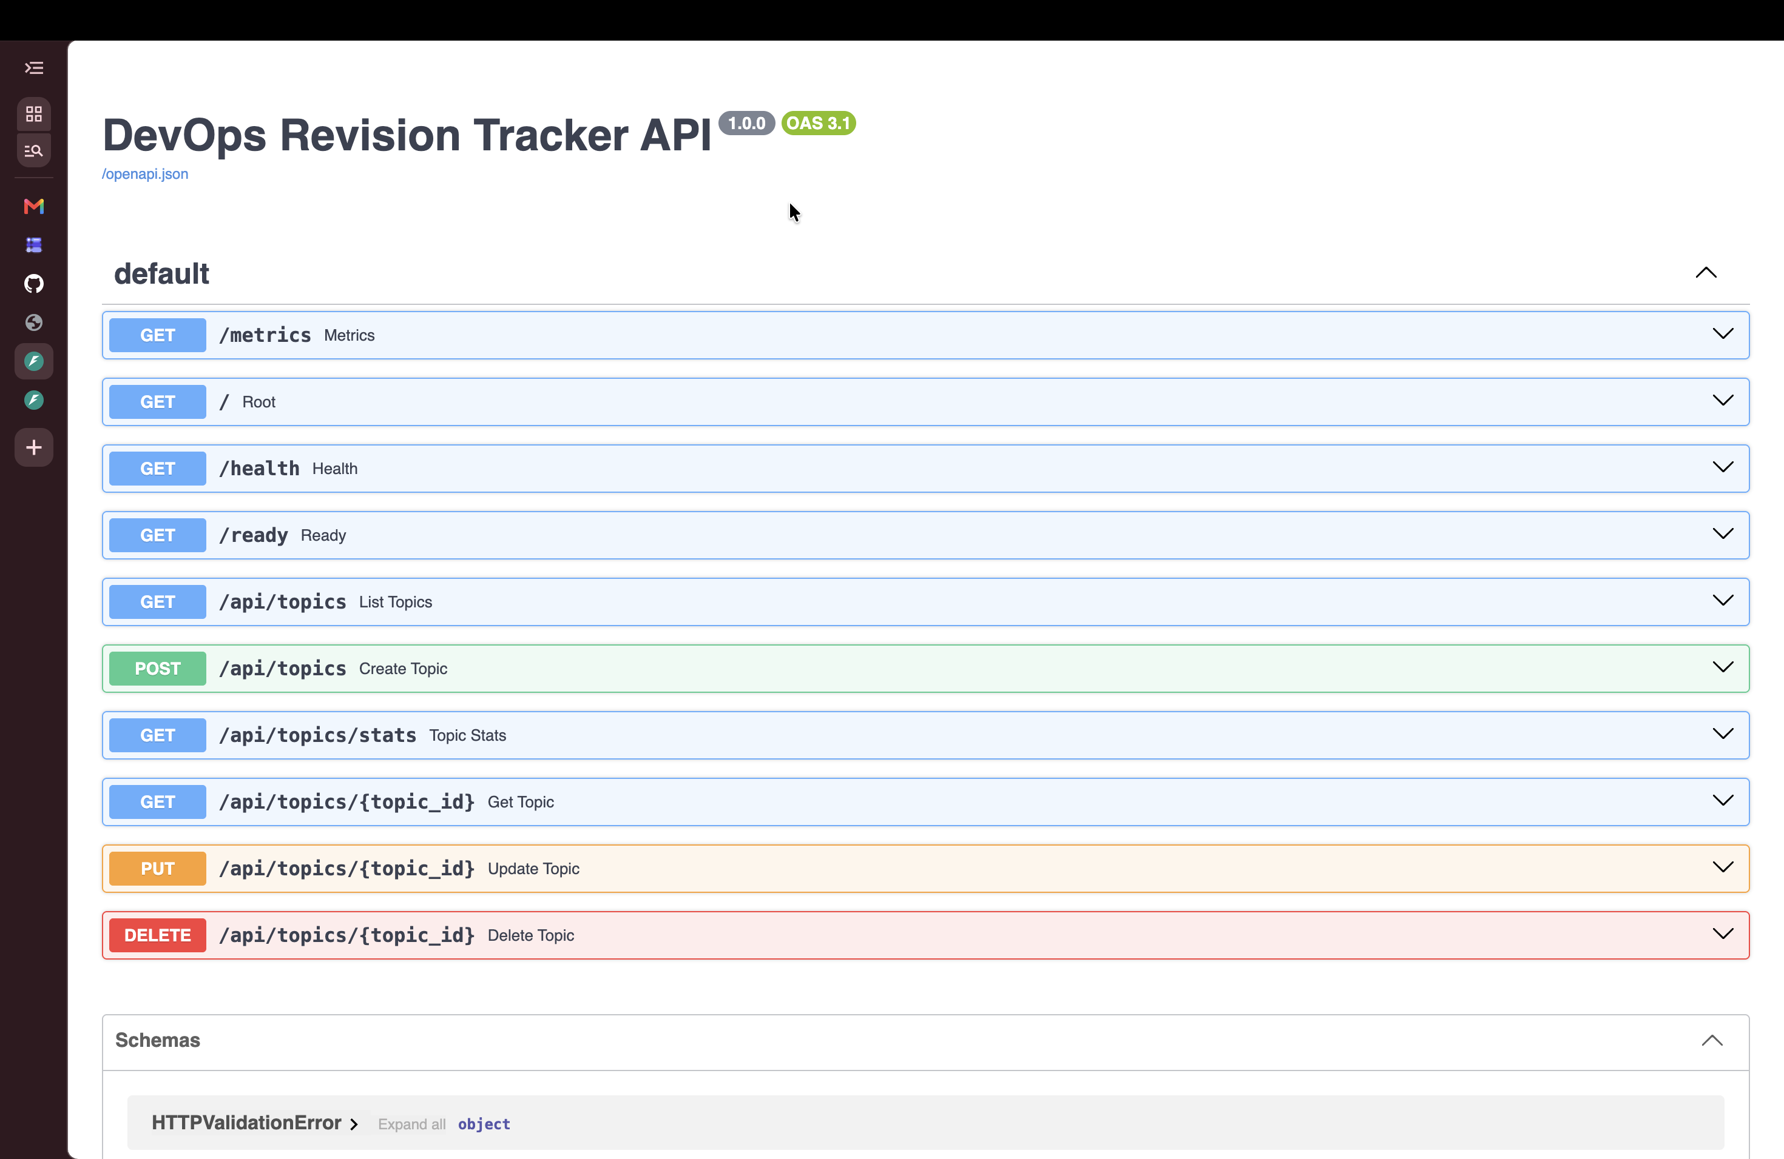
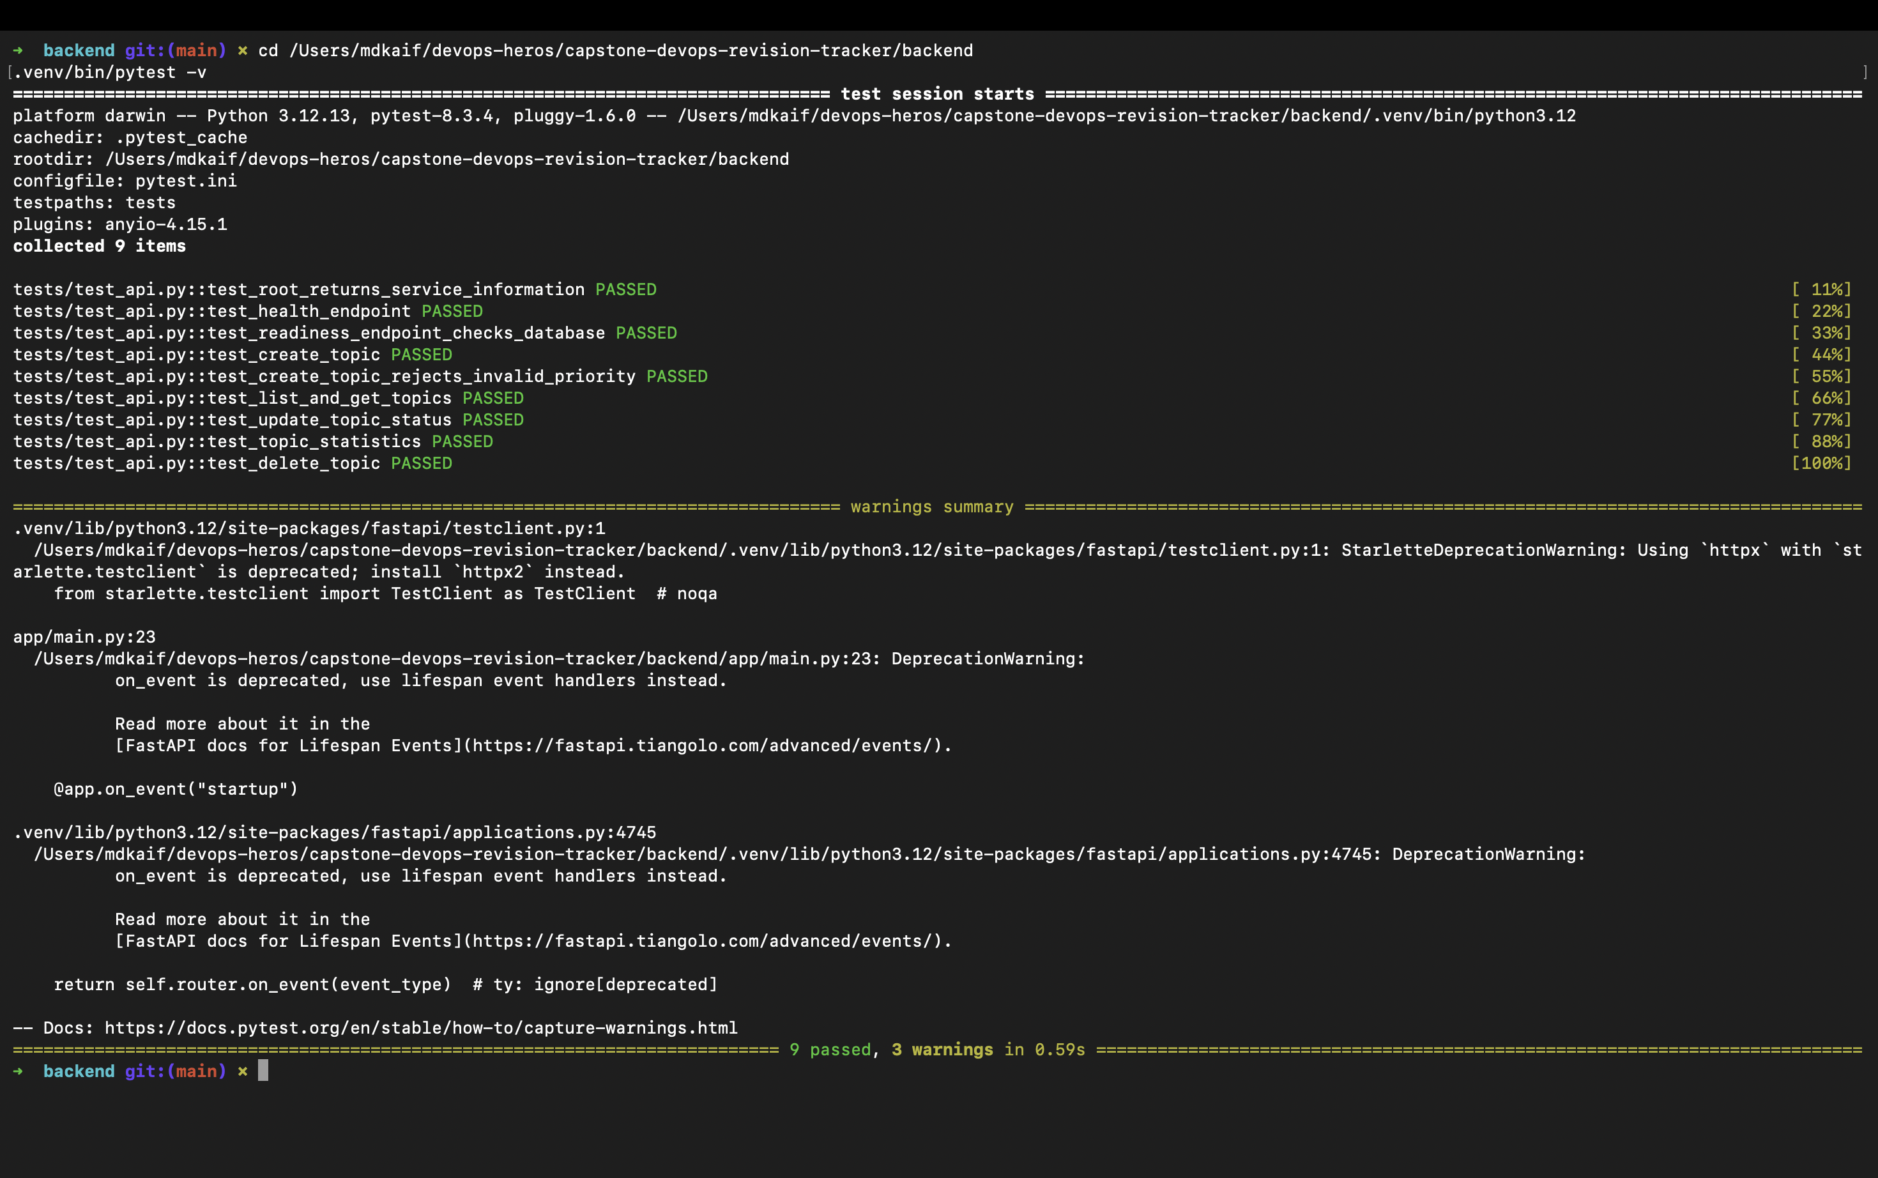
Application and automated testing
The API exposes health, readiness, metrics, and CRUD endpoints; nine tests protect the core behavior
Swagger documents the contract
9 passed in 0.59s
DevOps Revision Tracker
03

Slide 4
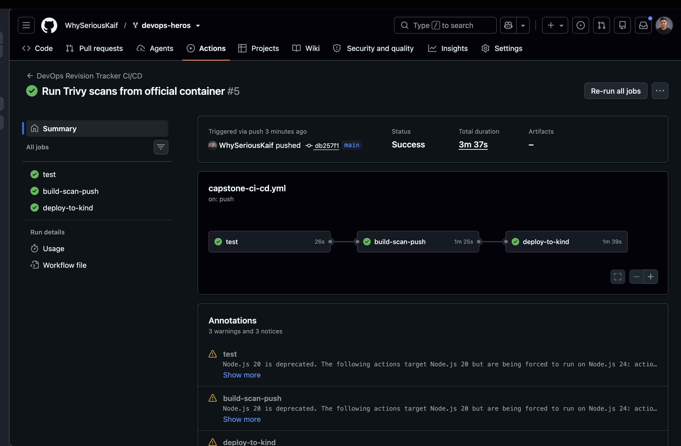
CI/CD pipeline
Every push runs tests, builds and scans images, publishes artifacts, and verifies a Helm deployment on kind
All three jobs completed successfully: test, build-scan-push, and deploy-to-kind
DevOps Revision Tracker
04

Slide 5
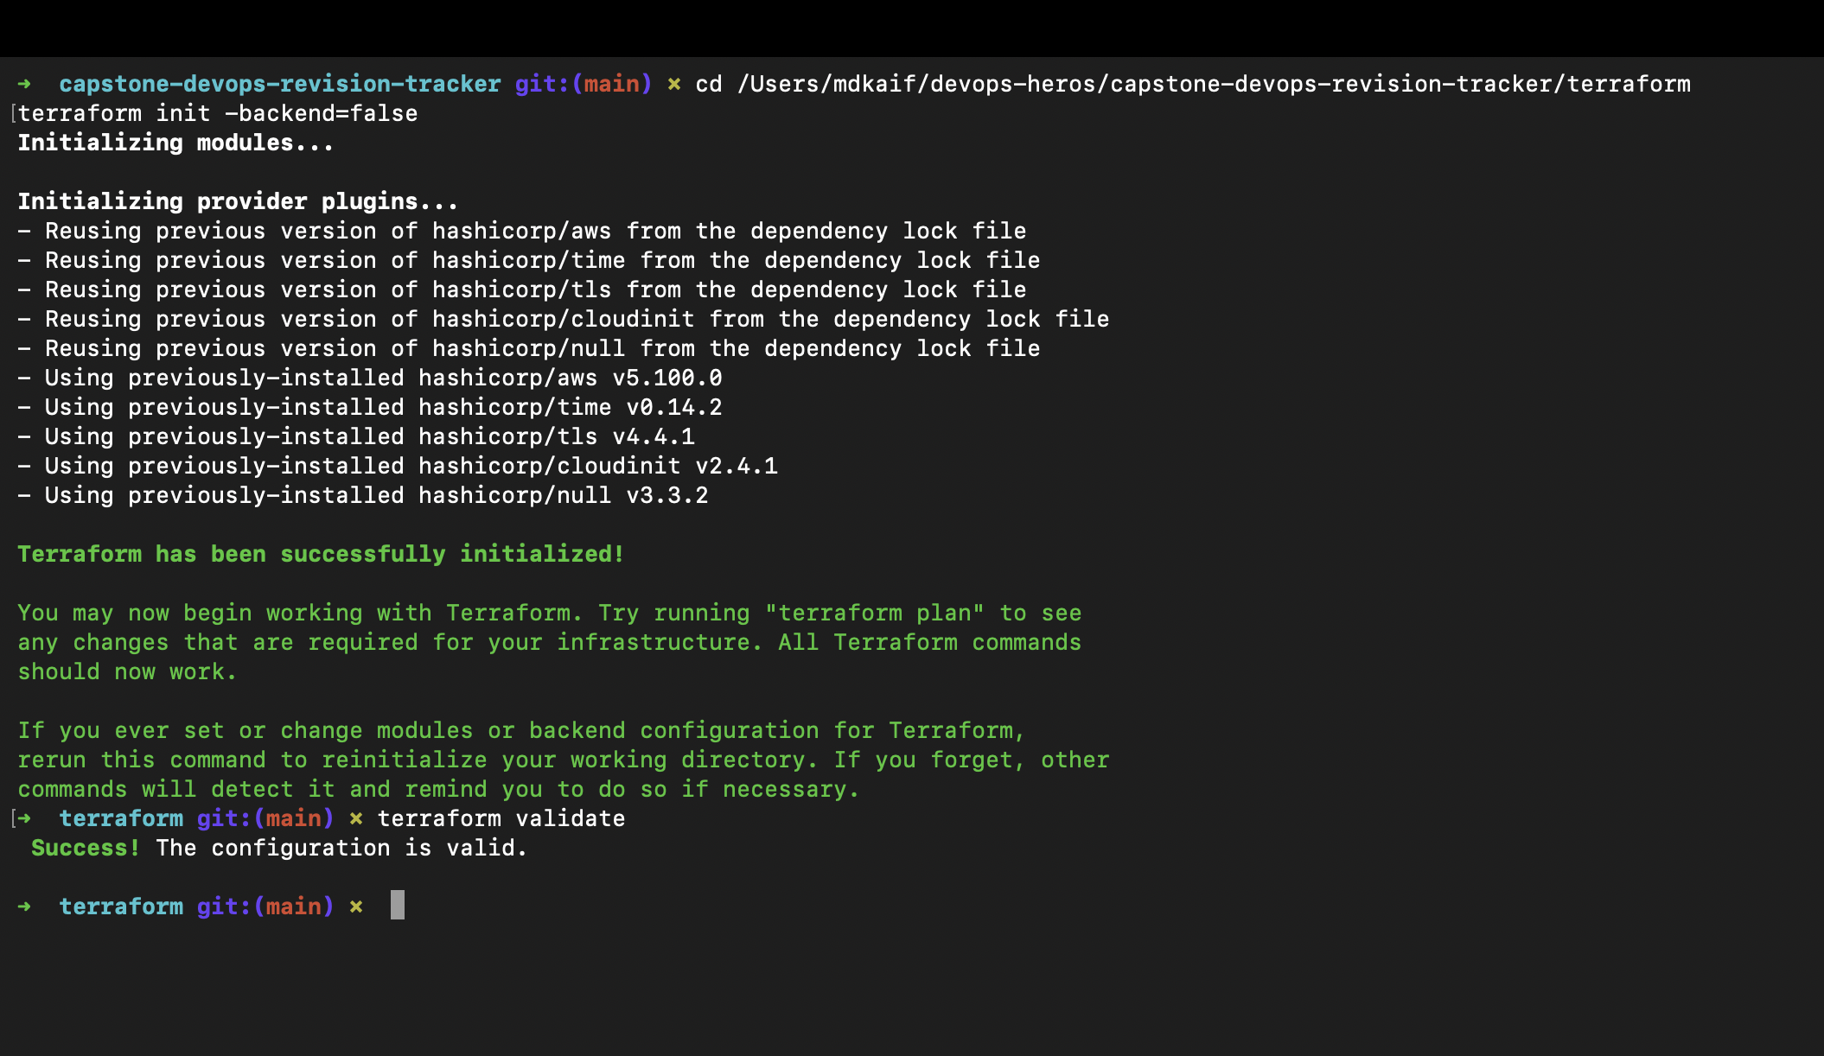
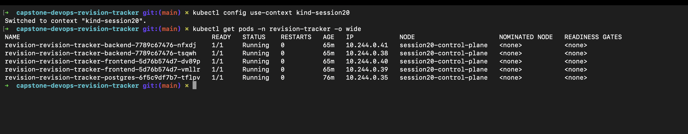
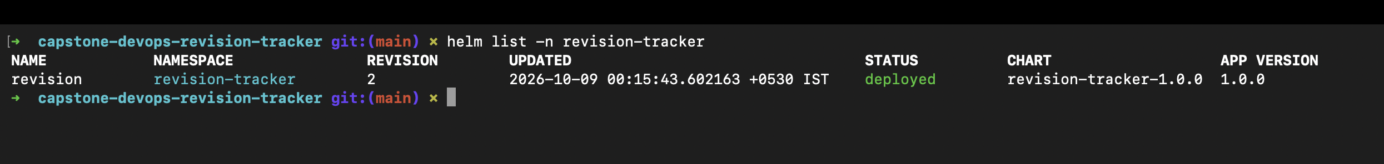
Infrastructure and Kubernetes
Terraform validates the AWS design; Helm deploys five healthy application pods to the local cluster
VPC and EKS configuration validates without provisioning paid cloud resources
DevOps Revision Tracker
05

Slide 6
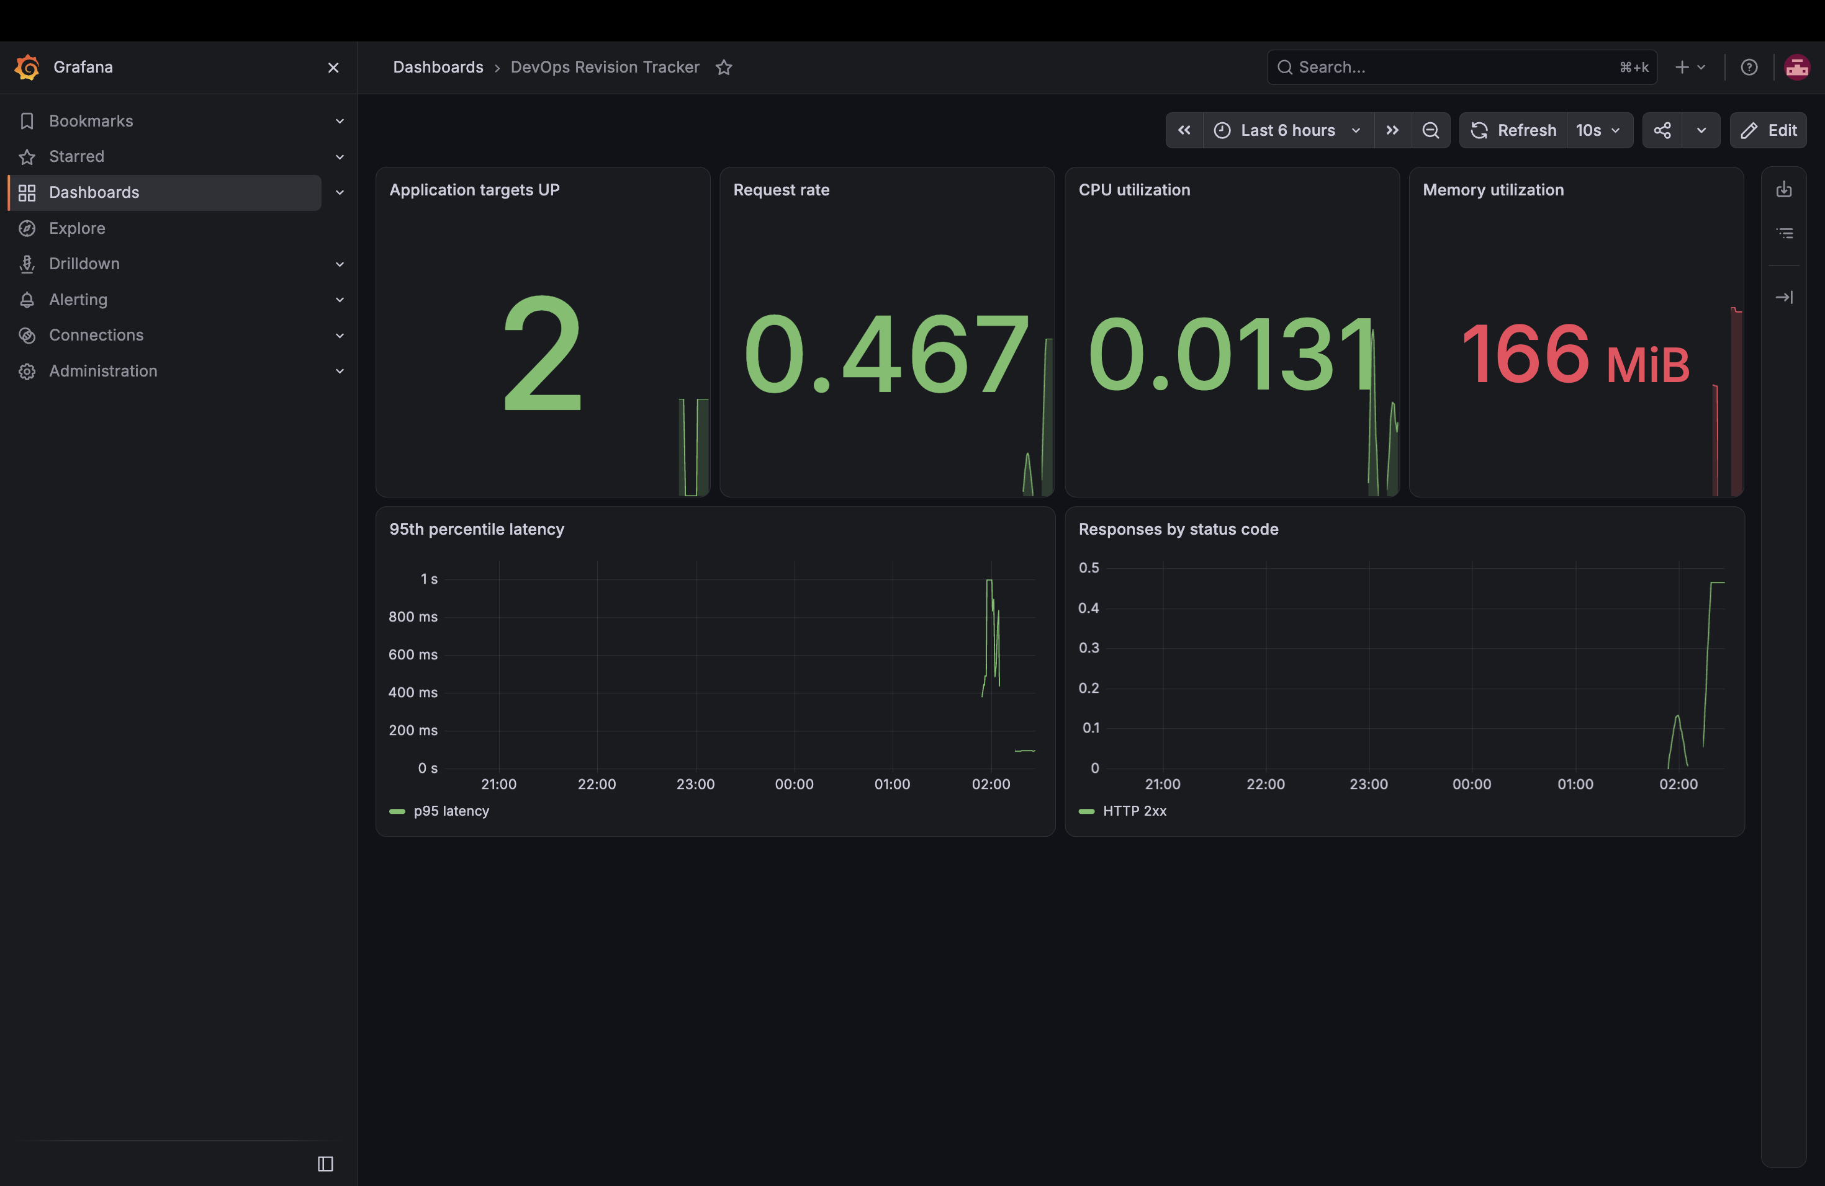
Monitoring dashboard
Prometheus scrapes both replicas; Grafana displays health, traffic, CPU, memory, latency, and response status
Memory is 166 MiB, below the 500 MiB warning threshold; both application targets are UP
DevOps Revision Tracker
06

Slide 7
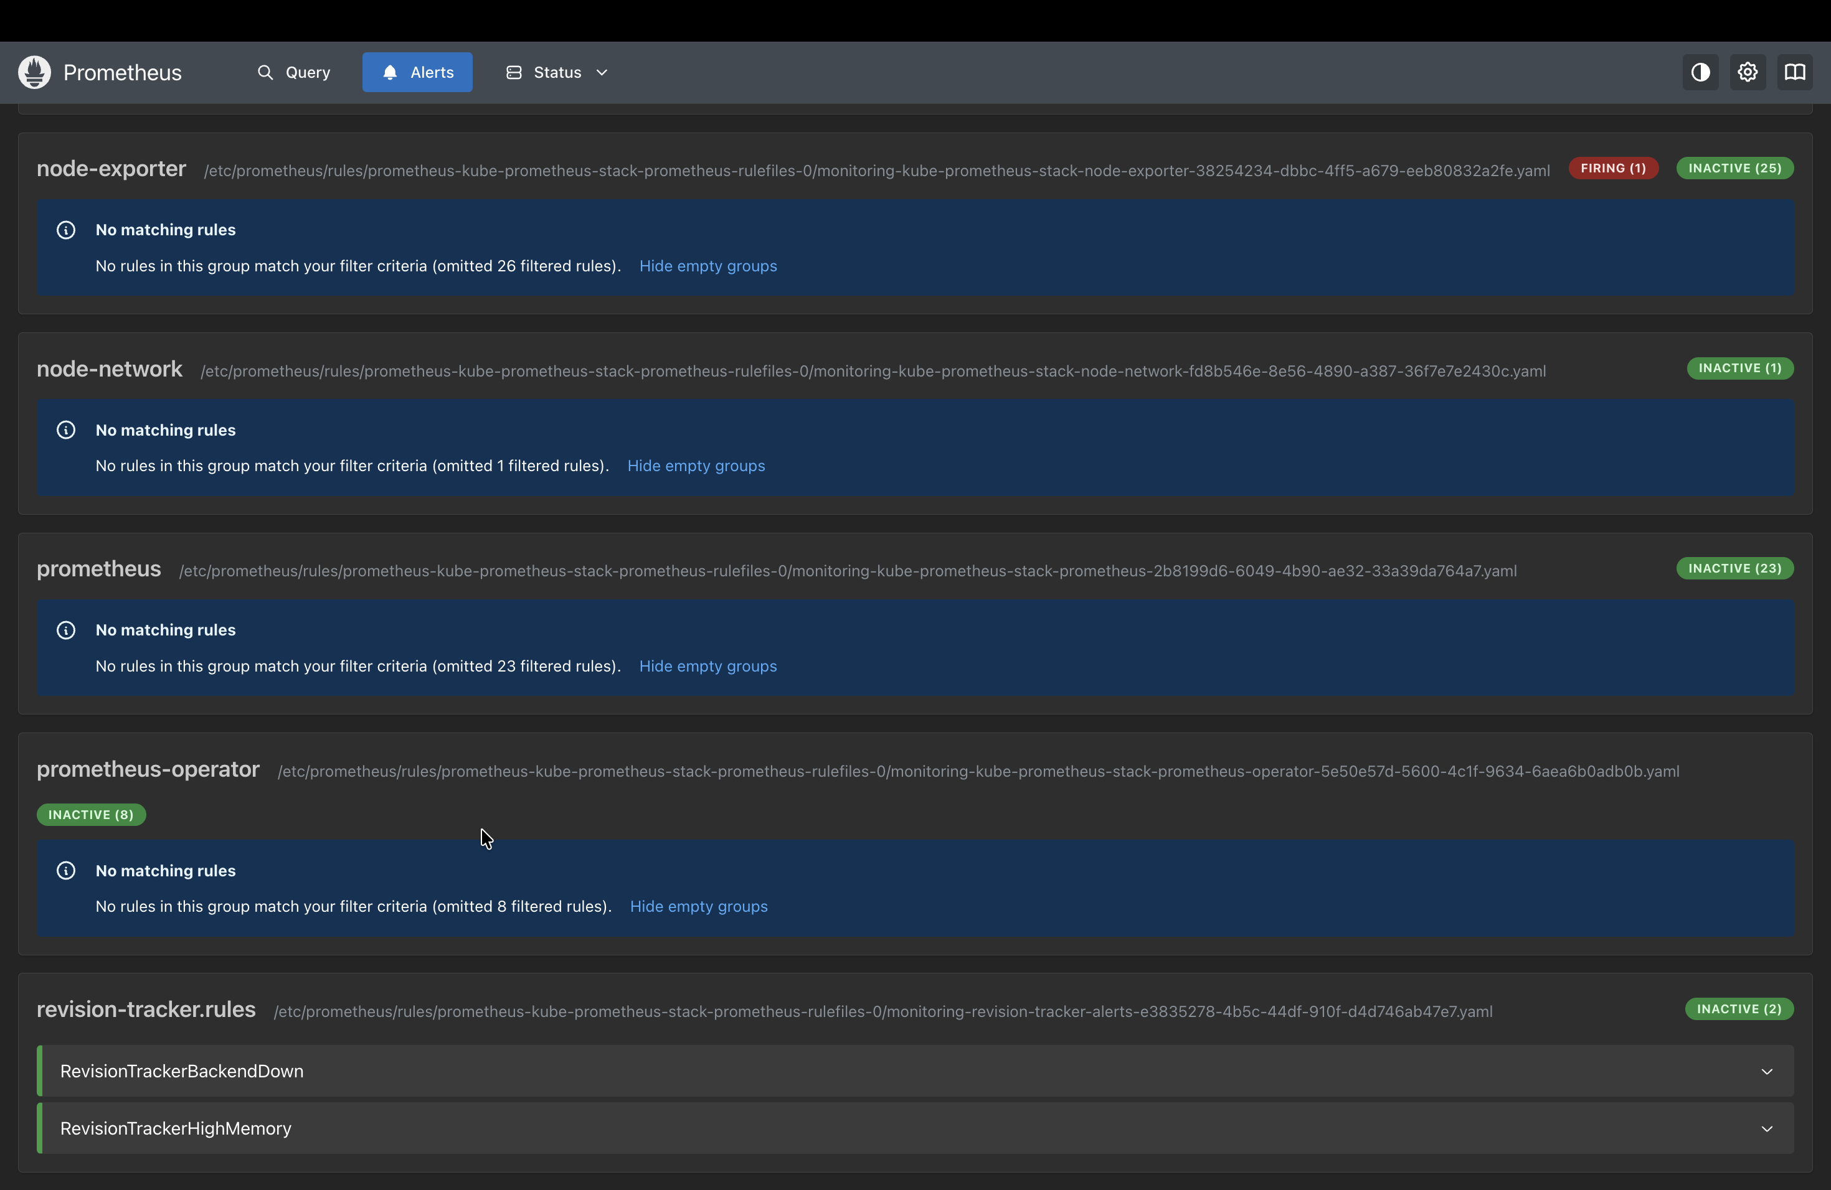
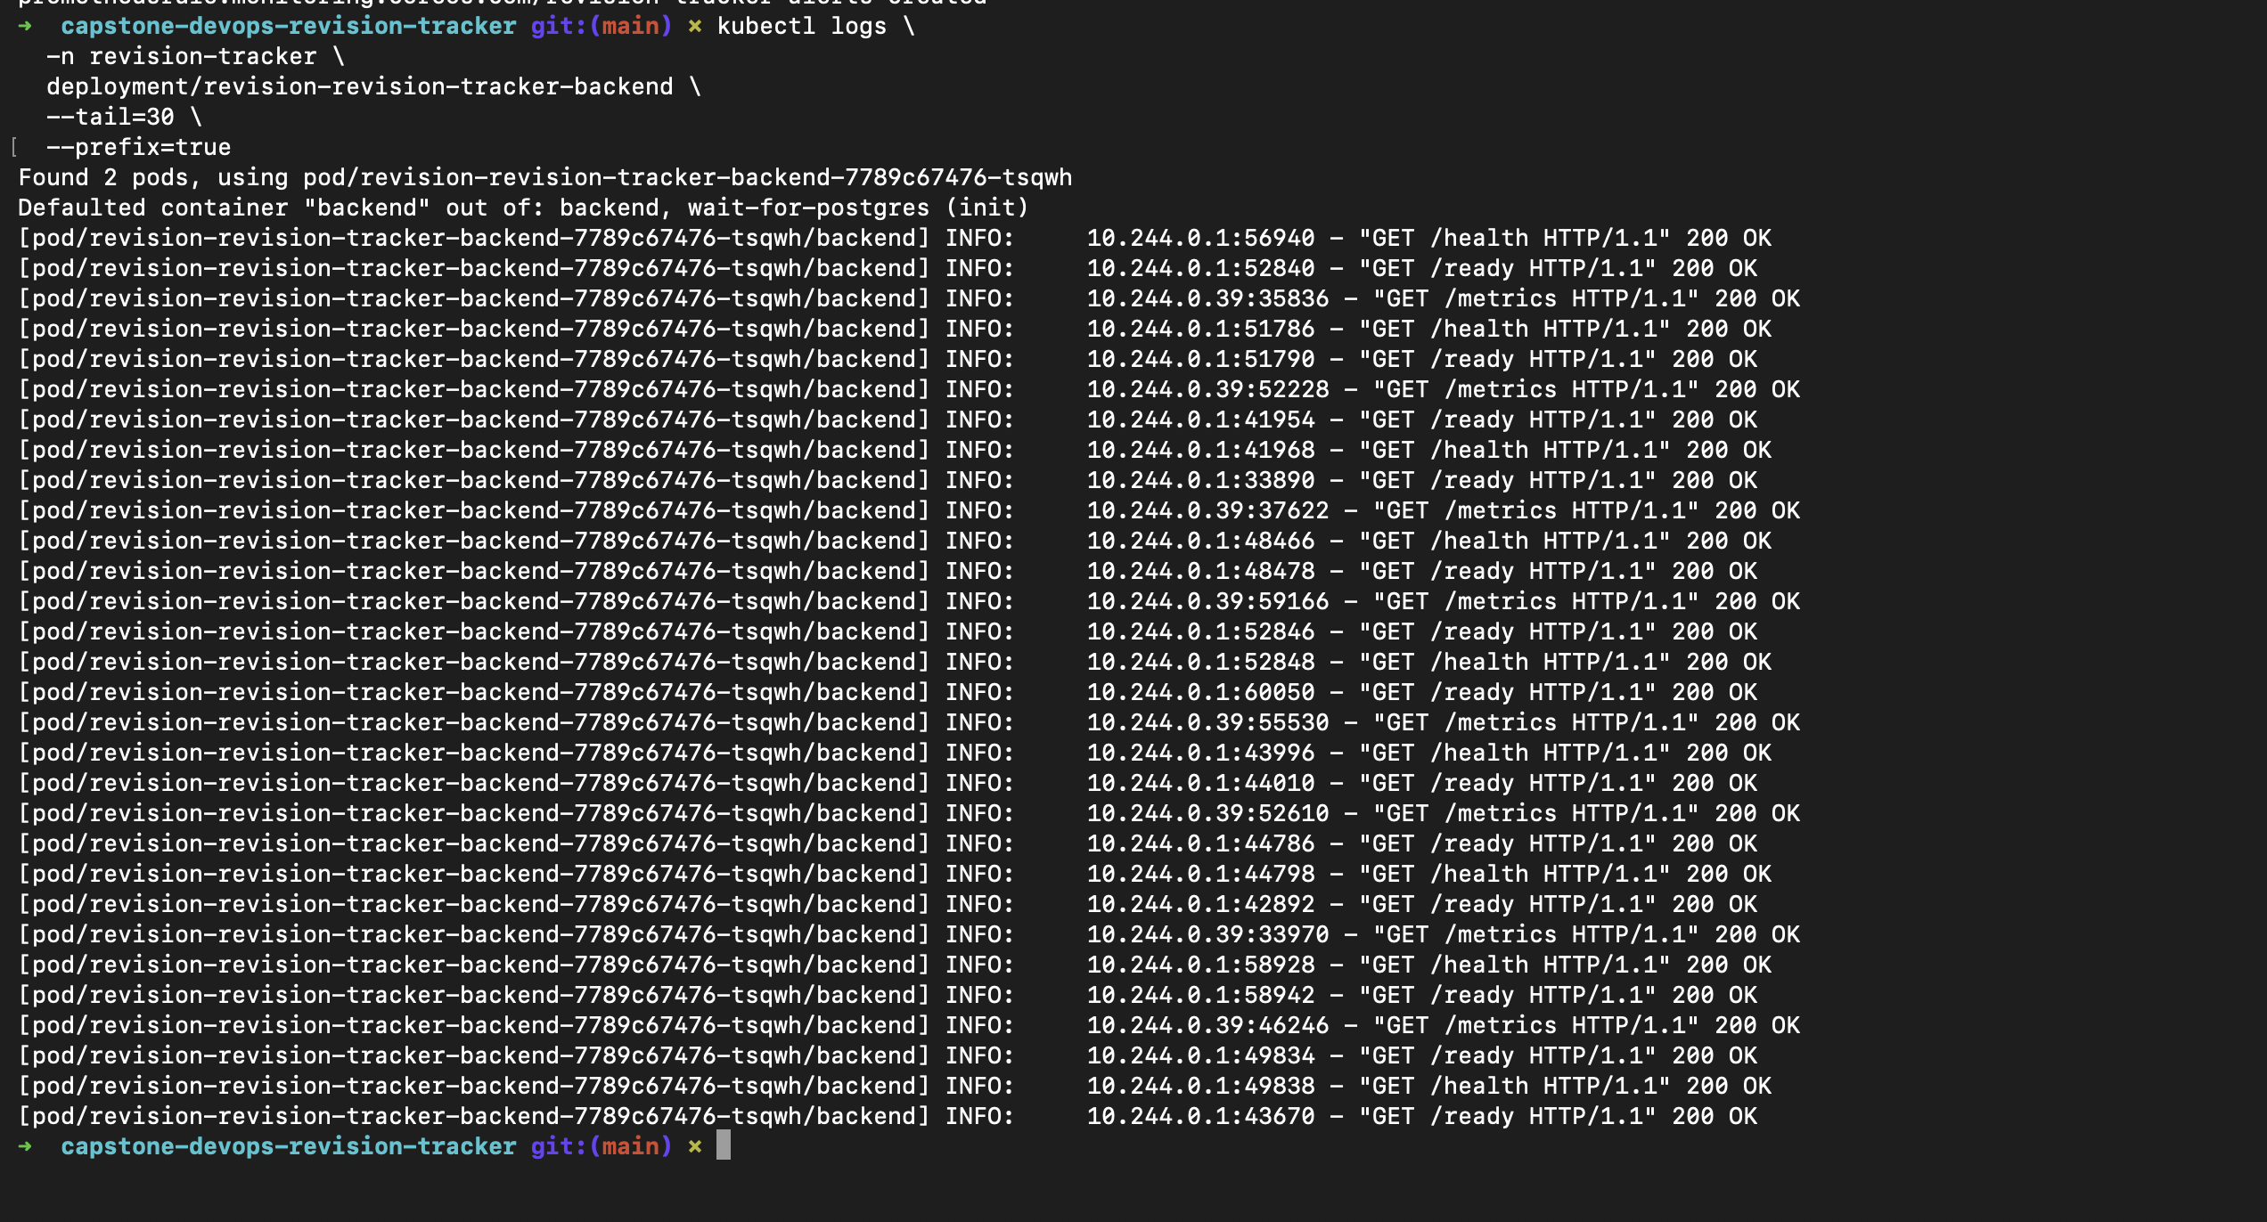
Alerts and logs
Prometheus detects backend availability and memory risk; Kubernetes logs provide request-level evidence
Both custom rules are inactive while the application is healthy
Health, readiness, and metrics requests return HTTP 200
DevOps Revision Tracker
07

Slide 8
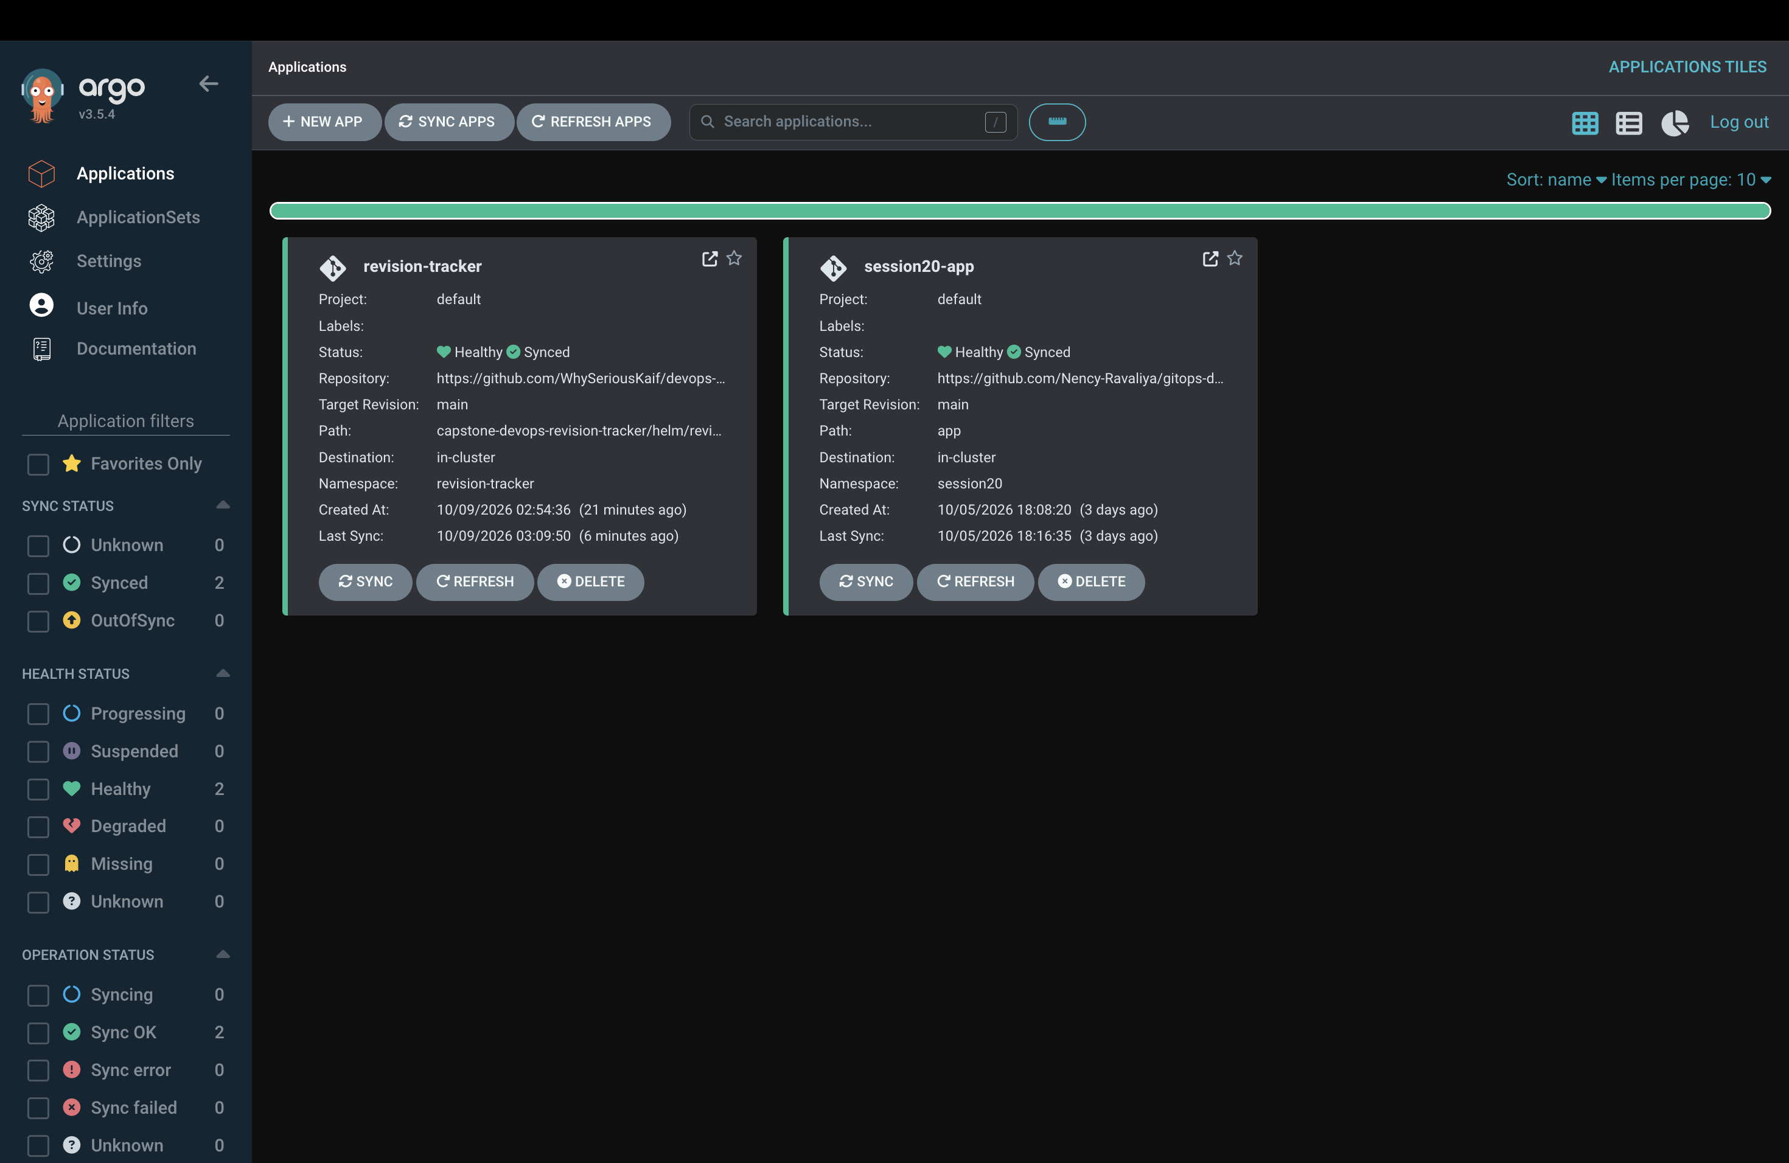
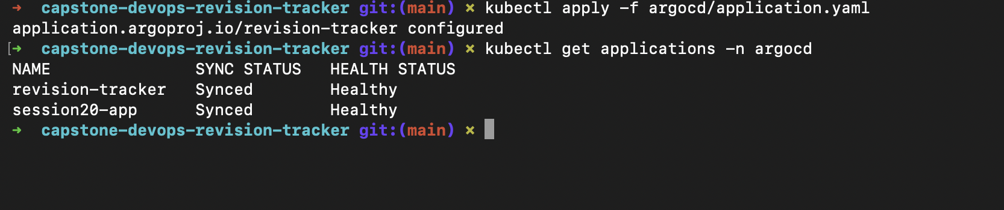
GitOps reconciliation with Argo CD
Git defines the desired Helm state; automated sync, pruning, and self-healing keep the cluster aligned
DevOps Revision Tracker
08

Slide 9
Verified outcomes
The submission connects application code, delivery automation, infrastructure, operations, and GitOps in one reproducible repository.
9 tests passed
FastAPI behavior and database operations verified before image creation
2 replicas scraped
Prometheus sees both backend targets as UP
5 application pods
Frontend, backend, and PostgreSQL workloads run with zero failed containers
Healthy and Synced
Argo CD continuously reconciles the Helm release from Git
github.com/WhySeriousKaif/devops-heros
Questions
Repository

