Slide 1

LAB 11

Slide 2
for loop
Used when a definite number of loop iterations is required
One convenient statement indicates:
The starting value for the loop control variable
The test condition that controls loop entry
The expression that alters the loop control variable

Slide 3
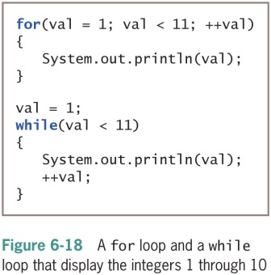

Slide 4
Unconventional for loops
Initialization of more than one variable
Place commas between separate statements
Performance of more than one test using AND or OR operators
Decrementing or performance of some other task
Altering more than one value
You can leave one or more portions of a for loop empty
Two semicolons are still required as placeholders

Slide 5
Use the same loop control variable in all three parts of a for statement
To pause a program:
Use the for loop that contains no body (do-nothing loop)
for(x = 0; x < 100000; ++x);
Or use the built-in sleep() method

Slide 6
Nested For loop
•nested loop: A loop placed inside another loop.
for (int i = 1; i <= 5; i++) {
for (int j = 1; j <= 10; j++) {
System.out.print("*");
}
System.out.println(); // to end the line
}
•Output:
**********
**********
**********
**********
**********

Slide 7
While loop
A while statement has the following syntax:
•If the condition is true, the statement is executed
•Then the condition is evaluated again, and if it is still true, the statement is executed again
•The statement is executed repeatedly until the condition becomes false

Slide 8
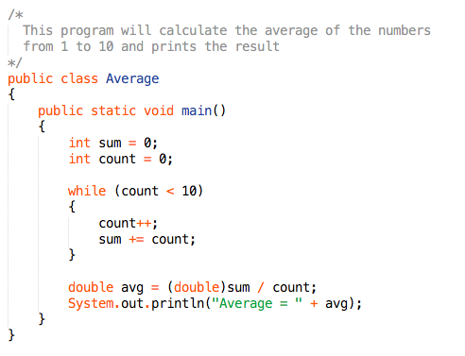

Slide 9




FOR LOOP | WHILE LOOP
Initialization may be either in loop statement or outside the loop. | Initialization is always outside the loop.
Once the statement(s) is executed then after increment is done. | Increment can be done before or after the execution of the statement(s).
It is normally used when the number of iterations is known. | It is normally used when the number of iterations is unknown.
Condition is a relational expression. | Condition may be expression or non-zero value.
It is used when initialization and increment is simple. | It is used for complex initialization.
For is entry controlled loop. | While is also entry controlled loop.
for ( init ; condition ; iteration ) { statement(s); } | while ( condition ) { statement(s); }

