Slide 1
Mid-exam Review
In-class paper exam. 75 minutes.
No Cheat sheet. No calculator.
Question type:
1) Given statement, judge if it is true or not.
2) Calculate the Big-O of time and space
3) Code implementation
4) Proof
5) Justification: explain your answer.
Do not copy answers

Slide 2
Unit 1: Programming Review & Basic Algorithms
1. Divide and Conquer
Guess My Number: what is the optimal number of guesses?
How to calculate Log?
Given a random number range, what is the formula for the guesses?
2. Search
What is linear search and binary search.
3. Proof
How to use inductive proof.
4. Coding style

Slide 3
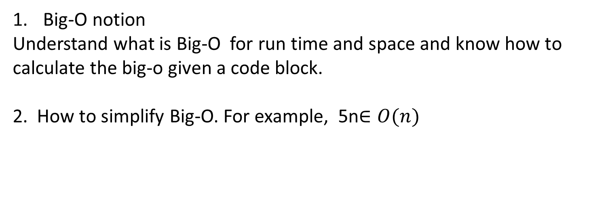
Unit 2: Asymptotic Analysis
Big-O notion
Understand what is Big-O for run time and space and know how to calculate the big-o given a code block.
2. How to simplify Big-O. For example, 5n$∈O(n)$

Slide 4
Unit 3: Sorting
Sorting
Understand sorting algorithms we have learnt. Given a code block, you should be able to calculate the Big-O for the time and space.
Understand the merge sort. How to merge two arrays?

Slide 5
Practices
1) Statement
T/F log2(32) = 4
log(xy) = xlog(y)
2) Simplify functions below
10n³ +5n² +4
3)Calculate the big-o below
for(i=1; i<=n; ++i) {
j = i;
j++;
}

Slide 6
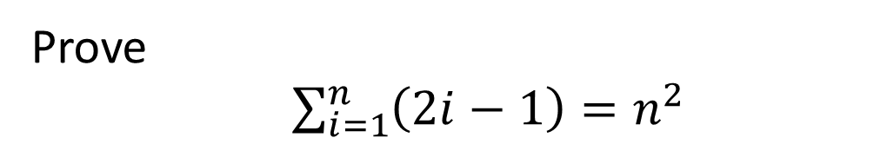
Prove
$\sum_{i=1}^{n}{\left(2i−1\right)=n^{2}}$

