Slide 1
CSC 2720: Data Structures and Algorithms
Jun Yi

Slide 2
Diagnostic Exam Results
Big thanks to all of you for the effort you put into the diagnostic exam.
Let’s go over some of the questions

Slide 3
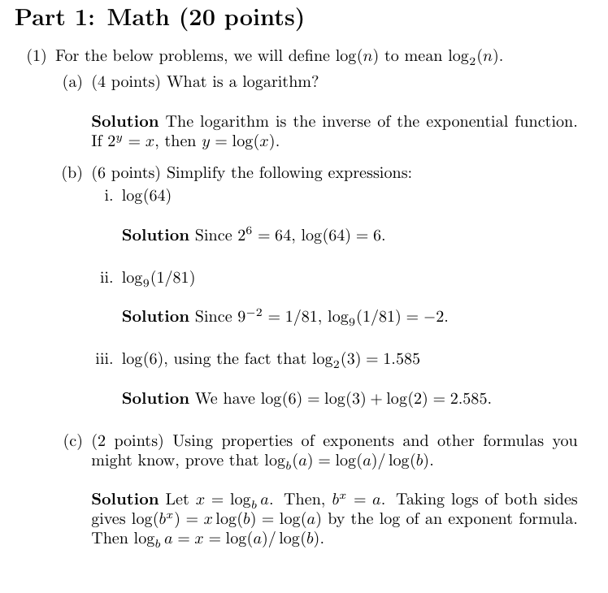
Diagnostic Exam Results

Slide 4
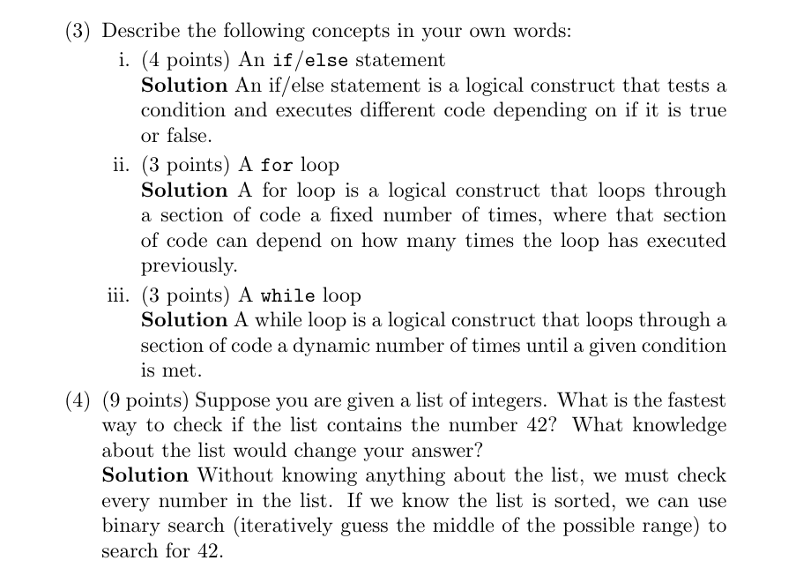
Diagnostic Exam Results

Slide 5
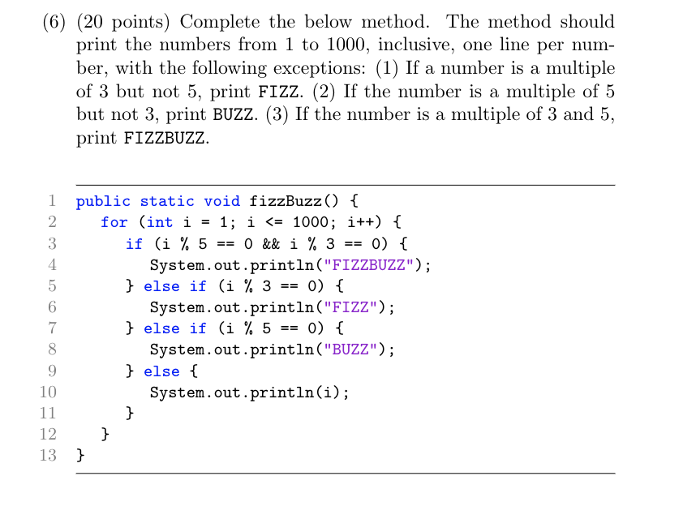
Diagnostic Exam Results

Slide 6
Lecture 3: Linear and Binary Search

Slide 7
Warmup: Thought Experiment
How would I find a word in a dictionary? If I was looking for “cat”, is it before or after “elephant”?
How would I find a word in an essay or a book? If I was looking for “cat”, is it before or after “elephant”?

Slide 8
Linear Search
Linear search is the best way to search through a list about which you know nothing. Linear search is, quite simply, checking every item in the list in order until you find (or don't find) your answer.
Example: Find 3 in 1,2,4,7,9,3,12

Slide 9
Linear Search
Linear search is the best way to search through a list about which you know nothing. Linear search is, quite simply, checking every item in the list in order until you find (or don't find) your answer.
Example: Find 3 in 1,2,4,7,9,3,12

Slide 10
Linear Search
Linear search is the best way to search through a list about which you know nothing. Linear search is, quite simply, checking every item in the list in order until you find (or don't find) your answer.
Example: Find 3 in 1,2,4,7,9,3,12

Slide 11
Linear Search
Linear search is the best way to search through a list about which you know nothing. Linear search is, quite simply, checking every item in the list in order until you find (or don't find) your answer.
Example: Find 3 in 1,2,4,7,9,3,12

Slide 12
Linear Search
Linear search is the best way to search through a list about which you know nothing. Linear search is, quite simply, checking every item in the list in order until you find (or don't find) your answer.
Example: Find 3 in 1,2,4,7,9,3,12

Slide 13
Linear Search
Linear search is the best way to search through a list about which you know nothing. Linear search is, quite simply, checking every item in the list in order until you find (or don't find) your answer.
Example: Find 3 in 1,2,4,7,9,3,12

Slide 14
Linear Search
Linear search is the best way to search through a list about which you know nothing. Linear search is, quite simply, checking every item in the list in order until you find (or don't find) your answer.
Example: Find 3 in 1,2,4,7,9,3,12

Slide 15
Binary Search
When we know a list is sorted (i.e. each number is greater than or equal to its predecessor), we can apply binary search. In binary search, we iteratively check the middle and then throw out half the list until we find our item.
Example: Find 42 in 1,5,6,8,9,10,23,42,59,73,105

Slide 16
Binary Search
When we know a list is sorted (i.e. each number is greater than or equal to its predecessor), we can apply binary search. In binary search, we iteratively check the middle and then throw out half the list until we find our item.
Example: Find 42 in 1,5,6,8,9,10,23,42,59,73,105

Slide 17
Binary Search
When we know a list is sorted (i.e. each number is greater than or equal to its predecessor), we can apply binary search. In binary search, we iteratively check the middle and then throw out half the list until we find our item.
Example: Find 42 in 1,5,6,8,9,10,23,42,59,73,105

Slide 18
Binary Search
When we know a list is sorted (i.e. each number is greater than or equal to its predecessor), we can apply binary search. In binary search, we iteratively check the middle and then throw out half the list until we find our item.
Example: Find 42 in 1,5,6,8,9,10,23,42,59,73,105

Slide 19
Binary Search
When we know a list is sorted (i.e. each number is greater than or equal to its predecessor), we can apply binary search. In binary search, we iteratively check the middle and then throw out half the list until we find our item.
Example: Find 42 in 1,5,6,8,9,10,23,42,59,73,105

Slide 20
Conclusion
We often have to search through really large databases to find a desired item. Binary search can save a lot of time (20 reads to find an item in 1,000,000 sorted items).

Slide 21
Lecture 3: Statistical Algorithms

Slide 22
Statistical Algorithms
Min
Max
Range
Mean
Mode

Slide 23
Statistical Algorithms
Min
Max
Range
Mean
Mode

Slide 24
Statistical Algorithms: Minimum
The minimum of a list is the smallest element in a list. We find the minimum of a list by keeping track of the current min and checking each element in turn to see if it's smaller than the current minimum.

Slide 25
Statistical Algorithms
Min
Max
Range
Mean
Mode

Slide 26
Statistical Algorithms: Maximum
The maximum of a list is the largest element in a list. We find the maximum of a list by keeping track of the current max and checking each element in turn to see if it's larger than the current maximum.
https://leetcode.com/problems/find-the-distance-value-between-two-arrays/

Slide 27
Statistical Algorithms
Min
Max
Range
Mean
Mode

Slide 28
Statistical Algorithms: Range
The range of a list is found by subtracting the minimum of the list from the maximum.
range = maximum - minimum

Slide 29
Statistical Algorithms
Min
Max
Range
Mean
Mode

Slide 30
Statistical Algorithms: Mean
The mean (or average) of a list is found by adding all the numbers in a list and then dividing it by the length.

Slide 31
Statistical Algorithms
Min
Max
Range
Mean
Mode

Slide 32
Statistical Algorithms: Mode
The mode of a list is the number that appears the most often in the list.

Slide 33
Statistical Algorithms
Min
Max
Range
Mean
Mode

Slide 34

Statistical Algorithms
Find the:
Min
Max
Range
Mean
Mode
Notes:
Min: 2.99
Max: 5.49
Range: 2.50
Mean: 4.00
Mode: 3.69 and 5.49

Slide 35
Conclusion
There is a lot of big data analysis going on today. Statistics and the computer programs that compute them are really important in this!

Slide 36
Lecture 3: Mathematical Algorithms

Slide 37
Finding Square Roots with Binary Search
How can we approximate sqrt(41) without using Math.sqrt()?
We'll start by noting that sqrt(41) is somewhere between 0 and 41. So, this is kind of like guessing a number between 0 and 41. What's a good first guess?
Notes:
maybe explain why the sqrt(41) is between 0 and 41

Slide 38
Finding Square Roots with Binary Search
How can we approximate sqrt(41) without using Math.sqrt()?
Let's first guess that it's 41/2 = 20.5. We have 20.5^2 = 420.25. So 20.5 is too high, and we now know sqrt(41) is between 0 and 20.5.

Slide 39
Finding Square Roots with Binary Search
How can we approximate sqrt(41) without using Math.sqrt()?
Let's then guess that it's 20.5/2 = 10.25. We have 10.25^2 = 105.0625. So 10.25 is too high, and we now know sqrt(41) is between 0 and 10.25.

Slide 40
Finding Square Roots with Binary Search
How can we approximate sqrt(41) without using Math.sqrt()?
After 20 guesses, we have a possible range of 41/(2^20) = 0.00003. So we can get pretty close pretty quickly!

Slide 41
Conclusion
Sometimes, guess-and-check can work really quickly! In fact, a lot of mathematical algorithms do this under the hood

Slide 42
Homework 1
repl.it Invite
11:30~12:15pm:
https://replit.com/teams/join/dqafkydupanpqywtiqprahocimsaczbf-CSC2720
Choose assignment1
3:30~4:15pm
https://replit.com/teams/join/dqafkydupanpqywtiqprahocimsaczbf-CSC2720
Choose Assignment1-2

