Slide 1
CSC 2720: Data Structures and Algorithms
Jun Yi

Slide 2
Lecture 4: Coding Style
Notes:
-differences in industry
-diary vs. publication

Slide 3
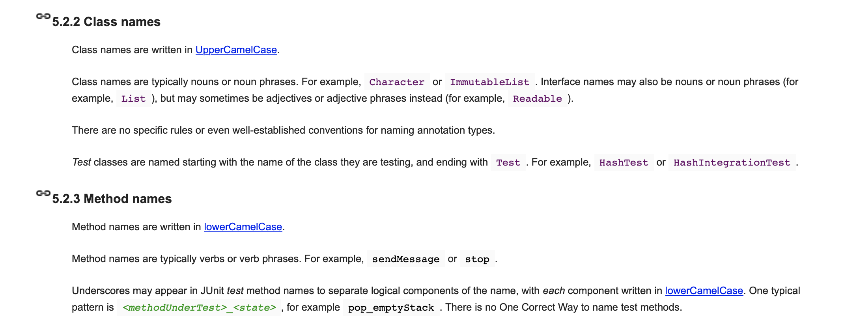
Naming

Slide 4
Naming
ThisIsUpperCamelCase
every first letter of a new word is capitalized
thisIsLowerCamelCase
every first letter of a new word is capitalized except the first word

Slide 5
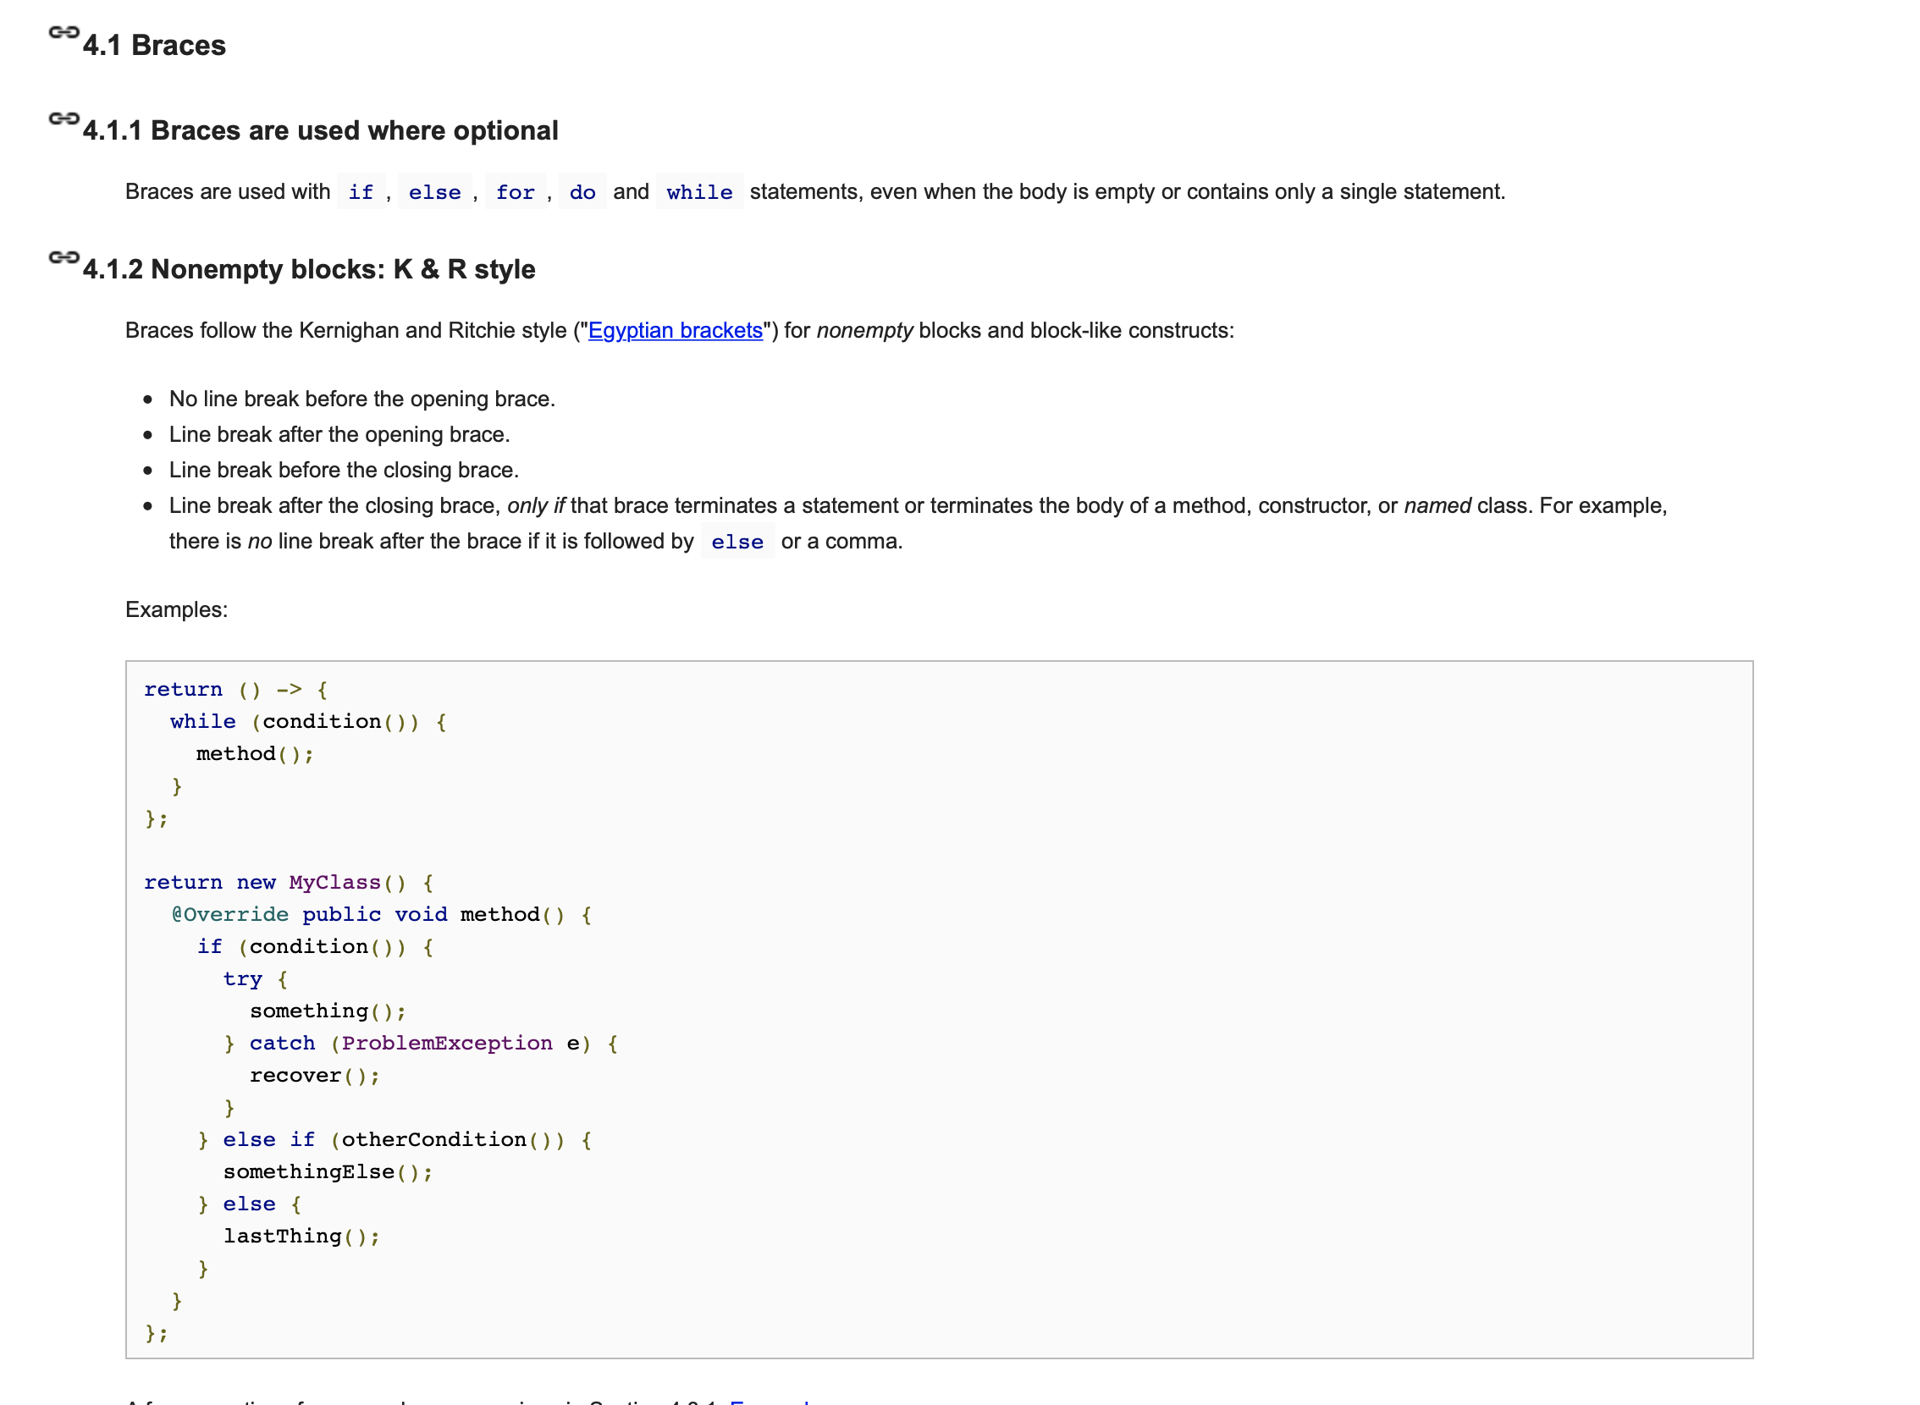
Brackets

Slide 6
Brackets
#2
#1
public myFunction() { if (apple == oranges) {
return 2;
}
}
public myFunction() {
if (apples == oranges) {
return 2;
}
}

Slide 7

Brackets
public myFunction()
{if (apple == oranges) {return 2;
}
}
Notes:
Brackets and Spacing

Slide 8
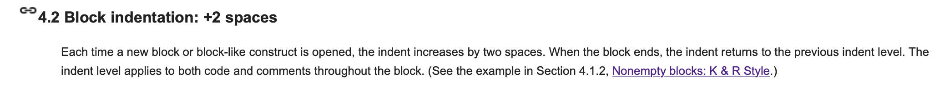
2-space tabs

Slide 9
Variables
if you’re using using something more than once, save it in a variable
ex:
int middle = (low + high) / 2;
if (middle == value) { … }
else if (middle <= value) { ... }
else if (value <= middle) { ... }

Slide 10
Variables
if you’re using using something once, probably don’t need to save it to a variable
ex:
int range = max - min;
return range;
vs.
return max - min;

Slide 11
Comments
int x = a + 1;

Slide 12
Comments
// Make x equal to a + 1
int x = a + 1;

Slide 13
Comments
What is this code actually doing??
int x = a + 1;

Slide 14
Self commenting code
float x = 9.81;
float y = 5;
float z = (1 / 2) * x * (y ^ 2);

Slide 15
Self commenting code
float gravitationalForce = 9.81;
float timeInSeconds = 5;
float displacement = (1 / 2) * gravitationalForce * (timeInSeconds ^ 2);

Slide 16
Self commenting code
float gravitationalForce = 9.81; // gravity
float timeInSeconds = 5; // time is in seconds
// Compute displacement with gravity and time
float displacement = (1 / 2) * gravitationalForce * (timeInSeconds ^ 2);

Slide 17
Self commenting code
/* compute displacement with Newton's equation x = vₒt + ½at² */
float gravitationalForce = 9.81;
float timeInSeconds = 5;
float displacement = (1 / 2) * gravitationalForce * (timeInSeconds ^ 2);
float computeDisplacement(float timeInSeconds) {
const float gravitationalForce = 9.81;
float displacement = (1 / 2) * gravitationalForce * (timeInSeconds ^ 2);
return displacement;
}

Slide 18
Conclusion
Unfortunately, there is no one-size-fits-all set of guidelines for Java. (There kind of is with Python if you google for PEP 8.)
The important thing is consistency within a group or company. In particular, if you join an established company, you must either follow their guidelines or persuade **everyone** why yours are better.

Slide 19
Reference
Please skim through the Google Java style guidelines (https://google.github.io/styleguide/javaguide.html).)
Alternative link: bit.ly/googlestyle1
Notes:
talk about why this is important in industry

