Slide 1
CSC 2720: Data Structures and Algorithms
Jun Yi

Slide 2
Announcements

Slide 3
Unit 4: Data Structures

Slide 4

Data Structures

Slide 5
CRUD & Lists

Slide 6
Warmup
We’ve mostly only used arrays. What are limitations to arrays? Are there any?

Slide 7
Warmup
We’ve mostly only used arrays. What are limitations to arrays? Are there any?
set size during initialization
impossible to insert or delete, only replace

Slide 8
CRUD

Slide 9
CRUD
CRUD = Create, Read, Update, Delete
^ This is a common abbreviation used by computer scientists, representing four common operations
*note that delete usually references deleting one item

Slide 10
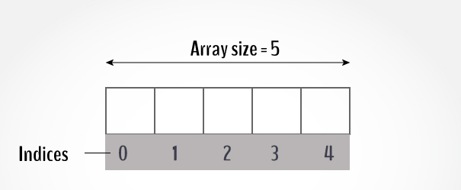
Arrays
What’s the time complexity?
Create (Include initializing) -
Read – Update (an existing index) –

Slide 11
Arrays
What’s the time complexity?
Create (Include initializing) – O(n)
Read – O(1) Update (an existing index) – O(1)

Slide 12
ArrayLists

Slide 13
Warmup
We’ve mostly only used arrays. What are limitations to arrays? Are there any?
set size during initialization
impossible to insert or delete, only replace

Slide 14
ArrayLists (Java)
An ArrayList is an implementation of List that uses a Java array under the hood. ArrayLists have logic for dynamically resizing this array in an efficient manner, to the extent that one usually doesn't need to worry about this in practice.
https://docs.oracle.com/javase/8/docs/api/java/util/ArrayList.html

Slide 15
ArrayLists (Java)
One way to implement an ArrayList is to double the size of the underlying array as needed.
How would we successively insert the elements 1,2,3,4,5,6,7,8 into an ArrayList in this manner?

Slide 16
List CRUD operations (ArrayList)
Create: myList.add() - amortized constant time
Read: myList.get() - constant time
Update: myList.set() - constant time
Delete: myList.remove() - linear time (constant time if it's at the end)

Slide 17
ArrayList
Pros:
constant access and update like arrays
Cons:
still hard to insert/delete things in the beginning or middle

Slide 18
Ask yourself
How exactly does Arraylist automatically increase the capacity?

Slide 19
Linked Lists

Slide 20
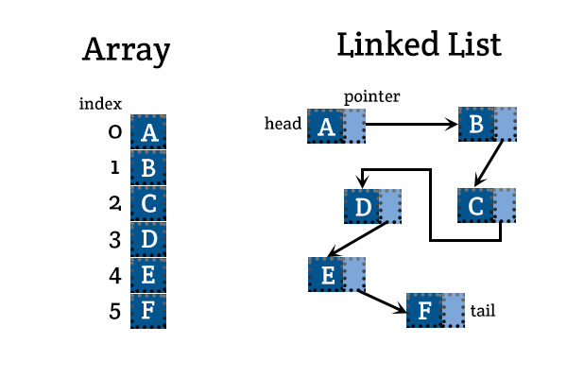
LinkedLists (Abstract)

Slide 21
LinkedLists (Java)
A LinkedList is an implementation of List that stores its elements in separate locations in memory (nodes). Each item has pointers to the previous and next nodes. The linkedList keeps track of the first and last node.

Slide 22
Nodes (Abstract)
For linked lists, nodes:
hold a value
have a “pointer” to the next node
have a “pointer” to the previous node

Slide 23
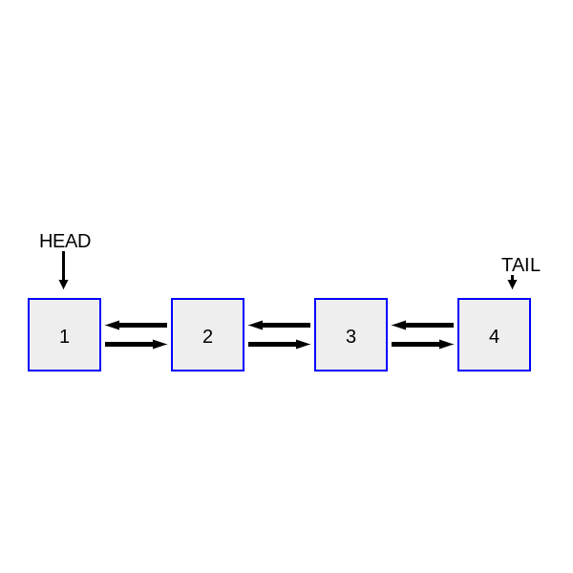
Nodes (Abstract)

Slide 24
LinkedLists (Abstract)
Linked Lists:
have a “pointer” to firstNode
have a “pointer” to lastNode
keep track of size (number of elements)

Slide 25
List CRUD operations (LinkedList)
CRUD-worst case: O(n)
CRUD-first or last: O(1)
Linked Lists give us insertion/deletion power at any index

