Slide 1
CSC 2720: Data Structures and Algorithms (but online!)
Jun Yi

Slide 2
Stacks & Queues

Slide 3
Queue (Computer Science)
A queue is a first-in first-out (FIFO) data structure that maintains the order in which the elements were inserted
supports operations:
add()
remove(): removes the head.
peek()

Slide 4
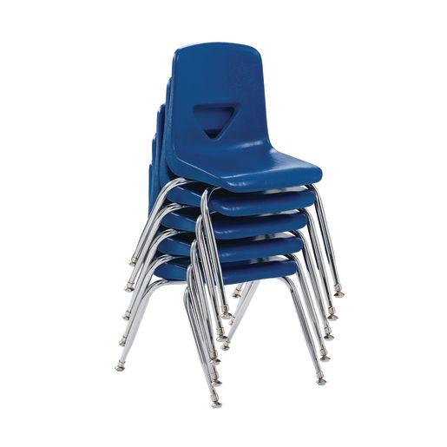
Stack
think of a stack of chairs!
the chair you take is the last
(or most recent) chair you put
on the stack

Slide 5
Stack
A stack is a last-in first-out (LIFO) data structure that maintains the order in which they were inserted
supports operations:
push()
pop(): get the first element of the stack.
peek(): get the first element of the stack without deleting the element
empty()

Slide 6
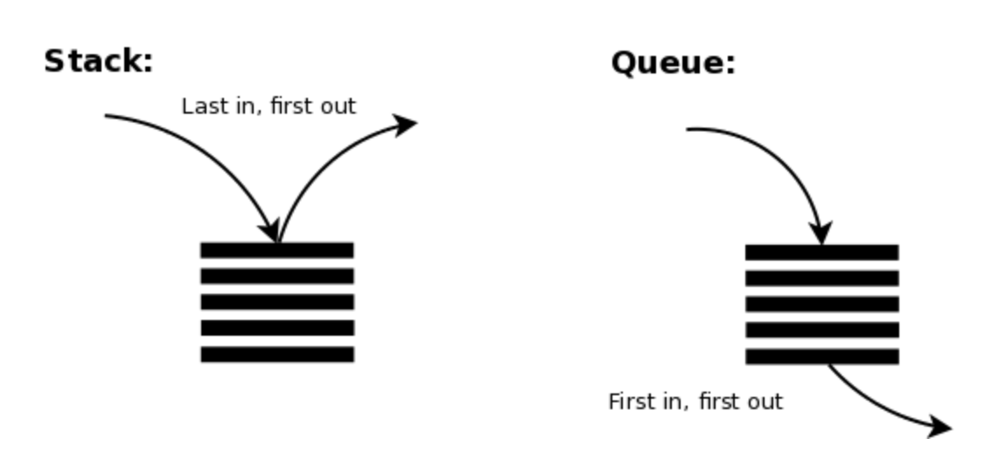

Slide 7
What data structure should we use?
What data structure should we use to implement stacks and queues?

Slide 8
What data structure should we use?
What data structure should we use to implement stacks and queues? Linked List or Array
Why?
We want to maintain order
We want fast access to the first and last elements

Slide 9
Queues Using Linked Lists
add to the end of the linked list
retrieve from the front of the linked list

Slide 10
Stacks Using Linked Lists
add to the end of the linked list
retrieve from the end of the linked list

Slide 11
Given an input, A B C. For example,
A in, A out, B in, B out, C in, C out (ABC), or
A in, B in , B out, A out, C in, C out (BAC)
Is that possible to get CAB as the output?

Slide 12
Java Docs
Stacks
https://docs.oracle.com/javase/8/docs/api/java/util/Stack.html
Queues
https://docs.oracle.com/javase/8/docs/api/java/util/Queue.html

Slide 13
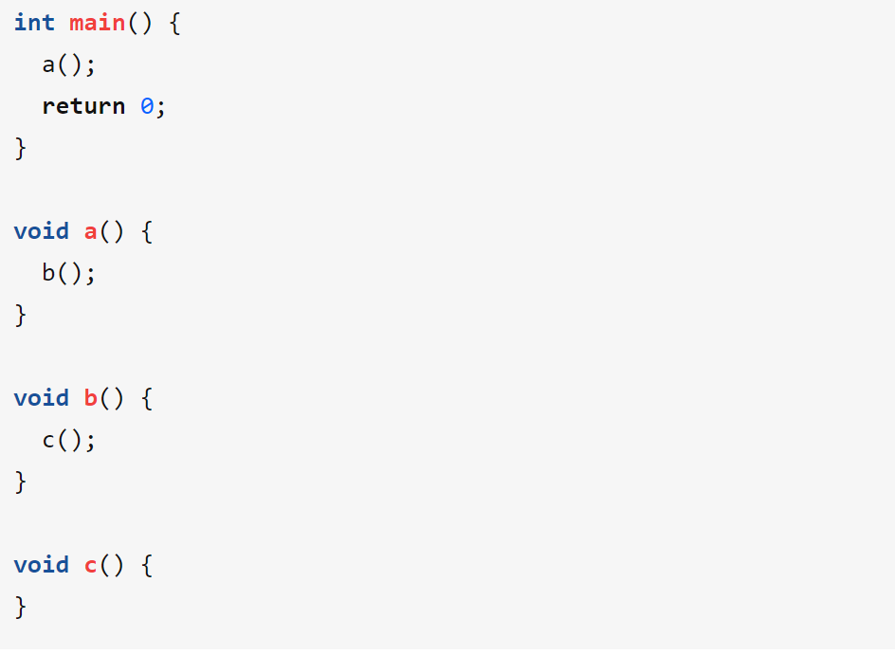
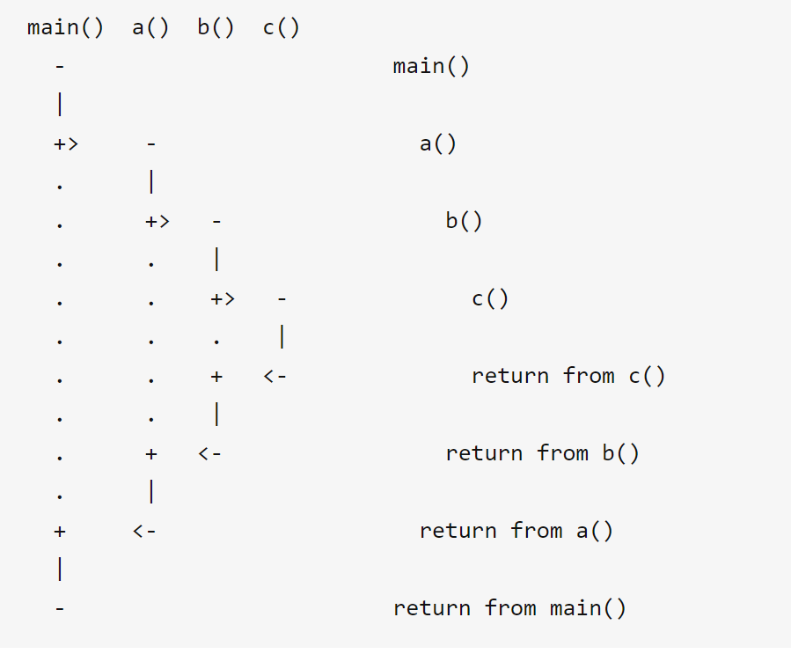
Why we need to use Stack

Slide 14
Bracket match
({[()]})
()] : illegal
{(}: illegal
Scan every bracket. If it belongs to left bracket, then PUSH it into the stack. If it is a right bracket, then check if it can match the top element in the stack. If they match, then pop it out of the stack
When the scan is over, if the stack is empty, then it means the bracket match.

Slide 15
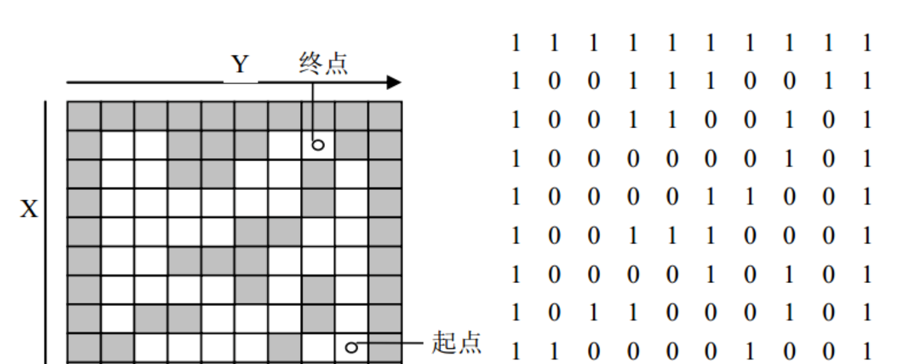

Slide 16
Expression Evaluation
https://www.geeksforgeeks.org/expression-evaluation/

Slide 17
Why we need to use Queue

