Slide 1
CSC 2720: Data Structures and Algorithms (but Online!)
Jun Yi

Slide 2
Linear and Non-linear Data Structure

Slide 3
Linear?
Each element in the data structure only has one previous element and one next element. Note that the first element only has one next element, and the last element only has one previous element.
For example, array, linked list, queue, stack.

Slide 4
Non-Linear?
Elements are not arranged sequentially. It may have different layers (Tree) and different groups (Graph).

Slide 5
Lecture 15: Graphs + Binary Search Trees (pt. 1)

Slide 6
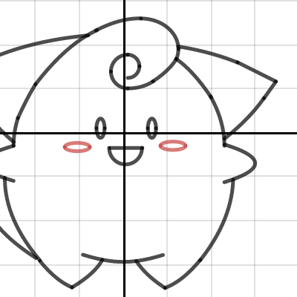
Graphs?

Slide 7
Graphs?

Slide 8
Graphs
A graph is a set of vertices representing people/places/things/ideas and a set of edges representing relationships between them.

Slide 9

Graphs

Slide 10
Graphs
1
3
4
2
6
5

Slide 11
Graphs
Edges can be directed (going from one node to another node)

Slide 12
Directed Graphs
1
3
2
4

Slide 13
Undirected Graphs
1
3
2
4

Slide 14
Example: Facebook
How would we model Facebook users as a graph?

Slide 15
Cycles
A cycle in a graph is where you can travel a path from one node back to itself
Note: cycles can be in directed
or undirected graphs
1
3
2
4

Slide 16
Trees
A tree is a graph that is:
connected: can go from one node to any other node
acyclic: no cycles
Note: trees can be directed or undirected

Slide 17
Applications?
Store hierarchical data: folder
Faster to search information.

Slide 18
Trees
7
8
1
2
4
9
3

Slide 19
Not a Tree
7
4
8
1
2
4
9
3

Slide 20
Not a Tree
7
8
1
2
4
9
3

Slide 21
Binary Search Trees
A binary search tree is a binary tree (a tree where each parent node has two or fewer children).
A binary search tree also has this characteristic (ignoring duplicates): For a given node N, any node to the left is N, and any node to the right is > N.

Slide 22
Binary Search Trees
9
8
2
1

Slide 23
Binary Search Trees
A tree is balanced if the maximum time it takes to reach any leaf node (i.e. a bottom node) is as small as possible.
It is an empty tree or the height difference between the left and right subtrees is smaller than 1
Both subtrees are balanced.

Slide 24
Balanced Binary Search Trees
4
3
7
2
6
8

Slide 25
Non-balanced binary search tree
6
2
7
1
4
3

Slide 26
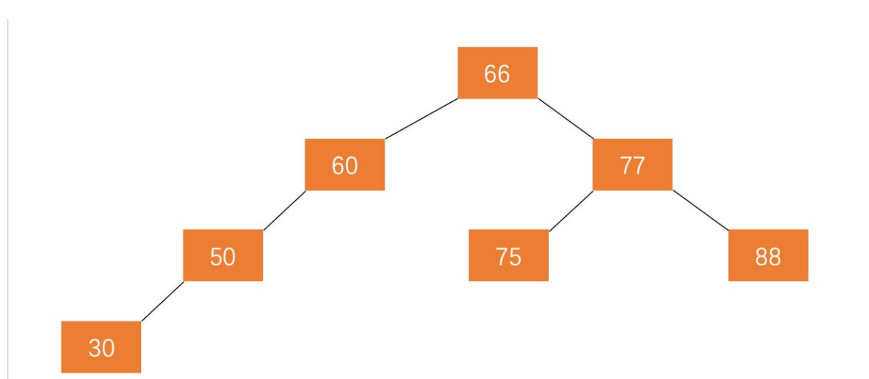

Slide 27
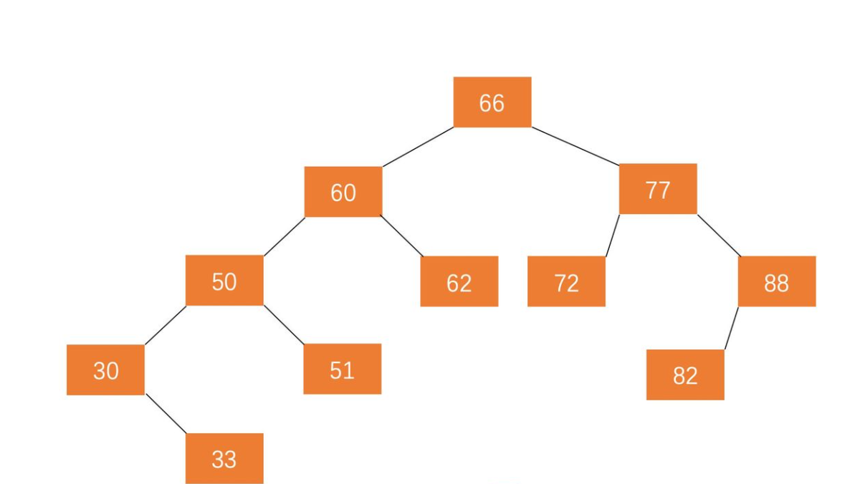

Slide 28
How we Represent BSTs
A Binary Search Tree is made of vertices. Each vertex (or node) keeps track of 3 things:
value
left child
right child
7
6
8

Slide 29
How we Represent BSTs
The Binary Search Tree itself keeps track of one thing:
the root node

Slide 30
Adding to Binary Search Trees
How do we add to a BST?
Add(10)
Add(3)
Add(5)
9
8
2
1

Slide 31
Lookup of Binary Search Trees
4
3
7
2
6
8

