Slide 1
CSC 2720: Data Structures and Algorithms
Jun Yi

Slide 2
HashMaps

Slide 3
Warmup
Suppose I want to give everyone a function mapping their full name to a number from 0 to 39. I want as many people in the class to have a unique number as possible.. What might such a function look like?

Slide 4
Warmup
Suppose I want to give everyone a function mapping their full name to a number from 0 to 39. I want as many people in the class to have a unique number as possible.. What might such a function look like?
Simple example: # of letters in one's name.

Slide 5
Warmup
What’s a limitation that arrays， BST, and linked lists have when we want to search a value?
Hint: what if I was trying to find a specific value?

Slide 6
What’s a limitation that arrays， BST, and linked lists have when we want to search a value?
Array: find a value using index O(1)
find a specific value O(n)
Linked list: O(N)
BST: O(log(n))

Slide 7
Maps & Hashing

Slide 8
Maps
A map is a key-value store. This is known as a dictionary in some languages, and an associative array in others.
Example: student → grades

Slide 9
HashMaps
A HashMap is the most common way to implement a map. It allows for constant-time CRUD operations.

Slide 10
HashMaps
Pros: O(1) CRUD operations
Cons: not ordered in anyway

Slide 11
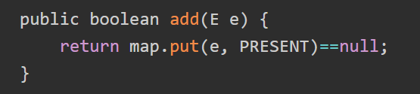
HashSets
A HashSet is built based on HashMap that don’t save duplicate value.
All the new elements will share an “Object” data type and this new element will work as “Key”

Slide 12
Lecture 17: Hashing

Slide 13
Motivation
A HashMap is designed in such a way that the CRUD operations run in constant time. How can we achieve this?

Slide 14
HashMap <> array
An array has constant-time access. Thus, if we find a way to implement a HashMap using an array of elements, we can achieve constant-time access for the whole HashMap.

Slide 15
Hash Functions
A hash function is a function that maps an object to an index. We can use these to map students to array indices in such a way that we can easily look them up again.
Recall our ideas for mapping students' names to numbers.

Slide 16
Hash Functions
ex: hashing names into Array of length 7
hash function: name → length of name
Rachel → 6
Alaya → 5
Alec → 4
Array: [“”, “”, “”, “”, “Alec”, “Alaya”, “Rachel”]

Slide 17
Hash Functions
Two problems:
what about names too long? ex: Nicholas → 8
two names of same length? Ilka, Alec

Slide 18
Hash Functions
what about names too long? ex: Nicholas → 8
solution: mod your hash function by the size of the array
if you mod by n, it results in a number between 0 and n-1, being within range of the array indices

Slide 19
Hash Functions
Nicholas → 8
8 % 7 = 1
Array: [“”, “Nicholas”, “”, “”, “Alec”, “Alaya”, “Rachel”]

Slide 20
Hash Functions
Two problems:
what about names too long? ex: Nicholas → 8
two names of same length? Ilka, Alec

Slide 21
Collisions
Chaining – value in our map will be a linked list of all objects that hashed to that value
There are other ways to handle collisions, but we won’t worry about that for this class.

Slide 22
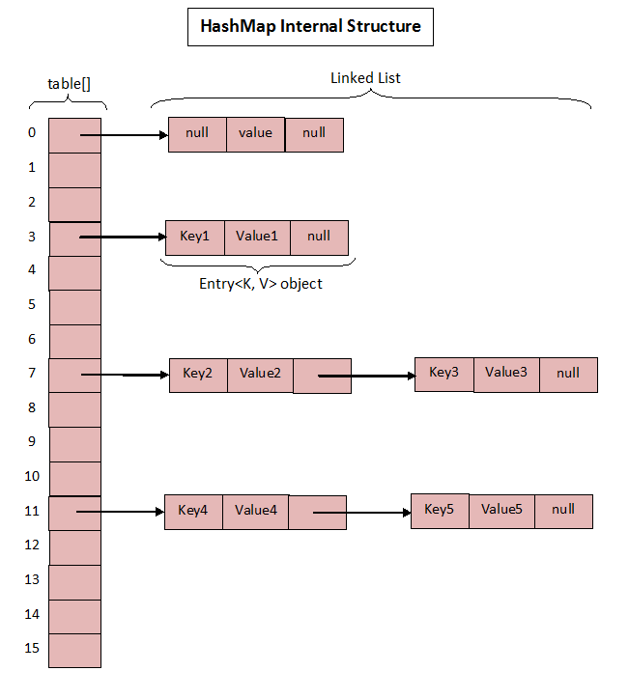
Collisions

Slide 23
Collisions
What happens if two objects end up in the same slot?
What does this do to our time complexity?

Slide 24
Collisions
With a bad hashing function (imagine all items got hashed to the same value), our lookup time is O(n).

Slide 25
Load Factor
Load factor = N/M
Where M is the size of the array (table), and N is the number of keys that have been inserted in the table.
Too low, lot of space for few elements (Wasted space)
Too high, lots of elements for little space (Collisions)

Slide 26
Let’s write our own
MyHashMap – Backed by an arraylist of size 5. Key,Value = Student Name, int grade
Using chaining for our collision handling

Slide 27
Let’s write our own
Let’s map it out – what will our hashing function be?
Turn String into array of characters – add up char values, and then mod by 5.

