Slide 1
CSC 2720: Data Structures and Algorithms
Jun Yi

Slide 2
Lecture 12: Recursion

Slide 3
Warmup
Riddle:
You have 26 identical looking coins. 25 coins weigh exactly the same, 1 is heavier. With a balance beam, isolate the heavier coin in 3 moves.

Slide 4
Warmup
Riddle Answer:
Weight group 9 coins against another 9 coins and set 8 coins to the side
Do again with 9 or 8 coins with 2 guesses
Do again with 3 or 2 coins with 1 guess

Slide 5
Recursion
In this class, we will study the idea of recursion. Recursion is a programming technique in which a function repeatedly calls itself with a smaller input until we reach the base case, a very small-sized input which the function computes directly.
google.com -> search recursion

Slide 6
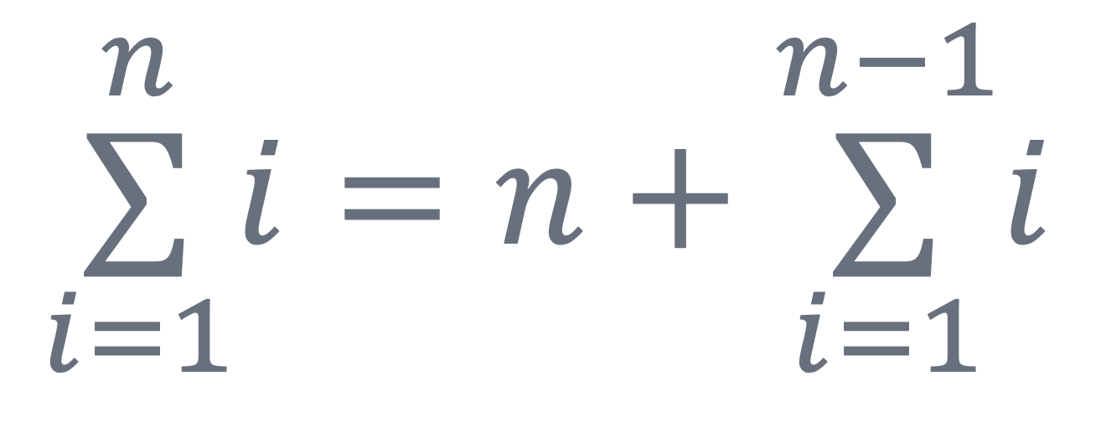
Recursion Example: Summing Integers
When summing the integers from 1 to n, we will first consider the base case where the sum of integers from 1 to 1 is just 1. We will then consider the recursive step:

Slide 7
Summing Integers
private static int sum1ToN(int n) {
if (n == 1) { // base case
return 1;
}
return n + sum1ToN(n-1); // calling with smaller input
}

Slide 8
Recursion Stack: Summing Integers
sum1ToN(3)

Slide 9
Recursion Stack: Summing Integers
sum1ToN(3) → return 3 + sum1ToN(2)

Slide 10
Recursion Stack: Summing Integers
sum1ToN(3) → return 3 + sum1ToN(2)
sum1ToN(2) → return 2 + sum1ToN(1)

Slide 11
Recursion Stack: Summing Integers
sum1ToN(3) → return 3 + sum1ToN(2)
sum1ToN(2) → return 2 + sum1ToN(1)
sum1ToN(1)

Slide 12
Recursion Stack: Summing Integers
sum1ToN(3) → return 3 + sum1ToN(2)
sum1ToN(2) → return 2 + sum1ToN(1)
sum1ToN(1) → return 1 // base case!

Slide 13
Recursion Stack: Summing Integers
sum1ToN(3) → return 3 + sum1ToN(2)
sum1ToN(2) → return 2 + sum1ToN(1)
sum1ToN(1) → return 1 // base case!

Slide 14
Recursion Stack: Summing Integers
sum1ToN(3) → return 3 + sum1ToN(2)
sum1ToN(2) → return 2 + 1

Slide 15
Recursion Stack: Summing Integers
sum1ToN(3) → return 3 + 3
so sum1ToN(3) returns 6

Slide 16
How to Write Recursive Code
what is/are the base case(s)?
how can we make this problem smaller
how is the smaller problem related to my original problem

Slide 17
Common Mistakes with Recursion
Am I returning something?
Are my base cases correct?
Is my relationship with my current problem and my smaller problem correct?

Slide 18
Binary Search
Lets code up recursive binary search:
What is the base case?
How can we make binary search a smaller problem of itself?

Slide 19
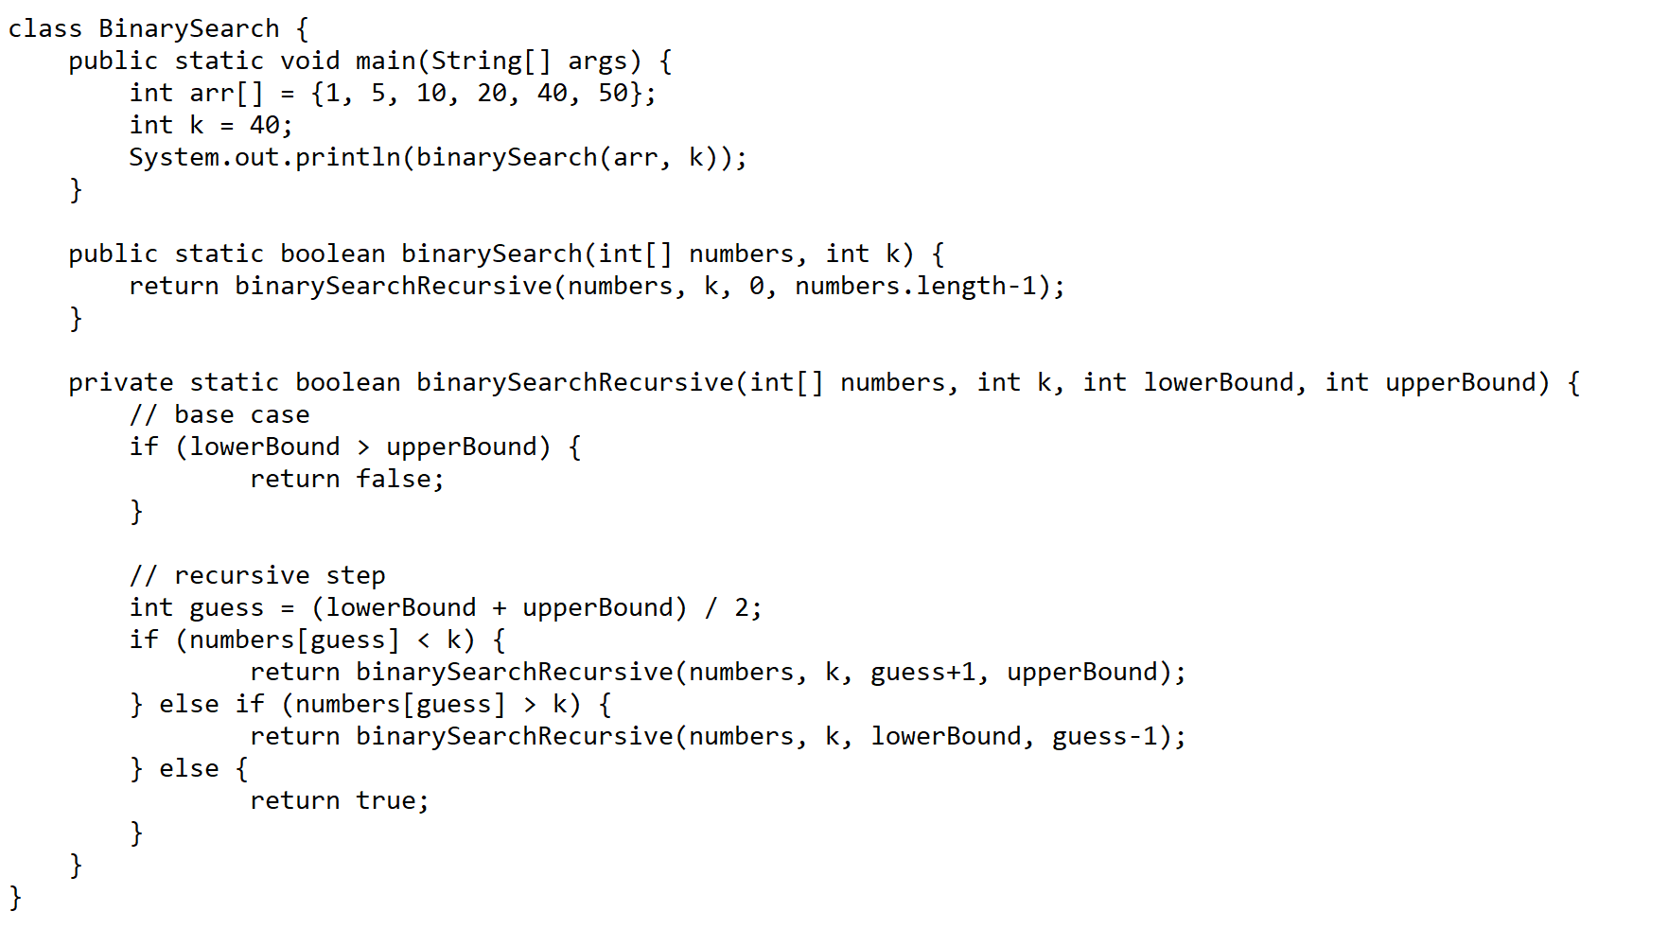
Binary Search

Slide 20
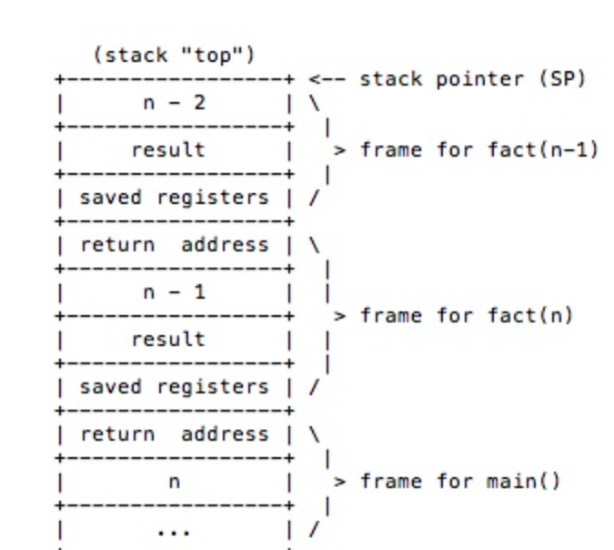
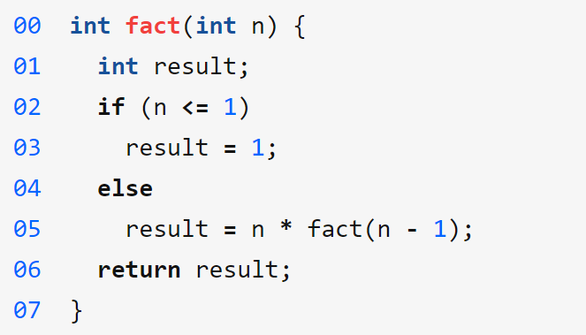
Understand the Call Stack
Saved register is used for variables.
Return address is used to save the address where the function can return back after being called.
Result is the return value
N is the input to the function being called

Slide 21
Reference
https://www.youtube.com/watch?v=Q2sFmqvpBe0

