Slide 1
CSC 3210 Computer Organization and Programming
Dr. Zulkar Nine
mnine@gsu.edu
Georgia State University
Spring 2022

Slide 2
Why Computer Organization and Programming in the first place?
To understand the detailed internals of computer. The crucial interaction between software and hardware.

Slide 3
Understand the computer
How computer works in fundamental level
How the hardware and programs work in low level
Low level programming and their interactions with hardware

Slide 4





Things you’re going to learn
Computer Architecture in fundamental level
Core concepts Assembly language programming
Hardware associated with x86 assembly language
Syntax and constructs of assembly language
Developing Assembly language programs

Slide 5
How many workers to run a Mcdonald’s !

Slide 6
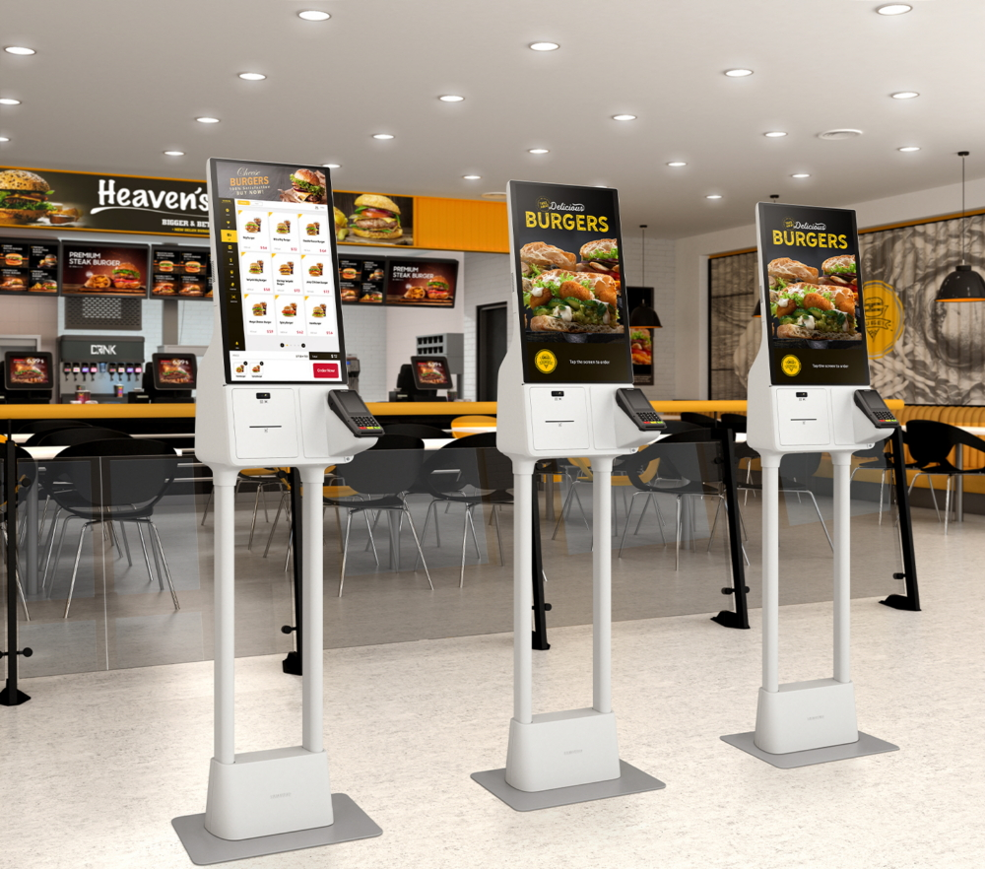
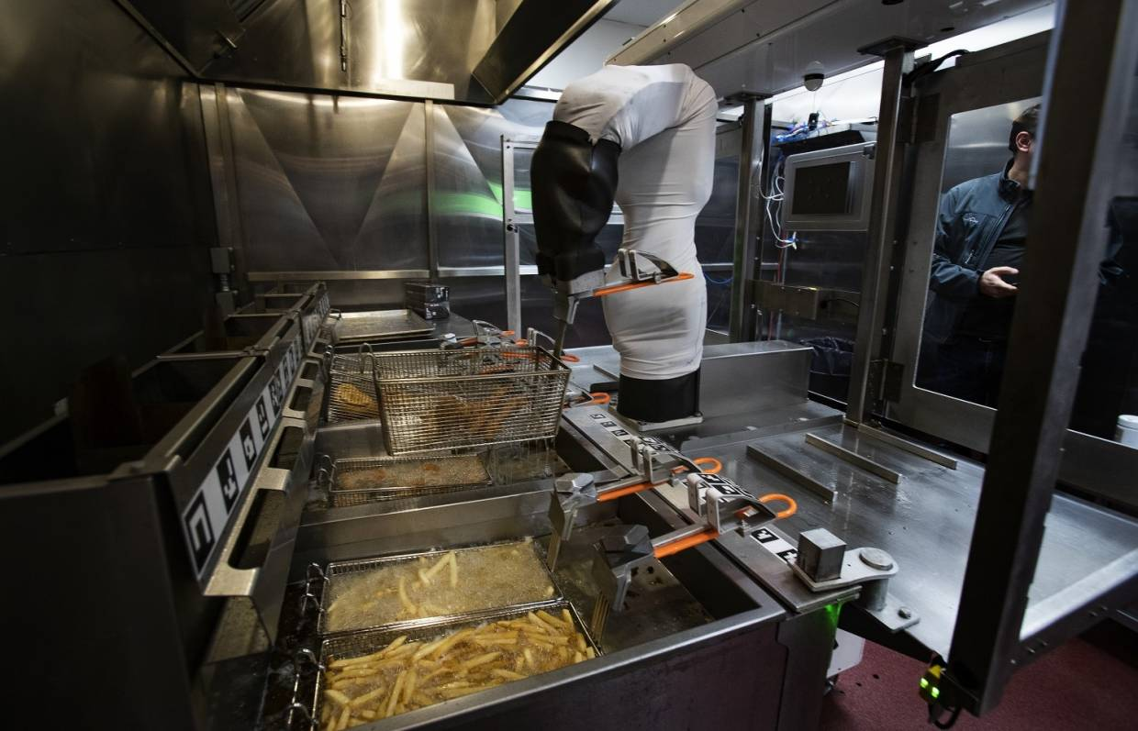

Slide 7

Programming Language
Low level programming
Very Powerful
Close to machine language
Direct access to computer hardware

Slide 8

Complete the survey!
https://forms.gle/Wa5AVHZi9BvkVA9R9

Slide 9
Prerequisites
CSC 1302: Principles of Computer Science II,
CSC 2510: Theoretical Foundations of Computer Science
MATH 2420: Discrete Mathematics, with grades of C or higher are enforced.

Slide 10
Lectures
Twice a week – on campus
Attendance – 5%
No attendance for week 1.

Slide 11
Labs (1)
On campus
Attendance – 2%
Lab work – 8%

Slide 12
How to reach me?
Email: mnine@gsu.edu
Office hours – Room 724, 1 Park Place
Monday 11:00 AM – 12:00 Noon
Wednesday 1:00 PM – 2:00 PM
Links are in the iCollege
Post your question on Piazza
Make an appointment through email : if office hours don’t work for you!

Slide 13
Textbook and materials
Textbook:
Assembly Language for x86 Processors,
By Kip R. Irvine (7th Edition)
Online
iCollege
Piazza

Slide 14
iCollege (1)
Every thing will be posted on iCollege.
Check the iCollege announcements regularly
I will also send email remainder for Quiz, Assignments, Exams, etc.

Slide 15
iCollege (2)
Table of Content
Syllabus
Lecture and Lab Schedule
Office hours and links
Lecture Slides
Lecture Video Recordings
Solutions
Quizzes
Assignments
Exams
Who graded my work!

Slide 16
Work load
Heavy
Lab sessions - 12
Assignments – 4~5
Quizzes – 5~6
Midterm exam - 1
Final exam – 1
Attendance

Slide 17
Grading
Final exam - 30%
Midterm – 25%
Biweekly Quizzes – 15%
Assignments – 15%
Lab work – 8%
Lab attendance – 2%
Lecture attendance/Lecture Quiz – 5%

Slide 18
Letter Grades
A+ (97 – 100)
A (90 – 96.9)
B+ (87 - 89.9)
B (80 - 86.9)
C+ (77 – 79.9)
C (70 – 76.9)
D (60-69)
F (59 and below)

Slide 19
Academic Integrity
Rule is simple.
Please do not copy other works.
Both will receive the same penalty.
First time – it will be a zero in particular component
Second time – an automatic F grade on the course.

Slide 20
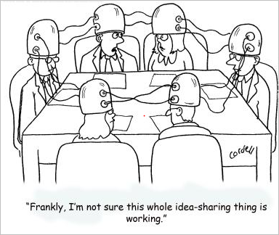
Group Study
is fine
However, submit your own work
You can share idea, but not the
code.

Slide 21
How to do well in this course?

Slide 22


Slide 23
Outline
Detailed outline is presented in the syllabus

Slide 24
“To Do” before next class
To Do 1: Activate your piazza account
To Do 2: Check iCollege for announcements
To Do 3: Read the syllabus carefully
To Do 4: Attend the lab and the lecture

Slide 25
Again welcome to CSC 3210 !

